Slide 1
Using Large Language Models for Bioinformatics
Harvard FAS Bioinformatics Virtual Training
March 12, 2026

Slide 2
A quick overview of the AI landscape
Example use cases for bioinformatics
Limits, caveats, and challenges

Slide 3
The AI Landscape in March 2026

Slide 4
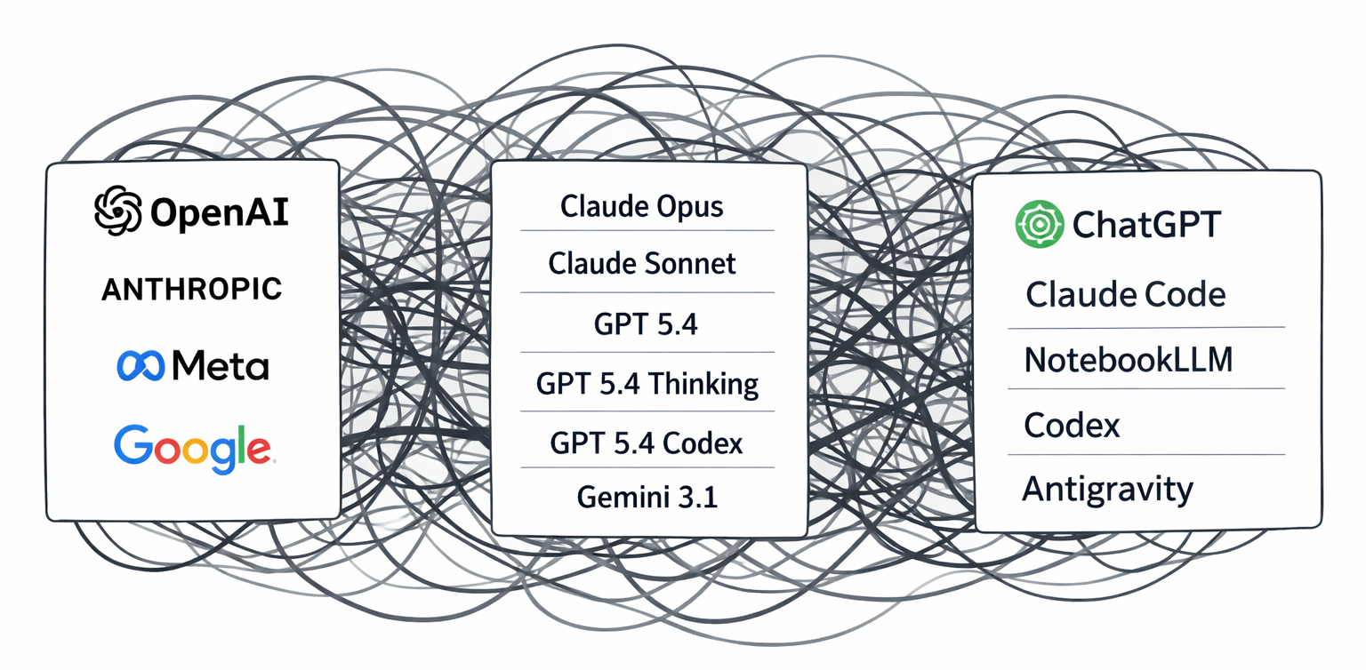
Image: ChatGPT 5.4

Slide 5
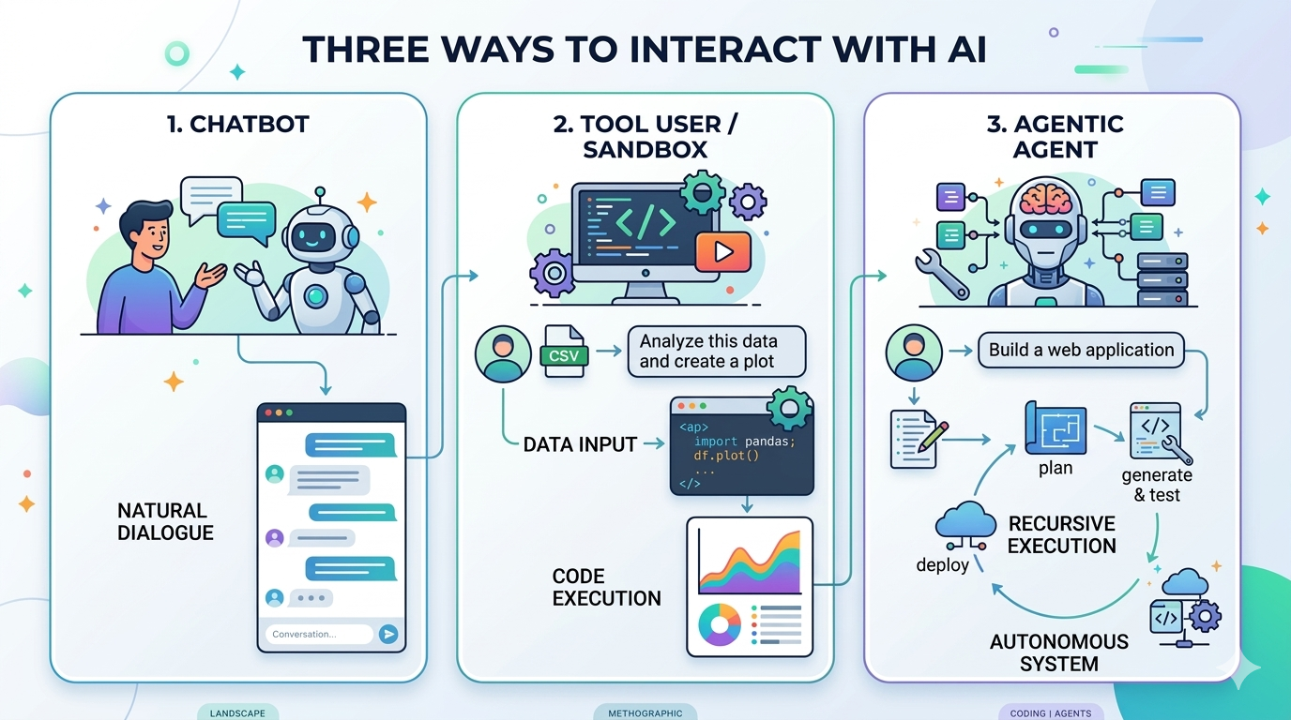
Image: Nano Banana 2 (Gemini/Google)

Slide 6
Harvard provides access to generative AI tools
Tool | Models | Use | Access
AI Sandbox | Multiple models from different providers | Chatbot | https://www.huit.harvard.edu/ai-sandbox
Gemini | Gemini 3, NotebookLLM, Antigravity (coding agent) | Chatbot, data analysis, agentic coding | https://gemini.google.com/ (g.Harvard account)
OpenAI ChatGPT Edu | GPT family, Codex (coding agent) | Chatbot, data analysis, agentic coding | https://www.huit.harvard.edu/openai-chatgpt-edu (request access)
Source: https://www.huit.harvard.edu/ai/tools
Notes:
Generally, free tier access has significant limits and often doesn’t include the latest models
Personal plans are usually around $20/month at the entry level
Harvard provides:
HUIT AI Sandbox
ChatGPT Edu
Gemini via g.Harvard
HUIT AI Sandbox is really a sandbox
Gemini via g.Harvard or ChatGPT Edu will give you access to current frontier models
Access via Harvard to protect privacy and data. Approved for up to Level 3 data. See GAI page for more

Slide 7
Harvard provides access to generative AI tools
Tool | Models | Use | Access
AI Sandbox | Multiple models from different providers | Chatbot | https://www.huit.harvard.edu/ai-sandbox
Gemini | Gemini 3, NotebookLLM, Antigravity (coding agent) | Chatbot, data analysis, agentic coding | https://gemini.google.com/ (g.Harvard account)
OpenAI ChatGPT Edu | GPT family, Codex (coding agent) | Chatbot, data analysis, agentic coding | https://www.huit.harvard.edu/openai-chatgpt-edu (request access)
Source: https://www.huit.harvard.edu/ai/tools
Notes:
Generally, free tier access has significant limits and often doesn’t include the latest models
Personal plans are usually around $20/month at the entry level
Harvard provides:
HUIT AI Sandbox
ChatGPT Edu
Gemini via g.Harvard
HUIT AI Sandbox is really a sandbox
Gemini via g.Harvard or ChatGPT Edu will give you access to current frontier models
Access via Harvard to protect privacy and data. Approved for up to Level 3 data. See GAI page for more

Slide 8
Harvard provides access to generative AI tools
Tool | Models | Use | Access
AI Sandbox | Multiple models from different providers | Chatbot | https://www.huit.harvard.edu/ai-sandbox
Gemini | Gemini 3, NotebookLLM, Antigravity (coding agent) | Chatbot, data analysis, agentic coding | https://gemini.google.com/ (g.Harvard account)
OpenAI ChatGPT Edu | GPT family, Codex (coding agent) | Chatbot, data analysis, agentic coding | https://www.huit.harvard.edu/openai-chatgpt-edu (request access)
Source: https://www.huit.harvard.edu/ai/tools
Notes:
Generally, free tier access has significant limits and often doesn’t include the latest models
Personal plans are usually around $20/month at the entry level
Harvard provides:
HUIT AI Sandbox
ChatGPT Edu
Gemini via g.Harvard
HUIT AI Sandbox is really a sandbox
Gemini via g.Harvard or ChatGPT Edu will give you access to current frontier models
Access via Harvard to protect privacy and data. Approved for up to Level 3 data. See GAI page for more

Slide 9
Harvard provides access to generative AI tools
Tool | Models | Use | Access
AI Sandbox | Multiple models from different providers | Chatbot | https://www.huit.harvard.edu/ai-sandbox
Gemini | Gemini 3, NotebookLLM, Antigravity (coding agent) | Chatbot, data analysis, agentic coding | https://gemini.google.com/ (g.Harvard account)
OpenAI ChatGPT Edu | GPT family, Codex (coding agent) | Chatbot, data analysis, agentic coding | https://www.huit.harvard.edu/openai-chatgpt-edu (request access)
Source: https://www.huit.harvard.edu/ai/tools
Notes:
Generally, free tier access has significant limits and often doesn’t include the latest models
Personal plans are usually around $20/month at the entry level
Harvard provides:
HUIT AI Sandbox
ChatGPT Edu
Gemini via g.Harvard
HUIT AI Sandbox is really a sandbox
Gemini via g.Harvard or ChatGPT Edu will give you access to current frontier models
Access via Harvard to protect privacy and data. Approved for up to Level 3 data. See GAI page for more

Slide 10
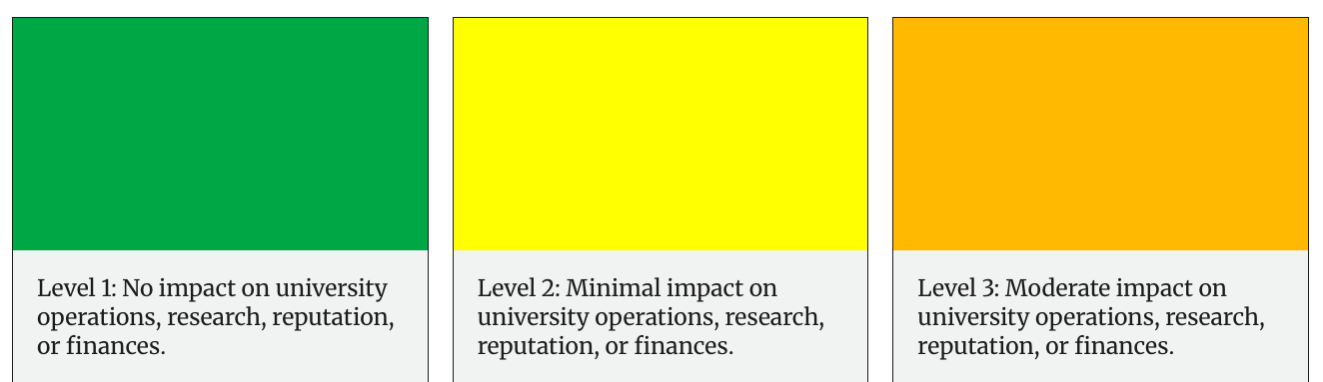
Benefits of Harvard AI Tools: Privacy and Security
Example:
Public Information
Example:
Unpublished Research
Example:
Student Records
OK
AGAINST GUIDELINES
Personal accounts (e.g, free ChatGPT or a personal Google account)
OK
Harvard-provided generative AI resources
Notes:
Generally, free tier access has significant limits and often doesn’t include the latest models
Personal plans are usually around $20/month at the entry level
Harvard provides:
HUIT AI Sandbox
ChatGPT Edu
Gemini via g.Harvard
HUIT AI Sandbox is really a sandbox
Gemini via g.Harvard or ChatGPT Edu will give you access to current frontier models
Access via Harvard to protect privacy and data. Approved for up to Level 3 data. See GAI page for more

Slide 11

Benefits of Harvard AI Tools: Cost
Harvard Provided Access
Extending thinking models
Deep Research models
Coding agents
Free ChatGPT
Limited models
No reasoning models
No agentic tools
(OpenAI example; Google pricing and capabilities are similar)
Notes:
Generally, free tier access has significant limits and often doesn’t include the latest models
Personal plans are usually around $20/month at the entry level
Harvard provides:
HUIT AI Sandbox
ChatGPT Edu
Gemini via g.Harvard
HUIT AI Sandbox is really a sandbox
Gemini via g.Harvard or ChatGPT Edu will give you access to current frontier models
Access via Harvard to protect privacy and data. Approved for up to Level 3 data. See GAI page for more

Slide 12
Example Use Cases for Bioinformatics
Notes:
Give a flavor of how to interact with LLMs in bioinformatics contexts. Feel free to play along!
I both have a lot experience with bioinformatics and a lot experience using and testing AI tools. But these are my personal observations. We don’t really have a lot of formalized “best practices” for AI yet, and it is a growing issue.
The best way to figure out effective ways to use AI productively is to just try using AI
Encourage people to try out some of these prompts as we go
Also – we have office hours every Wednesday afternoon in Northwest Labs B227, and encourage people to come by. We’re always happy to chat about people’s AI experiences.

Slide 13
“Debugging bioinformatics” with chatbots
Interactive data analysis
Agentic coding for tool and workflow development

Slide 14
“Debugging bioinformatics” with chatbots
Interactive data analysis
Agentic coding for tool and workflow development

Slide 15
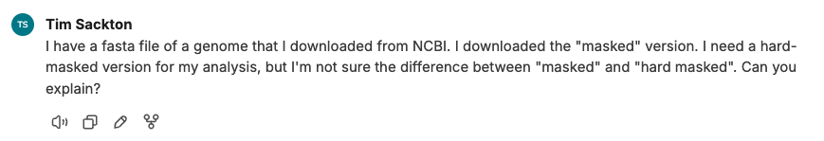
Scenario 1: How do I do X?
Harvard AI Sandbox. GPT-5.2
Notes:
Here is the setup. You are working on a genome assembly you downloaded from NCBI, and trying to get some tool to run. You labmate tells you the genome needs to be hard-masked. You know you downloaded a masked genome, but you’re not what “hard-masked” means or how to check if your genome is hard masked, and if its not how to hard-mask it.
Let’s look at prompt. Key points: provide context
tell what I want
Don’t bother with: “you are an expert bioinformatician” or other kinds of complex prompt engineering things like that
but you actually don’t always need context, you just have to be iterative. for example, if you try “what does hard-masked mean” as a prompt you’ll probably get to the right place if you just iterate a few times

Slide 16
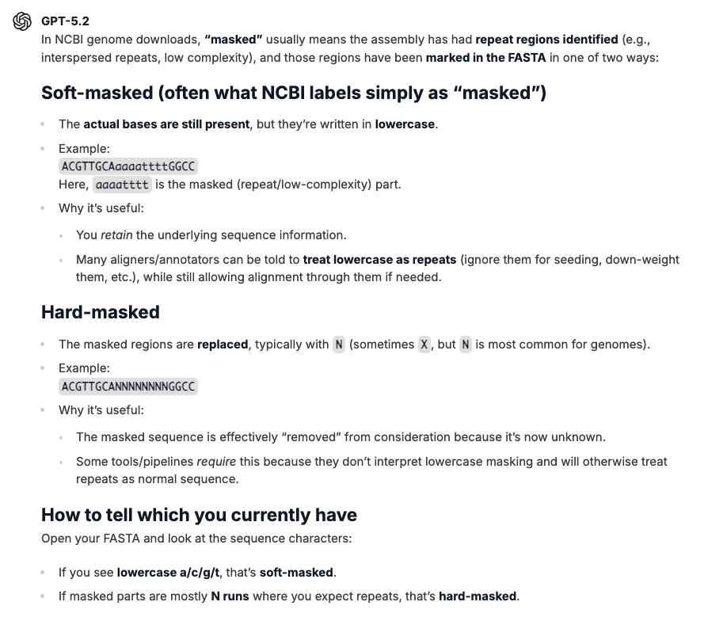
Scenario 1: How do I do X?
Gives some text, explaining things.
Tells me what to look for.
Harvard AI Sandbox. GPT-5.2
Notes:
Here is the setup. You are working on a genome assembly you downloaded from NCBI, and trying to get some tool to run. You labmate tells you the genome needs to be hard-masked. You know you downloaded a masked genome, but you’re not what “hard-masked” means or how to check if your genome is hard masked, and if its not how to hard-mask it.

Slide 17
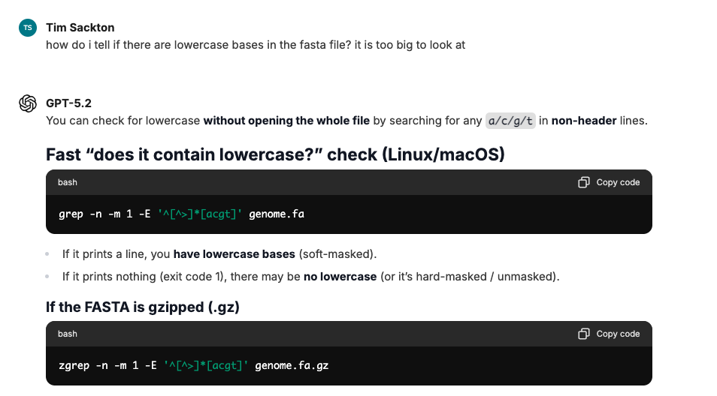
Scenario 1: How do I do X?
Outputs code to run.
If you don’t understand code, ask AI to explain before you cut and paste!
Harvard AI Sandbox. GPT-5.2
Notes:
Here is the setup. You are working on a genome assembly you downloaded from NCBI, and trying to get some tool to run. You labmate tells you the genome needs to be hard-masked. You know you downloaded a masked genome, but you’re not what “hard-masked” means or how to check if your genome is hard masked, and if its not how to hard-mask it.

Slide 18
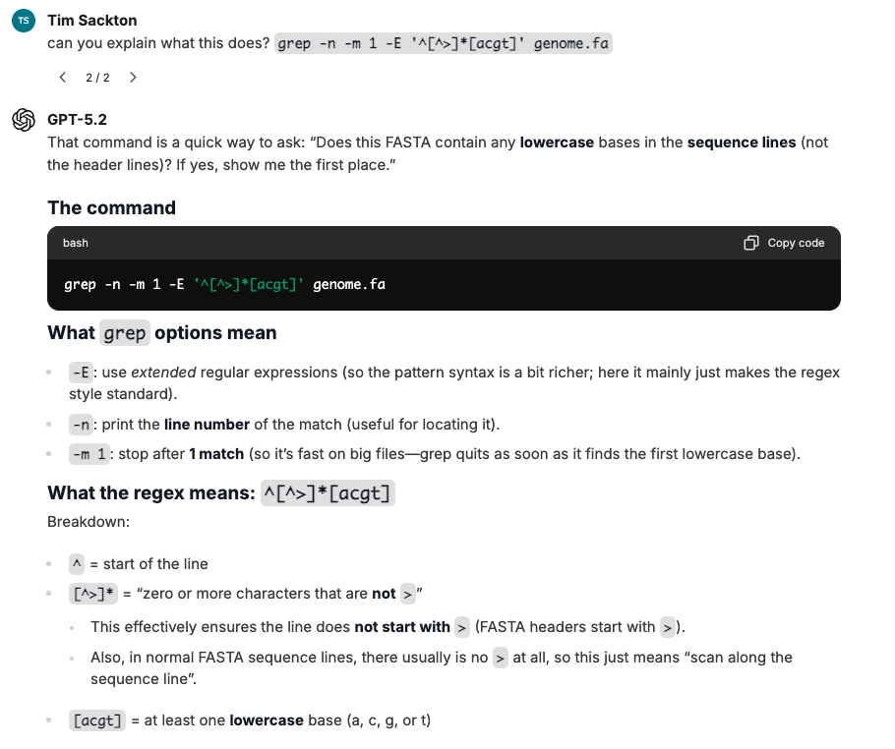
Scenario 1: How do I do X?
You can ask more if you don’t understand the explanation.
AI can make mistakes but it often corrects itself if you ask it to explain.
Harvard AI Sandbox. GPT-5.2
Notes:
Here is the setup. You are working on a genome assembly you downloaded from NCBI, and trying to get some tool to run. You labmate tells you the genome needs to be hard-masked. You know you downloaded a masked genome, but you’re not what “hard-masked” means or how to check if your genome is hard masked, and if its not how to hard-mask it.

Slide 19
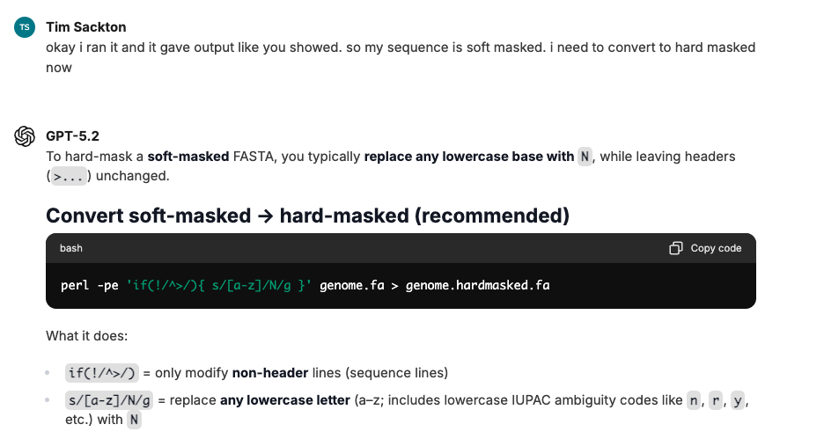
Scenario 1: How do I do X?
Now it is giving some explanation with its code.
You can still ask it to explain more.
Harvard AI Sandbox. GPT-5.2
Notes:
Here is the setup. You are working on a genome assembly you downloaded from NCBI, and trying to get some tool to run. You labmate tells you the genome needs to be hard-masked. You know you downloaded a masked genome, but you’re not what “hard-masked” means or how to check if your genome is hard masked, and if its not how to hard-mask it.

Slide 20
Scenario 1: How do I do X?
On a problem like this, most frontier AI models are pretty consistent.
But if you are not sure about the command it provides, you should still ask it to verify.
I asked this question about 10 times to different models. Nine out of ten times I got correct code. One time I got this.
awk '/^>/ {print; next} {print toupper($0) | "sed s/[ACGT]/N/g"}' input.fa
Notes:
Here is the setup. You are working on a genome assembly you downloaded from NCBI, and trying to get some tool to run. You labmate tells you the genome needs to be hard-masked. You know you downloaded a masked genome, but you’re not what “hard-masked” means or how to check if your genome is hard masked, and if its not how to hard-mask it.

Slide 21
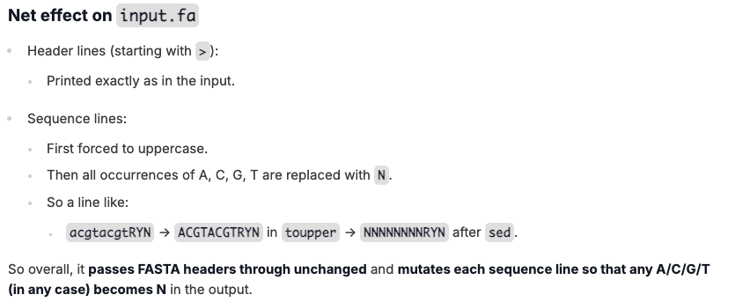
Scenario 1: How do I do X?
Model response
Notes:
This is obviously not what we want! Instead of hard masking, we’ve just turned our entire sequence to Ns.

Slide 22
Scenario 1: How do I do X?
I want to change all the sequencing files in my raw data directory to be read only, but not the other files. This is on my university HPC cluster
How can I combine a bunch of phylogenetic models (*.mod files) produced by phyloFit in the PHAST package into a single average mod file?
I need to remove UMIs from about 20 bam files I made by aligning RNA-seq data to my reference genome with STAR. This is on my university HPC slurm cluster.
I have 10000 fasta alignment files in a bunch of directories, called things like gene1/alignment.fasta, gene2/alignment.fasta, gene3/alignment.fasta. I need to copy them all to the alignments directory with names like gene1.fasta, gene2.fasta, gene3.fasta.

Slide 23
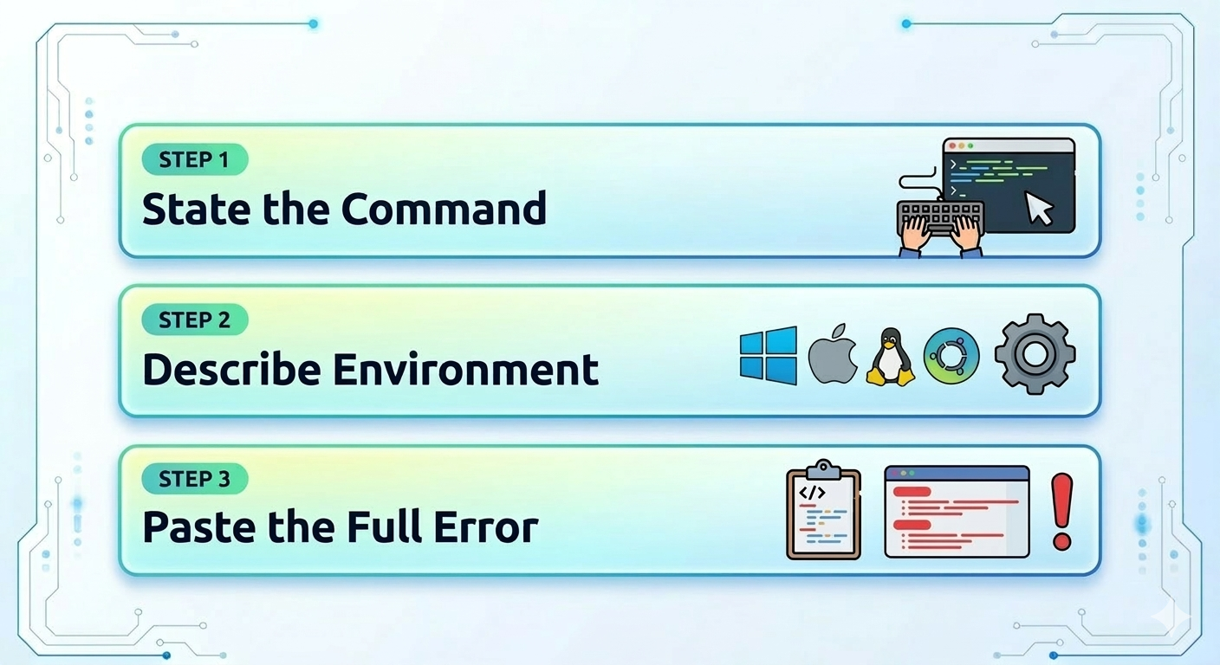
Scenario 2: What does this error message mean?
Image: Nano Banana 2 (Gemini/Google)
Notes:
You are doing some kind of analysis and you get some long error message that you don’t understand.
Let’s actually do a live demo here. I’m going to use Gemini for this, and I’ll go over a few error messages.
Use prompt2.txt

Slide 24
Scenario 2: What does this error message mean?
(bioinf) tsackton@holybioinf testing % bedtools merge -i bedtest.bed ERROR: file bedtest.bed has non positional records, which are only valid for the groupBy tool.
…
Notes:
You are doing some kind of analysis and you get some long error message that you don’t understand.
Let’s actually do a live demo here. I’m going to use Gemini for this, and I’ll go over a few error messages.
Use prompt1.txt

Slide 25
Scenario 2: What does this error message mean?
I ran a long pipeline with many steps and it failed somewhere in the middle.
The error log is long and I don’t know where to start…
Notes:
You are doing some kind of analysis and you get some long error message that you don’t understand.
Let’s actually do a live demo here. I’m going to use Gemini for this, and I’ll go over a few error messages.
Use prompt2.txt

Slide 26
Other Chatbot Comments
Good for helping generate a one-liner, explaining code snippets, Bash scripting, finding the right tool for a task.
Accuracy is not 100%, though at least the frontier models with reasoning effort hallucinate much less than they did even a few months ago. You need to develop an intuition for when the AI is on the wrong track.
LLMs can be weirdly “human-like” in their responses, and weirdly “not-computer-like”. For example, sometimes things like “can you double-check that”, or “please show me your sources for that” will fix mistakes. We are not used to having to tell computers to double-check their work.
For complex data analysis or coding tasks, it is it better to use tools that can run code, either in a sandbox or on your computer.

Slide 27
“Debugging bioinformatics” with chatbots
Interactive data analysis
Agentic coding for tool and workflow development

Slide 28

Location, color, and many other observations on squirrel sightings in Central Park in 2018
Notes:
Do a live demo
Need a sample data set

Slide 29
“Debugging bioinformatics” with chatbots
Interactive data analysis
Agentic coding for tool and workflow development

Slide 30

If you spend much time in certain corners of the internet, or know any software developers, the current AI moment can feel like a rocket taking off.
Perhaps we are blasting off for the Moon and beyond, but it it also feels like the rocket is still half-finished.
Image: ChatGPT 5.4
Notes:
Just about anything that you can accomplish by writing a computer program – which is a shockingly large number of things – you can potentially get an AI agent to do well.
But sometimes it will do it poorly.
How do you get good results?

Slide 31
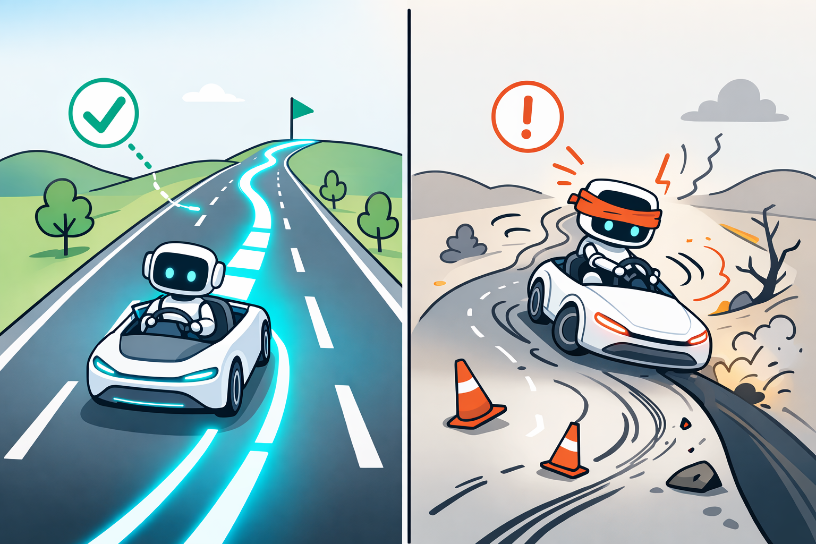
Point #1: Test-Driven Development
Agentic tools do better when they can verify their outputs.
Image: ChatGPT 5.4

Slide 32
Point #1: Test-Driven Development
A simple test: an input file and an output file that you know are correct.
More complicated: specific validated input/output pairs for specific functions.
Agents can bootstrap tests!
If you are fixing a bug: make a reproducible example first!
Verify outputs! Code that runs can still be wrong.

Slide 33
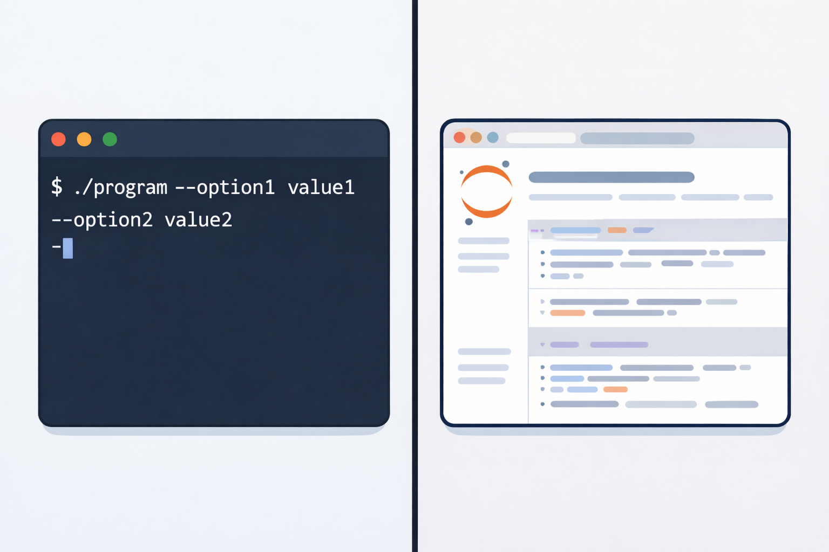
Example: Refactor a Jupyter Notebook into a script

Slide 34

Point #2: Plan First, Then Implement
Ask an AI to explain what it is going to do before it does it.
Check the logic.
Ask it to check the logic.
Have a different model check the logic.
Image: ChatGPT 5.4

Slide 35
Example: Convert Loose Notes to a Series of Scripts
My RNA-seq analysis:
- Trim reads
- Map to transcriptome. Maybe with salmon or STAR?
- Compute count matrix
- Run DESeq2 in R
My RNA-seq analysis:
trim_reads.sh
map_reads.sh
compute_counts.sh
analyze_matrix.R
[Though for this specific use case, consider nf-core/RNA-seq!]

Slide 36
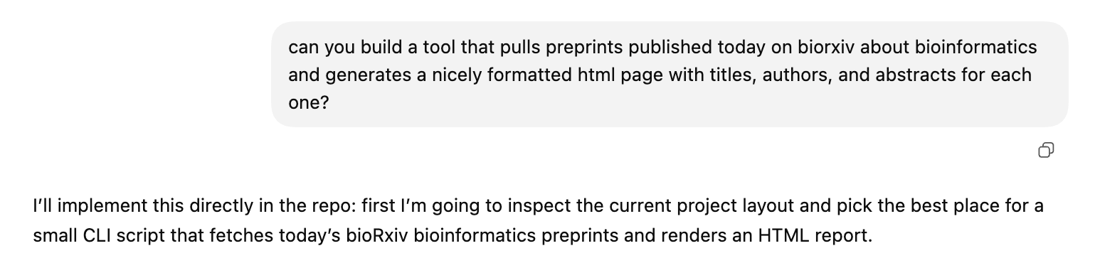
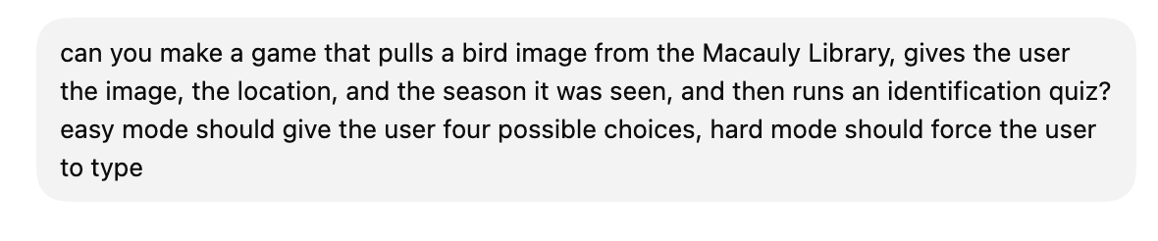
Point #3: Experiment

Slide 37
General Limits, Caveat, Challenges

Slide 38
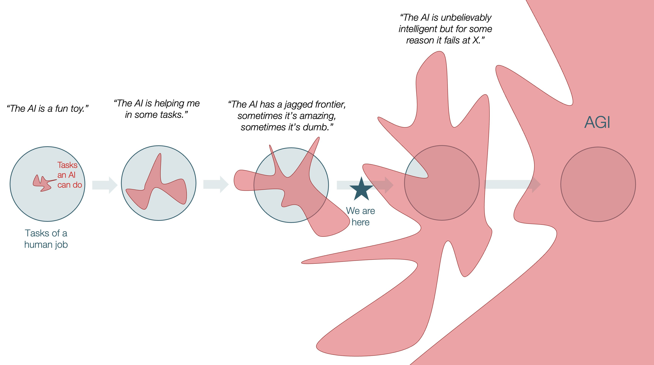
Ethan Mollick, “The Shape of AI: Jaggedness, Bottlenecks and Salients”
Notes:
Mention examples: How many “R”s in strawberry; should I walk or drive to a car wash Solutions: test and verify before you trust the output; in my experience at least, the jagged edge is not random, that is failure modes tend to be consistent. If AI is good at X, it is probably reliably good at X. but this is very different from how we usually think about computers as being deterministic If errors are catastrophic, build verification into your workflows!

Slide 39
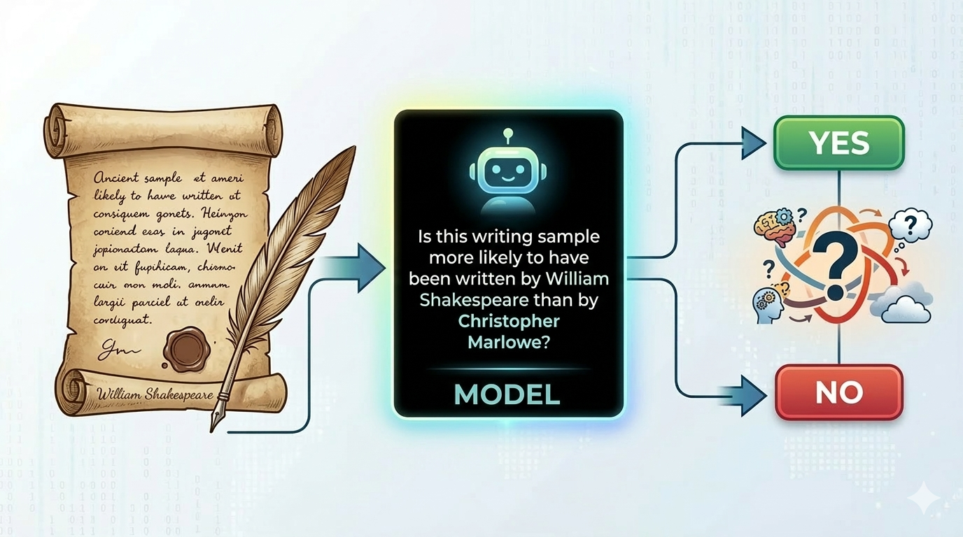
Chris Stubbs, “Generative AI and the Scientific Method - an Impending Collision?”
Image: Nano Banana 2 (Gemini/Google)
Notes:
Solutions: prefer to ask AI to generate code to analyze data, rather than just ”guess” at conclusions. Tricky for things like pattern matching here, though. Other solutions: report exact model; ask the question 10 (or 100?) times to generate a distribution of yes/no answers. Don’t trust AI self-reports of probability, though!

Slide 40
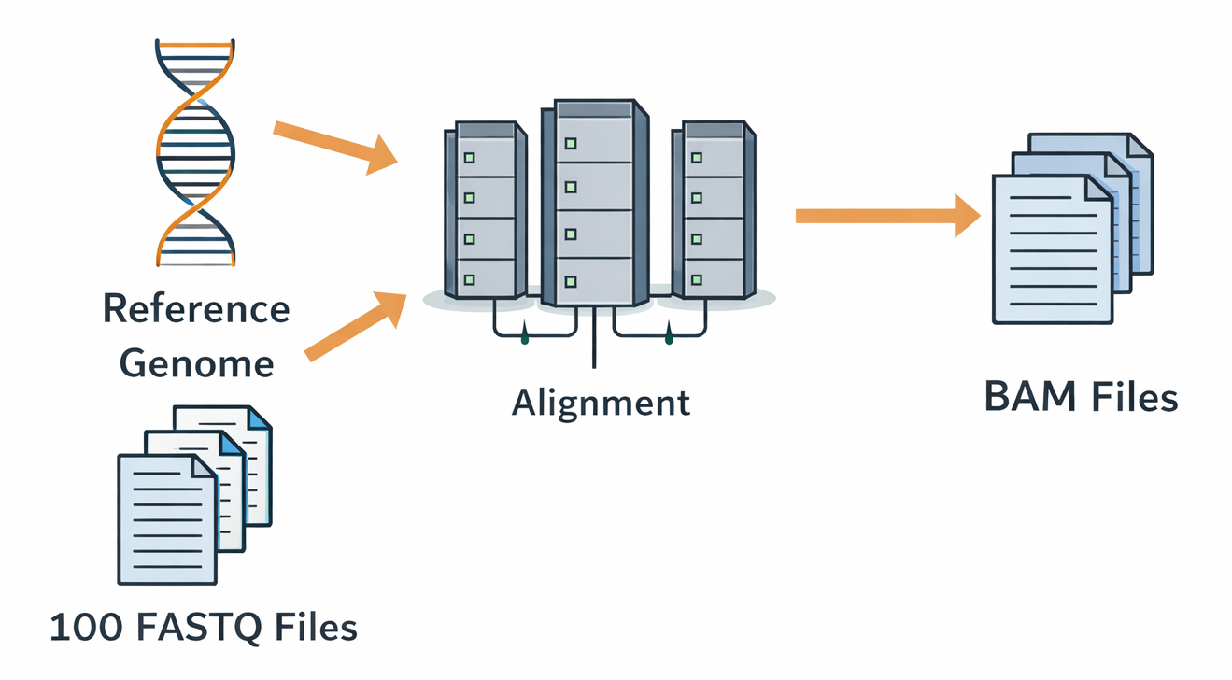
Bioinformatics-Specific Challenges: Heavy Compute
Image: ChatGPT 5.4
Notes:
Even ”simple” bioinformatics tasks often involve massively parallel analysis and require non-trivial compute. LLMs, while they can help set this kind of thing up and debug problems, are very poorly suited to actually managing large data flows (though, of course, this can change, and command line LLM agents may soon be able to submit jobs for you – who knows!)

Slide 41
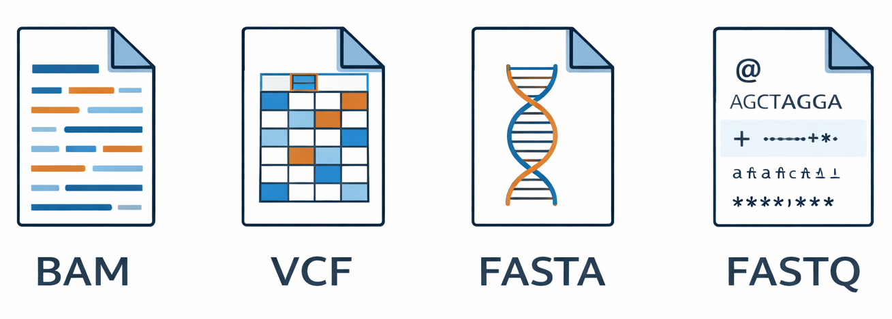
Bioinformatics-Specific Challenges: Big Files
Image: ChatGPT 5.4
Notes:
A lot of bioinformatics data is big files, often in binary formats, that AI cannot really handle. Too big to load into context, for example. Command line AI agents are a possibility, but these kinds of things are currently resistant to analysis in the kinds of tools we’ve discussed today Too large for direct inspection in chat. LLMs are better at helping with the code around these files.

Slide 42
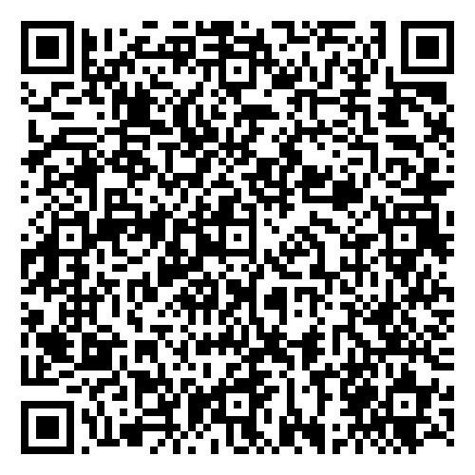
Bioinformatics-Specific Challenges: Big Files
Workshop – In Person
Genomics on the command line
April 2, 9, 16, 23
9:30 AM - 12:30 PM
informatics.fas.harvard.edu
Notes:
A lot of bioinformatics data is big files, often in binary formats, that AI cannot really handle. Too big to load into context, for example. Command line AI agents are a possibility, but these kinds of things are currently resistant to analysis in the kinds of tools we’ve discussed today Too large for direct inspection in chat. LLMs are better at helping with the code around these files.

Slide 43

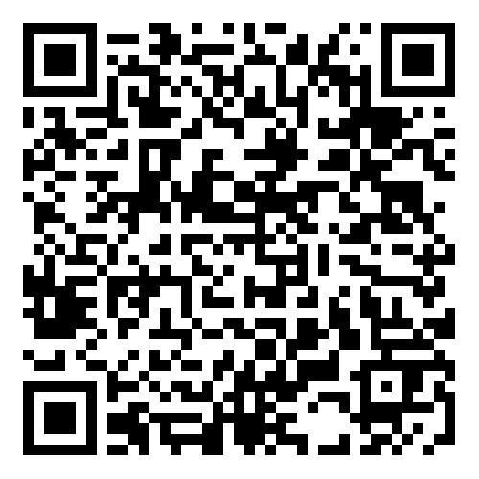
March 27 9 AM - 3 PM
Virtual

Slide 44
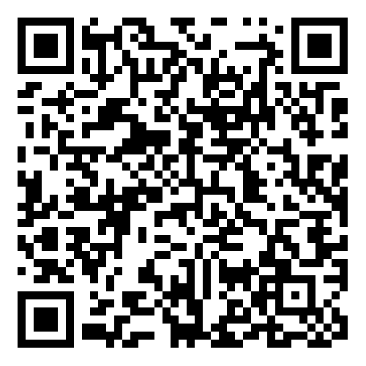
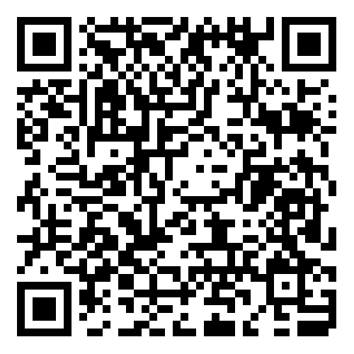
Intro to scRNA-seq part 1 zoom reg
March 19 11 AM - 12 PM
Intro to scRNA-seq part 2 zoom reg
March 26 11 AM - 12 PM

Slide 45
Conclusions and Looking Forward

