Slide 1
CEPC HCAL Readout Electronics

Slide 2
Content
Background
CEPC Calorimeters
CEPC HCAL
USTC SDHCAL
SDHCAL Readout ASIC
Design of the Test-Board
Introduction of Microroc
Design of the Stage1 Test-Board
Progress
Problem
Future Work
Design a Read-out Array
Prototype Machine

Slide 3
Content
Background
CEPC Calorimeters
CEPC HCAL
USTC SDHCAL
SDHCAL Readout ASIC
Design of the Test-Board
Introduction of Readout ASIC
Design of the Stage1 Test-Board
Progress
Problem
Future Work
Design a Read-out Array
Prototype Machine

Slide 4
CEPC Calorimeters
Key Calorimeters
Electromagnetic calorimeter (ECAL)
Hadron calorimeter (HCAL)
Designed for precise energy measurements of electrons, photons, taus and hadronic jets.
Basic resolution requirements
ECAL: 16%/√(𝐸(𝐺𝑒𝑉))
HCAL: 50%/√(𝐸(𝐺𝑒𝑉)).
To achieve these, a Particle Algorithm oriented calorimetry system is being considered as the baseline design.

Slide 5
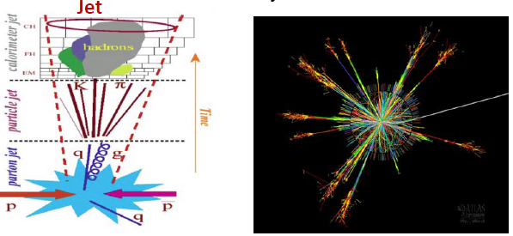
CEPC Calorimeters
Particle Flow Algorithm (PFA)
Charged particles –>tracker
Photons – >electromagnetic calorimeter
Neutral hadrons –> hadronic calorimeter
Approximately 72% of the jet energy is measured
Both ECAL and HCAL are high granularity

Slide 6
CEPC HCAL
HCAL
A high-granularity HCAL plays an essential role in CEPC. It allows separation of energy deposits from charged and neutral hadrons. The measurement accuracy of the neutral hadrons is the leading contribution to the jet energy resolution for jets with energy up to 100GeV.
The HCAL is a sampling calorimeter with steel as the absorber and scintillator tiles or gaseous devices with embedded electronics.

Slide 7
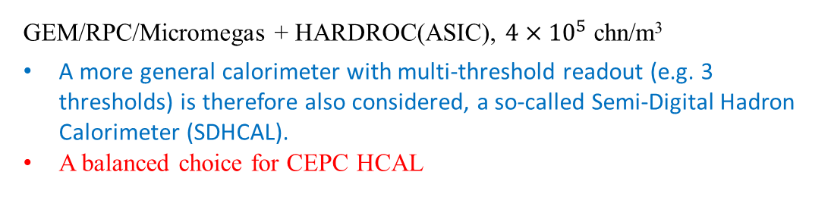
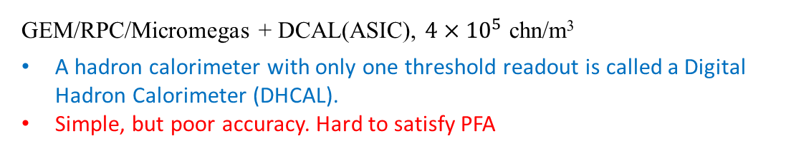
CEPC HCAL
HCAL Detector Options
Absorber: steel
Active layers: Gaseous detector
AHCAL
Scintillator + SiPM + SPIROC(ASIC), 8148channels,1m³
Analog Hadron Calorimeters(AHCAL).
High power consumption, expensive readout electronics
HCAL
DHCAL
GEM/RPC/Micromegas + DCAL(ASIC), $4×{10}^{5}$ chn/m³
A hadron calorimeter with only one threshold readout is called a Digital Hadron Calorimeter (DHCAL).
Simple, but poor accuracy. Hard to satisfy PFA
SDHCAL
GEM/RPC/Micromegas + HARDROC(ASIC), $4×{10}^{5}$ chn/m³
A more general calorimeter with multi-threshold readout (e.g. 3 thresholds) is therefore also considered, a so-called Semi-Digital Hadron Calorimeter (SDHCAL).
A balanced choice for CEPC HCAL

Slide 8
USTC SDHCAL
Architectural of the SDHCAL
A scheme of the ASU used to readout 1m² detector
Absorber(Fe, W)
Sensor(RPC,MM,GEMTHGEM)
PCB

Slide 9
USTC SDHCAL
Approximatively, 95% Energy included longitudinal length:
L(95%)=[0.56*ln(E/GeV)+2.33] λ_{I}
E=100GeV, L(95%)=4.9 λ_{I} =82.2cm(Fe)=48.7cm(W)=75.1cm(Cu)
The energy resolution of HCAL will be improved by using more sampling layers, but it won’t work any more when d<2cm (for Fe) .
95% Energy included transverse radius: ~30cm for 50GeV π±, 99% hits in 70cm× 70cm.

Slide 10
SDHCAL Readout ASIC
Hardroc
HAdronic Rpc Detector ReadOut Chip
Dynamic range: 10fC ~ 10pC
3 DAC for threshold
Microroc

Slide 11
Content
Background
CEPC Calorimeters
CEPC HCAL
USTC SDHCAL
SDHCAL Readout ASIC
Design of the Test-Board
Introduction of Microroc
Design of the Stage1 Test-Board
Progress
Problem
Future Work
Design a Read-out Array
Prototype Machine

