Slide 1
CEPC HCAL Readout Electronics

Slide 2
Content
Background
CEPC Calorimeters
Requirement of Readout Electronics
Frame of the Readout Electronics
Design of the Test-Board
Introduction of Readout ASIC
Design of the Stage1 Test-Board
Progress
Problem
Future Work
Design a Read-out Array
Prototype Machine

Slide 3
Content
Background
CEPC Calorimeters
Requirement of Readout Electronics
Frame of the Readout Electronics
Design of the Test-Board
Introduction of Readout ASIC
Design of the Stage1 Test-Board
Progress
Problem
Future Work
Design a Read-out Array
Prototype Machine

Slide 4
CEPC Calorimeters
Key Calorimeters
Electromagnetic calorimeter (ECAL)
Hadron calorimeter (HCAL)
Designed for precise energy measurements of electrons, photons, taus and hadronic jets.
Basic resolution requirements
ECAL: 16%/√(𝐸(𝐺𝑒𝑉))
HCAL: 50%/√(𝐸(𝐺𝑒𝑉)).
To achieve these, a Particle Algorithm oriented calorimetry system is being considered as the baseline design.

Slide 5
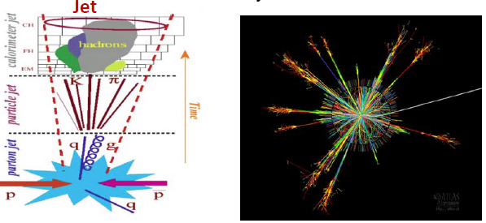
CEPC Calorimeters
Particle Flow Algorithm (PFA)
Charged particles –>tracker
Photons – >electromagnetic calorimeter
Neutral hadrons –> hadronic calorimeter
Approximately 72% of the jet energy is measured
Both ECAL and HCAL are high granularity

