Slide 1
Basic Statistics Methods for Data Analysis
M.C. Raúl Rodríguez A.

Slide 2
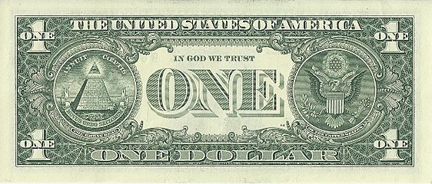
“In God we trust.
All others must bring data”
W.E. Deming

Slide 3
Fundamental Statistical Analysis Methods
Central tendency
(Mean)
Variability
(Standard Deviation)
Sample size
Hypothesis testing
Regression
5 main big data statistical analysis methods
https://www.allerin.com/

Slide 4
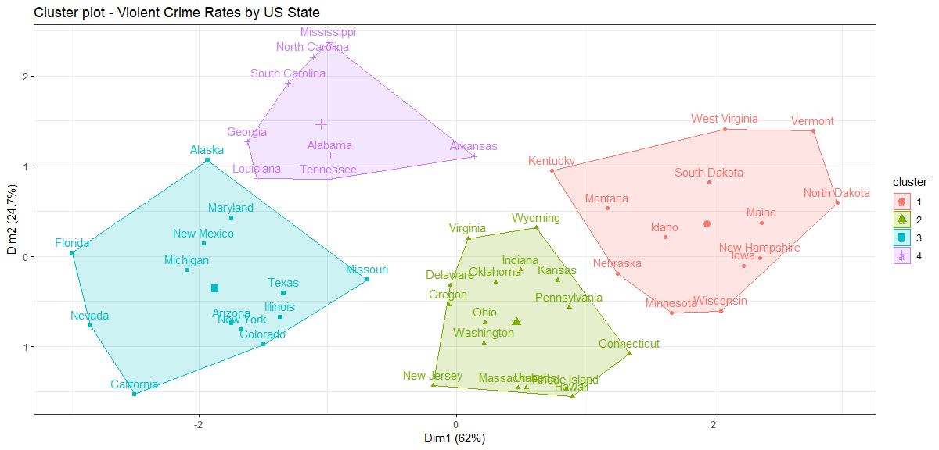
Data: Violent Crime Rates by US State
k=4 optimal cluster (for this case)
Arrests per 100,000 residents for assault, murder, and rape in each of the 50 US states in 1973

Slide 5
Cluster Analysis
“Structure grouping done on the basis of similarities or distances (dissimilarities)…
The basic objective is to discover natural grouping of the items (or variables).” (Johnson & Wichern, p.668)
Johnson, R. A. & Wichern, D. W. (2000). Applied Multivariate Statistics. Upper Saddle River, NJ. Prentice Hall.
“Cluster analysis is an unsupervised way to gain data insight into the world of Big Data. It will show you relationships in data that you may not realize are there.”
Catherine Bernardone
https://dzone.com/articles/cluster-analysis-and-big-data-the-basics

Slide 6
Clustering: some aspects to consider
Choice of similarity measure
Nature of variables (discrete, continuous, binary)
Scales of measurement (nominal, ordinal, interval, ratio)
Pre-process data (missing data, similar scales, etc.)
Clustering
Items (units or cases)
Variables
Similarity indicated by distance
Similarity indicated by correlation coefficient

Slide 7
Hierarchical
Agglomerative methods
Divisive methods
Nonhierarchical
Grouping items rather variables
Linkage methods: simple, complete, average
Ward method
K-means method
For items or variables
Some basic clustering methods

Slide 8
Data
(variables)
Qualitative
(Categorical)
Nominal
Ordinal
Quantitative
Discrete
Continuous
Any value within a range (measured data)
Fixed set numerical values (counted data)
Ordered data
Unordered data

Slide 9
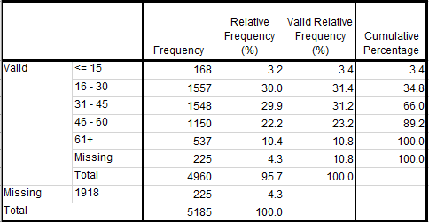
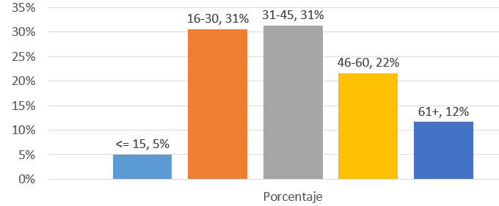
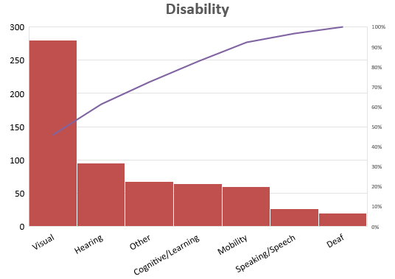
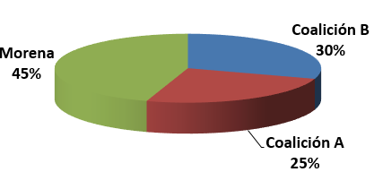
Qualitative (Categorical) Data
Numeric
Frequency Tables
Graphs
Bar Chart
Pie Chart
Pareto Chart
Mode

Slide 10
Summary Statistics
Quantitative Data
Central tendency
Mean $\overline{x}$ (arithmetic)
Mean 𝑥 ̅ (arithmetic)
Variability
Variance (s²)
Interquartile Range (IQR)
Range (R)
Median (Q₂)
Mode
Standard deviation (s)
Q₂: Second quartile (Middle value)
Value that appears often

Slide 11
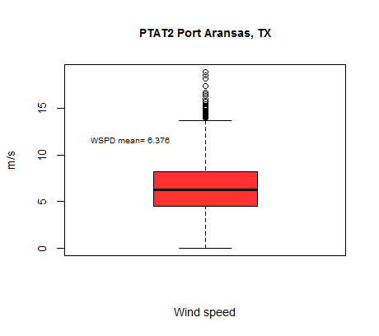
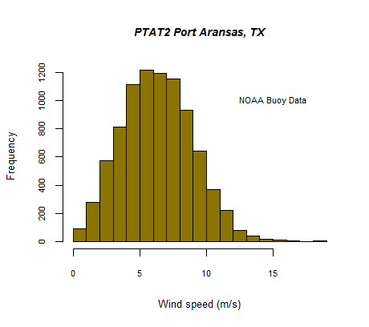
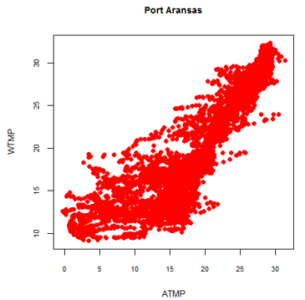
Quantitative data – Graphical summary
Histogram
Boxplot
Scatter plot

Slide 12
Basic data visualization tools
Box & whiskers plot
Central tendency (median)
Variability
Outliers

Slide 13
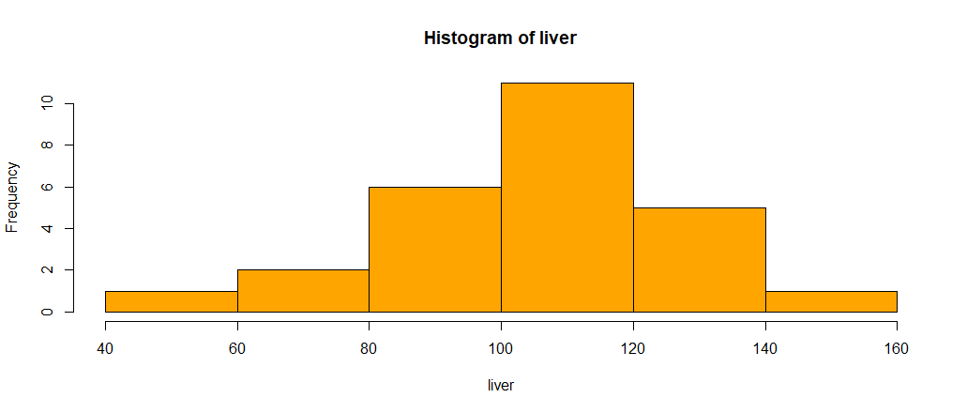
Basic data visualization tools
Histogram
Data distribution
Variability

Slide 14
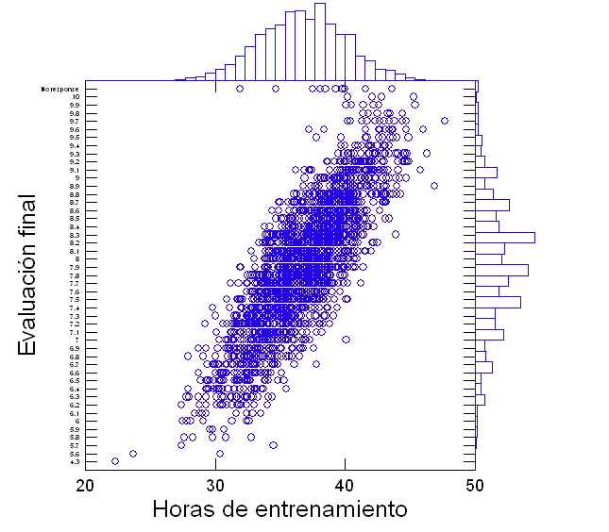
Basic data visualization tools
Scatterplot
Relationship between two variables

Slide 15
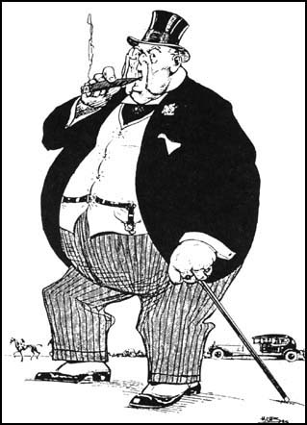



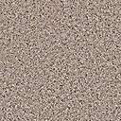

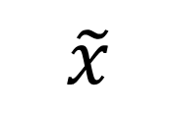




Mean (arithmetic) vs Median
$Median$ $\tilde{x}$
$$n odd$$
$$n even$$
$$Mean$$
$$\tilde{x}$$
Measures of central tendency
$$\overline{x}$$

Slide 16
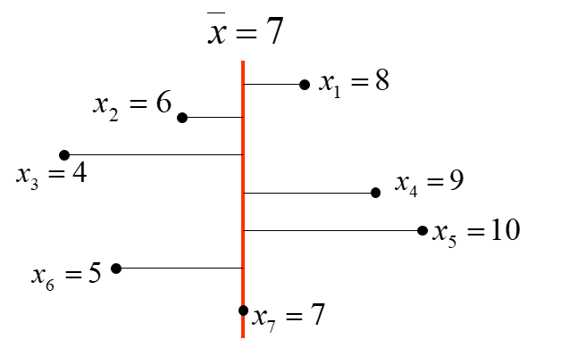
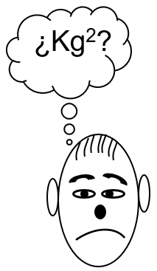
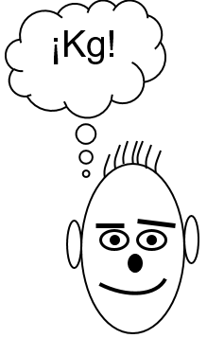
Measures of variability
Variance
Standard Deviation
X = {8, 6, 4, 9, 10, 5, 7}
Variance: squared distance between observations and mean

Slide 17
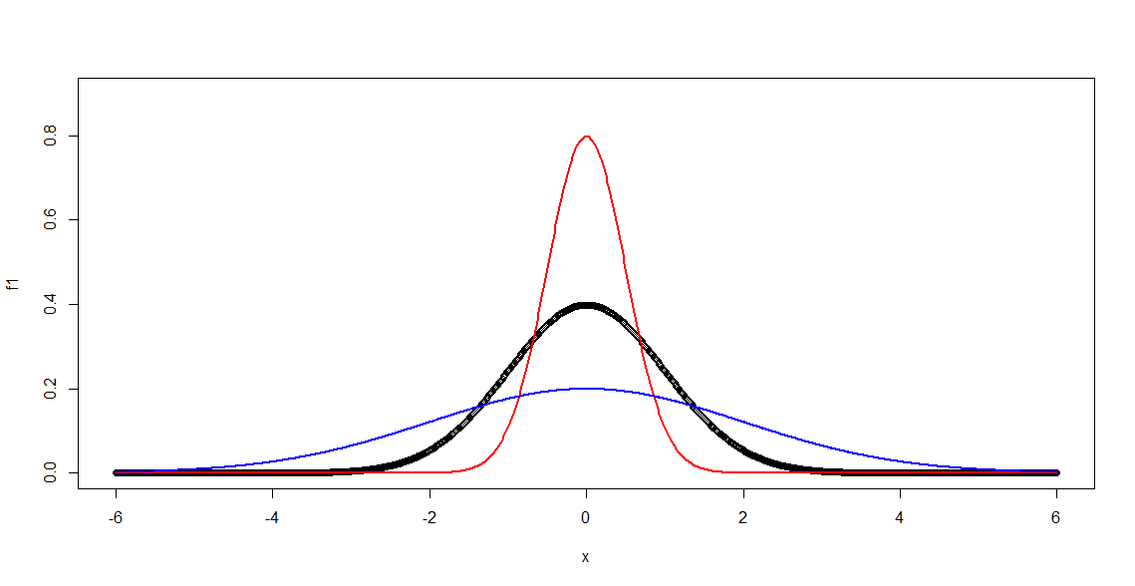
The Normal Distribution
Mean=0
standard deviation =0.5
Mean=0
standard deviation =2
Standard Normal Distribution
mean=0
standard deviation =1

Slide 18
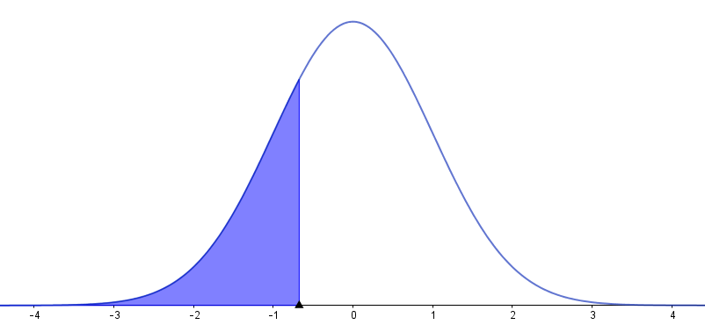
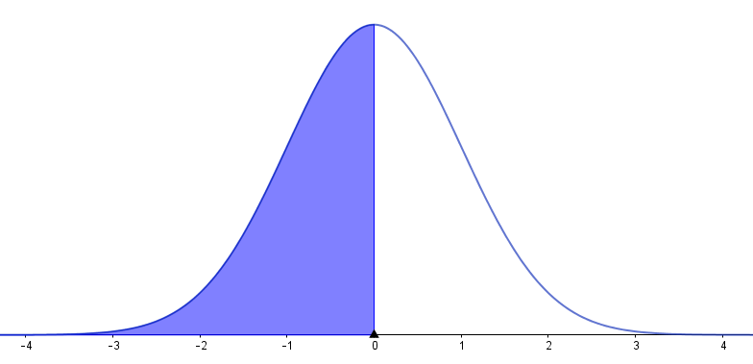
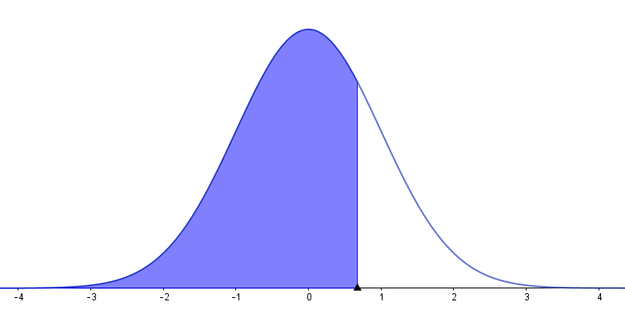
Q1: first quartile
(25th percentile)
Q2: second quartile
(50th percentile or median)
Interquartile range
Q3: third quartile (75th percentile)

Slide 19
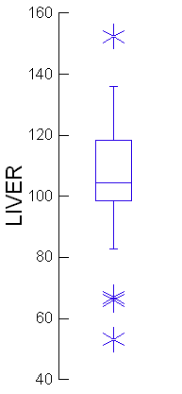
Outlier
Q2: Median
second quartile
Q3: third quartile
IQR: interquartile range
Q1: first quartile
Box & Whiskers Plot
Outliers

Slide 20
Clustering
Items (units or cases)
Variables
Similarity indicated by distance
Similarity indicated by correlation coefficient

Slide 21
Cluster Analysis
Some distance measure for pairs of items
Euclidean distance
Using matrices
Minkowski distance
For m=2, Minkowski distance becomes the Euclidean distance
Johnson, R. A. & Wichern, D. W. (2000). Applied Multivariate Statistics. Upper Saddle River, NJ. Prentice Hall.

Slide 22
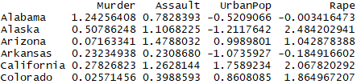
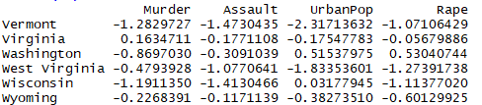
Violent Crime Rates by US State
USArrests {datasets}
head
tail
This data set contains statistics, in arrests per 100,000 residents for assault, murder, and rape in each of the 50 US states in 1973. Also given is the percent of the population living in urban areas.

Slide 23
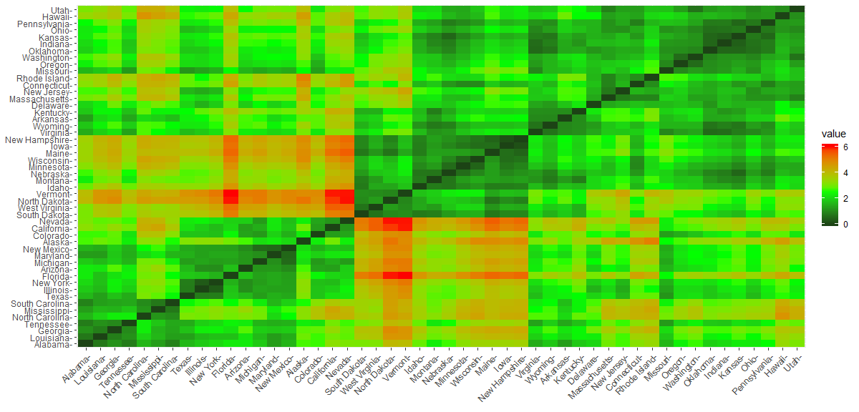
Violent Crime Rates by US State
Distance visualization (method: Euclidean distance)

Slide 24
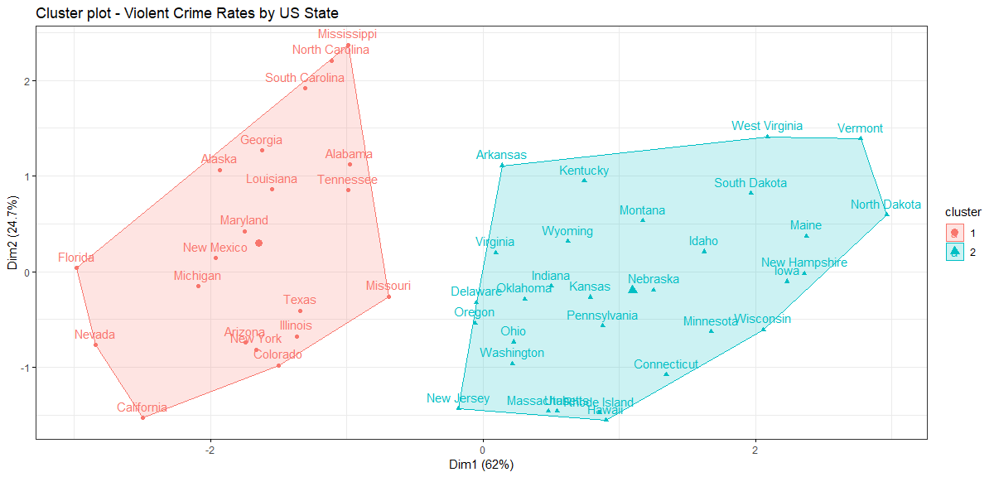
k-means Cluster Analysis
k=2

Slide 25
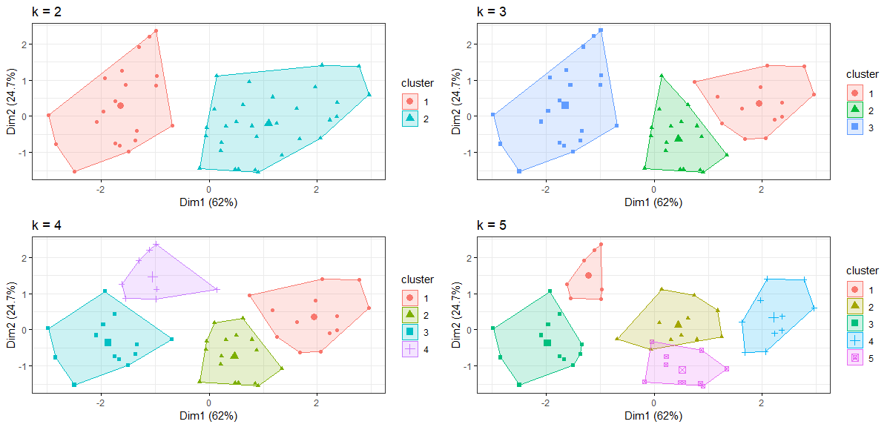
Data: Violent Crime Rates by US State

Slide 26
k=4 optimal cluster (for this case)
Data: Violent Crime Rates by US State

Slide 27
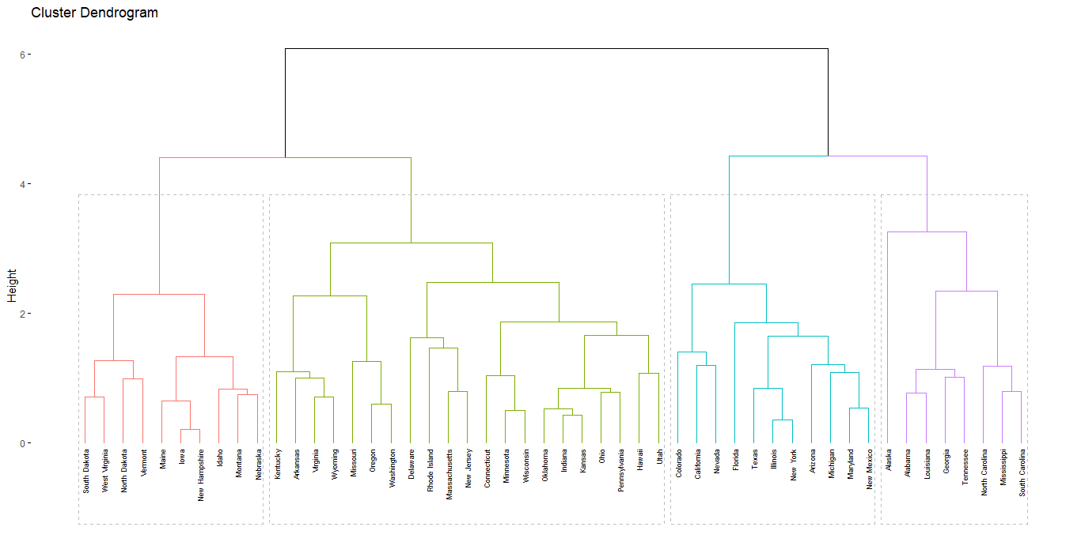
Hierarchical clustering
Data: Violent Crime Rates by US State

Slide 28

Exercise with RStudio

Slide 29
R features
R is a language and environment for statistical computing and graphics.
R is available as Free Software
It is a GNU project. Similar to the S language: It was developed at Bell Laboratories (formerly AT&T, now Lucent Technologies)
Advanced users can write C code to manipulate R objects directly.
CRAN (Comprehensive R Archive Network) mirrors
R comes with a standard set of packages. Others are available for download and installation.
RStudio is an integrated development environment (IDE) for R.

Slide 30
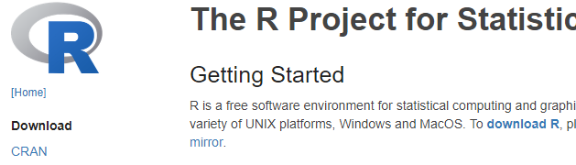
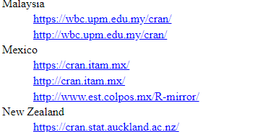

Installing R software
Go to http://www.r-project.org/
Click on “Download R” or on CRAN
Choose URL from a location close to you
Download precompiled binary distribution (Linus / Mac / Windows
Launch the installer and follow instructions

Slide 31
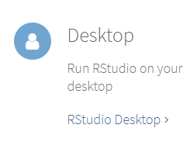
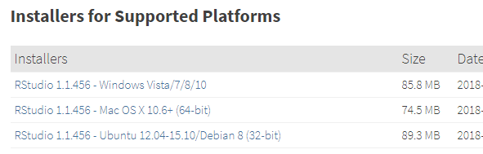
Installing RStudio
After R was installed, proceed to install RStudio
Go to https://www.rstudio.com/
Download RStudio Desktop open source license
Select platform
Launch the installer and follow instructions

Slide 32
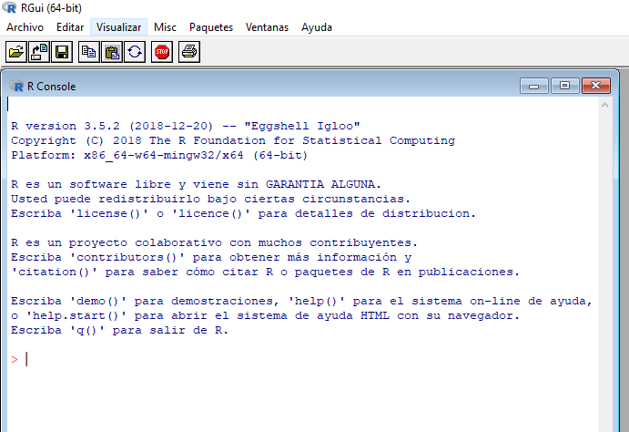
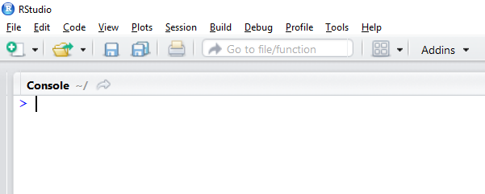
R software
RStudio

Slide 33
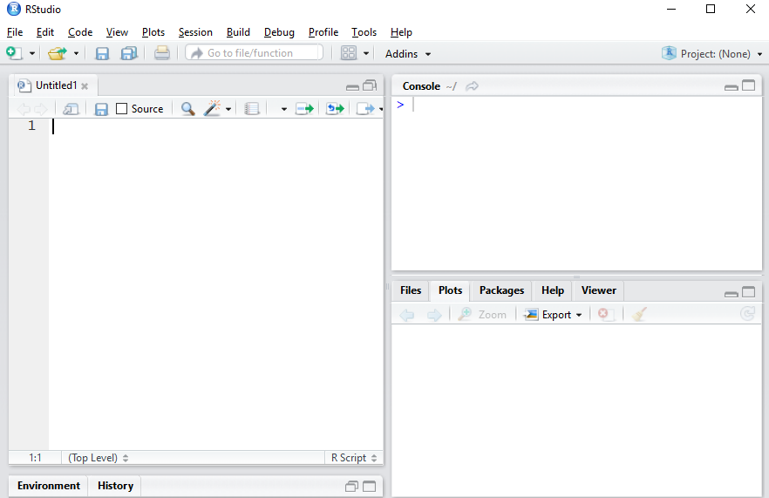
Create a new R script
RStudio interface

Slide 34
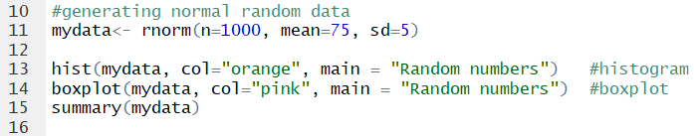

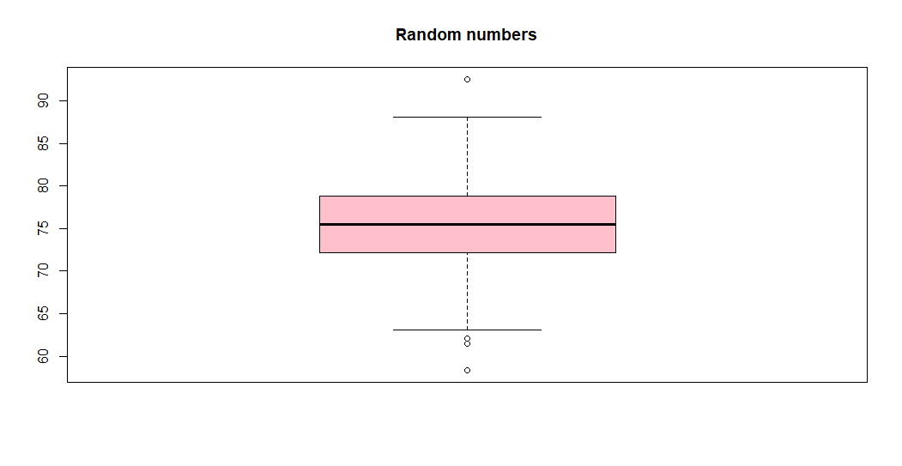
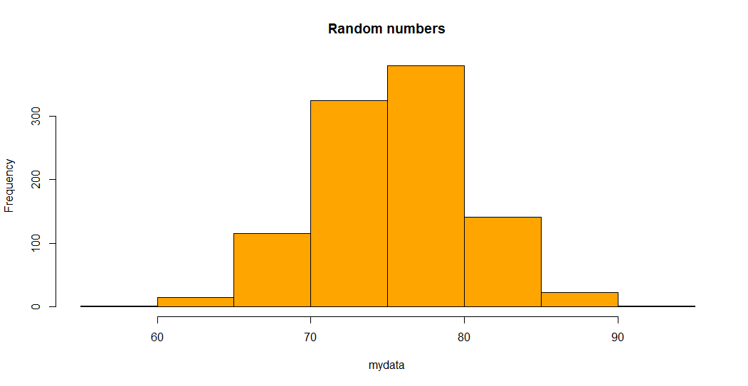

Slide 35

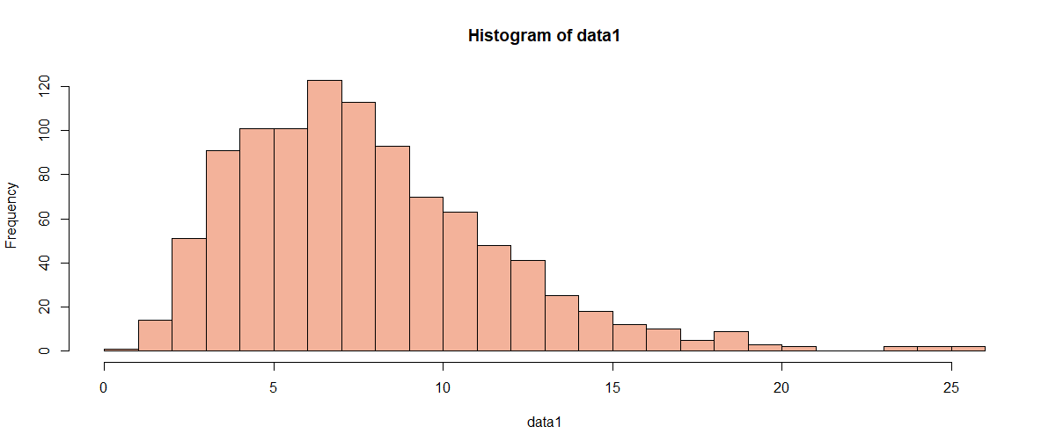

Slide 36
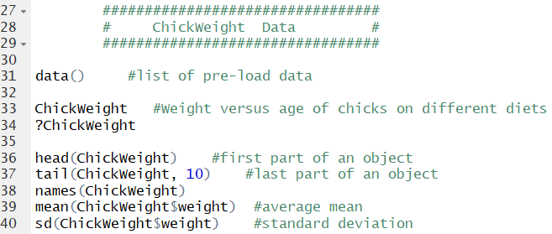


Slide 37
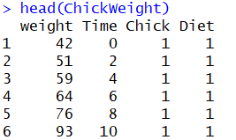
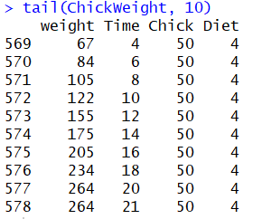



Slide 38

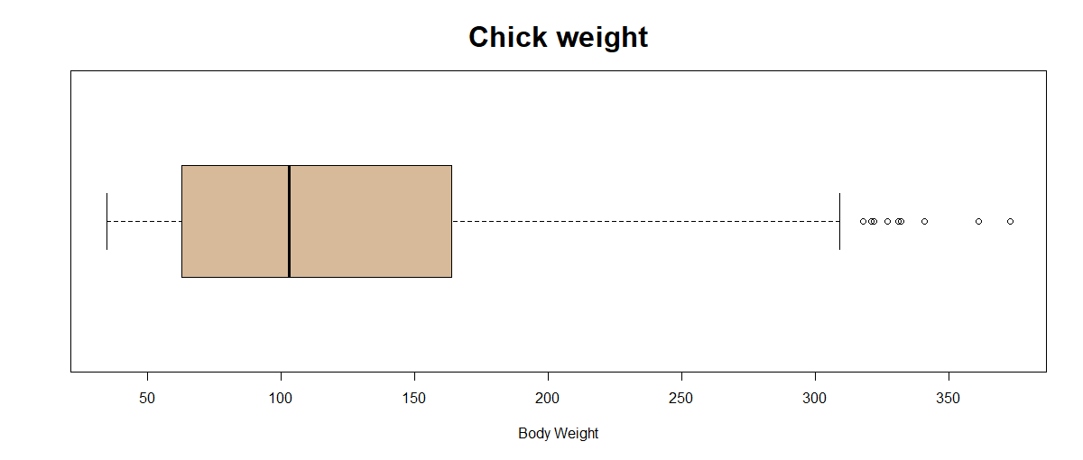
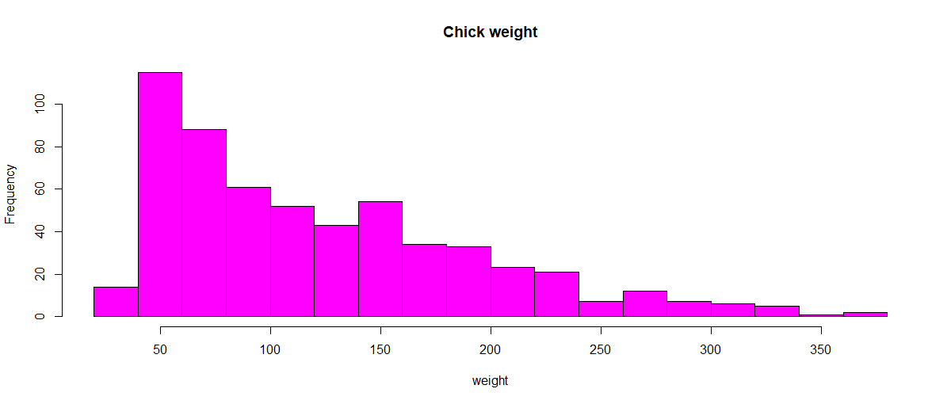
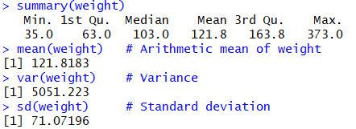


Slide 39
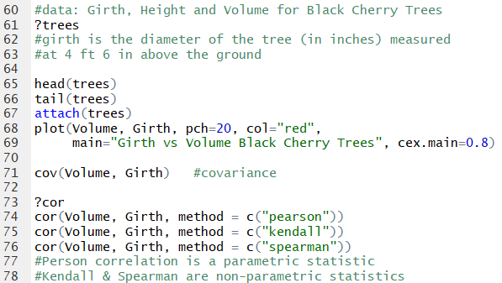

Slide 40
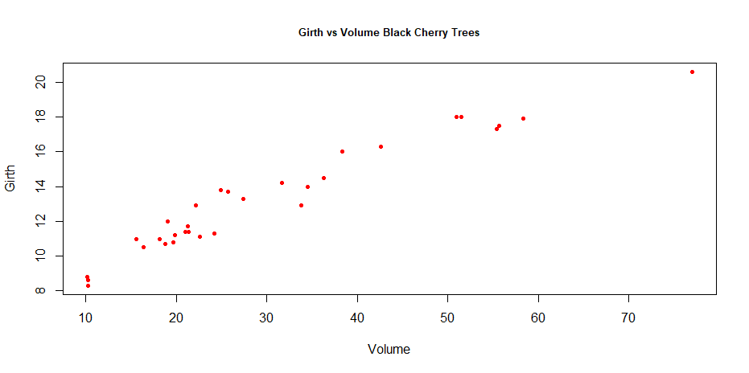
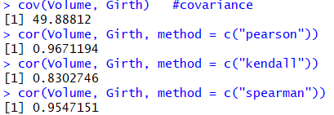
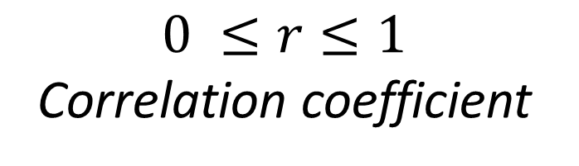
$$0 ≤r≤1$$
Correlation coefficient

Slide 41



Slide 42


Slide 43




Slide 44


Slide 45


Slide 46



Slide 47
Thanks !

