Slide 1
Submitting Data to CDER: Requirements for your Application
Heather Crandall
R/Pharma 2021
November 2-4, 2021

Slide 2
FDA Disclaimer
The views and opinions presented here represent those of the speaker and should not be considered to represent advice or guidance on behalf of the U.S. Food and Drug Administration.

Slide 3
Agenda
Electronic Submissions to CDER
eCTD Requirements
Study Data Requirements
Addressing the Most Common Error Reason

Slide 4
Electronic Submissions to CDER

Slide 5
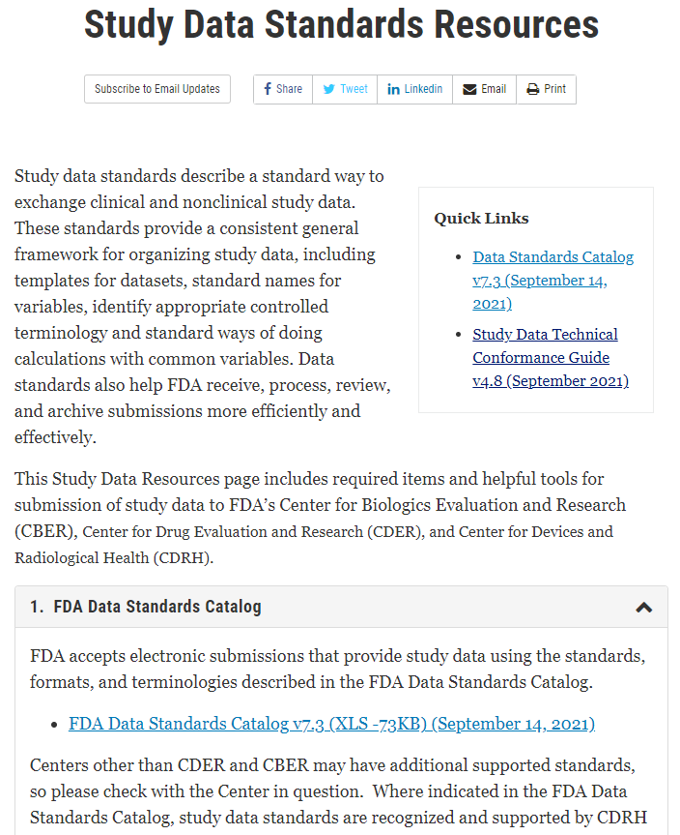
Requirements for Electronic Submissions
Electronic submissions to CDER must conform to standards in the FDA Data Standard Catalog
Section 745A(a) of the Federal Food, Drug, and Cosmetic Act (FD&C Act) requires that submissions under section 505(b), (i), or (j) of the FD&C Act and submissions under section 351(a) or (k) of the Public Health Service Act (PHS Act) be submitted in electronic format
Submissions to NDA, BLA, ANDA, Commercial IND and Master Files* must be in eCTD format
*excluding Non-Commercial IND and DMF Type III

Slide 6
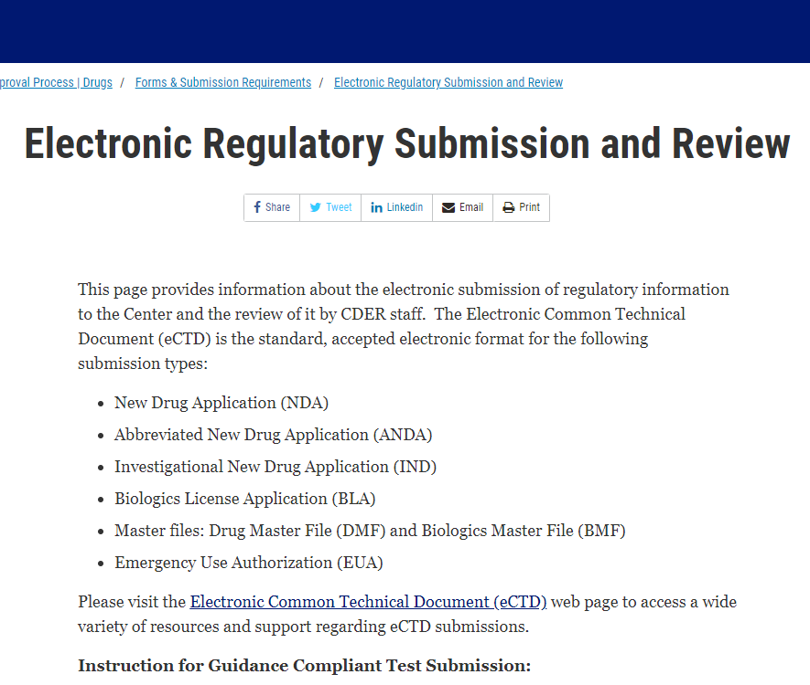
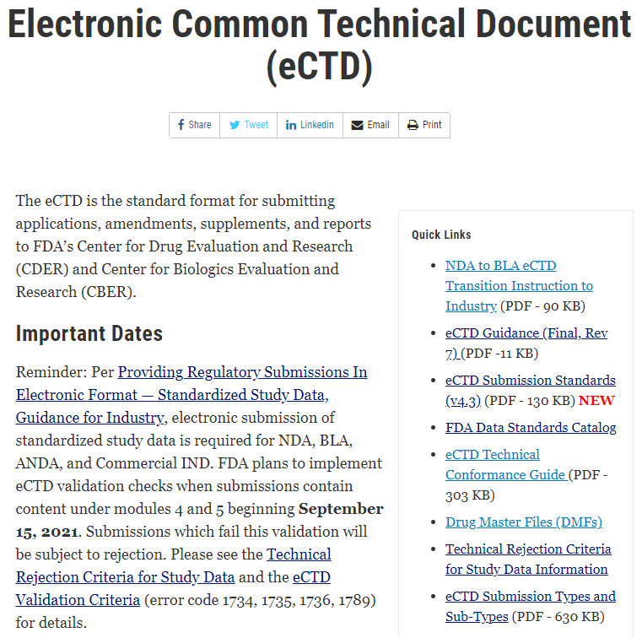
Electronic Submissions to CDER
Electronic submissions can be submitted to CDER in one of two ways:
Electronic Submission Gateway (ESG)
eCTD submission to NDA, BLA, ANDA, IND, DMF applications
Non-eCTD submission to Research IND applications
Non-eCTD submission to applications granted eCTD Waiver
eCTD is the standard format for submitting applications, amendments, supplements, and reports to CDER
CDER NextGen
Non-eCTD submission to Research IND applications
Non-eCTD submission to applications granted eCTD Waiver
Non-eCTD submission of EUA or Pre-submission Correspondence

Slide 7
Electronic Submissions to CDER
CDER received approximately 205,000* electronic submissions via ESG in FY 2020.
Nearly all were in eCTD.
*excludes Non-Commercial IND and DMF Type III

Slide 8
Study Data Requirements

Slide 9
Study Data Requirements
Study Data Guidance specifies that study data submitted to CDER must be in standardized format:
For NDAs, BLAs, ANDAs, studies that started after Dec. 17th, 2016
For Commercial INDs, studies that started after Dec. 17th, 2017
Clinical Data Interchange Standards Consortium (CDISC) study data standards:
Study Data Tabulation Model (SDTM) for clinical trial tabulations data
Standard Exchange for Nonclinical Data (SEND) for non-clinical trial tabulations data
Analysis Data Model (ADaM) for clinical trial analysis data
Study datasets should be provided in .xpt format

Slide 10
eCTD Placement of Study Data Files
Most study data files should be submitted in eCTD Module 4 (non-clinical) and Module 5 (clinical)
The proper placement of the datasets should follow the Comprehensive Table of Headings and Hierarchy
The eCTD File Format Types Specifications provides accepted file types and proper eCTD locations for those file types. Examples include:
File Type | File Format | Format Name | Accepted eCTD location
Modeling and Simulation | .rmd | R Markdown file | M5
Modeling and Simulation Reporting | .r | R Script file | M3 – M5
Module 1
Regional Admin Information
Module 2
Summaries
Module 4 - Non-clinical studies and components such as reports, datasets, protocols, etc.
2.4
Nonclinical Overview
2.5
Clinical Overview
2.3
Quality Overall Summary
Example:
4.2.3 Toxicology
4.2.3.1 Single dose toxicity
4.2.3.2 Repeat dose toxicity
2.6
Nonclinical Summary
2.7
Clinical Summary
Module 5 - Clinical studies and components such as reports, datasets, protocols, etc.
Module 3
Module 4
Module 5
Nonclinical Study Reports
Clinical Study Reports
Example:
5.3.1 Biopharmaceutic Studies
5.3.1.1 Bioavailability (BA) Study reports
5.3.1.2 Comparative BA and bioequivalence (BE) Study reports
Quality
The CTD Triangle

Slide 11
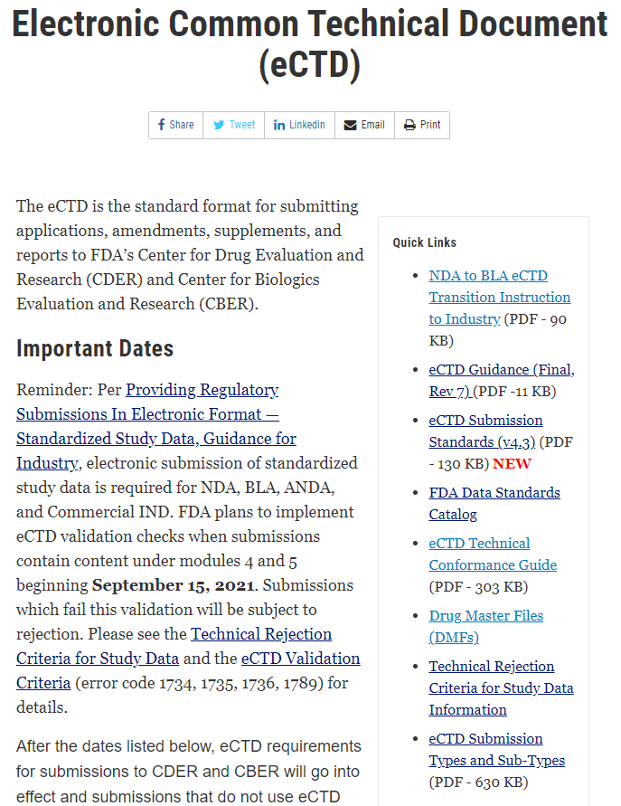
eCTD & Study Data Resources
eCTD Technical Conformance Guide (eCTD TCG) provides technical recommendations for submitting files in eCTD
Technical Rejection Criteria for Study Data (TRC) provides the conditions under which FDA will not accept submissions with study data
Study Data Technical Conformance Guide (SD TCG) provides technical recommendations for submitting study data according to CDISC standards
Planning and Providing Standardized Study Data
Exchange Format: Electronic Submissions
Study Data Submission Format: Clinical and Nonclinical
Therapeutic Area Standards
Terminology
Electronic Submission Format
Study Data Validation and Traceability

Slide 12
Overview of Technical Rejection Criteria
The TRC are eCTD validation criteria to determine compliance with requirements for submitting standardized study data in required sections in Modules 4 and 5, including:
4.2.3.1, 4.2.3.2, 4.2.3.4
5.3.1.1, 5.3.1.2, 5.3.3.1, 5.3.3.2, 5.3.3.3, 5.3.3.4, 5.3.4, 5.3.5.1, 5.3.5.2
Error | Description (Reference to FDA Study Data Technical Rejection Criteria March 2021 version) | Severity Level | Effective Date
1734 | A dataset named ts.xpt with information on study start date must be present for each study in required sections | High | Sept. 15, 2021
1735 | The correct STF file-tags must be used for all standardized datasets and corresponding define.xml files in required sections | High
1736 | For Standard for Exchange of Nonclinical Data (SEND) data, a Demographic (DM) dataset and define.xml must be submitted in Module 4 required sections For Study Data Tabulation Model (SDTM) data, a DM dataset and define.xml must be submitted in Module 5 required sections For Analysis Data Model (ADaM) data, an ADaM Subject level analysis dataset (ADSL) dataset and define.xml must be submitted in Module 5 required sections | High
Between September 15th and October 15th, 2021, 65% of TRC related rejections were caused by 1734 errors

Slide 13
Addressing the Most Common Error Reason

Slide 14
Causes of 1734 Errors
Trial Summary Dataset (ts.xpt) is present
Study ID (or SPREFID) matches STF Study ID
Study start date is provided (or TSVALNF = NA)
Study start date is in a valid format
A dataset named ts.xpt with information on study start date must be present for each study in required sections*
510
15% of submissions with study data in TRC applicable sections
292
58% of Study Errors:
Missing TS File
45
* Module 4 sections: 4.2.3.1, 4.2.3.2, 4.2.3.4
Module 5 sections: 5.3.1.1, 5.3.1.2, 5.3.3.1, 5.3.3.2, 5.3.3.3, 5.3.3.4, 5.3.4, 5.3.5.1, 5.3.5.2
**102 Studies in 45 Submissions with Error 1734 (September 15th – October 15th, 2021)

Slide 15
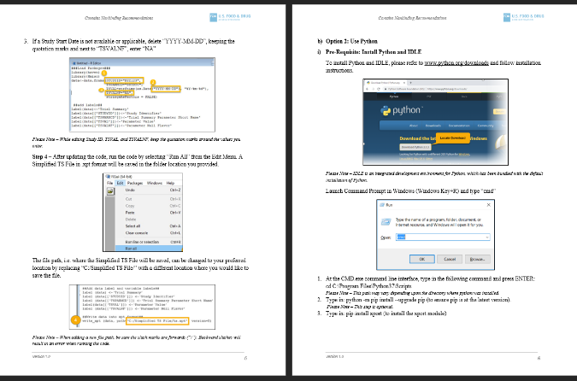
The Simplified ts.xpt Creation Guide
Helps industry create simplified TS files using free and open-source software, R and Python
Provides step by step instructions to install the necessary software
Users can copy and paste code samples from the guide into R or Python
Available on FDA’s web page, Study Data for Submission to CDER and CBER
Demonstration video also available at Study Data for Submission to CDER and CBER
Additionally, a publicly available tool was developed by PHUSE:
Simplified ts.xpt File Generator (https://geotiger.shinyapps.io/07_genTS/)

Slide 16
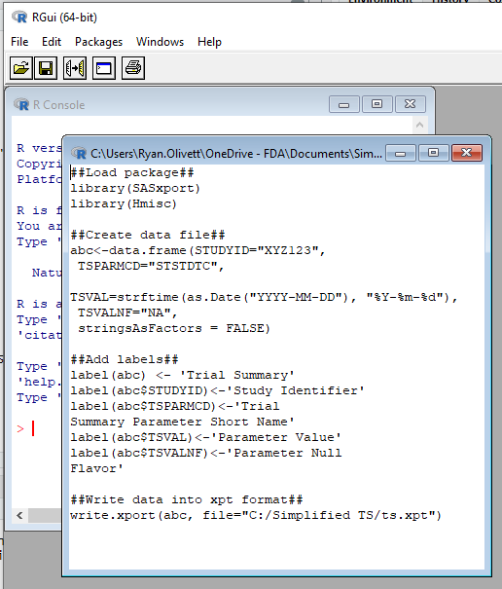
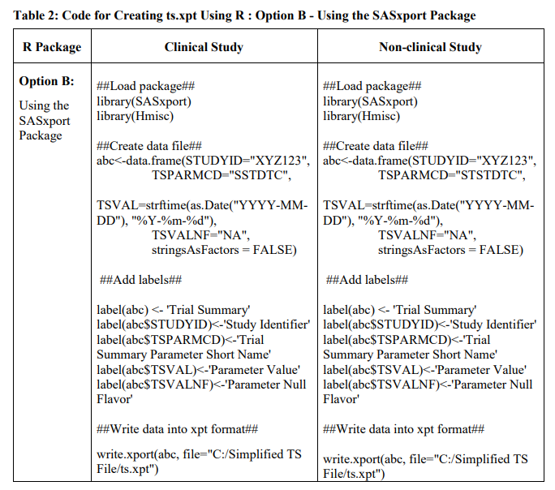
Option 1: Use the Simplified ts.xpt Creation Guide
1. Copy and paste code from the Guide into R Editor to create a script
2. Edit the Study ID
3. Edit the Study Start Date and TSVALNF Value
4. Edit where to save the file
Simplified TS File Creation Guide
R Application

Slide 17
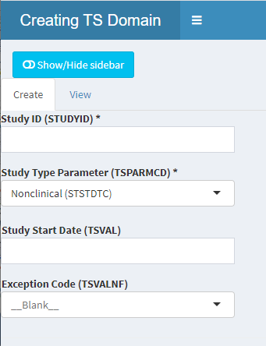

Option 2: Use the PHUSE Utility
Example using the online PHUSE Utility to generate a Simplified TS File:
1. Enter the Study ID
2. Select the TSPARMCD Code
3. Enter the Study Start Date or TSVALNF Value
4. Download the file
PHUSE Utility

Slide 18
Thank you!

Slide 19
References
Study Data Standards Resources​​
Providing Regulatory Submissions In Electronic Format - Standardized Study Data: Guidance For Industry​​ [Jun 2021]
Study Data Technical Conformance Guide​​ [Sep 2021]
FDA Data Standards Catalog​​ [Sep 2021]
Link: https://www.fda.gov/industry/fda-resources-data-standards/study-data-standards-resources
Study Data for Submission to CDER and CBER​​
Technical Rejection Criteria For Study Data ​​​​ [August 2021]
Technical Rejection Criteria Self-Check Worksheet ​​
Technical Rejection Criteria Self-Check Worksheet Instructions​​
Link: https://www.fda.gov/industry/study-data-standards-resources/study-data-submission-cder-and-cber
Providing Regulatory Submissions In Electronic Format - Submissions Under Section 745a(a) Of The FD&C Act: Guidance For Industry ​​
Link: Providing Regulatory Submissions in Electronic Format

Slide 20
Questions
For Questions Please Contact:​
Study Data Questions:​ edata@fda.hhs.gov​
eCTD Questions:​ esub@fda.hhs.gov

Slide 21
Acknowledgements
The author would like to thank Ethan Chen, Jonathan Resnick, Nitin Guptan, Anthony Fata, Ryan Olivett, Jiang Xu, Lina Cong, and other FDA staff for their time and effort in helping collect and analyze data and information as presented here.

