Slide 1
Introducing {admiral}
The ADaM in R Asset Library

Slide 2
Vision
It’s the year 2030. You’re waking up in the morning and after some exercise and breakfast head to work in your self-driving car. You’re working as a data scientist for clincial trials at a big pharma company. Once you arrive at the office and start your computer it’s time to choose the best tool for today’s job. The options are certainly plenty: R, SAS, Python, Julia—just to name a few... As a multi-langual data scientist you use all of them on a regular basis but today’s task—programming ADaM dataset—is best done in R.
Once RStudio is up and running you start loading your favorite package for the job. Again, the choice is a no-brainer. Over the past decade all big pharma companies have joined forces to to develop one open-source industry-standard toolkit. What package is that? It’s {admiral}!
Currently, you’re working on an oncology trial which will read out in 1 week. Submission is planned for 2 weeks later. A couple of years ago these kind of timelines would have made you shiver. Yet, nowadays it has become the norm. What changed? Thanks to a bulk of open source tools called the pharmaverse programming for submissions has become much more streamlined. Whereas in the past each company developed their own siloed solutions and had their own «interpretation» of standards like ADaM, in 2030 the whole industry jointly develops open source tools
as part of the pharmaverse. With everyone using the same tools, the quality has risen, time to delivery has decreased dramatically and talent flow across organizations is much more seemless.
The FDA and other health authorities endorse the usage of admiral due to its high quality and transparency. You as a data scientist value the modular approach which makes programming any ADaM dataset a breeze.

Slide 3

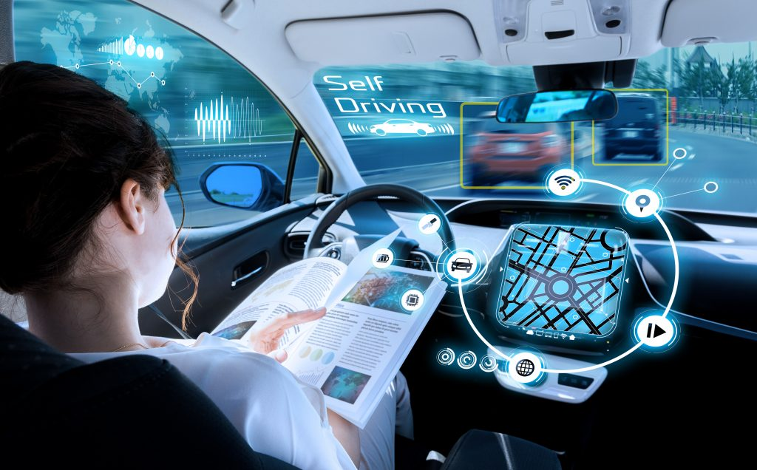

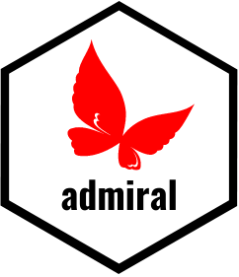
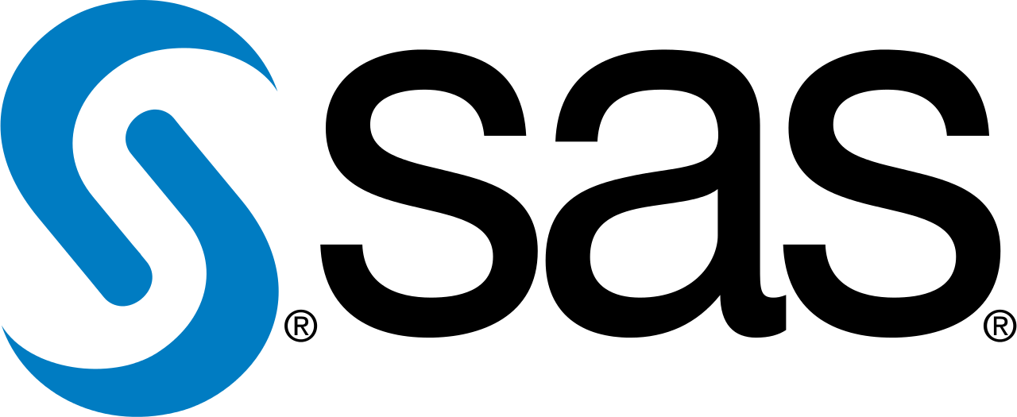
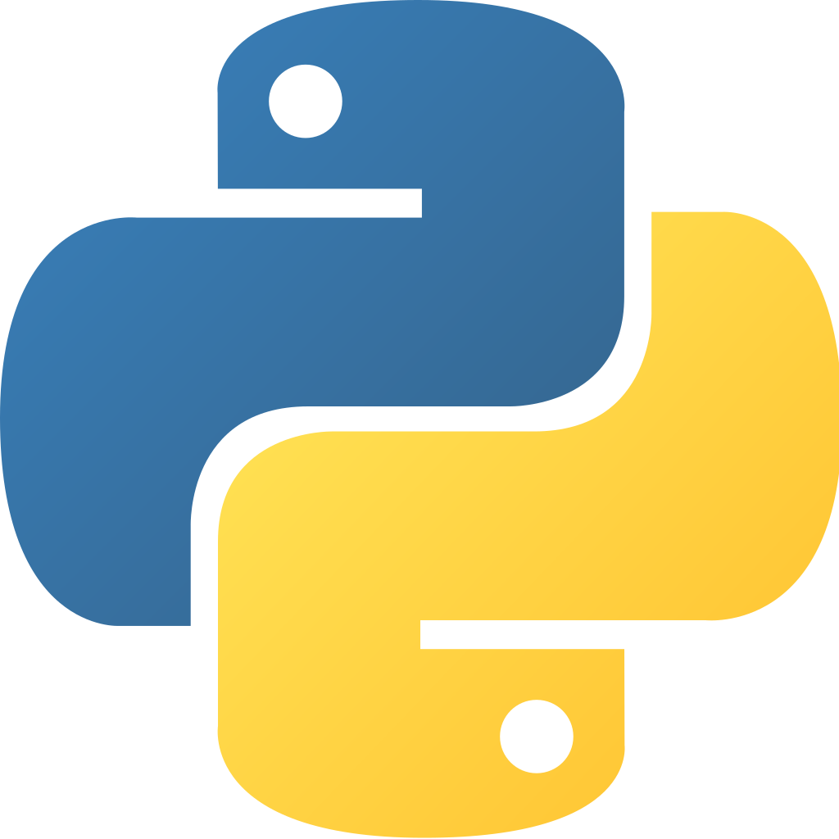
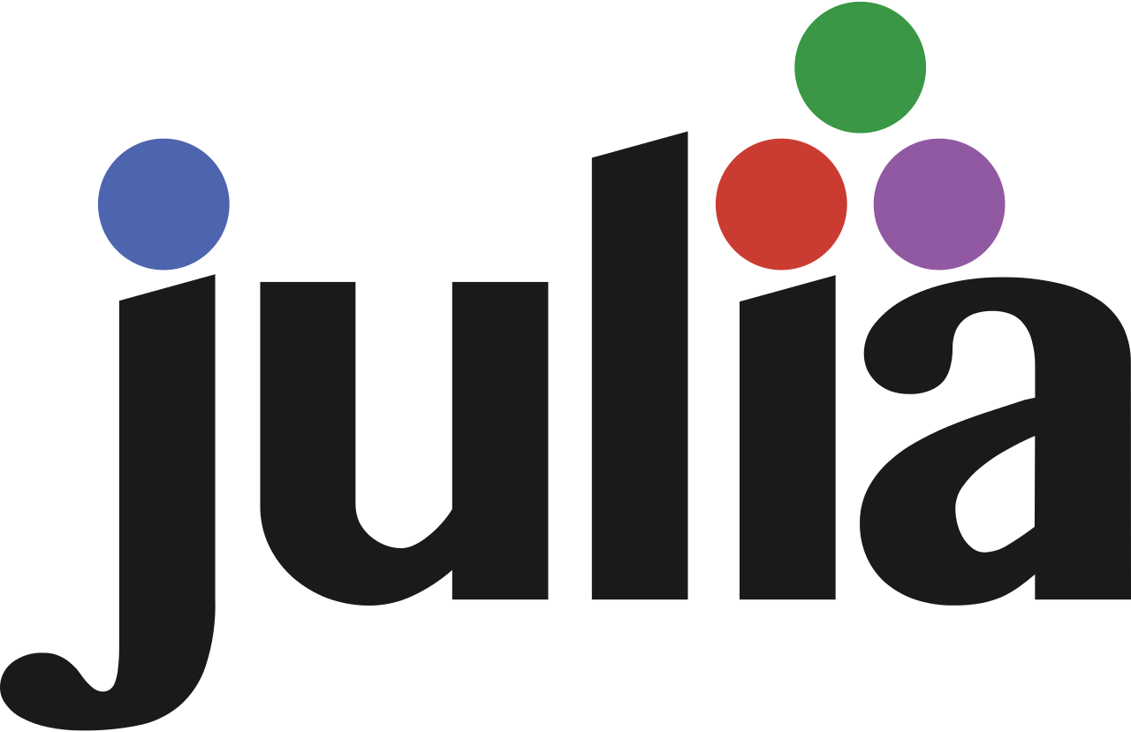
2030

Slide 4

What Makes {admiral} Special?
create_advs(
vs,
param_01 = ,
param_02 = ,
…,
param_99 =
)
vs %>%
derive_var_a() %>%
derive_var_b() %>%
derive_param_x() %>%
...
Notes:
Think of admiral as a toolbox of modular blocks (toolbox of R functions) →
each block has a stand alone purpose (each function provides a specific functionality)
Data Scientists can create their own blocks (create own R functions)
Constructing an ADaM dataset should become like building out of blocks that are based on admiral modular functions and user-created modular functions.

Slide 5
Demo

Slide 6


How Did We Get Here?
The ADaM in R Asset Library
Open-source modular toolkit for generating ADaM in R
Notes:
It all started in early 2021 when Roche and GSK joined source to develop an open-source modular toolkit for programming ADaM datasets in R—{admiral}.
LinkedIn post -> kick off meeting -> joint development
Across the pharmaceutical industry we all face the same challenge when it comes to analysis and creating ADaM datasets!
We all work on our own “standard solutions” for ADaMs
We all face the challenge of a changing and novel data landscape
New therapeutic areas and analysis concepts
Individual “blackbox” solutions instead of re-use, co-creation and sharing
We tend to see siloed and hierarchical approaches as more efficient than a collaborative approach

Slide 7
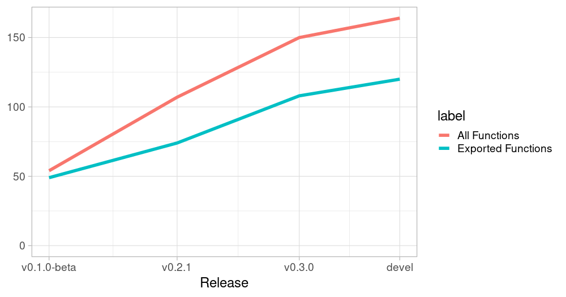

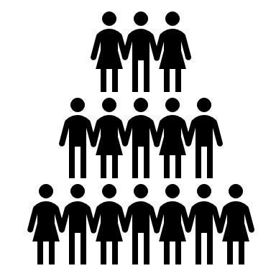
Current Status
March 2021 – conception
(Roche + GSK) - 6 developers
September 2021 – test release
60+ testers, across 19 companies
J&J/Janssen
Norvatis
Astrazeneca
Merck
Astellas
Pfizer
Bristol Myers Squib
Novonordisk
EMD Serono
Atorus
PCCTC
IQIVIA-CSG
Alnylam
GSK
Biogen
GenInvo
Cytel
EQRx
Jazz Pharma
Notes:
Started off with a small dev team – with the first release with about 50 fcnts and ever since then the team and code base has increased with the impressive milestone of open testing released in Sept 2021

Slide 8
Testing Feedback
«Extremely easy to learn and get into, well thought and planned. Plenty of minor functions instead of aiming to create a large ‘jack of all trades’ framework»
«I will highly recommend admiral in my company»
«I like the modular approach, the structure of the independent functions to create and derive new variables and parameters»

Slide 9
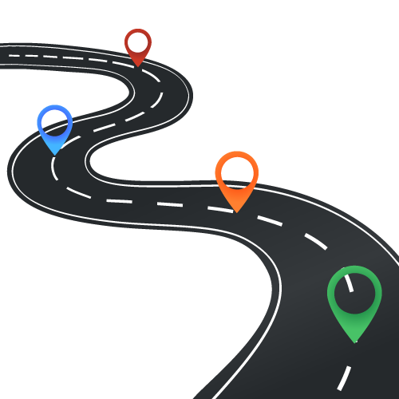
Roadmap/Outlook
Limited Testing Release – complete Oct. 2021
GITHub Repo open to everyone (read-only)
.
Nov. 2021
Phuse EU Connect
Hands-on workshop
Mar. 2022
Phuse US Connect
Hands-on workshop
.
Open-source release
Q1/Q2 2022
This Photo by Unknown Author is licensed under CC BY-NC
Notes:
And now that we have closed the feedback session- we are looking at incorporating the issues raised to make admiral robust and will be offering hands on workshops at EU and US leading to open source
Full open source is planned for Q1/Q2 next year
Gradually reduce the development team
Focus on user contribution

Slide 10
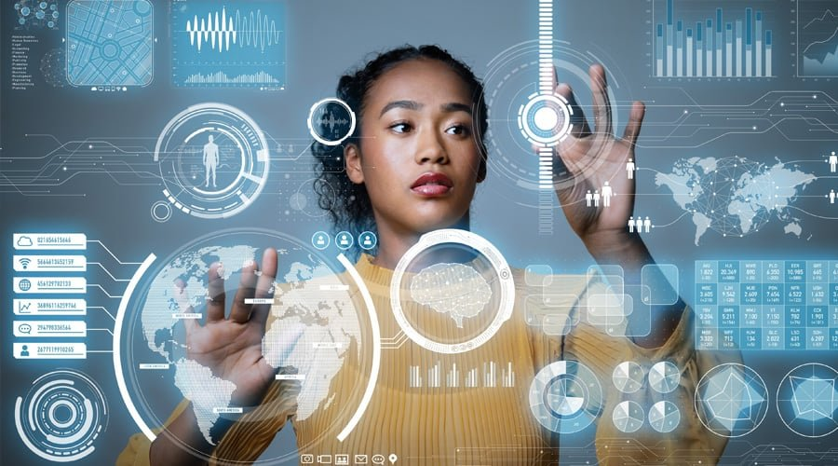

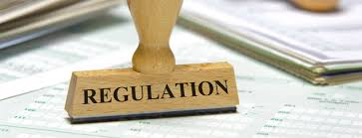
Reducing the burden of ADaM across industry, focus on insights bringing treatment faster to patients
2030
Open-source release
Q1/Q2 2022
Collaborate with other like-minded people
Re-use and inheritance
Seamless talent flow
Seamless talent flow
Efficient resource management
Accelerated timelines
Transparency, quality and consistency of submitted work
Notes:
As a Data Scientist: contribute to something bigger
An option to make a name for yourself in the Pharma open-source community (i.e. an extension of just sharing a paper), and an avenue to collaborate with other like-minded people across the world
Share, re-use and inheritance as a community instead of re-inventing the analysis for each study
As a company: harmonization and robustness
A robust framework for R-based ADaM shared ready-to-use modules
Imagine ADaM code becomes more transparent across the industry (QC, readable code, talent flow ..)
Resource management, focus, accelerated submissions (shorter time to CSR), talent flow is seamless
FDA: transparency, quality and consistency of submitted work
Patients & Society: concentrate on the right work
If we can collectively reduce the burden of ADaM across-industry, imagine the data scientist skills and resources this unleashes towards making more with the insights of our data, and the speed at which we’re able to bring treatments to patients

Slide 11

Meet the team
Thomas Neitmann
Alice Ehmann
Michael Rimler
Ondrej Slama
Robin Koeger
Ross Farrugia
Teckla Akinyi
Samia Kabi
Stefan Bundfuss
Vignesh Thanikachalam
Shimeng Huang
Gordon Miller
Eric Simms
Michael Thorpe
Pavan Kumar
Ben Straub
Pooja Kumari
Hamza Rahal
Annie Yang
Kamila Duniec
Lucy Hoch
Eddy Foster
Suhas Kirani Ravindra
Live booth sessions
[Timings of booth]
10:00AM – 02:00PM EST
admiral website
https://roche-gsk.github.io/admiral/index.html

Slide 12
Meet the team
Thomas Neitmann
Alice Ehmann
Michael Rimler
Ondrej Slama
Robin Koeger
Ross Farrugia
Samia Kabi
Stefan Bundfuss
Teckla Akinyi
Vignesh Thanikachalam
Shimeng Huang
Gordon Miller
Eric Simms
Michael Thorpe
Pavan Kumar
Ben Straub
Pooja Kumari
Hamza Rahal
Annie Yang
Kamila Duniec
Lucy Hoch
Eddy Foster
Suhas Kirani Ravindra
Live booth sessions
[Timings of booth]
10:00AM – 02:00PM EST
admiral website
https://roche-gsk.github.io/admiral/index.html

