Slide 1
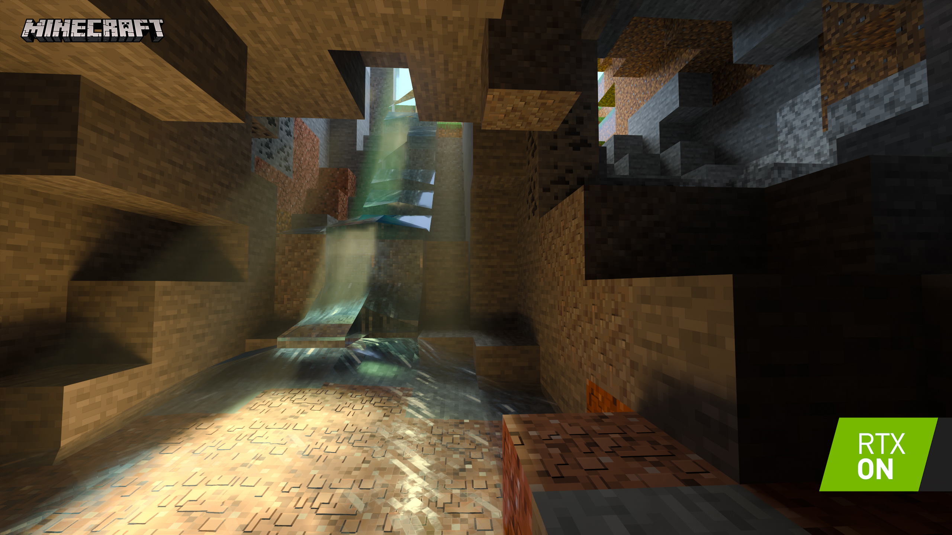
DE/AR
2024
Week X : Revision

Slide 2
This class
→ Do a high level overview ←
(Dig into some problem topics)
Break
QA / problem topics

Slide 3
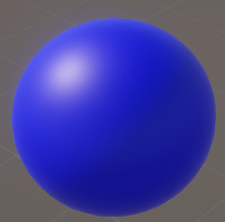
High level overview
A whole semester we’ve understood things bottom up
Let’s got top down (for the most important part
Let’s start at the start (week 1)
What’s the image on the right again?

Slide 4
High level overview
This is a render (in Unity) of a plastic blue sphere
Rendering is writing the algorithms to make virtual objects look like they’re in a 3D environment
To understand these algorithms, we look at real life, and how our eyes see the world

Slide 5
High level overview
→ How reality works ←
Primary visibility (aka geometry)
The rendering equation (aka color)
How it fits into GPU’s and Unity

Slide 6
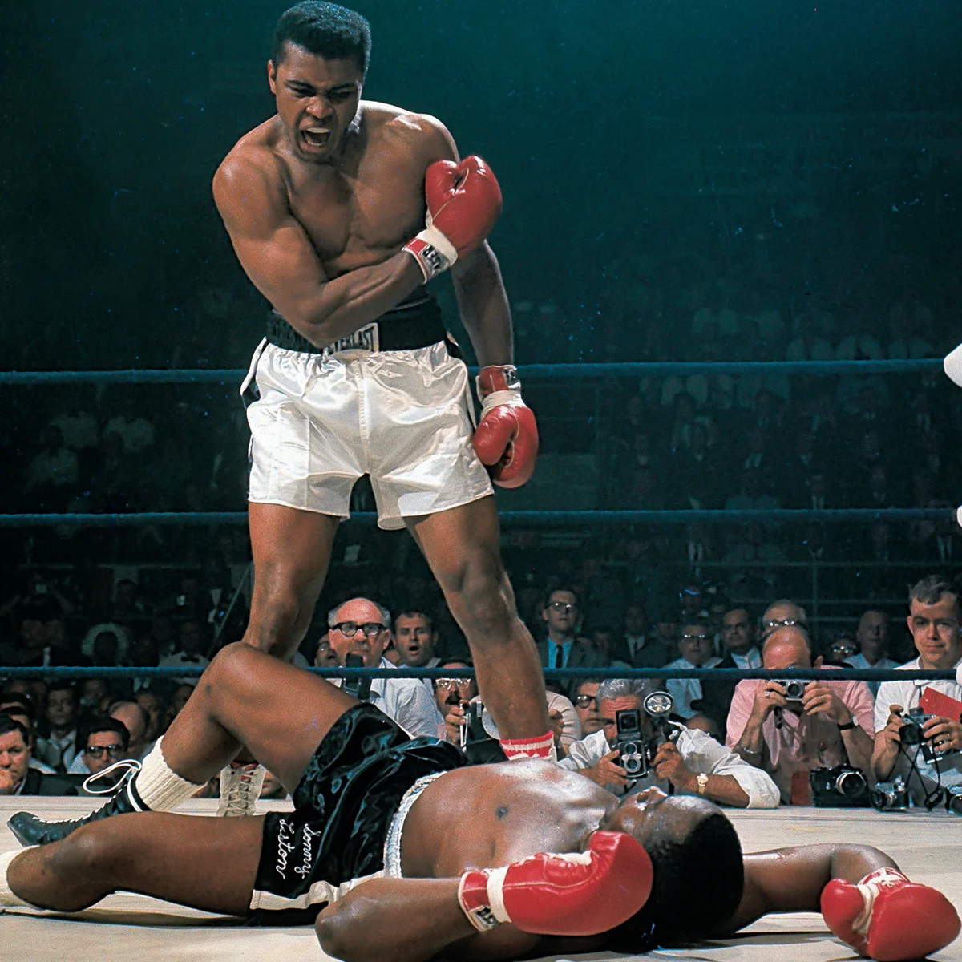
How reality works
Taking a real picture resembles rendering (3D scene -> 2D image)
If we understand this, it allows us to get an idea on how to divide the problem

Slide 7


How reality works
Light bounces off surfaces
We see the light that hits the camera
It comes from the closest object to the camera

Slide 8
How reality works
How do we calculate what geometry is visible (closest to the camera)? This is called the “primary visibility” problem
How do we calculate the exact color at that point? This is solved in the “rendering equation” which is specific materials

Slide 9
High level overview
How reality works
→ Primary visibility (aka geometry) ←
The rendering equation (aka color)
How it fits into GPU’s and Unity

Slide 10
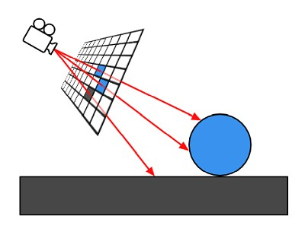
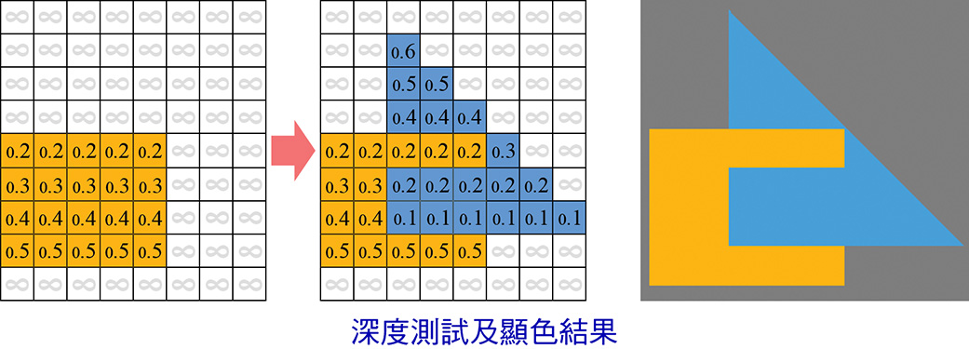
Primary visibility
The fundamental difference between raytracing and rasterizers
Raytracing : shoot a line from the camera, find nearest triangle
Rasterizer : for each triangle, make pixels, use depth buffer to have the closest pixel color at the end.

Slide 11
High level overview
How reality works
Primary visibility (aka geometry)
→ The rendering equation (aka color) ←
How it fits into GPU’s and Unity

Slide 12
Rendering equation
Don’t know this in detail
It describes how much light goes to the camera from a surface
Simplified, it’s foreach light: output_light += material(dot(N,L) * light_intensity)

Slide 13
High level overview
How reality works
Primary visibility (aka geometry)
The rendering equation (aka color)
→ How it fits into GPU’s and Unity ←

Slide 14




GPU’s
Specifically made to do realtime rendering
Using rasterization and triangles
Can run custom code called “shaders” on vertices and fragments
We want to use the gpu as much as possible
Vertex shader
Fragment shader

Slide 15
Forward rendering
Old way of doings things
Supported in Unity when you make an unlit shader
Calculate all the lights/shadows in the material
Fragment shader
Light lights; (from cpu)
Float4 outputColor = 0;
For each light:
if (inShadow(shadowMap))
continue
outputColor += BRDF(N, light) *
Return outputColor
Vertex shader
(Apply animation)
Apply mvp matrix

Slide 16
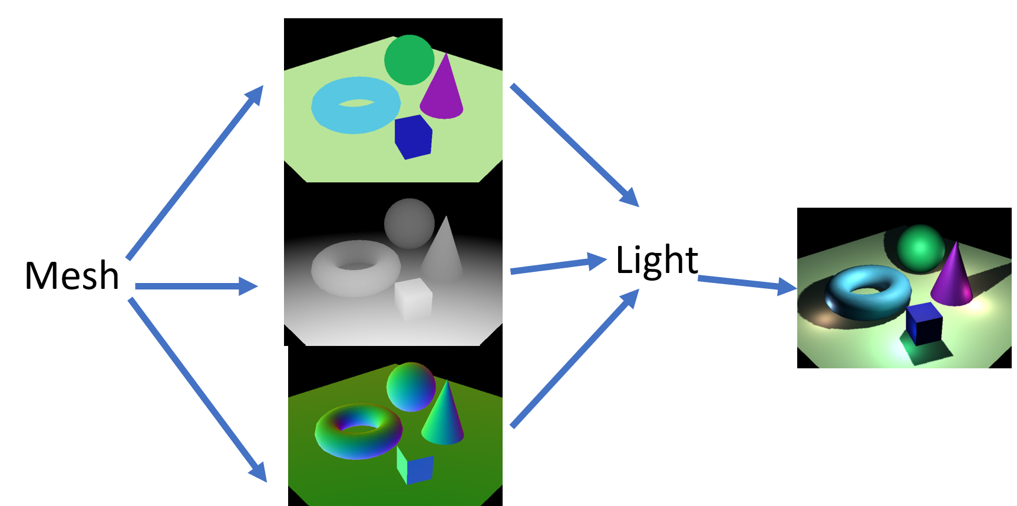
Deferred rendering
New way of doings things
Supported in Unity when you make a lit shader
Calculate only base color, normal in material
Lights calculated in a later stage (usually inaccessible in the engine)

Slide 17
Questions?
We skipped a lot of essential stuff: geometry, normal
This was just to connect everything for the pipeline part
The rest is (relatively) selfcontained

Slide 18
This class
Do a high level overview
→(Dig into some problem topics) ←
Break
QA / problem topics

Slide 19
This class
Do a high level overview
(Dig into some problem topics)
→ Break←
QA / problem topics

Slide 20
This class
Do a high level overview
(Dig into some problem topics)
Break
→ QA / problem topics ←

Slide 21
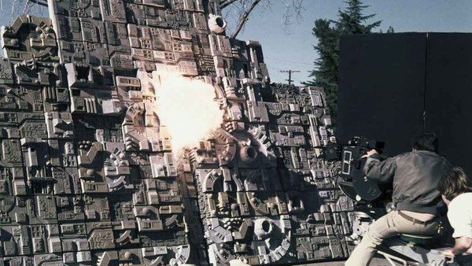
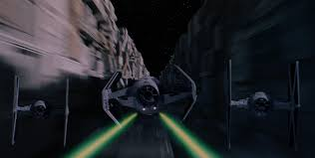
GOOD LUCK!
Exam slots posted Friday 1700
If they’re full, just email me, it’s expected

