Slide 1
Week 2b : 3D lab

Slide 2
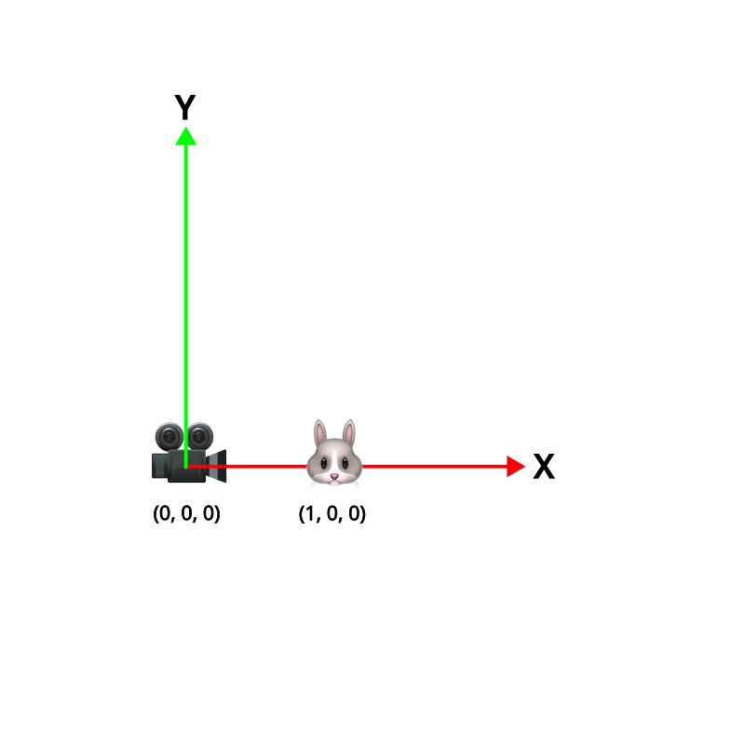
Last class
Point & Vectors
Transforms
Transformation spaces
Dot & Cross product

Slide 3
This class
Learn some C#
Make a character creator
Animate our character

Slide 4
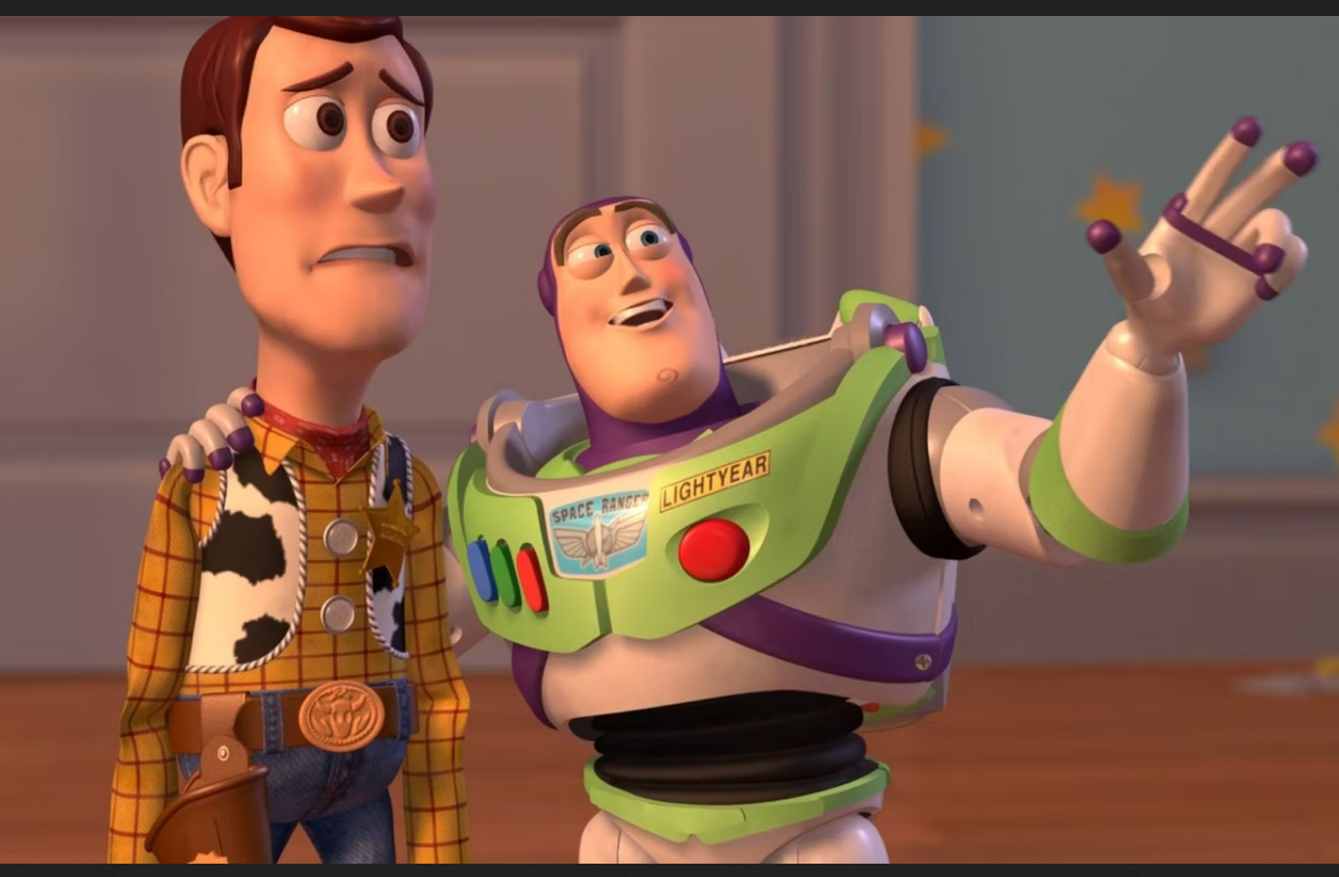
Course schedule
 | Monday | Thursday
Week 1 : 12/02 | Introduction | C#/Unity Lab
Week 2 : 19/02 | 3D reasoning | 3D Lab
Week 3 : 26/02 | Basic Pipeline | Lab
Week 4 : 04/03 | Textures Normal maps | Post processing / lab
Week 5 : 11/03 | Camera’s Light | lab
Week 6 : 18/03 | Advanced pipeline | Advanced pipeline lab
Week 7 : 25/03 | Materials Aliasing | Materials Lab
Week 8 : 15/04 | Procedural generation | Procedural generation lab
Week 9 : 22/04 | Project explanation | Project lab
Week 10 : 29/04 | Guest Lecture Project Labs | Guest Lecture Project Labs
Week 11 : | Revision | Revision
Highly likely to change ☹
What are you looking forward to?

Slide 5
C#
→ Properties ←
Events
Operator overloading

Slide 6
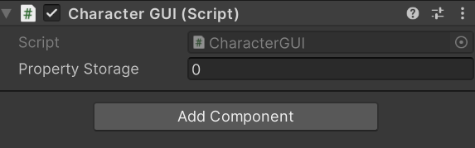
C# properties
public int variable;
[SerializeField] private int propertyStorage;
public int property
{
get { return propertyStorage; }
set
{
if(value >= 0)
propertyStorage = value;
}
}

Slide 7
C# properties
public int variable;
[SerializeField] private int propertyStorage;
public int property
{
get { return propertyStorage; }
set
{
if(value >= 0)
propertyStorage = value;
}
}
Works with a lot of Unity types : Vector3, GameObject, Color

Slide 8
C#
Properties
→ Events ←
Operator overloading

Slide 9
C# events
public delegate void OnHealthChanged(int newHealth);
public event OnHealthChanged onHealthChanged; onHealthChanged += UpdateHealthUI;
onHealthChanged.Invoke(newHealth);

Slide 10
C#
Properties
Events
→ Operator overloading ←

Slide 11
C# operator overloading
public static Vector2 operator /(Vector2 a, Vector2 b)
{
return new Vector2
(
a.x / b.x,
a.y / b.y
);
}

Slide 12
Lab time!

