Slide 1
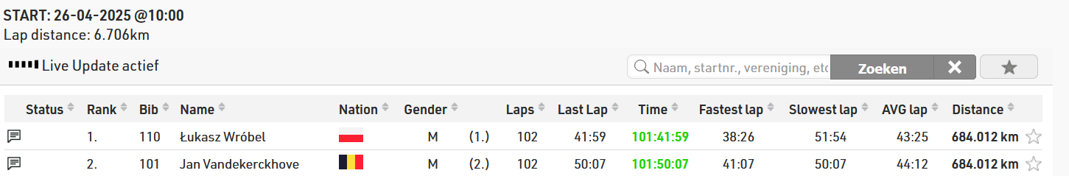
DE + AR
2025
Week 10b: Postprocessing

Slide 2
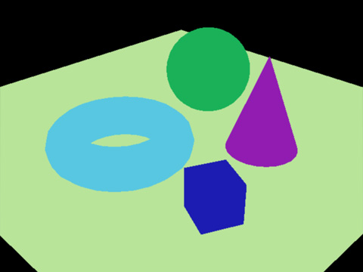
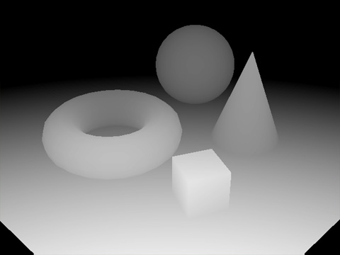
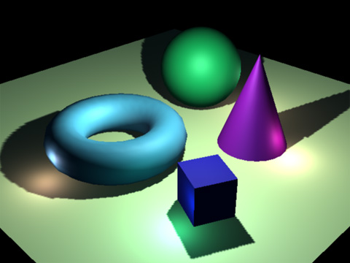
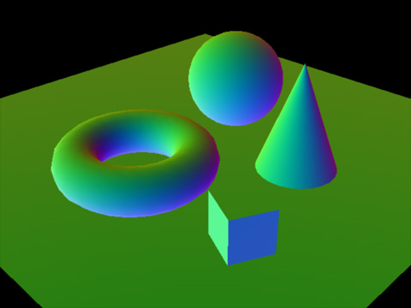
Last class: Deferred rendering
Light
Mesh

Slide 3
Your job:
* Every multiple of 10 chunks, add a portal to the chunk. Eg the chunks at (0,0), (10, 0), (0, 10), and (10, 10) all should have a portal, and the portal should sit mostly correctly on the terrain (the portal is on top of the terrain, and the center is not obscured by blocks),
* Create a new unlit material for the obsidian blocks. Implement blinn-phong lighting. As a light source, only account for the directional light in the scene. You can use [_WorldSpaceLightPos0](https://docs.unity3d.com/Manual/SL-UnityShaderVariables.html) to get the direction. For the formulae, either refer to the slider, or if you want it explained a different way, [this chapter](https://developer.download.nvidia.com/CgTutorial/cg_tutorial_chapter05.html) made it click for me originally
* Use procedural generation to generate a heightmap, and use finite differencing to turn this into your normals. The color can be anything you want.
* Create geometry and material for the center of the portal. How you do this is completely free, just make sure the effect is interesting. Remember, you have a method to create a plane. You must use at least one custom shader. Spend at least an hour on this.

Slide 4
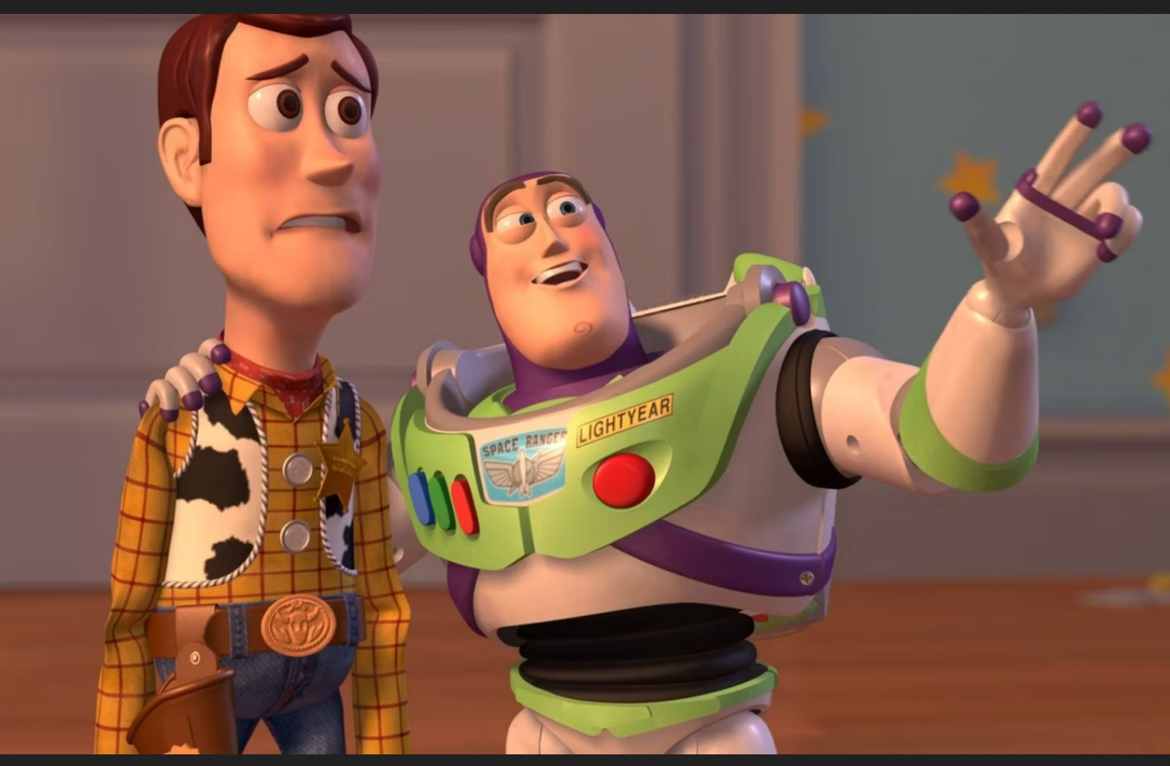
Course schedule
 | Mon | Wed
Week 1 |  | Introduction
Week 2 |  | 3D reasoning
Week 3 |  | Geometry
Week 4 |  | Pipeline & Materials
Week 5 |  | Proceduralism
Week 6 |  | Textures & Normal maps
Week 7 |  | Aliasing / Presentations
Week 8 | Lab | Advanced pipeline 1 Lab
Week 9 | Lights, shadows, camera’s, primary visibility Lab | Forward rendering Lab
Week 10 | Deferred rendering / lab | Post processing / lab
Week 11 | Bonus | Quiz
Week Rev |  | Revision
I’m not sure what to teach on Monday
What are your struggles in the project?
I probably can find a topic that reinforces a lot of what you need to know
Or we can revise a topic deeply
Tell me!

Slide 5
This class
Full pipeline
Grayscale
HDR (color)
Lab?
(Bloom (blur))
(Ambient occlusion)
(Night vision (live coding))
Lab!

Slide 6
I actually forgot to tell you the full pipeline!
This is the part we already talked about
It typically takes about 60% of the time we spend rendering a frame
Render shadow maps
Render meshes
Render lights

Slide 7
The other 40% : post processing
Post processing is a very general term
It’s a bunch of algorithms which take a texture of the rendered scene, and manipulates it
We’re not rendering meshes anymore
The interesting part is what they do

Slide 8
This class
Full pipeline
Grayscale
HDR (color)
Lab?
(Bloom (blur))
(Ambient occlusion)
(Night vision (live coding))
Lab!

Slide 9
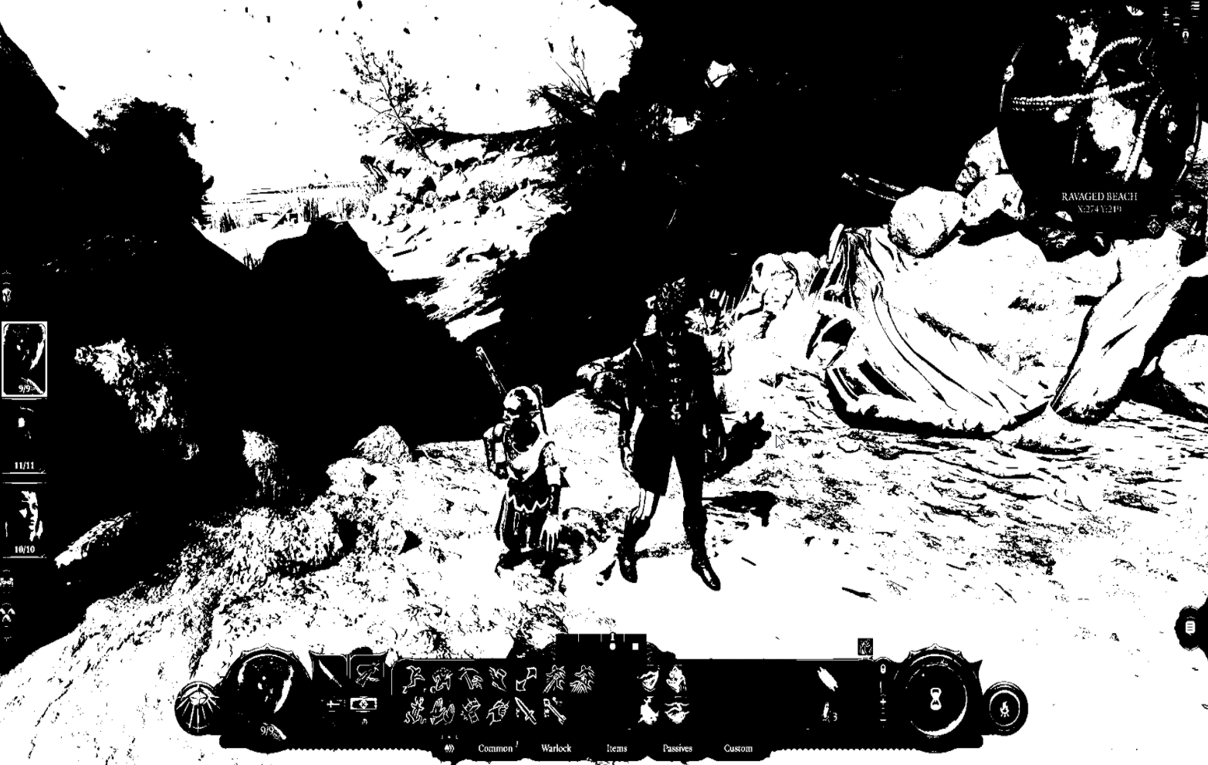
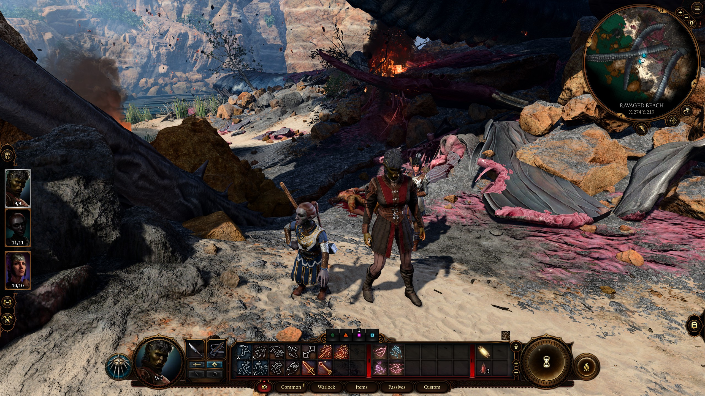
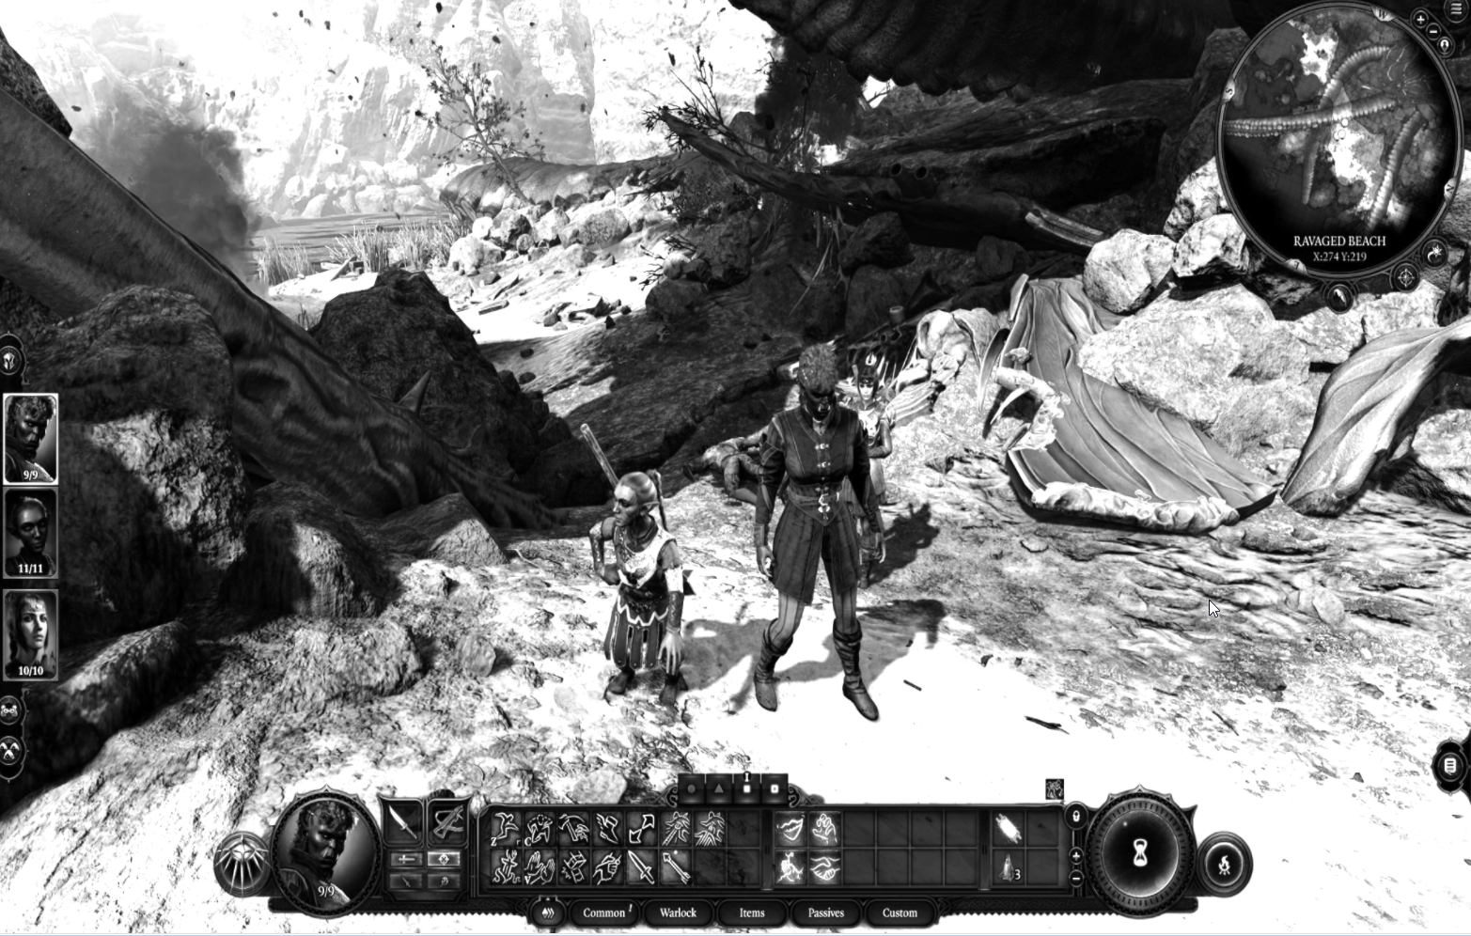
Grayscale
Grayscale == Black and White
More accurate term
How would you do it?

Slide 10
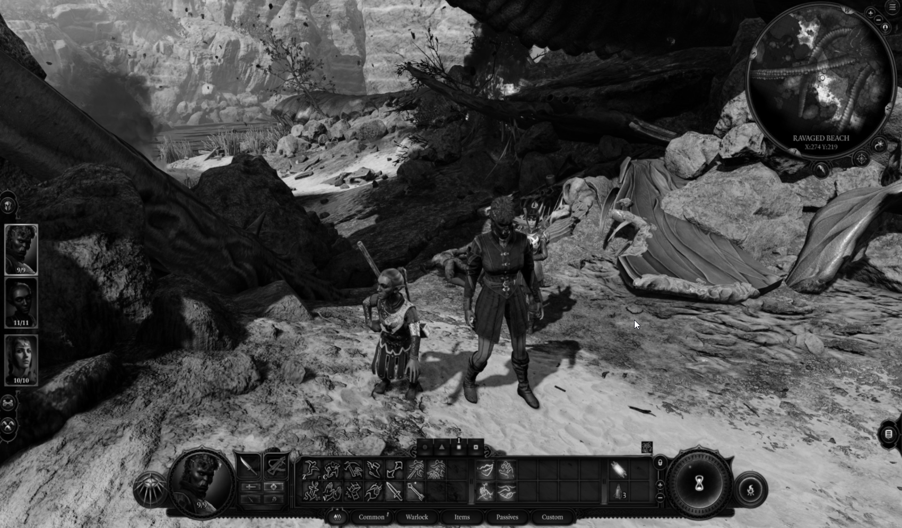
Obvious solution
Average red, green and blue
Greyscale = R*0.333 + G*0.333 + B*0.333

Slide 11
Less obvious
Not every color channel (r, g, b) is created equal
They’re perceptually more or less bright
Perceptually = To our eyeballs (perceived)
Try to sort the next slides in perceived brightness

Slide 15
How would you rank the brightness?

Slide 16
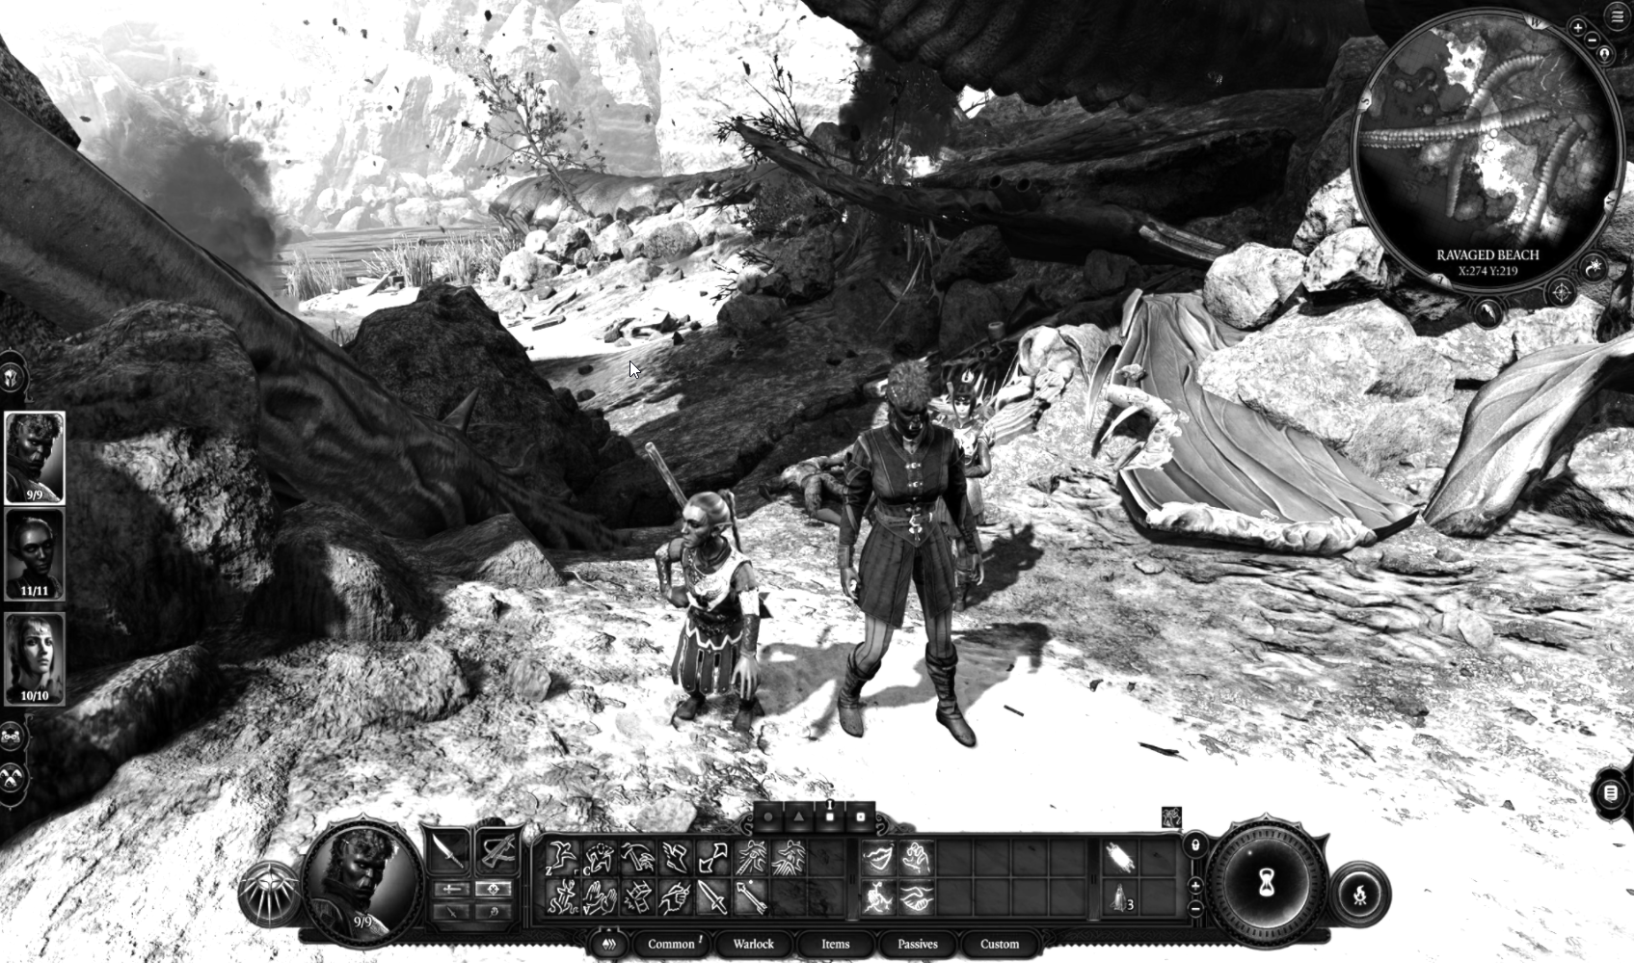
Better feeling solution
Greyscale = R*0.3 + G*0.59 + B*0.11

Slide 17
Recap
Textures are used for spatially varying information
They can be 1,2, and 3d. Or cubes.
They can be used for visible color, or normal, or any other parameter

Slide 18
Side by side

Slide 19
This class
Full pipeline
Grayscale
HDR (color)
Lab?
(Bloom (blur))
(Ambient occlusion)
(Night vision (live coding))
Lab!

Slide 20
HDR (tonemapping)
Who can tell me what HDR is?

Slide 21
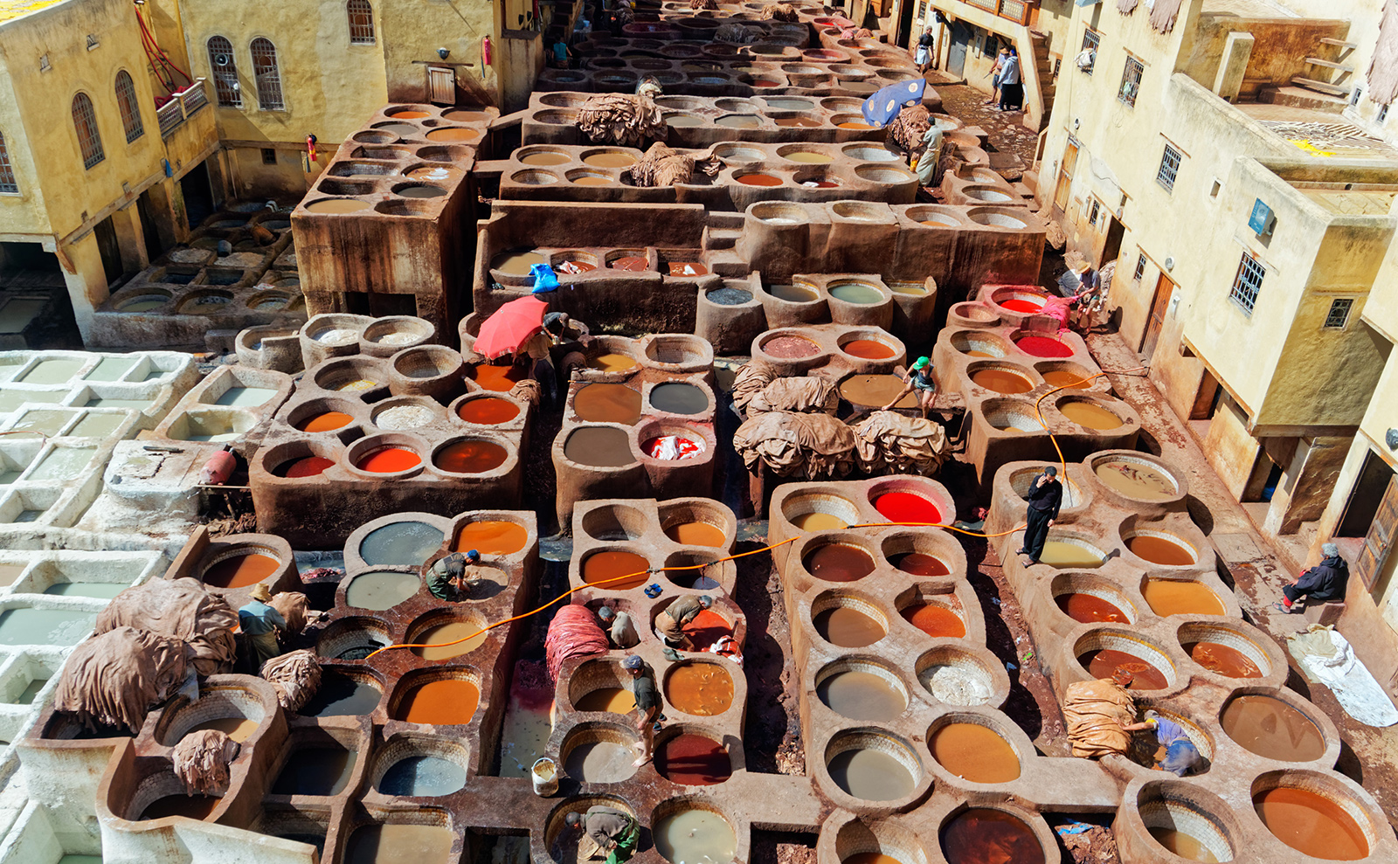
HDR (tonemapping)
To talk about HDR, we need to talk about color
You’ve seen color as 8bit per channel (eg #FF000000 in red)
You’ve seen color as a float per channel in shaders (eg float3(1.0,0.0,0.0))
You’ve always seen it as rgb (red, green, blue)
BTW, what is color?

Slide 22
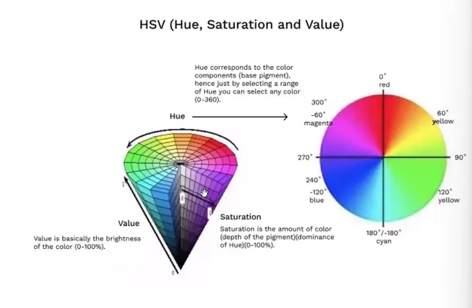
Color
Why do we use rgb?
We won’t look at how color work in physics (it’s not a single color, more of a wave)
We have 3 kind of receptors in our eyes: red, green, blue
Our monitors emit 3 kinds of light…. red, green, blue
Still not ideal! Why use 8 bits for blue, if it’s much less bright as green, which also uses 8 bits?
Alternatives exists, like HSV
In rendering, we use RGB 99% of the time
It comes up more in video / image compression

Slide 23
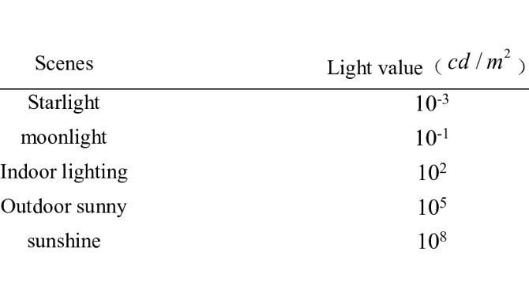
HDR is actually about brightness
Intensity of light that we can see can be incredibly bright or dark
Outdoors during the day is a 1000 times brighter than in indoors
The sun is a millions times brighter than inside during the day
We only have 255 values in our color to represent that ☹
.. But we can use a float3 (in our textures) to get many more values
Float are good at adapting to being very small or large
They are 4 bytes, making our gbuffers larger ☹
You might know this from taking pictures in RAW format (it’s much more than this, but it has higher precision per pixel)

Slide 24
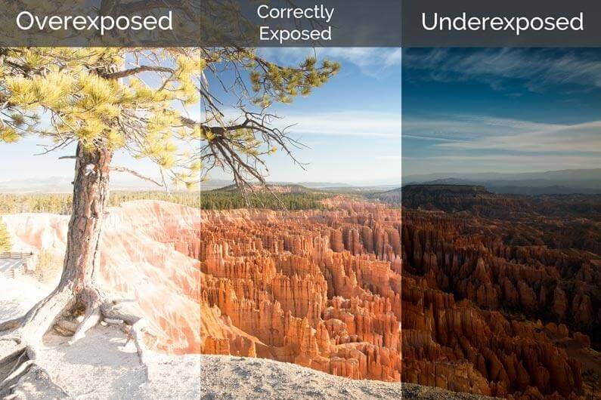
Tonemapping
The extra precision is only part of the problem
We always assume color goes up to 1.0f / 255, as that’s white on the monitor
But that’s arbitrary, we can always add more lights, or make our lights brighter
Eg we can have float3(3.2, 0.9, 0.5) returned from our shader
But 1.0 is the maximum we can show on our display
How do we solve this?

Slide 25
Tonemapping
Tonemapping is remapping our input colors (intensities) to values used by the display, in a way that doesn’t lose too much information
We want to remap our values ( from 0.0 to > 1.0)
We choose a value that is white. Eg, we say that 64.5 is white. We call it the white point
Now we remap our values
The simplest way is linear: we divide everything by the whitepoint. Eg 32.25 / 64.5 -> 0.5
If our whitepoint is too dark, many pixels will be > 1.0: overexposed
If our whitepoint is too bright, many pixels will be very small (eg < .3) : underexposed

Slide 26
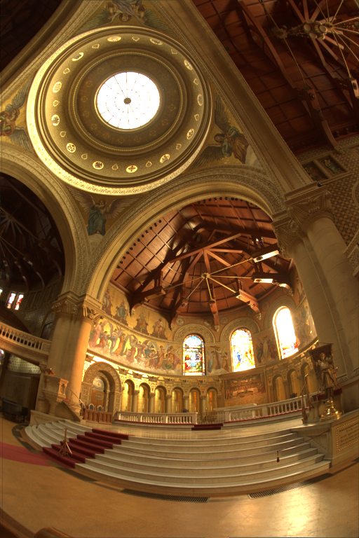
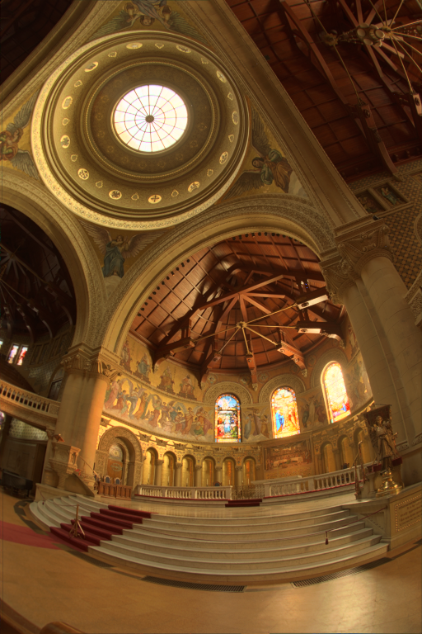
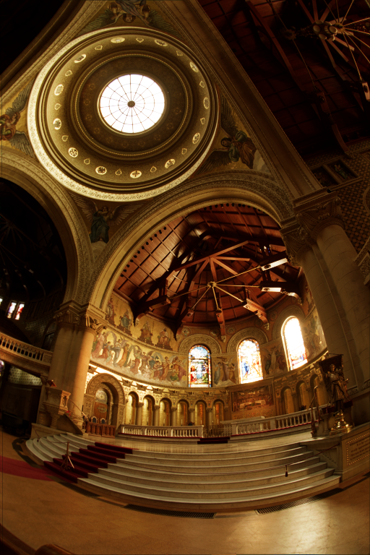
Tonemapping : advanced
Dividing by the whitepoint is a linear curve
It’s not ideal, as our values are distributed evenly
The difference between 0.2 and 0.4 is much larger than the difference between 0.8 and 1.0 (200% and 25%), but they get the same amount precision in the display intensity
Luckily, there are more complicated functions that distribute the values (we’ll go in more detail in a next bit)

Slide 27
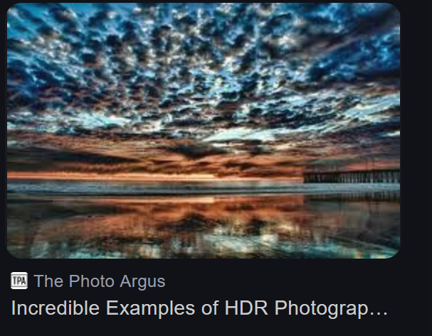
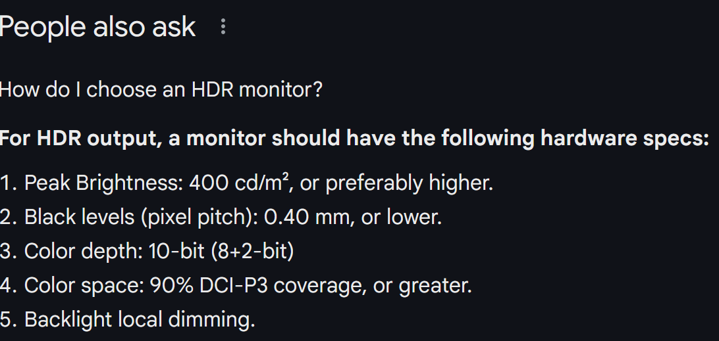
HDR = high dynamic range
A bit of a fuzzy term when you look closely
In rendering, your white point is not fixed, and you have better precision than standard 8bit rgb
In photography, you can use multiple pictures with different exposure and assembled them into an image (eg .hdr)
In monitors, there’s two related but different technologies: Accepting higher precision color How bright a pixel or region can get (and how big the regions are)
In stores, they pump the brightness and contrast up to maximum on tv’s and displays to look more “hdr-y”. I hope that now you can see why it’s horrible (and you can fix people’s tv’)

Slide 28
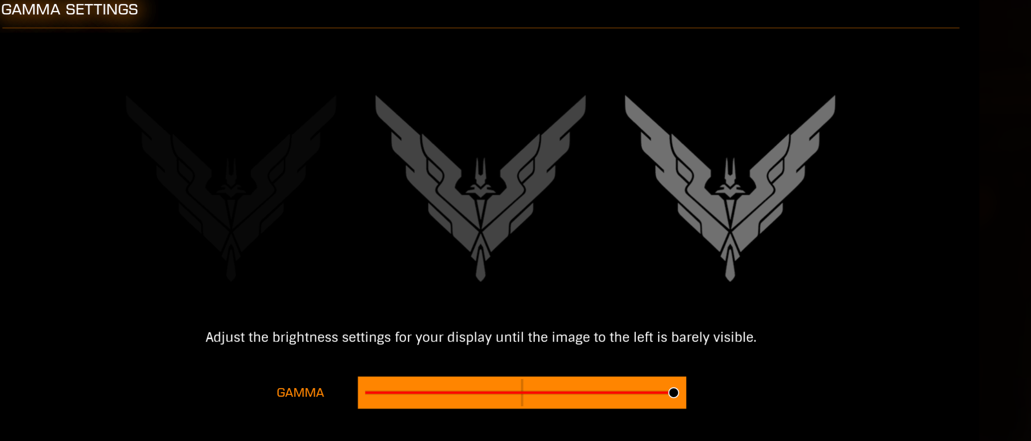
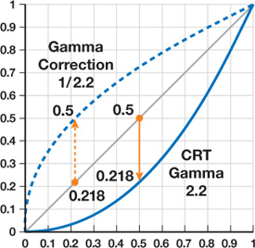
Important: gamma
For much longer than HDR, there has been a ‘hack’ for getting more precision in dark areas
We use a simple function, the gamma curve. It’s a pow curve, usually with exponent 1.0 / 2.2
We store images with his curve, as it makes more values in the darker range, taking it from the brighter range
This happens in all
Loading the image, we convert to linear
Our monitor is also non-linear , so we need to use the curve (opposite) again when we send our image to the monitor
Why do we convert then?

Slide 29
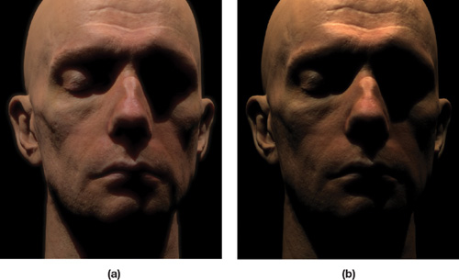
Which one is correct?

Slide 30
This class
Full pipeline
Grayscale
HDR (color)
Lab?
(Bloom (blur))
(Ambient occlusion)
(Night vision (live coding))
Lab!

Slide 31
This class
Full pipeline
Grayscale
HDR (color)
Lab?
(Bloom (blur))
(Ambient occlusion)
(Night vision (live coding))
Lab!

Slide 32
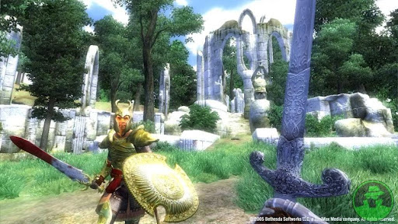
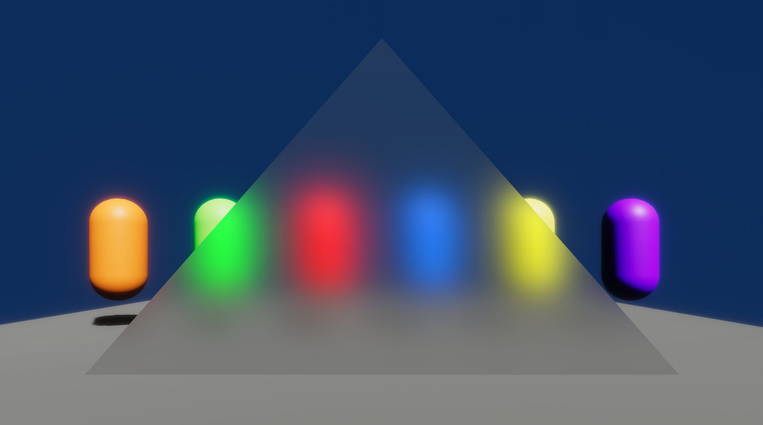
Bloom
Emphasizes bright areas by “bleeding” into neighbouring pixels
We use a blur
Opposite idea: gather pixels around us (why do we need to do the opposite

Slide 33
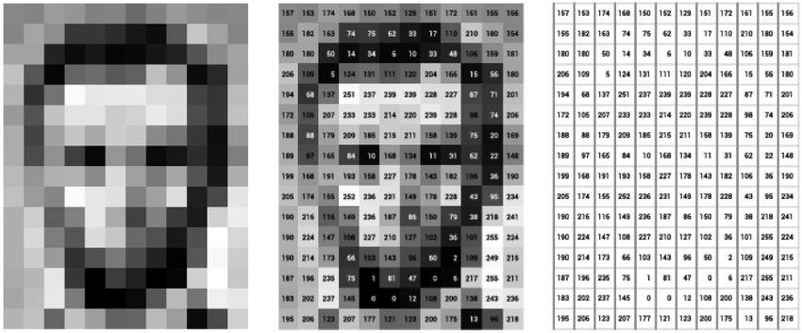
Image as matrix

Slide 34
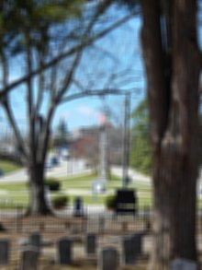
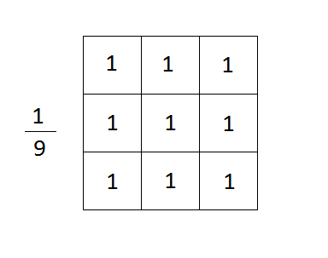
Blur as a matrix
Center pixel is the pixel we’re working on
Number is weight (multiply)
Add them all together
Left term is normalization (so it doesn’t get brighter
The matrix is called a kernel (this is a box blur)

Slide 35
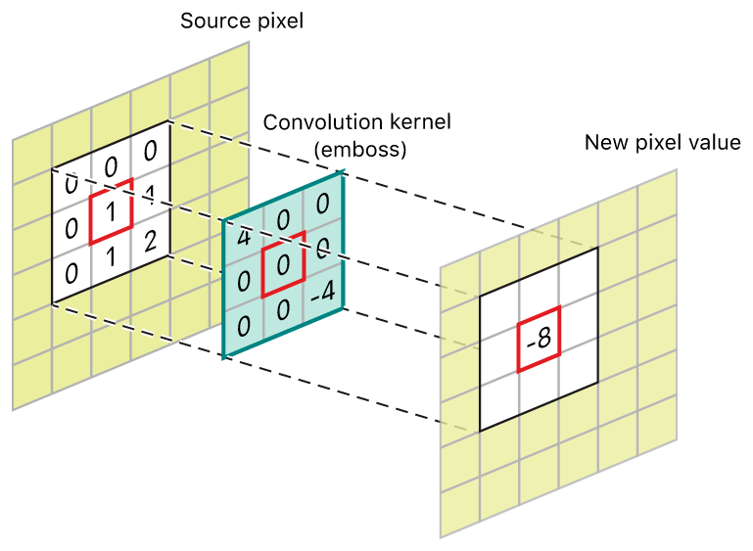
Convolution
Convolution is applying our kernel to the image
For each pixel
Sample the texture for each element in the kernel
Normalize

Slide 36
Box blur in code
fixed4 c = 0;
for (int y = -1; y < 2; ++y)
{
for (int x = -1; x < 2; ++y)
{
float2 uv = IN.uv_MainTex;
uv.x += pixelSize * x;
uv.y += pixelSize * y;
c += tex2D (_MainTex, uv);
}
}
c /= 9;

Slide 37
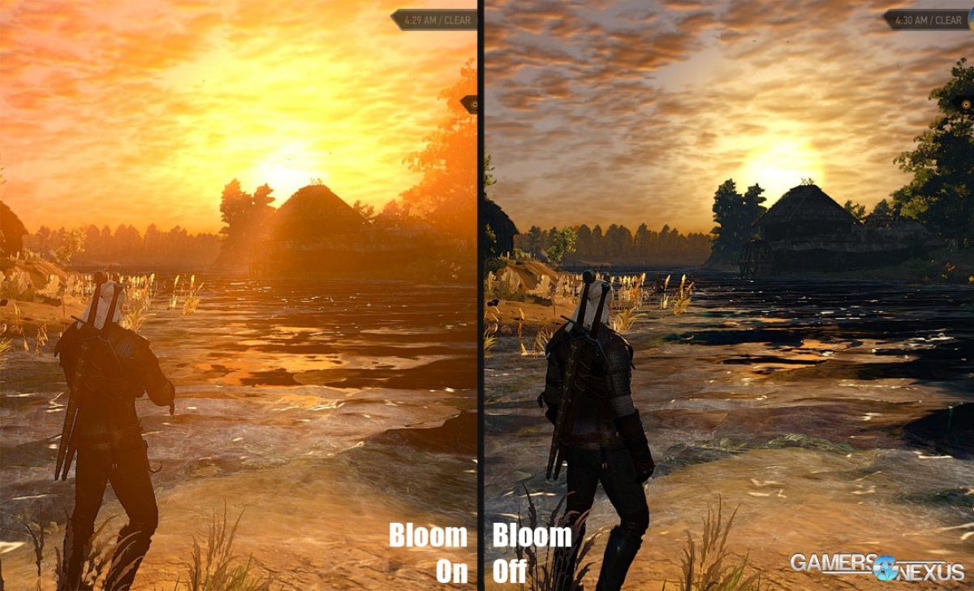
Bloom
Want to blur very bright values
But keep everything else sharp

Slide 38
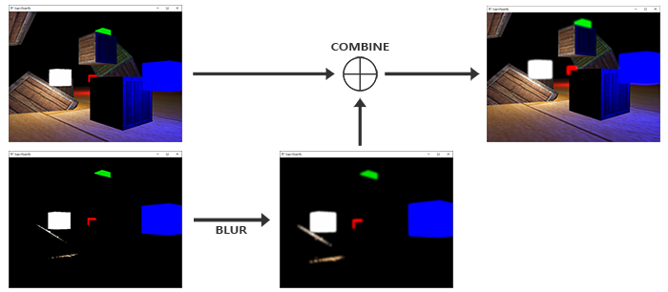
Visually

Slide 39
Fixed
fixed4 c = 0;
int weight = 0;
for (int y = -1; y < 2; ++y)
{
for (int x = -1; x < 2; ++y)
{
float2 uv = IN.uv_MainTex;
uv.x += pixelSize * x;
uv.y += pixelSize * y;
float4 temp = tex2D (_MainTex, uv);
//only blur bright pixels
if (dot(temp.xyz, float3(0.3, 0.59, 0.11) > 10 ||
x == 0 && y == 0)
{
weight += 1;
c += temp;
}
}
}
c /= 9;

Slide 40
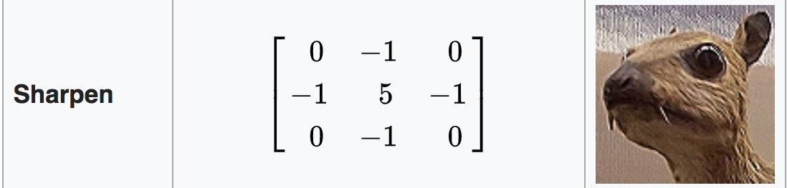
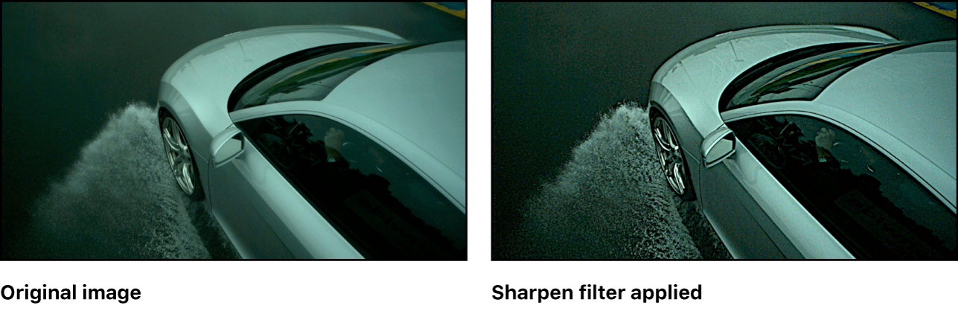
Many effects are achieved by using a kernel

Slide 41
Note that our blur is very basic
Realistically:
Not 3x3
Not the same value everywhere (eg Gaussian)
Tricks to make it fast

Slide 42
This class
Full pipeline
Grayscale
HDR (color)
Lab?
(Bloom (blur))
(Ambient occlusion)
(Night vision (live coding))
Lab!

Slide 43
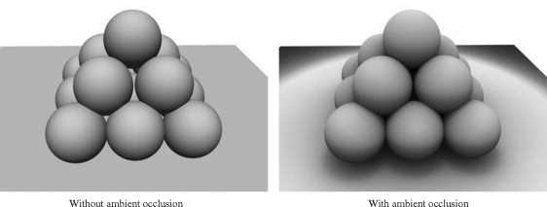
Problem
What problems on the left do you see fixed on the right?

Slide 44
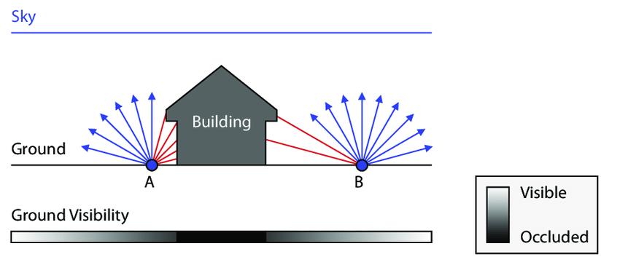
Ambient occlusion simulates how difficult light reaches an are (not shadows)

Slide 45
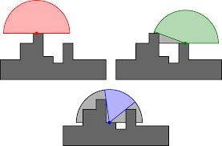
Per pixel operation, uses the depth buffer

Slide 46
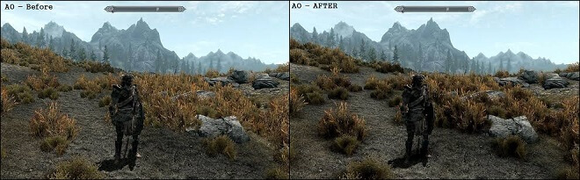
Results

Slide 47
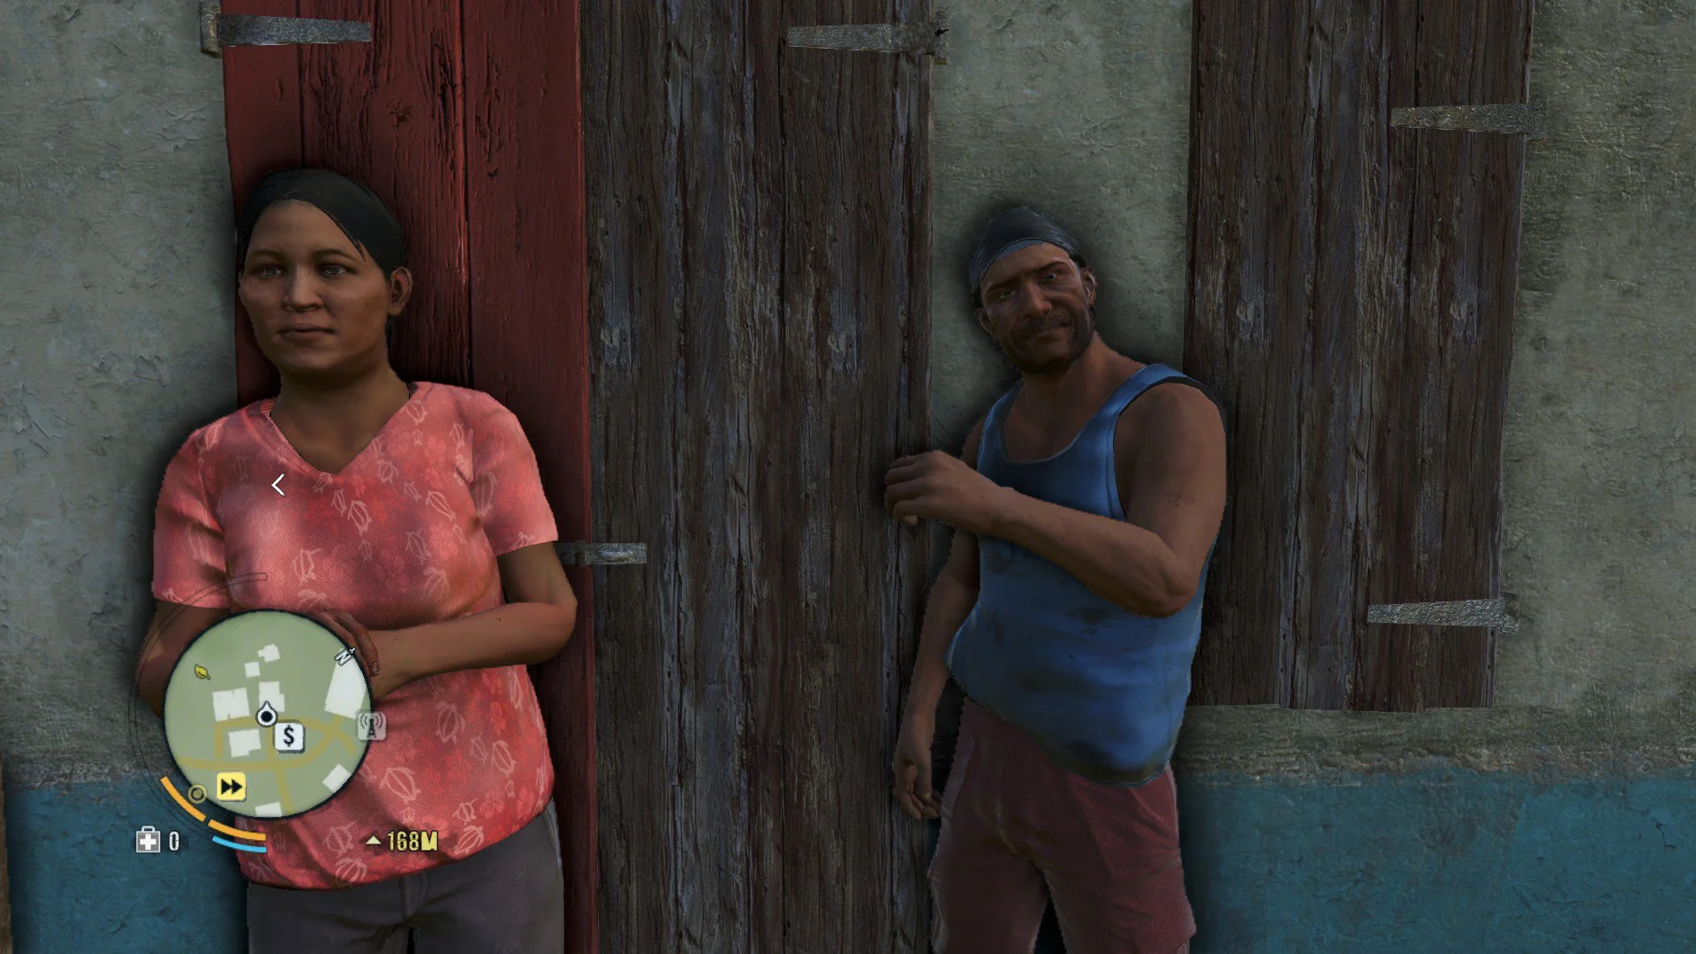
Bad results

Slide 48
This class
Full pipeline
Grayscale
HDR (color)
Lab?
(Bloom (blur))
(Ambient occlusion)
(Night vision (live coding))
Lab!

