Slide 1
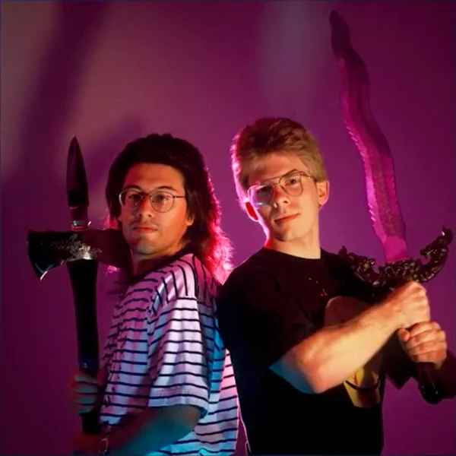
2024
Why do games have so many bugs at launch?
One puzzle piece : pygame -> open(tex).get_alpha() libglew.dll : [73]windows cannot access the file
Week 6: Textures

Slide 2
Quick detour
Why do games have so many bugs at launch?
One puzzle piece : pygame -> open(tex).get_alpha() libglew.dll : [73]windows cannot access the file

Slide 3
Project
Description will be feature complete Fri
After that only clarifications and images
How is it going?

Slide 4
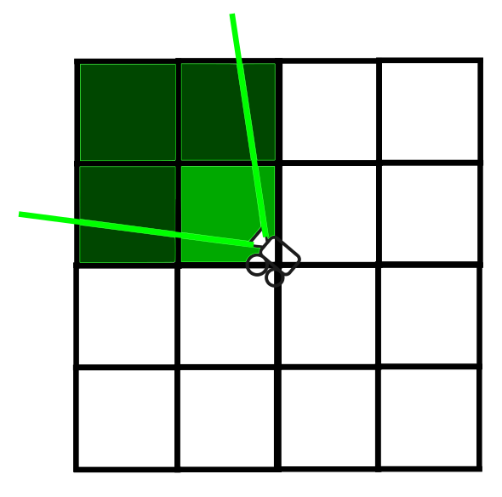
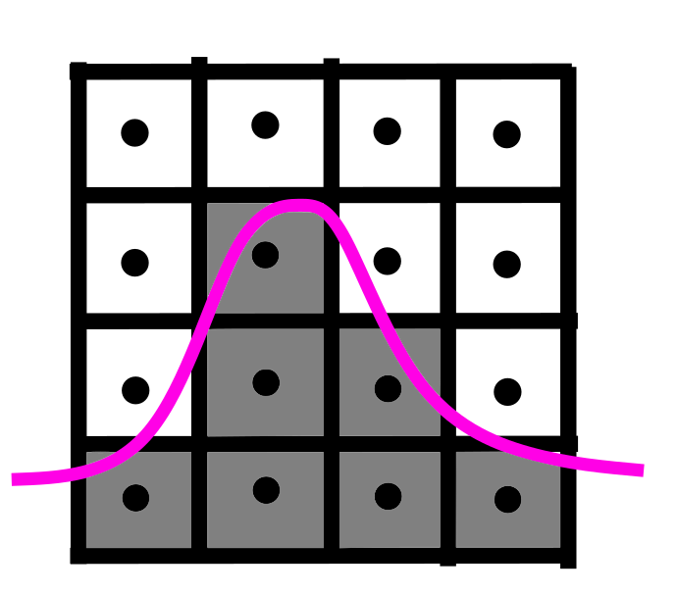
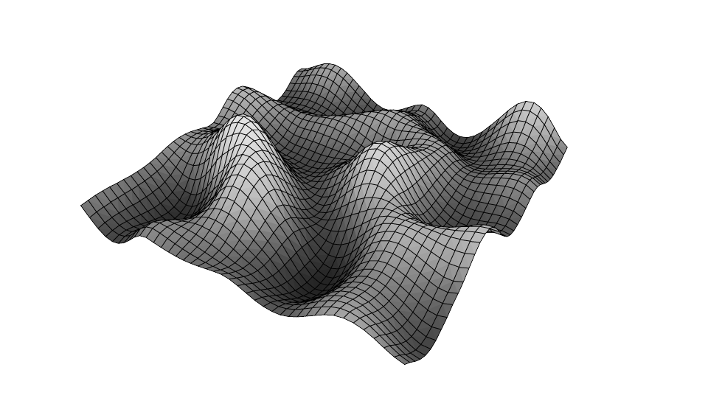
Last class
History of procedural generations (procgen)
Seeing functions as geometry
Generating geometry
Infinite terrain

Slide 5

Course schedule
Week 1 | Introduction
Week 2 | 3D reasoning
Week 3 | Geometry
Week 4 | Pipeline & Materials
Week 5 | Proceduralism
Week 6 | Textures & Normal maps
Week 7 | Advanced pipeline
Week 8 | Post Processing
Week 9 | Aliasing / Presentations
Week 10 : | Project
Week 11 : | Revision
Highly likely to change ☹

Slide 6
This class
→ Texture basic ←
Texture types
Border’s, mips, and sampling
Normal maps
Creating normal maps

Slide 7
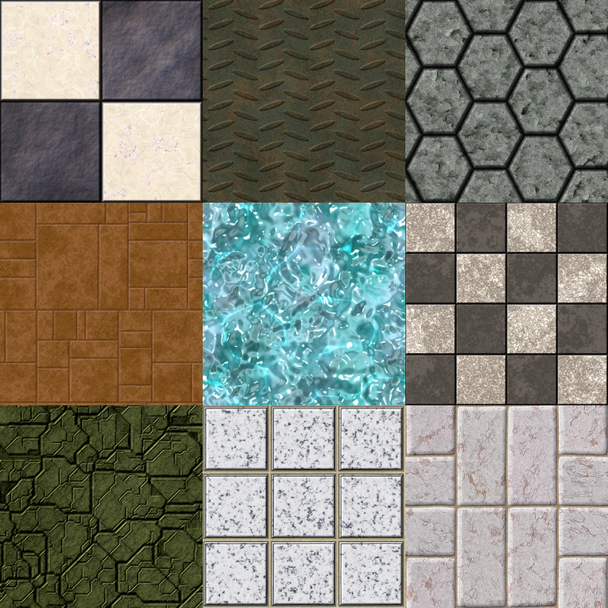
Textures
Can someone tell me what
they are?

Slide 8
Textures
Commonly : “a 2d grid of colors”
3d graphics : “discrete spatially varying information”

Slide 9
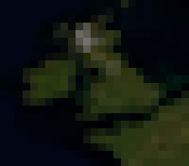
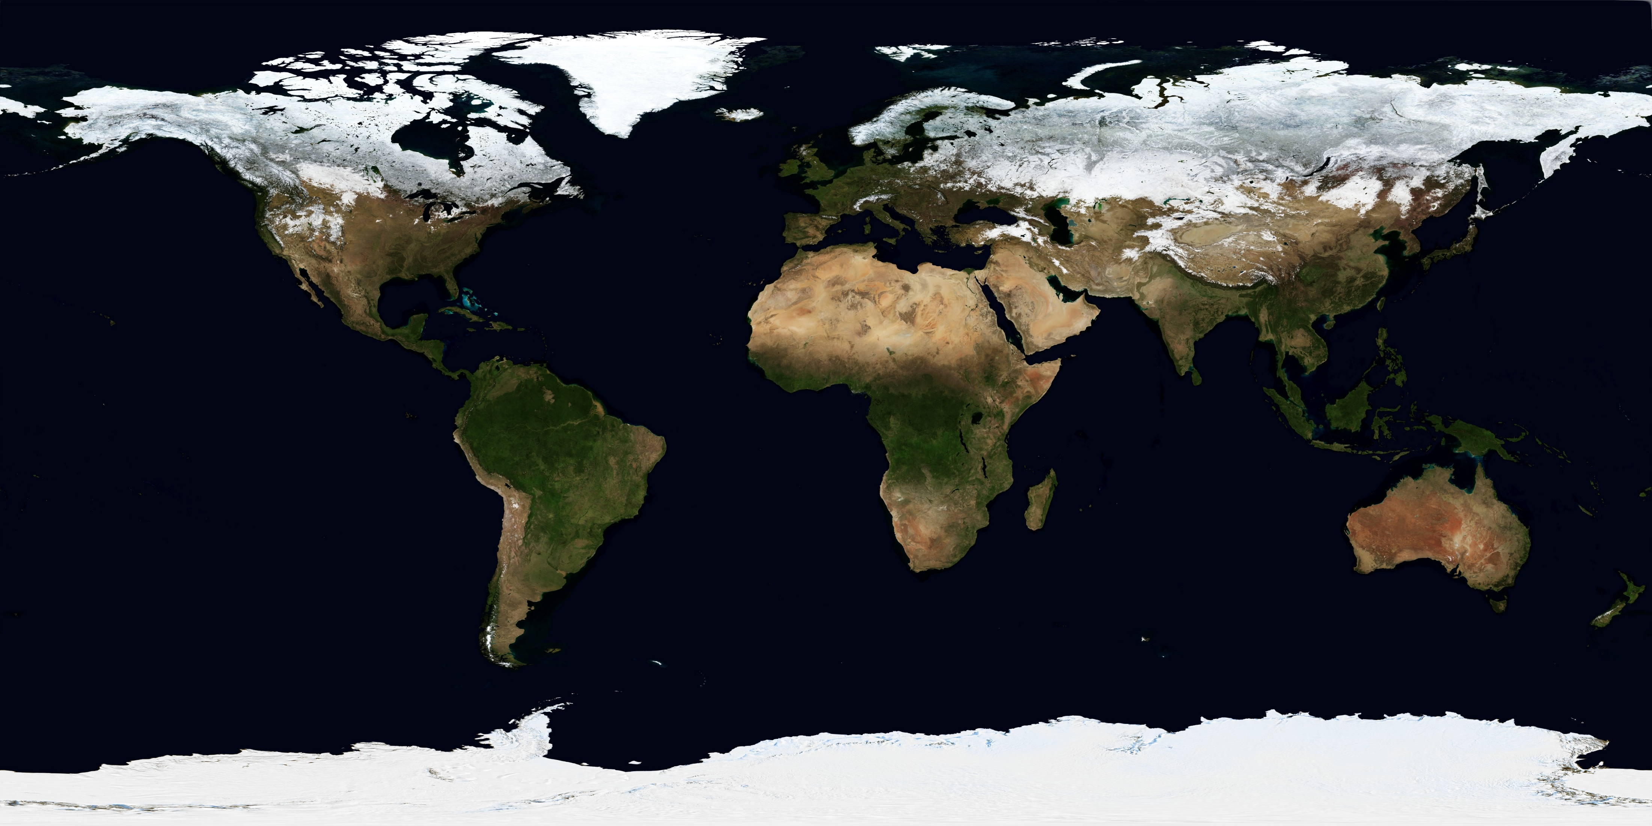
Textures : 2D grid of colors

Slide 10
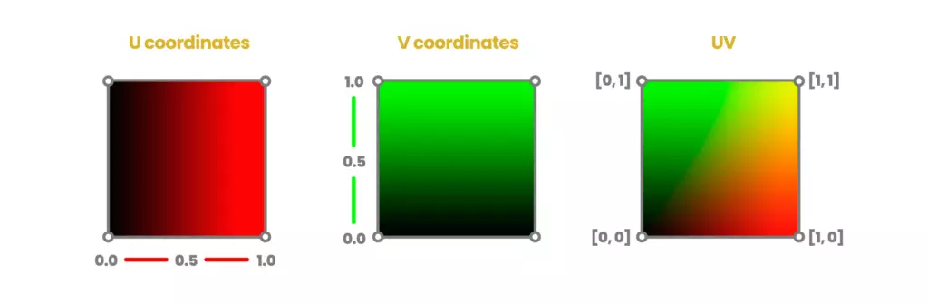
Spatially varying
Different areas in the texture have different values
We use UV coordinates.
Vector2D, 0.0 -> 1.0 (typically)
They are part of the vertex
Notes:
Ok, so the whole gist of it is, is that a texture (image) is a 2D grid of color values
To access these color values, we need an index. But we don’t use integer indices
In the context of textures, we use floats, and we call them coordinate. The coordinates go from 0 to 1 in each dimension
An example would be the coordinate (0,0). This would fetch the bottom left color value
Do understand the images below. They’re quite simple: they’re visualizing the x coordinate in red, and the y coordinate in green over a square. In 3D graphics, we’re often visualizing a ton of data in space, and it can be very useful to use color for that.

Slide 11
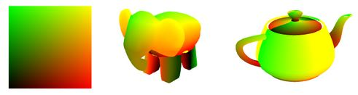
2D coordinate system on a 3D model
Most common way to put textures on 3D models
Referred to als “uv mapping”
Notes:
When people make models, they need to put uv coordinates in the vertices, so we can figure out where parts of the texture goes.

Slide 12
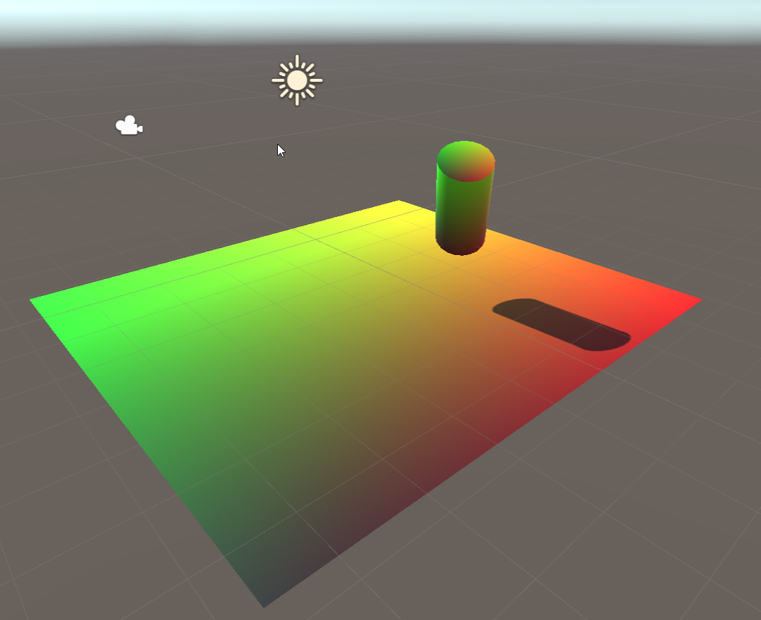
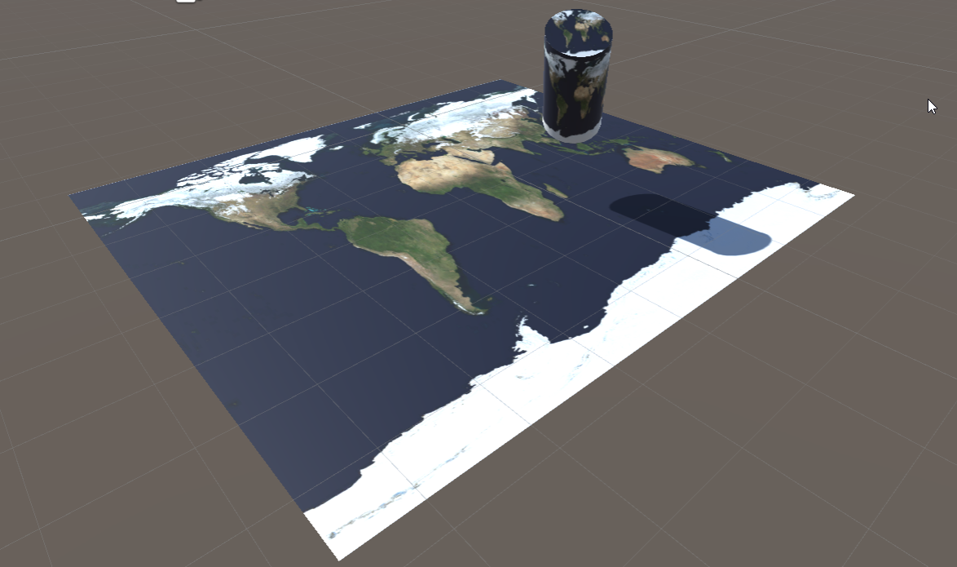
UV: float2 coordinates
Float2 uv(0,0) -> image[0,0]
Float2 uv(1,1) -> image[width, height]
Notes:
The plane has obvious texture coordinates, and when we put the world map on the plane using these coordinates, it looks like we expect
On the cylinder, we have the same world map, but it’s wrapped around the geometry.

Slide 13
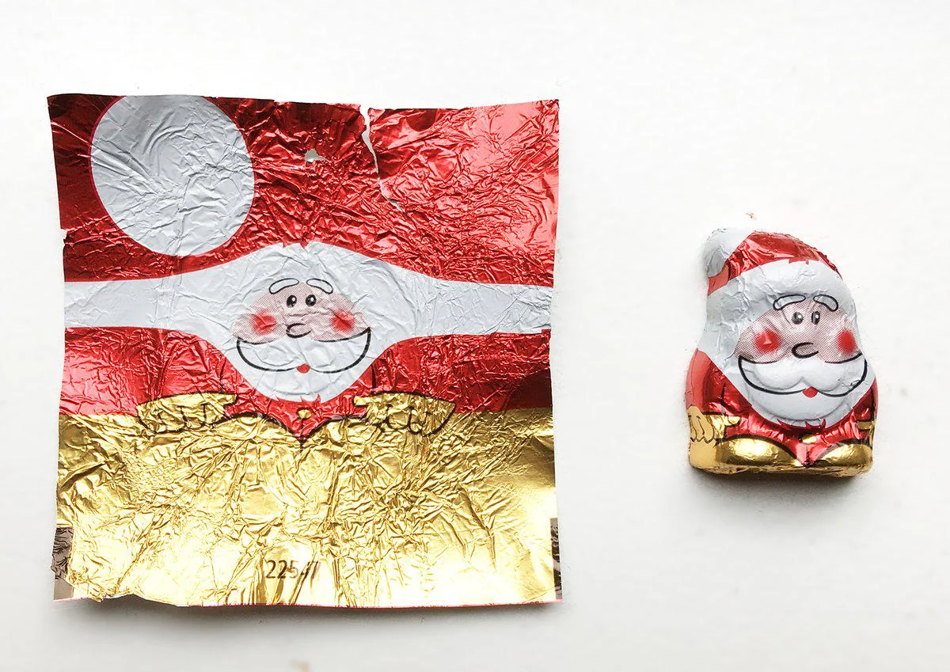
Notes:
I guess we’ve always known how this works, just the other way around
A model is 3 dimensional, but a texture is 2 dimensional
Our vertices, with 3 dimensional positions, have another set of coordinates, in 2D, called uv coordinates. We need those so we know where our 2D texture goes in 3D space.

Slide 14
In code
// in Properties
_MainTex ("Albedo (RGB)", 2D) = "white" {}
// in SubShader
sampler2D _MainTex;
struct Input
{
float2 uv_MainTex;
}; // in fragment shader fixed4 color = tex2D (_MainTex, IN.uv_MainTex)
Notes:
In code, this is dead simple
We have a texture, which is the 2D array of color values
We also have a sampler. A sampler we’ll see later, but we need a sampler to get use our coordinates to access the texture

Slide 15
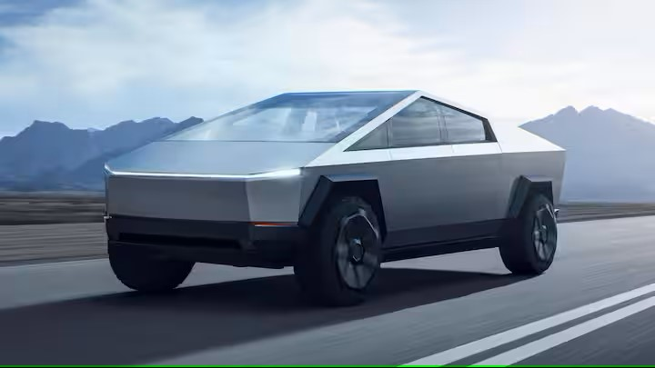
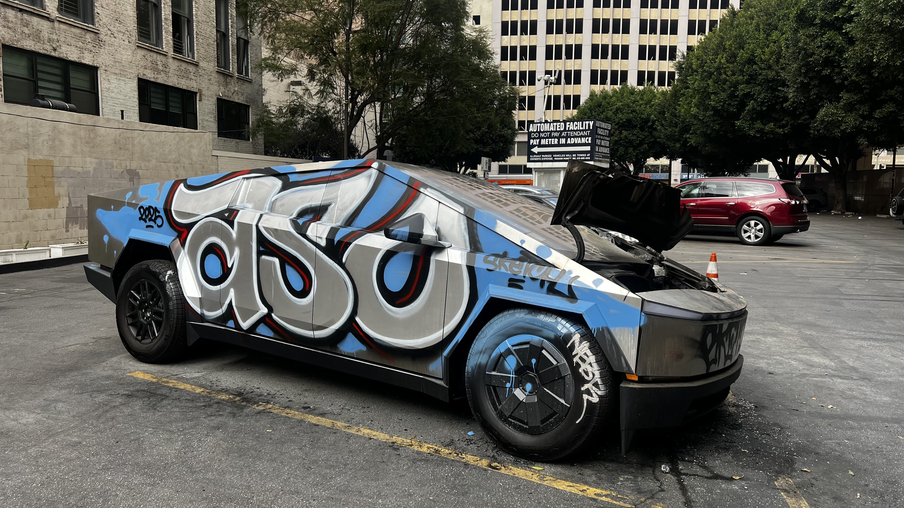
Why not put this information in a vertex?
Good question!
Vertex density vary with geometric complexity (wheels have more vertices than doors)
Textures have a more homogenous resolution
Notes:
This is a bad example. But imagine we would have a 3D model of the cybertruck. We would only need very few triangles to store the geometry (position of the triangles)
The graffiti, we would need a big texture to capture all the detail and the curved lines.

Slide 16
Any questions?

Slide 17
This class
Texture basic
→ Texture types ←
Border’s, mips, and sampling
Normal maps (for normal students ©Margot Schepers)
Creating normal maps
←

Slide 18
We just saw 2D textures as an example
Any guess what the others types are?

Slide 19

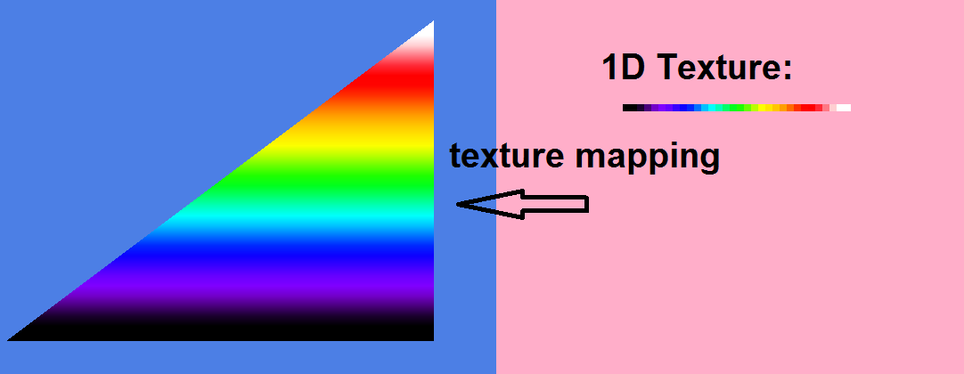
Texture 1D
Used for lookup tables
In practice, 2D textures anyway
Triangle: multiple pixels access the same 1D texture location
Notes:
1D textures are almost exactly the same as 2D textures, but the coordinate is just a simple float
This is often used as a lookup table : for example, what is the color of the sun over a 24 hour period.
The texture above could be made to make an incorrect rainbow: a rainbow changes color top to bottom, but not left to right

Slide 20
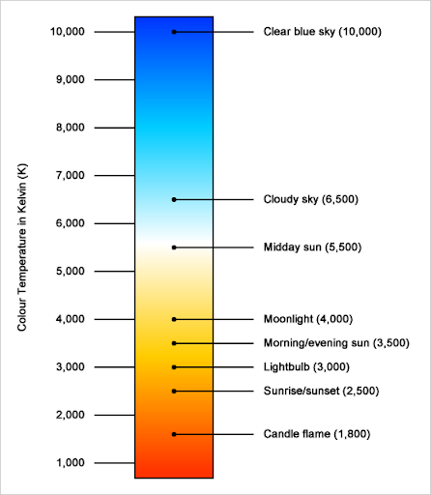
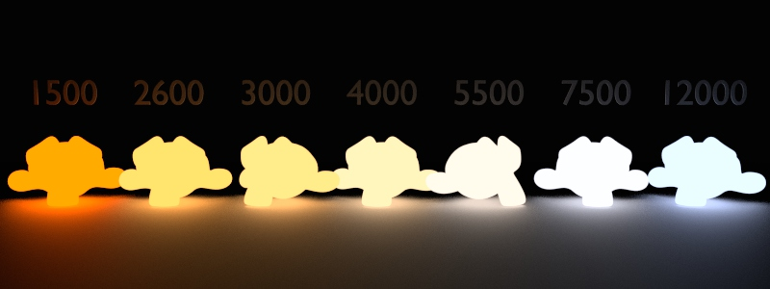
Texture 1D example: blackbody
Notes:
This shows how the color of a light changes with it’s temperature (not exactly the same as air temperature) changes. When you’re shopping for a lightbulb, you’ll see these numbers pop up as well

Slide 21
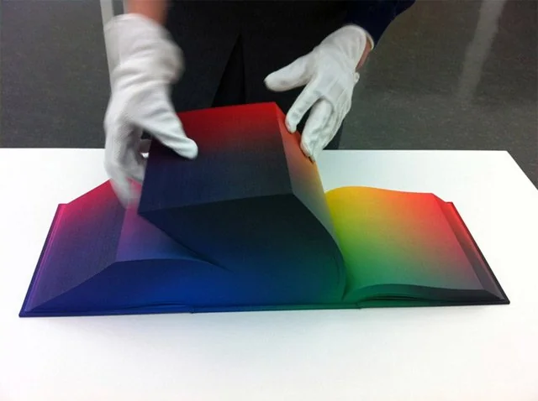
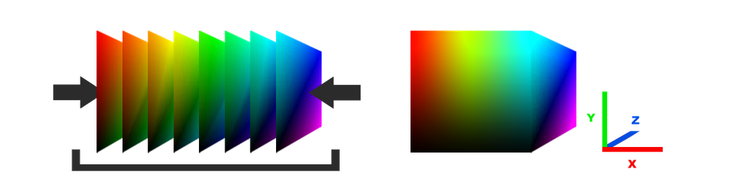
Texture3D
Has a width, a height, and a depth
Need 3d uv’s / texture coordinates
Anyone have an example?
Notes:
3D textures are similarly straightforward. They are a stack of 2D textures, all of the same size, and are accessed using 3D coordinates.

Slide 22
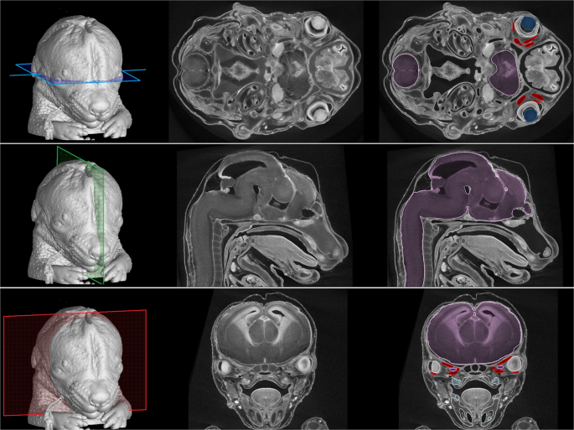
Notes:
Another example of 3D textures: presenting results from medical scans. Scans work in “slices”, basically a 2D scan slicing through the object. The scanner then mover a small distance and doing it again, create a stack of 2D scans
Medical visualization is actually a good example of realtime 3D graphics outside of games. It’s not easy to make comprehensible visualizations about such big and complicated datasets.

Slide 23
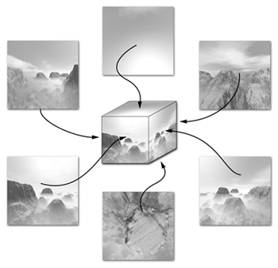
TextureCube
Resembles a six sided die
We index it with a direction
POV: center of the cube
Perfect for a skybox / reflections
Notes:
Cube textures are maybe the hardest. Imagine you stand in the middle of a room. Take a (square) picture of each wall, and the floor and ceiling. Now paste them on the inside of a box. That’s exactly what cube textures are.
It also works inside out. You can take 6 pictures of a dice, and paste them on the outside of a box.
The ‘inside’ usecase is very common, often used to provide sky in a scene
The ‘outside’ usecase is a perfect fit for Minecraft blocks ;)

Slide 24
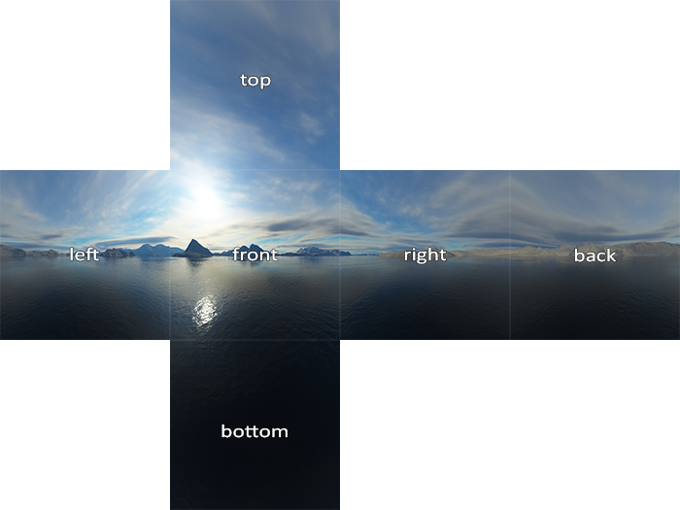

Slide 25
This class
Texture basic
Texture types
→ Border’s, mips, and sampling ←
Normal maps
Creating normal maps

Slide 26
We said UV’s typically go 0.0->1.0
We can configure what happens when access the texture with uv coordinates going outside that range

Slide 27
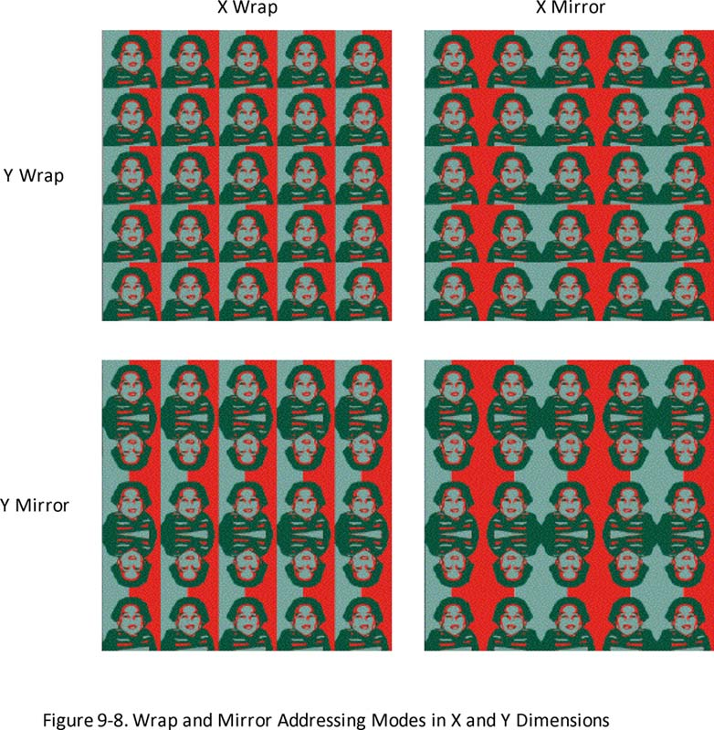
Wrap and mirror
Good for tiling textures
Why?
Notes:
Because otherwise there would be seam between repititions

Slide 28
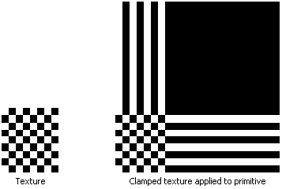
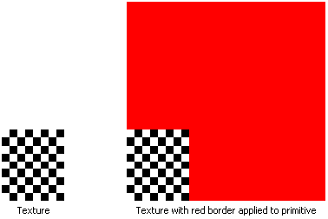
Clamp and border
Clamp is a good default
Border is good for finding bugs

Slide 29
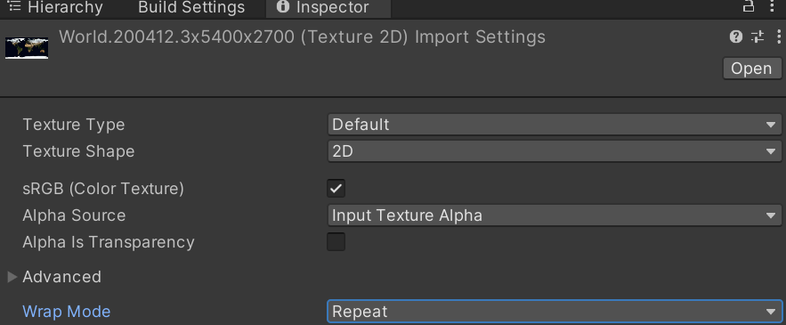
In unity, you can find this on your asset

Slide 30
Is everything clear?

Slide 31
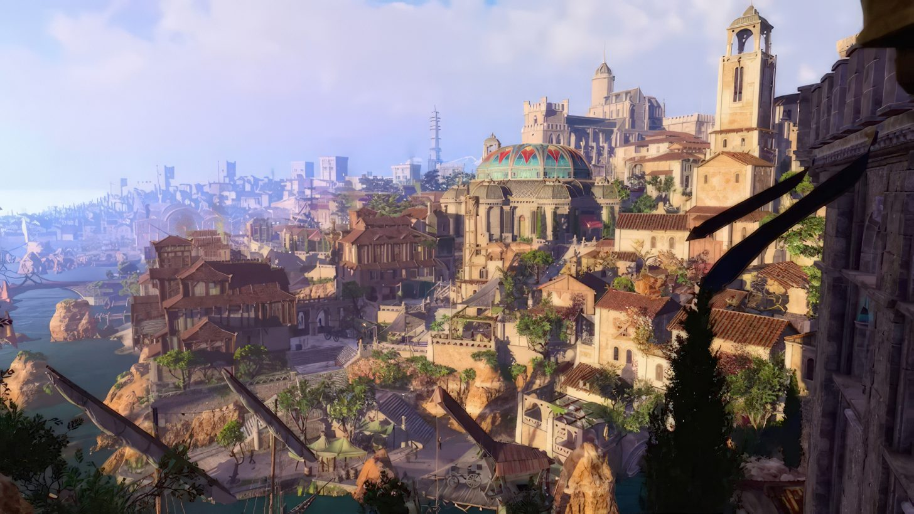
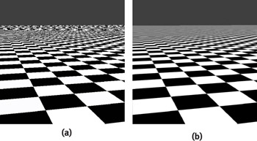
Textures have some problems
For faraway objects, we need the entire texture in memory
For faraway objects, the full texture is too detailed, and creates aliasing (later class)
Notes:
Textures tend to take up double the space of geometry. In a AAA game, that can be more than 100Gb

Slide 32
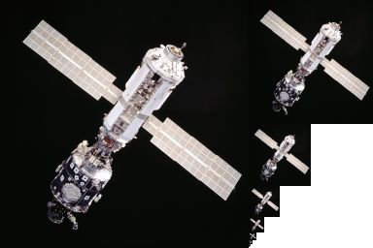
Solution
Create smaller versions iteratively
Often called a “pyramid”
Increases size by 33% (unless special implementation)
Only in memory what is used
Worth it
Also for 1D, cube, and 3D

Slide 33
We don’t use this directly (in this course)
Unity handles a lot under the hood
Very important concept
We’ll see more in the aliasing class

Slide 34

Our uv / texcoords are floats
We can sample a texture with eg (0.0, 0.4)
Imagine we have a 2x2 texture
What should the result be?
(Assume the border mode is set to clamp)
Notes:
The questions we’re asking here, is, if we ask for the color of a texture, but we’re not giving a coordinate in the center of a pixel, what will the value be?

Slide 35
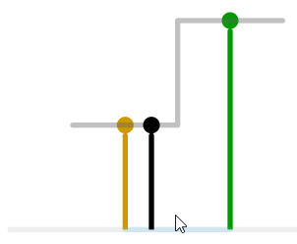
You probably said black
And this is true is some circumstances
Especially since we know it’s a checkerboard
We call this “nearest neighbour” or “point” filtering

Slide 36
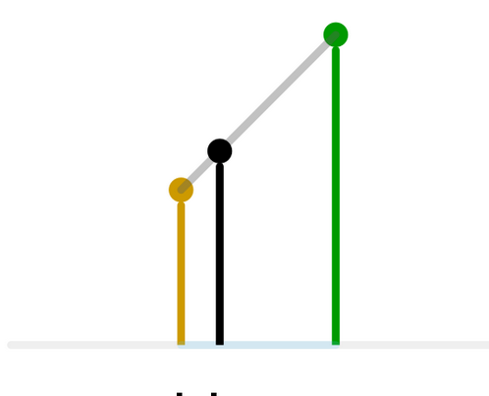
We can also try to make a smoother transition
We calculate the distances between pixels of our “sample”
We interpolate linearly

Slide 37
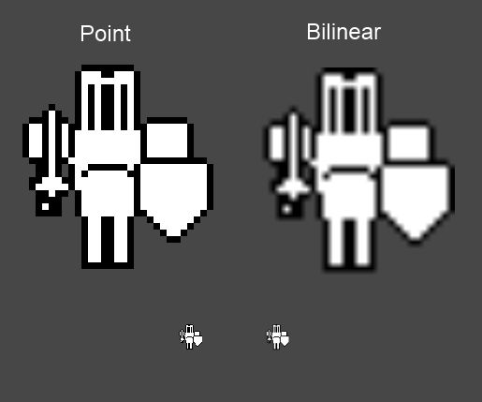
Point is good when you want *exact* pixel values
2D sprites
Fonts

Slide 38
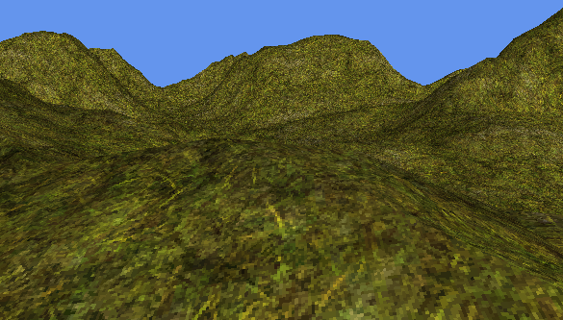
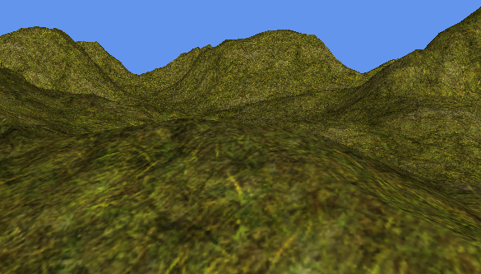
Linear is good in realistic 3D scenes
Less aliasing
Looks higher resolution
Above is point
Below is linear

Slide 39
BTW, I’m sweeping sampling under the rug
We can see the gray line (and the texture) as a function
Asking a value is called “Sampling”
There’s a ton of theory behind it
In HLSL, we create a Texture (grid of values)
We also create a Sampler (the way in which values are calculated for our uv coordnates

Slide 40
Recap
You usually want linear
In 2D, you usually want point
Point filtering gives your exact pixel values
Linear gives you smoother transition

Slide 41
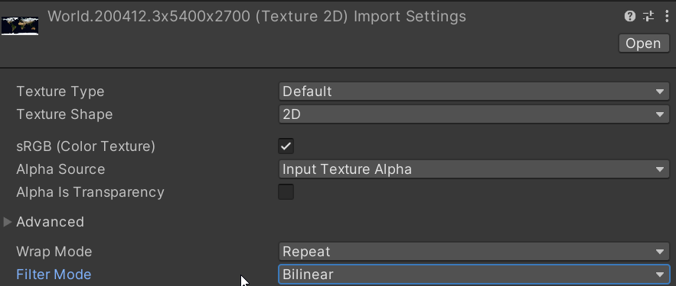
In Unity : Asset -> Filter mode

Slide 42
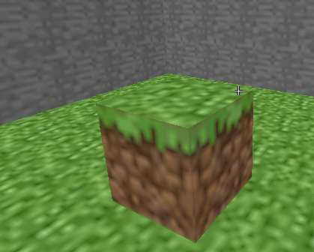
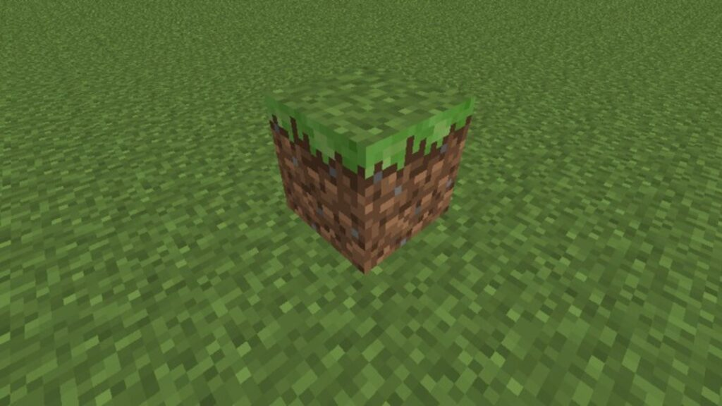
You do need to care about this

Slide 43
Recap
Textures are used for spatially varying information
They can be 1,2, and 3d. Or cubes.
They can be used for visible color, or normal, or any other parameter

Slide 44
This class
Texture basic
Texture types
Border’s, mips, and sampling
→ Normal maps ←
Creating normal maps

Slide 45
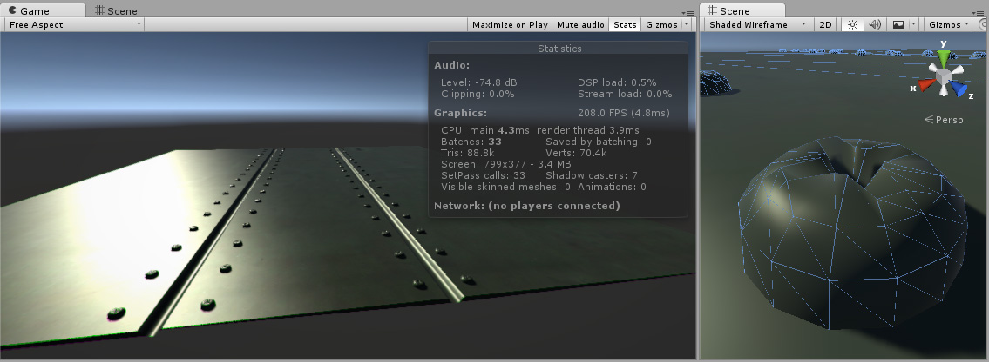
Problem
We want as few triangles (vertices) as possible
But we do want the geometric detail normal give us

Slide 46
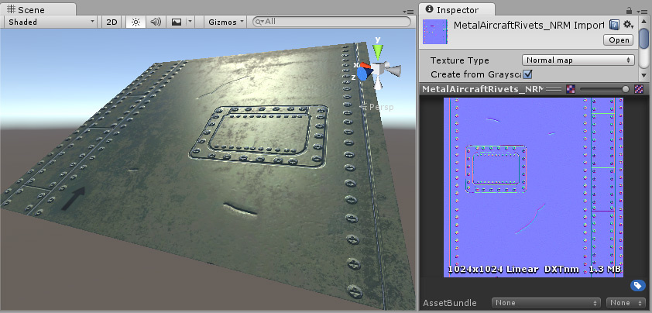
Solution
Less vertices
Normals in textures
Notes:
It’s very important to note that the geometry on the left is just triangles. It ‘seems’ that there’s a bunch of rivets and other detail, but that’s only because we’re changing the normals

Slide 47
Wait, don’t we have more data now?

Slide 48
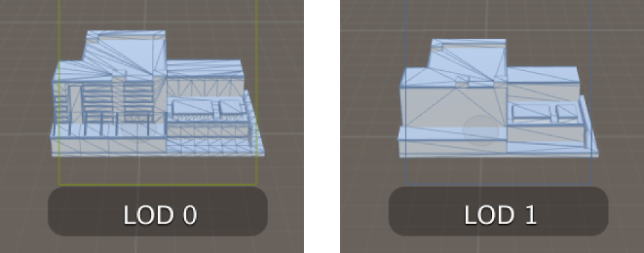
Yes… but no
Mesh LOD is per object
Texture LOD is per pixel
We have more data in the texture, but we may read less of it in a draw call

Slide 49
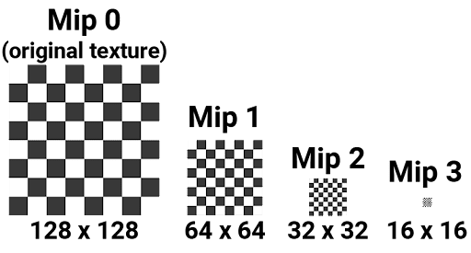
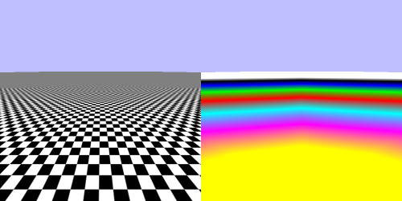
Yes… but no
Mesh LOD is per object
Texture LOD is per pixel

Slide 50
Final tally
More data on disk (in most cases)
Maybe more in RAM (if all mips are loaded are loaded)
Maybe less in ram (with advanced texture streaming)
Most important : less read from RAM (“fillrate”)

Slide 51
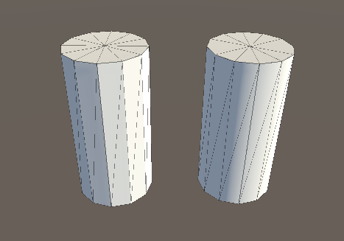
Triangle vs vertex normals
Notes:
Left image : triangle normals. The normal is constant (the same) over an entire triangle. Doesn’t seem very round.
Right image : vertex normal. The normal is interpolated over the triangle, so the geometry seems more smooth than it really is

Slide 52
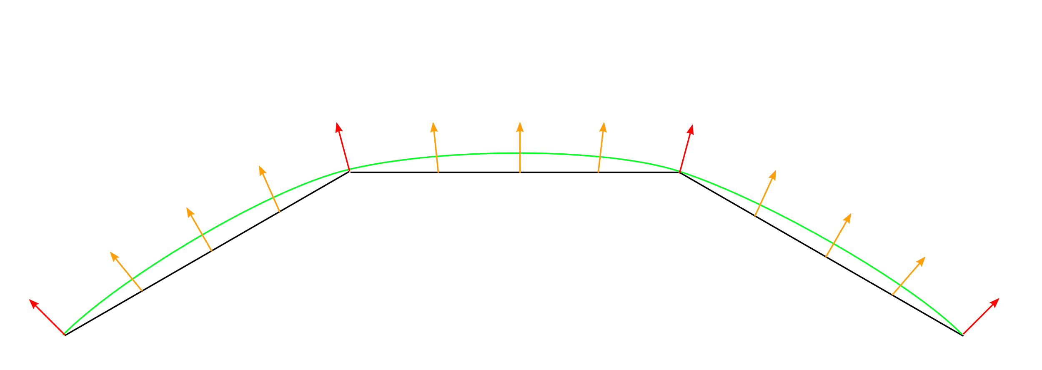
Without a normal map
Notes:
Black : the actual geometry of the mesh
Red : the vertex normal that we added to our mesh
Orange: the interpolated vertex normal calculated by the rasterizer
Green : what the geometry looks like when using the interpolated normals for shading

Slide 53
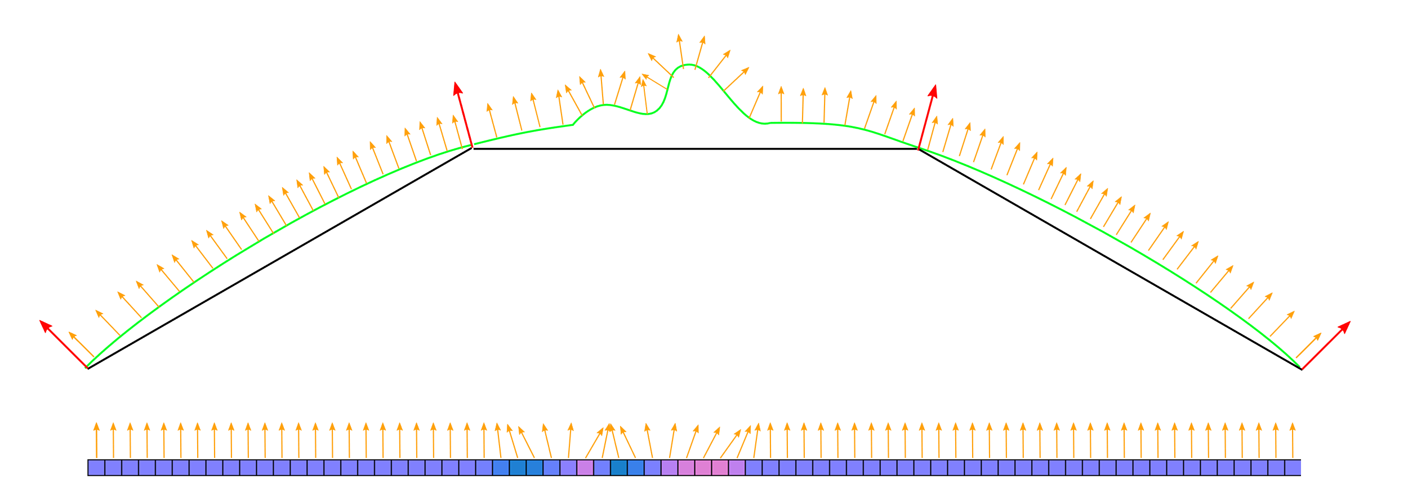
With a normal map
Green: apparent geometry, not triangles Orange: mapped normal
Red: Vertex normal
Black: actual geometry
Notes:
We create a texture, that has normal in it. We use those to “push” the interpolated vertex normal. This means we have smaller scale geometry (eg bumps) that what the actual triangles allow.

Slide 54
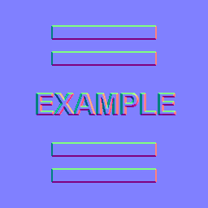
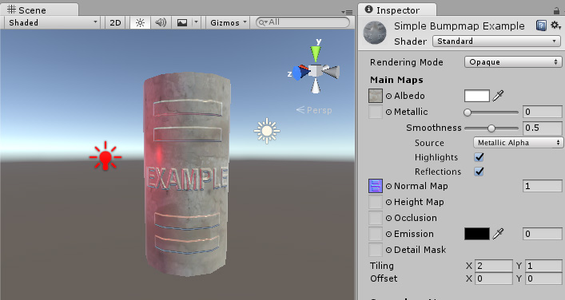
Result
Notes:
Just another example. On the right, the geometry is still a smooth cylinder, but the normal map (specially, the lighting on the cylinder) give the impression of a lot more detail.

Slide 55
Can someone explain why it’s purple?
Notes:
It’s because the default normal points directly off the surface. The surface goes in X and Y, so the normal is Z. It’s (0,0,1)
But that’s blue! Why purple?
Well, normal go from -1 to 1 in each dimension. But textures go from 0 to 1. So we remap the normals by adding 1, and dividing by 2.
((0,0,1) + 1) / 2 = (0.5, 0.5, 1.0) = purple

Slide 56
This class
Texture basic
Texture types
Border’s, mips, and sampling
Normal maps
→ Creating normal maps←

Slide 57
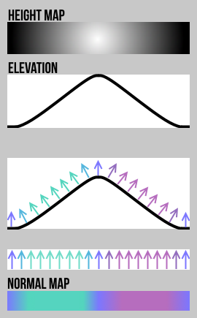
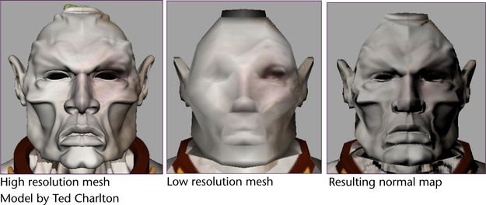
In the real world
Create high detail model
Compare differences with a low detail model (distance)
Notes:
In the real world, we have artists create both a model with a lot of triangles, and a model with a low amount of triangles.
We can use the difference between the two to generate a height map(the difference between the high and the low resolution mesh).

Slide 58
But how do we go from heightmap to normal?
How do we calculate these vectors?

Slide 59
We can do this ‘blindly’ by finite differencing
Attractive method because we don’t need to integrate (think about it)
Evaluate the function twice (in 2D)
Gives us the slope
Perpendicular = N
A B
B – A
Perpendicular(B-A) == Normal
Notes:
This slide tries to calculate the normal at a point A
It first creates a point B
It then creates the vector (B-A)
But we’re doing this in 2 dimensions. We choose B on the x axis, and a C on the y axis
Now that we have (B-A) and (C-A), we can use the cross product

Slide 60
Same for texture
A B
B – A
Perpendicular(B-A) == Normal
Notes:
This slide clarifies how you create the point.
A is where your uv coordinate is, so vec3(u, v, ?)
We get the third component by using the height value in the texture, so vec3(u, v, h)
The location of B we choose ourself. We almost always want to use the next pixel. If this texture is 20x20 pixels, we can use (u+0.05, v, h). H here is the value at the new pixels.
Do the same fox C, but in the Y dimension.
With your 3 positions, you can construct the normal

Slide 61
Why am I explaining this method if you already know how to make normal?

Slide 62
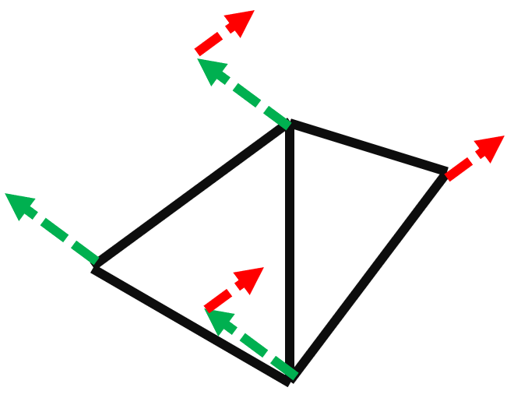


Works on the GPU
You’ll be making water
Why doesn’t the previous method work on the GPU?
Notes:
The previous method doesn’t work, because we can’t access multiple vertices in our shaders

Slide 63
Possible Exam questions (not exhaustive)
How can you calculate normal from a heightmap on the gpu?
Explain the finite differencing algorithm
What are mip maps?
Explain sampling
Name a texturetype other than Texture2D and give me a usage

Slide 64
Next class
Advanced pipeline
This is going to be a hard one
Learn about camera’s, lights, shadows, and how most games are rendered

