Slide 1
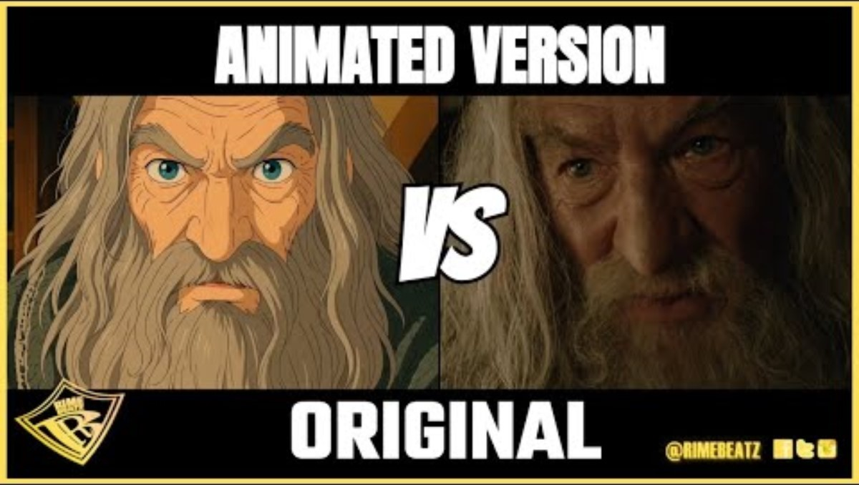
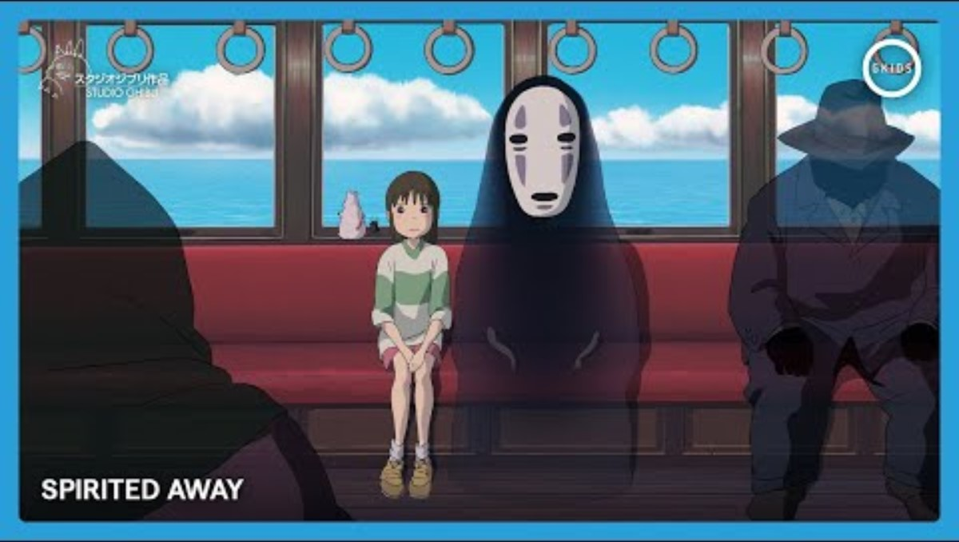
2024
Week 8: Advanced pipeline

Slide 2
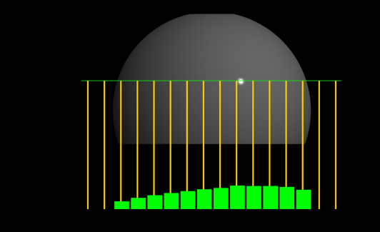
Last class
Aliasing

Slide 3
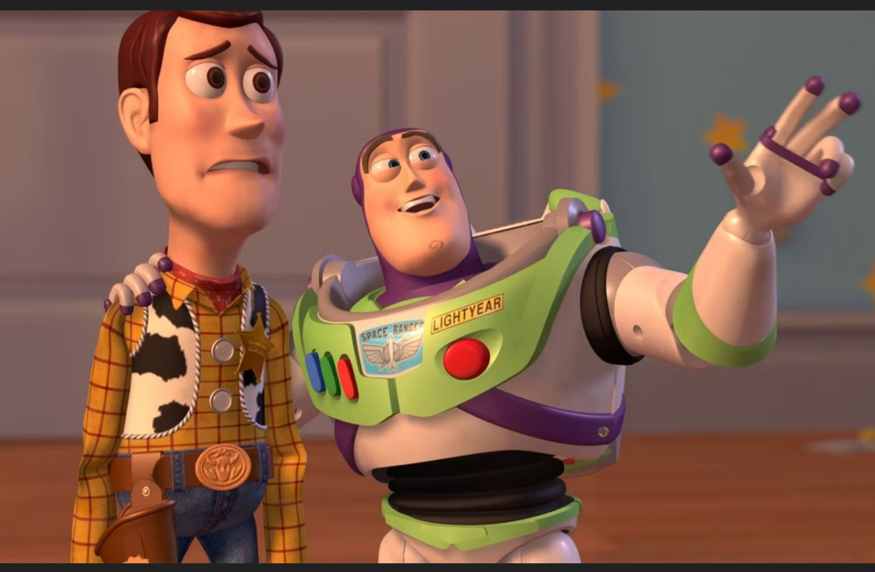
Course schedule
 |  | Wed
Week 1 |  | Introduction
Week 2 |  | 3D reasoning
Week 3 |  | Geometry
Week 4 |  | Pipeline & Materials
Week 5 |  | Proceduralism
Week 6 |  | Textures & Normal maps
Week 7 |  | Aliasing / Presentations
Week 8 | Lab | Advanced pipeline 1 Lab
Week 9 | Advanced pipeline 2 Lab | Post Processing
Week 10 | ? | Project
Week 11 | ? | Revision
Highly likely to change ☹

Slide 4
This class
→ Pipeline recap ←
Back in the day
Light & Shadow
Camera
Ray Tracing vs Rasterization
Forward rendering

Slide 5

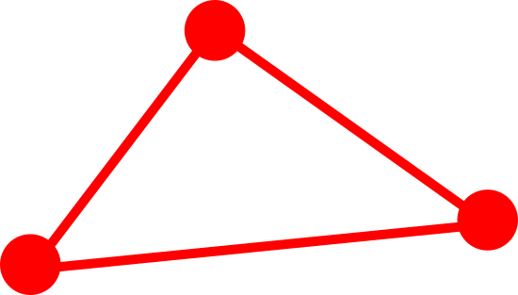


GPU Pipeline
Remember, the GPU pipeline was a series of steps (and hardware) developed for rendering
It’s very low level. It allows us to do rendering, but doesn’t do many features. That’s for engines (like Unity)
For example, it doesn’t do lights, shadows, camera’s. It does matrices, vectors, textures
Vertex Shader
Rasterize
Calculate pixel color

Slide 6
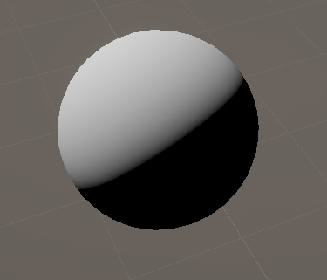
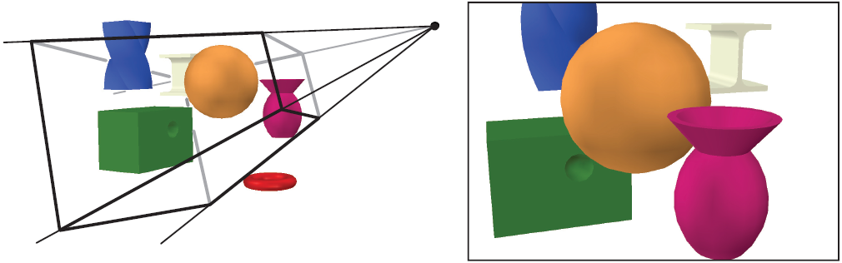
Graphics Pipeline (partially)
Transform vertices In Detail
Rasterize
Calculate pixel color
In Detail
These features, like shading and projection, are done by us
We use shaders to implement them
Notes:
It’s partial, because there’s a lot of stuff happening when we render an image that doesn’t fit in our vertex->rasterization->pixel pipeline. An example would be color correction
In detail, I mean that we use the shaders for actual graphics tasks, like transform our mesh into view space, or shading. This is also part of the pipeline, but not of the graphics api

Slide 7
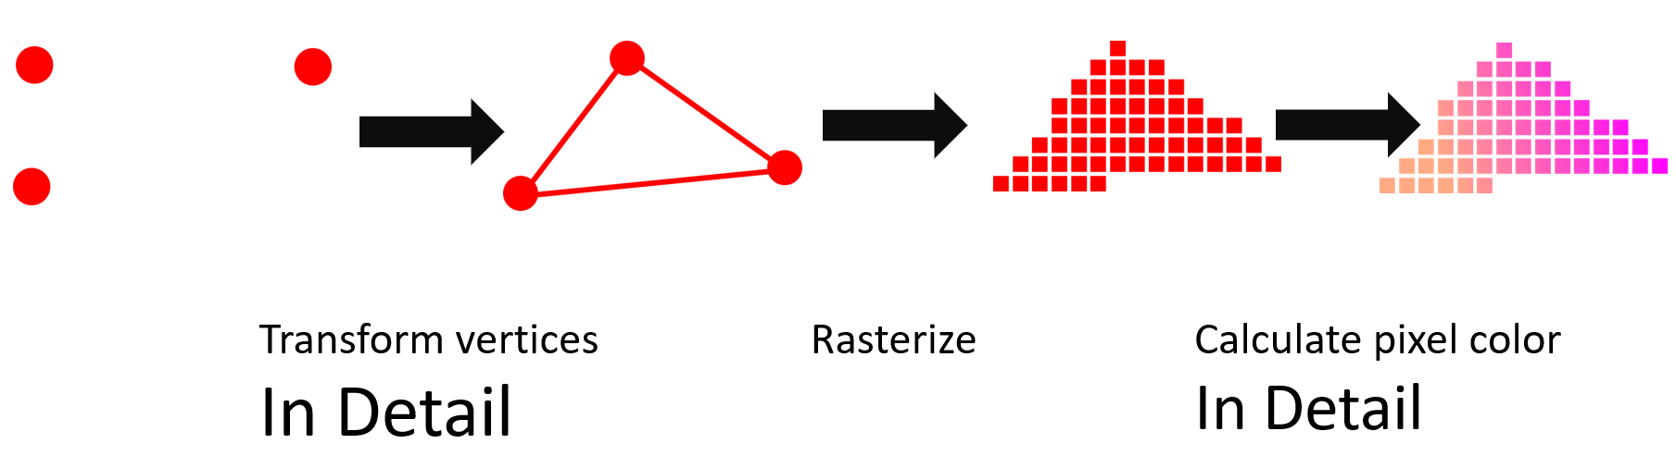
Graphics Pipeline
There’s a ton more things that we can’t just fit in the vertex of pixel shader of an object
How does fog work?
How does HDR work?
There’s more to the pipeline than rendering a single object
?
?

Slide 8
This class
Pipeline recap
→ Back in the day ←
Light & Shadow
Camera
Ray Tracing vs Rasterization
Forward rendering

Slide 9
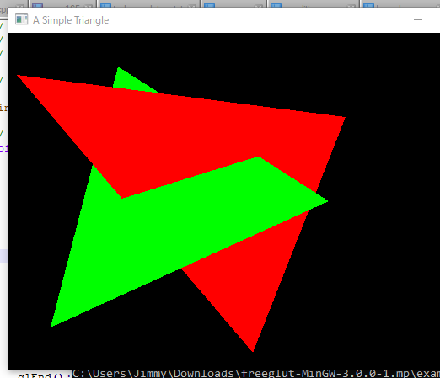
Back in the day
When starting out, the main problem in 3D graphics was *visibility*
In a 3D scene, triangles can occlude (hide) each other
It’s easy to know where each triangle should go where (which pixel are covered)
The hard problem is to know which pixels are in front
The original solution was to draw triangles back to front, but it doesn’t solve the case on the right
Notes:
This is going on a tangent, but becomes relevant later
In the early days of rendering, they faced a difficult problem. They could rasterize triangles by writing to a grid, just like you would paint them on a wall: first the one in back, then the one covering it.
What they could not due, was solve the problem where one wasn’t always completely behind the other.

Slide 10
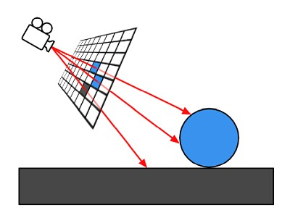
Raytracing
Store all the triangles in a data structure
For each pixel, create a ray
“shoot” the ray, finding the intersections with triangles
Take the closest intersection

Slide 11
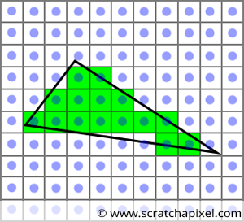
Rasterization
For each triangle
Project triangle onto grid
Calculate which pixels are covered (center)
That doesn’t solve the visibility problem

Slide 12
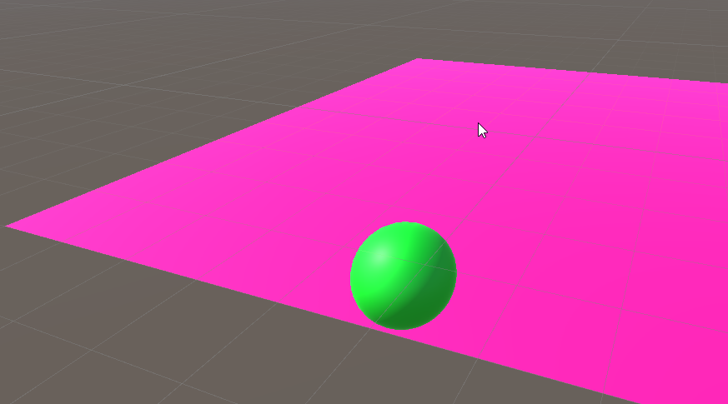
Primary visibility : rasterization
Objects are drawn on top of eachother
Eg closest to camera
Last object “overwrites” pixels
Like a painting
In this case, the plane is penetrating the ball
Notes:
We render a ball that sinks into the plane
We render the plane first, and then the ball
But now the ball looks like it’s standing on the plane

Slide 13
This is not correct

Slide 14
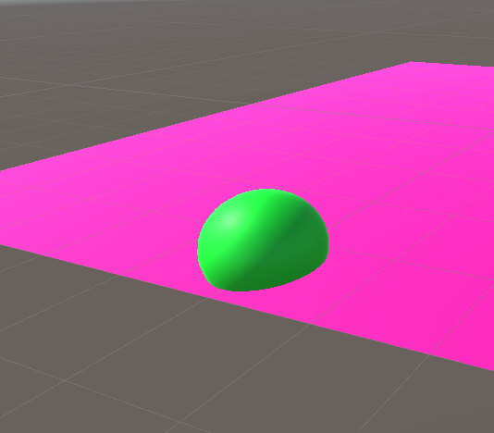
This is correct
Notes:
Part of the plane is behind the ball
Part of the plane is in front of the ball

Slide 15
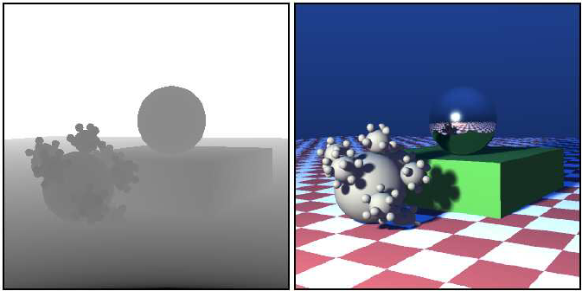
Depth buffer
Separate texture
Stores the depth (distance to camera) of pixel writing color
If a new pixel is further than the depth value : skip
If a new pixel is closer than the depth value : write depth, write color

Slide 16
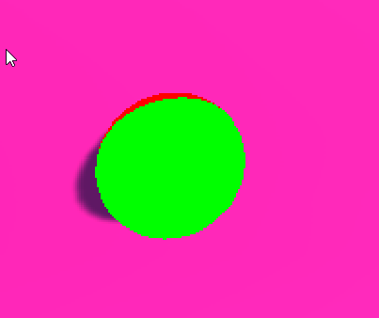
Draw ball after plane
Check which pixels are closer
The hardware does this for us
Order doesn’t matter, drawing the plane after the ball would also work
Closer to the camera : this passes
Further from the camera : this fails
Notes:
We’re now drawing the ball
The green pixels are closer to the camera than the plane in the same pixel position, so the ball color is set in that pixel
The red pixels have the ball further from the camera than the plane. We’re going to skip it and just keep the pixel from the plane

Slide 17
This class
Pipeline recap
Back in the day
→ Light & Shadow ←
Camera
Ray Tracing vs Rasterization
Forward rendering

Slide 18
Quick detour, it’ll make sense after?

Slide 19
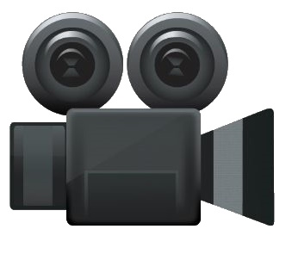

Light transport
Light hits an object
That light bounces
It enters our eye

Slide 20
Light transport
Light hits an object
That light bounces
In many directions
Some materials more than others
Some of it enters our eye

Slide 21
Light transport
Light hits an object
That light bounces
In many directions
Most hit another object (and bounce again)
Some of it enters our eye

Slide 22
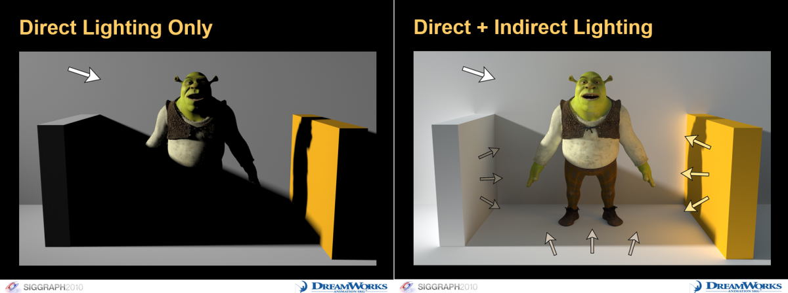
This is called global illumination
Most lighting comes directly from a light source (lamp, sun, sky)
It’s reflected on the surface
Some of it hits the camera, some of it reflects off of other surfaces
Some of that reflected light will get reflected again towards the camera
We’re not going to look at it, but it’s good knowledge for the next section

Slide 23
Next problem: secondary visibility
The visible point (pixel on screen) needs to be shaded (BRDF)
For that, we need to know where the lights are
We also need to know where the shadows are?

Slide 24
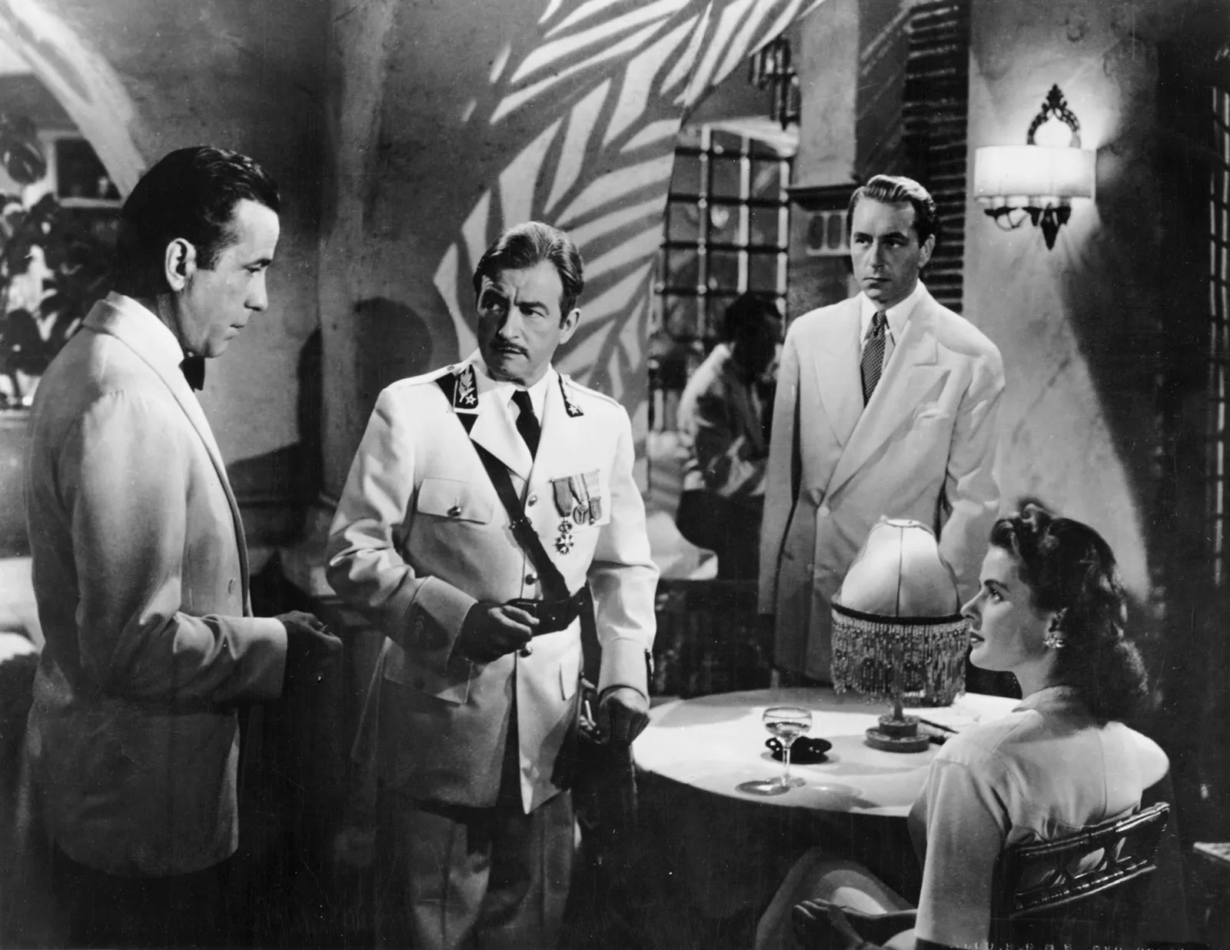
What are shadows anyway?

Slide 25
What are shadows anyway?
Shadows are places on a surface a light *doesn’t* reach
They’re a hard problem
Unity does it for us (same as with lights and camera’s)
But let’s look at how they’re made, it’s interesting

Slide 26
Raytracing : easy
For each light, shoot a ray towards the light
If there is geometry closes, skip (this is called occlusion

Slide 27
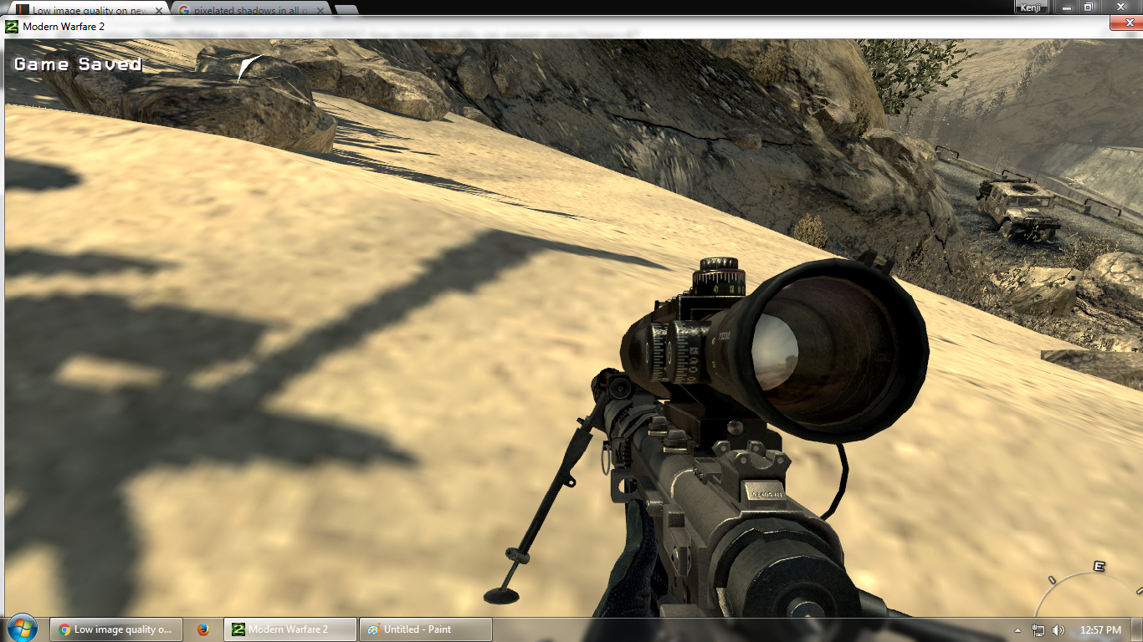
Rasterization : hard
Same idea
But we can’t shoot rays
How can we tell if light or geometry is closer?
We solved a similar problem this class

Slide 28
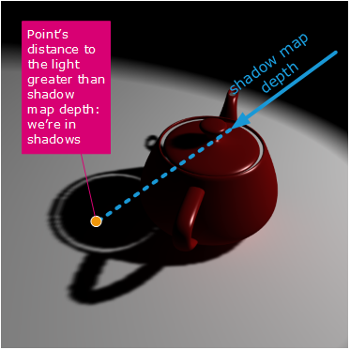
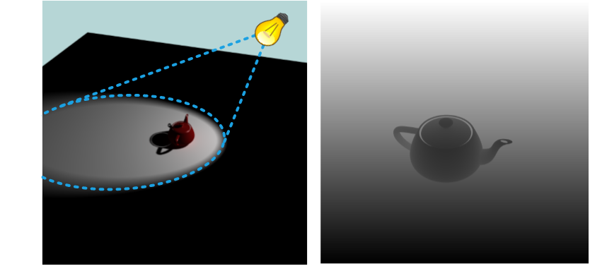
Shadow mapping
Render a depth buffer from the light
We calculate the distance from the pixel to the light
We calculate the distance of the pixel from the light
If they’re equal, the object is not in shadows
TONS of nuances, bugs, artifacts. Even in Unity, we need to care
Notes:
Right : depth buffer from the position of the light. This tells us how far thigs are from the light
Middle: we’re shading a pixel, the one with the orange color. We know it’s worldspace position, and, using a transform, know the position from the pov of the light. So we know how far it is from the light. That gives us the information if something is even closer (here, the teapot), and is occluding (casting a shadow) the floor.

Slide 29
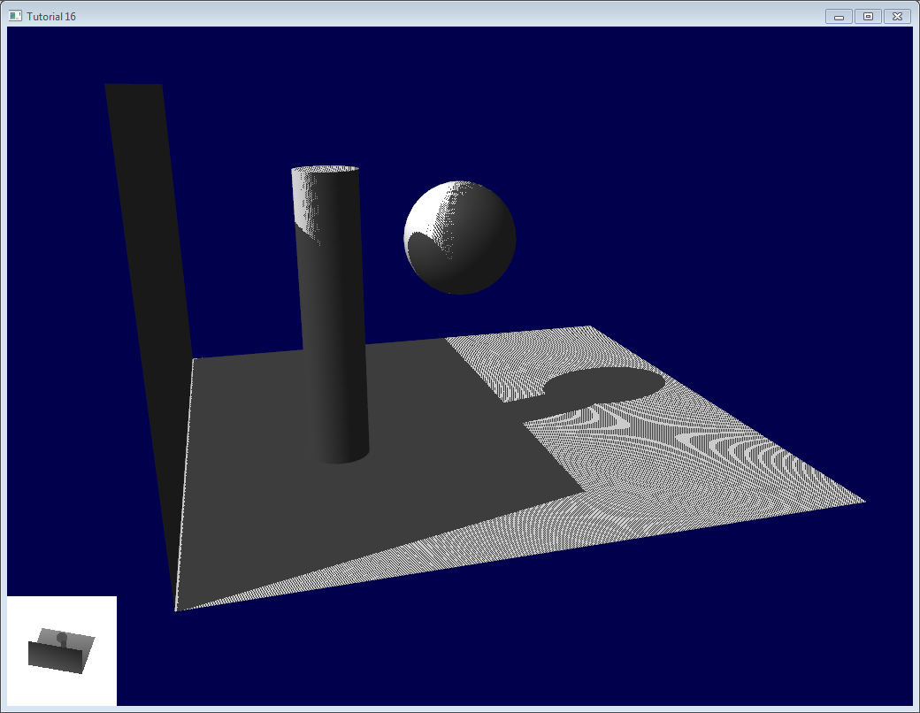
Shadow mapping : problems
What problems do you see?
I see at least 3
Notes:
“Shadow acne” where the pixels flip on and off on the floor
“Peter panning”, where the shadow of the wall doesn’t properly hit the wall
Both are caused by floating point precision issues
And also, the edge of the big shadow plane is very jagged, which is due to low-quality texture filtering

Slide 30
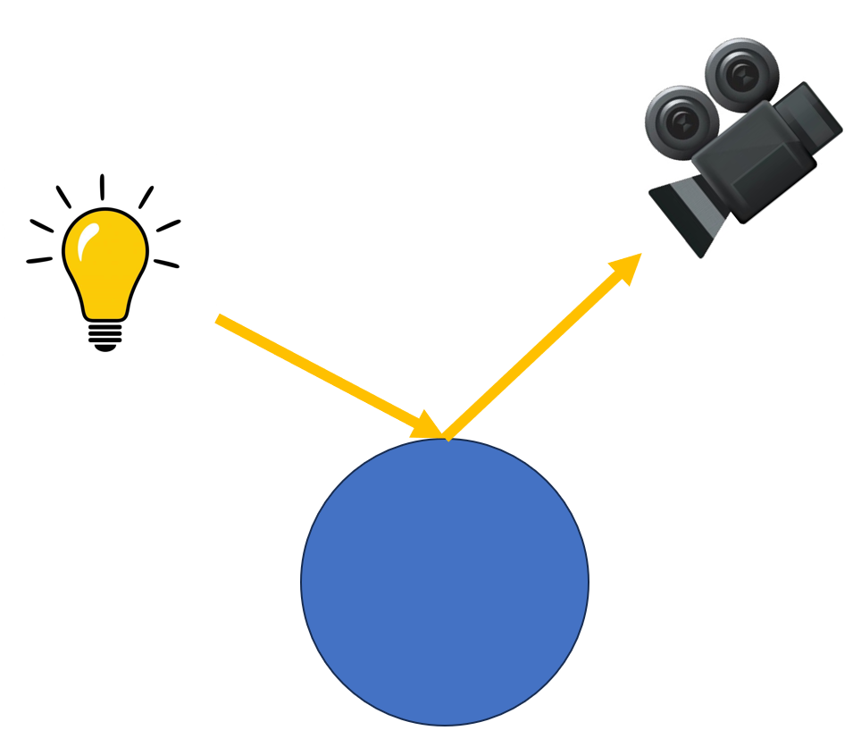
Light is and additive
If we make the light twice as strong, the material emits twice as strong
We can treat two lights separately, they don’t influence each other

Slide 31
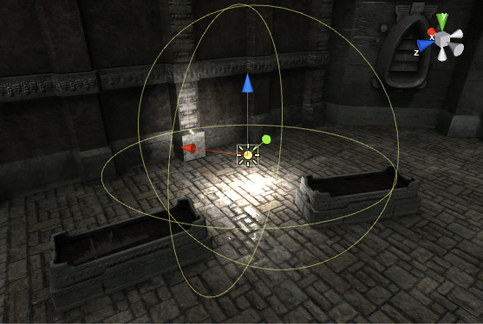
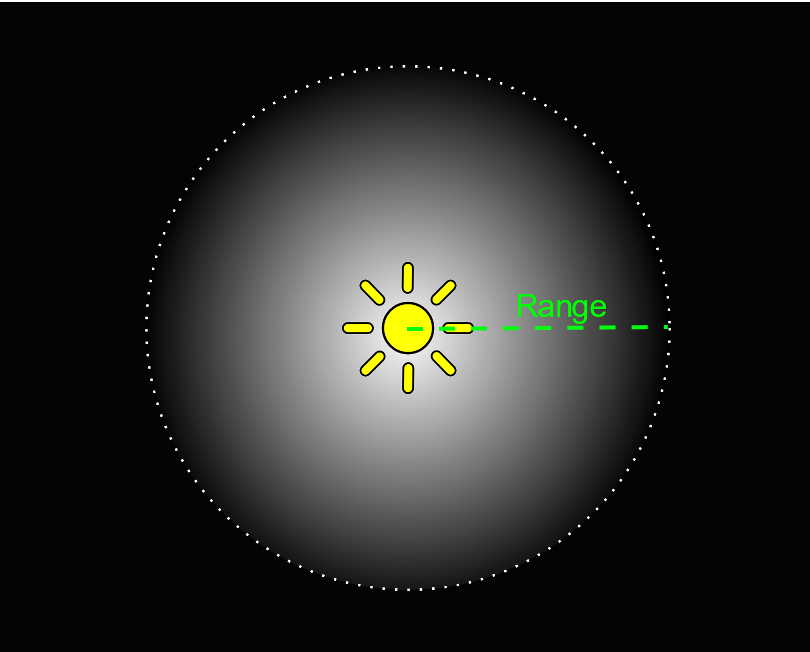
Point lights

Slide 32
Attenuation
Describes how light get less powerful with distance (with a cutoff)

Slide 33
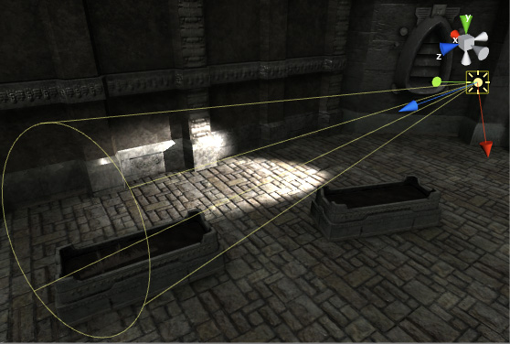
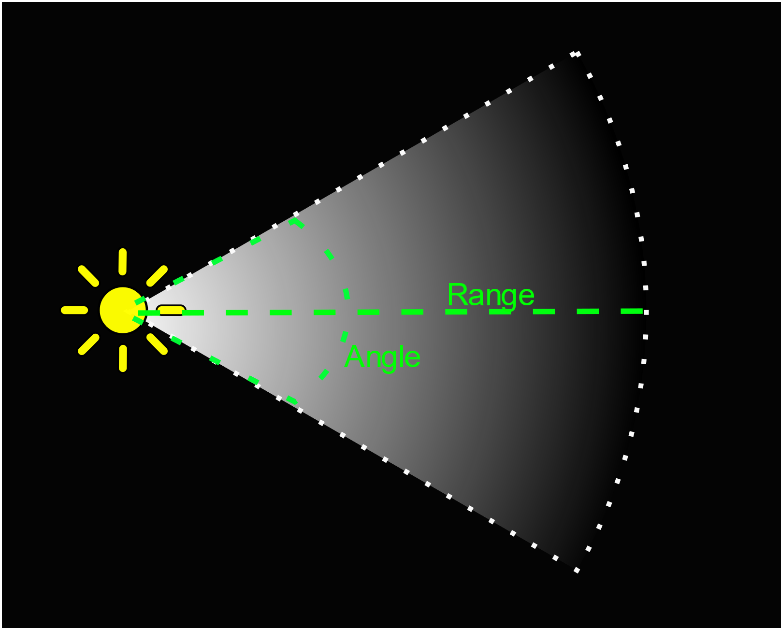
Spot light
Notes:
Same as point light, but with two angles

Slide 34
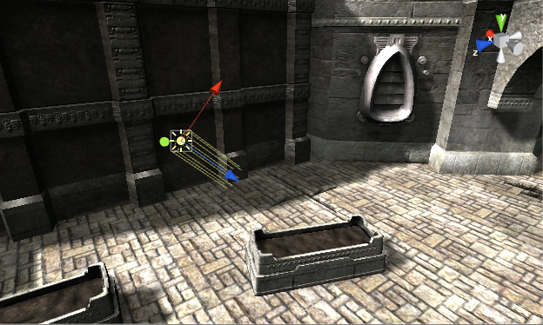
Directional light
Like sunlight
Does not fall off with distance
Why?
Notes:
The light doesn’t spread out, like it does for point and spot lights.

Slide 35
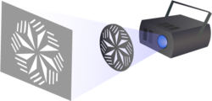
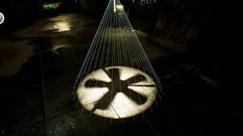
Light cookies
Like a painted plastic film on a light
Cheap way to create detail

Slide 36
This class
Pipeline recap
Back in the day
Light & Shadow
→ Camera ←
Ray Tracing vs Rasterization
Forward rendering

Slide 37

Perspective camera
Objects get smaller the further they are (depth cue)
All real cameras are perspective camera’s

Slide 38
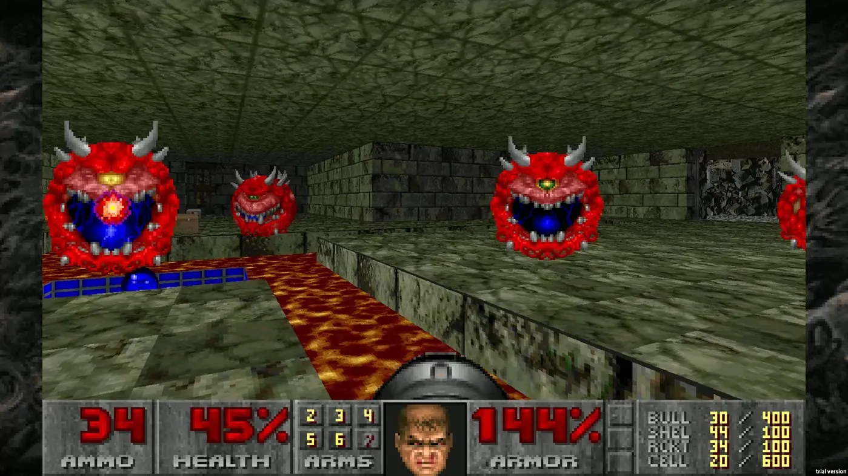

Slide 39
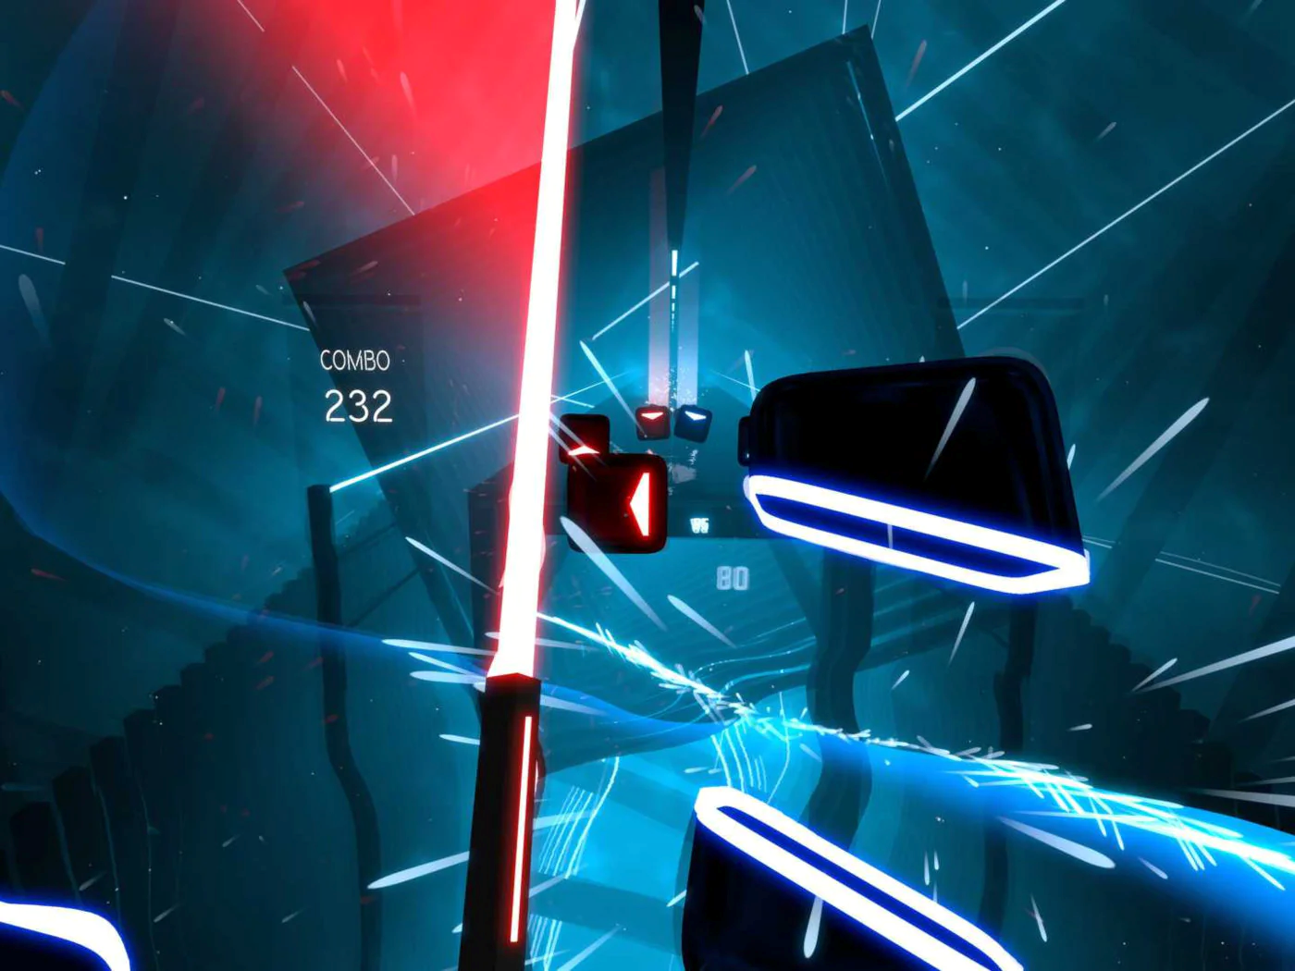

Slide 40
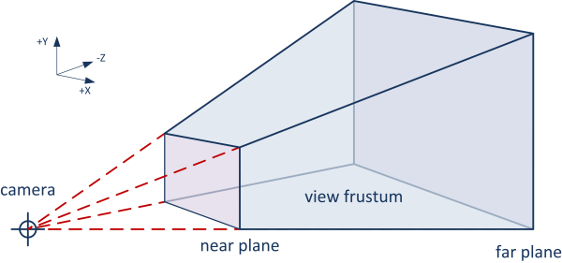
Perspective camera : frustum
The camera has a frustum (capped pyramid)
Anything visible has to be in the frustum

Slide 41
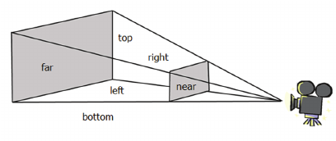
Perspective camera : near / far
The closest cutoff is called the near plane
The furthest cutoff is called the far plane
We need the cutoff due to the depth buffer

Slide 42
Perspective camera : field of view
This might already be familiar to you?

Slide 43
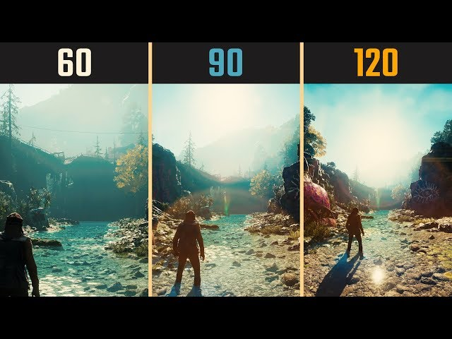
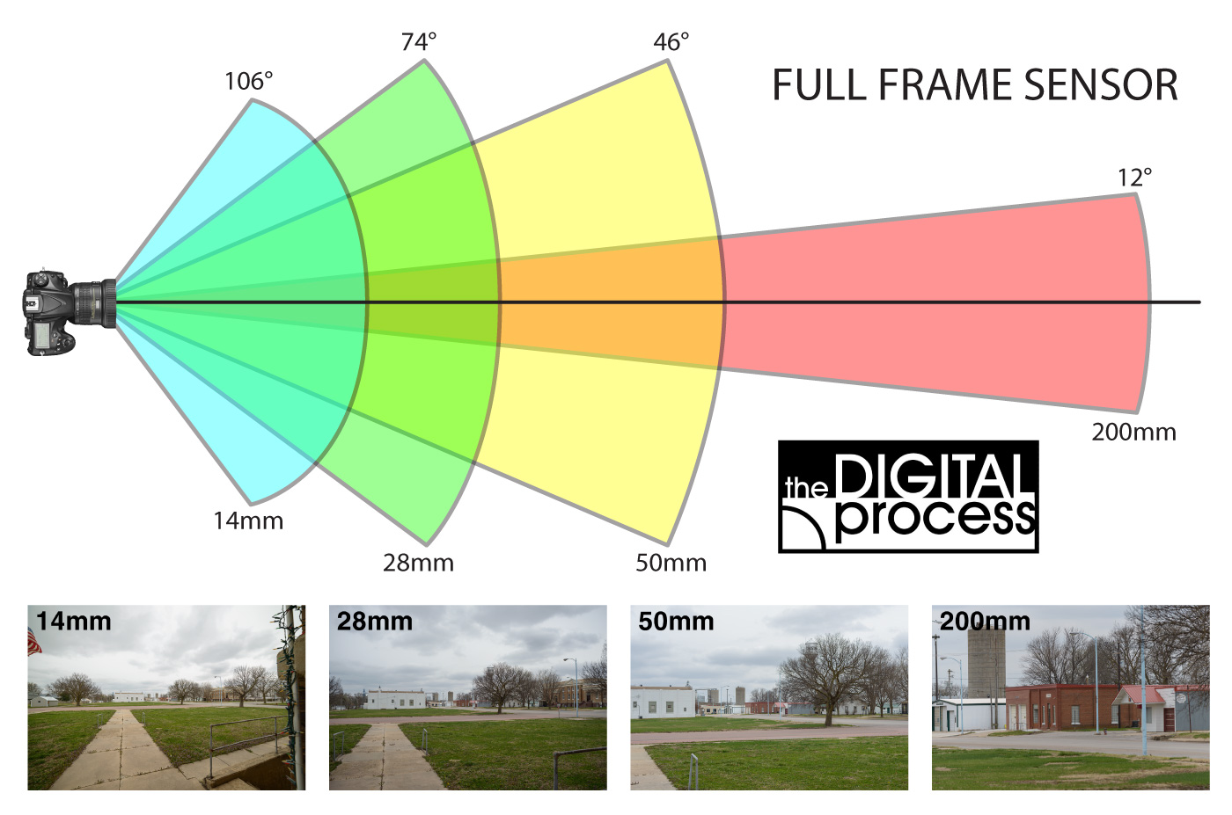
Analogous to different lenses
Larger field of view : smaller objects

Slide 44
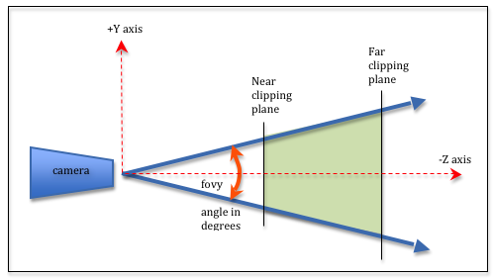
Field of view in frustum

Slide 45
Field of view is determined by aspect ratio
Aspect ratio : resolution.x / resolution.y
Eg 1920 * 1080
Common (nowadays) : 16/9
For FOV, we usually choose the vertical one, eg 90 degrees Multiply by aspect ratio for horizontal one : (16 * 90) / 9 FOV = (160, 90)

Slide 46
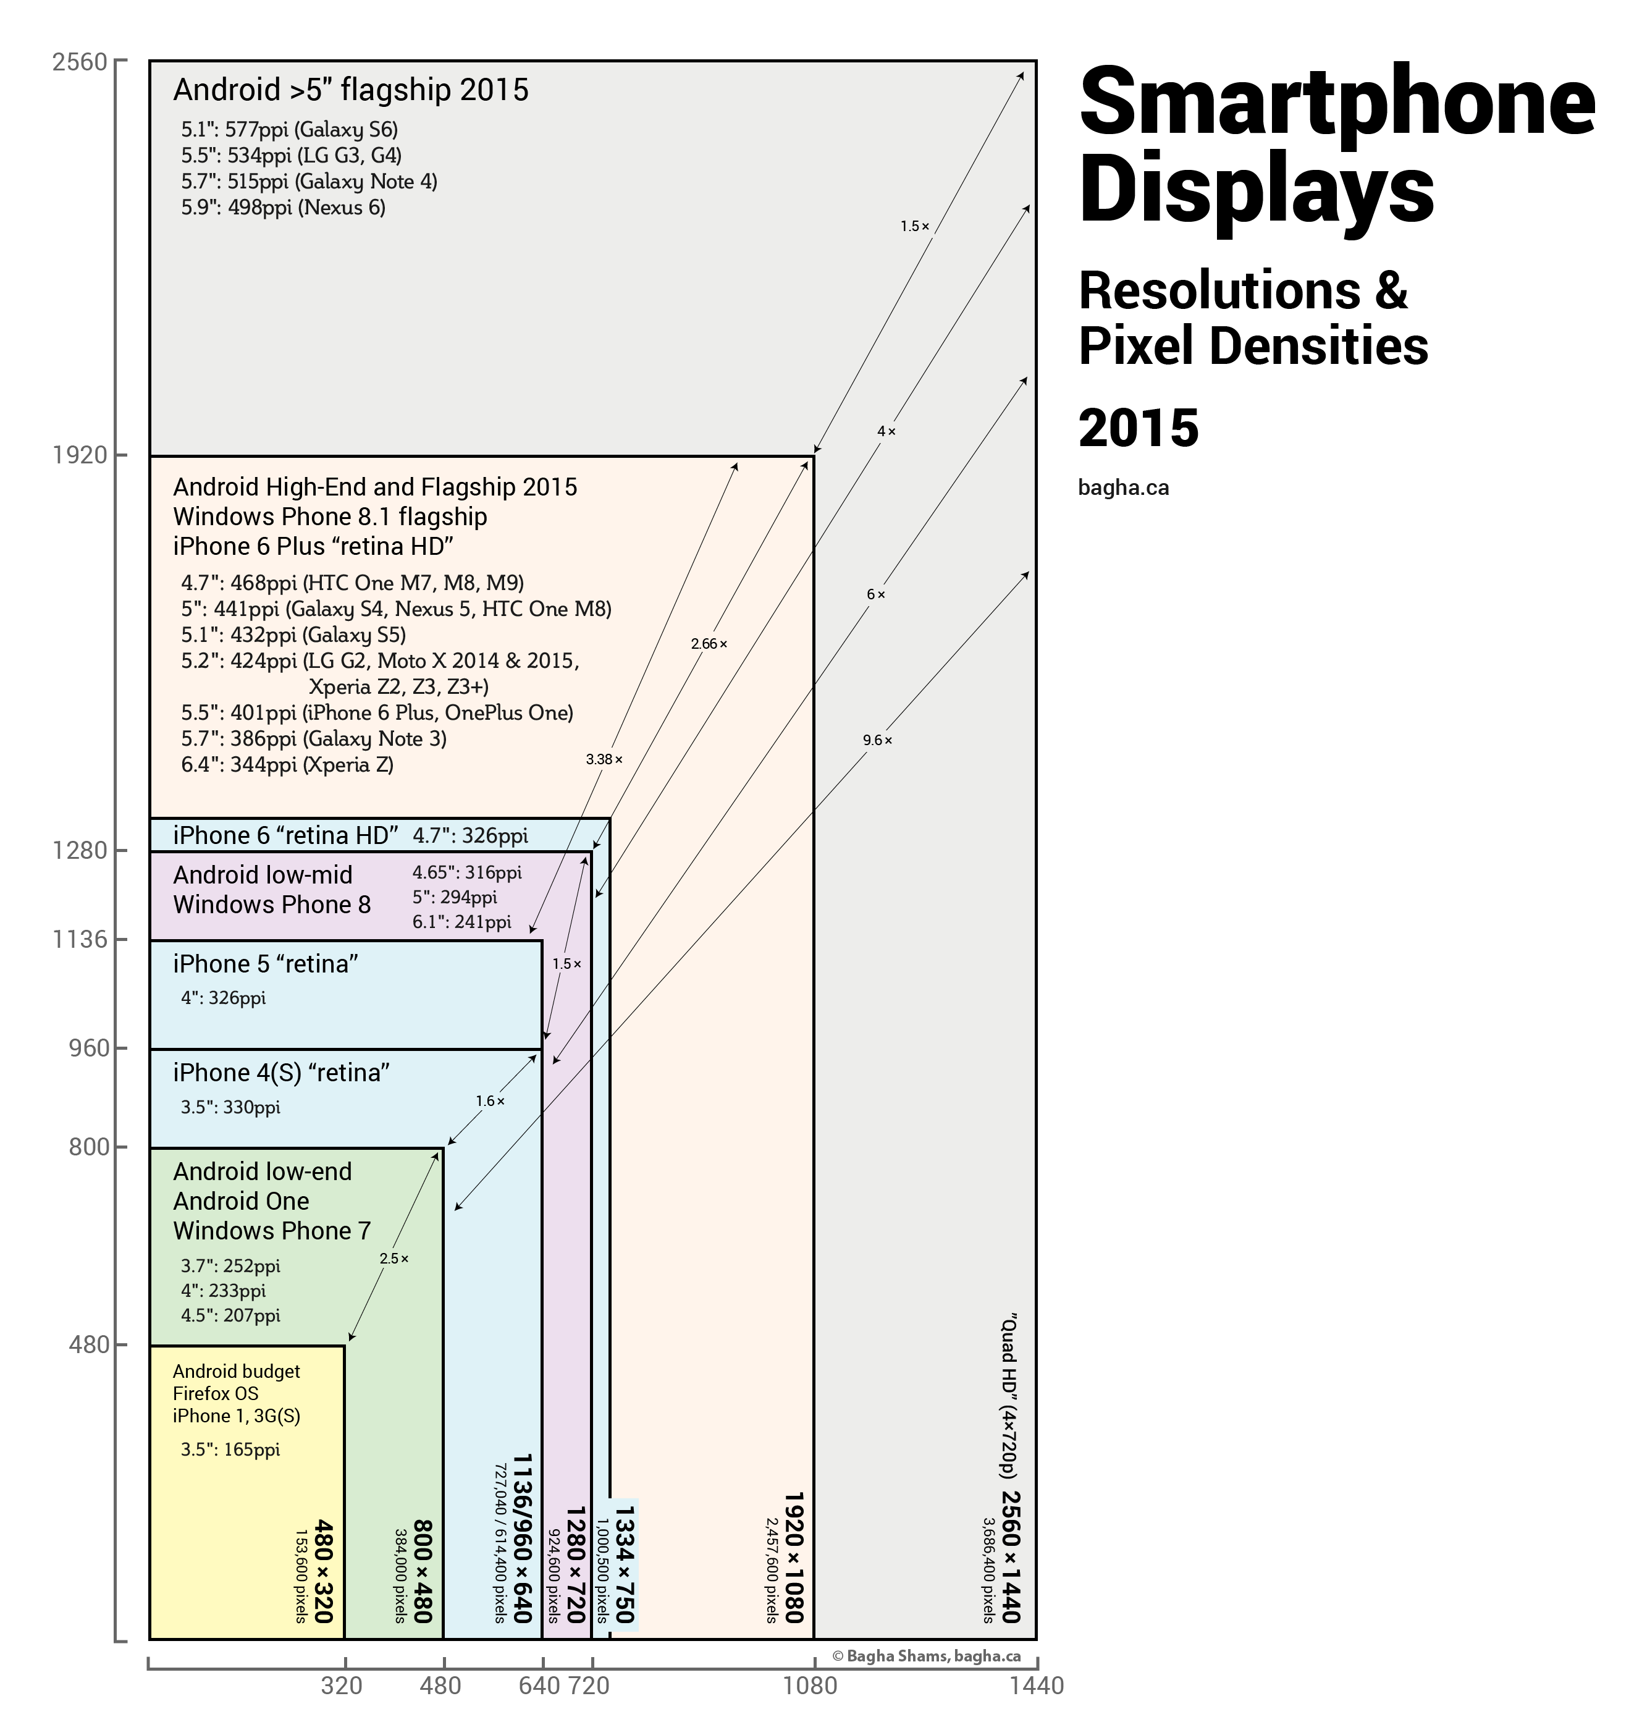
Phones are a nightmare

Slide 47
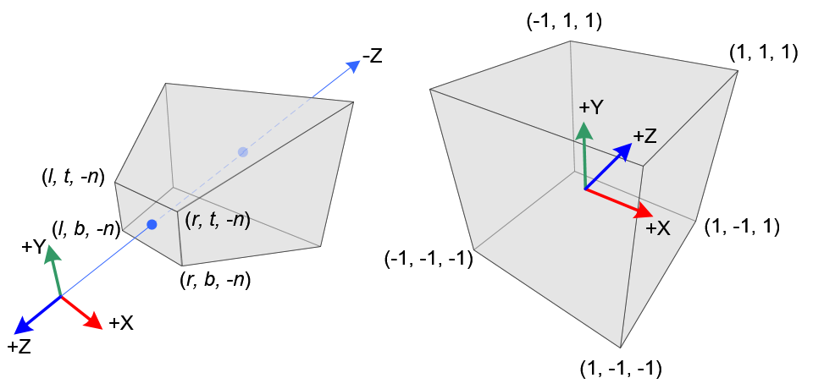
Perspective matrix
Takes care of perspective transform
Comes after the view matrix
Common : MVP (ModelViewProjection)

Slide 48
Questions?

Slide 49
Camera’s
Perspective
→Orthographic←

Slide 50
Orthographic
Objects do not get smaller as they get further
Does anyone know an example?

Slide 51
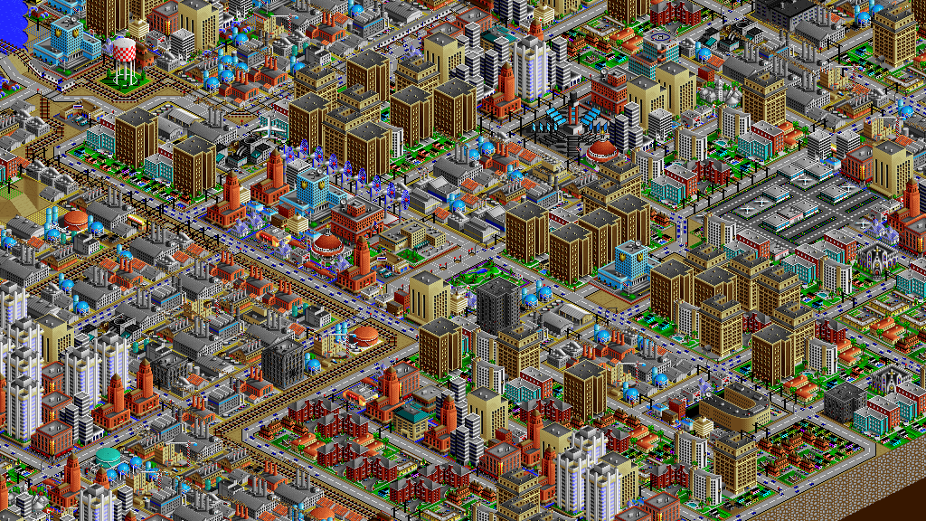

Slide 52
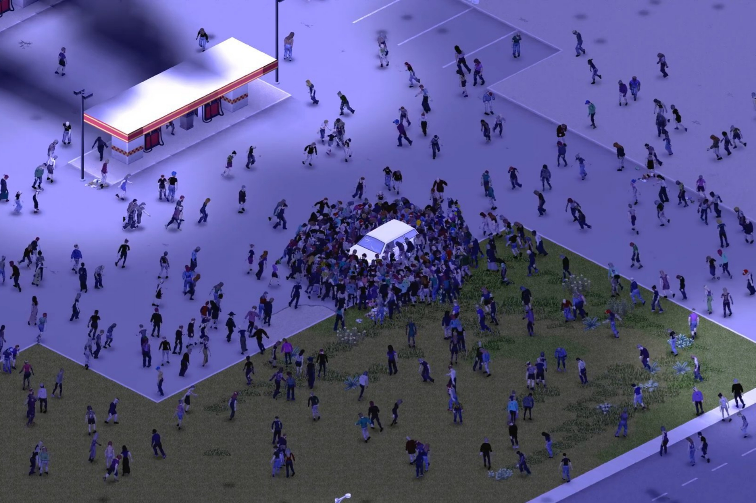

Slide 53
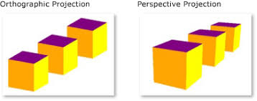
Comparisio n1

Slide 54
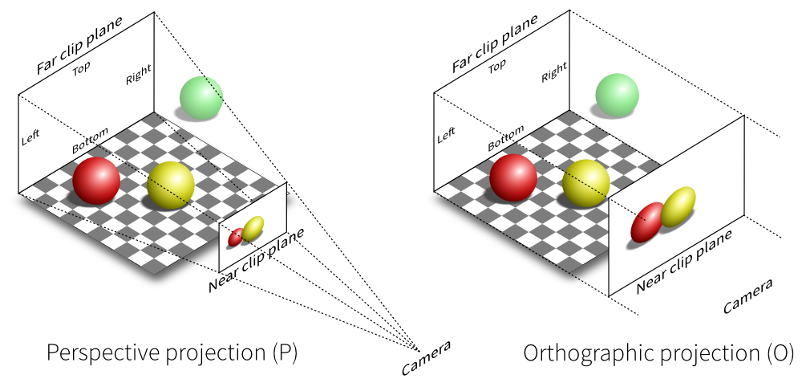
Comparison 2
Very similar to perspective
No fov
Near (and far) have width and hight

Slide 55
Questions?

Slide 56
Questions?

Slide 57
This class
Pipeline recap
Back in the day
Light & Shadow
Camera
→ Ray Tracing vs Rasterization ←
Forward rendering

Slide 58
Pros and cons
Raytracing
Good quality (multiple rays per pixels)
Easy implementation (at the start)
Manages smoke, mirrors
Bad performance
Rasterization
Ok quality (one fragment per pixels)
Hard implementation (at the start
Difficult smoke, mirrors
Good performance
* Lots of simplifications and lies on this slide

Slide 59
Pros and cons
Raytracing
Good quality (multiple rays per pixels)
Easy implementation (at the start)
Manages smoke, mirrors
Bad performance
Rasterization
Ok quality (one fragment per pixels)
Hard implementation (at the start
Difficult smoke, mirrors
Good performance
* Lots of simplifications and lies on this slide

Slide 60
Pros and cons
Raytracing
Good quality (multiple rays per pixels)
Easy implementation (at the start)
Manages smoke, mirrors
Bad performance
Rasterization
Ok quality (one fragment per pixels)
Hard implementation (at the start
Difficult smoke, mirrors
Good performance
* Lots of simplifications and lies on this slide

Slide 61
Pros and cons
Raytracing
Good quality (multiple rays per pixels)
Easy implementation (at the start)
Manages smoke, mirrors
Bad performance
Rasterization
Ok quality (one fragment per pixels)
Hard implementation (at the start
Difficult smoke, mirrors
Good performance
* Lots of simplifications and lies on this slide
Notes:
Performance is king in realtime rendering. If we can render a scene faster, we can add more detail, making it slower, so we make it faster….

Slide 62
Forward rendering
So, we go with rasterization
We get our vertex shader / pixel shader
How do we implement lights, camera’s and all that?

Slide 63
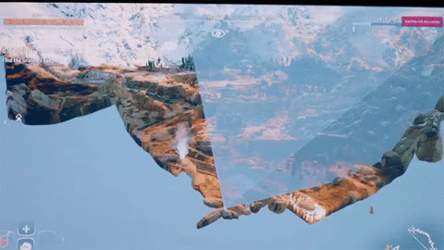
Gather objects : frustum culling
Instead of rendering all objects, render only the ones in the camera frustum
Not necessary, but it’s cheap and gives us a lot of performance
Unity does this for us

Slide 64
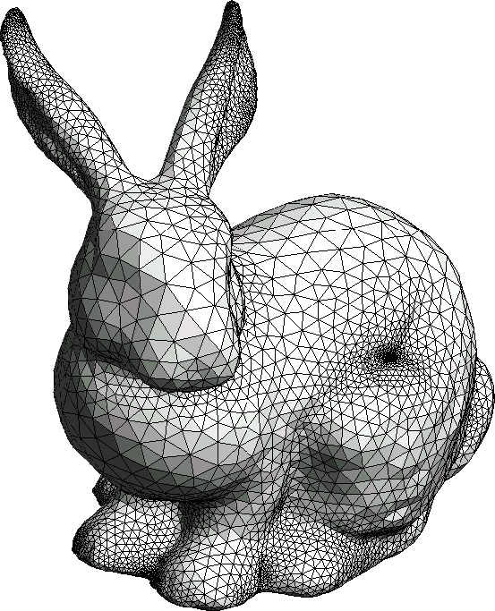
For each object, find lights
Done using bounds tests
Often with an acceleration structure (100’s of lights, 1000’s of objects)
Find lights overlapping objects

Slide 65
For each object, render
Fragment shader
Light lights; (from cpu)
Float4 outputColor = 0;
For each light:
if (inShadow(shadowMap))
continue
outputColor += BRDF(N, light) *
Return outputColor
Vertex shader
(Apply animation)
Apply mvp matrix

Slide 66
BRDF Function
BRDF (one light)
Very free
Can use color maps, or not
Can use normal maps, or not,
Gooch, toon, blinn-phong…
Float3 outputColor = albedo; // baseColor outputColor *= light.Intensity / distance(light.pos, vertex.pos); // attenuate outputColor *= light.color;
outputColor *= sampleShadow(light, pos); outputColor *= dot(N, normalize(pos – light.pos))
Return outputColor;

Slide 67
Possible Exam questions
What is primary visibility?
What is the depth buffer? What problem does it solve?
What is a perspective / orthographic camera? Give an example usecase for each

Slide 68
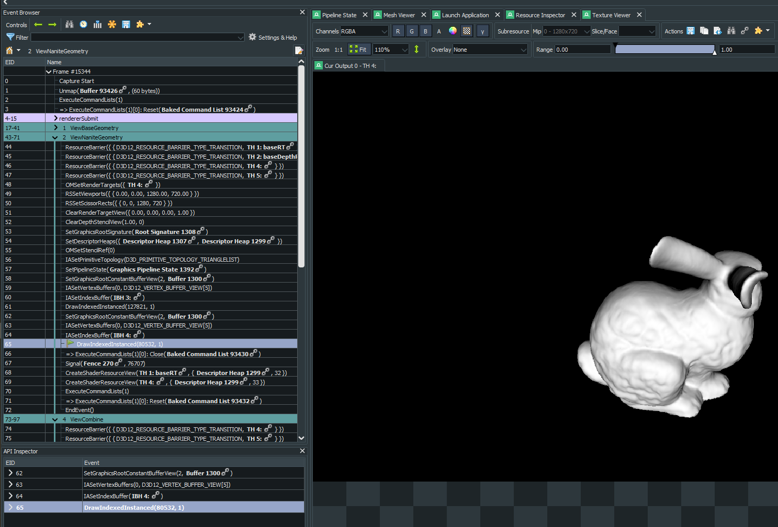
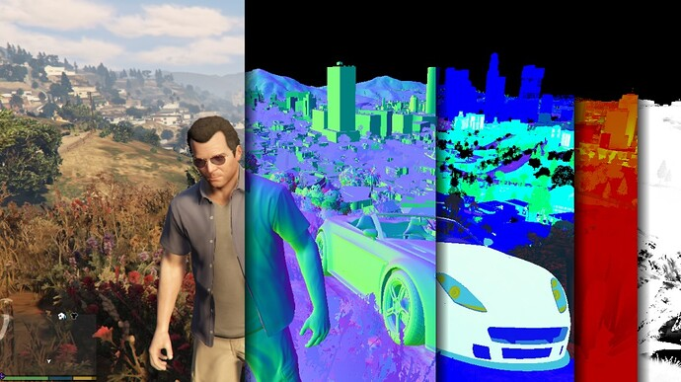
Next week
Deferred rendering
Used in virtually all games after 2007
Will look at a renderdoc capture of unity / AAA game

