Slide 1
DE + AR
2025
Free coffee if you can tell me what forward rendering is
Week 10: Deferred rendering

Slide 2

Last class: the problem
What is the color of one pixel?
Two separate problems: Which triangle? Which color on the triangle?

Slide 3




For each object, evaluate brdf while rendering the model
Vertex Shader
Rasterize
Evaluate everything when drawing the model
Foreach(light) light_out += brdf(L, N) * light.color * shadow(light)
float3 brdfLambert(float3 L, float3 N) // just an example return float3(dot(N,L))

Slide 4

Course schedule
 |  | Wed
Week 1 |  | Introduction
Week 2 |  | 3D reasoning
Week 3 |  | Geometry
Week 4 |  | Pipeline & Materials
Week 5 |  | Proceduralism
Week 6 |  | Textures & Normal maps
Week 7 |  | Aliasing / Presentations
Week 8 | Lab | Advanced pipeline 1 Lab
Week 9 | Lights, shadows, camera’s, primary visibility Lab | Forward rendering Lab
Week 10 | Deferred rendering / lab | Post processing / various / lab
Week 11 | ? | Revision

Slide 5
This class
→ Problems with forward rendering←
Deferred rendering
Renderdoc

Slide 6
Forward rendering: problem 1
We evaluate all the lights and the material when we render the mesh
If a light is small relative to the mesh (eg a flashlight on a building, shining only on the ground floor), we still need to check that light for each pixel of the entire building ☹

Slide 7
Forward rendering: problem 1
We evaluate all the lights and the material when we render the mesh
If a light is small relative to the mesh (eg a flashlight on a building, shining only on the ground floor), we still need to check that light for each pixel of the entire building ☹
…. forward rendering is not good with small lights

Slide 8
Forward rendering: problem 2
We evaluate all the lights and the material when we render the mesh
Our material needs to know about every light type
When we add / change a light type or it’s code, this needs to be changed in *all* materials
Forward rendering strongly couples lights and materials ☹

Slide 9
Forward rendering: problem 2 (continued)
We evaluate all the lights and the material when we render the mesh
For 3 light types: for (int i = 0; i < pointLightCount; ++i) outColor += brdf(pointLights[i]) for (int i = 0; i < spotLightCount; ++i) outColor += brdf(spotLights[i]) for (int i = 0; i < boxLightCount; ++i) outColor += brdf(boxLights[i])
Even if we only have 1 light, we still need to evaluate all these loops
On the cpu, this is a joke. In a shader… it counts
We can make a MyShader_1Point_2Spot shader
This is measurably faster
But we needs 10s of shader for one material ☹
Notes:
By a MyShader_1Point_2Spot shader
I mean that instead of these for loops, we implement
outColor += brdf(pointLight_0)
outColor += brdf(spotLight_0)
outColor += brdf(spotLight_1)
Skipping all the loops

Slide 10
Forward rendering: problem 2 (conclusion)
People ended up makin one ‘big’ shader called an Ubershader which can be used to generate specific shaders
This supported many combinations of lights
But also, normal map, or vertex normal?
But also, animated or not?
Etc…
These descinions are at compile time, not branching with an if #ifdef NORMAL_MAP float3 N = calculateNormal(normalTexture, vertex.normal) #else float3 N = vertex.normal
This works! And it’s fast
But you end up with tens of thousands of shaders, eg Lambert_2spot_normalMap_alpha
10000 shaders = huge compile times, ton of boilerplate ☹

Slide 11
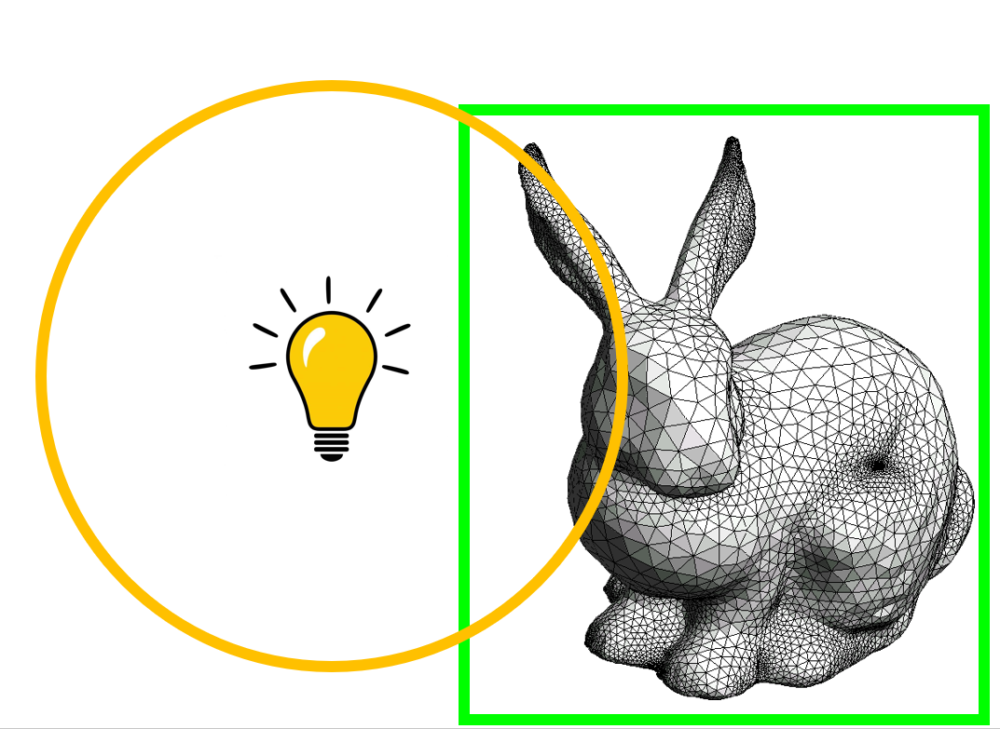
Forward rendering: problem 3
We need to find lights that shine on a mesh
Send it to the gpu
Set up the whole shader pipeline stuff
It’s not that hard, but it’s quite a bit of work ☹

Slide 12
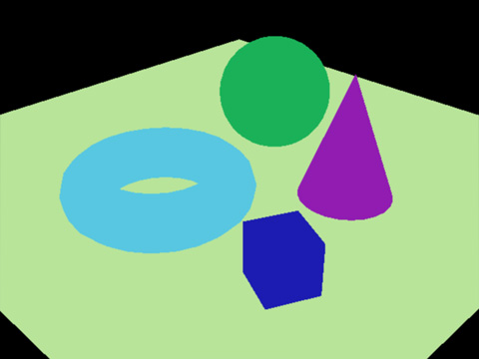
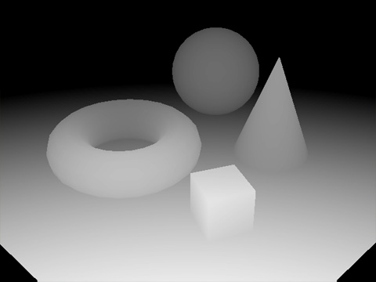
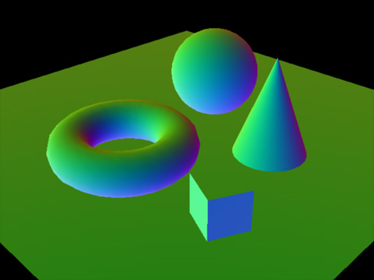
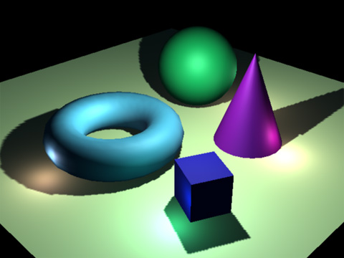
Deferred rendering
Deferred rendering tries to address all these problems
It does so by pulling apart the rendering of meshes, and applying the lights
Remember : we need several parameters (normal, base color, light intensity) to calculate the color (reflected light) of a surface
Deferred rendering : 1 mesh writes Normal, base_color, and other stuff to intermediate textures
2 light render as a mesh, read these parameters, and calculate color

Slide 13
Intermediate textures : GBuffers
Light
Mesh

Slide 14
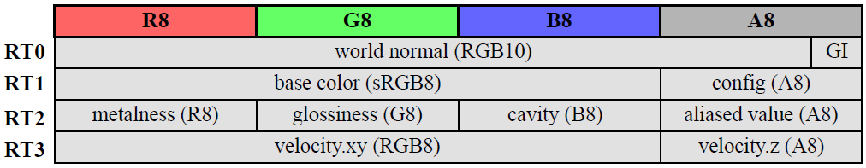
GBuffers
Must contain *everything* from a mesh that is needed after it is rendered
Must also be as small as possible
Here, we have 4 textures. How much is that in MB?
Why is that a problem on the GPU?

Slide 15

What this looks like in a real game

Slide 16
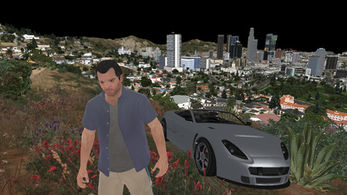
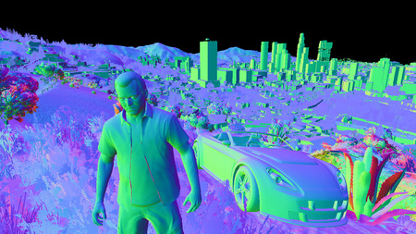
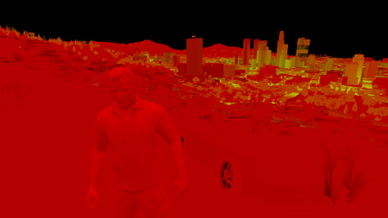
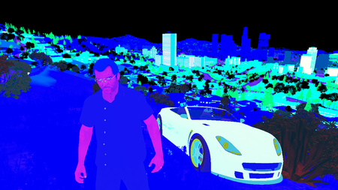

Slide 17


Slide 18
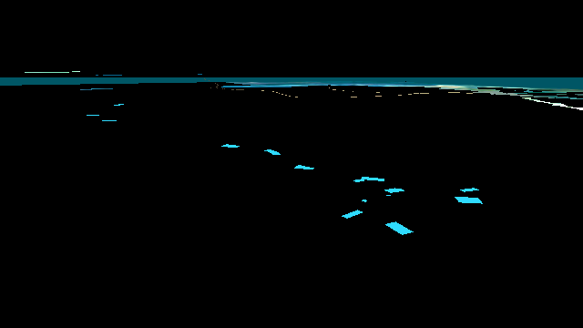
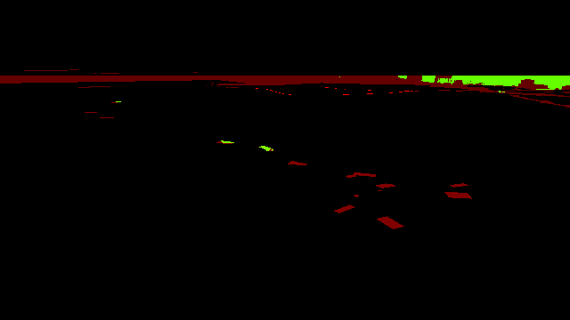

Slide 19
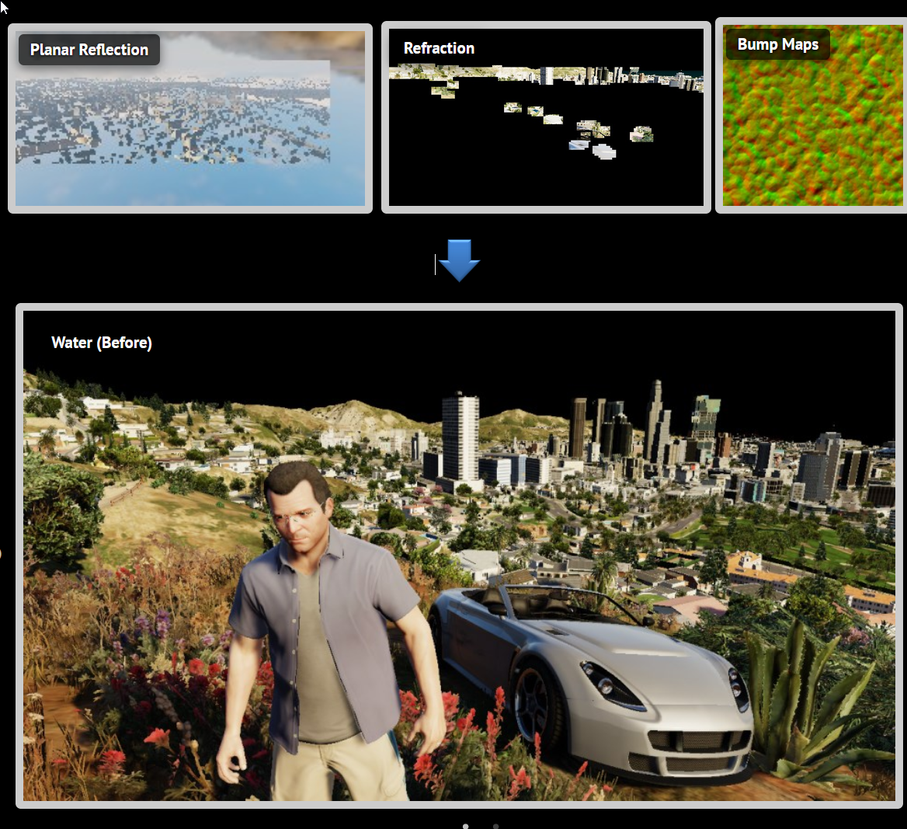

Slide 20


Slide 21
Deferred rendering: solutions?
Only evaluated light where it’s actually present ☺
Meshes only need to write parameters, know nothing about lights ☺
Lights need to know about materials ☹ Only very few materials ☹ ☹
Simpler to implement ☺

Slide 22
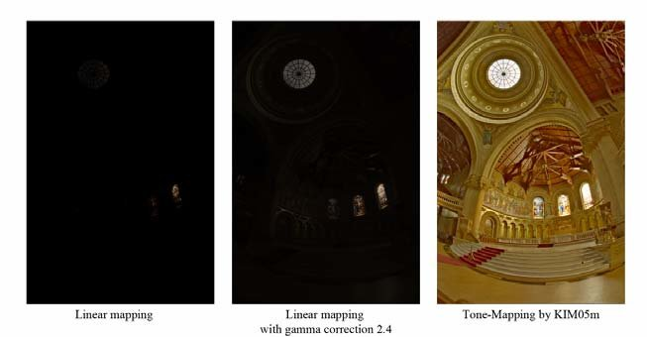
Wednesday
Postprocessing : HDR (just like displays), ambient occlusion
Mostly as a reason to repeat some concepts
But also as it accounts for 30% of time spend in the gpu

