Slide 1
DE + AR
2025
Week 11: Finite differencing

Slide 2
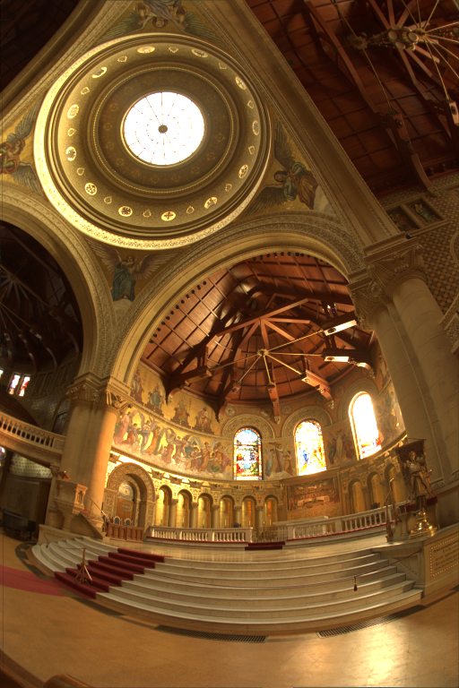
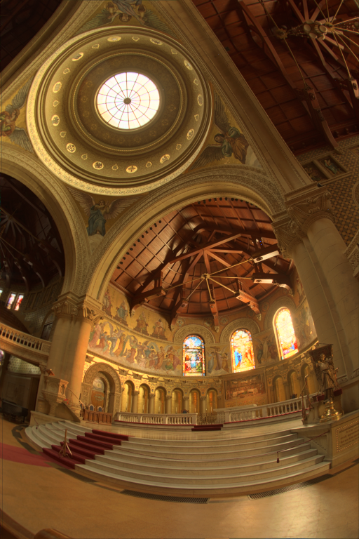
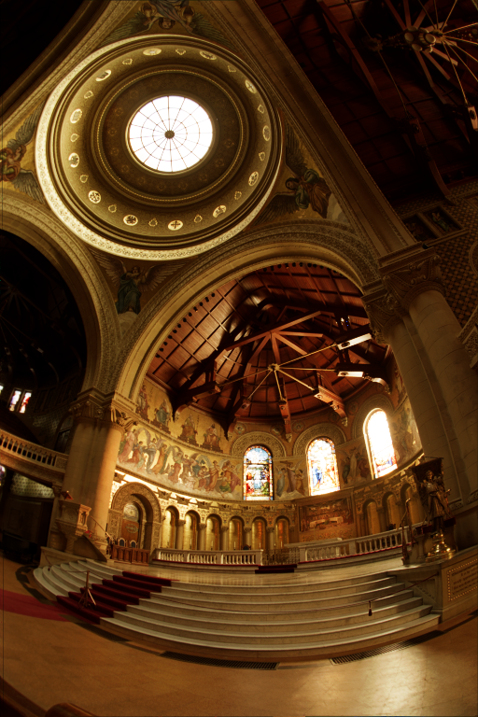
Last week

Slide 3

Course schedule
 | Mon | Wed
Week 1 |  | Introduction
Week 2 |  | 3D reasoning
Week 3 |  | Geometry
Week 4 |  | Pipeline & Materials
Week 5 |  | Proceduralism
Week 6 |  | Textures & Normal maps
Week 7 |  | Aliasing / Presentations
Week 8 | Lab | Advanced pipeline 1 Lab
Week 9 | Lights, shadows, camera’s, primary visibility Lab | Forward rendering Lab
Week 10 | Deferred rendering / lab | Post processing / lab
Week 11 | Bonus | Quiz
Week Rev |  | Revision
I’m not sure what to teach on Monday
What are your struggles in the project?
I probably can find a topic that reinforces a lot of what you need to know
Or we can revise a topic deeply
Tell me!

Slide 4
This class
Finite Differencing
Bloom
Ambient Occlusion
Lab

Slide 5
Finite differencing
Solves a very real problem we have in our project
Anyone remember which problem? For a coffee

Slide 6
We need normals
Because all geometry in a lighted environment needs normal
Anyone know why? For a coffee

Slide 7
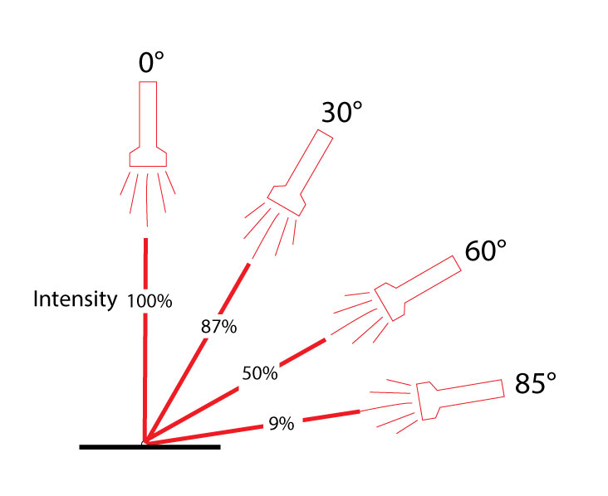
We need normals
All light is directional (comes from a certain direction on a certain
Dot(normal, light.direction) tells us how much light lands on the surface

Slide 8
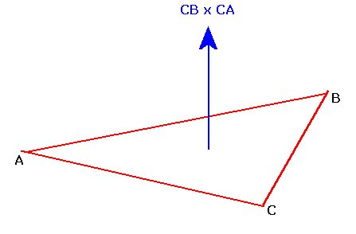
Normals : the usual solution
We can easily calculate the normal of a triangle
By extension, we can also calculate the normal of a vertex
But we can’t for the water in our project!

Slide 9
Normals : the problem
We’re calculating positions in our vertex / pixel shader (for water, portal)
For calculating the normal with the dot product, we need 3 points
But in our shaders, we only have access to one vertex / point ☹
Eg vertex A has position(0,0,1). What is it’s normal?

Slide 10
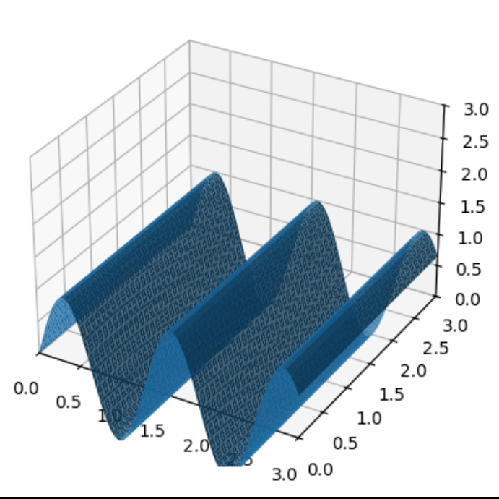
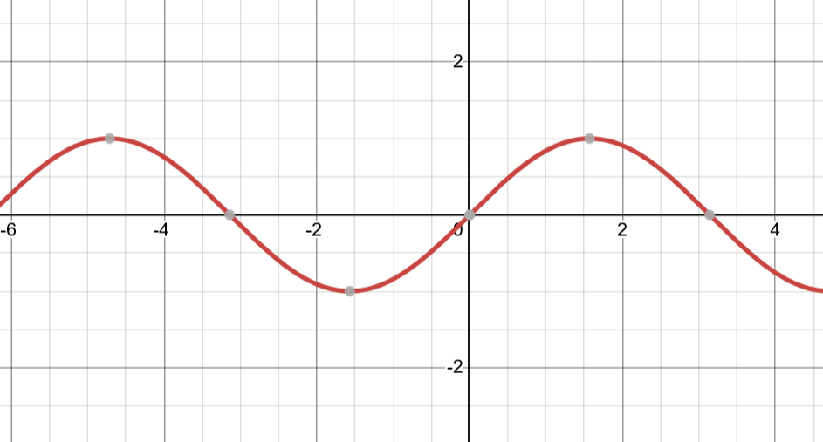
Fox example: sin
Imagine we’re determining the height of our water using sin(x)
You have one position (and value) to determine the normal
How do you do it?
Especially, without knowing the function is sin?

Slide 11
We take two points really close

Slide 12
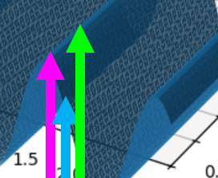
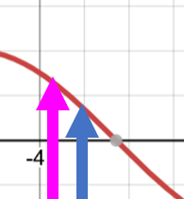
Now we construct the slope
It’s the vector from our original point to a new point

Slide 13
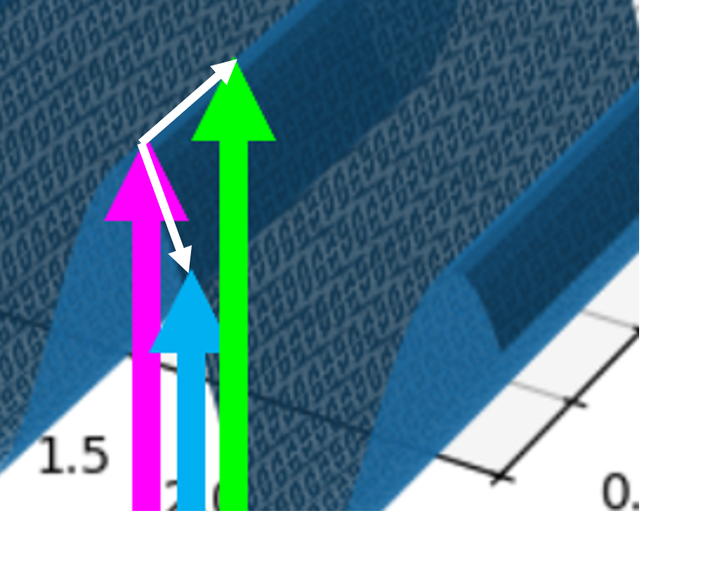
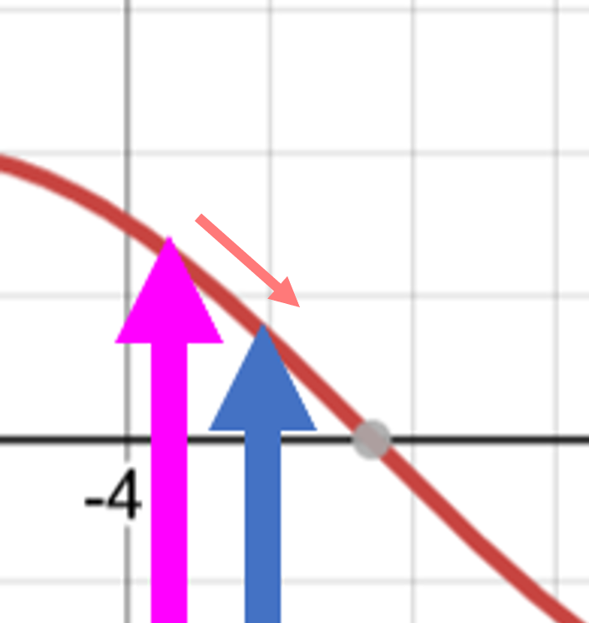
Using the cross product, we can create the normal

Slide 14
This class
Finite Differencing
Bloom
Ambient Occlusion
Lab

Slide 15
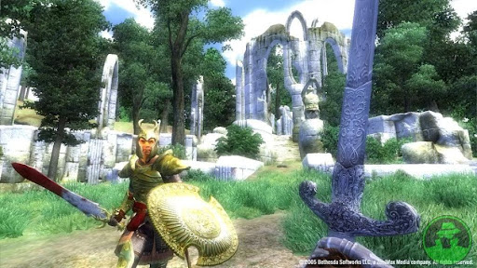
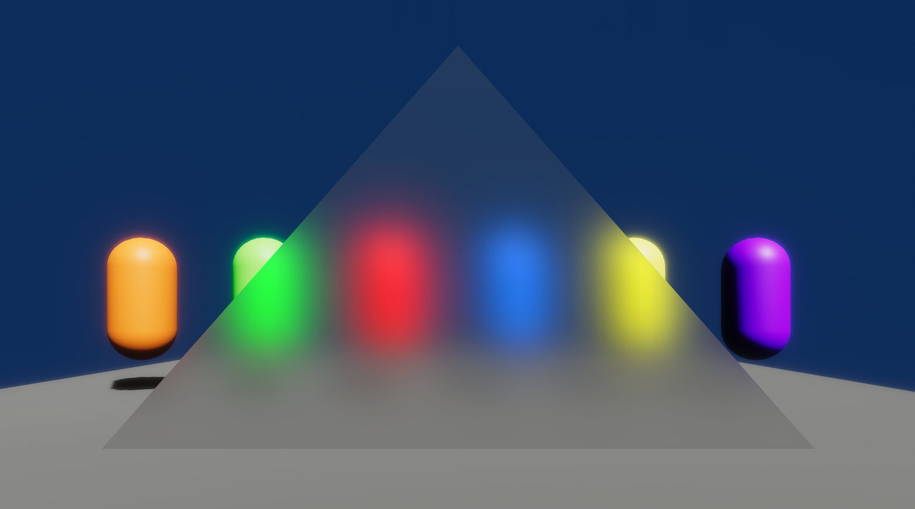
Bloom
Emphasizes bright areas by “bleeding” into neighbouring pixels
We use a blur
Opposite idea: gather pixels around us (why do we need to do the opposite

Slide 16
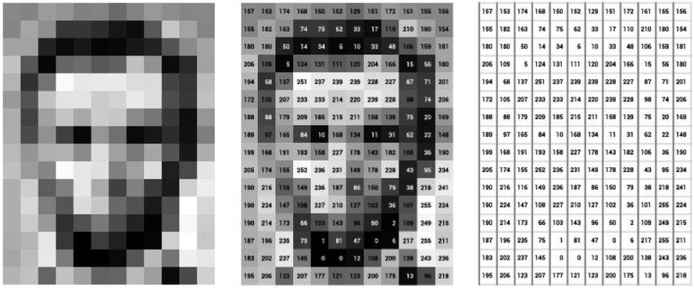
Image as matrix

Slide 17
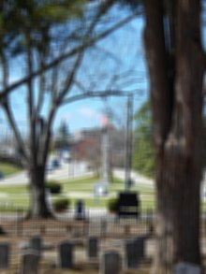
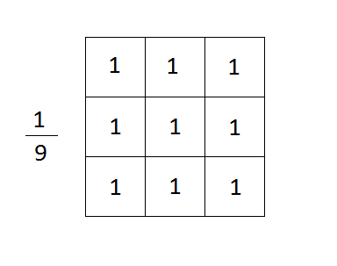
Blur as a matrix
Center pixel is the pixel we’re working on
Number is weight (multiply)
Add them all together
Left term is normalization (so it doesn’t get brighter
The matrix is called a kernel (this is a box blur)

Slide 18
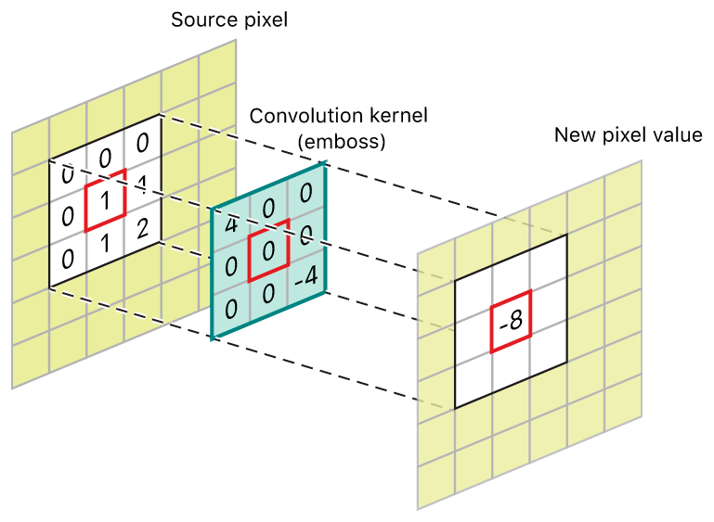
Convolution
Convolution is applying our kernel to the image
For each pixel
Sample the texture for each element in the kernel
Normalize

Slide 19
Box blur in code
fixed4 c = 0;
for (int y = -1; y < 2; ++y)
{
for (int x = -1; x < 2; ++y)
{
float2 uv = IN.uv_MainTex;
uv.x += pixelSize * x;
uv.y += pixelSize * y;
c += tex2D (_MainTex, uv);
}
}
c /= 9;

Slide 20
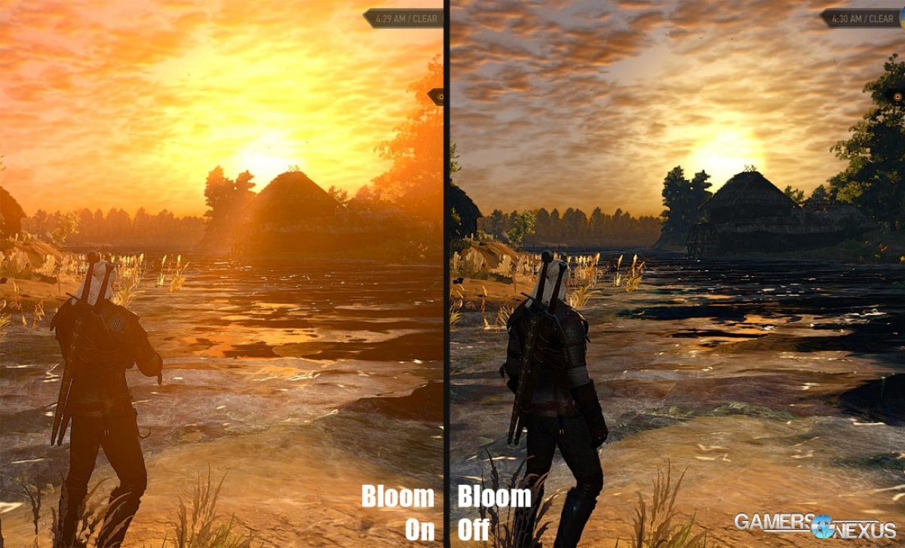
Bloom
Want to blur very bright values
But keep everything else sharp

Slide 21
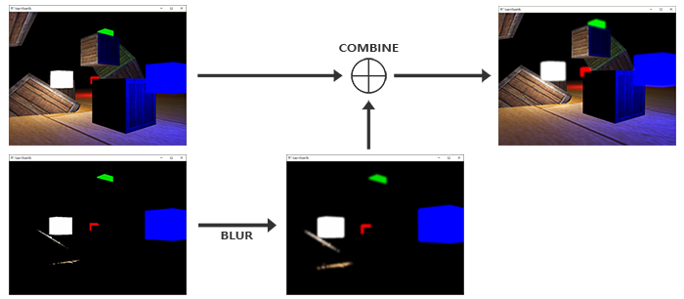
Visually

Slide 22
Fixed
fixed4 c = 0;
int weight = 0;
for (int y = -1; y < 2; ++y)
{
for (int x = -1; x < 2; ++y)
{
float2 uv = IN.uv_MainTex;
uv.x += pixelSize * x;
uv.y += pixelSize * y;
float4 temp = tex2D (_MainTex, uv);
//only blur bright pixels
if (dot(temp.xyz, float3(0.3, 0.59, 0.11) > 10 ||
x == 0 && y == 0)
{
weight += 1;
c += temp;
}
}
}
c /= 9;

Slide 23
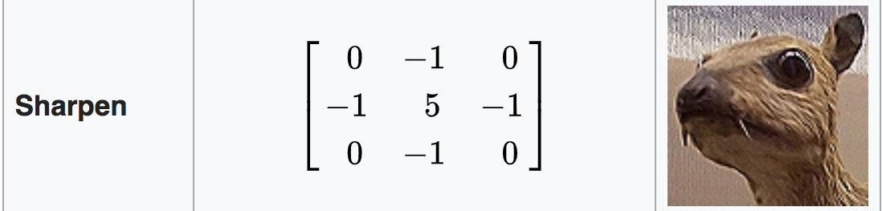
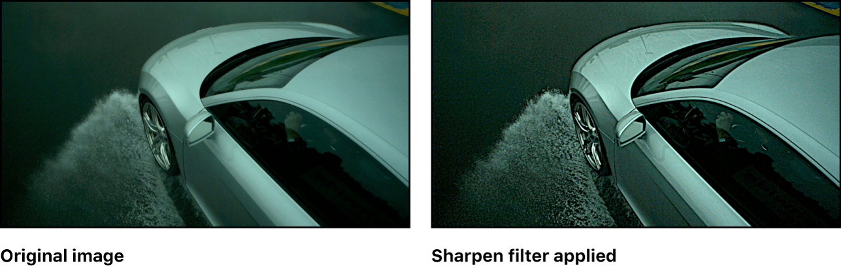
Many effects are achieved by using a kernel

Slide 24
Note that our blur is very basic
Realistically:
Not 3x3
Not the same value everywhere (eg Gaussian)
Tricks to make it fast

Slide 25
This class
Finite Differencing
Bloom
Ambient Occlusion
Lab

Slide 26
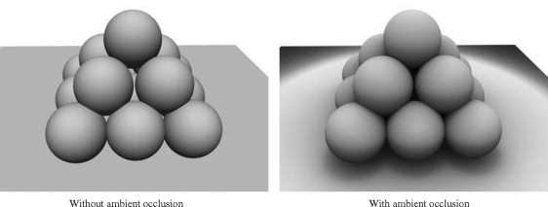
Problem
What problems on the left do you see fixed on the right?

Slide 27
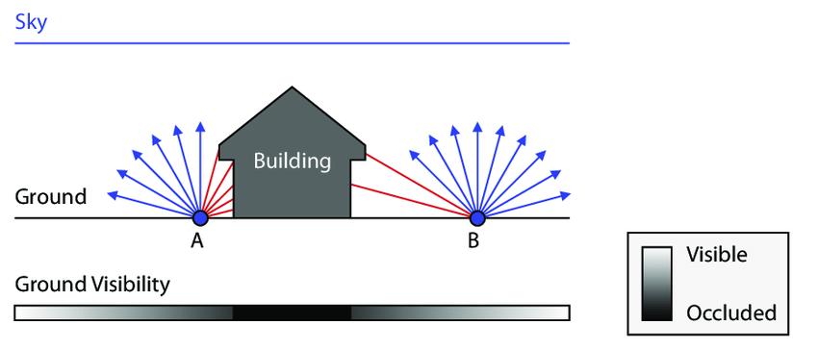
Ambient occlusion simulates how difficult light reaches an are (not shadows)

Slide 28
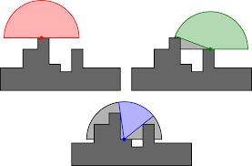
Per pixel operation, uses the depth buffer

Slide 29
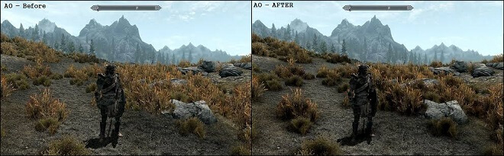
Results

Slide 30
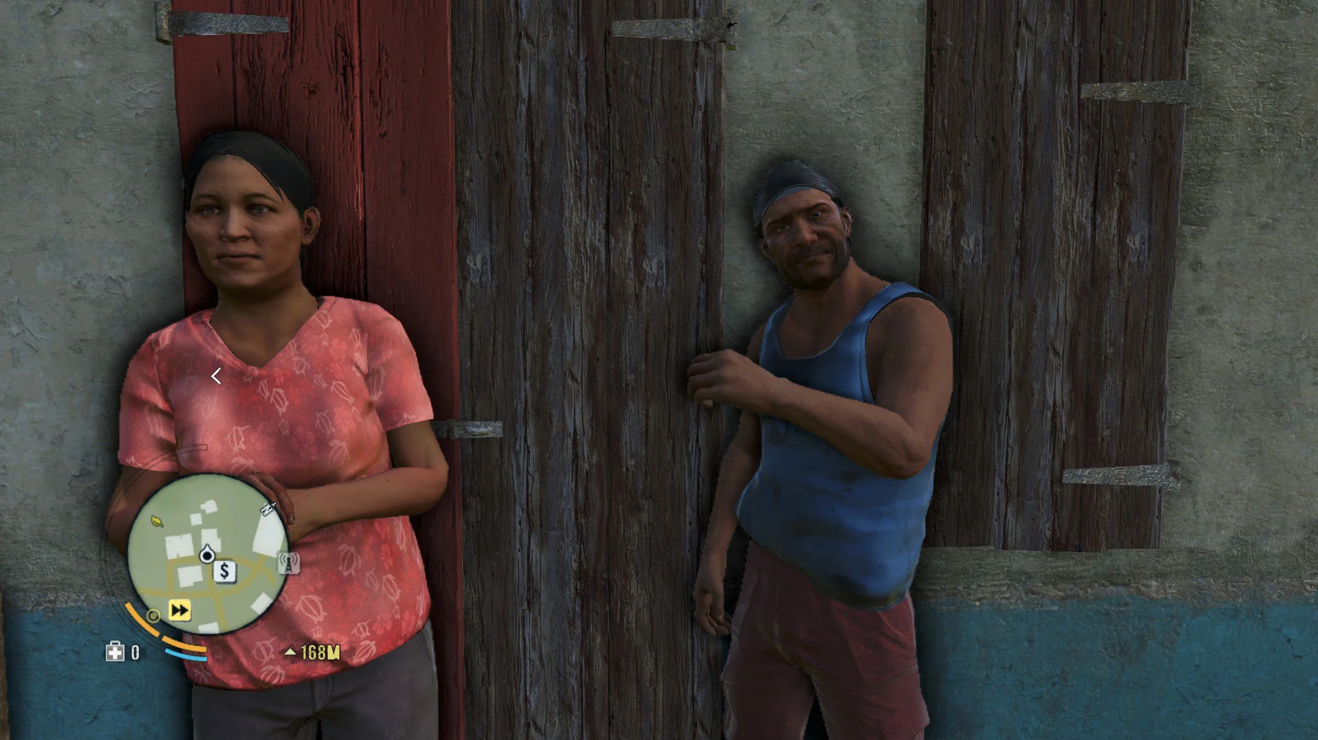
Bad results

Slide 31
This class
Finite Differencing
Bloom
Ambient Occlusion
Lab

