Slide 1
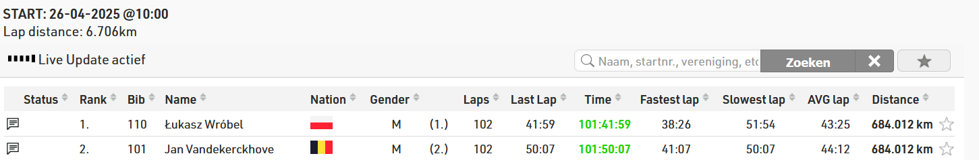
DE + AR
2025
Week 10b: Postprocessing

Slide 2
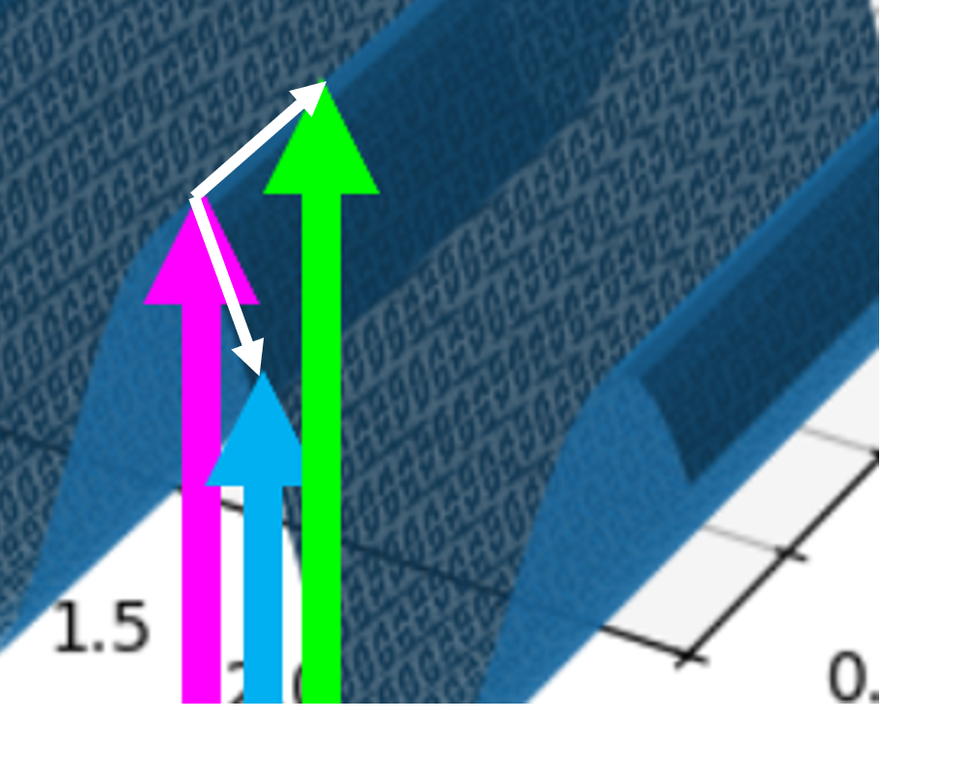
Last class: Finite differencing

Slide 3

Course schedule
 | Mon | Wed
Week 1 |  | Introduction
Week 2 |  | 3D reasoning
Week 3 |  | Geometry
Week 4 |  | Pipeline & Materials
Week 5 |  | Proceduralism
Week 6 |  | Textures & Normal maps
Week 7 |  | Aliasing / Presentations
Week 8 | Lab | Advanced pipeline 1 Lab
Week 9 | Lights, shadows, camera’s, primary visibility Lab | Forward rendering Lab
Week 10 | Deferred rendering / lab | Post processing / lab
Week 11 | Bonus | Quiz
Week Rev |  | Revision
I’m not sure what to teach on Monday
What are your struggles in the project?
I probably can find a topic that reinforces a lot of what you need to know
Or we can revise a topic deeply
Tell me!

Slide 4
This class
Project questions
Quiz
Lab

Slide 5
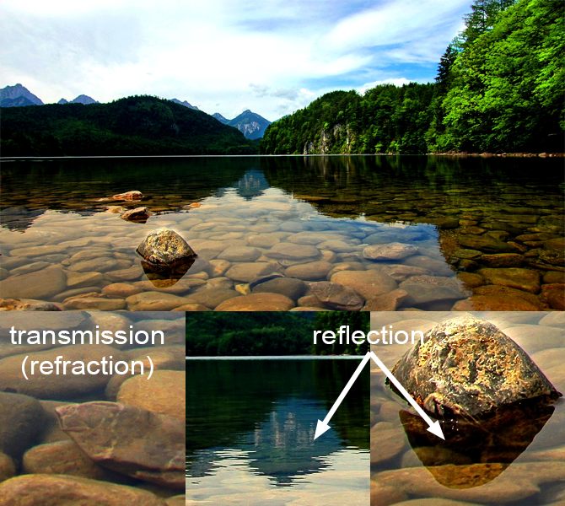
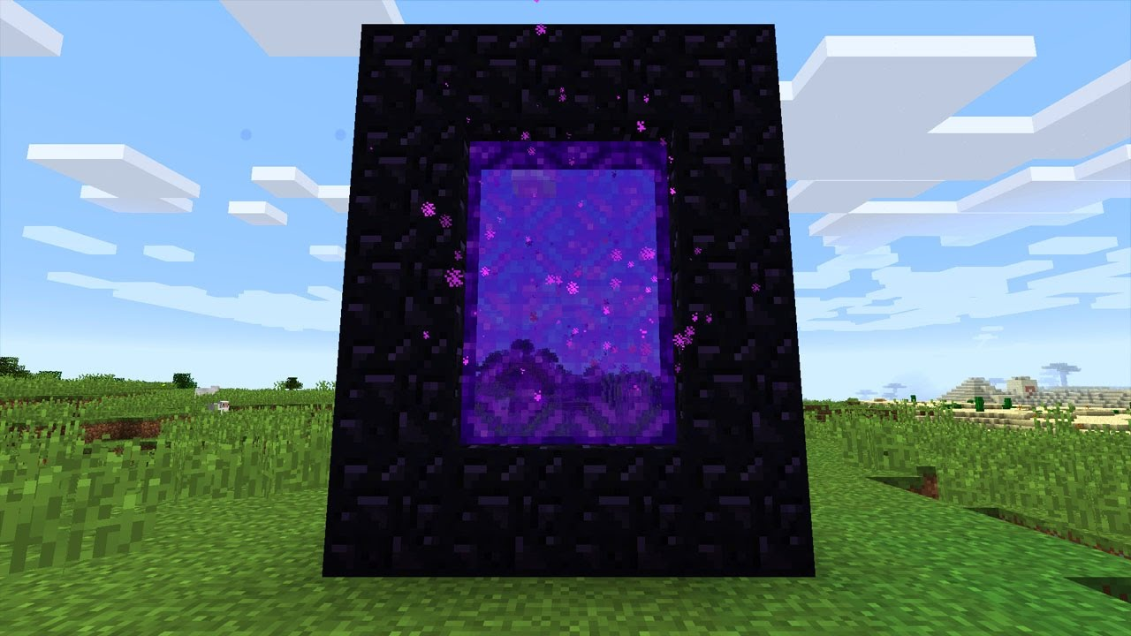
How do you know it looks correct?

Slide 6
This class
Project questions
Quiz
Lab

Slide 7
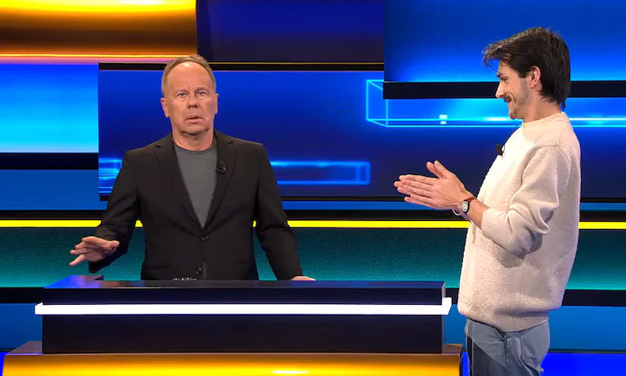
Quiz time!

Slide 8
This class
Project questions
Quiz
Lab

