Slide 1
2024
Week 1 : Introduction

Slide 2
I’m very happy you’re here
I really like 3d graphics
It’s a very satisfying topic
We got a lot of class hours
We have very few class hours ☹

Slide 3
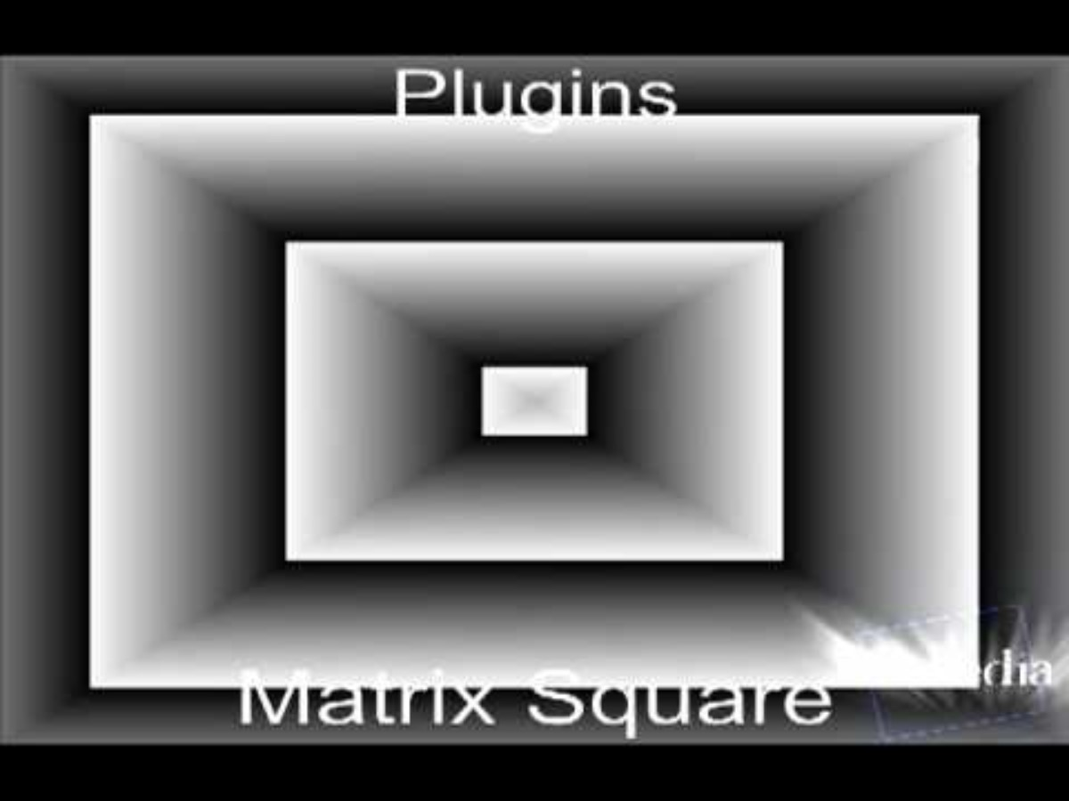
I really like 3d graphics
Tried to get into 3d in my last year at UCLL
Worked on video servers in first jobs
Mostly games after
2 patents in something I explain week… 6?

Slide 4
It’s a very satisfying topic
Not that much indirection between your code and result
Instant feedback
If it works, it works tens of millions of time per second
Allows you to understand what you already experience (eg games, movies)

Slide 5
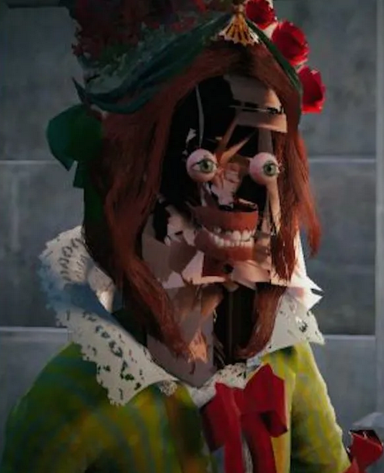
We have very few class hours ☹
Last year we had 40
This year we have half
I’m very unhappy about this
No labs in person
Certain topics will be self-directed
Focus on important theory in class
Address common questions from self-study

Slide 6
This class
Contents of this course
Evaluation of this course
Some bureaucracy
Get our hands dirty with Unity

Slide 7
Contents of this course
What are you all hoping to learn in this course? Let’s see what we’re going to learn…
Notes:
Here are a few things students often think we’ll see, but isn’t in this course:
Modeling (eg blender) or texturing (photoshop). We’re technical people, we’ll deal with these assests (“art pieces”, things like 3d models and images), but we won’t be creating them in an artistic way
Game programming: what we’re doing is very close (and you can do this fulltime in a game studio), but we’re only looking at graphics.
Unity / other game engine. We’ll be using Unity. I’ll be using it as little as possible, as I want to focus on learning how to do things by doing things yourself. But you’ll have to learn quite a bit of Unity specific things on the way.
What *is* in the course, is what’s in coming in this class ☺

Slide 8
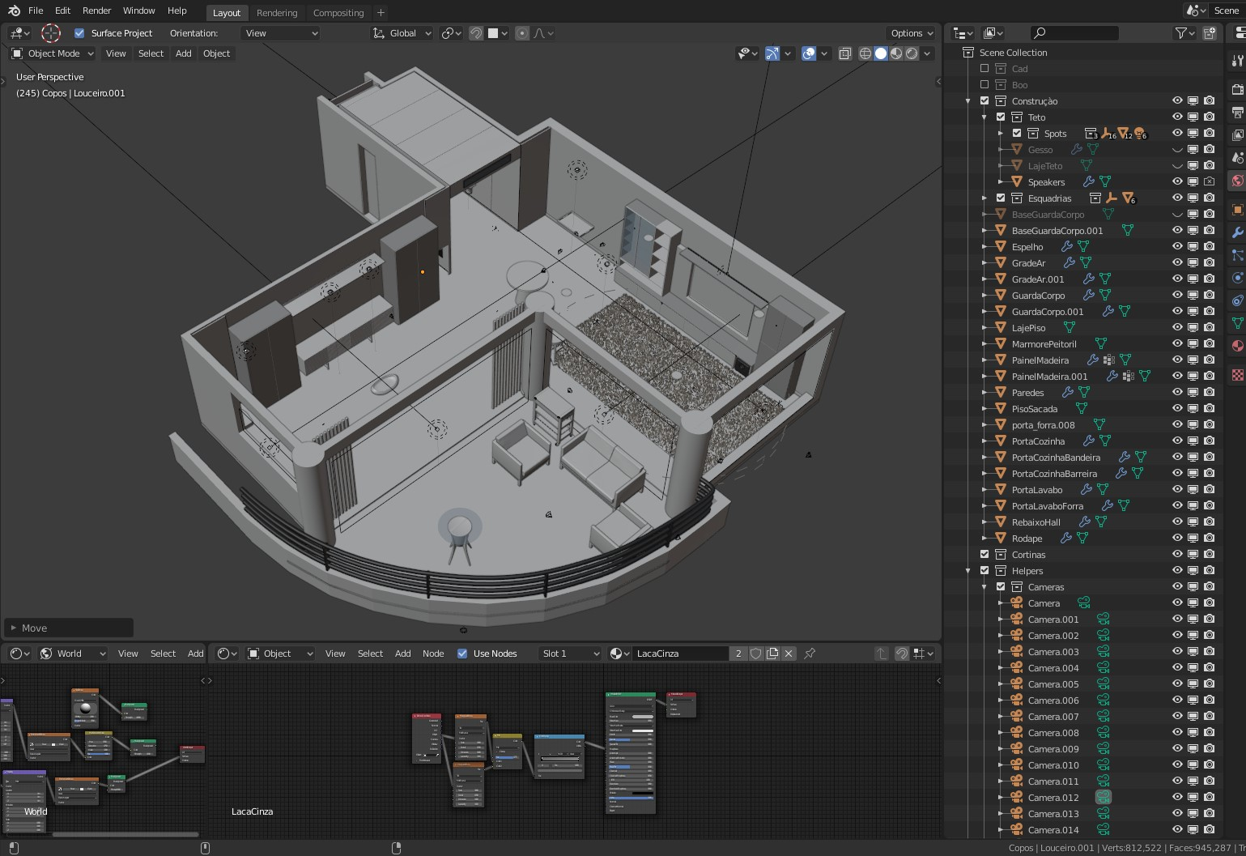
What are “3D graphics”?
“Images representing a 3d scene created by transforming 3d models and textures using algorithms”
This is not *the* definition, this is my definition
It’s a badly defined term

Slide 9
Creating 3D graphics
We need to create 3D models : 3D modeling
We need to create textures : Texturing
We need to create a scene : World Building
We need to transform them into an image : ??? Does anyone know the term ???

Slide 10

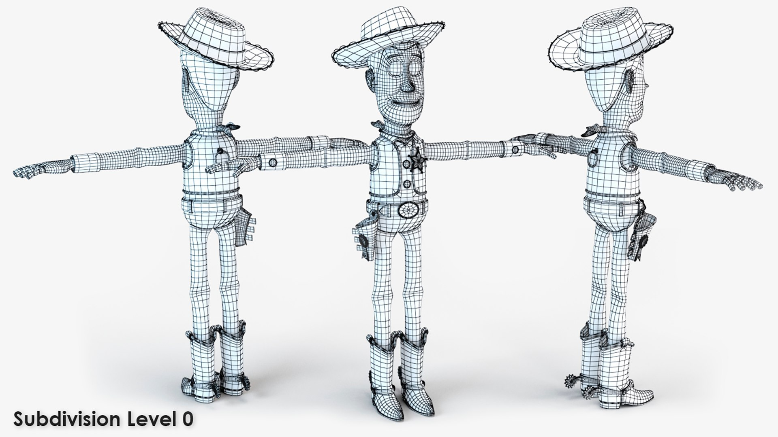
This course should be called 3D rendering
Rendering : creating an image, based on a description of a scene, using algorithms
Description is models, textures, animations, camera settings… and a bunch of other stuff
“graphics programming” would also be a good name for this course

Slide 11

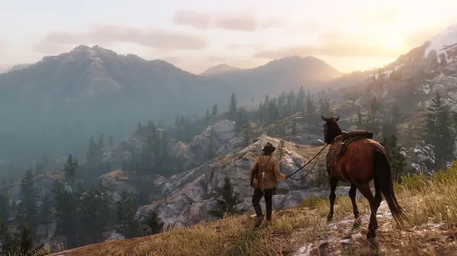
There are two kinds of rendering
Does anyone know the difference?

Slide 12
There are two kinds of rendering
Movie
Game

Slide 13
There are two kinds of rendering
Game Do calculations continuously
Why?
Offline rendering Do calculations once
Notes:
Because we need to react to user input. For example, in a modern game the player can move the camera at any time. We need to create a new image to display in about 30 ms (milliseconds). Movies never change, so we can spend much longer creating an image.

Slide 14
There are two kinds of rendering
(offline) rendering
Realtime rendering
Notes:
Offline: up to hundreds of hours can be spend on rendering a single image
Realtime 10-30 ms are spend rendering an image

Slide 15
What is the big difference?
How long do we have to render the frame? Assume we’re rendering 60 frames per second (fps)

Slide 16
What is the big difference?
60 frames per second
1 second / 60
16.6 ms per frame
Notes:
We usually think in ms as programmers, not frames per second. A simple example explains why:
Say we have a piece of code that takes 2 milliseconds. The rest of the rendering takes 18 milliseconds
Before optimization 2ms + 18ms = 20ms = 50 fps
After optimization: 1ms + 18ms = 19ms = 52.6 fps
So we are 1ms faster in time, and we ‘won’ 2,6 frames
Let’s say we change a setting in the rest of the rendering, and it takes twice as long
Before optimization 2ms + 39ms = 41ms = 24,4 fps
After optimization: 1ms + 39ms = 40ms = 25,0 fps
We’re still 1ms faster in time, but we ‘won’ only 0.6 frames
Why is this important? Well, when we optimize, we need an objective starting point to compare against. It would be weird to use fps as a metric, as it can change due to the entire system being slower/faster, not just our algorithm
Long explanation, simple rule:
Use ms when optimizing
Use FPS when talking about user experience (eg too slow to play)

Slide 17
What is the big difference?
How long do we have to render the frame?
Movies display at least 24 fps

Slide 18
What is the big difference?
How long do we have to render the frame?
Movies display at least 24 fps

Slide 19
Trick question! It doesn’t matter
We only need to render once (no user input)
Anecdotally, about 80-400 hours on a single pc for one frame, but is always rendered on a farm

Slide 20
This course should be called “realtime 3D rendering”
We need to learn how to make 3D images
We need to use the graphics card (GPU) to do it fast enough
Notes:
The most common number for ‘realtime’ is 30 frames per second. This means rendering is fast enough that a user doesn’t notice the image is made out of separate frames (it’s fluid).
Another term is ‘interactive’, usually somewhere 10-15fps This is enough time for a user to interact with the system (eg move the camera) and see it update (new image from new camera point) fast enough to not be annoying/unnatural. This is what you really should hit when doing a professional app (eg if you’re making something like blender.
Most games *have* to hit 30 fps to be allowed to be sold on consoles (most of the time anyway), but 60 fps is becoming more common.
VR is often quoted on having at least 90fps as a bare minimum to avoid nausea, but there’s a ton of interesting magic happening behind the scenes that that doesn’t translate to the frames you see through the headset

Slide 21

Course schedule
 | Monday | Thursday
Week 1 : 12/02 | Introduction | C#/Unity Lab
Week 2 : 19/02 | 3D reasoning | 3D Lab
Week 3 : 26/02 | Basic Pipeline | Lab
Week 4 : 04/03 | Textures Normal maps | Post processing / lab
Week 5 : 11/03 | Camera’s Light | lab
Week 6 : 18/03 | Advanced pipeline | Advanced pipeline lab
Week 7 : 25/03 | Materials Aliasing | Materials Lab
Week 8 : 15/04 | Procedural generation | Procedural generation lab
Week 9 : 22/04 | Project explanation | Project lab
Week 10 : 29/04 | Guest Lecture Project Labs | Guest Lecture Project Labs
Week 11 : | Revision | Revision
This was last year ☹
Still need to think about this

Slide 22
This might not make a lot of sense yet
We’ll do some hands one things with Unity this class and (hopefully) it will start to make more sense
Unfortunately, this will be true of this course as well. Rendering is a lot of simple separate parts, that only make sence once you can make the connections
Some connections are hidden within unity ☹

Slide 23
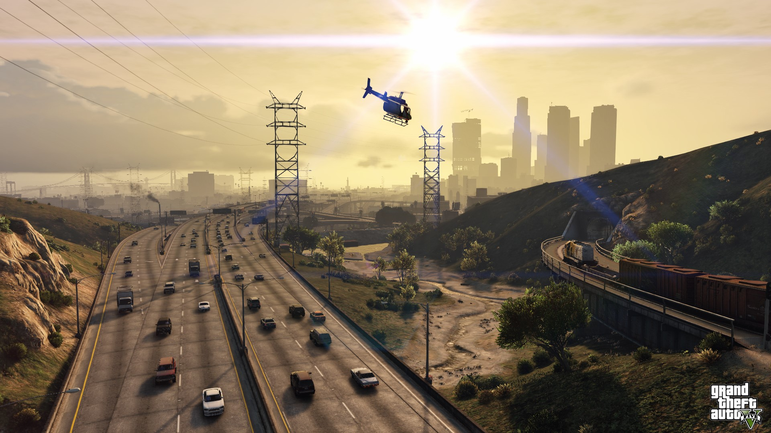
Reframe: we want to understand why a pixel has it’s color
Notes:
If we understand how an existing games calculates what color a pixel is, we’ll have learned everything we need to learn in this course
The fact that we’re doing it in Unity is actually not *that* important, most of the knowledge we have is transferable to any engine

Slide 24
What questions do you have?

Slide 25
This class
Contents of this course
→ Evaluation of this course ←
Some bureaucracy
Get our hands dirty with Unity

Slide 26
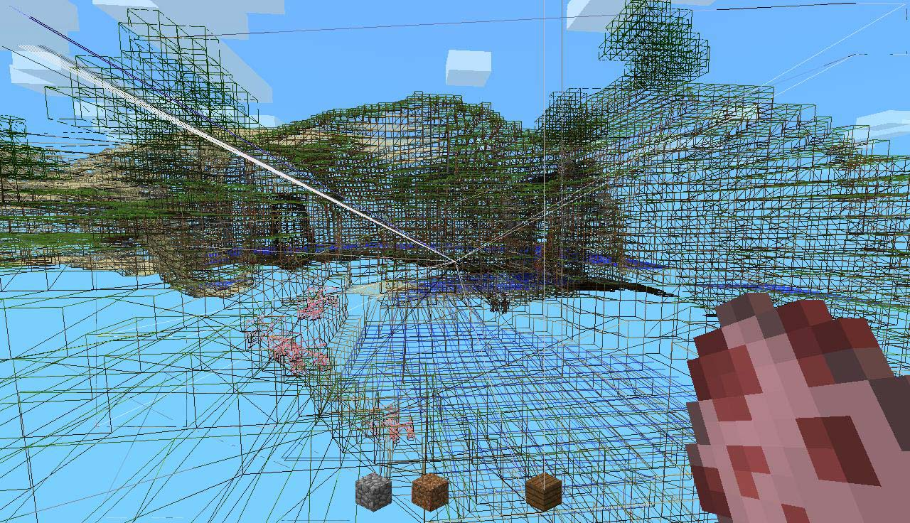
Evaluation of this course
20 points on the oral exam
Defend your project (Minecraft-like)
Also defend it theoretically
It’s not going to be very different from DAML except you have more time for your project except the theory questions are used in your project

Slide 27
Project
Minecraft-like
Not a group project
Implement infinite terrain
Implement visual effects
Optimize
…. And more….

Slide 28
Is that clear? Any concerns?

Slide 29
This class
Contents of this course
Evaluation of this course
→ Some bureaucracy ←
Get our hands dirty with Unity

Slide 30
Questions
Just put up your hand

Slide 31

Contacting me : send me an email!
I usually respond in 3 or 4 working
I might miss you on Toledo or Teams, just send me an email
I never get enough emails from my students
Write me in English or Dutch

Slide 32

Abscences
Class is not mandatory \o/
I *very strongly* recommend you come
This is a hard subject to learn remotely
Last year attendance was great, and so was pass rate

Slide 33

ChatGPT et al
Of course, you’re allowed to use ChatGPT to do your labs / project
ChatGPT and other LLM’s are not allowed during the exam
Use it to understand, not to make
I’ve used ChatGPT and it creates Unity code that…. I disagree with
I’ve seen students try to understand ChatGPT code I don’t understand
Use it in a smart way, or it will make you stupid
Notes:
The basic idea is… if you have to rely on chatgpt for your project or 3d graphics knowledge, I, as a professional in the field, might as well use chatgpt myself.
But I won’t. No matter how good the AI model, it’ll be trained on publicly available code/discussion, which, in this field, is mostly hobbyist code. This is in large part due to a lot of research happening in private institutions, and even public research rarely published.

Slide 34
This class
Contents of this course
Evaluation of this course
Some bureaucracy
→ Get our hands dirty with Unity ←

Slide 35
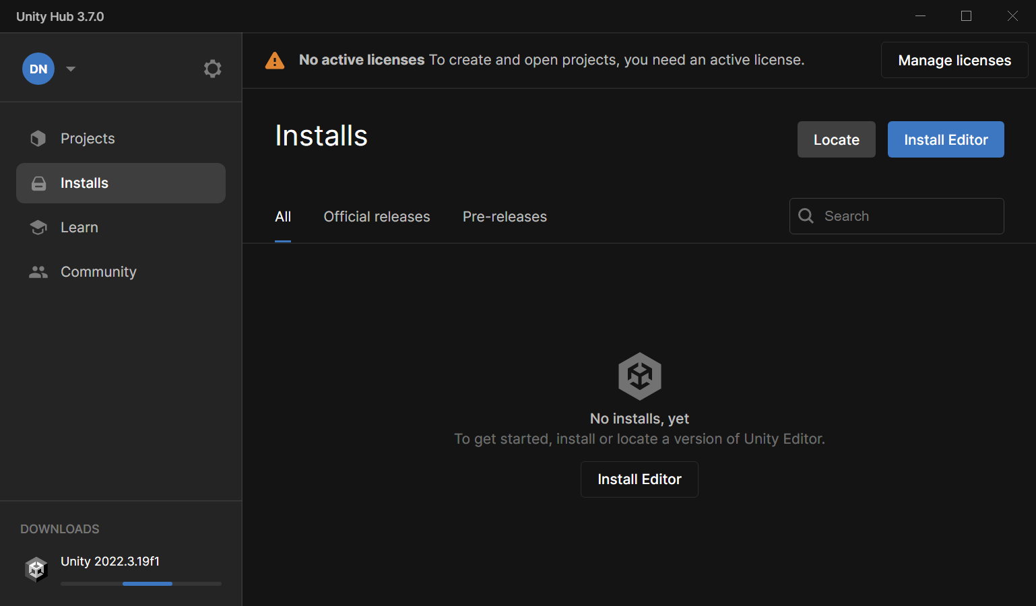
First install the following
Unity Hub : https://unity.com/download
Still need to install an engine! Open the hub, install what it suggests

Slide 36
What is Unity?
Unity is a “game engine”
Framework for interactive application (do you know any other than games?)
Provides API for rendering, physics, networking, AI, collision, etc….

Slide 37
Why Unity? Any ideas?

Slide 38
Why Unity?
Most popular game engine on the market
Easier to google problems (or ChatGPT ☹)
C# is a low barrier to entry (Unreal uses C++)
Useful for other courses

Slide 39
Why not Unity? Any ideas?

Slide 40
Why not Unity?
Closed source
Hides what we’re interested in
Has a lot of things we don’t need
Maybe we would like to do things ourself
Uncertain future
Notes:
By doing things ourself, it’s especially important when we’re learning. We can make very nice graphics in Unity without knowing how Unity does that. Unfortunately, for this course, this is exactly what we’re learning
By uncertain future I mean that there’s been some news of recent layoffs at Unity, and pricing changes that some people found excessive. That doesn’t really matter for us. For me Unity is widely used, and it uses C#. That makes it very attractive as a teaching tool.

Slide 41
What do we need to learn
Unity Editor
C#
HLSL

Slide 42
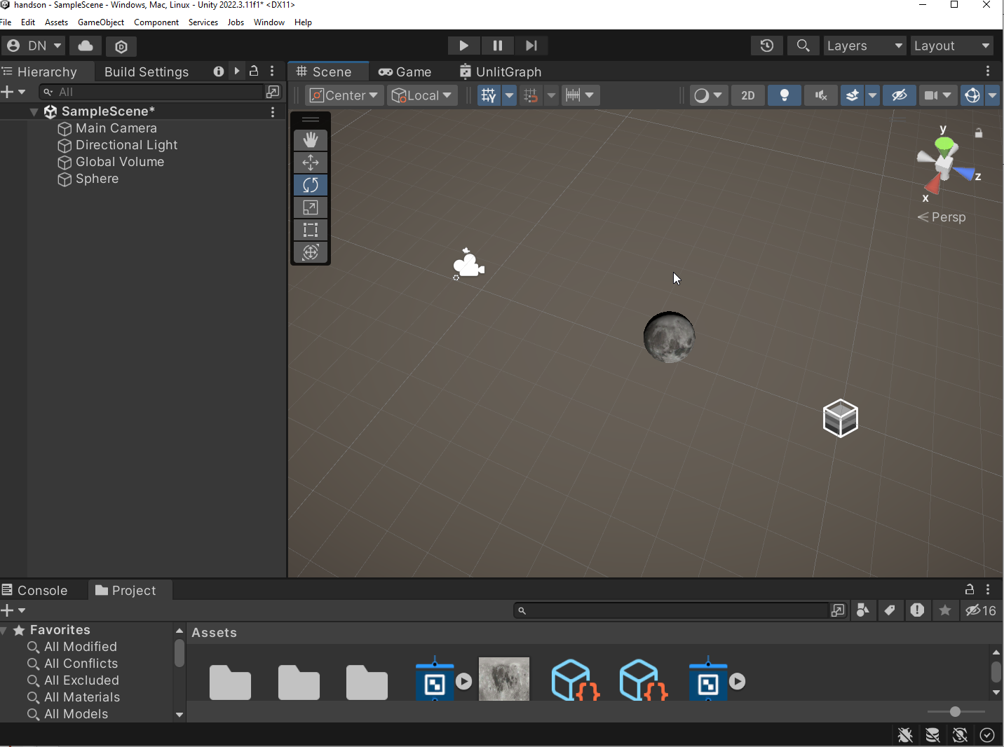
1 Unity Editor
Lot’s of buttons ☹
Artist focused ☹

Slide 43
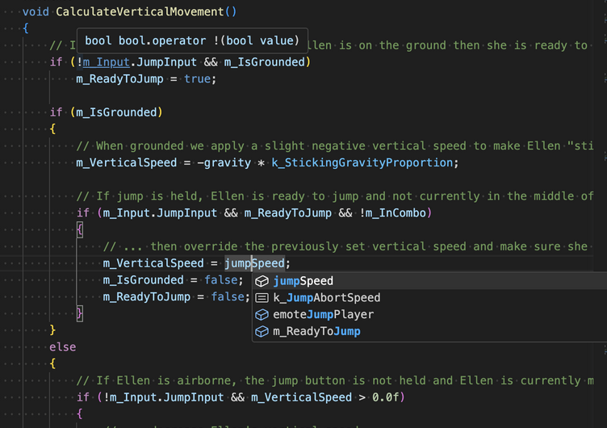
2 C#
Used by Unity for CPU scripting
Very useful language to know
Looks a lot like Java

Slide 44
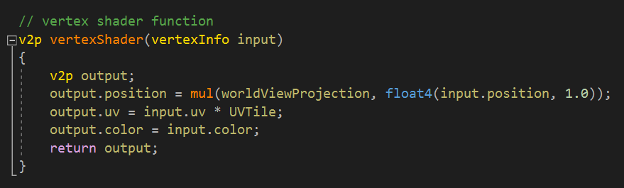
3 HLSL
GPU programming language
No oop ☺
Lots of support for math

Slide 45
The next hour-ish
We’re going to do an experiment
We’re going to implement a “material” (how something looks) in Unity
We want to see if we can render a blue sphere
We’re going to introduce a lot of terms fast
Don’t worry! Will come back in detail in class
This is an exercise to show you (a lot of) what we’re going to see

Slide 46
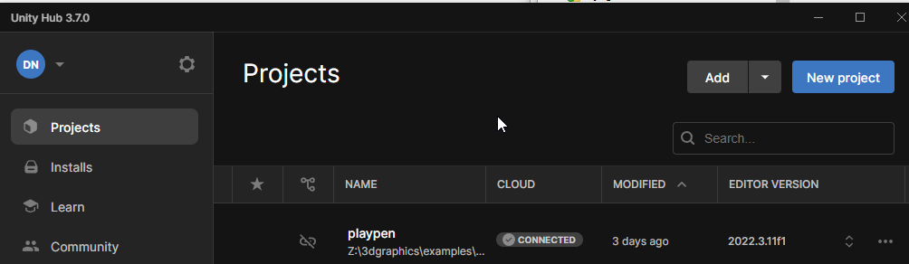
1 : Create a new project

Slide 47
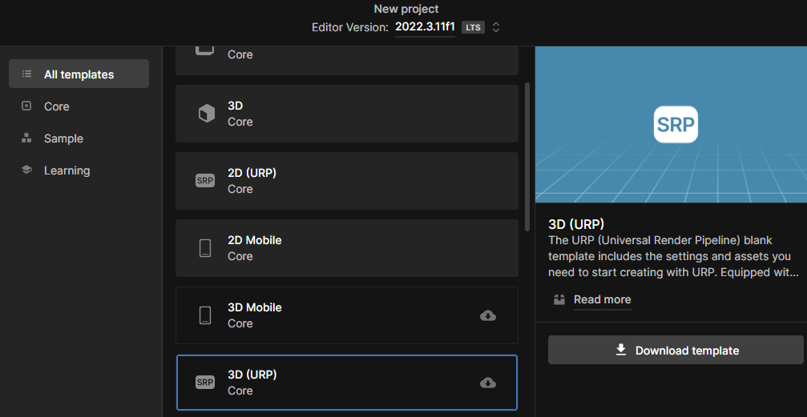
2. Choose 3D (URP), download template

Slide 48
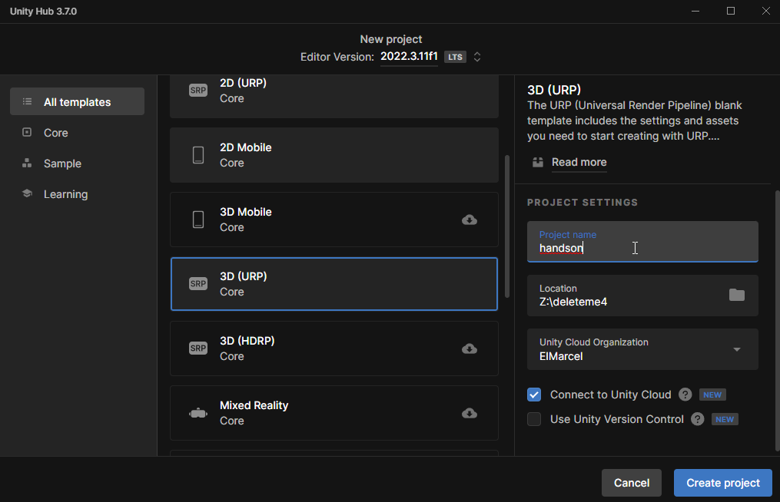
3 Actually create the project
Location doesn’t matter
We won’t use this project after this class
Not a cloud drive (like OneDrive)!

Slide 49
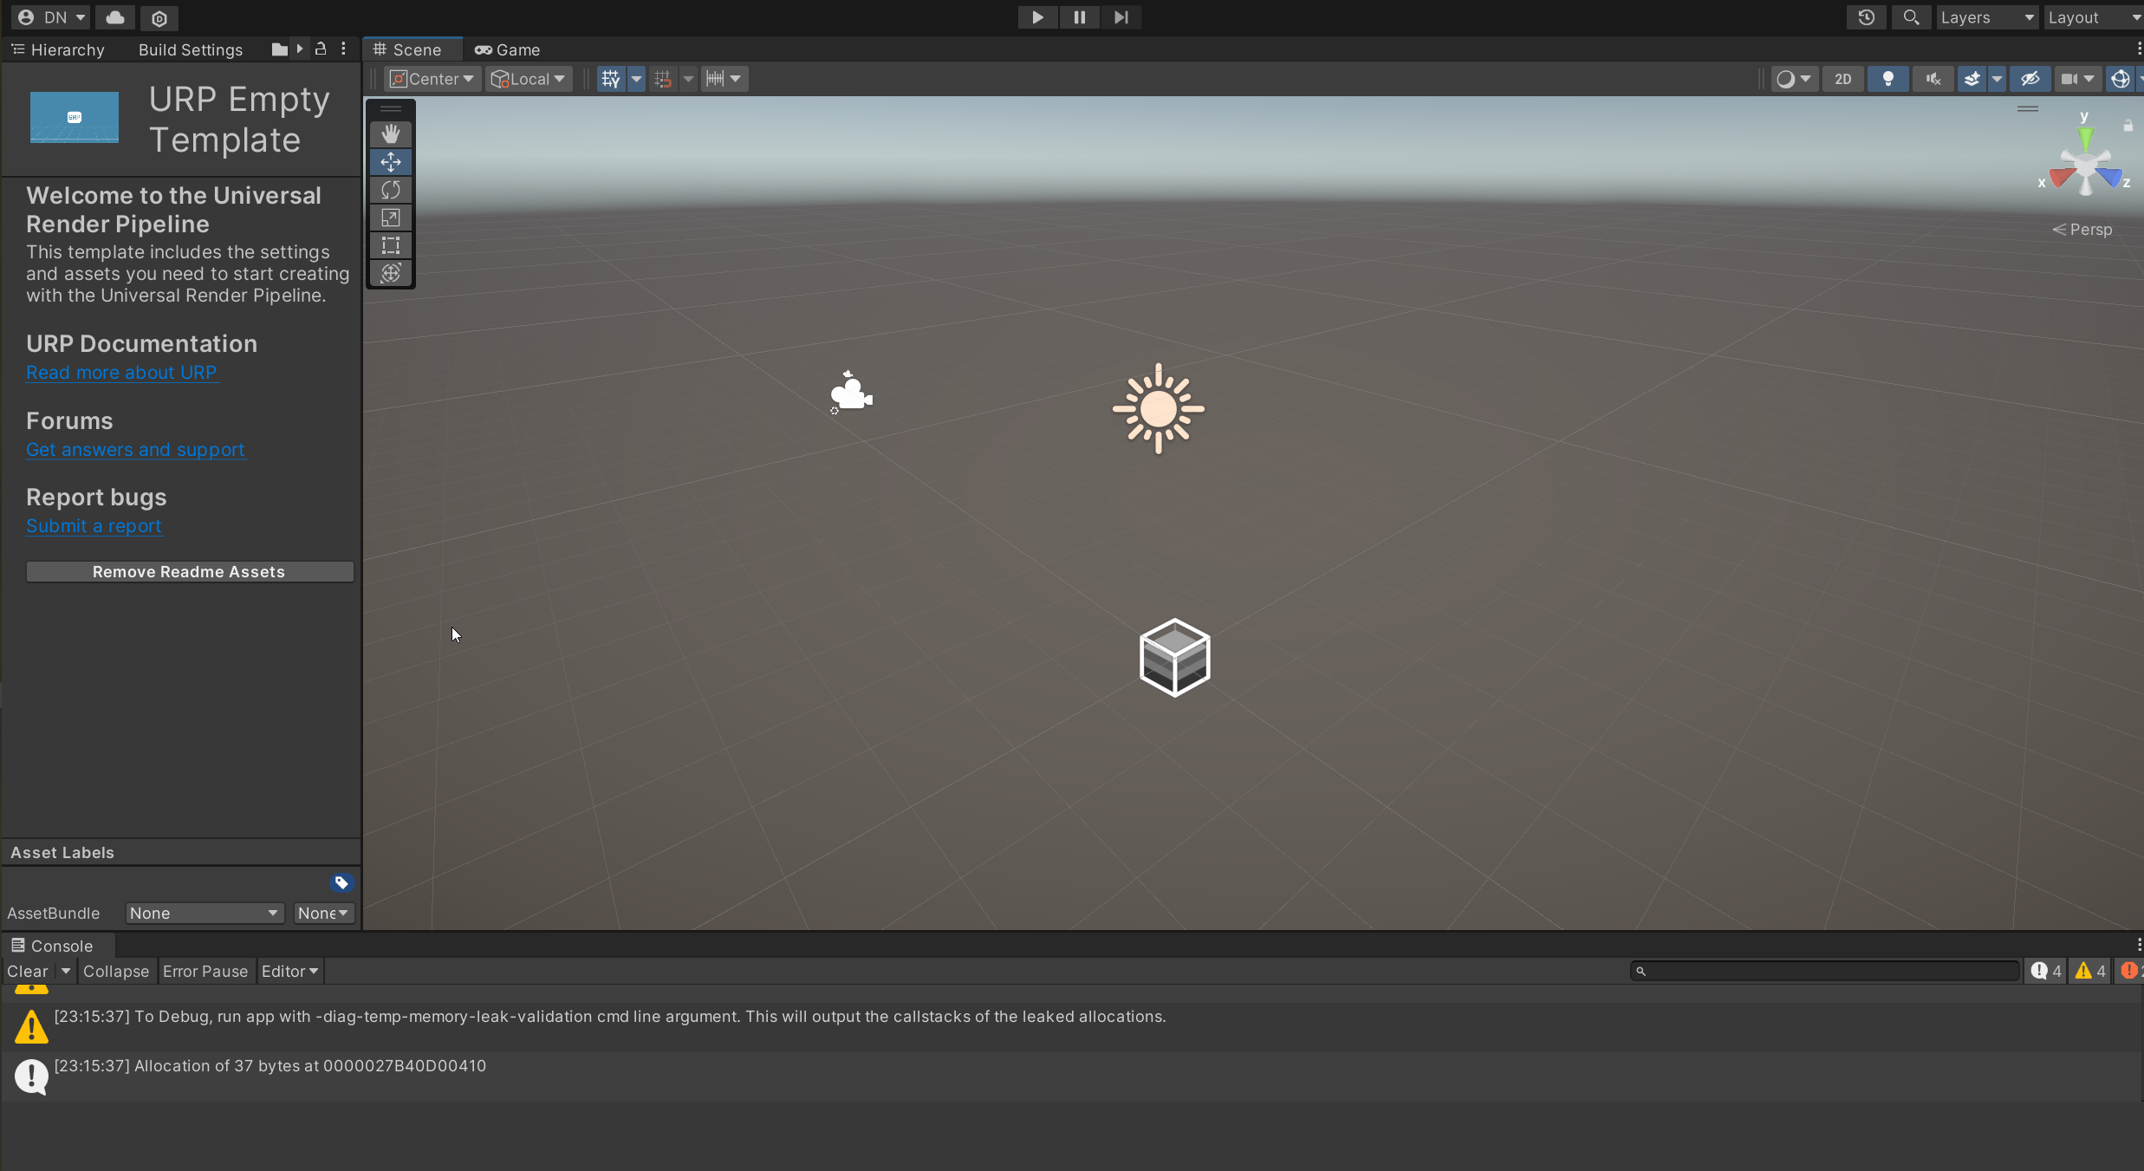
4 Check that you see this, and try to move around
RMB to rotate the camera
MMB to pan the camera
Scrollwheel to zoom

Slide 50
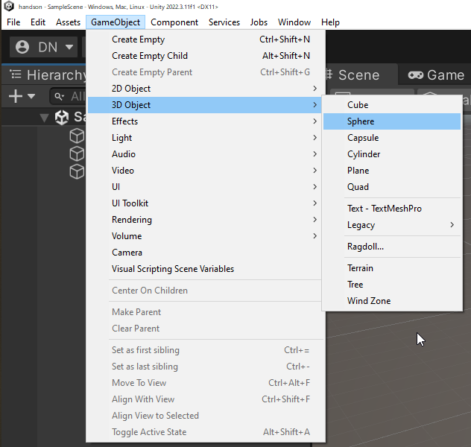
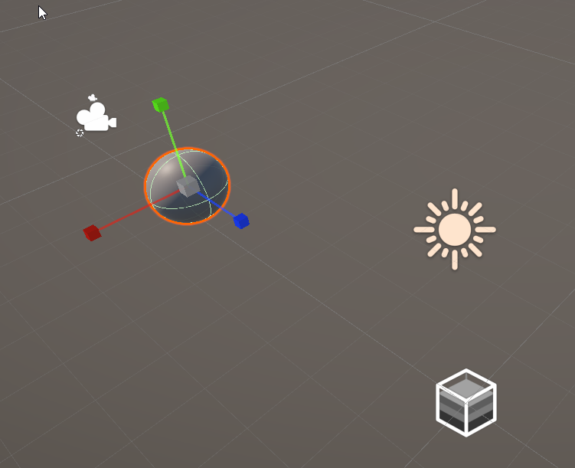
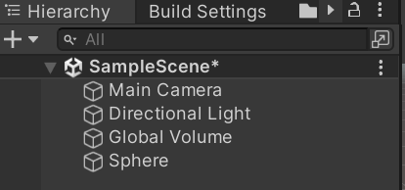
5 Add a sphere to the world

Slide 51
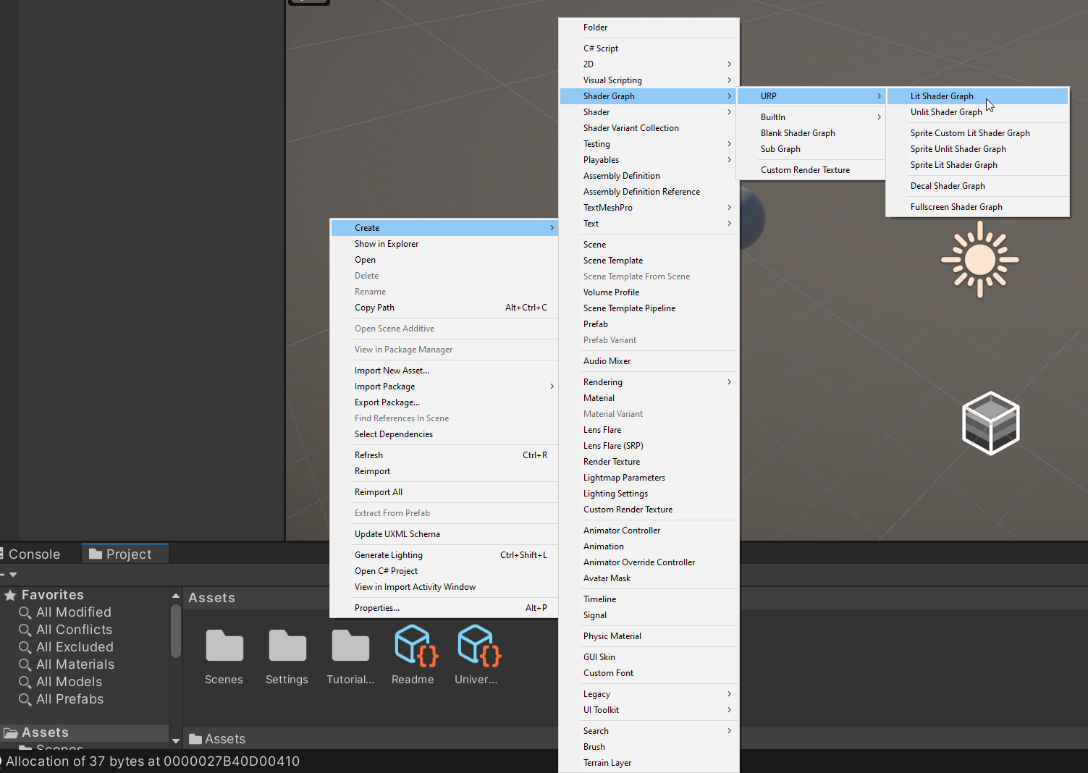
6 Right click in project window, Create->Shader Graph->URP->Lit Shader Graph

Slide 52
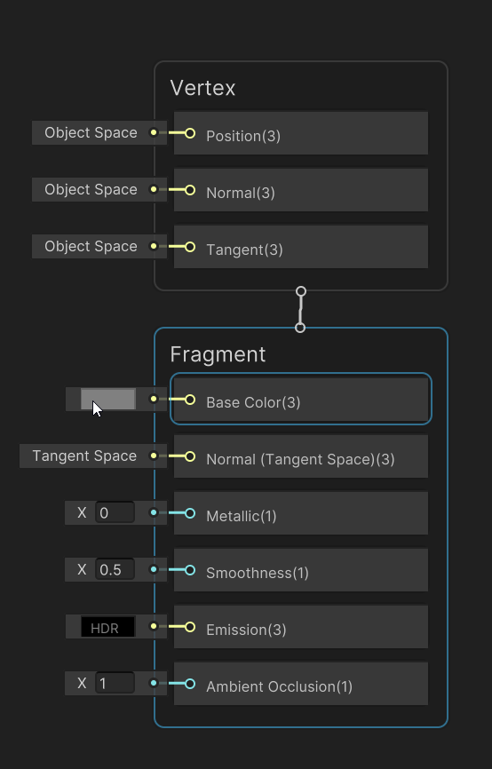
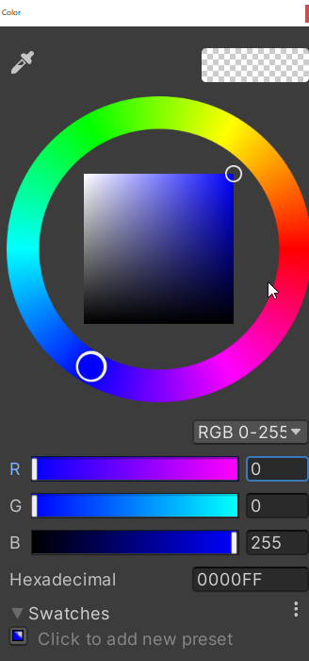
7 Click the box next to “Base Color”, and pick blue

Slide 53
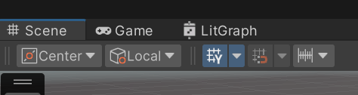
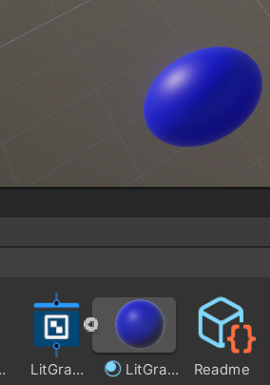

8 Go back to scene view. Click arrow next to graph, and drag that (material) on the scene sphere

Slide 54
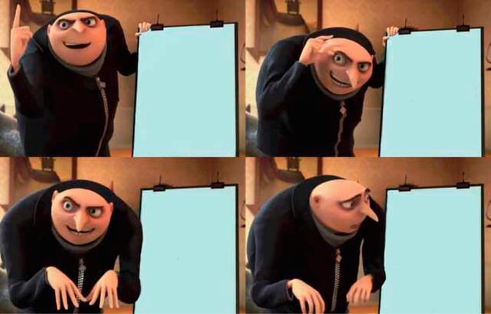

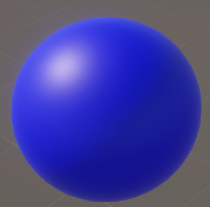
9 Victory?

Slide 55
What is the difference between these two?

Slide 56
This is a sphere that is pure blue

Slide 57
This is a blue sphere, lit by a light

Slide 58
We are going to learn how to make the lit one
By ourself
This is an example of Unity being helpful (we don’t need to know)
But it’s unhelpful (we want to learn how it to do it)

Slide 59
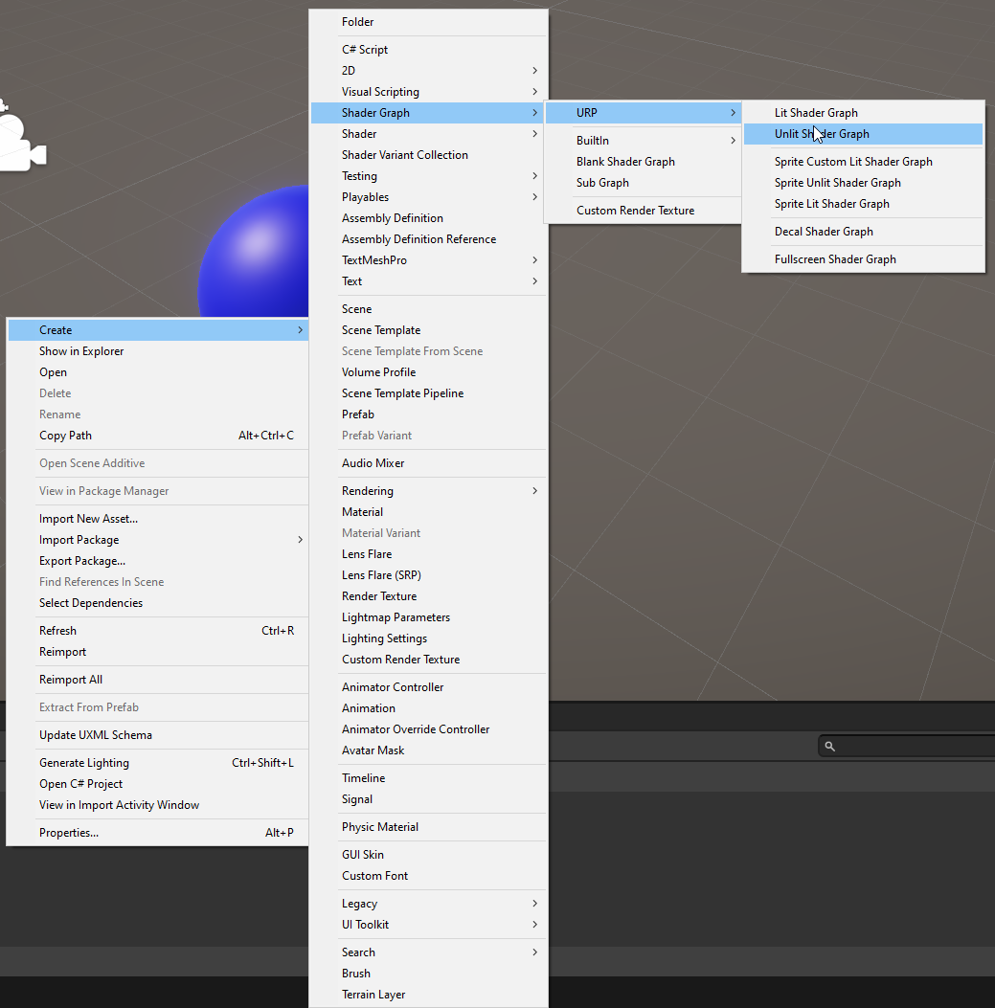
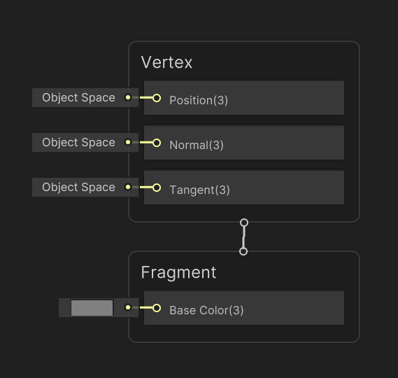
10 Right click in project window, Create->Shader Graph->URP->Unlit Shader Graph

Slide 60
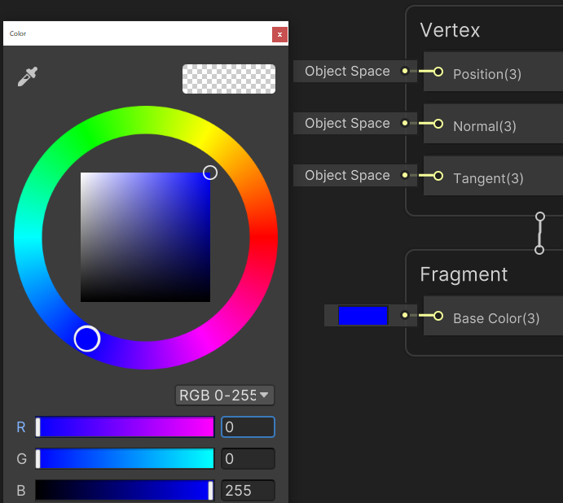
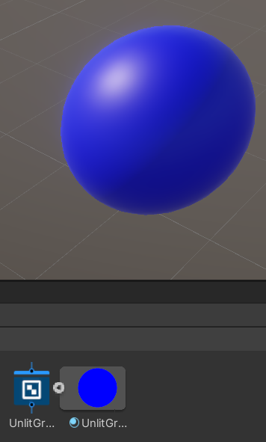
11 Set base color to blue, SAVE, apply the material

Slide 61

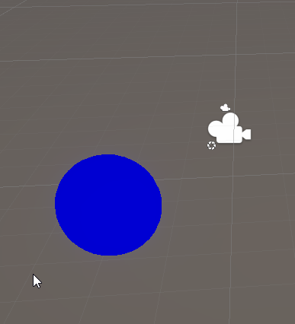
12 Check your results in Scene View

Slide 62
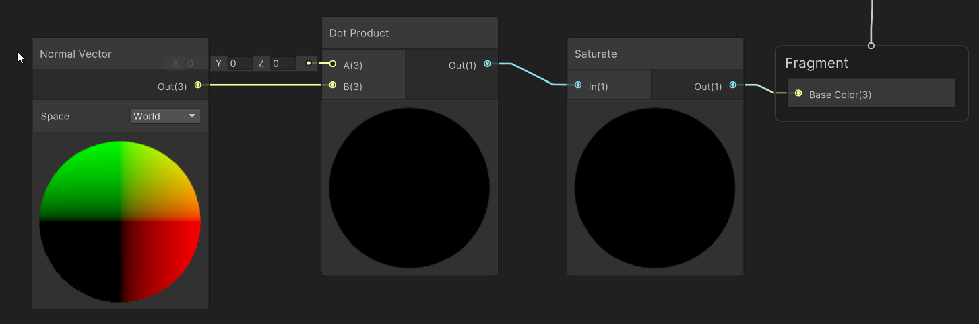
13 Start adding nodes to your graph On graph: right click, create node
Create a Saturate node, connect its output to Base Color’s input
Create a Dot Product node, connect its output to Saturate’s input
Create a Normal Vector node, connect it’s ouptup to Dot Product’s input

Slide 63
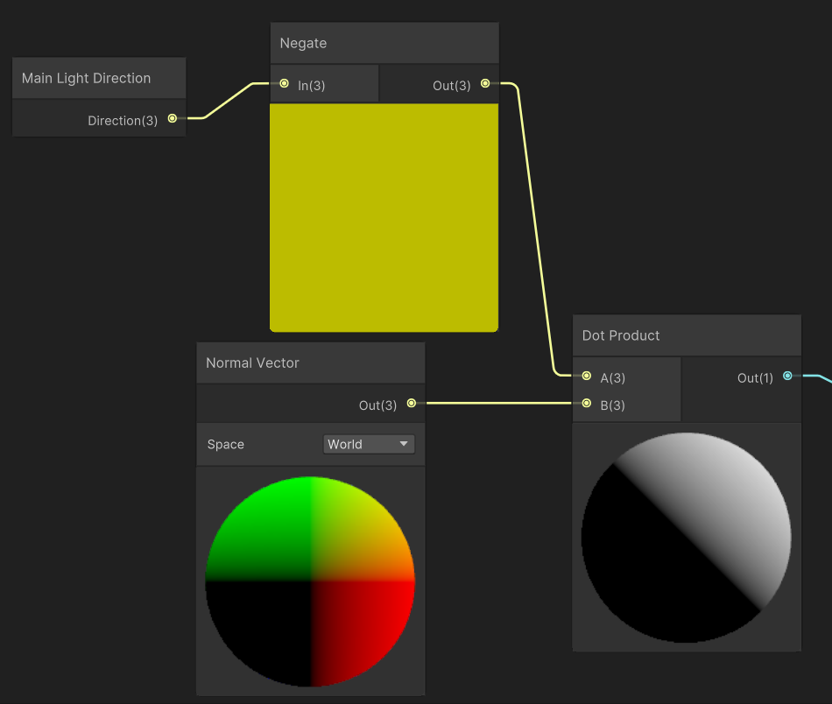
14 Continue adding nodes to your graph
Create a Negate node
Connect it to Dot Product’s free input
Create a Main Light Direction node
Connect it to Negate’s input

Slide 64
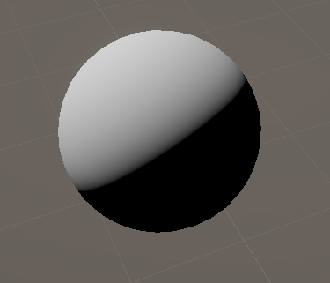
15 Save your graph and check your results

Slide 65
This looks very interesting!
Does this look like something you know?
If you think your answer is ridiculous, it might be correct

Slide 66
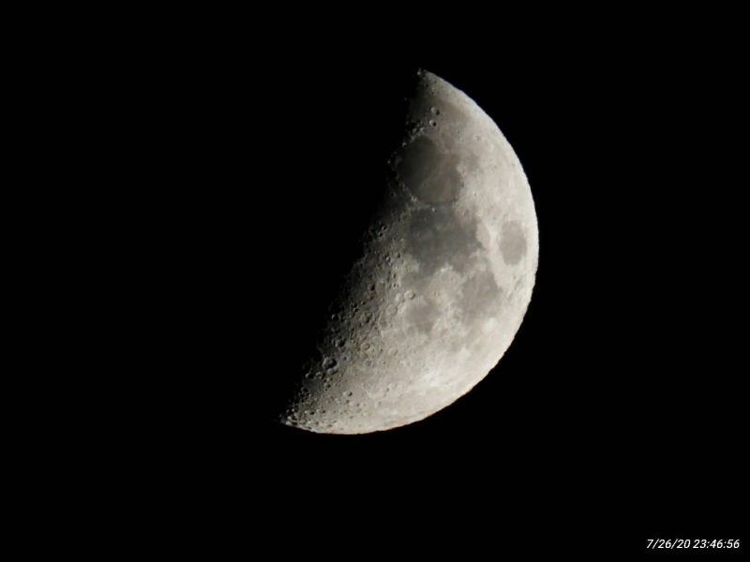
This looks very interesting! (not a joke)

Slide 67
We have just implemented diffuse lighting
Diffuse lighting dominates on rough materials : unglazed pottery, dusty surfaces
It’s color and intensity is independent of the angle you look at it from
You can check by moving your head
Any other examples of diffuse materials?

Slide 68
We used 3 concept to implement it
The normal, N
The light direction, L
The dot product

Slide 69
1 N is the vector perpendicular to the surface
N
Notes:
As you know from me referencing it all the time, this is very important and an unmissable part of calculating lighting

Slide 70
1 N is the vector perpendicular to the surface

Slide 71
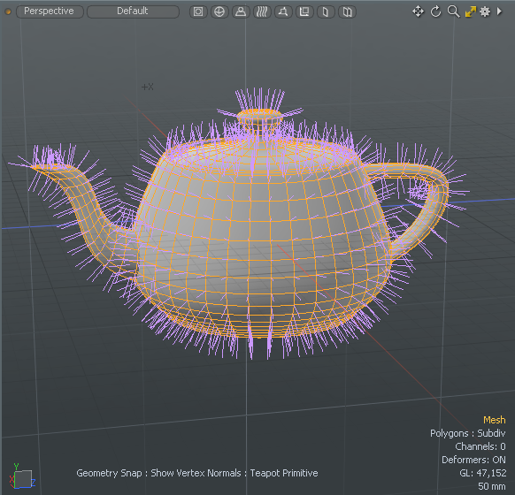
1 N is the vector perpendicular to the surface
Notes:
Note that the normal is always length 1.

Slide 72
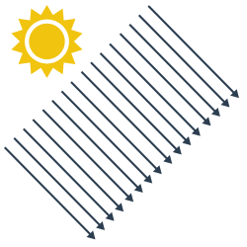
2 The light direction
N

Slide 73

2 The light direction
L
Main Light
Direction
N
N
Notes:
We need the direction the light is coming from
Why?
Well, imagine a flashlight. Shining it at your feet is a lot brighter on the ground than shining it forward. The last step calculates exactly how bright the object is depending on the relationship between the normal, and the light direction. That relation is calculated using the dot product.

Slide 74
3 The dot product
Takes two vectors
Outputs how “similar” the vectors are
Goes from -1 to +1 (if the inputs == 1 length)
Dot = 1.0
Dot = -1.0
Dot = 0.0
Dot = 0.7
Notes:
We combine the normal and the light direction, using a function that computes how close those two vector are in direction.
If it returns 1, they’re perfectly the same in direction
Between 0-1, they’re more or less pointing in the same direction
0 and they’re perfectly perpendicular
Negative, and they’re pointing away from eachother

Slide 75
So now we should understand this image
Blue = N
Yellow = L
Color = dot(N, L)

Slide 76
You see why this course is complex
Many small parts before it comes together
This diffuse implementation is incredibly simple
But now we can build on it
It’s still unclear, because I left quite a lot out

Slide 77
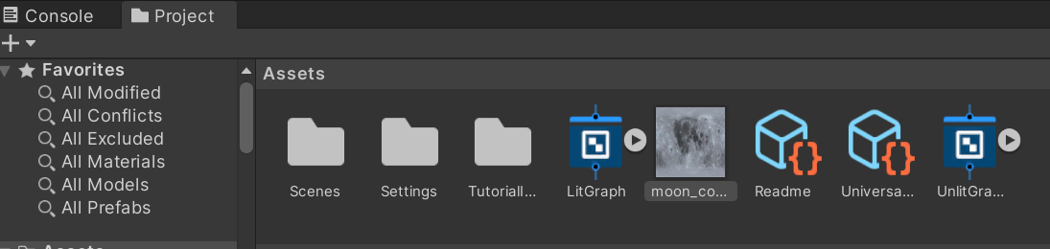
Let’s use a texture for a nicer result
Download textures from Toledo
Drag moon_color.jpg onto your project window

Slide 78
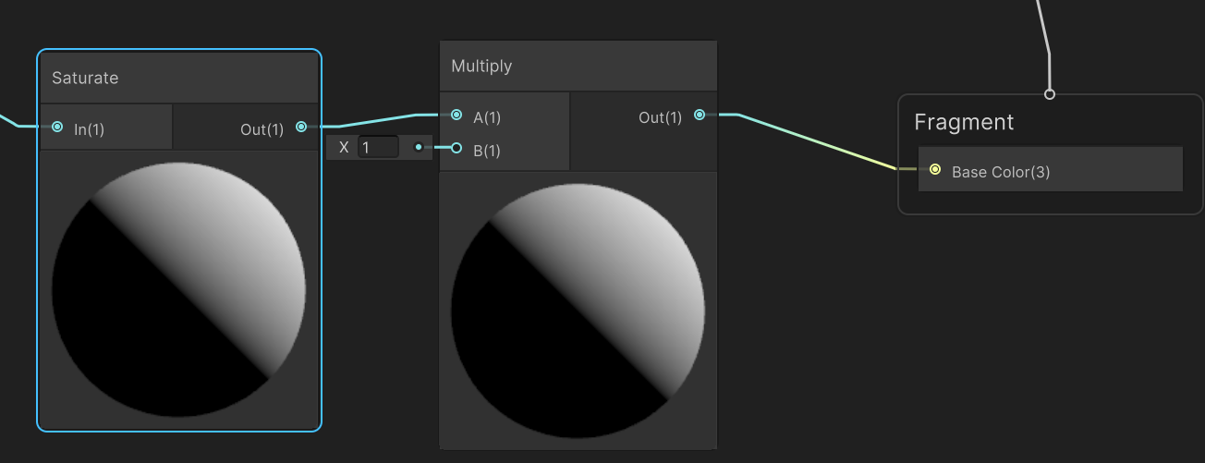
Add a Multiply between Saturate and the output

Slide 79
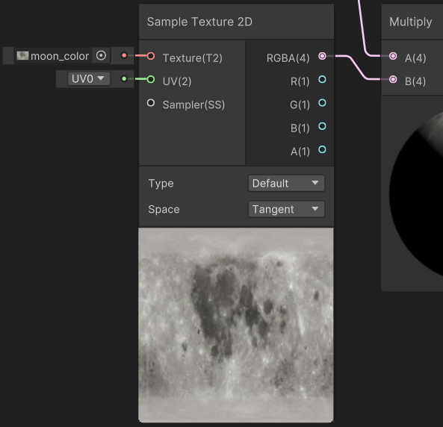
Add a Sample Texture 2D
Connect the output to the free input on Multiply
Set the input texture to our moon_color

Slide 80
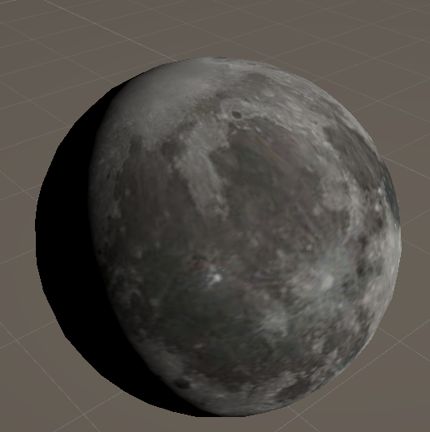
Save and check your results
Does this look good to you?
What is missing?

Slide 81
It looks flat
It looks painted on
Almost like a balloon or marble
This is because we are still lighting it as a sphere
Normal maps can fix this

Slide 82
Quick tour of the rest of the course

Slide 83
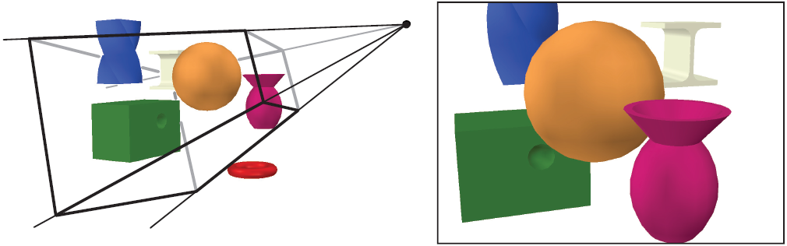
Camera’s

Slide 84
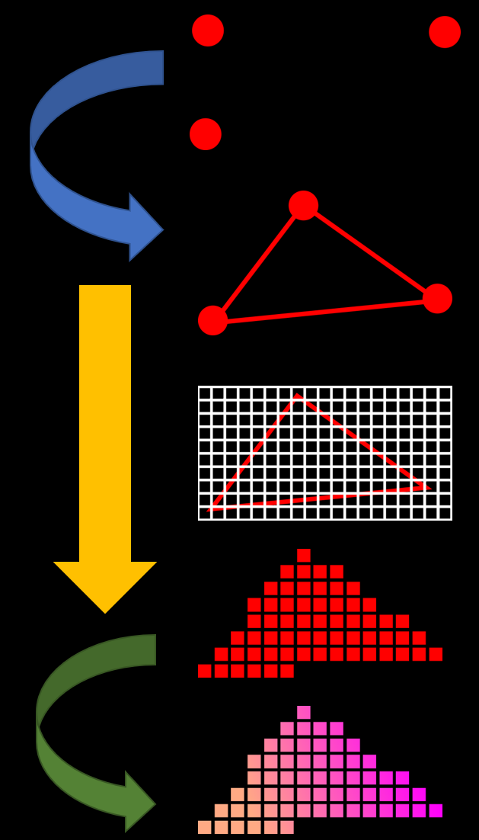
Pipeline

Slide 85
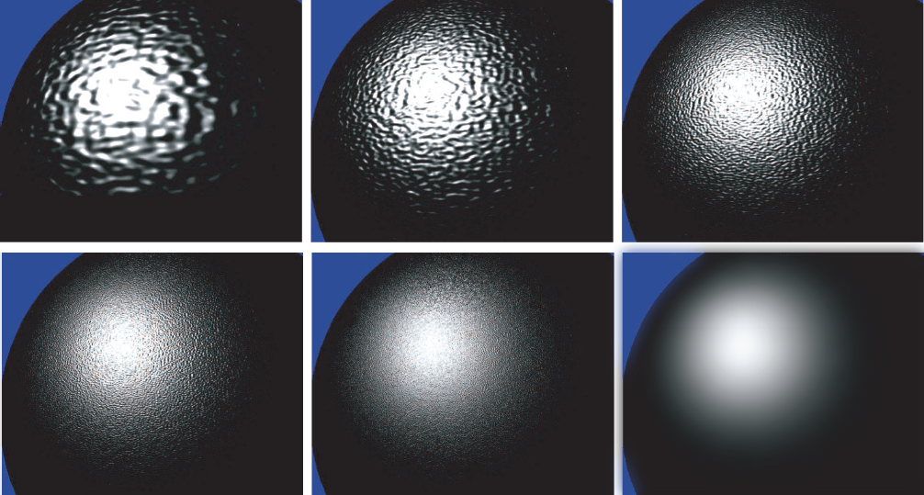
Materials

Slide 86
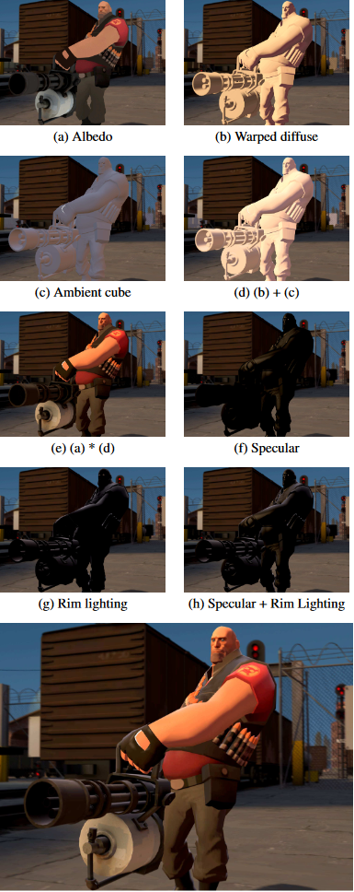
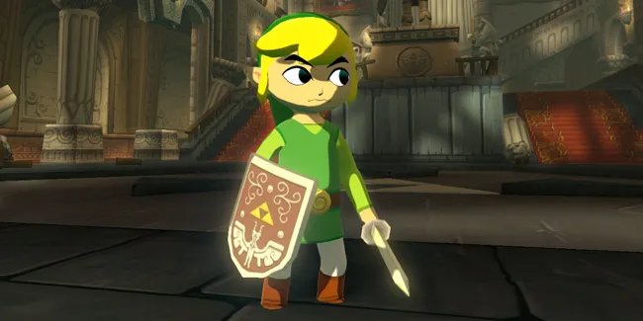
Materials

Slide 87
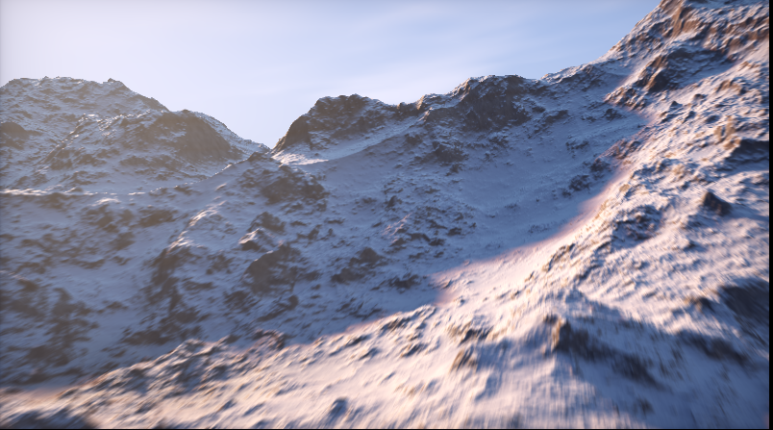
Procedural generation
https://www.shadertoy.com/view/MdX3Rr

Slide 88
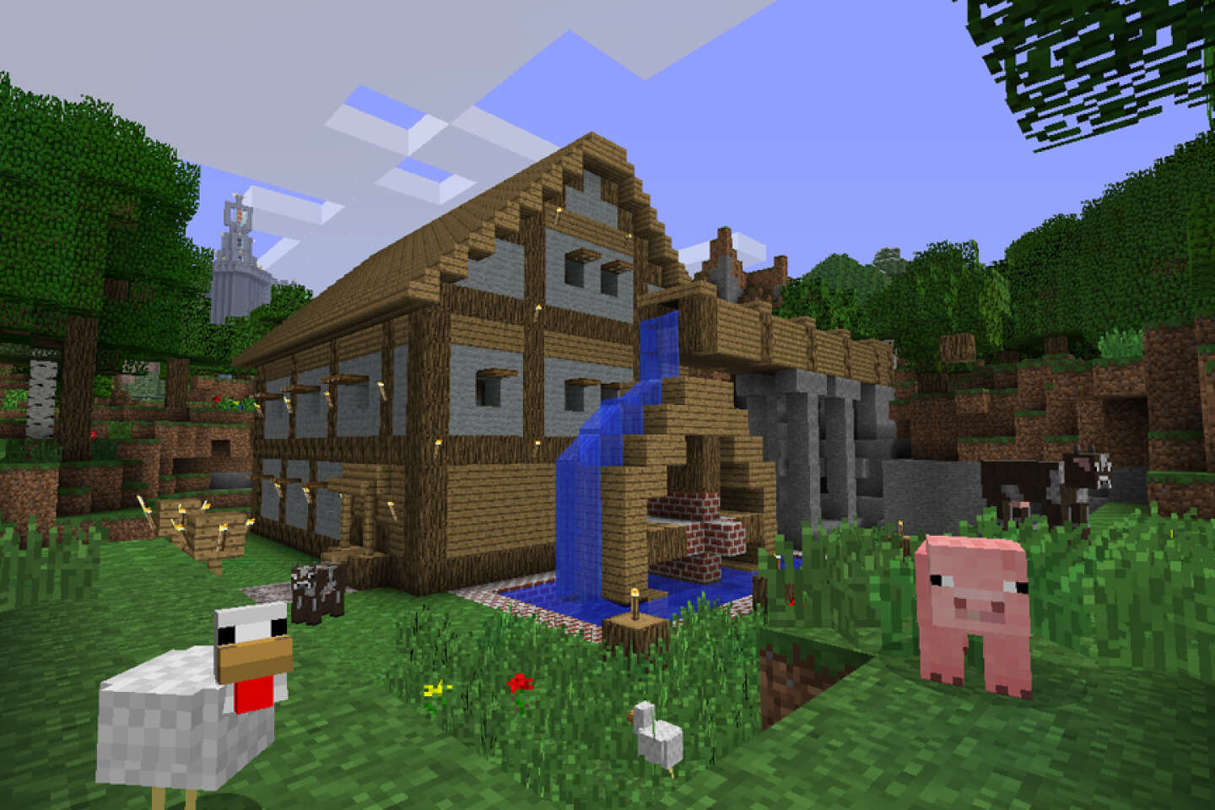
Procedural generation

Slide 89
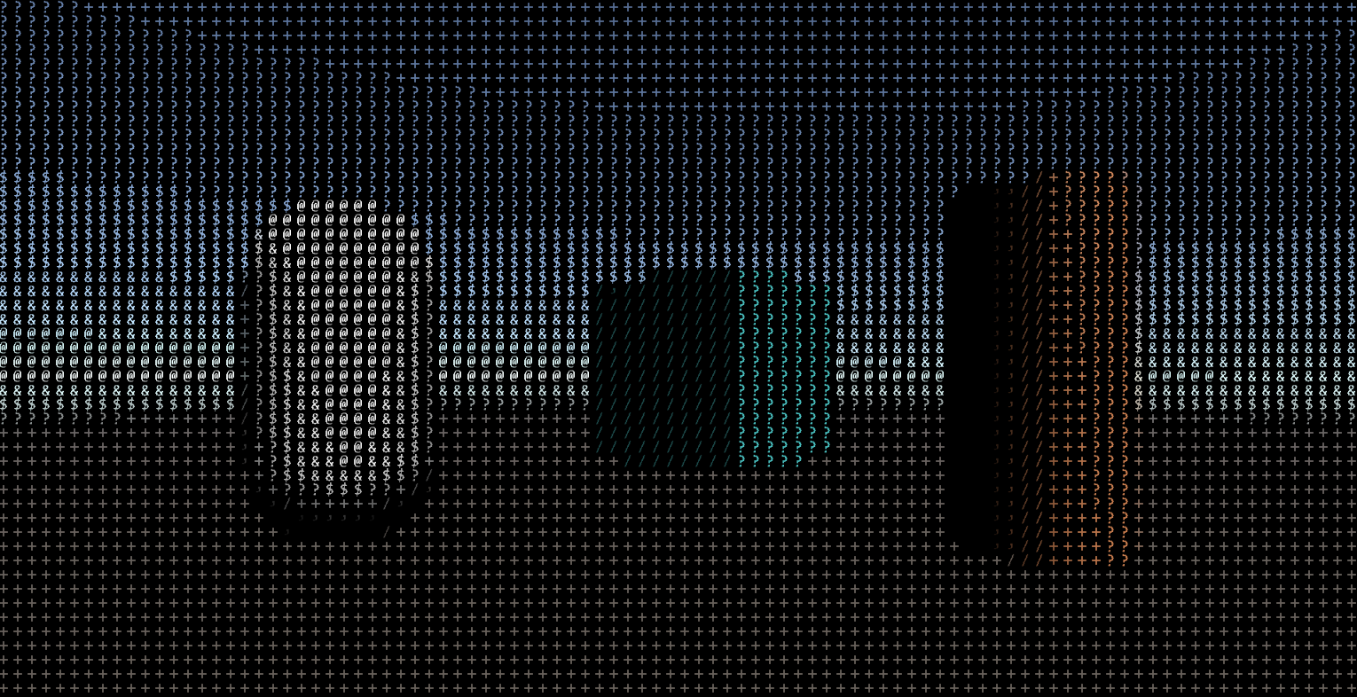
Post Processing

Slide 90
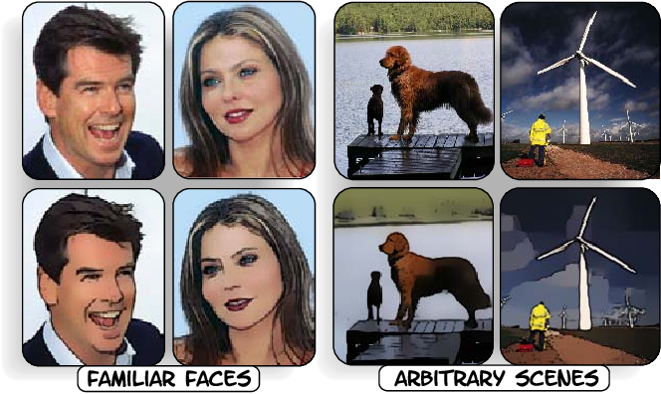
Post Processing

Slide 91
Aliasing

Slide 92
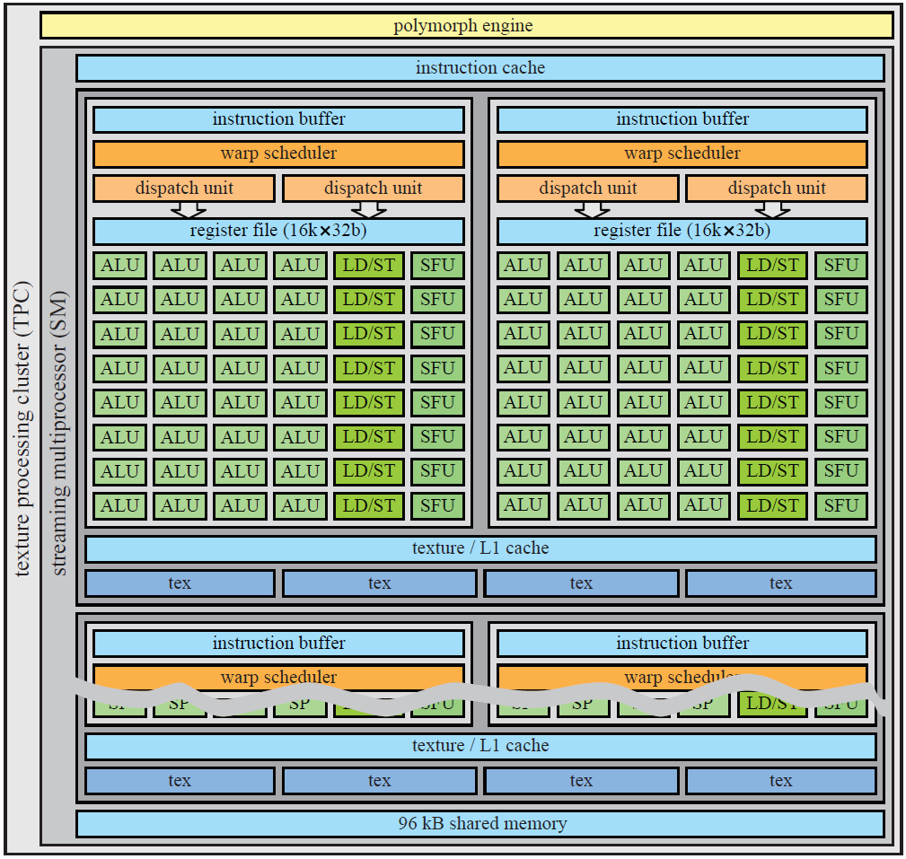

(Hardware)

Slide 93
Recap
This course teaches you how 3d rendering works
Specifically, realtime 3d rendering
It’s a lot of simple concepts
These concepts interact, so it can be rough

Slide 94

Tomorrow (maybe)
Will post some homework

Slide 95

Next week
Thinking in 3D
How to position, rotate, scale objects
Dot product (like before)
More…..
Important class, this will be confusing for a while

