Slide 1
Week 2: 3D reasoning

Slide 2
Last class
3D coordinate system
Points & Vectors
Translate
Rotate
Scale
We’ll go over them again

Slide 3
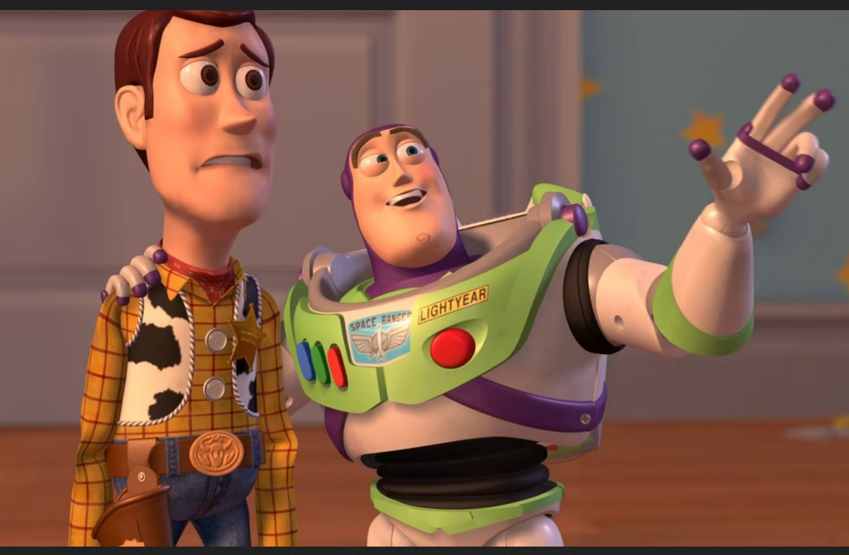
Course schedule
 | Theory | Practice
Week 1 : 12/02 | Introduction
Week 2 : 19/02 | 3D reasoning | Camera Placement
Week 3 : 26/02 | Geometry | Hardcoded chuncks Chunk loading
Week 4 : 04/03 | Textures Materials | Materials
Week 5 : 11/03 |  | l
Week 6 : 18/03
Week 7 : 25/03
Week 8 : 15/04 | Procedural generation | Procedural generation lab
Week 9 : 22/04 | Project explanation | Project lab
Week 10 : 29/04 | Guest Lecture Project Labs | Guest Lecture Project Labs
Week 11 : | Revision | Revision
Highly likely to change ☹

Slide 4
This class
→ Unity basics ←
3D coordinates
3D transforms
Why they are important
Dot & Cross product
Quaternions

Slide 5
Unity external architecture
Unity
Graphics API
DirectX
Vulkan
OpenGL ☹
OS Support
Many Others
Driver
Intel
AMD
NVIDIA
Notes:
Unity can be seen as big monolithic library, wrapping many other libraries one.
The big one would be the graphic api’s DirectX (from Microsoft), Vulkan (crossplatform), OpenGL (deprecated cross platform). These API’s provide access to the graphics card (or GPU), and allow us to actually draw stuff.
Other libraries we can access through Unity are the OS libraries (eg creating files), physics and sound libraries…

Slide 6
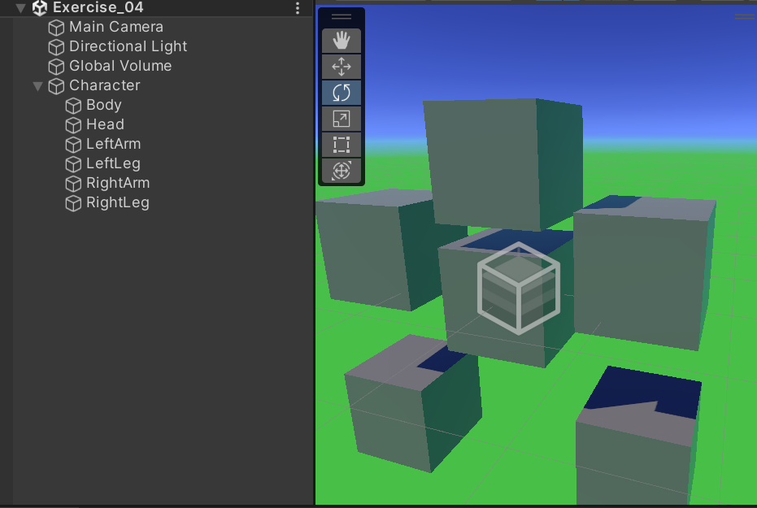
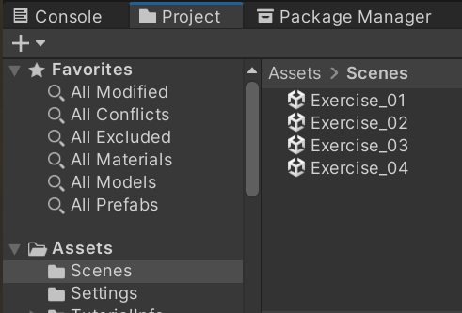
Unity internal architecture : Scene
A scene is the highest level container we will interact with
They are a lot like “levels”
They contain all of our GameObjects (“stuff”)

Slide 7
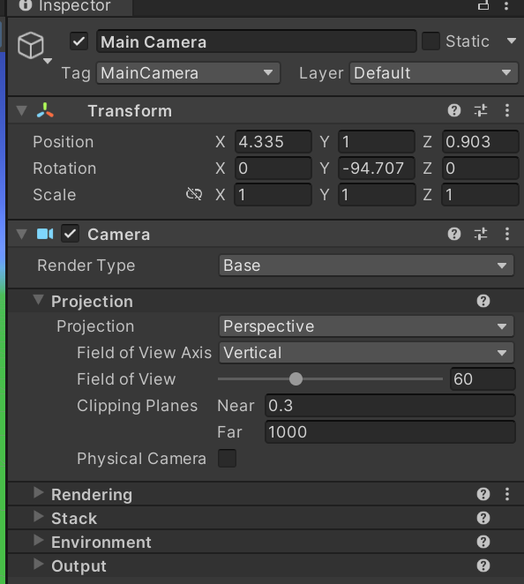
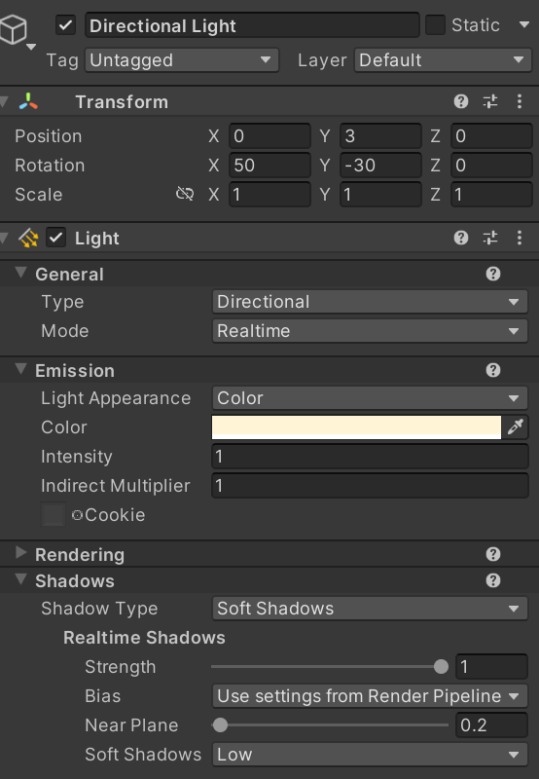
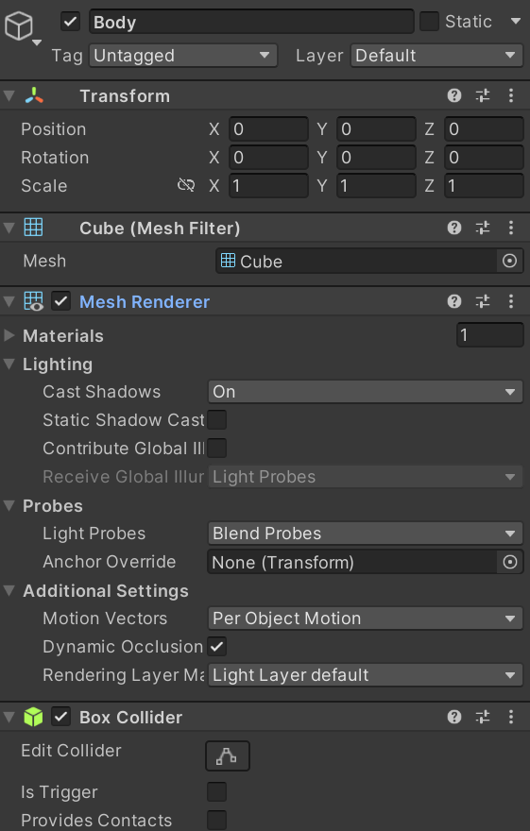
GameObjects are containers of Components
They can be almost anything : light, camera, cube, enemy, global settings,…
They can have 1 -> unlimited amount of components
They always have a transform component (we will see what a transform is later)
They can only have zero or one of each component
This is not ECS

Slide 8
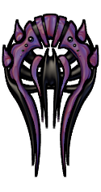


Why do it this way?
Player ship
PositionComponent
CollidableComponent
PlayerInputComponent
HealthComponent
Bullet
PositionComponent
CollidableComponent
PhysicsComponent
ProjectileComponent
Enemy
PositionComponent
CollidableComponent
AIComponent
HealthComponent
Notes:
So we can ‘cobble together’ entities in your gameworld
These entities often don’t fit well in strict hierarchies you would get in an inheritance pyramid. History has shows that having components is a good way to balance flexibility with reuse

Slide 9
Unity internal architecture
Game Loop
Load Scene
Update Components
Render
One Frame
Notes:
As you saw in pygame, games always have the same basic execution:
Initialize everything one while forever: update everything (eg input, positions)
render

Slide 10
Script Components
Have a method called Start, which is called once
Have a method called Update, which is called every frame
Game Loop
Load Scene
Update Components
Render
One Frame
Start
Update
Notes:
This slides just clarifies unity terminogy
A ScriptComponent is a component that exists out of code, and is where you’ll spend most of your time

Slide 11
This class
Unity basics
→ 3D coordinates ←
3D transforms
Why they are important
Dot & Cross product
Quaternions

Slide 12
Coordinate system
Y
RGB -> XYZ
X is right
Y is up
Z is “into”
Try putting your thumb as the x axis
Put your index on the Y axis
Hold your middle finger perpendicular to both
Z
X
Notes:
Try the instructions, it’s not a joke

Slide 13
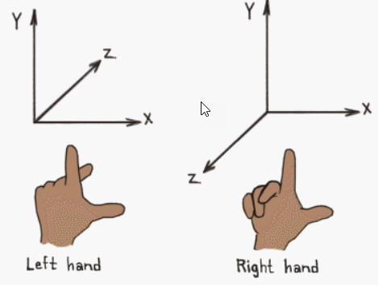
Did you succeed?
If you did, you’re left-handed
3D coordinate system are either left-handed or right-handed
Unity is left handed
Notes:
It’s no joke, I still spend a lot of time looking at my hand. This is going to come back in a big way when we see the cross product

Slide 14
Y is up
You can implement applications where another axis is up (eg space games)
But most people follow this convention
Models are oriented by this way by default
Gravity is oriented this way by default
Best to follow it
Trigger warning for the next slide

Slide 15
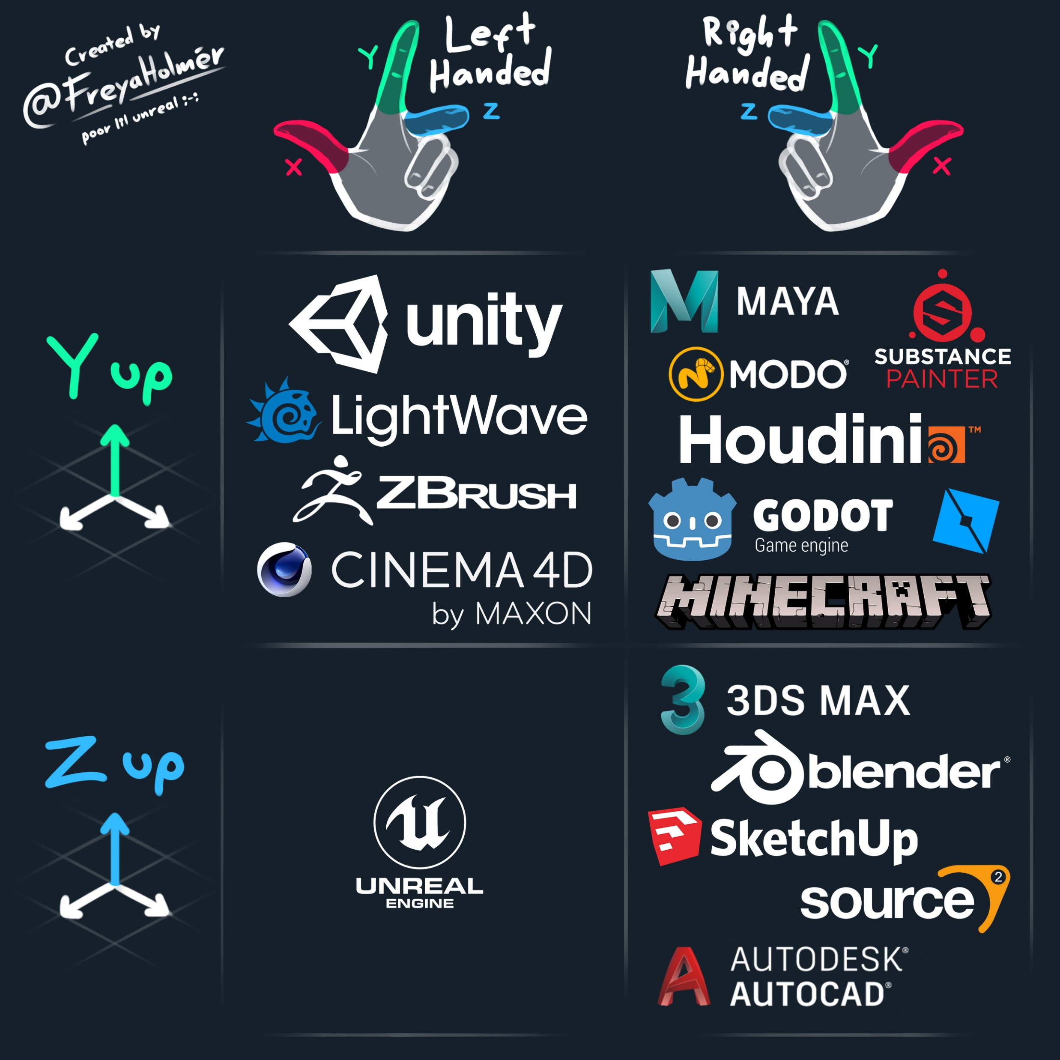
It’s a mess out there
Almost every import requires conversion
It might be done automatically
It might have to be done explicitly
Notes:
In the end, you can’t get around understanding the coordinate system. Stuff will always go wrong, and other stuff we will see still need you to understand this.

Slide 16
Vectors
Y
Is an annoying concept to explain
You know it as an array that can grow
In graphics, it’s collection of 3 or 4 float’s
More specifically, it’s an offset from the origin
Z
(3.0, 1.0, 0.0)
X
Notes:
What this means is, a vector(x,y,z) is an arrow starting at (0,0,0) and going to (x,y,z)

Slide 17
Unity
// initialize with all components
Vector3 v1 = new Vector3(2, 1, 0);
// shorthand for (0, 0, 0)
Vector3 v2 = Vector3.zero;
// shorthand for (1, 0, 0). All 6 directions exist
Vector3 v3 = Vector3.right;

Slide 18
Each element of a vector is called a component
Take a vector of (2, 1, 3), called A
The x component is A.x is 2
The third component (A[2]) is 3
Notes:
This is important because the names x, y, and z won’t always makes sense
For example, we will often use a Vec3 to store colors in rgb. X then refers to the amount of red in the color, and we access it using ‘.x’

Slide 19
Positions
The type in code is often called a vector
In Unity, a Vector3
A point is technically different than a vector, but it’s not important
Y
(1, 2, 0)
X
Notes:
I put it here, because I will inevitably use this terminology, often wrongly. I’ll try and give you the right idea, but I will never subtract any grades if you use the wrong term.
Wrong but quick : points are just vectors
Correct but long:
A vector is an “offset”. An offset is a *change*. Examples would be: one meter left of, 5 minutes driving north, halfway towards brussels
A point is a “position”. For example, the GPS coordinates of a city Leuven (50.8775, 4.70444)

Slide 20
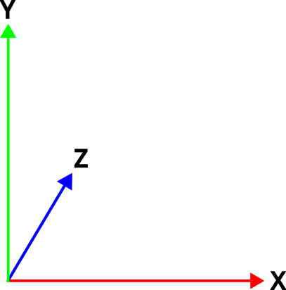
Origin
A position in our coordinate system
Position is (0, 0, 0)
Place where all the axis are 0
(0, 0, 0)

Slide 21
We can do calculations with vectors
I’m going to remove the Z axis for the next couple of slides, for clarity
Notes:
The math works out the same anyway.

Slide 22
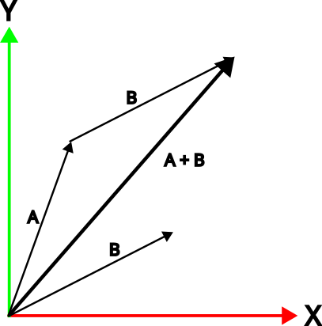
Addition
We can add two vectors together
We add all components separately
This is called “component-wise”
A = (1, 2, 0)
B = (2, 1, 0)
A+B = (3, 3, 0)
Notes:
Visually, we can start the second vector from the end point of the first, and where the second vector ends, is our sum.
In words : 5km north (5,0) + 2km east (0,2) = (5,2) 5km north and 2km east

Slide 23
Addition
We can add two vectors together
We add all components separately
This is called “component-wise”
A = (1, 2, 0)
B = (2, 1, 0)
A+B = (3, 3, 0)
Vector3 a = new Vector3(1.0f, 2.0f, 0.0f);
Vector3 b = new Vector3(2.0f, 1.0f, 0.0f);
Vector3 c = a + b;

Slide 24
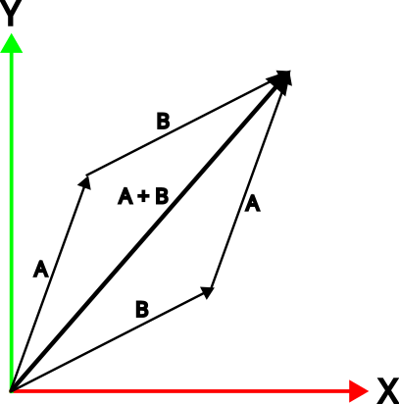
Addition is communicative
Order doesn’t matter
A + B = B + A

Slide 25
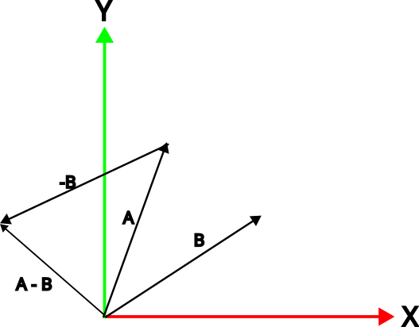
Subtraction
We can subtract one vector from another
We subtract all components separately
Order does matter
A = ( 1, 2, 0)
B = ( 2, 1, 0)
A-B = (-1, 1, 0)
Notes:
A lot is happening in this image
We can negate (make negative) any vector my moving the arrow to the other end. We’ve done this with B, making -B.
Now we can do A+ (-B), which we know how to do
This is just visually, the numbers do exactly what you expect.

Slide 26
Multiplication / division
We can’t meaningfully multiply/divide 2 vectors
But we can multiply/divide by a single float (“scalar”)
A = (2, 1 , 0)
A*2 = (4, 2 , 0)
A/2 = (1, 0.5, 0)
Notes:
By meaningfully, I mean for a good reason.

Slide 27
Multiplication / division changes length
A
A * 2 A / 2

Slide 28
We can subtract / divide vectors
By a single number: it changes the length of the vector
Y
C * 2 = (4, 2, 0)
C = (2, 1, 0)
C / 2 = (1, 0.5, 0)
X
X
X

Slide 29
Normalization
Make a vector length one
N and L are examples of normalized vectors. We call these unit vectors. They are always used for directions
X, Y, and Z axis are unit vectors of (1, 0, 0), (0, 1, 0), and (0, 0, 1)

Slide 30
Special and import case : normalization
When we normalize a vector, it’s length becomes 1
A vector with length one is known as a unit vector
It’s used for directions
I live 3 km north-west <-> I live to the north west
L and N in the previous class were unit vectors, otherwise the algorithm would work
Notes:
This is really important, and will come back all the time

Slide 31
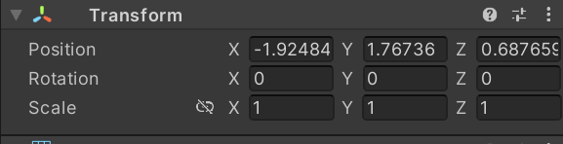
TransformComponent has a vector for position
Notes:
TransformComponent is unique, as every GameObjec has exactly one

Slide 32
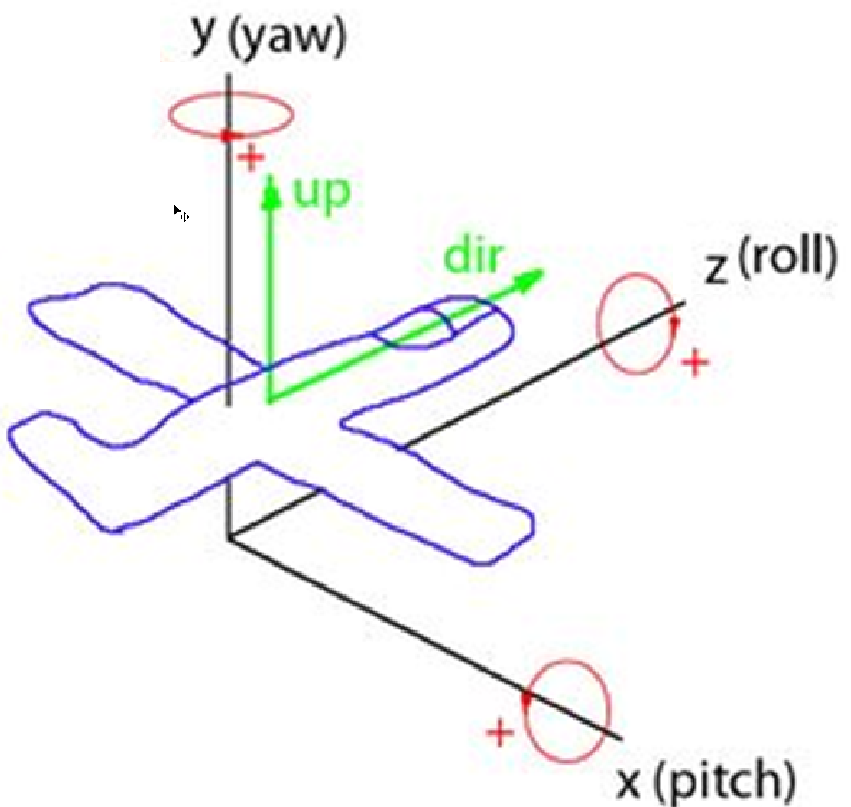
Rotations are stored as Vectors too
XYZ = pitch yaw roll
You’ll use this for your 1st person camera
Notes:
Pitch = imagine you head rotating op and down as if nodding “yes”. What line are you rotating around? The one between your ears, X
Yaw = imagine your head rotating side to side, as if saying “no” What line are you rotating around? The one from the top of your head to the ground between your feet, Y
Roll = turn your head around your nose, moving the horizon. What line are you rotating around? The same one as if you were pointing straight forward, Z

Slide 33
Framerate independence
1s
10 fps
60 fps

Slide 34
Say we translate 1 cm each frame
60 fps = 60 centimeters per second
10 fps = 10 centimeters per second

Slide 35
Solution: multiply by frame duration
We want 1 meter per second
60 fps : frame is 16.67 milliseconds
1 meter * 0.016 second = 1.6 cm
Framerates vary during runtime, always use Time.DeltaTime

Slide 36
Unity
// initialize with all components
Vector3 v1 = new Vector3(2, 1, 0);
// shorthand for (0, 0, 0)
Vector3 v2 = Vector3.zero;
// shorthand for (1, 0, 0). All 6 directions exist
Vector3 v3 = Vector3.right;

Slide 37
This class
3D coordinates
→ 3D transforms ←
Why they are important
Dot & Cross product
Quaternions

Slide 38
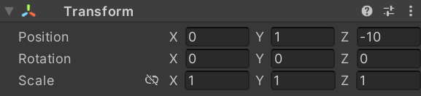
So, why did we learn all of this?
Now we can learn about Unity transforms
Every Unity GameObject has a TransformComponent
It contains:
A position
A rotation
A scale

Slide 39
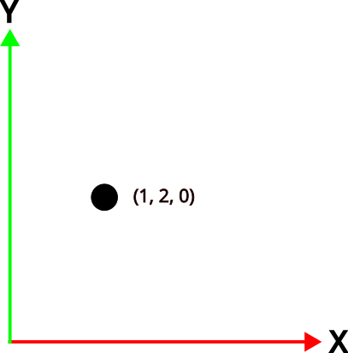
Transform.position
Remember: position is a point in space
is a property on Transform
Has a getter and a setter
We can assign or read position
Transform transform = gameObject.transform;
transform.position = new Vector3(1, 2, 0);

Slide 40
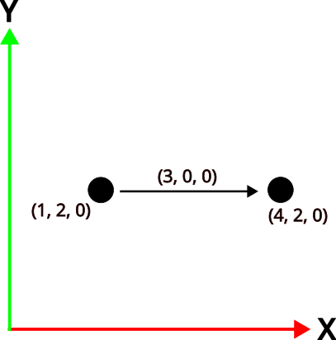
Transform.translate()
Translation is moving an object
Without changing it’s rotation or scale
It’s a relative movement
transform.Translate(new Vector3(3, 0, 0));

Slide 41
Transform.rotation
We will look at them in the Quaternion section

Slide 42
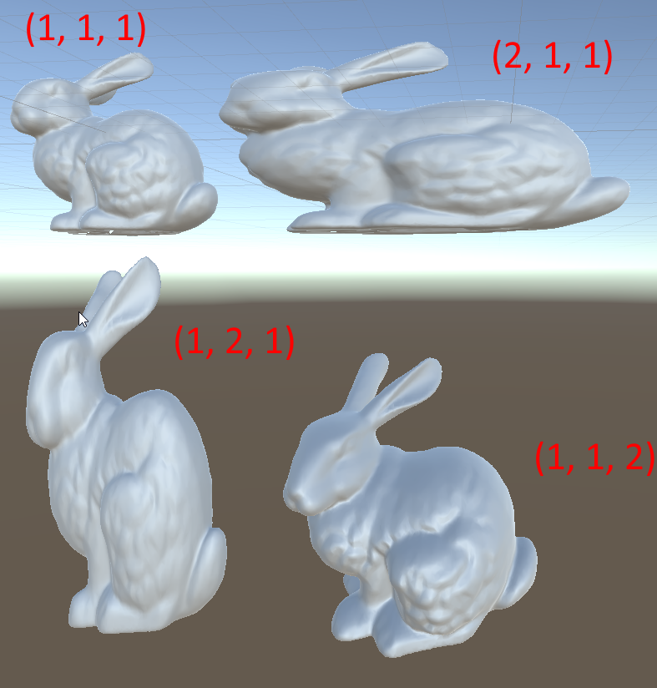
Transform.scale
Stretching coordinates
Among one or multiple axis
Almost always want a “uniform” scale
“uniform scale” = components are the same eg (2, 2, 2)

Slide 43
What are your questions?

Slide 44
Transforms are represented by a Matrix
4x4 grid of floats
Contains a translation, rotation, and scale
Can contain other things (eg camera projection)

Slide 45

Let’s learn about space(s)

Slide 46
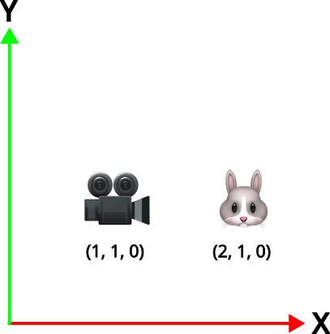
Example

Slide 47
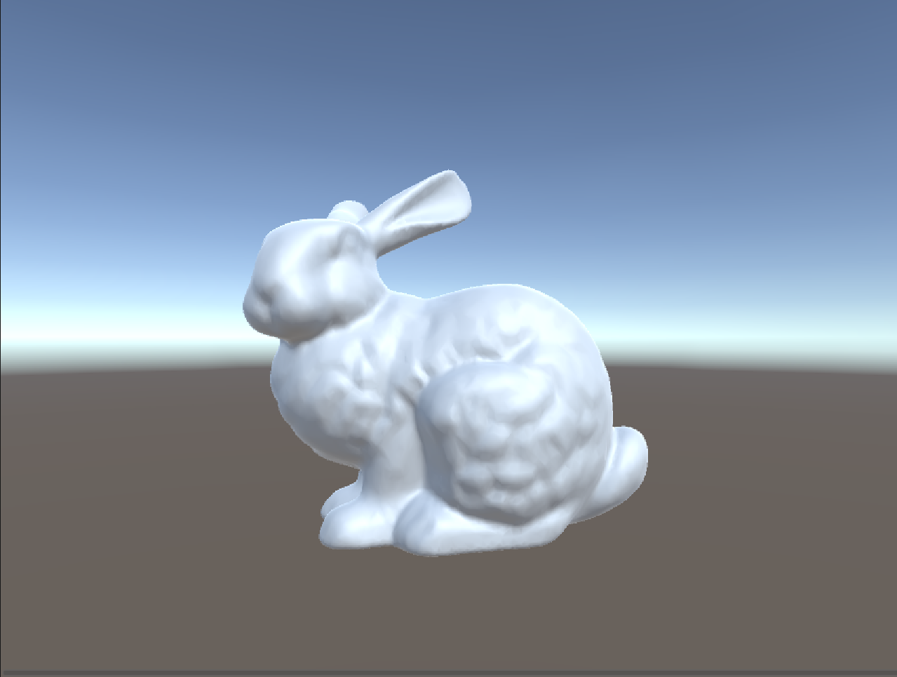
Camera is looking down +X

Slide 48
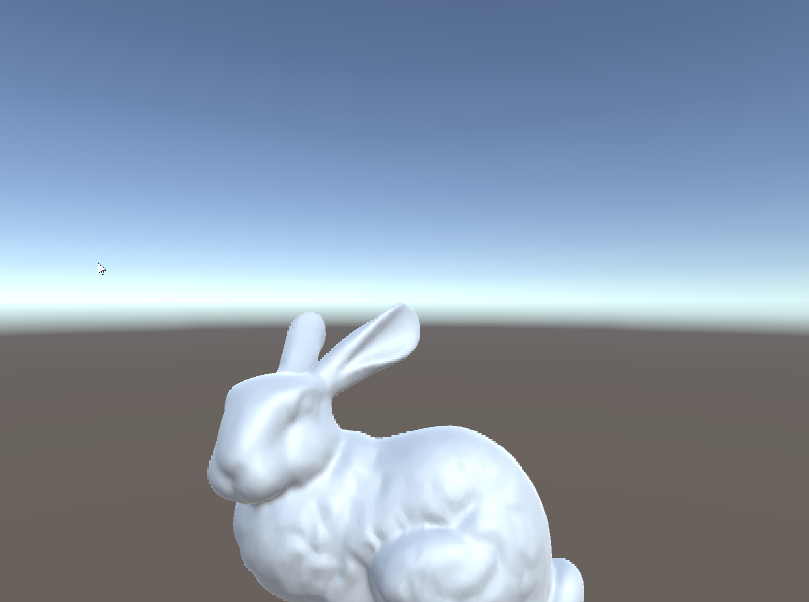
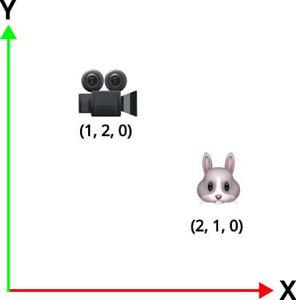
We move the camera up (+Y) by one unit

Slide 49
The bunny moved down
This doesn’t surprise us, but maybe it should!

Slide 50
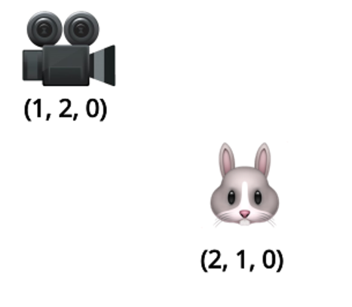
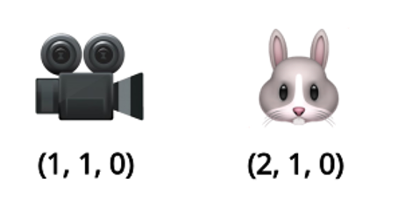
Rendering is done from a camera’s point of view
Moving the camera up is the same as moving the bunny down

Slide 51
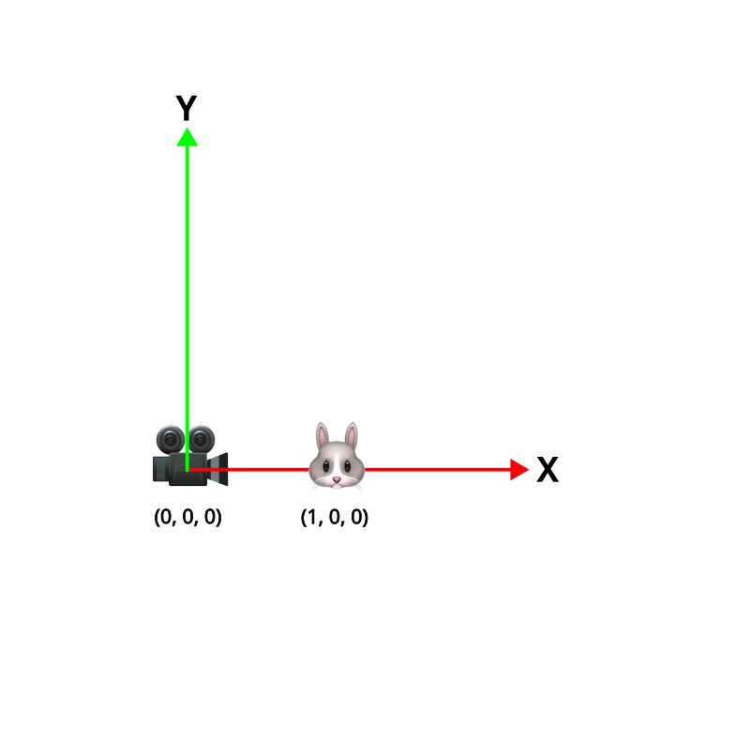
The camera has it’s own coordinate space
Space = frame of reference
We call it view space
When only the camera moves, everything seems to move
It’s because the coordinate system moves

Slide 52
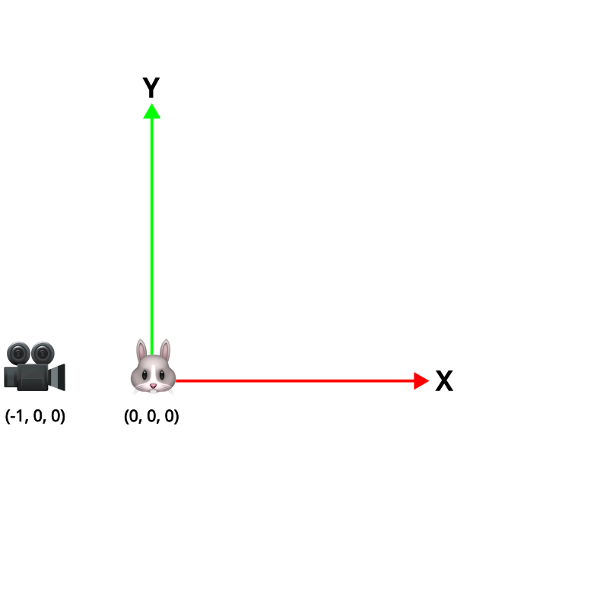
The bunny has it’s own coordinate space
It’s called object or model space
All the triangles are defined in this space
They are static (never change)
We transform them to view space to render

Slide 53
These all exist at the same time
World space
View space
Object space

Slide 54
We can transform point between spaces with transforms
Vector3 position = bunnyGameObject.transform.position; // in WorldSpace
cameraGameObject.transform.InverseTransformPoint(position); // in CameraSpace
position is in WorldSpace
Transform.TransformPoint transforms from LocalSpace to WorldSpace
Transform.InverseTranformPoint transform from WorldSpace to LocalSpace
Every Matrix transforms form one space to another
Inverting the Matrix does it the other way around

Slide 55
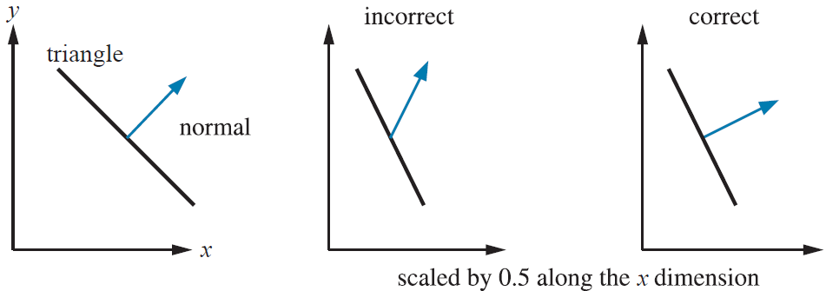
Warning! Use different methods for directions
Direction = N or L
Use TransformDirection
Not TransformPoint, your result will be incorrect

Slide 56
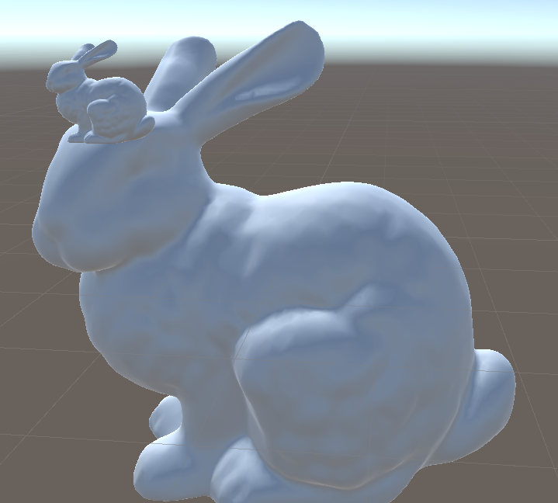
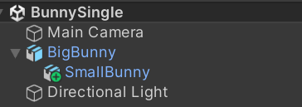
It’s a big hierarchy
SmallBunny’s transform is relative to BigBunny
If I translate BigBunny, SmallBunny follows
It’s transform is in “BigBunny space”
All previous examples had no explicit parents
It had the root as parent
And that is world space
Same here for BigBunny

Slide 57
Cool things we can do
Matrices multiply, and it add’s (concatenate) the transforms
Matrix4x4 worldToView = cameraGameObject.transform.worldToLocalMatrix;
Matrix4x4 bunnyToWorld = bunnyGameObject.transform.localToWorldMatrix;
Matrix4x4 bunnyToView = bunnyToWorld * worldToView; If you name it like this, bugs are very obvious

Slide 58
Does that make sense?

Slide 59
This class
3D coordinates
3D transforms
→ Why they are important ←
Dot & Cross product
Quaternions

Slide 60
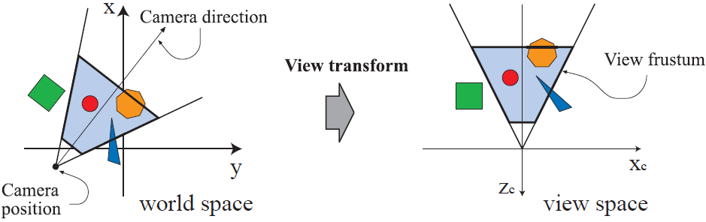
This is how we position object in front of the camera

Slide 61
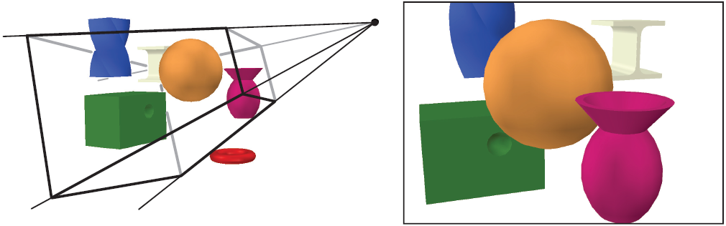
This is how we position object in front of the camera
Transform the model into the world
Transform the model in the world to the camera viewpoint
Transform (project) the model onto the “film” of the camera
This is called the ModelViewProjections transform, and we’ll see it in one of the later classes

Slide 62
This class
3D coordinates
3D transforms
Why they are important
→Dot & Cross product ←
Quaternions

Slide 63
Dot product
A
angle
B
Definition 1 : Dot(A,B) = A.length() * B.length() * cos(angle)
Definition 2 : A.x * B.x + A.y * B.y + A.z * B.z
Unit vectors: Dot(A,B) = cos(angle)
Measure of closeness
Notes:
You don’t need to know the definition the definitions, only that it computes a degree of closeness.

Slide 64
Unit vectors → just the cosine
Dot = 1.0
Dot = -1.0
Dot = 0.0
Dot = 0.7
Notes:
Unit vector == length one
If we have 2 unit vectors (I also call them directions), the result of the dot product will always be between -1 and 1 where 1 is that both vectors are identical.

Slide 65
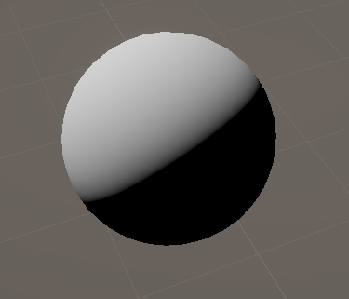
Dot product uses: shading
Notes:
Remember the first class? We can use the dot product between the normal and the direction of the light to create a very simple appearance of a lit (light falls on it) surface

Slide 66
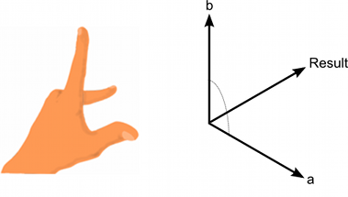
Cross product
Creates a third vector perpendicular to two given vectors
Order matters! AxB = -BxA (result is flipped)
Length depends on angle, length of A and B
Perpendicular A and B, A and B are unit vectors : length 1
Notes:
I actually never find myself caring about the length of the crossproduct, so I’m in the habit of normalizing it. You should too.

Slide 67
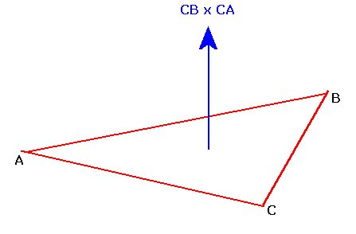
Cross product uses : calculate normal
Notes:
So the idea is to construct two vectors: one vector from C to B (B-C), and one vector from C to A (A-C)
These gives you the inputs of the cross product:
Especially in this usecase you have to normalize the result of your crossproduct, as normal are always length 1

Slide 68
This class
3D coordinates
3D transforms
Why they are important
Dot & Cross product
→ Quaternions←

Slide 69
Quaternion: better rotations
Used by unity to represent rotations
Based on complex numbers (we treat it as a black box)
Implemented as a Vector4

Slide 70
Quaternion: advantages
Brings us too far
Feel free to check https://www.youtube.com/watch?v=zjMuIxRvygQ
TLDW Quaternions do not have some problems separate XYZ rotations have

Slide 71
Quaternion : uses
// rotation to bunny
Quaternion rotation = Quaternion.LookRotation(
bunnyGameObject.transform.position - transform.position, Vector3.up);
// rotate around up
Quaternion rotation = Quaternion.AngleAxis(30, Vector3.up);

Slide 72
Recap
Transformations move positions and directions between spaces
Unity transform is relative to the parent
We can use Matrix4x4 to transform between any 2 spaces
A dot product gives us a measure of similarity between 2 vectors
A cross product construct a vector perpendicular to 2 other vectors

Slide 73
After class
Will post external content going over these topics
Will post project specifics. You’ll make a unity project with a flat plane Add controls to control a cube in 1st and 2nd person Bonus: build a character out of cubes and make it move like a Minecraft character

Slide 74
Next Class
Going to look at geometry
You’re getting your hands dirty making chunks

