Slide 1


2024
Doechii / Tiny Desk concert
Week 3: Geometry

Slide 2
Last class
3D coordinate system
Points & Vectors
Translate
Rotate
Scale
Dot & Cross product
Need to respond to question about memory
Notes:
You can catch up on last week’s class by last weeks slides, or by the the video’s posted in the announcement

Slide 3
Do these transformation spaces increase memory?
No, these spaces are conceptual
You always have single coordinate for a point
Which you can transform into another spce
But you don’t need to store it
Analogy: units
50 meters
We can express it in feet
Don’t need to store that, can convert when we need it
Notes:
Last week someone asked me if all these transformation spaces increase the memory requirement of the application. The good news is that they don’t.
The main idea is that you only store one set of coordinates. You can transform these coordinates into a set of coordinates in another space that you need, but there’s no need to store them. You can just forget about the transformed coordinate when you’re done with it, and transform it again when you need it again.
The analogy here is temperature. Image we have a temperate (20 degrees Celsius), and sometimes we want it in Fahrenheit, and maybe in Kelvin. We can easily calculate these 2 from Celsius. Will we store 3 temperatures in different units? No, it takes more memory, and the duplication is a prime target for bugs.
Fun fact: CPU’s (and GPU compute) speed is increasing faster than memory speed. Twenty years ago, you would store things in memory so you wouldn’t need to recompute them. Nowadays, the trend is towards recomputing things so you don’t have to fetch them from memory.

Slide 4
Part of the project is available
Please accept it right now and submit on Toledo
Missing the 3rd person part of the camera exercise
Also uploaded the Minecraft terrain
Missing the introduction for that (it used to be a lab)
Hoping to update by Fri
Notes:
The hidden message here, is that you really should be getting started on your this week

Slide 5

Course schedule
Week 1 | Introduction
Week 2 | 3D reasoning
Week 3 | Geometry
Week 4 | Pipeline & Materials
Week 5 | Textures & Normal maps
Week 6 | Proceduralism
Week 7 | Post Processing
Week 8 | Advanced pipeline
Week 9
Week 10 :
Week 11 : | Revision

Slide 6
This class
→ 3D geometry ←
Generating normals

Slide 7
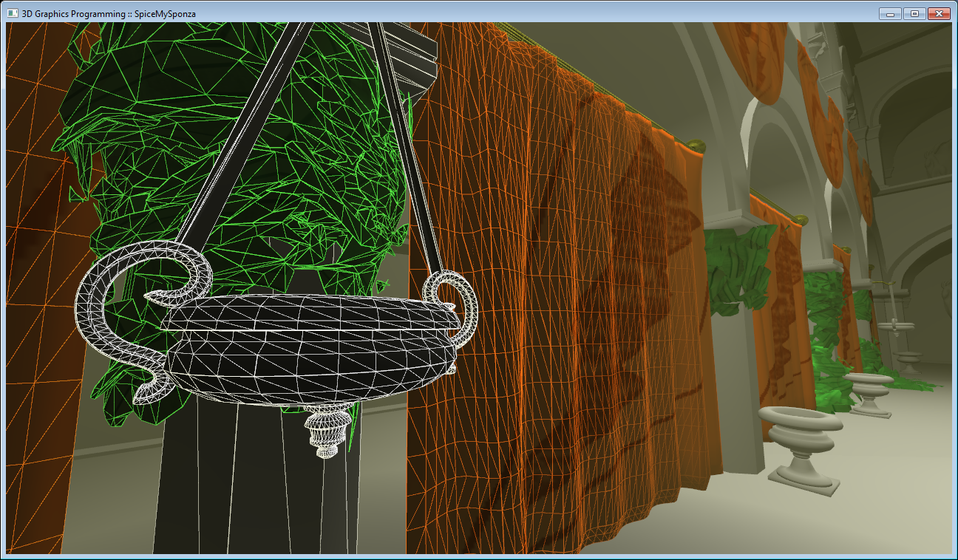
GPU’s draw meshes
A mesh is a surface made of triangles
Notes:
The vast majority of all real-time rendering is done with triangles. It’s a feedback loop, as GPU’s specialized towards triangles, making it even more attractive for applications to choose triangles

Slide 8
GPU’s draw meshes
Meshes are a list of vertices
A vertex is (at least) a position
3 vertices make a triangle
Notes:
Not that the triangle is defined only by it’s points/vertices. The lines (called edges) between the points only exist conceptually: we don’t store anything for them, we have enough with just the points.

Slide 9
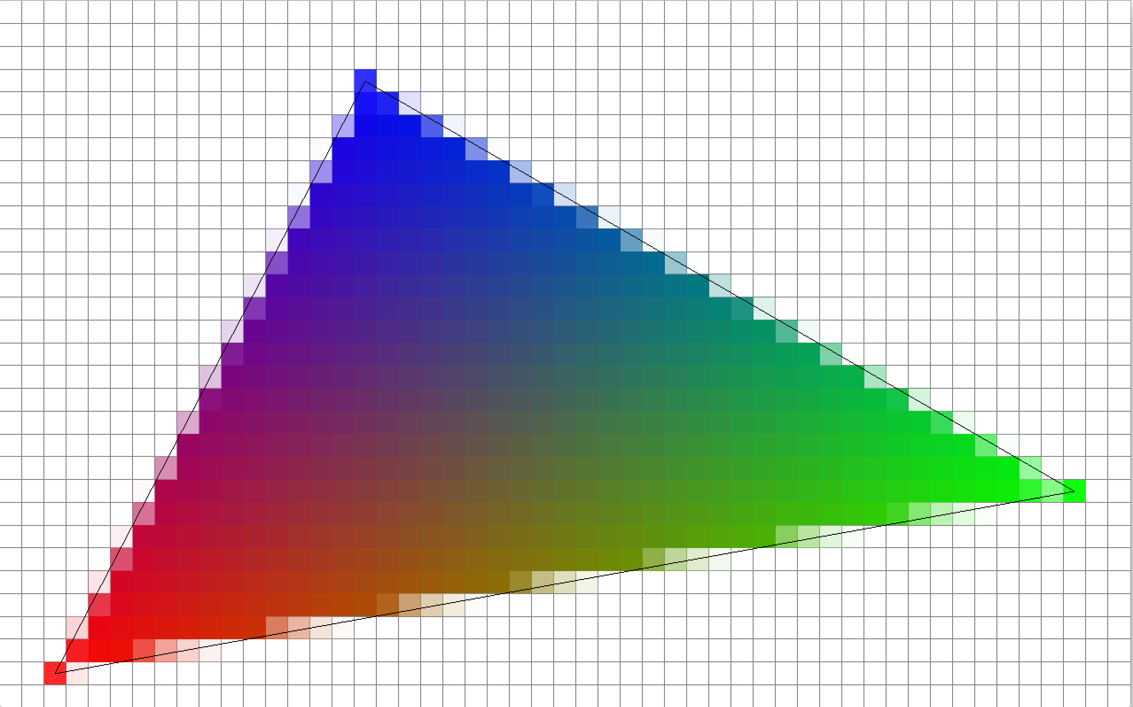
Meshes are lists of vertices
A vertex (singular) is at least a position
Can have other arbitrary data
Eg color, normal, ….
A vertex is a struct
(0, 0) | (1, 0, 0)
(0.3, 0.9) | (0, 0, 1)
(0.9, 0.2) | (0, 1, 0)
Notes:
The vertex isn’t just a position, although it always has some. It often has additional data. This data is arbitrary: you, as a graphics programmer, decide what you need. Common ones include
Normal (direction perpendicular to the surface)
Texture coordinates (or ‘UV coordinates’. We’ll see what these are in another class)
Color (when not using textures)
Less common ones include
Animation data
Multiple texture coordinates
Many more…..

Slide 10
Interpolation (linear)
(1, 1)
(0, 0)
Notes:
When we need a value from the vertex, and we’re not exactly at a vertex, the value is interpolated: it takes values from all three vertices
Don’t worry, this slide just illustrates that we can have other things in vertices than positions.

Slide 11
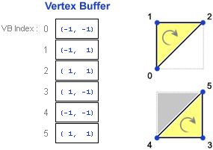
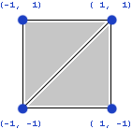
Meshes
Array of vertices
Called “vertex buffer”
3 vertices -> 1 triangle
Notes:
A simple mesh with 2 triangles
One triangle = 3 vertices
Two triangles = 3*2 vertices
We put this in a vertex buffer, where each vertex is put in sequence. In this example, the first 3 vertices in the buffer are the first triangle, the second group of 3 are the second triangle
Not that 2 of the positions (the diagonal) occur twice. We have four corners, but six vertices. Two positions occur twice, which is a wasteful. We’re going to fix that in a later slide
Also note the rotating arrows on the triangle. These come from the order of the 3 vertices making each triangle. We’ll come back to that in the next slide.

Slide 12
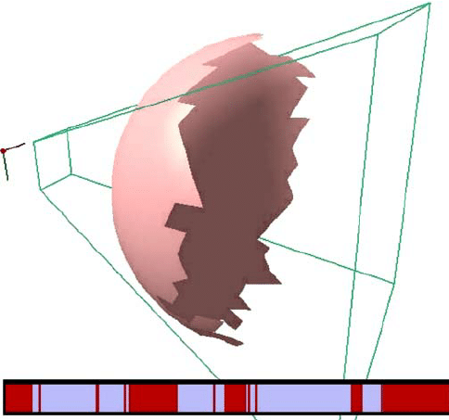
Why are the arrows important?
A triangle has only one side
Either it faces us, or it doesn’t
If it doesn’t, we don’t need to draw it
Notes:
Look at an object on your desk. Roughly speaking, you only see half of an object, the other half is on the backside. Ideally, we don’t want to render it, as it will take time, and we won’t see it anyway.
Above is an example of the results of backface culling, a simple but effective algorithm for getting rid of all those non-visible triangle.

Slide 13
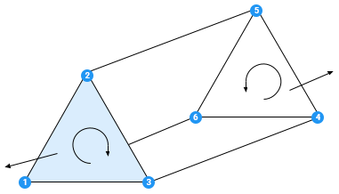
Mesh winding
Triangles can be clockwise or counterclockwise
Depends on your viewpoint
One direction : front of triangle
Other : back. We can skip (cull) it for performance
Unity uses clockwise
Notes:
Backface culling looks at the winding of triangles. Winding is whether the sequence of the vertices of a triangle goes clockwise, of counterclockwise.
In unity (by default, it’s configurable), any triangle with a counterclockwise winding will be skipped when rendering, as they will be on the backside of the object.
Why is this important? You need to get this right when you create your meshes. If you don’t you will not see some (or all) of your triangles. How I get it right is, tbh, just visualizing it as I type it. Create one triangle at a time. Visualize their positions in your head. Check the winding.

Slide 14
We’re being sloppy in this rectangle
We have 2 floats per vertex
How big is our vertex buffer, in bytes?
Notes:
Try it for yourself! Remember, a float is 4 bytes

Slide 15
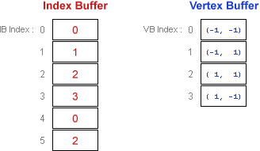
Index buffer
Remove duplicate vertices
Add an indirection buffer
Smaller in total
Notes:
So, we do waste a handful of bytes, as 33% of our information is redundant.
Instead of duplicating a vertex that is used twice, we can use another trick. Instead of triangle being composed of 3 vertices, a triangle is composed of 3 indices. These indices are an index into the vertex ufferThat means we just have 3 int’s per triangle, and all the vertices we store will still be unique.

Slide 16
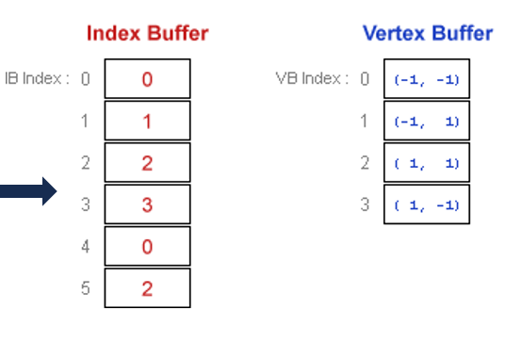
How many bytes now?
Notes:
Calculate the size of the index buffer and the vertex buffer. Remember, and int is 4 bytes, and so is a float.
How much do we win?
In reality (meshes with 10’s of thousands of triangles, if not more), vertices are often shared between 4-6 triangles , giving us even more saving with this scheme.

Slide 17
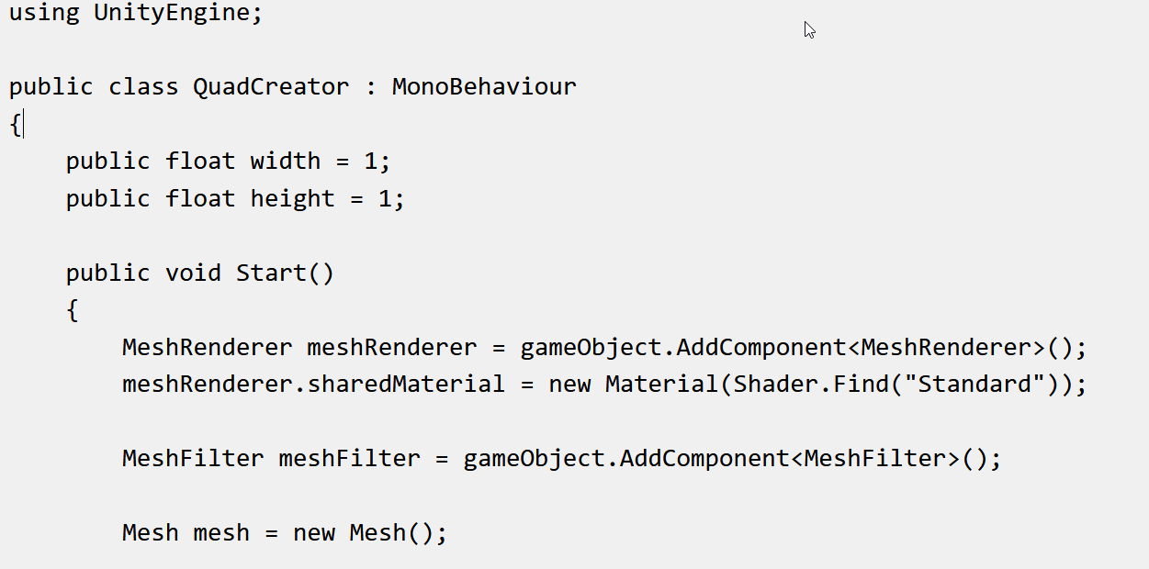
Creating a quad : setup
Notes:
So how do we create a mesh in unity?

Slide 18
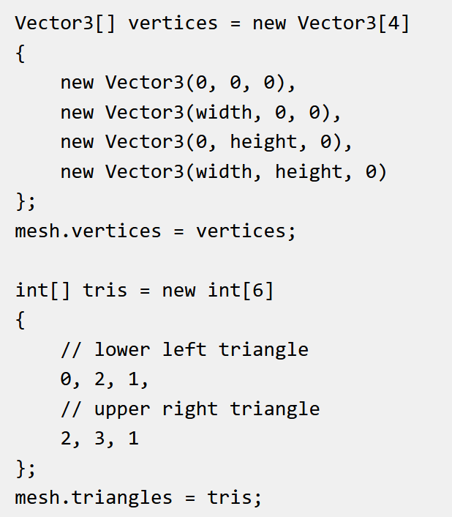
Creating a quad : vertices & indices

Slide 19
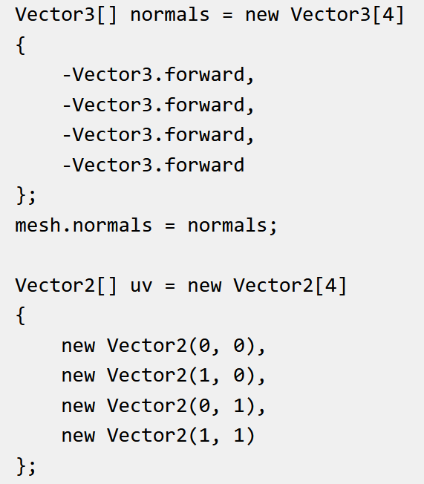
Creating a quad : normals & uv

Slide 20
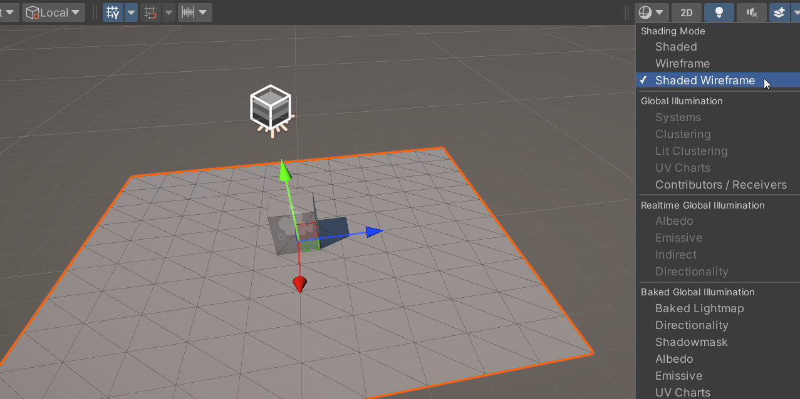
Future assignment: tessellated plane
Notes:
This is not yet in the assignment at the time of writing, but it definitely will be, as we need it to add water to our world

Slide 21
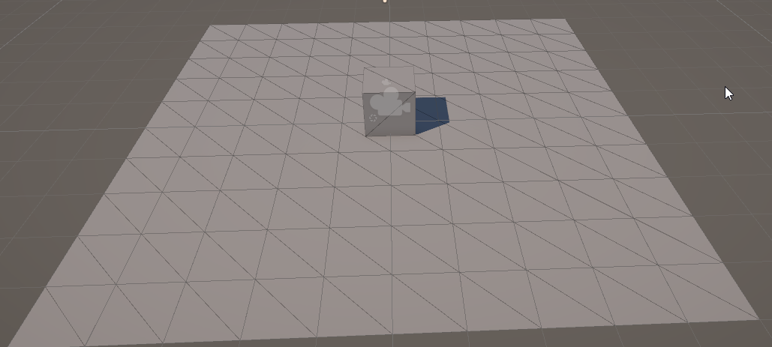
Future assignment: tessellated plane
Write a function that creates a plane
Takes width and height parameters
Takes parameter for number of quads in x and y
We’ll use this for water

Slide 22
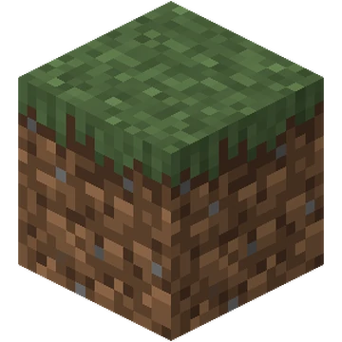
Future assignment: make a cube
Let’s see what ChatGPT makes out of it

Slide 23
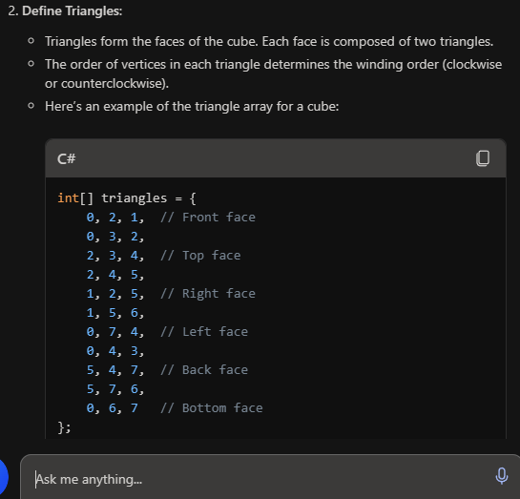
Ghost writer (ChatGPT)

Slide 24
Does it look good?

Slide 25
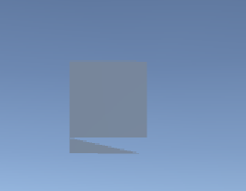
Result
Any problems?

Slide 26
Do you see the problem?

Slide 27
It’s right here

Slide 28
How you could have known : symmetry
Code that looks “wrong” has a high chance of being wrong
Usually, thing come in 3’s or a multiple of 2’s
This is how I find code to talk about
Reminder for self : look at vertices / indices
Notes:
Look for symmetry in your code. If you have a triple loop over each dimension, the loop heads should look similar. This is true in all code, but especially graphics code can have multiple dimensions (rgb, xyz, uv) where you treat each axis the same). This leads to symmetry.
And, of course, don’t trust AI with code you can’t write yourself, as you won’t be able to spot / fix any mistakes

Slide 29
Questions?

Slide 30
This class
3D geometry
→ Generating normals ←

Slide 31
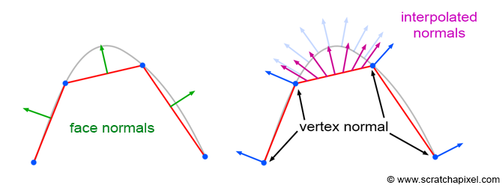
We defined normal on the surface, but they’re stored per-vertex
Notes:
A normal is defined on top a face (we used triangle, but a face can be any polygon that is ‘flat’).
Unfortunately, we need normal at our vertex. There are ways to calculate them, but it’s always a heuristic (there’s no ‘correct’ answer, only something we can come up with that seems ok).
Once we have our vertex normal (we’ll see one way of calculating in later slides), we’re still faced with the problem of what a normal is on a surface. The answer is that we interpolate between all 3 normal vertices of that triangles, depending on where we are in the triangle.

Slide 32
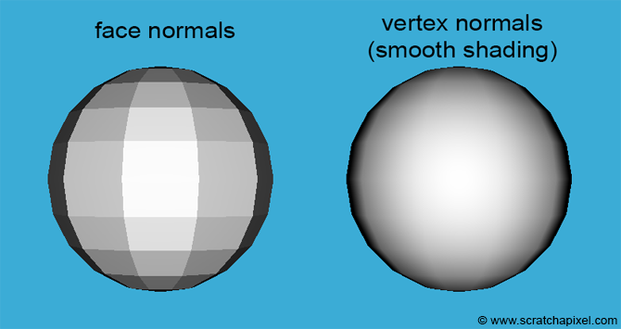
Why interpolation?
Notes:
Left, use the face normal. It’s constant across the entire face, so we get these really solid colored polygons
Right is the result when we interpolate our vertex. We see a smooth shading.
Note, both these sphere have the same amount of triangles. The one on the left more accurately shows the geometry. The one on the right gives the impression of a more smooth mesh than is actually present.

Slide 33
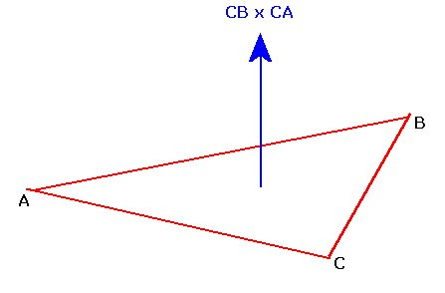
We know how to generate face (triangle) normals
Notes:
But let’s recap anyway ☺
The normal is the direction perpendicular to the surface
The cross product creates a vector perpendicular to two other vectors
Those two other vectors? We can take any two edges of the triangle. Eg (B-A) and (C-A)
Gotchas: get them in the right order (check your left hand) or your normal will point in the wrong way. Also, normalize your result!

Slide 34
Let’s try to generate vertex normals for this mesh
0, 4
3
1
2,5
Hard to see depth, half of a pyramide
Notes:
The number are the sequence of the vertices

Slide 35
Let’s try to generate vertex normals for this mesh
We use the cross product for that We don’t forget to normalize the result

Slide 36
We add each face normal to each vertex of the face (we first initialize to zero)
Notes:
Basically, each triangle ‘contributes’ it’s normal to each vertex which is part of it

Slide 37
And normalize the result

Slide 38
We can do better, right now each triangle contributes equally
We can take into account the actual angle
Vertex normals are a dark art
Notes:
We can account for the angle -> multiply the normal with the angle before adding
We can also account for the size of the triangle -> multiply the area
Experiment!

