Slide 1
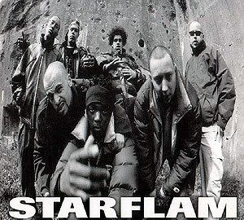
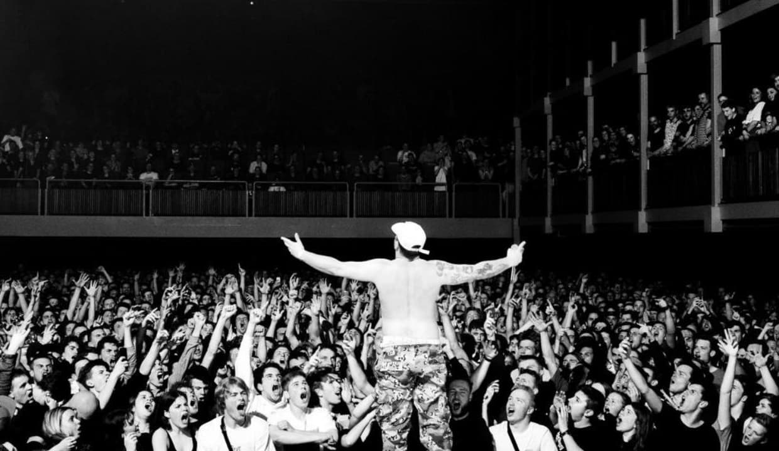
DE/AR
2024
← Zwangere Guy
Week 4: Graphics pipeline

Slide 2
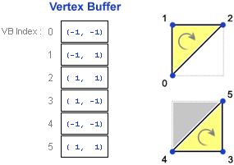
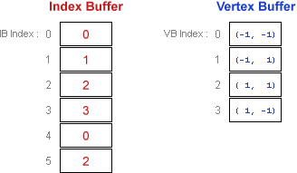
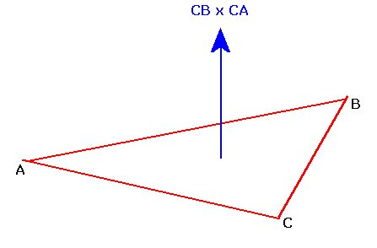
Last class
Geometry
Vertices, indices
Winding
Normal generation

Slide 3
Possible exam questions
What is a vertex? How many bytes is a vertex?
What is an index buffer?
What is a normal? How long is it?
How do you create a face normal?
How could you create a vertex normal?
Notes:
What is a vertex? How many bytes is a vertex?
A vertex is a point in space, that can hold several different attributes, such as a position, normal, color, animation information. They are commonly used to define the corners of a triangle. Because it can have different attributes, it doesn’t have a specific size
What is an index buffer?
An index buffer holds indices of vertices in the vertex buffer. Three indices make a triangle. The idea is to use the index buffer to avoid duplicating vertices in the vertex buffer.
What is a normal? How long is it?
A normal is a vector of length one, perpendicular to a surface
How do you create a face normal? We take the cross product of two of the edges, and normalize the result
How could you create a vertex normal? Add all the face normal’s of faces that include the vertex, and normalize the result

Slide 4

Course schedule
Week 1 | Introduction
Week 2 | 3D reasoning
Week 3 | Geometry
Week 4 | Pipeline & Materials
Week 5 | Textures & Normal maps
Week 6 | Proceduralism
Week 7 | Post Processing
Week 8 | Advanced pipeline
Week 9 | Aliasing / Presentations
Week 10 : | Project
Week 11 : | Revision

Slide 5
Project questions?

Slide 6
This class
→ The graphics pipeline ←
Shaders
Materials

Slide 7
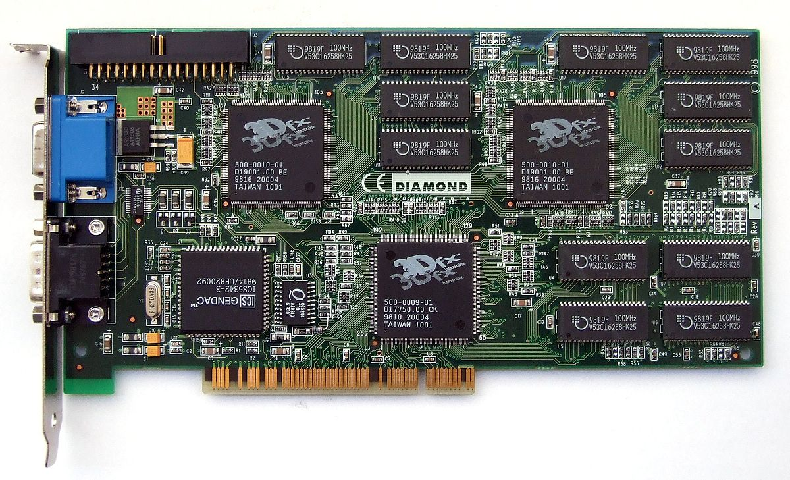
The graphics pipeline
“All the steps an application takes to render”
Also, “the steps the GPU does when you ask it to draw something”, which is different
Let’s take a look at the latter, first
Notes:
The graphics pipeline is as important a concept as it’s ill defined.
One graphics pipeline is everything that happens for your application to render visuals
Another graphics pipeline is everything in your graphics card how they work together to render images

Slide 8

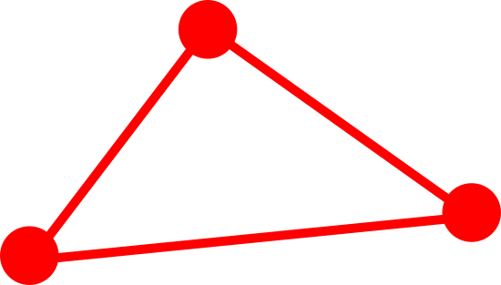

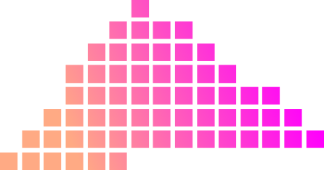
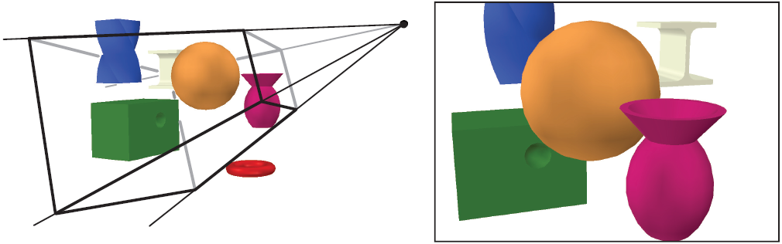
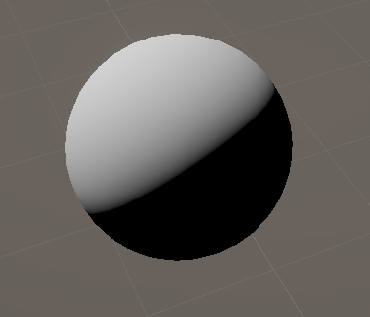
Configurable GPU Pipeline : vertices -> pixels
Configurable means that we can’t program the GPU, only set values
Transform vertices
Rasterize
Calculate pixel color
Notes:
The gpu pipeline takes vertices (which we give to the gpu), and transform them. An important example is that it takes vertices defined in local space or local space, and transforms them into the right position for the camera (camera/view space). Another is animation, which transforms vertices. We also connect the vertices to form triangles, but this is purely a conceptual idea.
Next, the rasterizer turns this conceptual triangle into a bunch of pixels (called fragments).
These fragments are “colored”. This is usually implemented as calculating the light hitting this particular fragment, and shading it accordingly.
Above is the diagram of GPU’s up until about 2005. These GPU’s were configurable. That means we can’t write programs for them, but we can set some settings. An example would be if the object should be drawn with transparency or not.

Slide 9
Configurable -> programmable
Vertex shader
Rasterize (not programmable)
Pixel shader
Shader: program
Massively multithreaded: thousands of pixels/vertices at a time
Glue between shaders is vertex -> rasterizer -> pixels
Notes:
Post 2005, GPU’s started becoming programmable. The vertex transformations stage, and the fragment / pixel processing stage could now run arbitrary programs written by developers. This allowed a lot of algorithms that were impossible to configure, such as cartoon-like shading.
The rasterizer remain configurable, as before

Slide 10
Compute shaders also exist
VS and PS started out as separate hardware
Later, they created a compute shader (CS)
VS AND PS use a CS under de hood
This generalization led directly to the rise of modern AI ☺
Also bitcoin ☹
Most supercomputers use GPU’s….
Not bad for some gaming hardware..
Notes:
This programmability would allow people to realize the GPU could be used to for non-graphical tasks. An early example would be stock option price prediction. The big modern example is, of course, machine learning, which would be prohibit expensive on CPU’s

Slide 11
This class
The graphics pipeline
→ Shaders ←
Materials

Slide 12
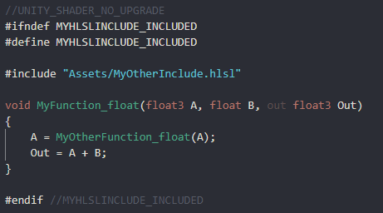
But what does programmable look like?
We use HLSL. GLSL also exists, but they all look pretty similar
They are c-like, have structs and functions, but no oo (inheritance)
You can’t run them directly, you need both when you draw a mesh

Slide 13
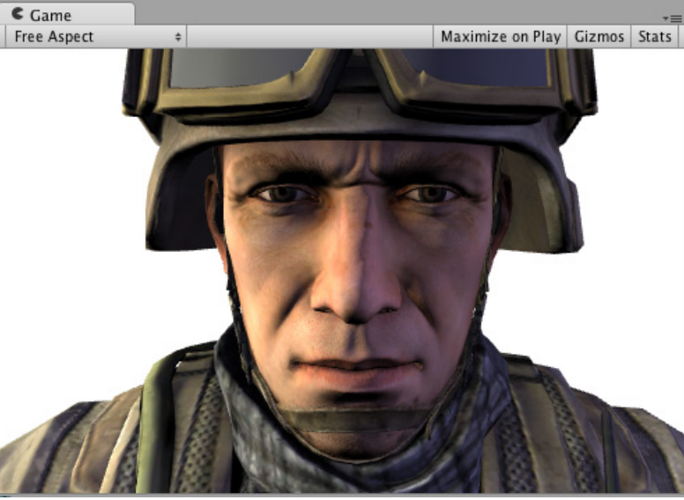
Normal render
Notes:
There is no “normal render”, this is just a mesh rendered with a shader that we’re going to modify in the next slide

Slide 14
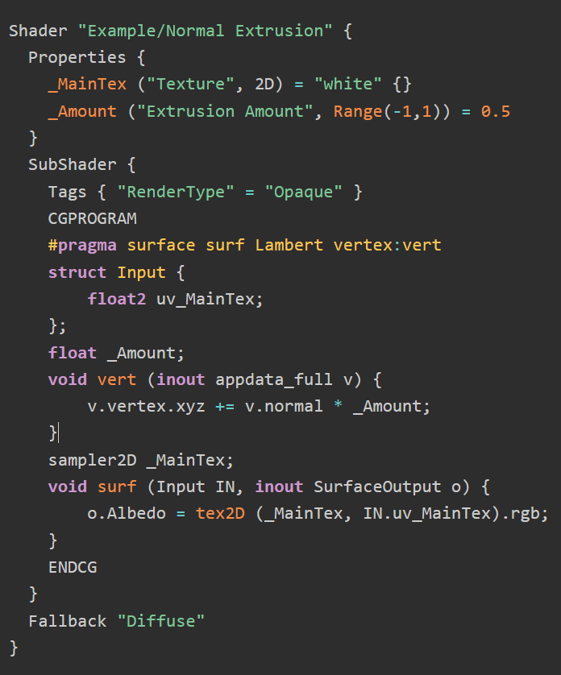
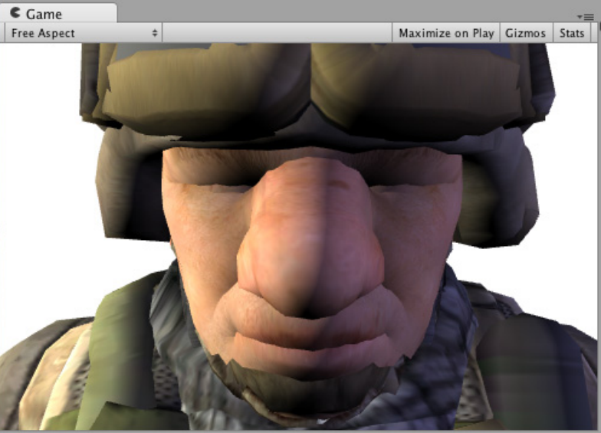
Vertex offset
Notes:
This shader has two methods:
surf, which implements the pixel shader
Vert, which implements the vertex shader, which “blows up” the model by moving the vertices along the normal. This has the effect of moving the vertices away from the original position (skin surfaces), making the model look “blown up”

Slide 15
Properties
Variables that can be accessed (set) from script (cpu)
This is what artists usually interact with

Slide 16
Tags
Can make changers to the rasterizer (opaque == not transparent)

Slide 17
Tags
Can make changers to the rasterizer (opaque == not transparent)

Slide 18
pragma
Weird syntax (preprocessor)
Define global things
Here: which functions is the vs / ps?

Slide 19
Actual vertex shader
Changes position of the vertex

Slide 20
Actual vertex shader
Changes position of the vertex

Slide 21
Actual pixel shader
Changes output struct
More info in a later class….

Slide 22
Vertex shader <-> pixel shaders
Vextex shaders operate on vertices
The shader takes in 1 vertex, and outputs another vertex
Used for animation, positioning the triangle according to the camera
Pixel (also called fragment) shaders operate on pixels
It takes a vertex from the vertex shader (but interpolated by the rasterizer), and outputs one or several colors to get written to render textures or the screen)
Notes:
Don’t worry to much about the fragment shader outputs, we’ll see how it’s used in the more complicated way when we see deferred rendering. For now, it suffices to think of it as output a color to the screen.

Slide 23
This class
The graphics pipeline
Shaders
→ Materials ←
Notes:
Please see a later class for full notes, I left this here for completion

Slide 24
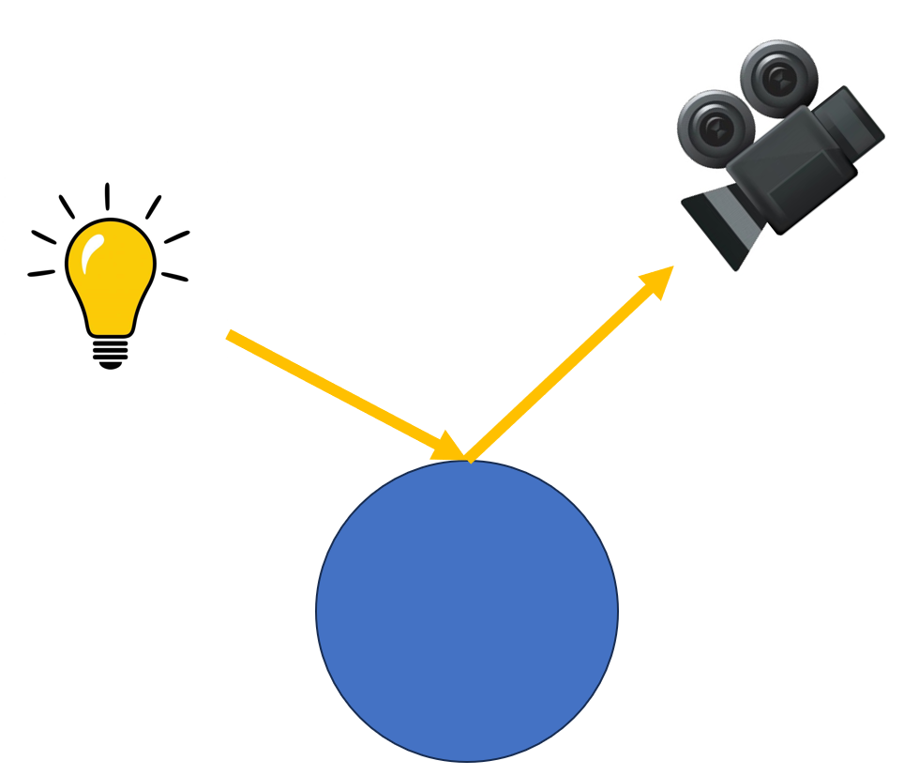
Material ~= BRDF
Material in unity : parameters for a shader
Material “in general” : how a surface reacts to light
Precise term : BRDF
Bidirectional Reflectance Distribution Function

Slide 25
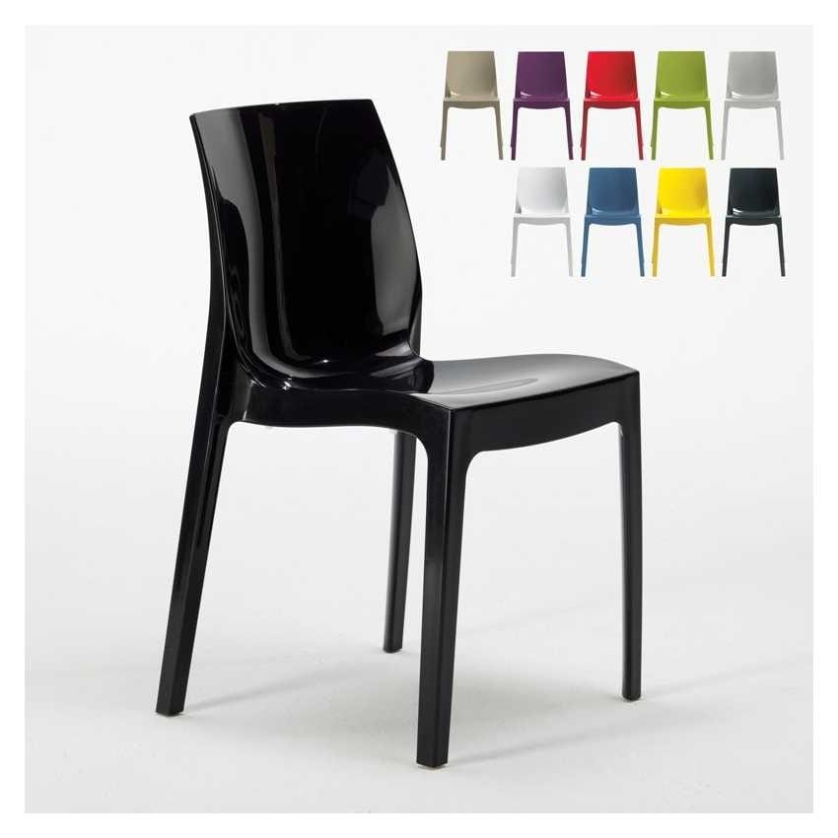
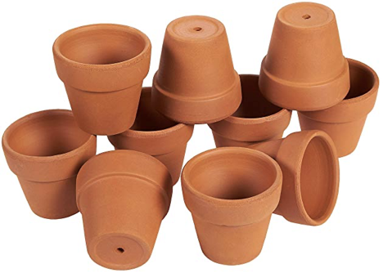
BRDF’s tend to have a diffuse and specular part
Diffuse : independent on view direction (like dirt, unglazed pottery)
Specular : dependent on view direction (like plastic, metal)

Slide 26
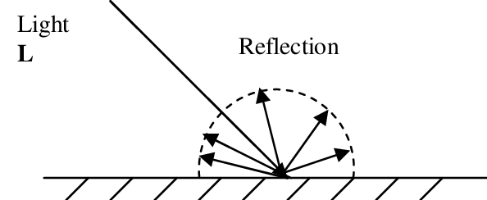
Lambert diffuse
Light enters an object
Scatters / reflects in all directions
dot(N, L)

Slide 27
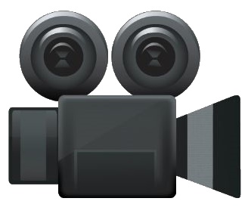
Lambert diffuse
Diffuse is view-independent
Same color / intensity no matter how we look at it

Slide 28
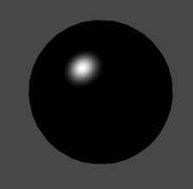
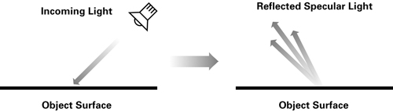
Blinn-Phong specular
“Shininess”
Looks like a highlight
Is view dependent (highlight changes position when you move your head)

Slide 29
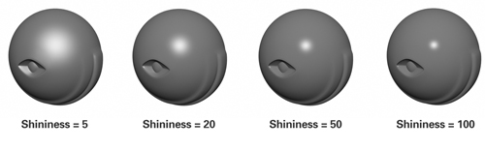
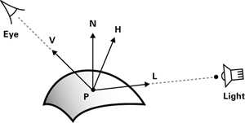
Blinn-Phong specular
specular = K_{s} x lightColor x facing x (max(N · H, 0)) ^{shininess}
More details in lab

Slide 30
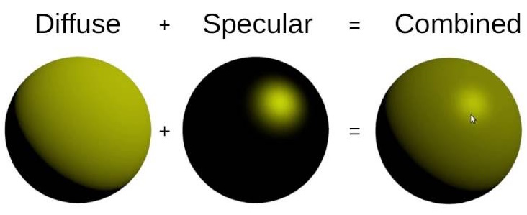
Putting it together
Simply diffuse + specular

Slide 31
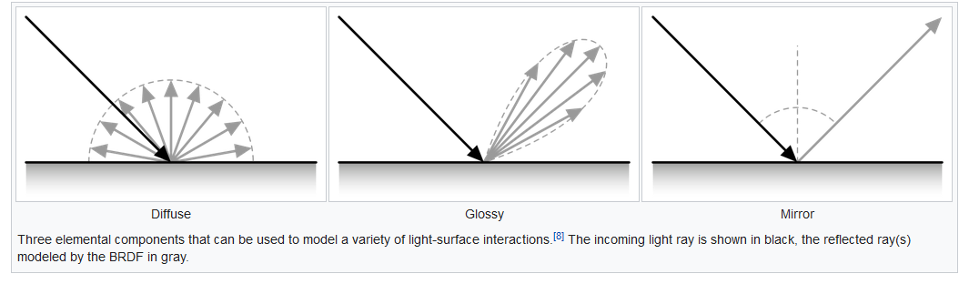
Mirrors are perfectly specular

Slide 32
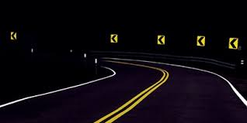
How does this work?

Slide 33
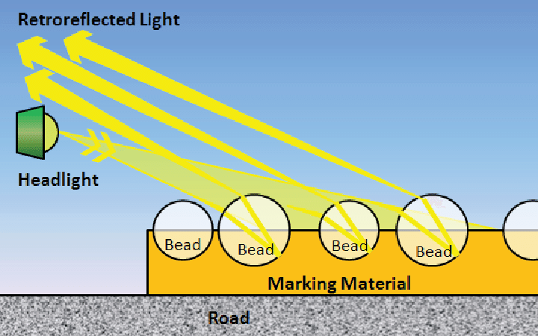
Retroreflectivity

Slide 34
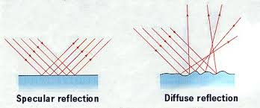
Microfacets
The origin of these models is the microscopic structure of materials
If it’s rough, it tends to be diffuse
If it’s flat, it tends to be specular

Slide 35
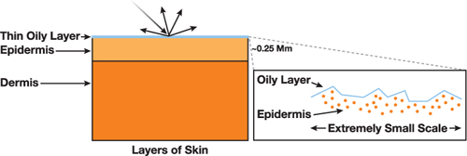
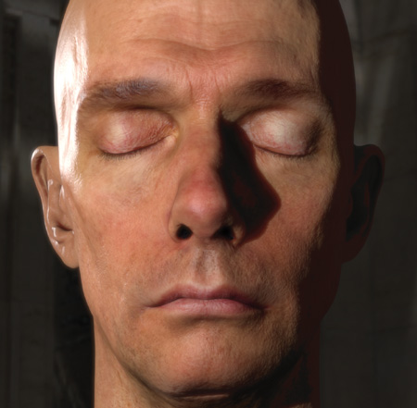
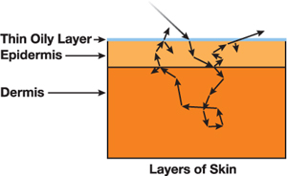
Complicated models : skin
Skin has layers : oil, epidermis, fatty tissues. And light penetrates.

Slide 36
Unity : GGX
Unity uses deferred rendering (more info in advanced pipeline class)
Can only support 1 BRDF
Unity uses GGX

Slide 37
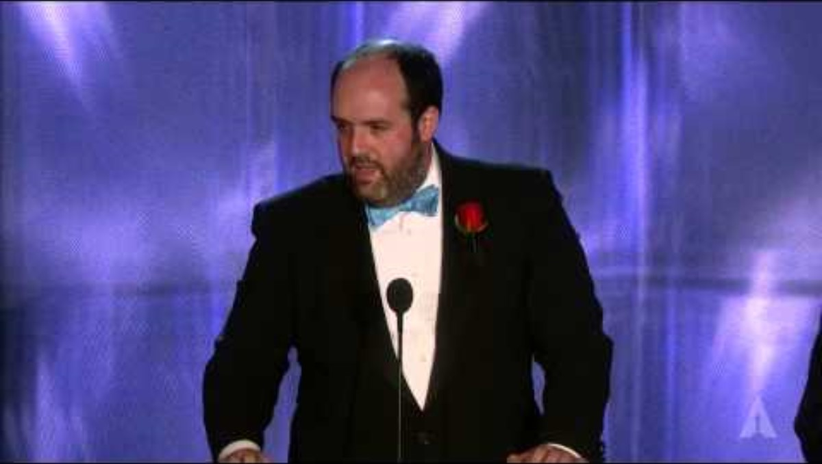
Physically based rendering

Slide 38
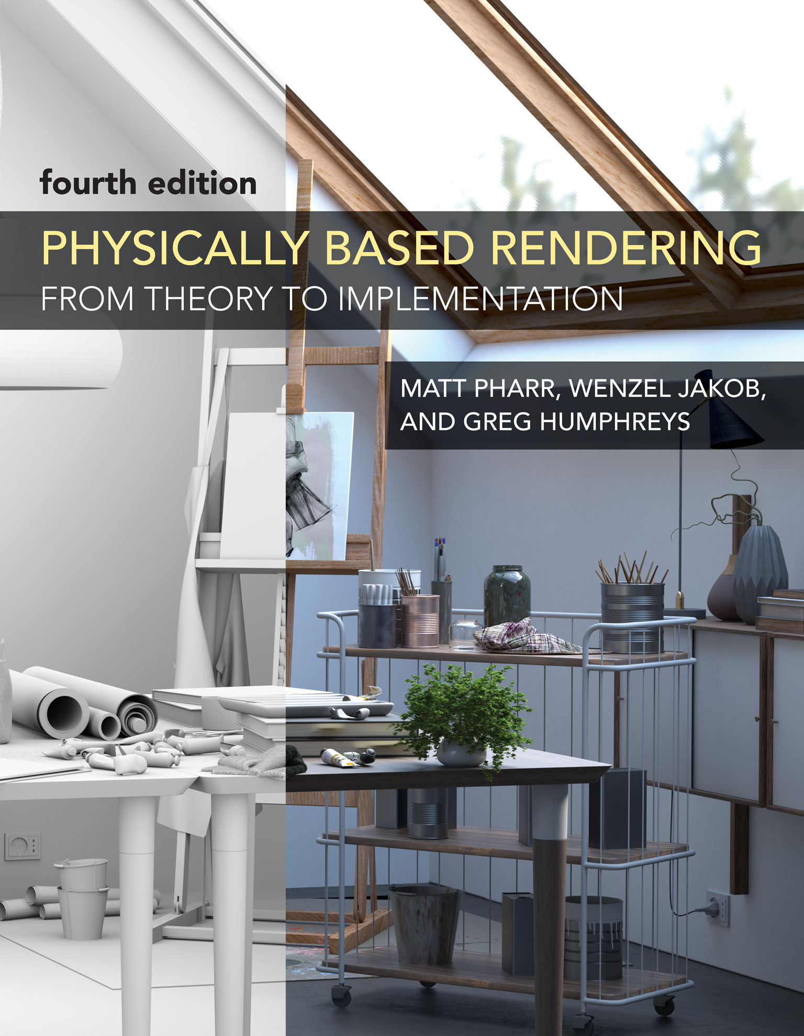
Physically based rendering
So good it won an oscar
Available at https://www.pbrt.org/ for free (not mandatory)
Physically based rendering theory is rendering while respecting physics
Before 2010’s, everything was pretty hacky
When it’s based in physics, everything works predictably
Example: an object should only reflect as much light as entered it
Example: a light shines on all objects (no artist set exceptions)

Slide 39
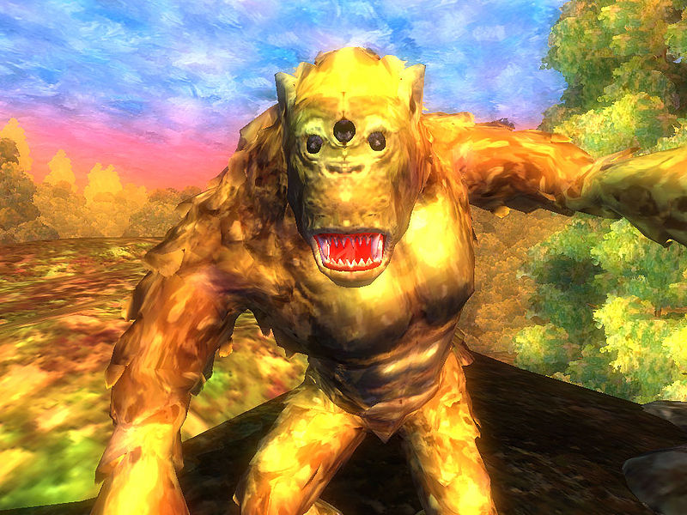
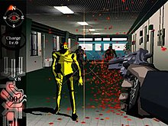
Another idea : Non photorealistic rendering
Because sometimes we don’t want our images to look photorealistic

Slide 40
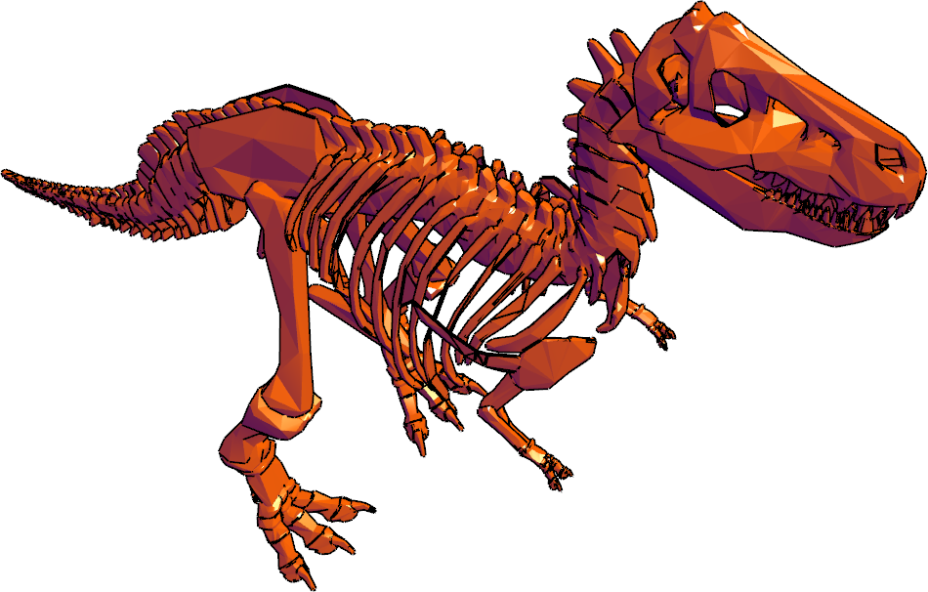
Gooch shading
Used for technical drawing
Want more readability in dark areas

Slide 41
Gooch shading
Normal rendering: dot(N,L) -1 : black 0 : black 1 : color
Gooch rendering
dot(N,L) -1 : purple 1 : color

Slide 42
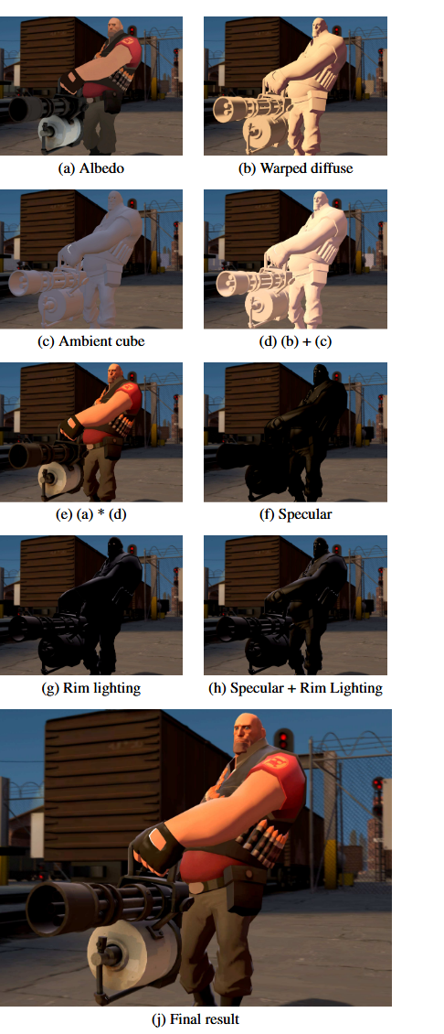
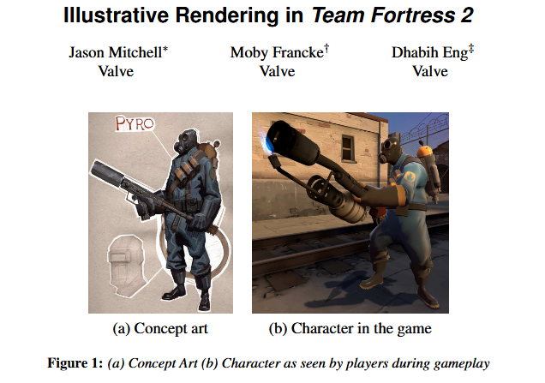
Team Fortress 2 Rendering

Slide 43
Questions? Possible exam questions :
What is the difference between diffuse and specular highlighting?
Give me the algorithm for a diffuse model
What is physically based rendering?
What are difference between the vertex and the pixel shader?
Explain the parts of the GPU graphics pipeline

