Slide 1
Week 5: Proceduralism

Slide 2
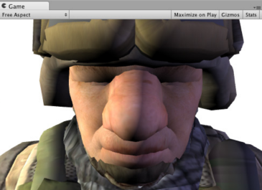
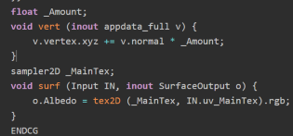
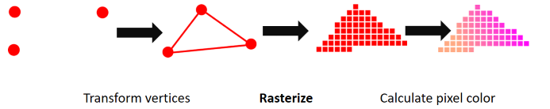
Last class

Slide 3

Course schedule
Week 1 | Introduction
Week 2 | 3D reasoning
Week 3 | Geometry
Week 4 | Pipeline & Materials
Week 5 | Proceduralism
Week 6 | Textures & Normal maps
Week 7 | Post Processing
Week 8 | Advanced pipeline
Week 9 | Aliasing / Presentations
Week 10 : | Project
Week 11 : | Revision
Btw, why is this image here?

Slide 4
This class
→ Introduction to procedural generation←
Simple functions
Complex functions
Infinite terrain

Slide 5
Procedural generation
Making content using code, not data
Using code to make models, textures, etc…

Slide 6
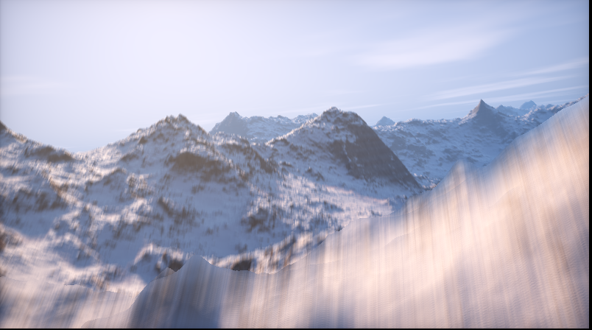
Example : Elevated
Very small (about 4kb)
https://www.shadertoy.com/view/MdX3Rr
Includes renderer!

Slide 7
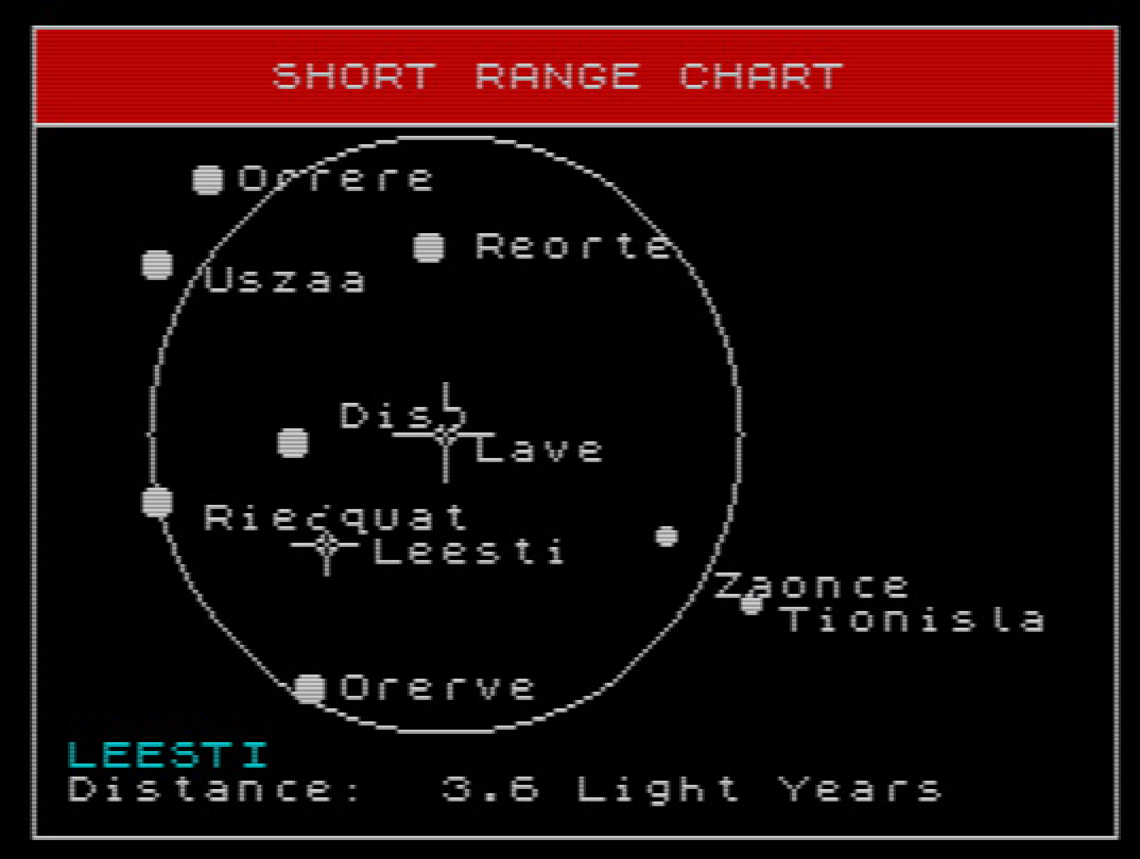
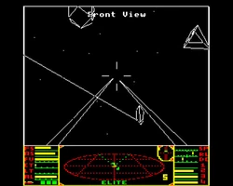
History: Elite 1984
“…star systems were procedurally generated from a fixed seed, which generated the description of the star system, including its economy, government, and population. There were 8 galaxies of stars in the original Elite, each with 256 generated stars.”
“There were originally going to be 282 trillion galaxies in the game, but Acornsoft, the publisher, convinced the developers to trim it down to a manageable eight, each with 256 stars. Running your generator too many times often results in less interesting results.”
“text strings are chosen numerically from a lookup table and assembled to produce unique descriptions, such as a planet with "carnivorous arts graduates"

Slide 8
Why did they use procedural generation?

Slide 9
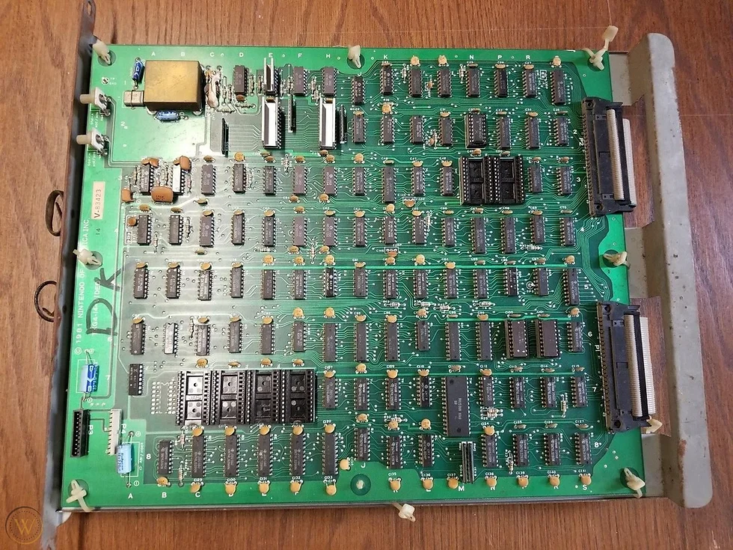
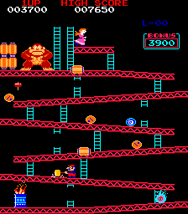
Why did they use procedural generation?
Memory was extremely expensive
Procedural generation allows “on demand” generation
Notes:
On demand means, not when the game is made by the developers, but when the game is running. For example, when you fly to a new planet, the terrain of that planet is generated when the player flies there, not before the game is published

Slide 10
Explicit vs implicit representation
Explicit: everything is stored. For example: Romeo & Juliet. Finite (eg 64kb)
Implicit: everything must be calculated. For example: fibonacci numbers Infinite (potentially)

Slide 11
Quick random number recap
Random number sequence: 77, 1, 4, 9, 0, 0, 0, 0, 0, 0, 0, 0, 1, 31, 25
Deterministic from seed! Same seed, same sequence Seed : 15 Rand : 1, 5, 5, 1, 84, 38, 94 Seed : 17 Rand : 208, 198, 150, 28 Seed : 15 Rand : 1, 5, 5, 1, 84, 38, 94
Elite used seed to have the same planets every time (why?)
Pseudorandom, but for us that is fine (not for encryption)

Slide 12
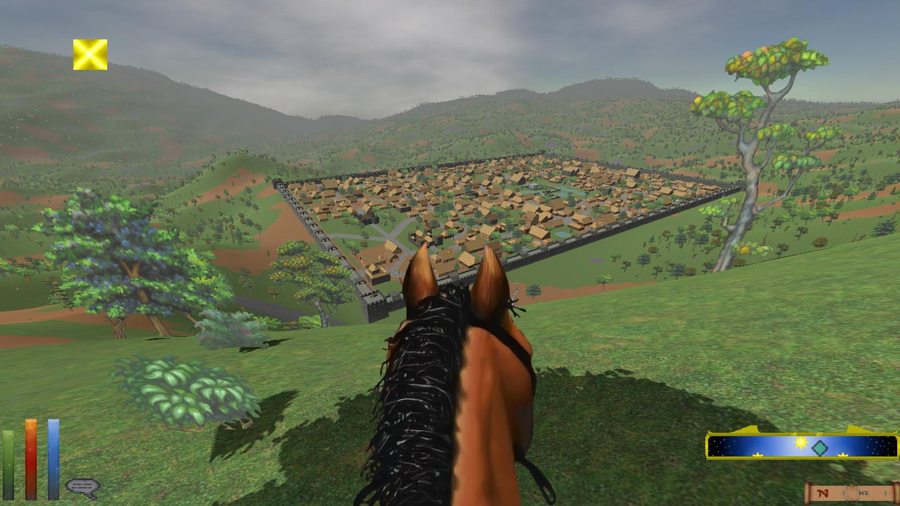
Elder Scrolls : Daggerfall 1997
Procedural generation for terrain, villages, npc’s
229,000 square kilometers
Why would they use procedural generation?

Slide 13
Elder scrolls : reasoning
Space reasons
If we had 1Gb, and 32bit rgb, how big of a patch (in cm2) would one color cover?
But also artist time
Any problems with this approach?

Slide 14
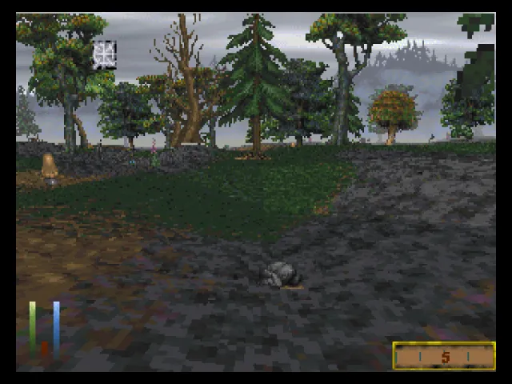
Elder scrolls : “sameyness”
When we use the same algorithm a lot of times, everything still looks similar
(50 shades of gray)
Only very little of the terrain is interesting

Slide 15
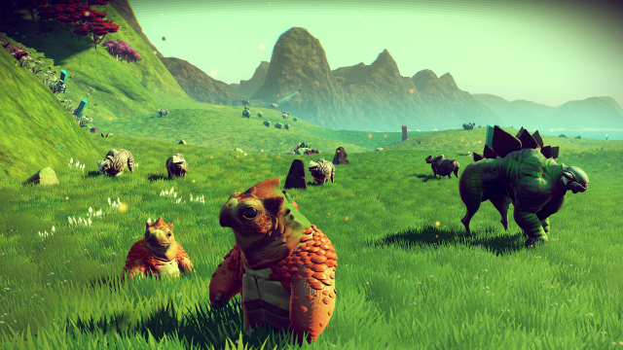
No man sky

Slide 16
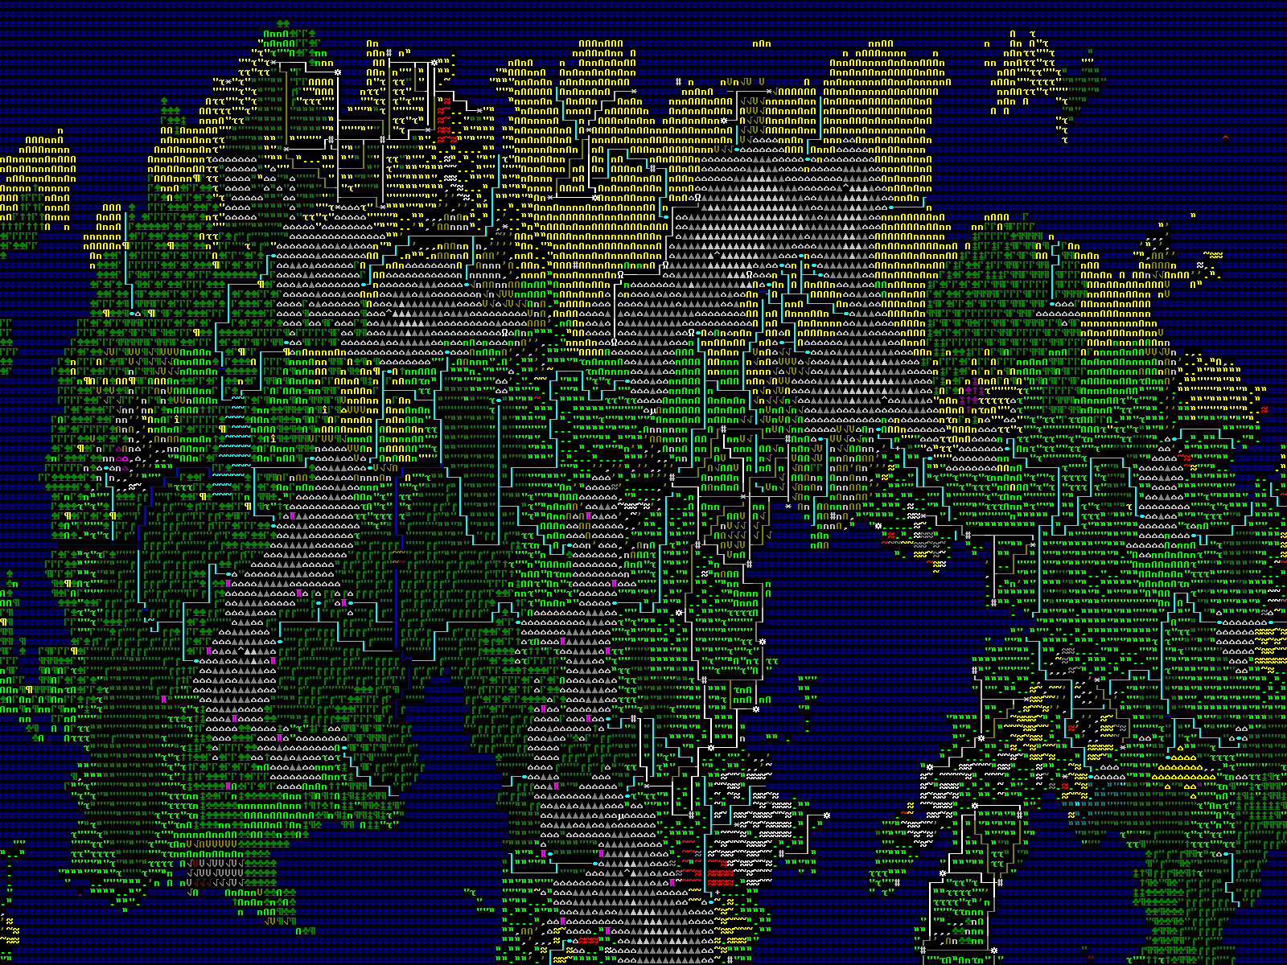
Dwarf fortress
Generates world
And history
And pantheon
And description
“On the wheel of cheese is an image of a wheel
cheese”

Slide 17
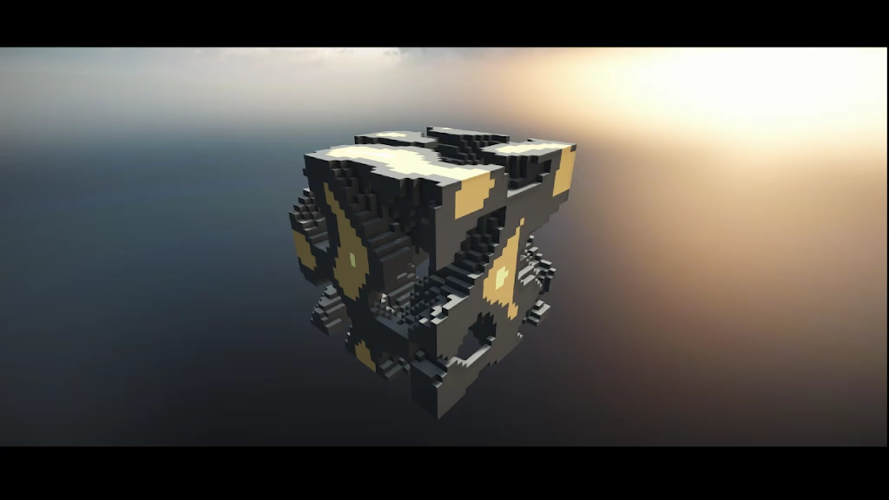
Kaspar’s experiment
Notes:
Friend of mine (who works at Lugus studios, interesting simulator / game company) knocked this up in unity in an hour or two

Slide 18
Takeaway
Proceduralism creates content algorithmically
Big advantage is very little size on disk
Other is potentially infinite content
Even though it can feel repetitive / ‘samey”
Random numbers can be deterministic (repeating), and that’s good

Slide 19
This class
→ Introduction to procedural generation←
Simple functions
Complex functions
Infinite terrain
I also deliberately put a mistake in these slides, prize for who finds it

Slide 20
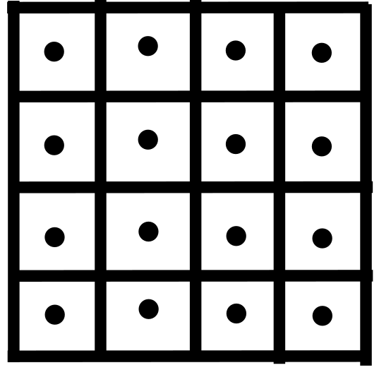
So that was fun, but how does that help us?
We need to determine which blocks go where
We usually see this as a 3D function
BlockType getType(int x, int y, int z)
What is the simplest implementation?

Slide 21
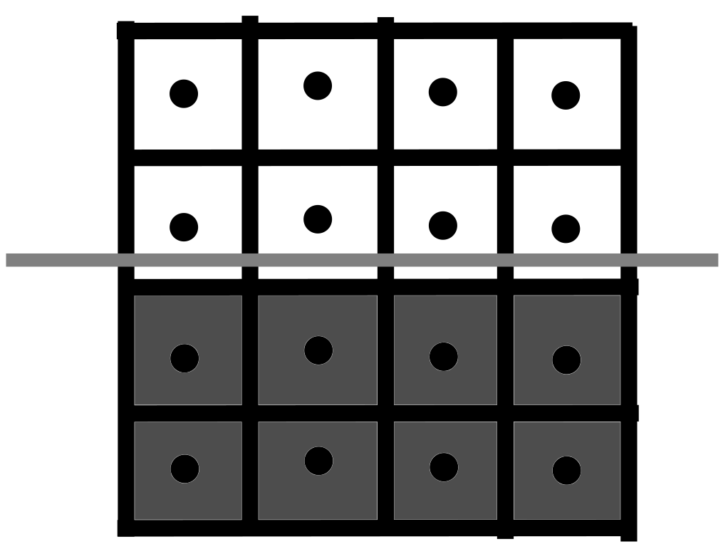
Simplest terrain: flat
BlockType getType(int x, int y, int z)
{ if (y < height) return Stone; return Empty; }

Slide 22
Simplest terrain: flat
Important
We use math for the way it looks
Not because it calculates a specific thing
What would we use for something more “hilly”?

Slide 23
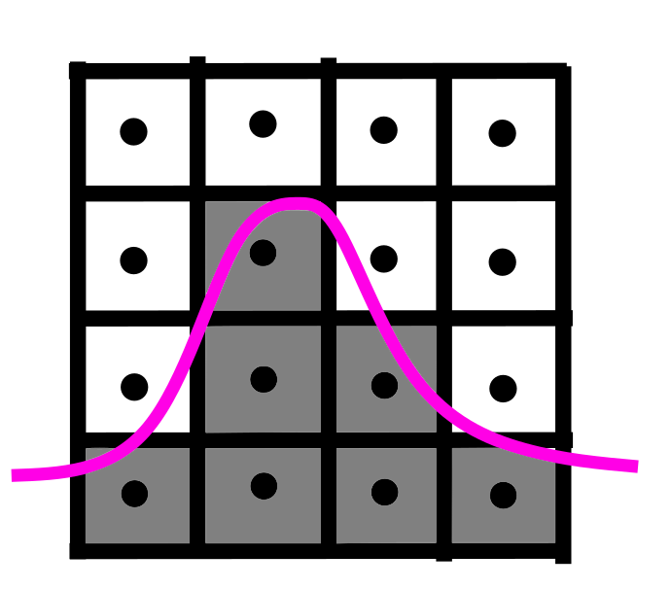
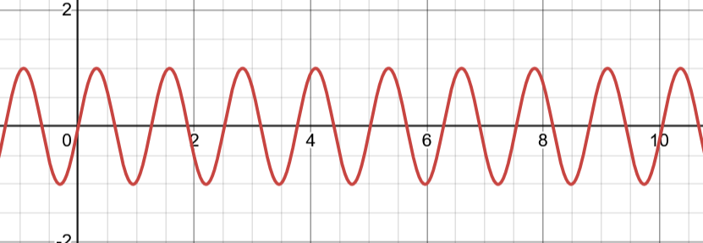
Wavy terrain: sin
Looks hilly ☺
Repetitive ☹

Slide 24
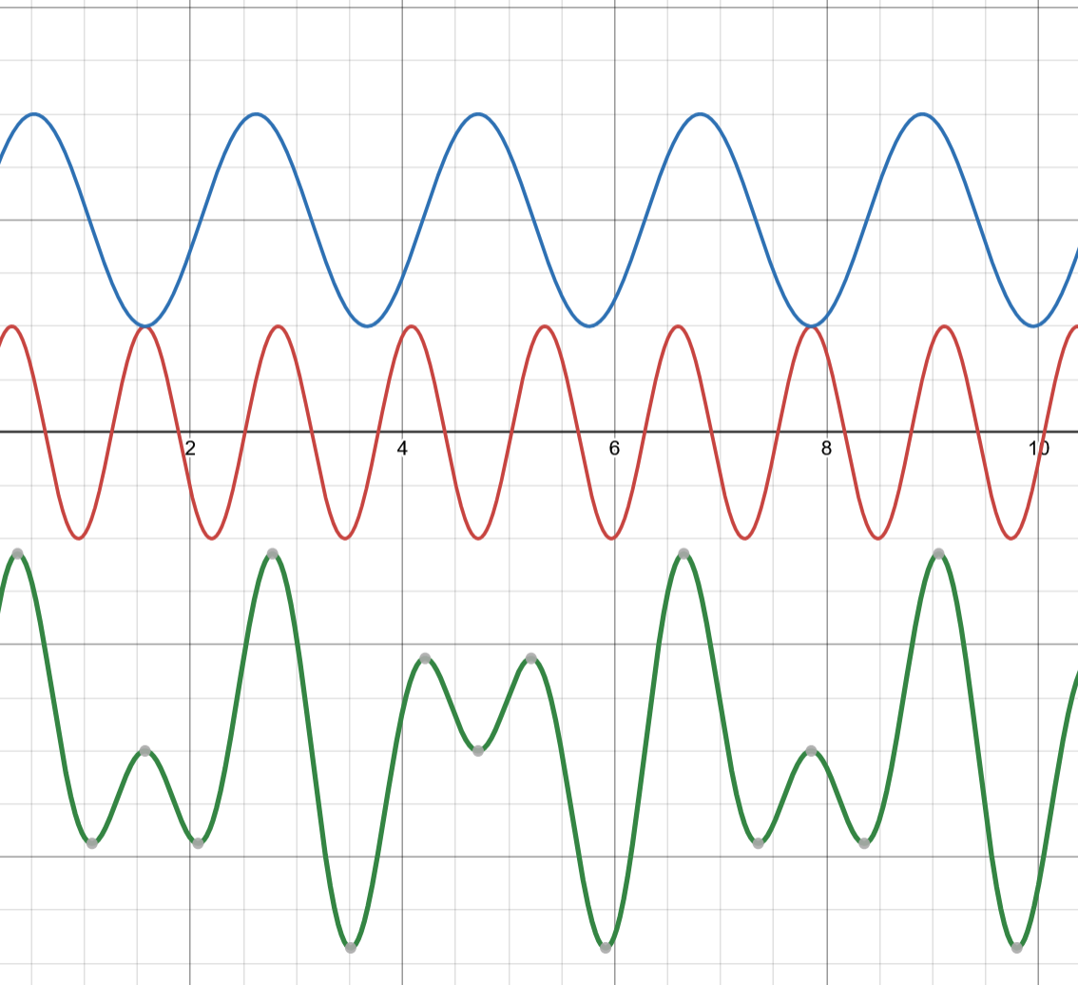
Build complex shapes from simple blocks
Here I added 2 sine waves

Slide 25
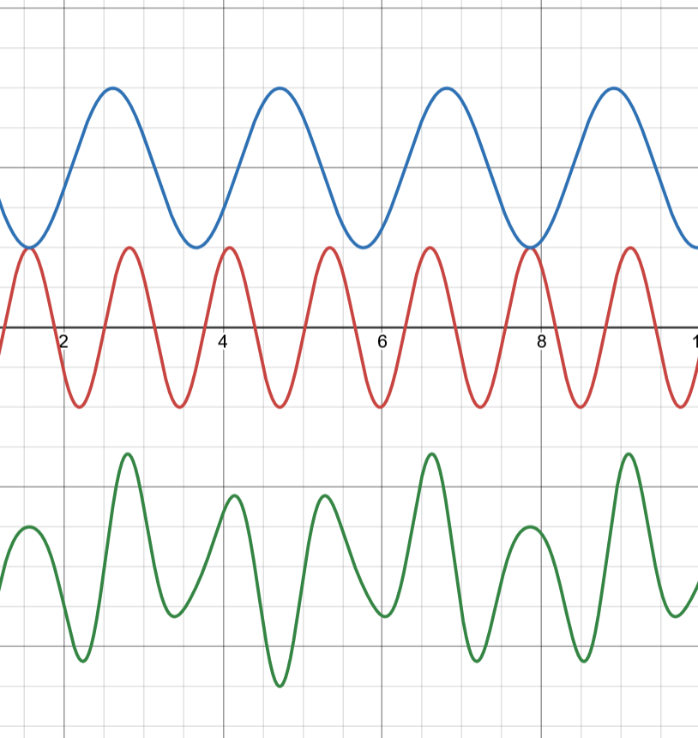
Build complex shapes from simple blocks
Here I multiplied 2 sine waves

Slide 26
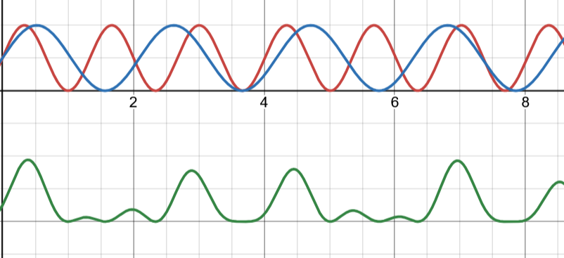
Build complex shapes from simple blocks
Here I multiplied 2 sine waves
Before, I made them go from 0 - 1

Slide 27
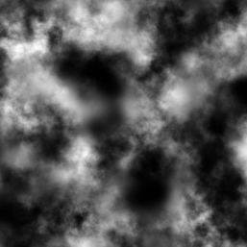
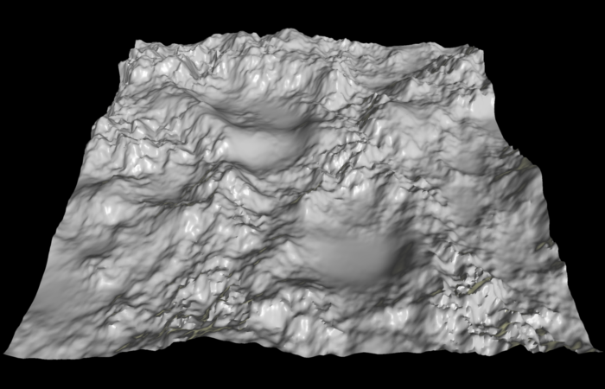
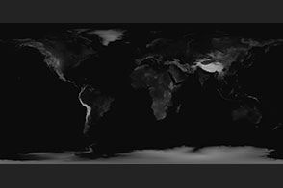
Heightmaps
Use a texture to store height
Use texture on a plane
Offset with texture value
Great for tooling! (photoshop, terragen)
Great for explaining noise

Slide 28
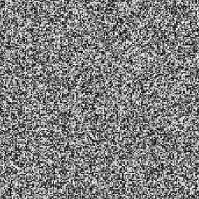
Random numbers
No correlation between numbers (samples)
Any number can come after any number

Slide 29
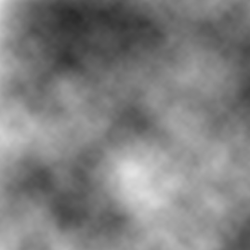
Value noise
Interpolates between random numbers

Slide 30
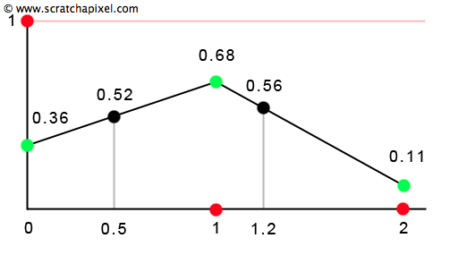
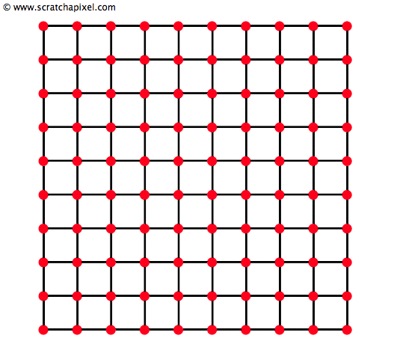
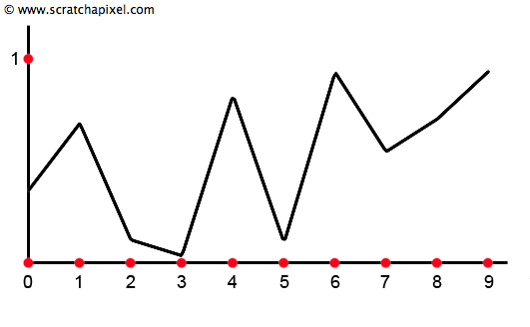
Value Noise

Slide 31
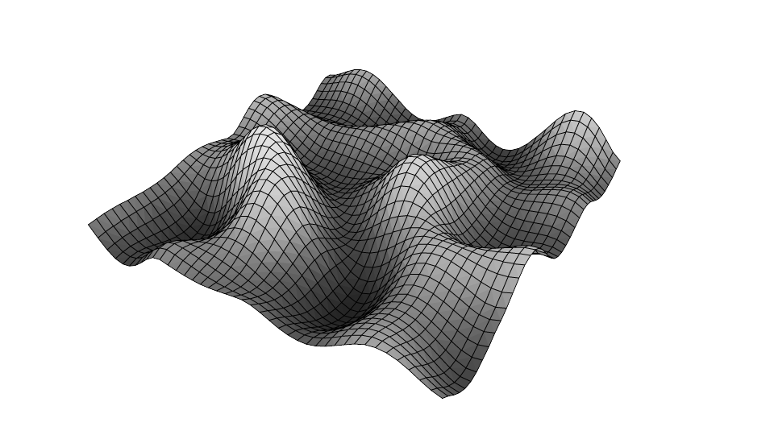
Value Noise
Getting somewhere
Too smooth
Equally chunky everywhere

Slide 32
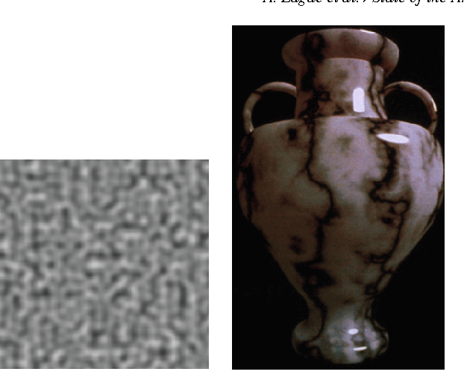
Other noise
Perlin noise : the original one
Often interchangeable
Value noise is usually better, especially on the gpu

Slide 33
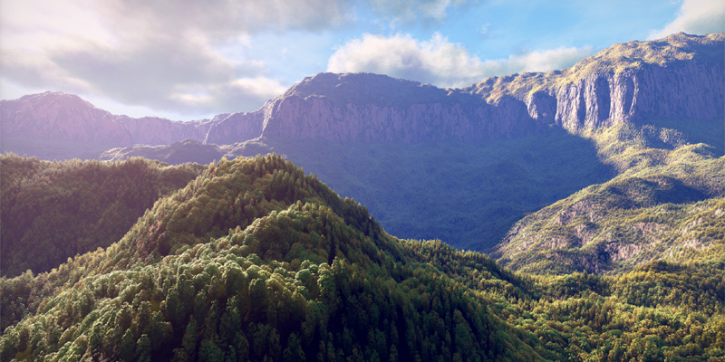
Making it better : fBm

Slide 34
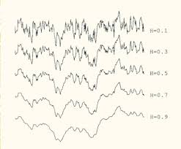
fBm: fractal Brownian Motion
Add several layers value noise (like we did with sine waves)
Make each layer smaller, in all dimensions
Notes:
fBm is several loop iterations (usually called octaves, close but smaller than 10, eg 7) of noise added together. Each iteration, the peaks and valley of the noise get bigger together by scaling the input coordinate, and the output value is scaled smaller
The first iteration is the really large scale details : mountaintops, hundreds of meter high, 100’s of meters apart
The next iteration could be smaller tops, a couple on the same bigger one from the previous iteration
The next iteration could be smoother hills, 10 tens of meters, apart
The last iteration could be very small height variations only centimeters apart.

Slide 35
This class
Introduction to procedural generation
Simple functions
→ Complex functions ←
Infinite terrain

Slide 36
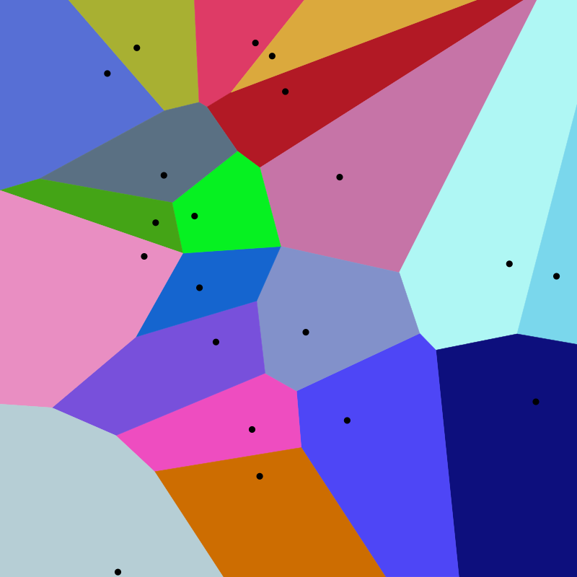
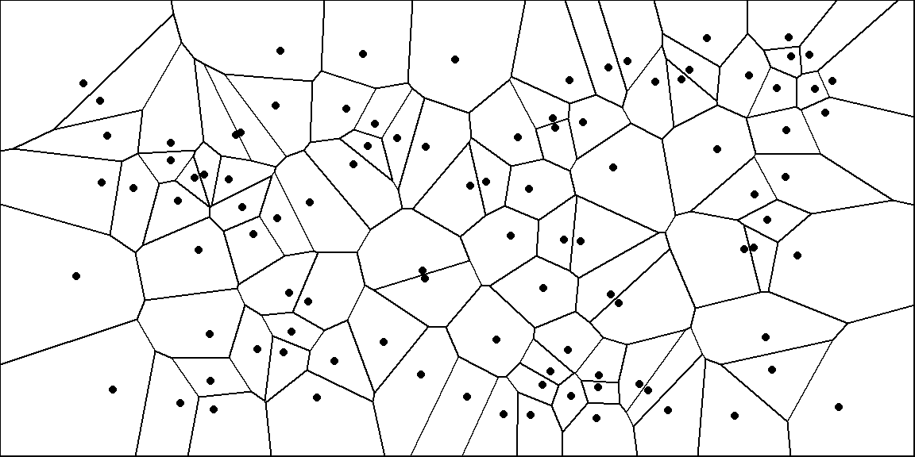
Voronoi
Generate random points
Assign random value to point
Sample: take closest point’s value

Slide 37
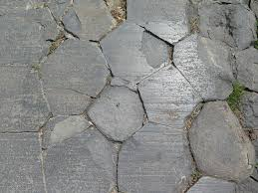
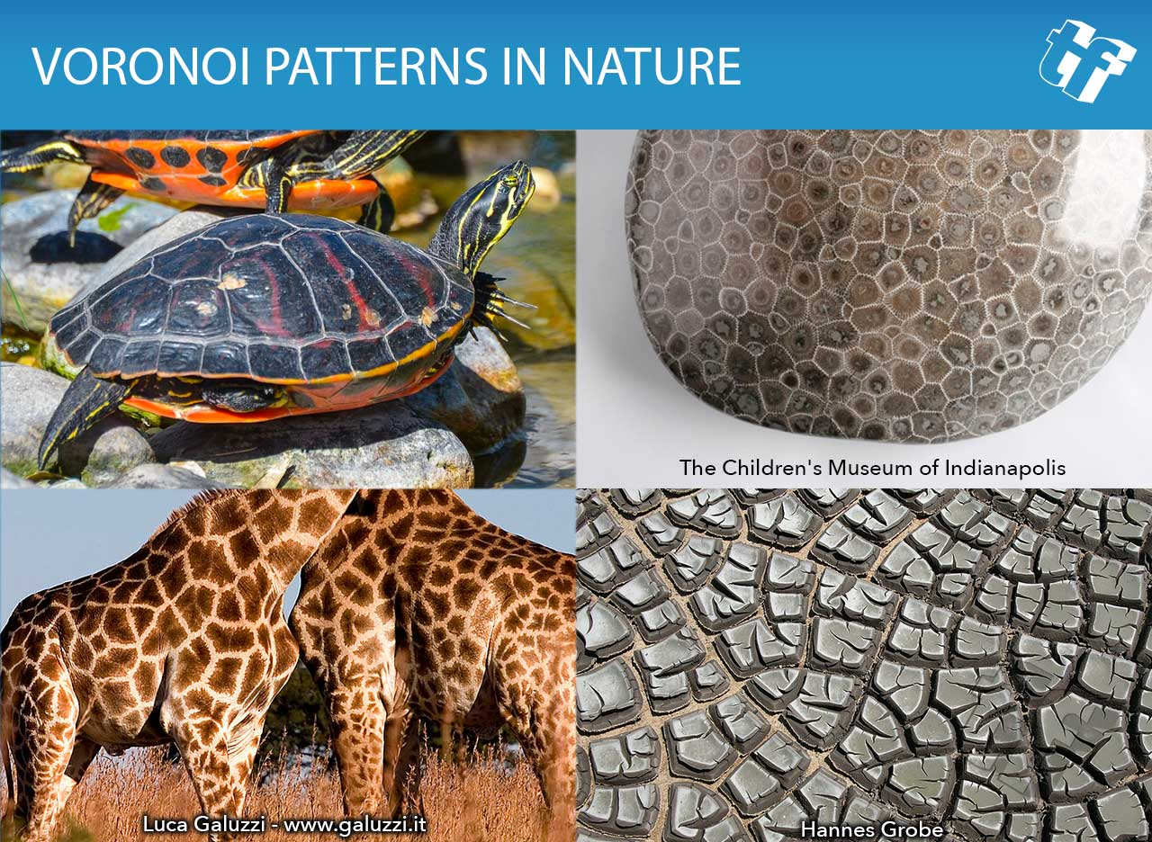
Voronoi applications

Slide 38
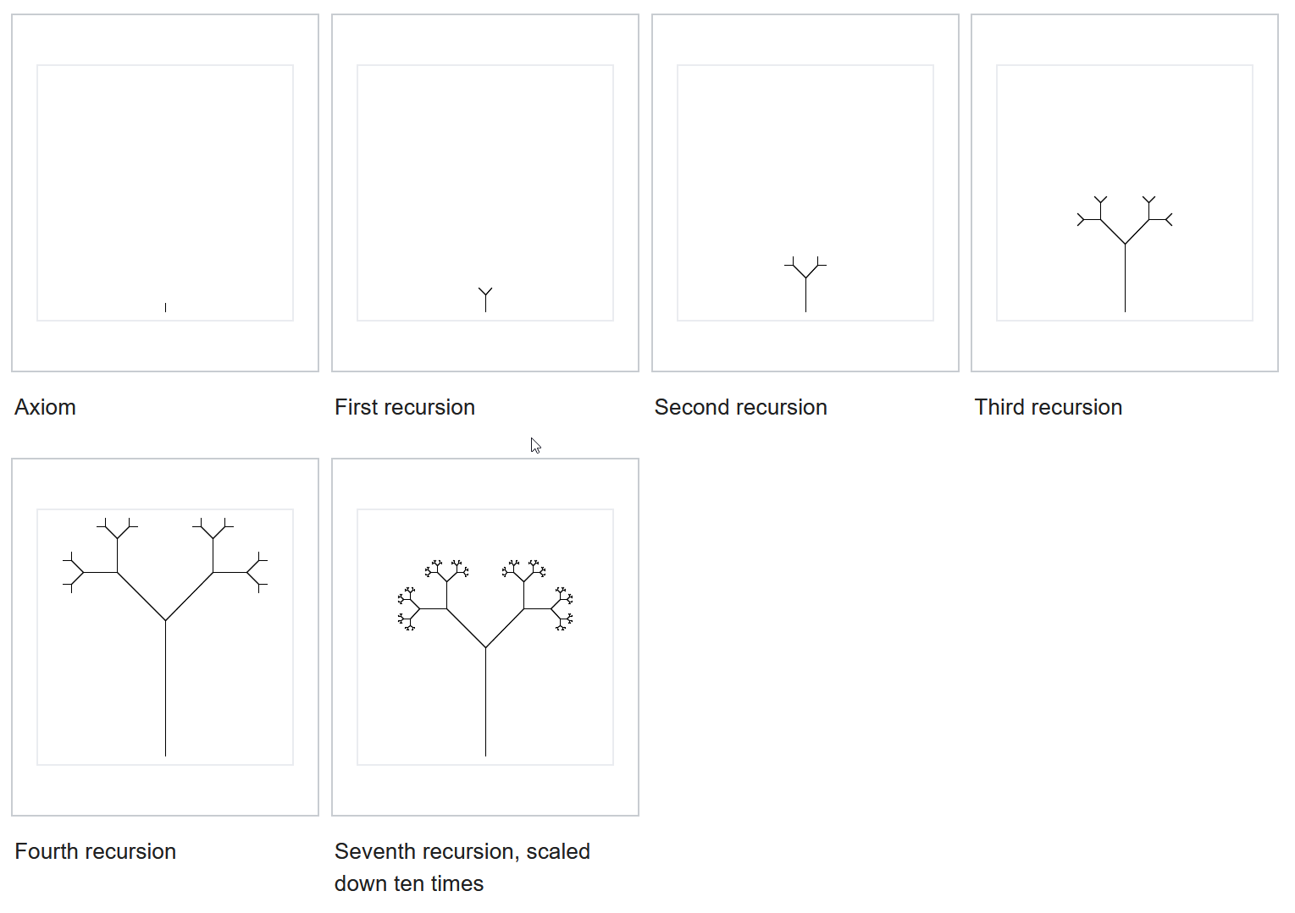
L Systems

Slide 39
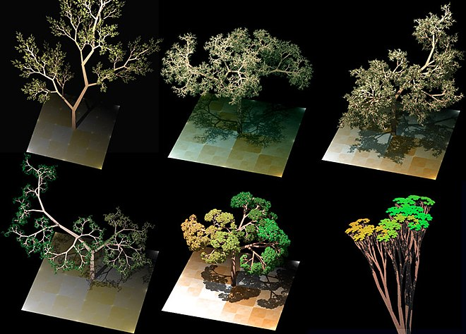
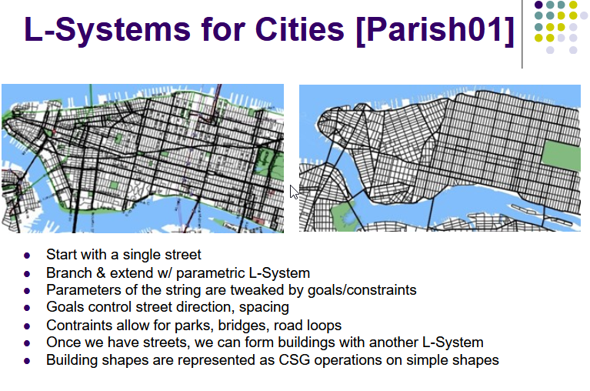
L Systems

Slide 40


Slide 41
This class
Introduction to procedural generation
Simple functions
Complex functions
→ Infinite terrain ←
I also deliberately put a mistake in these slides, prize for who finds it

Slide 42
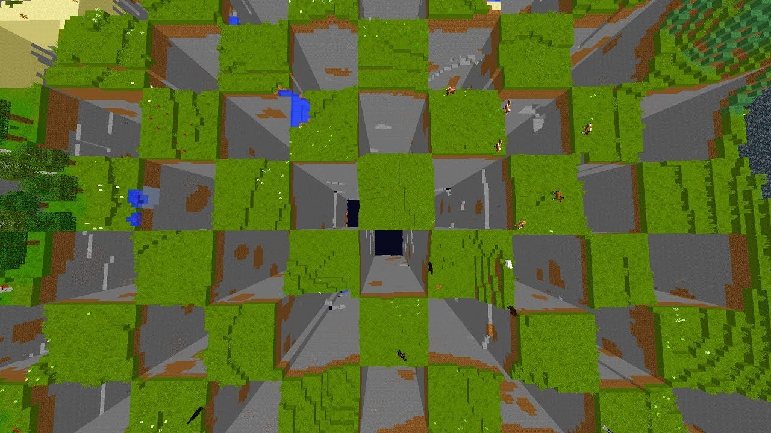
Infinite worlds

Slide 43
We want an infinite world
But we only have a finite … something
What is keeping us from having infinite chunks?

Slide 44
Let’s whiteboard for a bit, see if we get there

Slide 45
We have limited chunks
We are limited on memory
We are limited on render time (framerate)
We want a limited amount of chunks (eg 100)
Which chunks?

Slide 46
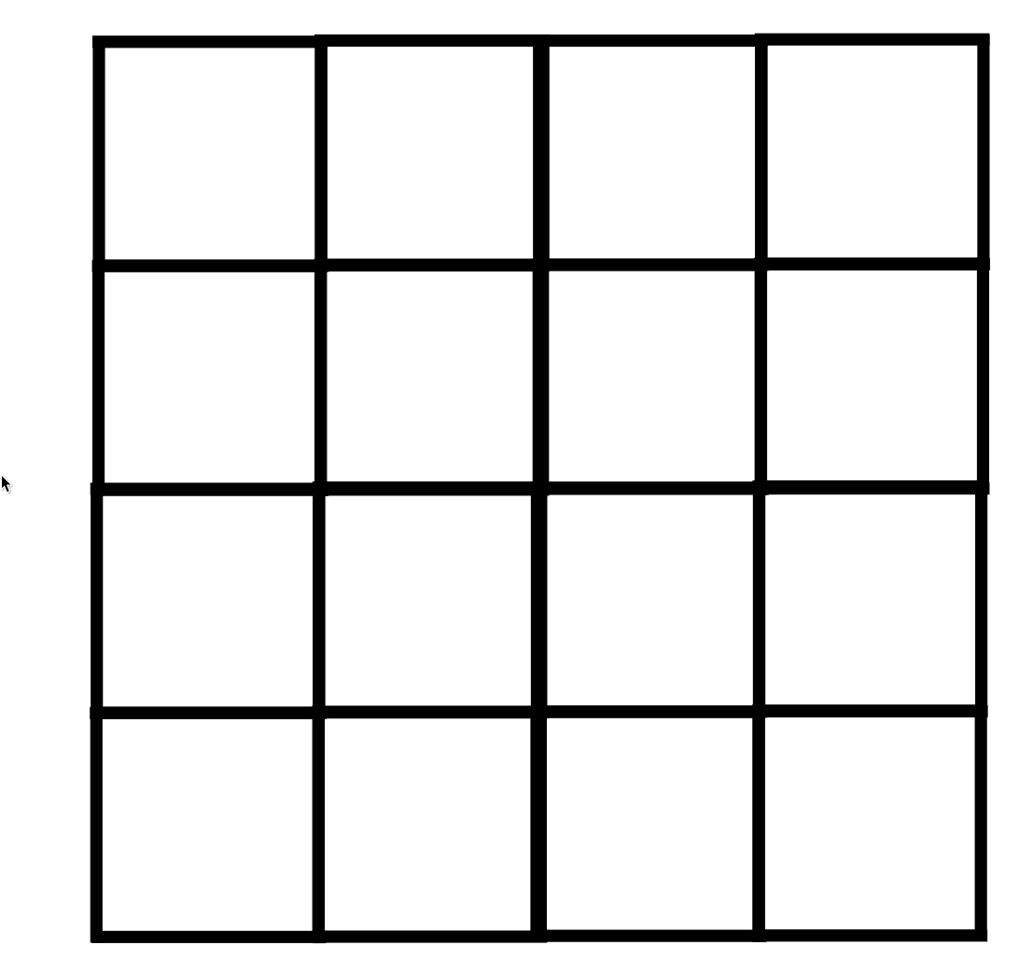

We want the chunk in view, close to the camera

Slide 47
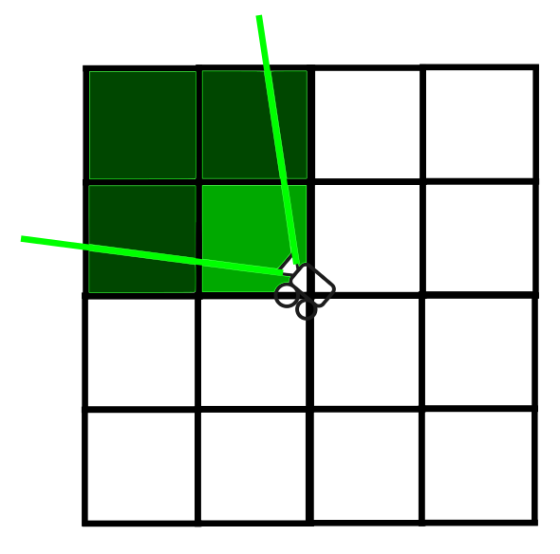
We want the chunk in view, close to the camera
Distance = distance chunk (bounding box) to camera position
In view = bb in frustum camera
Notes:
This only tells us “how desirable”, how much we want a chunk to be loaded (we need to pick which ones)

Slide 48
Heuristic
Make a list of potential chunks (eg closer than 1000 units)
Give them a score (single float): how close, how much in view…
Sort them on score
Compare with what you have already loaded (resident)
Remove resident chunks with a lower score than a chunk that isn’t loaded with a higher score
Always keep a constant # loaded
Notes:
We have two real problems: Load a certain amount of chunks at all times
Make sure those are the most desirable
Above accomplishes that by looking for a lot of close chunks, and the ones already loaded. Taking the N with the highest score (desirabity) achieves what we want

Slide 49
Questions?

Slide 50
Next week
Textures
Normal maps (normals in a texture)

