Slide 1

DE + AR
2025
So, what is a bug anyway?
Week 9: Forward rendering / renderdoc

Slide 2
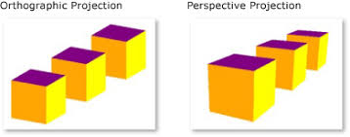
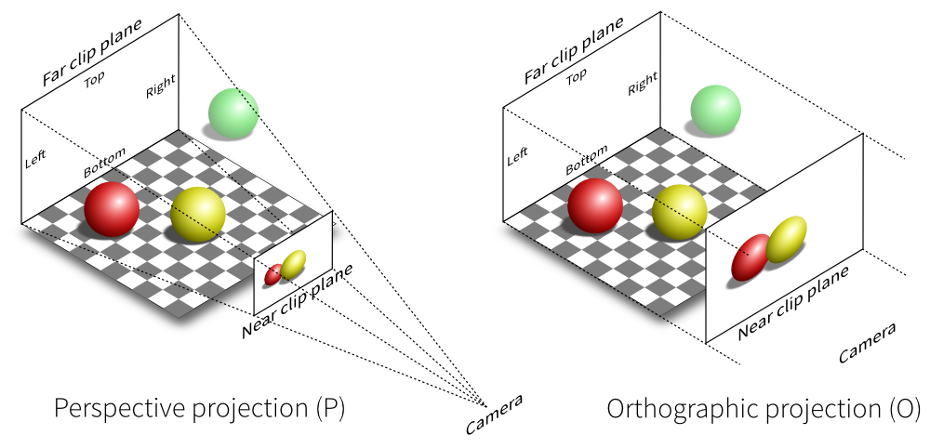
Last class : Camera’s

Slide 3
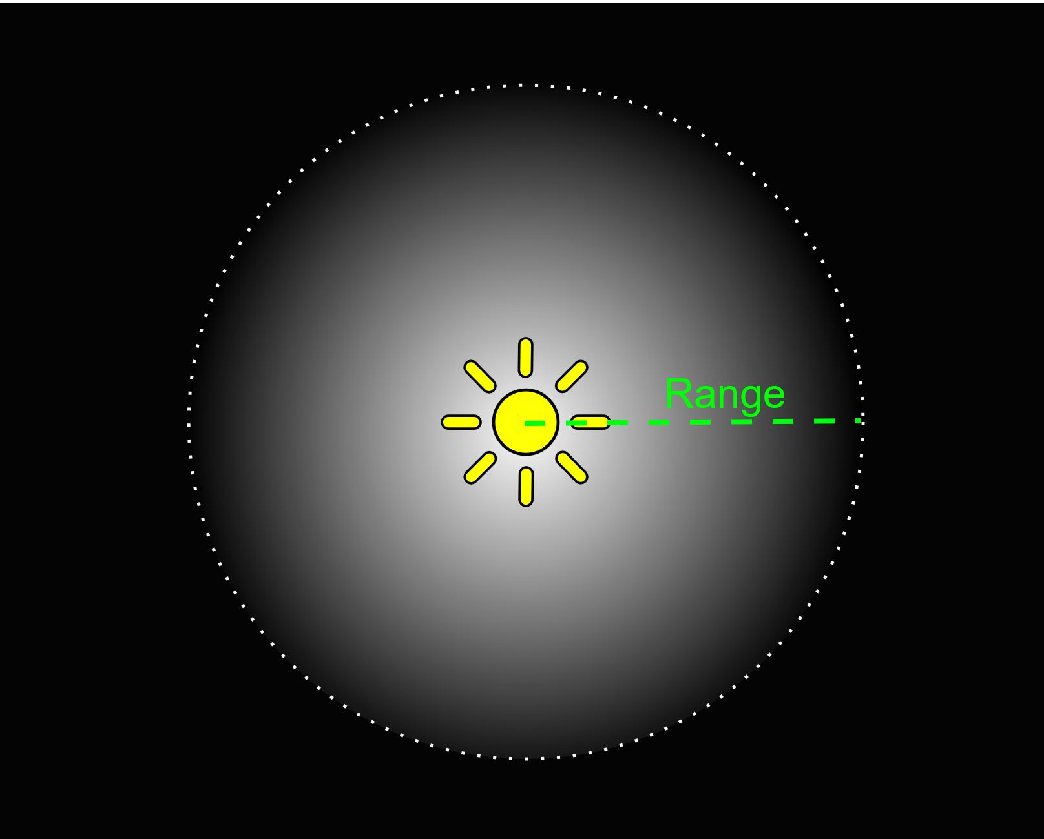
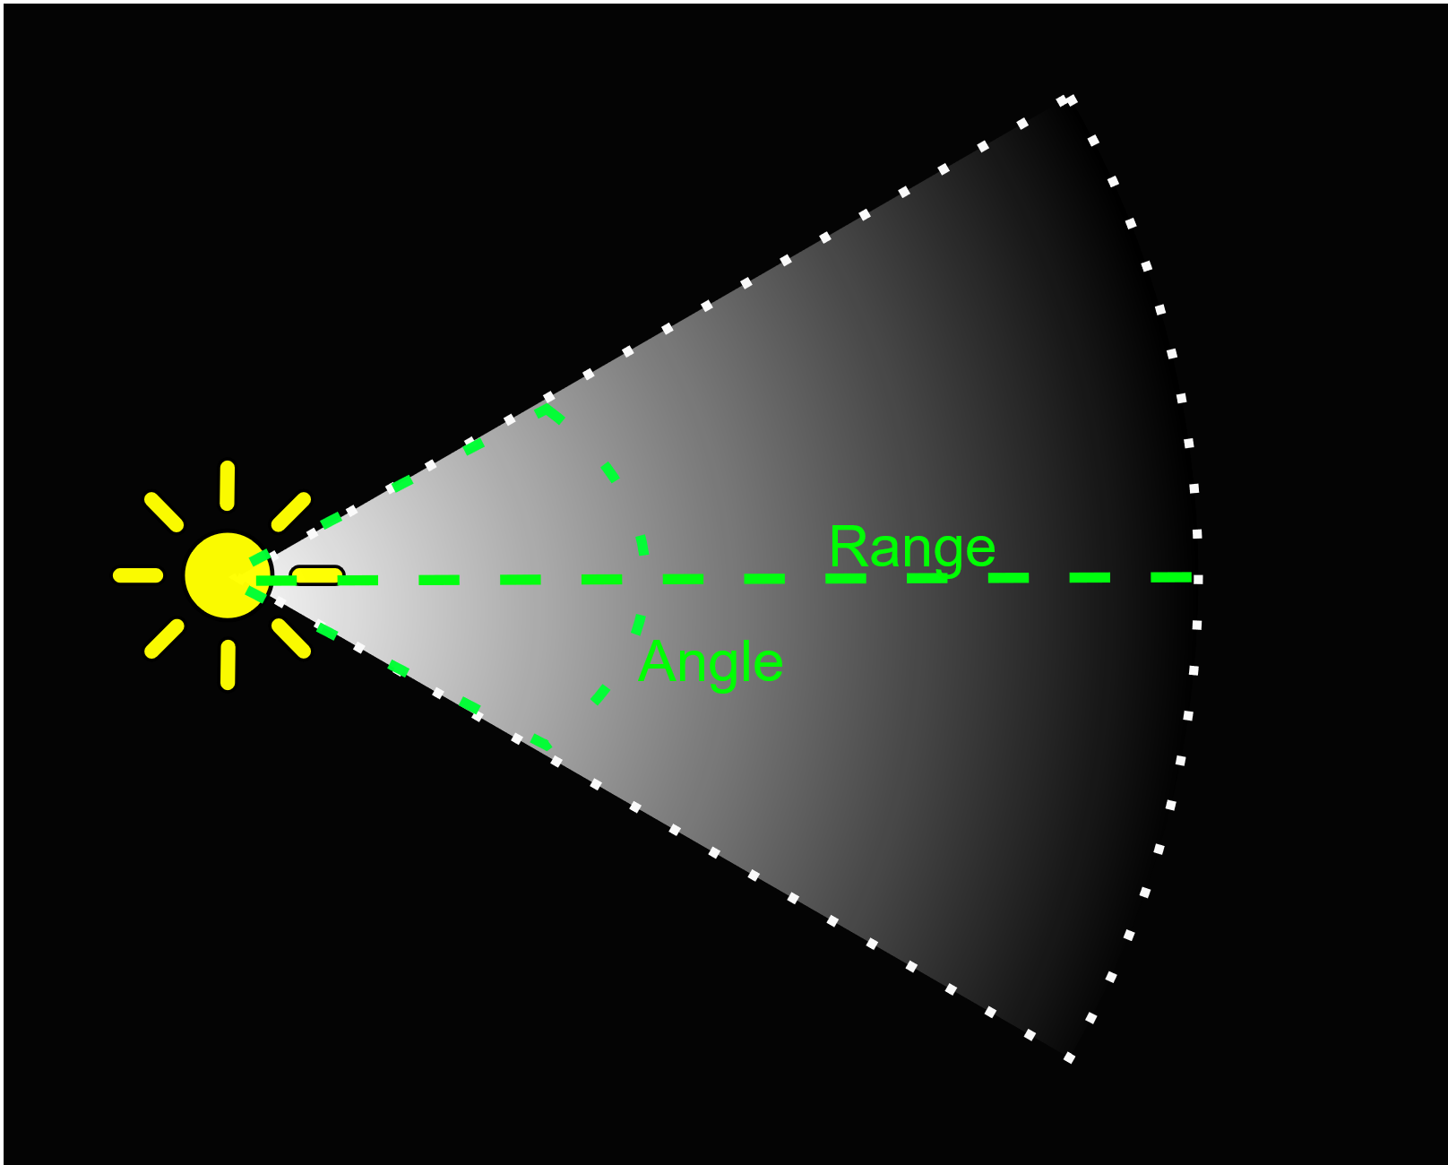
Last class : Light’s

Slide 4
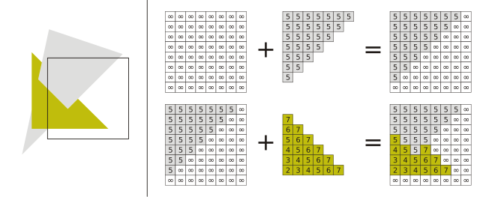
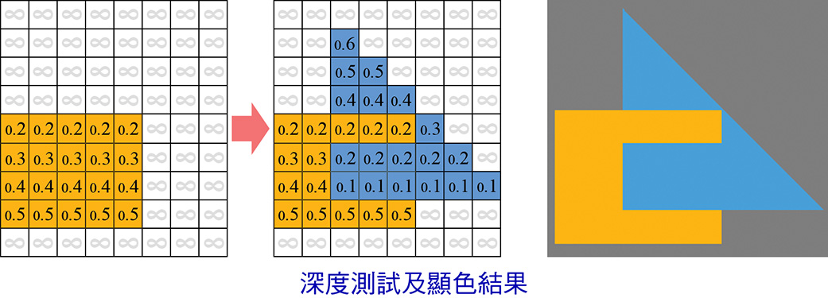
Last class : depth buffer
What does it do?
Give 2 uses

Slide 5
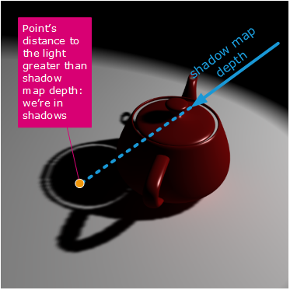
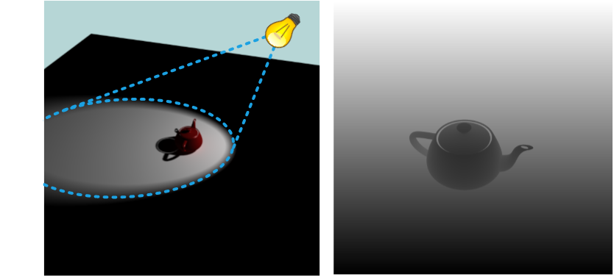
Last class : Shadows

Slide 6

Course schedule
 |  | Wed
Week 1 |  | Introduction
Week 2 |  | 3D reasoning
Week 3 |  | Geometry
Week 4 |  | Pipeline & Materials
Week 5 |  | Proceduralism
Week 6 |  | Textures & Normal maps
Week 7 |  | Aliasing / Presentations
Week 8 | Lab | Advanced pipeline 1 Lab
Week 9 | Advanced pipeline 2 Lab | Post Processing
Week 10 | ? | Project
Week 11 | ? | Revision
Highly likely to change ☹

Slide 7
It’s suspiciously quite
In my inbox
In the github classroom
Is everything ok, or am I not hearing about it?
Make sure you have the most recent project from Toledo!!!!!

Slide 8
This class
→ Original problem ←
Forward rendering
Renderdoc

Slide 9

Original problem
What problem are we learning to solve? In this entire course

Slide 10
Original problem
How to create this image
In real-time

Slide 11
Original problem
Image = 2 million pixels (1080p)
Almost the same question as: What is the color of one pixel?

Slide 12
Original problem
What is the color of one pixel?
Two separate problems: Which triangle? Which color on the triangle?

Slide 13
Which triangle?
This is the primary visibility problem
In rasterizers, it’s solved using a depth buffer

Slide 14
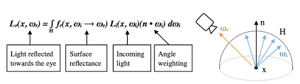
Which color?
This is the most difficult problem
It’s already solved in the rendering equation
I don’t expect you to know the equation, or be able to read it
I do expect you to know what it says “The light exiting from a surface, is the sum of all the light reflected by the surface. The reflected light is the incoming light, changed by the material (brdf) and weighted by the angle (dot product)”

Slide 15
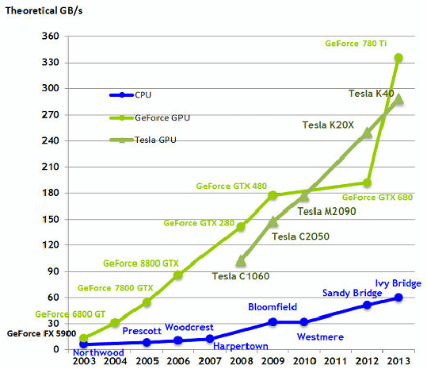
How does this help us?
We can’t render equations
We need to translate this into code
But it gives us a goal, keeps us from “hack stuff until it looks right”
Most importantly, we need to do as much work on the GPU as possible (why?)
Notes:
Because the cpu is wanted by *everyone*. In a game, physics, gameplay, audio, multiplayer code, is all running on the cpu. As well as discord, perhaps youtube…
The gpu is *ours*. It’s only means for the graphics bit. Tangent, modern AI like neural networks also run on the gpu, but usually not at the same time as real-time rendering>
But especially, the GPU is an incredibly powerful piece of hardware. It’s heavily multithreaded, with tons of cores. Each core is around 5 times slower than a cpu one, but a recent desktop GPU has thousands of times more cores.

Slide 16
First solution: forward rendering
Evaluate everything when drawing the model : lights, material,…..
Notes:
The problem is: how do we do as much rendering as possible (as efficient as possible) on the GPU

Slide 17
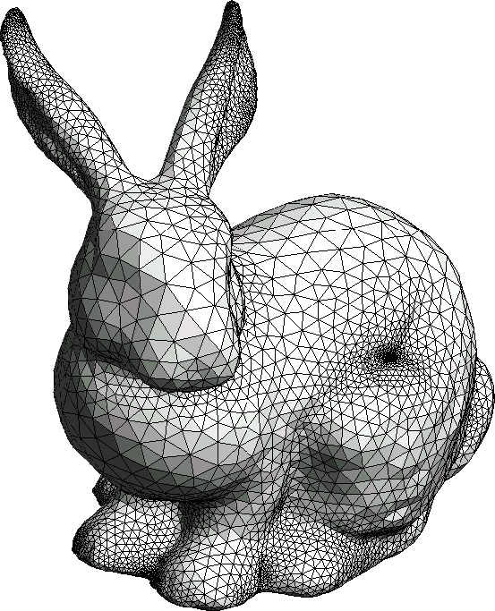

For each object, find lights
Done using bounds tests
Often with an acceleration structure (100’s of lights, 1000’s of objects)
Find lights overlapping objects
Send them to the gpu/shader

Slide 18




For each object, evaluate brdf while rendering the model
Vertex Shader
Rasterize
Evaluate everything when drawing the model
Foreach(light) light_out += brdf(L, N) * light.color * shadow(light)
float3 brdfLambert(float3 L, float3 N) // just an example return float3(dot(N,L))

Slide 19
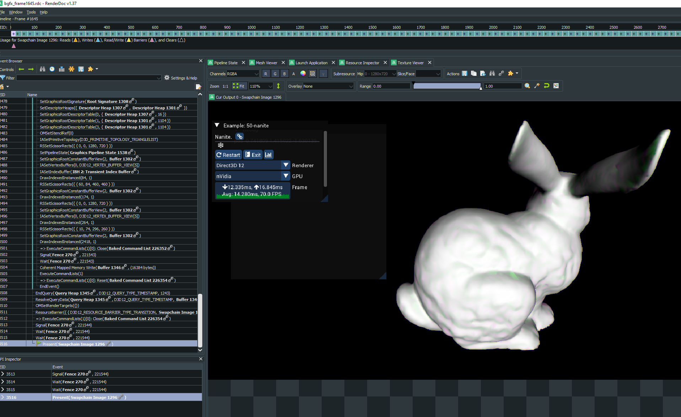
Renderdoc : graphics debugger
Your Application
Renderdoc
Vulkan/DirectX/OpenGL

Slide 20
Live demo!
Hope to show you how useful it is
Shader debugging, mesh inspection…
Everyone uses it

Slide 21
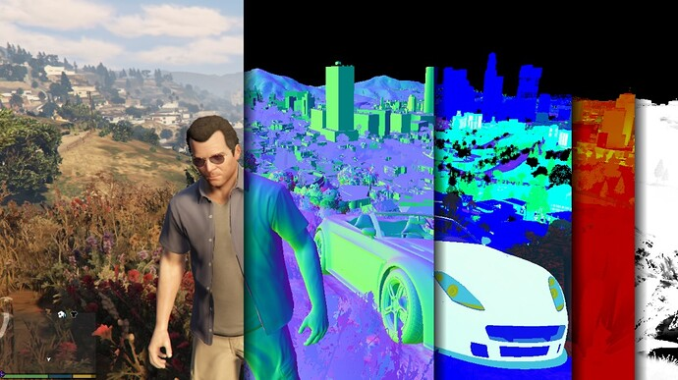
Next week
Mon : Deferred rendering
Mon : Used in virtually all games after 2007, and Unity
Tue : Miscellaneous (HDR, post processing, on request?)
Labs in both!

