Slide 1
Week 1b : Basic Unity, C#

Slide 2
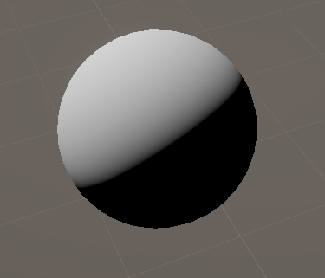
Last class
Blue = N
Yellow = L

Slide 3
This class
Look at Unity architecture
Look at some 3d basics
Look at C#
Do some Labs

Slide 4

Course schedule
 | Monday | Thursday
Week 1 : 12/02 | Introduction | C#/Unity Lab
Week 2 : 19/02 | 3D reasoning | 3D Lab
Week 3 : 26/02 | Basic Pipeline | Lab
Week 4 : 04/03 | Textures Normal maps | Post processing / lab
Week 5 : 11/03 | Camera’s Light | lab
Week 6 : 18/03 | Advanced pipeline | Advanced pipeline lab
Week 7 : 25/03 | Materials Aliasing | Materials Lab
Week 8 : 15/04 | Procedural generation | Procedural generation lab
Week 9 : 22/04 | Project explanation | Project lab
Week 10 : 29/04 | Guest Lecture Project Labs | Guest Lecture Project Labs
Week 11 : | Revision | Revision
Highly likely to change ☹

Slide 5
This class
→ Look at Unity architecture ←
Look at some 3d basics
Look at C#
Do some Labs

Slide 6
Unity external architecture
Unity
Graphics API
DirectX
Vulkan
OpenGL ☹
OS Support
Many Others
Driver
Intel
AMD
NVIDIA

Slide 7
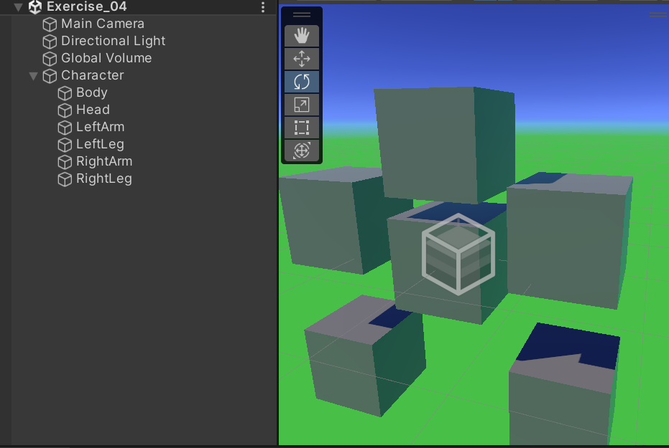
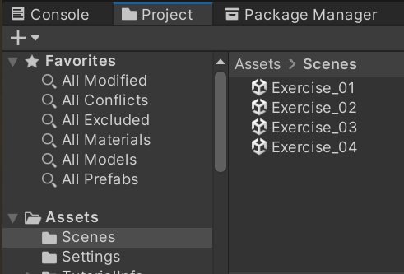
Unity internal architecture : Scene
A scene is the highest level container we will interact with
They are a lot like “levels”
They contain all of our GameObjects (“stuff”)
Our labs contain multiple exercises, contained in their own scene

Slide 8
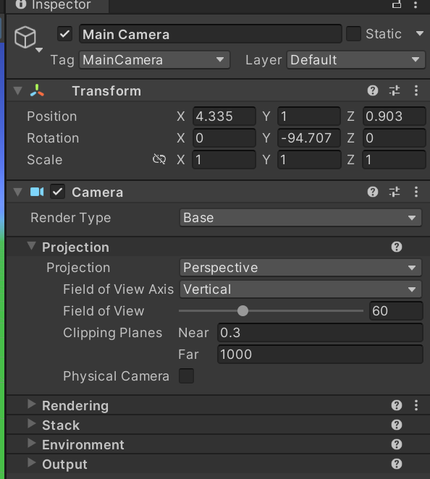
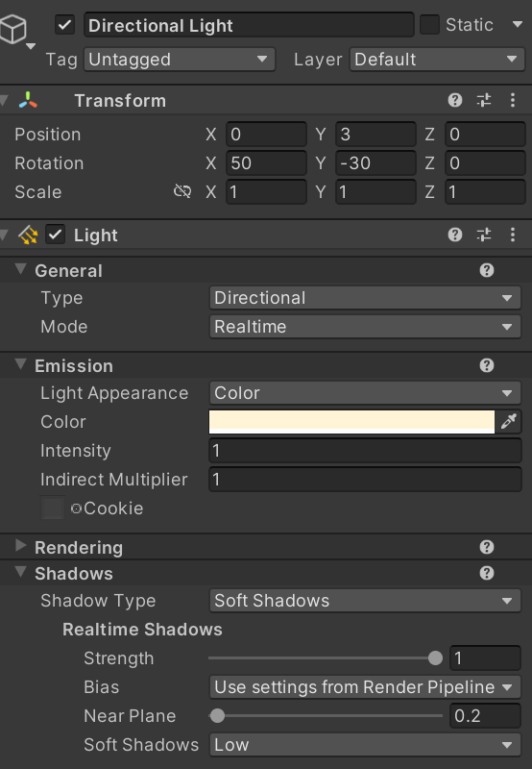
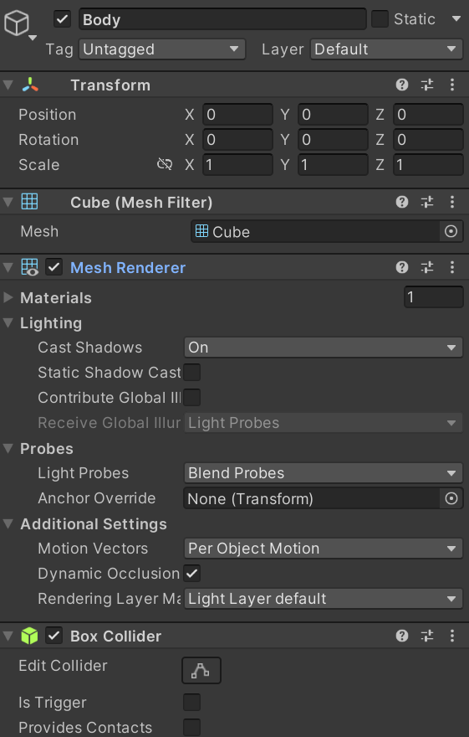
GameObjects are containers of Components
They can be almost anything : light, camera, cube, enemy, global settings,…
They can have 1 -> unlimited amount of components
They always have a transform component (we will see what a transform is later)
They can only have zero or one of each component
This is not ECS

Slide 9



Why do it this way?
Player ship
PositionComponent
CollidableComponent
PlayerInputComponent
HealthComponent
Bullet
PositionComponent
CollidableComponent
PhysicsComponent
ProjectileComponent
Enemy
PositionComponent
CollidableComponent
AIComponent
HealthComponent

Slide 10
Unity internal architecture
Game Loop
Load Scene
Update Components
Render
One Frame

Slide 11
Script Components
Have a method called Start, which is called once
Have a method called Update, which is called every frame
Game Loop
Load Scene
Update Components
Render
One Frame
Start
Update

Slide 12
3D basics
Look at Unity architecture
→ Look at some 3D basics ←
Look at C#
Do some Labs

Slide 13
Transform Component
Look at Unity architecture
→ Look at some 3d basics ←
Look at C#
Do some Labs

Slide 14
Coordinate system
Y
RGB -> XYZ
X is right
Y is up
Z is “into”
Try putting your thumb as the x axis
Put your index on the Y axis
Hold your middle finger perpendicular to both
Z
X

Slide 15
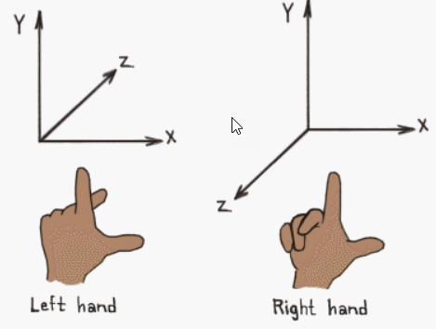
Did you succeed?
If you did, you’re left-handed
3D coordinate system are either left-handed or right-handed
Unity is left handed

Slide 16
Y is up
You can implement applications where another axis is up (eg space games)
But most people follow this convention
Models are oriented by this way by default
Gravity is oriented this way by default
Best to follow it
Trigger warning for the next slide

Slide 17
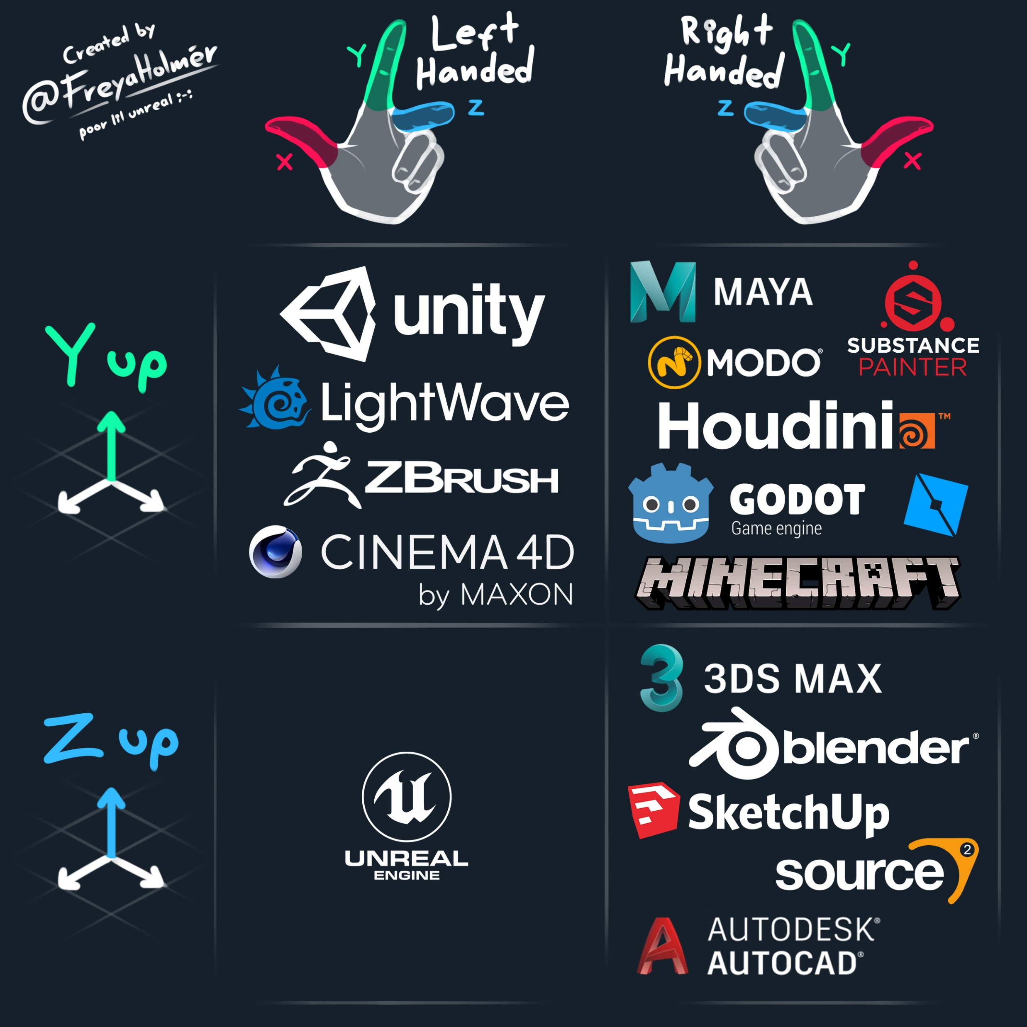
It’s a mess out there

Slide 18
Vectors
Is an annoying concept to explain
You know it as an array that can grow
It is also a 3D offset
It is also a tuple of 3 floats
Or 4 :/
Y
Z
(3.0, 1.0, 0.0)
X

Slide 19
Each element of a vector is called a component
Take a vector of (2, 1, 3)
The x component is 2
The third component is 3

Slide 20
Positions
The type in code is often called a vector
In Unity, a Vector3
Y
(1, 2, 0)
X

Slide 21
We can add positions / vectors
We add them component-wise
A + B
(0, 2, 0) + (2, 0, 0)
= (2, 2, 0)
Y
Y
A = (0, 2, 0)
A = (0, 2, 0)
A + B = (2, 2, 0)
X
X
B = (0, 2, 0)

Slide 22
We can subtract positions / vectors
We subtract it component-wise
B – A
(2, 1, 0) – (1, 2, 0)
(1, -1, 0)
Y
A = (1, 2, 0)
B = (2, 1, 0)
X

Slide 23
We can subtract / divide vectors
By a single number: it changes the length of the vector
Y
C * 2 = (4, 2, 0)
C = (2, 1, 0)
C / 2 = (1, 0.5, 0)
X
X
X

Slide 24
Special and import case : normalization
When we normalize a vector, it’s length becomes 1
A vector with length one is known as a unit vector
It’s used for directions
I live 3 km north-west <-> I live to the north west
L and N in the previous class were unit vectors, otherwise the algorithm would work

Slide 25
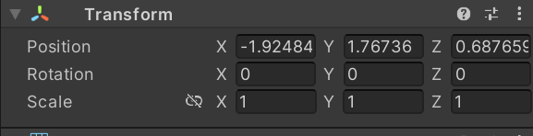
TransformComponent has a vector for position

Slide 26
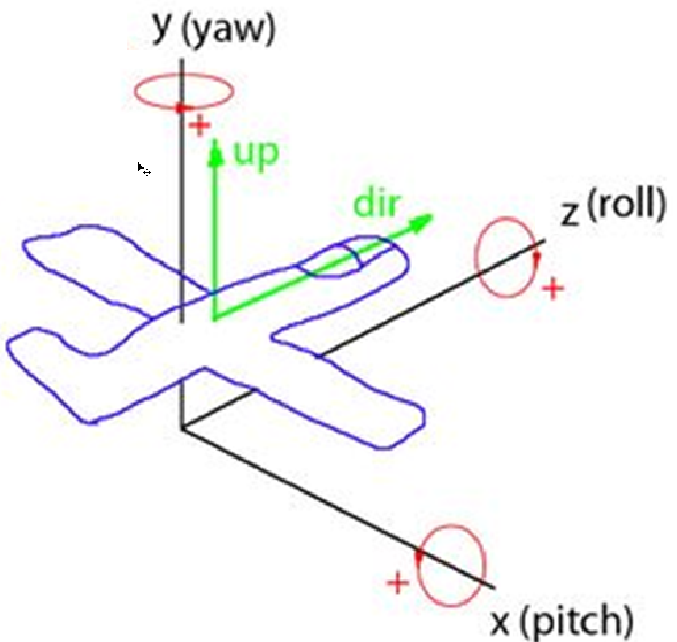
Rotations are stored as Vectors too
XYZ = pitch yaw roll

Slide 27
Framerate independence
1s
10 fps
60 fps

Slide 28
Say we translate 1 cm each frame
60 fps = 60 centimeters per second
10 fps = 10 centimeters per second

Slide 29
Solution: multiply by frame duration
We want 1 meter per second
60 fps : frame is 16.67 milliseconds
1 meter * 0.016 second = 1.6 cm
Framerates vary during runtime, always use Time.DeltaTime

Slide 30
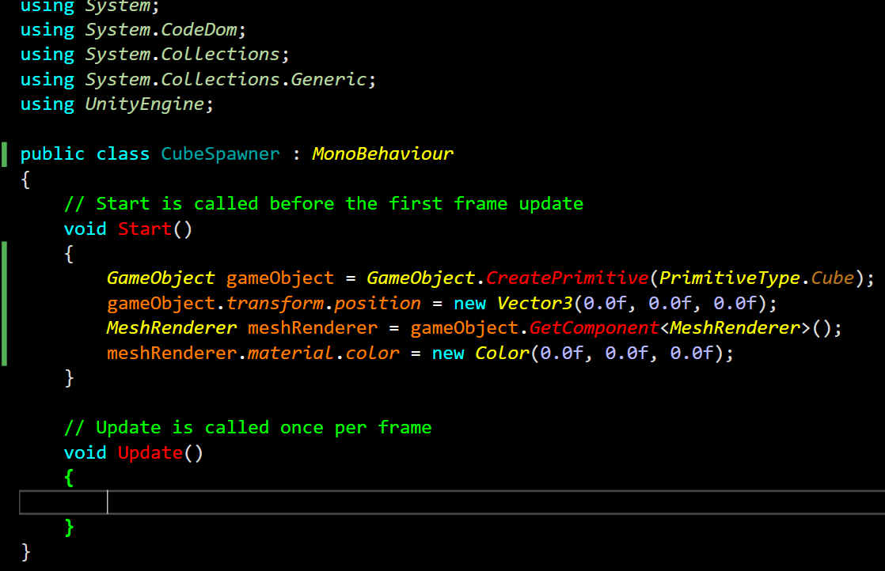
C#

Slide 31
Recap
We use the word Vector for many things. It’s a tuple of floats
Examples are positions, directions
Scenes are containers for GameObjects
GameObjects are containers for Components
We should ensure our program is framerate independent

Slide 32
Next Class
A lot more 3D
Hierarchies
Quaternions
Dot product
Cross product

Slide 33
Lab
Git Classroom had issues, fixing them asap
Work locally for now
Will post classroom and assignment today, with instructions
Files are in a zip on Toledo, under week 1
Let me know if you have issues
Will do the first lab point live (missing some Unity explanation

