Slide 1
2024
Week 7: Aliasing

Slide 2
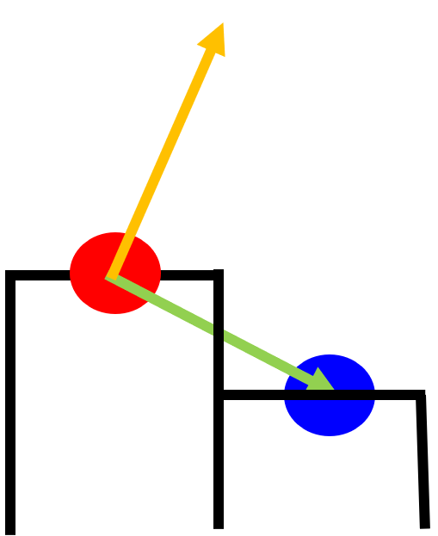
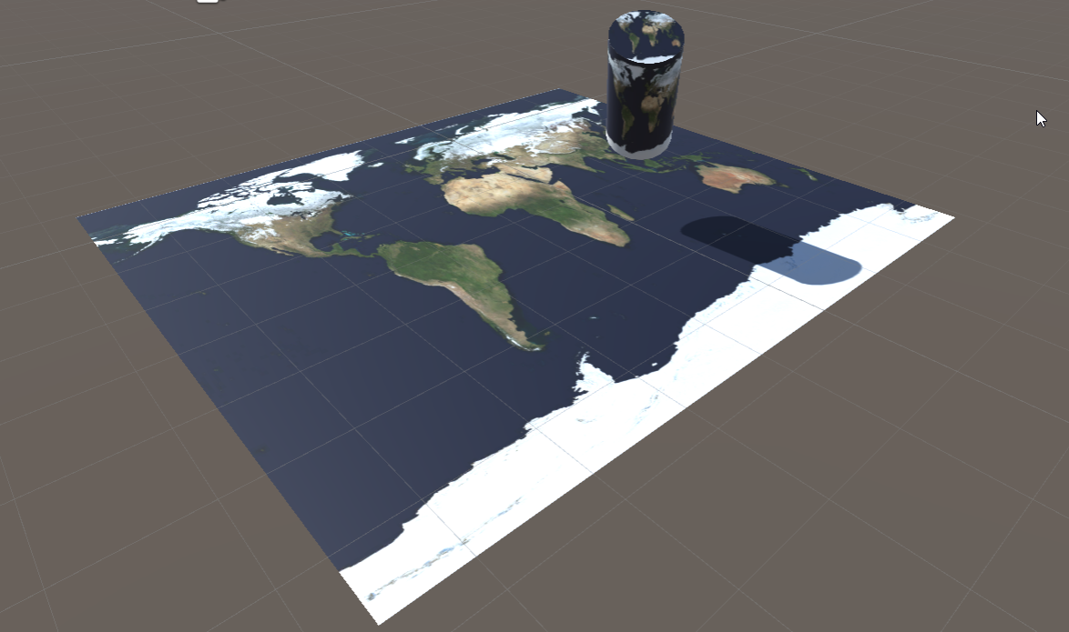
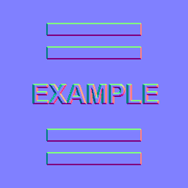
Last class
Textures
Normal maps

Slide 3
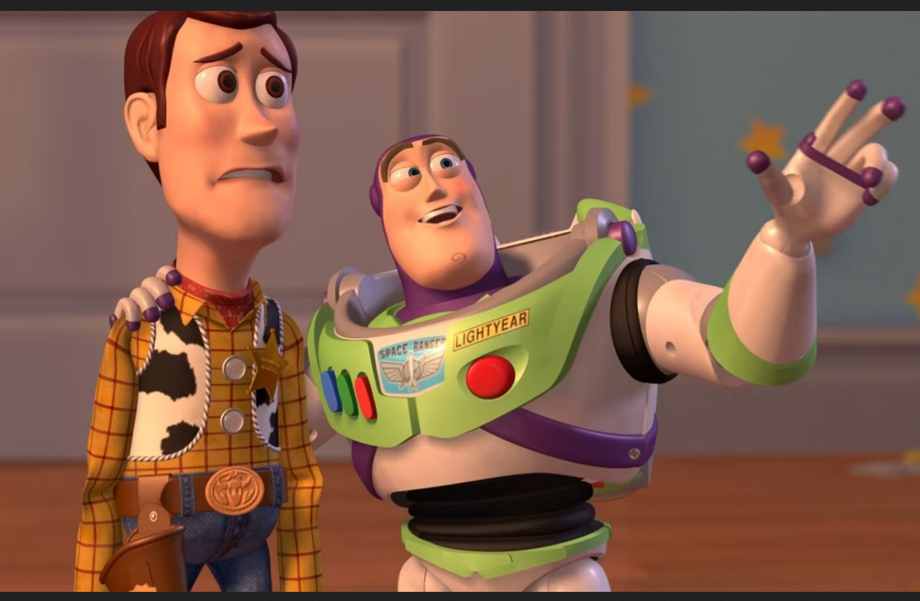
Course schedule
 |  | Wed
Week 1 |  | Introduction
Week 2 |  | 3D reasoning
Week 3 |  | Geometry
Week 4 |  | Pipeline & Materials
Week 5 |  | Proceduralism
Week 6 |  | Textures & Normal maps
Week 7 |  | Aliasing / Presentations
Week 8 | Advanced pipeline: Forward rendering | Advanced pipeline: Deferred rendering
Week 9 | ? | Post Processing
Week 10 | ? | Project
Week 11 | ? | Revision
Highly likely to change ☹

Slide 4
This class
→ Temporal aliasing←
Aliasing
Anti – Aliasing

Slide 5
Temporal aliasing
Notes:
The helicopter obviously has his rotor (the part that moves at the top) moving. But why does it appear the rotor stays still? Think about it for a second before moving on to the next slide.

Slide 6
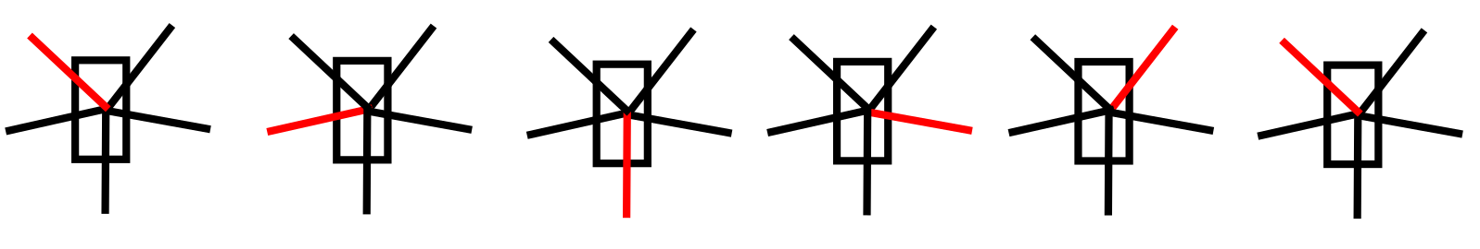
Rotor does rotate over time
Notes:
I highlighted one of the blades in red, to make it easier to see what’s going on
Above shoves the rotor turning, as it would when we observe it directly (not on video)

Slide 7
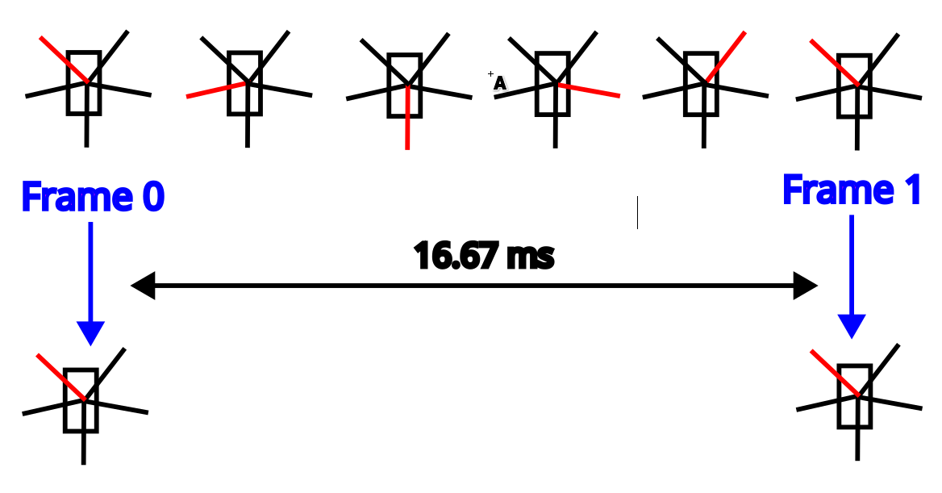
We capture (sample) at different times (and get unlucky)
Notes:
Above, we still have the helicopter as we look at it in real life
Beneath, I’ve visualized what a camera would see. A camera works like a display, capturing tens of images every second
We see that it captures the same image twice, due to the time for the rotor to rotate 360 degrees being the same as the time between two frmaes. In a movie, it would looks like the helicopter doesn’t move at all
Aliasing put very, very simply is when we “show something different than what it really is”
In this case, we’re showing a helicopter with a rotor that doesn’t move, while in reality, the rotor is moving very fast.

Slide 8
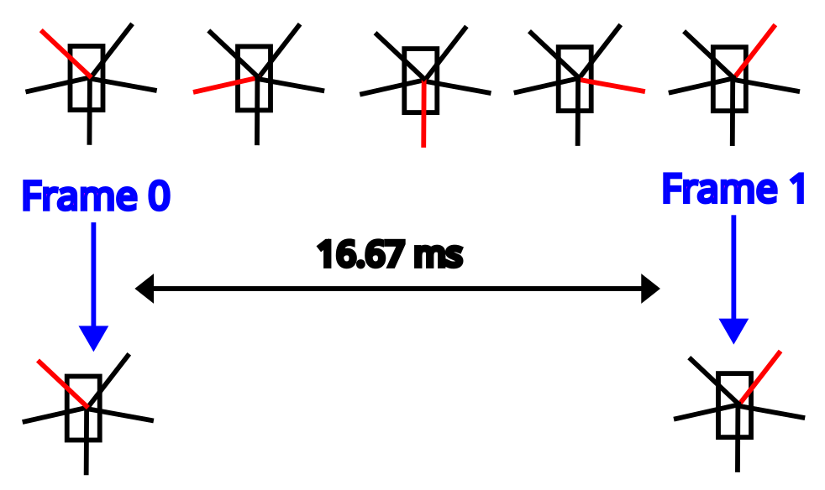
It could appear to go backward as well
Notes:
Another example
Here, in reality, the rotor is turning counterclockwise
But for the camera, it’s turning clockwise

Slide 9
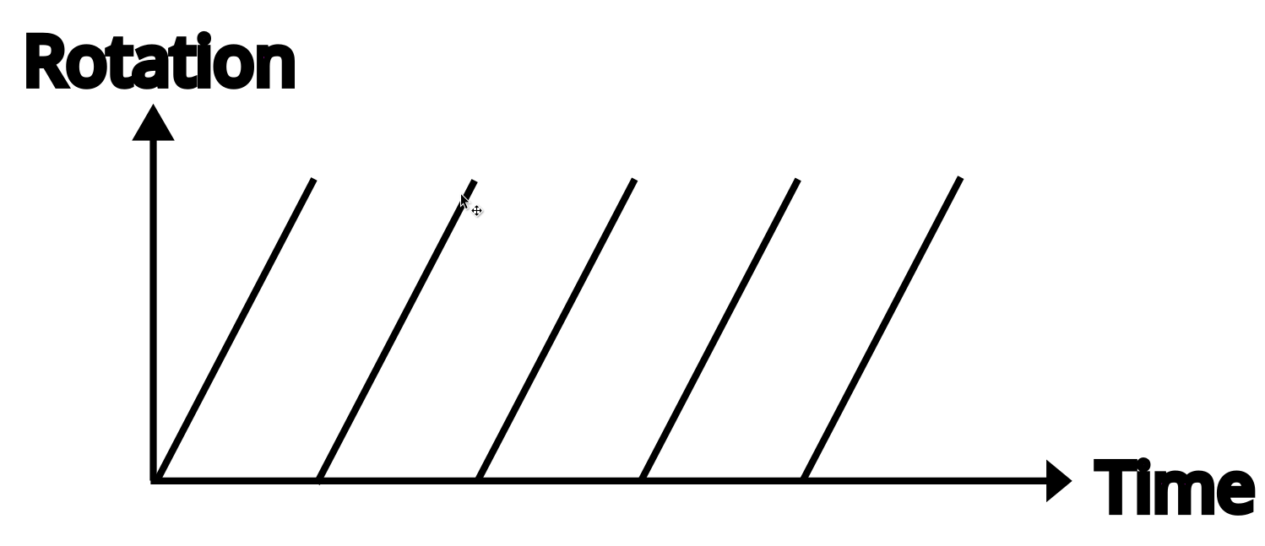
We can draw the rotation as a function of time
Notes:
This shows the angle of that single blade over time, going from 0 to 360 degrees. It’s choppy as it jumps from 360 -> 0

Slide 10
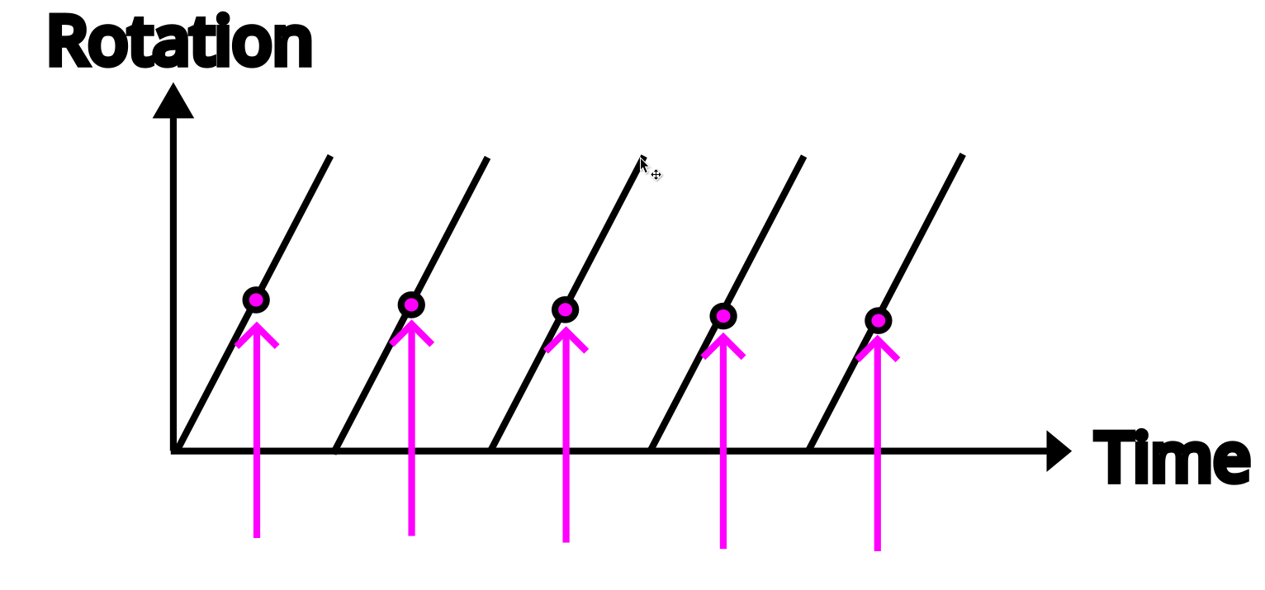
We sample this function (sample = get 1 value)
Notes:
Here in magenta, the arrows are the times that the camera captures the rotor, and the dots are the rotation the rotor is at when the camera takes a picture

Slide 11
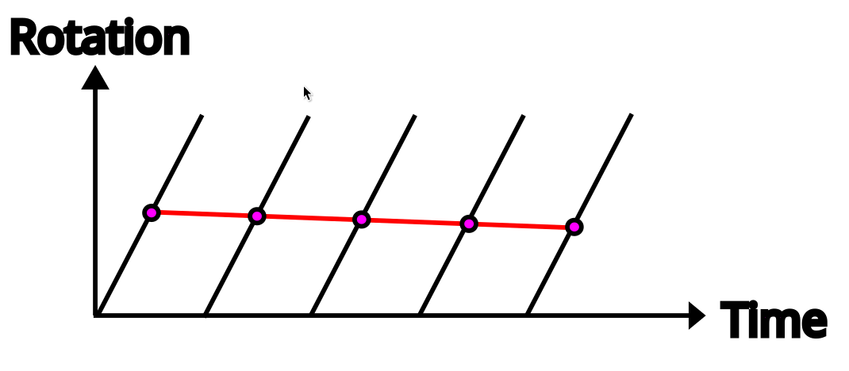
And get a new function (a reconstruction)
Notes:
Red it what the rotation over time looks like for the camera. Again, almost no rotation, even though the actual rotation (in black) happens fast

Slide 12
And it’s totally wrong!
We don’t take enough samples
We get a function that is aliasing the actual function

Slide 13
This class
Temporal aliasing
→ Aliasing ←
Anti – Aliasing

Slide 14
TODO show foveation deck
Notes:
There’s another powerpoint this class, that ends in _fr. Check that one now, and come back here when you’re done

Slide 15
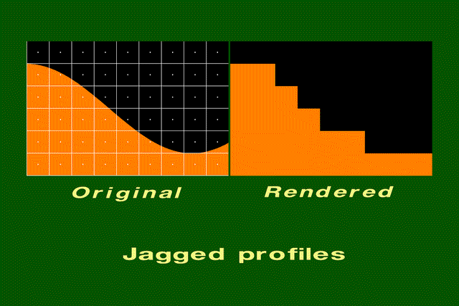
Example of staircasing
Notes:
An example how the typical jagged staircase happens. The curve is too complicated for the resolution

Slide 16
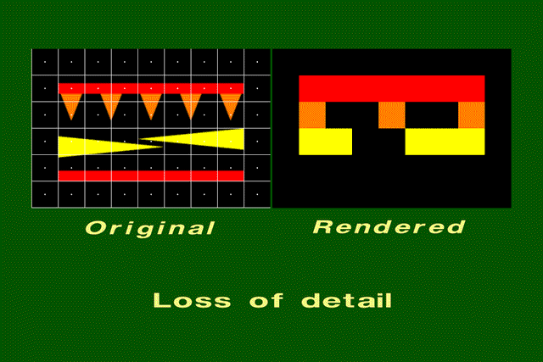
Too much geometric detail
Notes:
Same here. If something covers the center of a pixels, it turns into a square pixel of that color. But the results looks nothing like the original. The triangles are too small

Slide 17
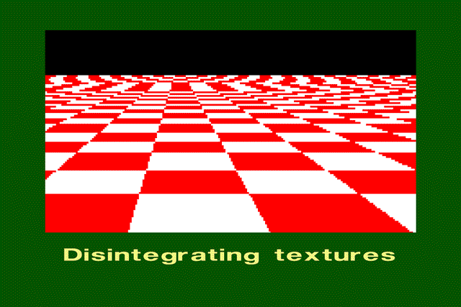
Too much texture detail
Notes:
Here, in the front, we have enough pixels to show the checkered pattern. In the distance, we suddenly start skipping checks, and the whole pattern breaks apart.

Slide 18
This class
Temporal aliasing
Aliasing
→ Anti – Aliasing ←

Slide 19
Anti - Aliasing
We can never remove aliasing completely without sampling more Why?
We can avoid the problem
We can remove the reslting issues

Slide 20
Anti - Aliasing
Varying techniques that help our renderer alias less
Some can coexist (LODing is almost always done)
Supersampling
MSAA
FXAA
TAA
LOD’s

Slide 21
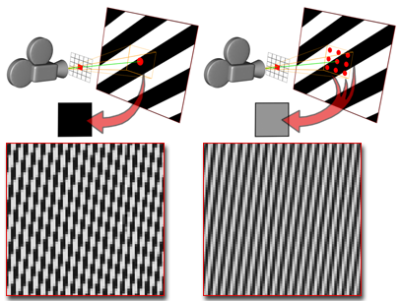
Supersampling
Render at a higher resolution
Downsample to display resolution
Eg display is 1920 x 1080 → render at 3840 x 2160 (4 samples per pixels)
Works very well
Very expensive and wasteful (most pixels don’t need more samples)
Pixar does this (thousands of samples per pixel)

Slide 22
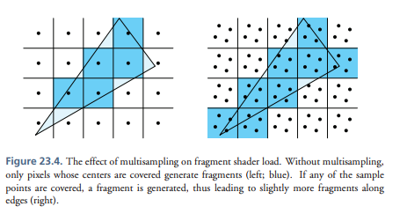
MSAA
Multi sample antialiasing
More samples at the edge of objects
Works well with staircasing
“more samples where we need them”
Fragment shader run for each object!
Doesn’t work with modern pipelines

Slide 23
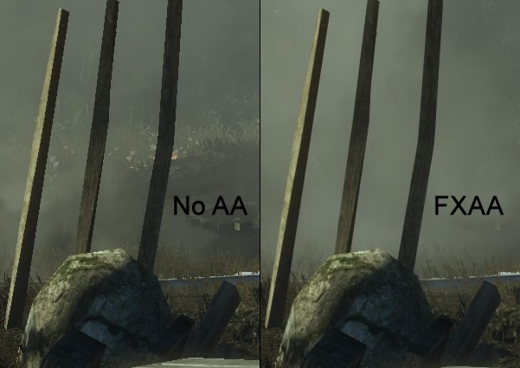
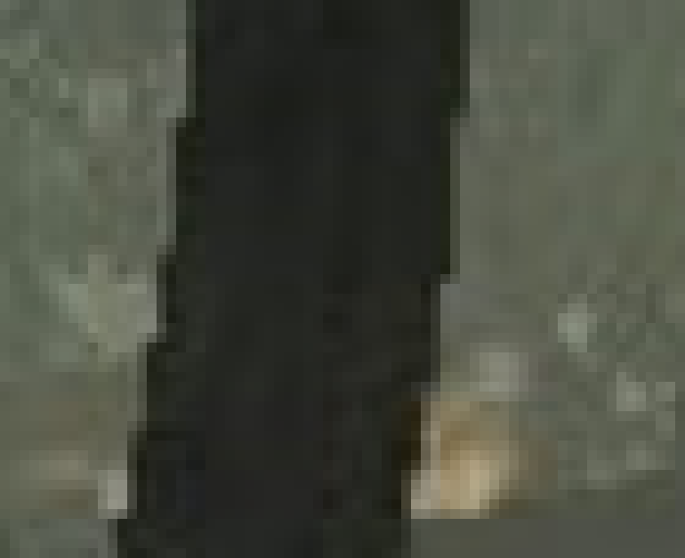
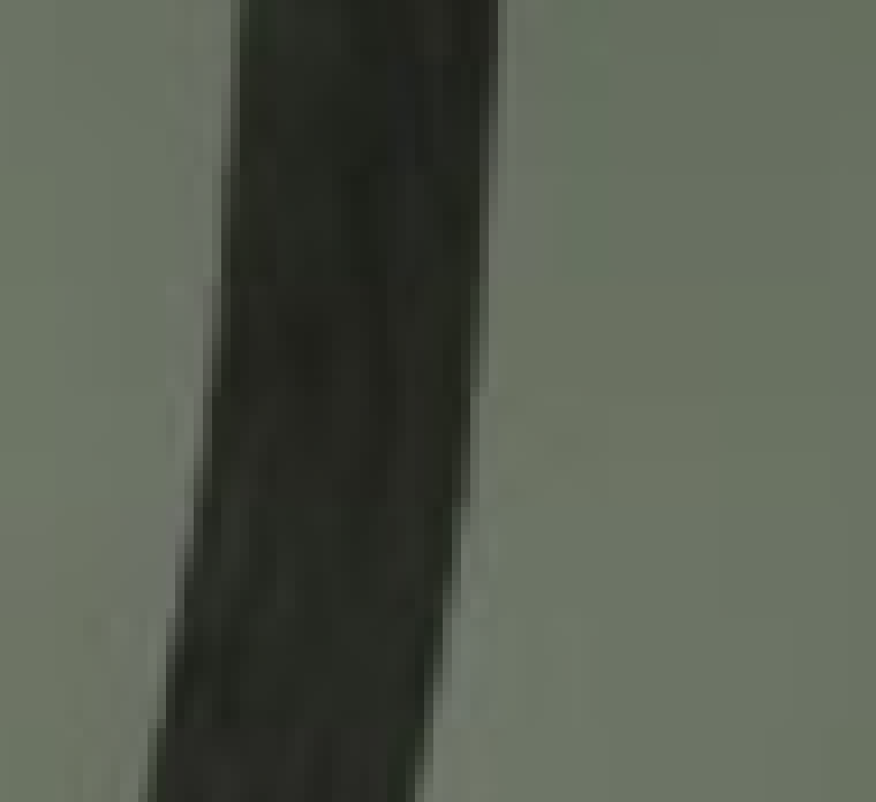
FXAA
Full screen pass (post process)
Doesn’t avoid aliasing
Tries to hide it
“edge blurrer” : how does blur work?
Easy and cheap

Slide 24
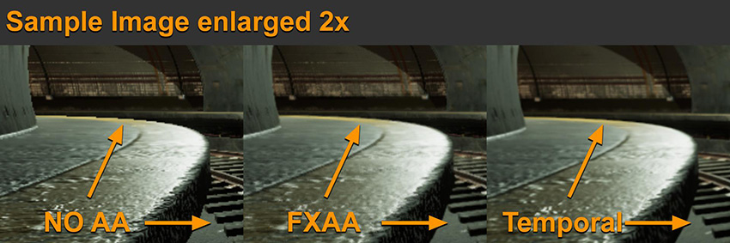
TAA
Temporal Anti Aliasing
Gather samples over different frames
Complex : camera moves (have to find previous position of pixel)
Preferred method for AAA games
Notes:
Don’t look to long at the image, it’s a bad one. Just remember TAA works by looking at multiple frame

Slide 25
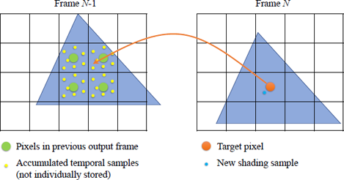
Every frame: Take exact position on triangle: calculate in previous frame Take previous samples to detect aliasing Eg 3 blue camples, one white : should be blue

Slide 26
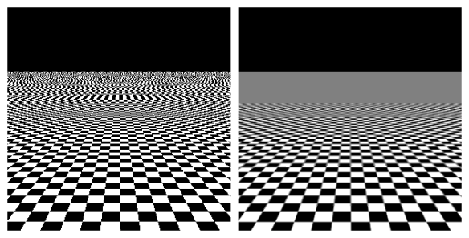
LOD’s
Use less detail in the distance, where there are less samples
Which one looks better?
Which one is more correct?
Notes:
I hope you agree the right looks better
The right one is more correct because it more accurately represents the checkers: gray in the distance, because the squares blend together (white and black blended is gray). The left shows a weird, wavy checkers that is wrong.

Slide 27
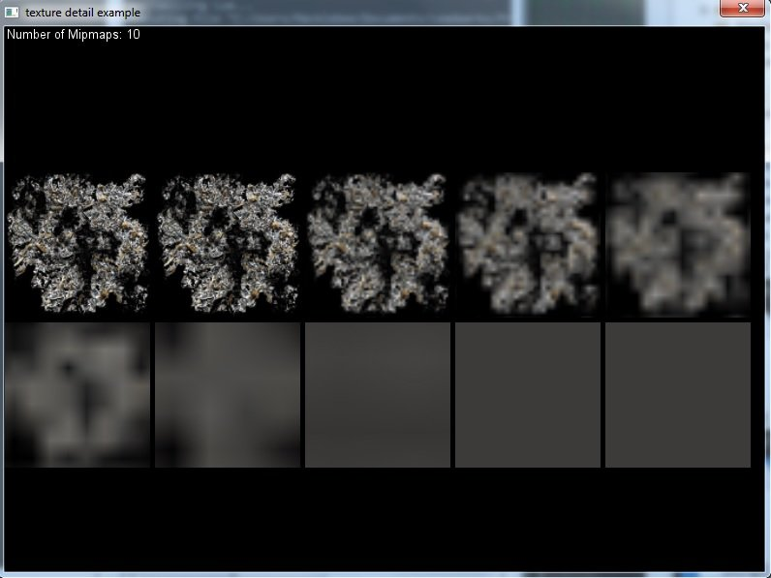
Mipmaps
Mipmaps always have a dimensions / 2 compared to the previous mip
It’s not a “simpler” version, it’s correctly filtered (less small detail)
Notes:
Each texture has an array of smaller textures, aka ‘mips’. When the texture is being far away (with too much detail), it uses one of the smaller (blurrier) mips

Slide 28
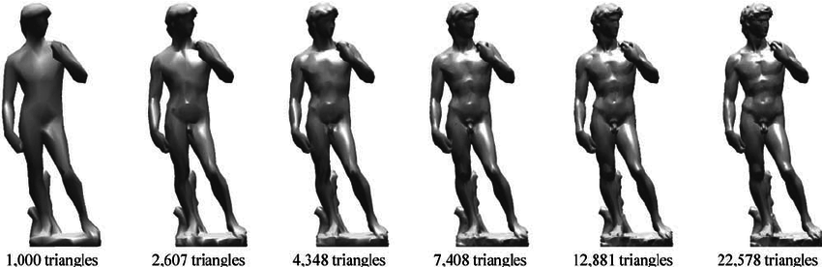
Mesh LOD’s
Big difference with textures: the entire model is one LOD, while textures are sampled across all the LOD’s
Notes:
We also do this with meshes, but it’s simpler. We have a bunch of models with different triangle counts. When rendering, we choose the most appropriate one based on the distance between the model and the camera

Slide 29
Recap
Aliasing happens when you have too much detail (geometry, texture, shader) for your resolution
Looks like creeping pixels, loss of structure
Common on very thin geometry: grass, telephone wire, hair
Supersampling, fxaa, taa can help
LODing is very important

Slide 30
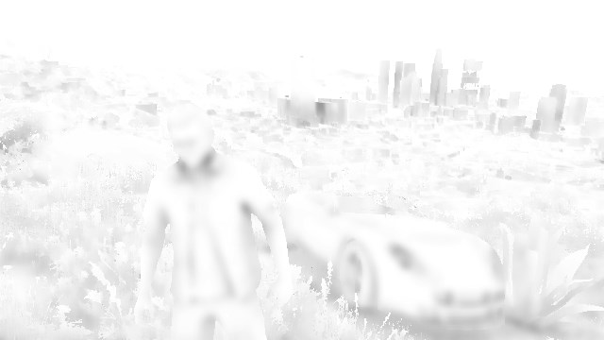
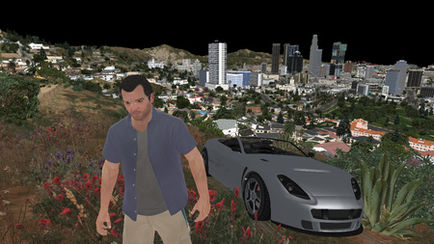
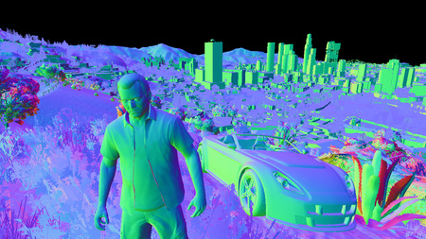
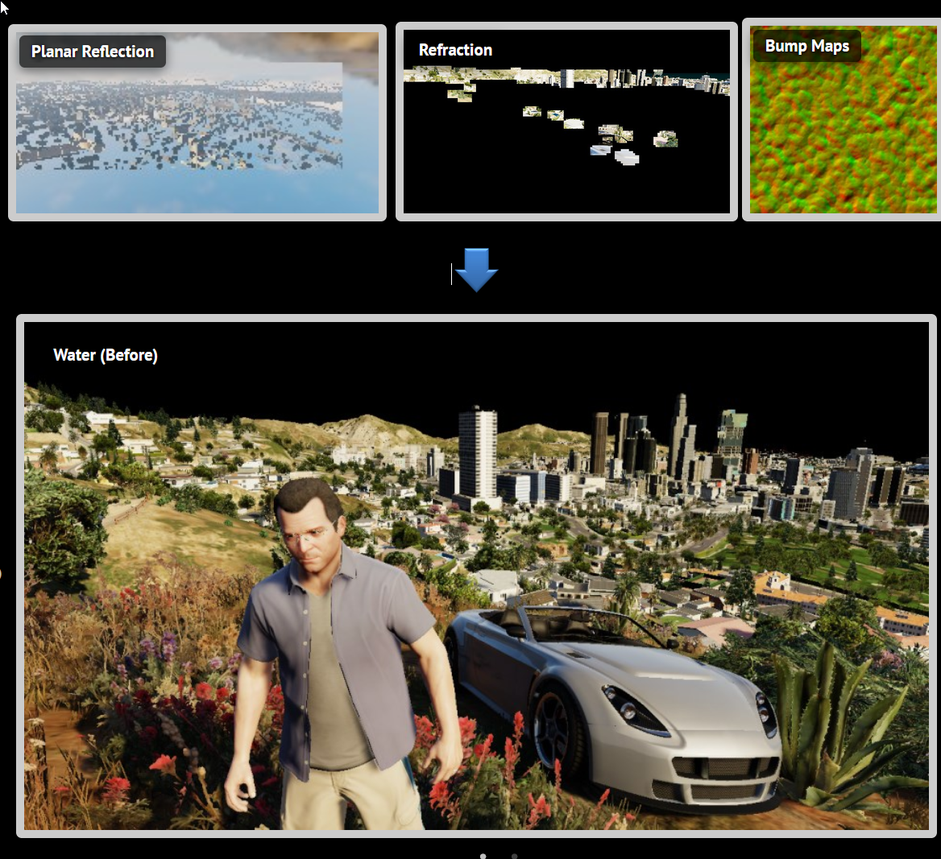
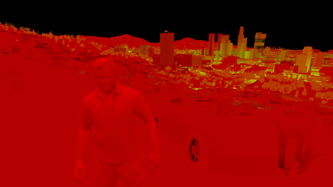
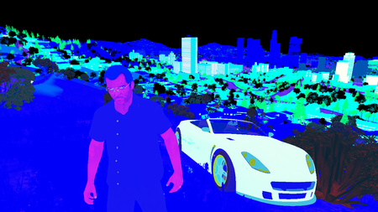
Next class(es)
Advanced pipeline concepts
High level algorithms for using the GPU
Accounting for light, shadow, and camera’s

