Slide 1
Revision

Slide 2

Course schedule
 | Monday | Thursday
Week 1 : 12/02 | Introduction | C#/Unity Lab
Week 2 : 19/02 | 3D reasoning | 3D Lab
Week 3 : 26/02 | Basic Pipeline | Lab
Week 4 : 04/03 | Textures | Normal maps Labs
Week 5 : 11/03 | Post processing | Camera’s Light
Week 6 : 18/03 | Materials | Aliasing Materials Lab
Week 7 : 25/03 | Procedural generation Theory | Procedural generation Practice
Week 8 : 15/04 | Advanced pipeline | Cancelled
Week 9 : 22/04 | Lab 07 explanation | Project explanation
Week 10 : 29/04 | Project explanation 2 | Guest Lecture Project Labs
Week 11 : | Problem solving 101 | Holiday ☹

Slide 3
This class
→ Bureaucracy←
Chunk spawning
Water
?????

Slide 4
Bureaucracy
Will post the link for exam slot 10/06/2024 at 2000
!!! Some people haven’t posted their github on Toledo !!!
I’m not allowed to take exams of people who haven’t hand in on Toledo

Slide 5
This class
Bureaucracy
→ Chunk spawning ←
Water
?????

Slide 6
Chunk spawning
We want multiple chunks loaded
We want to have an upper limit to the number of chunks loaded
We need to find a way to decide what to load, and what to unload

Slide 7
Remember: there is no correct answer
You’re developing a heuristic
A heuristic comes up with a good answer, not a perfect answer

Slide 8
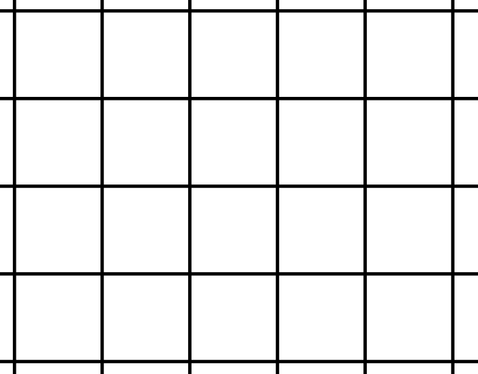

Conceptually
We start with zero chunks loaded
Need to find what to load first
There is an infinite choice
We want to load the “most interesting ones”

Slide 9
Problem : we can’t check infinite chunks
How do we check a finite number of chunks?

Slide 10
Many options
Check all chunks within the camera frustum (good)
Check all chunks within a certain distance from the camera (ok)

Slide 11
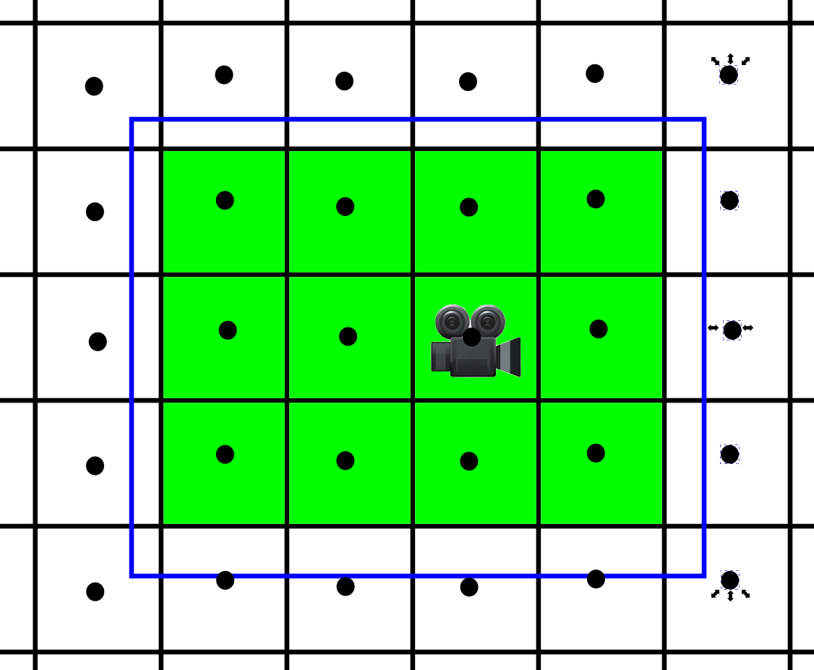
Closer chunks are more interesting
Find a way to make a list of candidates
These we will prioritize later
What is a reasonable number?

Slide 12
You now should have a collection of candidates

Slide 13
Which chunks do we want to load first?

Slide 14
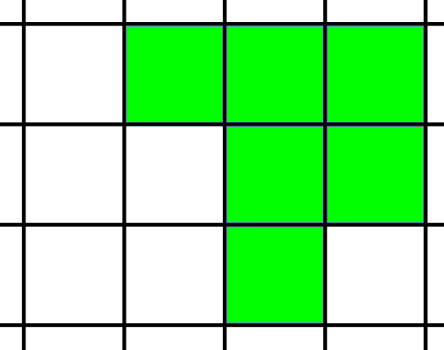
Which chunks do we want to load first?
Close to the camera
(Visible )

Slide 15
Start with distance only
How do determine distance from a chunk to the camera?

Slide 16
Distance to chunk
Correct solution : distance to box
Possible to implement
Not that hard due chunk’s lying on xz grid

Slide 17
Distance to chunk : Simple
Good solution : distance to center
Easy to implement

Slide 18
Let’s say we can load 10 chunks
We want to check all
We can’t check all chunks (infinite)
How do we solve it?

Slide 19
For example ,we checked 25 distances
4.7, 20.3, 12.8, 9.2, 1.6, 18.9, 5.4, 14.1, 22.7, 3.2, 7.5, 16.0, 10.6, 23.4, 2.1, 19.6, 13.3, 8.0, 21.5, 6.3, 15.4, 11.9, 24.2, 0.5, 17.7
Sort them
0.5, 1.6, 2.1, 3.2, 4.7, 5.4, 6.3, 7.5, 8.0, 9.2, 10.6, 11.9, 12.8, 13.3, 14.1, 15.4, 16.0, 17.7, 18.9, 19.6, 20.3, 21.5, 22.7, 23.4, 24.2
Take the top ten
0.5, 1.6, 2.1, 3.2, 4.7, 5.4, 6.3, 7.5, 8.0, 9.2
These are the chunks we want to load

Slide 20
Distance == Score
We can account for our other factors later

Slide 21
Suppose we have all our chunks loaded to the limit
Our camera moved
Maybe an unloaded chunk is now closer / better than a loaded one
How do we solve that?

Slide 22
* Create a datastructure that holds all our loaded chunks.
* Each frame, loop through unloaded chunks. We want to assign a priority to all of them. Because our world is infinite, you can't do all of them, so think of a heuristic to choose which chunk potentially should be loaded. It will involve distance to the camera. Create a loop that iterates over chunks that might be loadable.
* Calculate a priority: the importance to generate a certain chunk. You can assume that a chunk that is in front of the camera, and close to the camera, is important to load.
* Also (re)calculate the priority of all loaded chunks.
* Merge both priorities, so you have a list of unloaded and loaded chunks, sorted by priority.
* Check if any unloaded chunk has a higher priority than a loaded chunk. If so, you want to load the unloaded chunk, and unload the loaded chunk. Unload the loaded chunk with the lowest priority.

Slide 23
Questions?

Slide 24
This class
Bureaucracy
Chunk spawning
→ Water ←
?????

Slide 25
Specification
* When looking at water, it should be transparent (we should see blocks under the water)
* Water should be animated : it should visually move with time. It doesn't actually move, just create a moving effect.

Slide 26

Animation
Don’t touch the vertices
Animate the fragments / pixels
Don’t google “water shader”, google “water pixel shader”

Slide 27
Questions?

Slide 28
This class
Bureaucracy
Chunk spawning
Water
→ ????? ←

Slide 29
Fill in the feeback
Check the link in the message on Toledo
Especially since there are so few people in this course

Slide 30
Teach me how I can get you to email
I see from the git logs that a couple of you got stuck
I don’t want you to get stuck on random Unity/C#/HLSL problems
It’s also a form of feedback
Can’t guarantee an answer this weekend

Slide 31
Exam
It’s only there to check you did your work and understand it
If I tell you it’s done before time, it doesn’t mean you did badly
I can ask you about any line in your code, for example, why did you use dot(N,L) and what does it do

Slide 32
Any remaining questions?

Slide 33

Next class

