Slide 1
Week 4b: Normal maps

Slide 2
Last class
Textures
1D, 2D, 3D and cube’s
Mipmap’s

Slide 3

Course schedule
 | Monday | Thursday
Week 1 : 12/02 | Introduction | C#/Unity Lab
Week 2 : 19/02 | 3D reasoning | 3D Lab
Week 3 : 26/02 | Basic Pipeline | Lab
Week 4 : 04/03 | Textures | Normal maps Labs
Week 5 : 11/03 | Post processing | Camera’s Light
Week 6 : 18/03 | Advanced pipeline | Advanced pipeline lab
Week 7 : 25/03 | Materials Aliasing | Materials Lab
Week 8 : 15/04 | Procedural generation | Procedural generation lab
Week 9 : 22/04 | Project explanation | Project lab
Week 10 : 29/04 | Guest Lecture Project Labs | Guest Lecture Project Labs
Week 11 : | Revision | Revision
Highly likely to change ☹

Slide 4
This class
→ Normal maps←

Slide 5
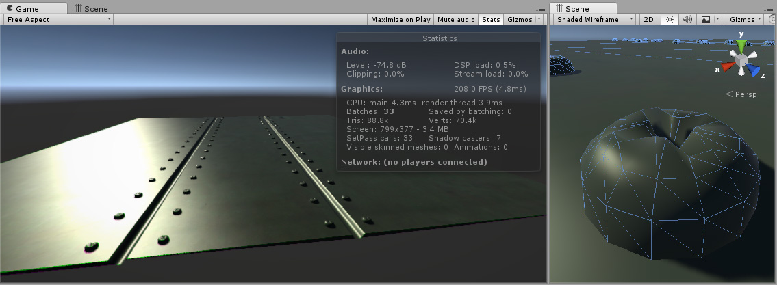
Problem
We want as few triangles (vertices) as possible
But we do want the geometric detail normal give us

Slide 6
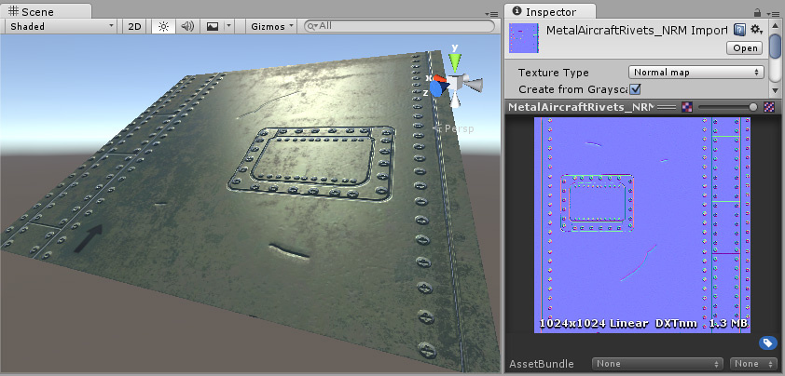
Solution
Less vertices
Normals in textures

Slide 7
Wait, don’t we have more data now?

Slide 8
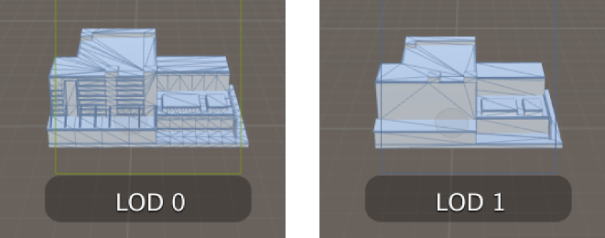
Yes… but no
Mesh LOD is per object
Texture LOD is per pixel

Slide 9
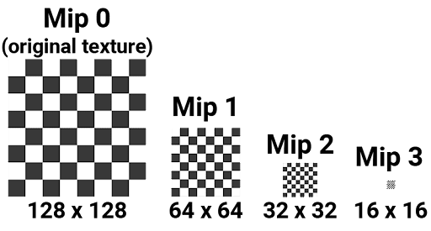
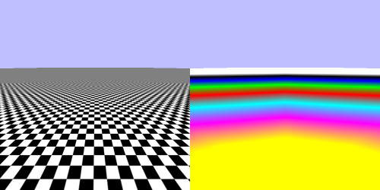
Yes… but no
Mesh LOD is per object
Texture LOD is per pixel

Slide 10
Final tally
More data on disk (in most cases)
Maybe more in RAM (if all mips are loaded are loaded)
Maybe less in ram (with advanced texture streaming)
Most important : less read from RAM (“fillrate”)

Slide 11
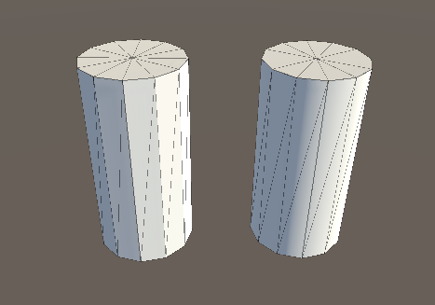
Creating normal maps

Slide 12
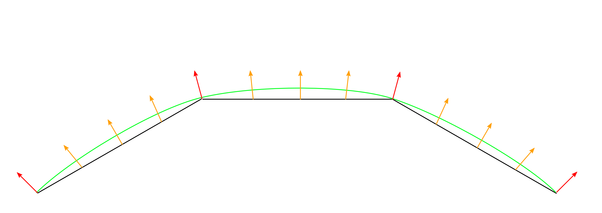
Without a normal map

Slide 13
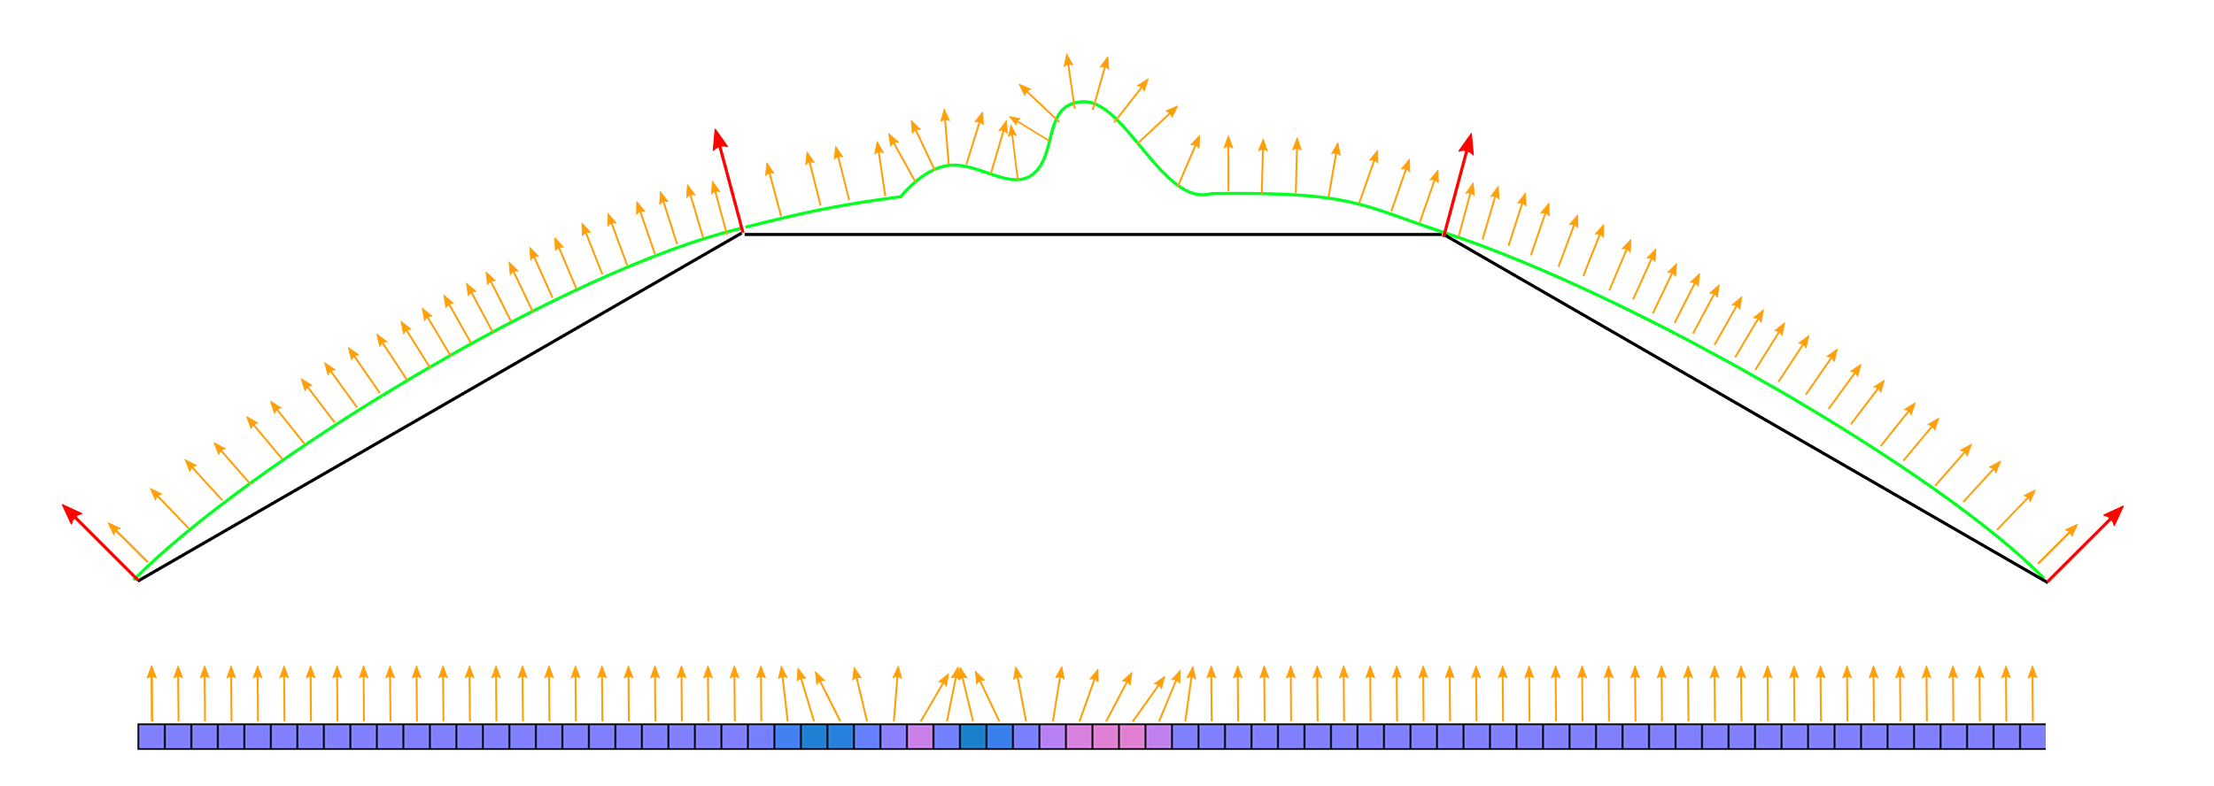
With a normal map

Slide 14
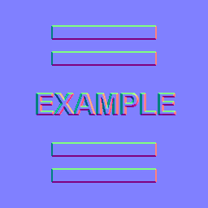
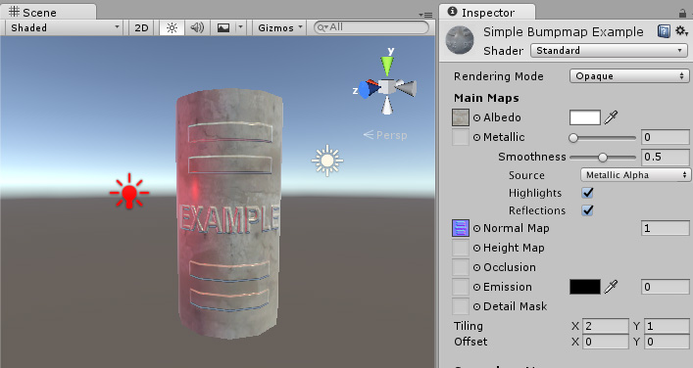
Result

Slide 15
Can someone explain the colors?

Slide 16
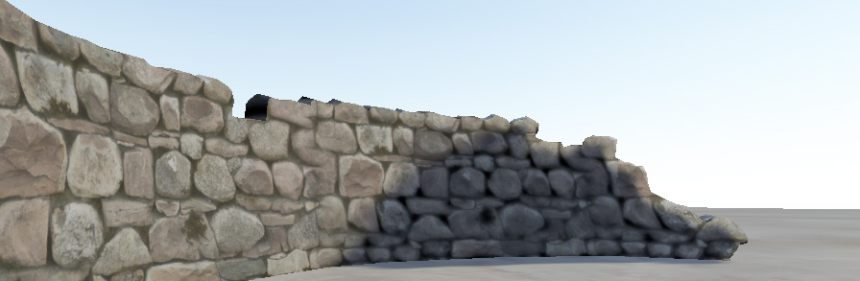
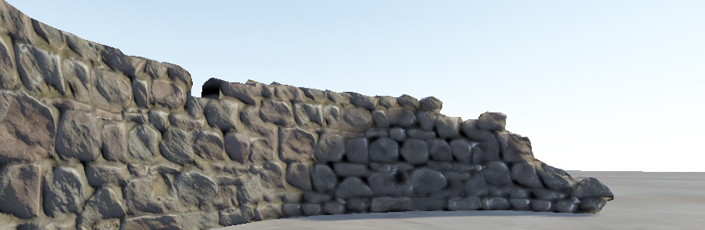
Another result

Slide 17
Recap
Textures are used for spatially varying information
They can be 1,2, and 3d. Or cubes.
They can be used for visible color, or normal, or any other parameter

Slide 18
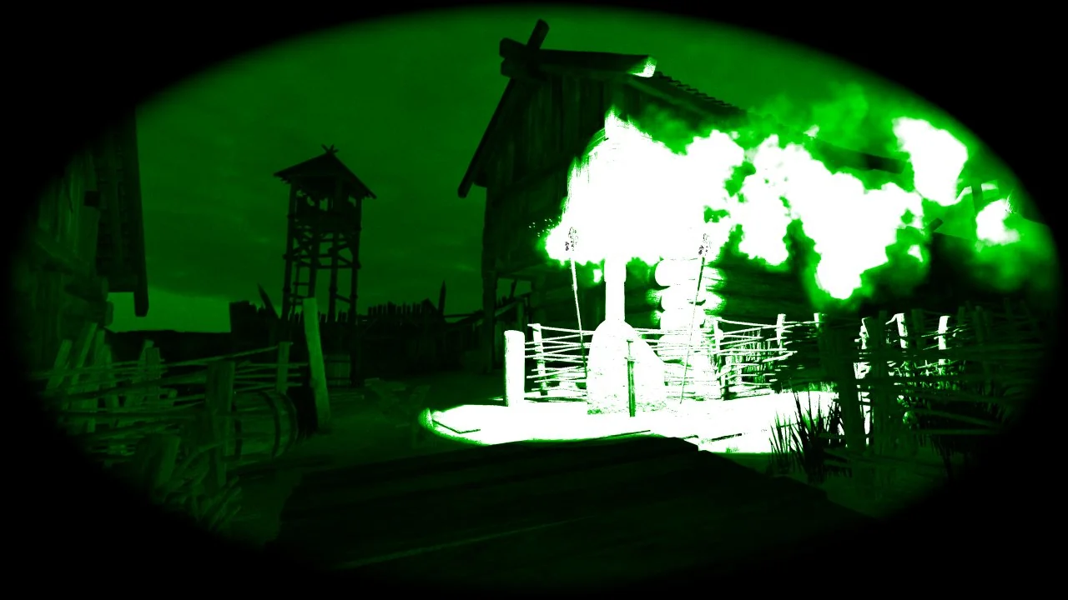
Next class
Postprocess
This is going to be a fun one

