Slide 1
Week 7a: Procedural Generation

Slide 2
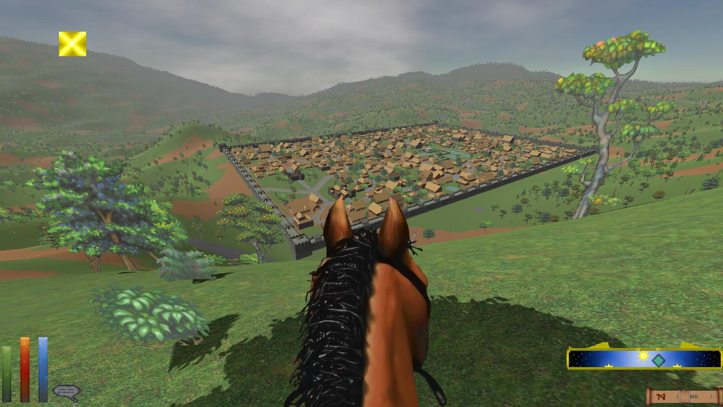

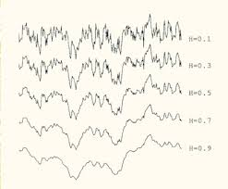
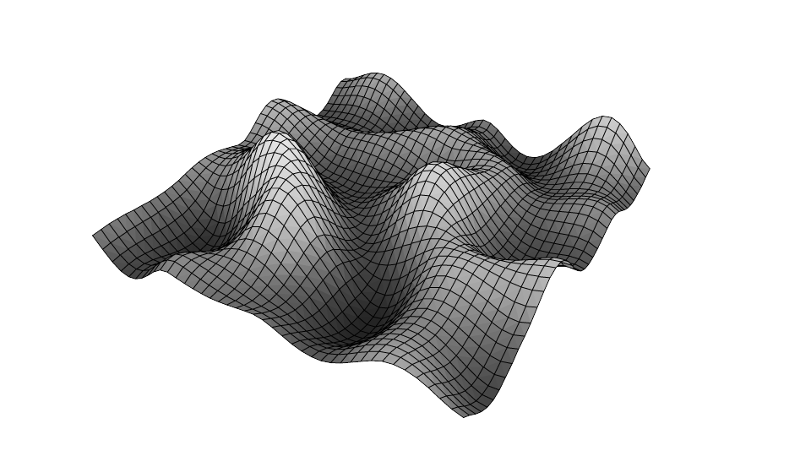
Last class
Why use procedural generation?
Noise
fBm

Slide 3

Course schedule
 | Monday | Thursday
Week 1 : 12/02 | Introduction | C#/Unity Lab
Week 2 : 19/02 | 3D reasoning | 3D Lab
Week 3 : 26/02 | Basic Pipeline | Lab
Week 4 : 04/03 | Textures | Normal maps Labs
Week 5 : 11/03 | Post processing | Camera’s Light
Week 6 : 18/03 | Materials | Aliasing Materials Lab
Week 7 : 25/03 | Procedural generation Theory | Procedural generation Practice
Week 8 : 15/04 | Advanced pipeline | Advanced pipeline lab
Week 9 : 22/04 | Project explanation | Project lab
Week 10 : 29/04 | Guest Lecture Project Labs | Guest Lecture Project Labs
Week 11 : | Problem solving 101 | Problem solving 101
Highly likely to change ☹ Bonus class : problem solving?

Slide 4
I’m behind on the labs ☹
Will post ASAP and push notify on Toledo
Last lab of this course
Remember : Deadline 28 / 04

Slide 5
This class
→ Procedural meshes←
Procedural Textures

Slide 6
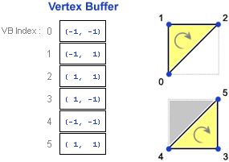
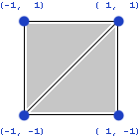
Meshes
Array of vertices
Called “vertex buffer”
3 vertices -> 1 triangle

Slide 7
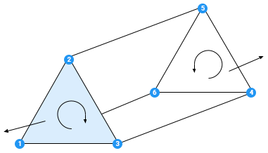
Mesh winding
Triangles can be clockwise or counterclockwise
Depends on your viewpoint
One direction : front of triangle
Other : back. We can skip (cull) it for performance
Unity uses clockwise

Slide 8
Recall: Vertices can be quite large
Position : float3
Texcoord : float2
Normal : float3
How many bytes is that?

Slide 9
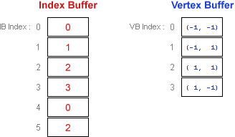
Index buffer
Remove duplicate vertices
Add an indirection buffer
Smaller in total

Slide 10
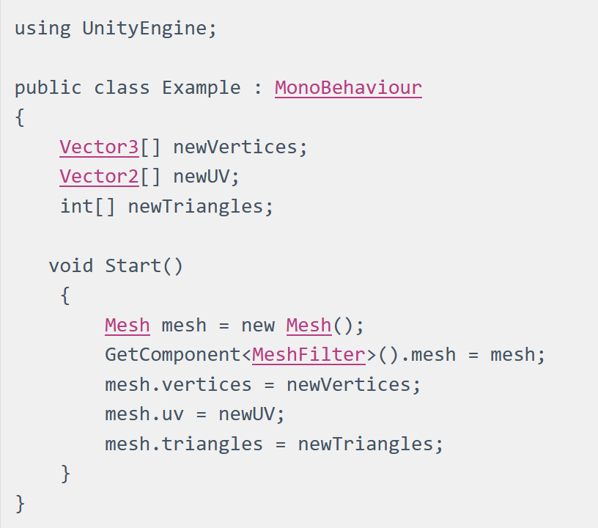
Unity : Simple Way

Slide 11
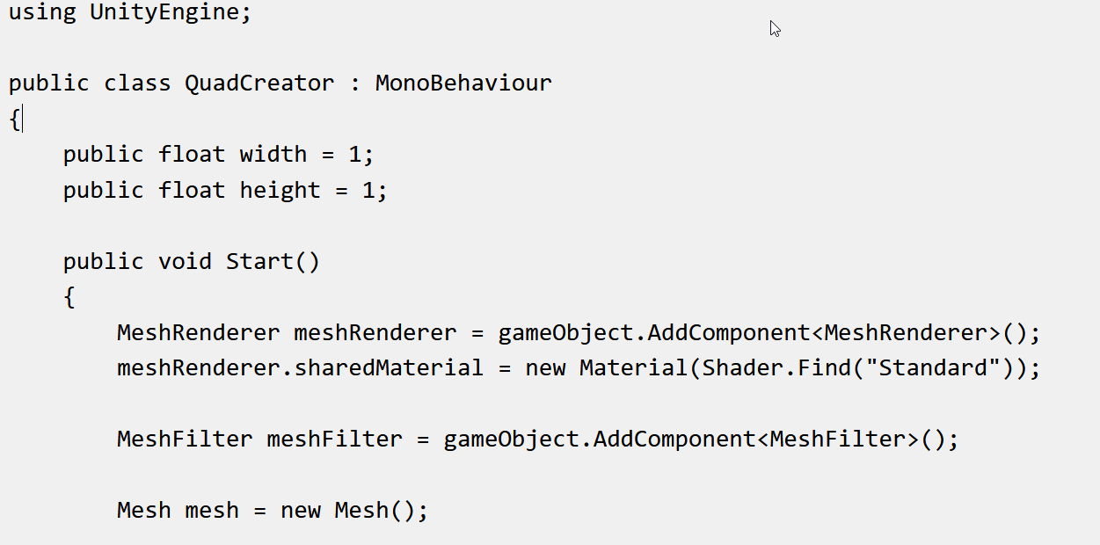
Creating a quad : setup

Slide 12
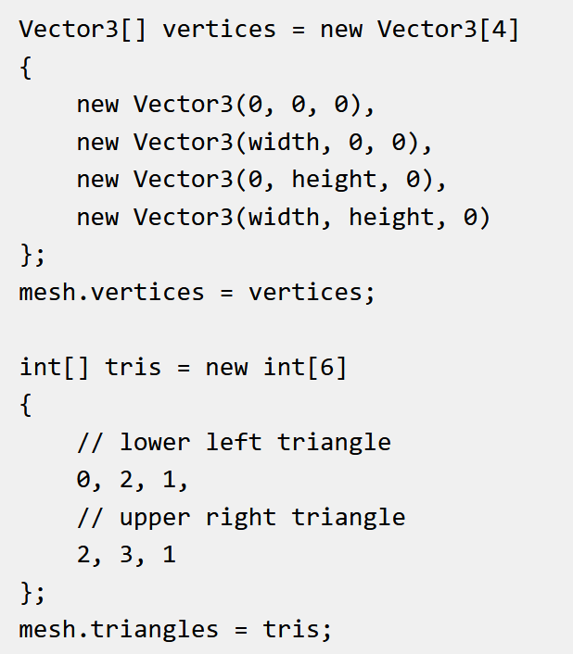
Creating a quad : vertices & indices

Slide 13
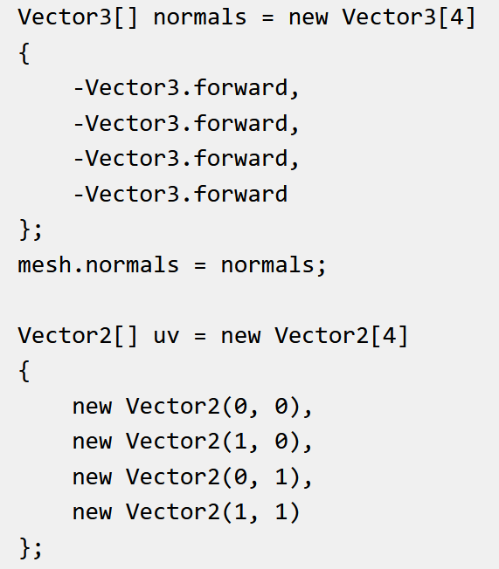
Creating a quad : normals & uv

Slide 14
Questions?

Slide 15
This class
Procedural meshes
→ Procedural Textures ←

Slide 16
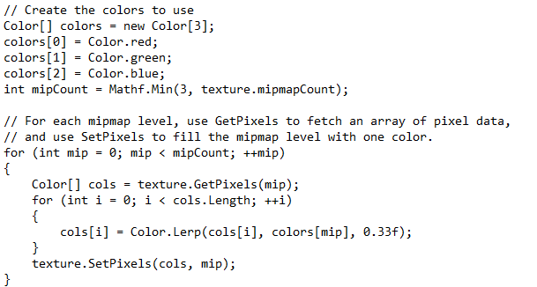
Unity

Slide 17
Why line by line?
Why not pixel by pixel?
Why not the entire image at once?

Slide 18
Recap
Can set mesh/textures in code by copying raw data
Meshes can be complicated
Textures are intuitive

Slide 19
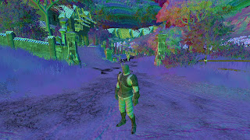
Next class
Holiday / labs
After, pipeline

