Slide 1
Week 9a: Solving lab 07

Slide 2
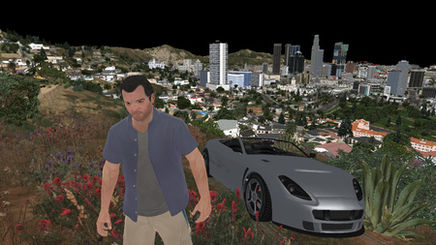
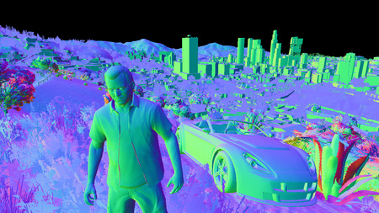
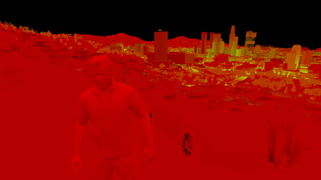
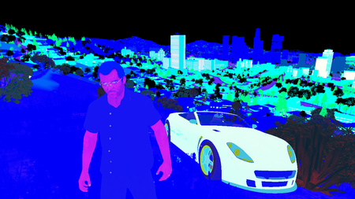
Last class
Forward and deferred rendering

Slide 3

Course schedule
 | Monday | Thursday
Week 1 : 12/02 | Introduction | C#/Unity Lab
Week 2 : 19/02 | 3D reasoning | 3D Lab
Week 3 : 26/02 | Basic Pipeline | Lab
Week 4 : 04/03 | Textures | Normal maps Labs
Week 5 : 11/03 | Post processing | Camera’s Light
Week 6 : 18/03 | Materials | Aliasing Materials Lab
Week 7 : 25/03 | Procedural generation Theory | Procedural generation Practice
Week 8 : 15/04 | Advanced pipeline | Cancelled
Week 9 : 22/04 | Lab 07 explanation | Project explanation
Week 10 : 29/04 | Guest Lecture Project Labs | Guest Lecture Project Labs
Week 11 : | Problem solving 101 | Problem solving 101

Slide 4
This class
→ Solving the ball ←
Solving the plane
Watch cubes fight

Slide 5
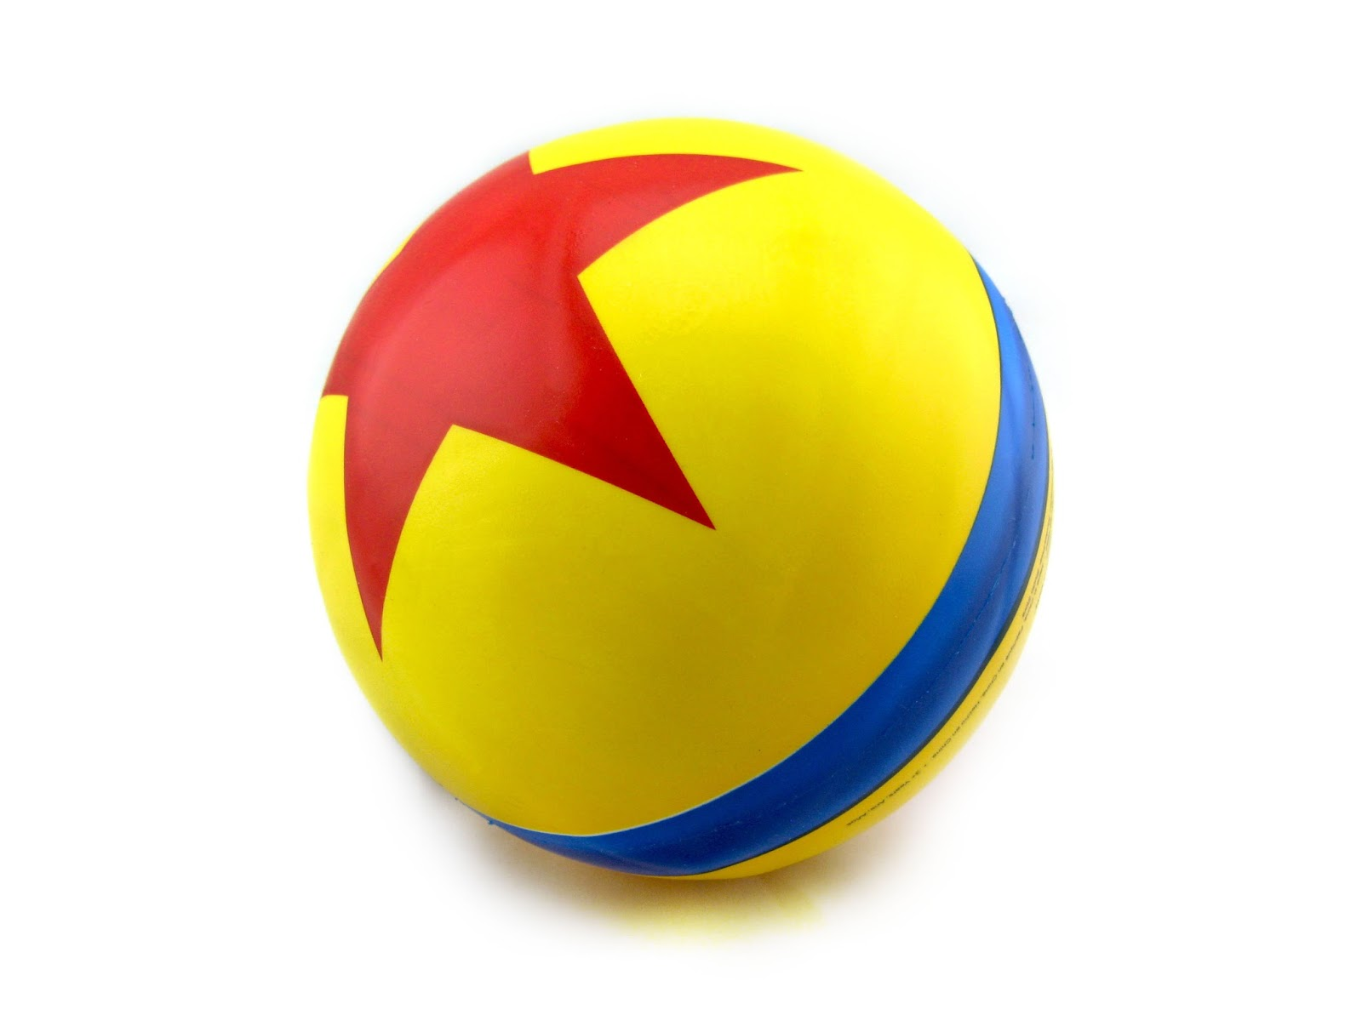
Solving the ball
You’re asked to recreate this ball on a blank sphere
What is your first step?

Slide 6
Step 1 : pick a space
Problems are easier in some spaces than others
Similar to choosing the right programming language for a task
Which one should we pick?
Object space?
World space?
View space?
Texture space?

Slide 7
Texture space
We have non-flat geometry, which will make it hard to do the star
It’s easier to work in 2D
Object space is possible I think, but it’s way more complicated

Slide 8
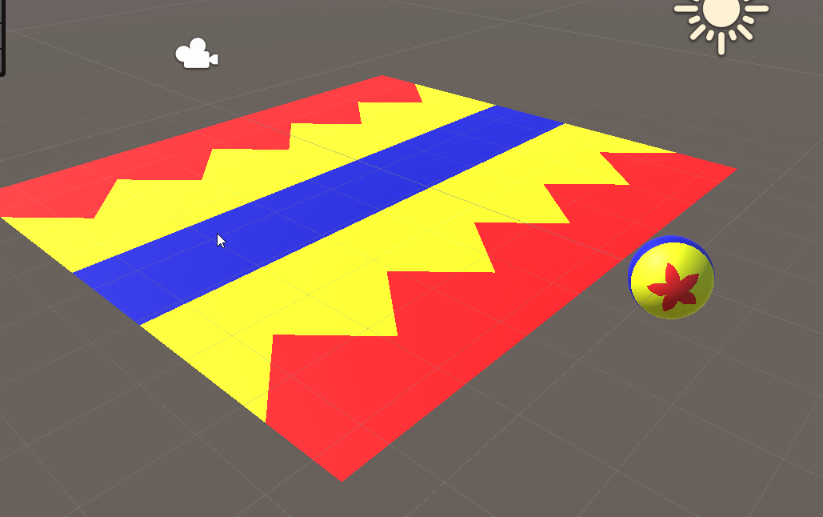
Step 2 : commit to the space
Think about the problem in terms of the space you choose
Visualize it! I used a plane, and stopped thinking about spheres
Can be non-trivial

Slide 9
Step 3 : divide the problem
Called “divide and conquer”
Rather have 3 mediocre problems than a big one
How can we divide this problem?

Slide 10
3 subproblems
Yellow background
Blue band
“Red star”, which looks like triangles in texture space

Slide 11
Step 4: find symmetry
What symmetry can you find?

Slide 12
Vertical symmetry

Slide 13
Horizontal symmetry

Slide 14
Vertical symmetry
Mirrored over the middle horizontal line ( y = .5)

Slide 15
Vertical symmetry
0
By default, y goes from 0 -> 1.0
One side goes from 0 -> 0.5
The other is mirrored, goes from .5 -> 1
We want them to have the same coordinates
We have 0.0 -> 0.5 -> 1.0
We want 0.0 -> 1.0 -> 0.0
How do we do this?
1
1
0
0.5
0

Slide 16
Divide and conquer
We split it up in 2 problems
Remap 0 -> 0.5 to 0 -> 1.0
Remap 0.5 -> 1.0 to 1.0 -> 0

Slide 17
Remap 0 -> 0.5 to 0 -> 1.0
Texcood.y *= 2
Is this obvious?

Slide 18
Remap 0.5 -> 1.0 to 1.0 -> 0
Trickier, as it’s ascending, and we want it descending
Start with 1.0 – texcoord.y
We now have 0.5 -> 0.0
What’s the next step?

Slide 19
Putting it together
If (texcoord.y < 0.5) texcoord.y *= 2.0 else texcoord.y = (1.0 – texcoord.y) * 2

Slide 20
Anyone see a faster way?
We can do it without an if statement
Not obvious, I only noticed making these slides

Slide 21
Faster way
-0.5
Now we go -0.5 -> 0.5
Abs()
Now we go 0.5 -> 0 -> 0.5

Slide 22
Horizontal symmetry
We have 5 triangles
Texcoord.x goes from 0 -> 1
Multiply by 5 : 0 -> 5
Fmod (remainder at division)
0 -> 1.0 | 0 -> 1.0 (5 times)

Slide 23
Next class
Explain project to you, as well as how to approach it

