Slide 1
DE/AR
2025
Who wants to be a string programmer?
Who wants to be a float programmer?
Week 1 : Introduction

Slide 2
I’m very happy you’re here
I have 12 years of experience in graphics programming
Still happy I chose this as a specialization
It’s a very satisfying topic due to instant feedback
Interesting applications (movies, games, medical), collegues, domains (optimization, hardware)
Interesting research (fundamentals will always be true, many conferences, papers, forward progress
We got a lot of class hours

Slide 3
This class
Contents of this course
Evaluation of this course
Some bureaucracy
Get our hands dirty with Unity

Slide 4
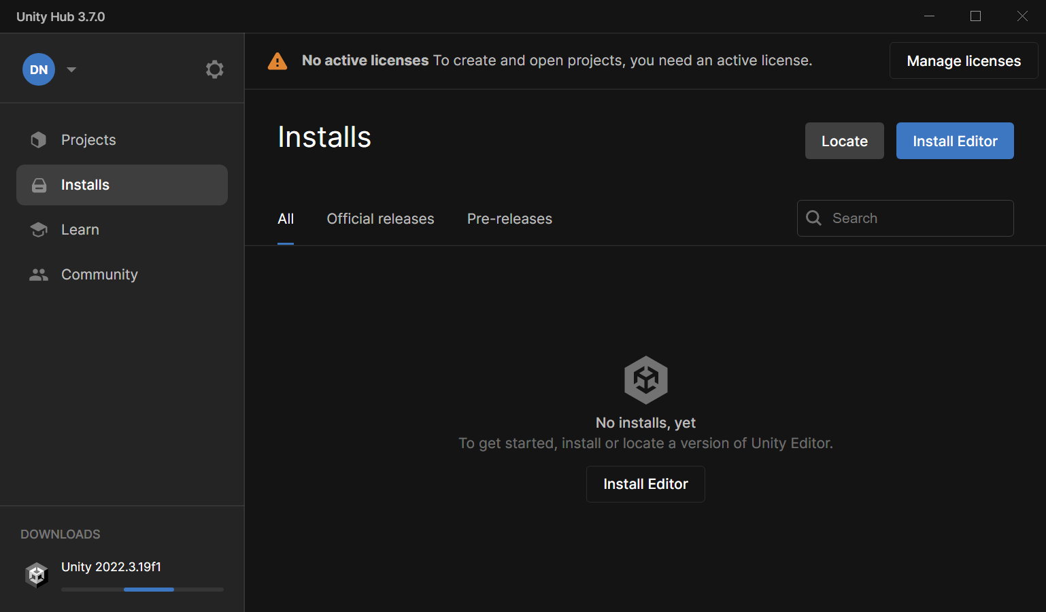
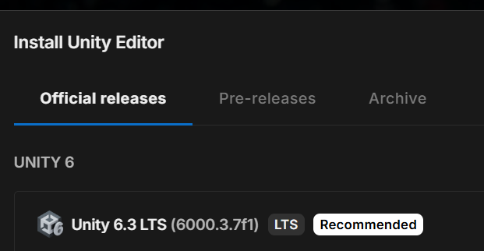
TODO But first, install Unity!
I ask you know as it’s quite big and we’ll swamp the wifi
Don’t worry, there’ll be time during the break
It’s a two step process:
Go to Unity website: https://unity.com/
Install Unity hub. It’s not enough, but is used to download an actual engine
Open Unity hub, and install the editor 6.3 LTS
6.3 LTS is required for this course
Otherwise, I might need to upgrade your project and it can lead to weird errors
While we’re waiting for a bit, what are you all hoping to learn in this course?

Slide 5
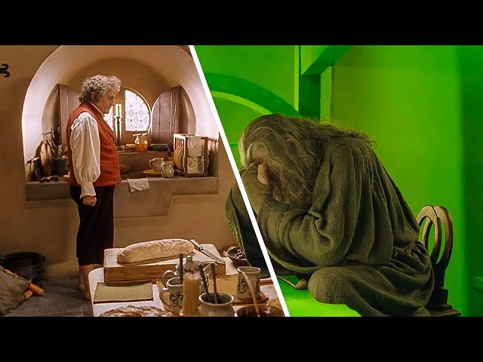
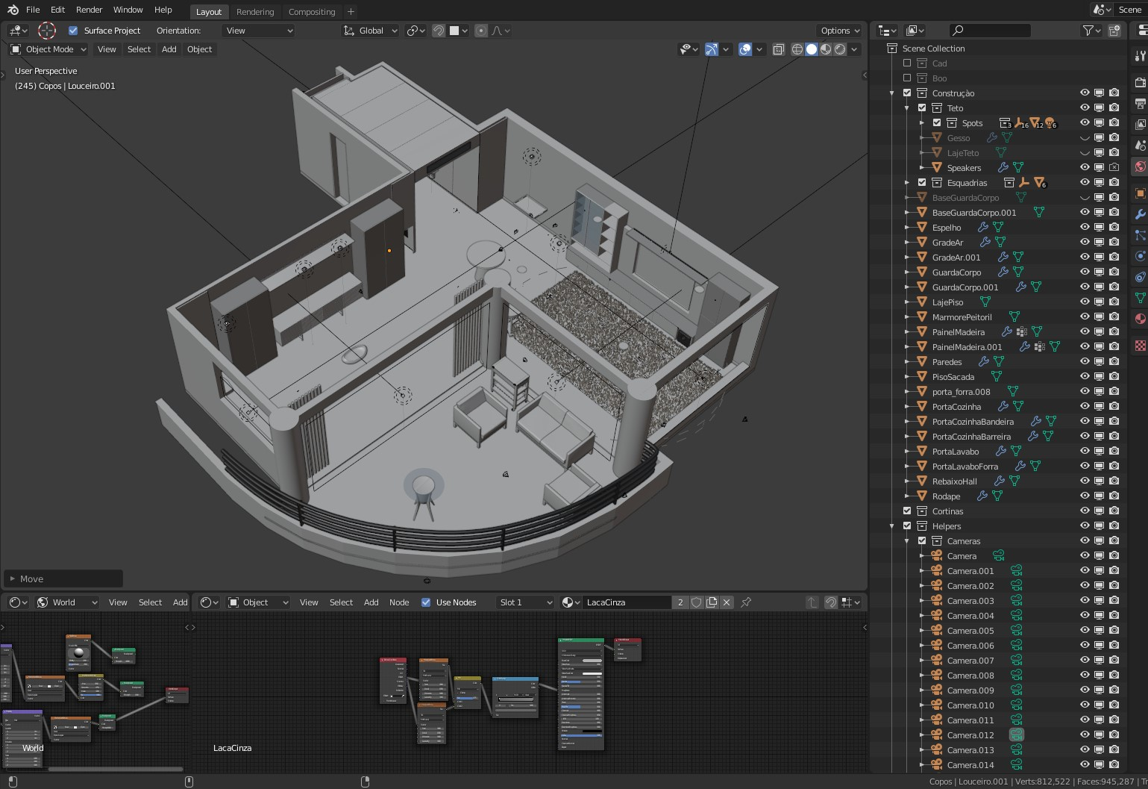
What are “3D graphics”?

Slide 6
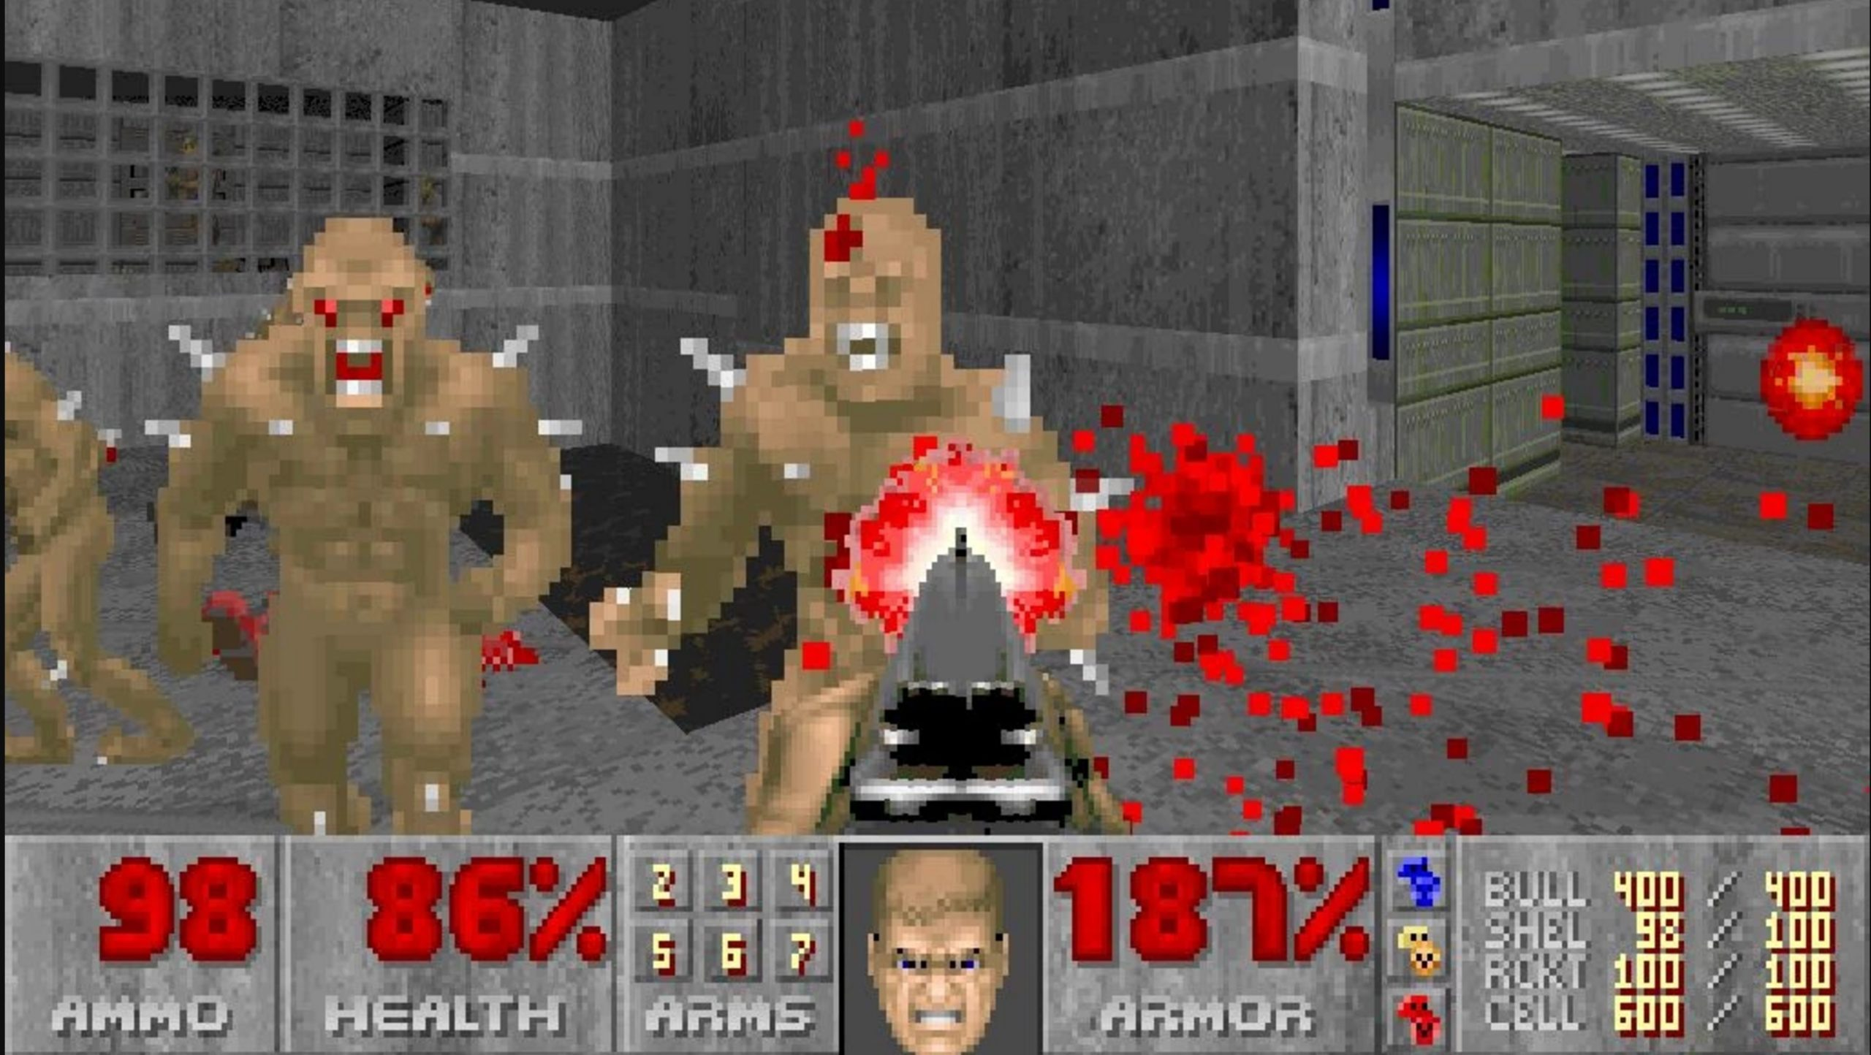
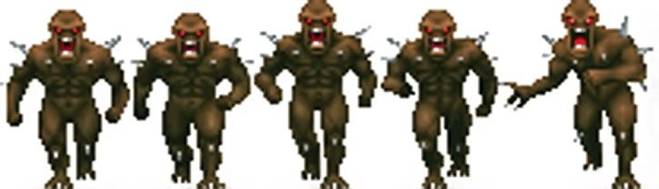
What are “3D graphics” ?
“Images representing a 3d scene created by transforming 3d models and textures using algorithms”
This is not *the* definition, this is my definition
It’s a badly defined term. “You know it when you see it”
Can be a mix of 3D and 2D
Doom world: 3D. GUI: 2D. Enemies: 2D (sprites)

Slide 7
Creating 3D graphics
We need to create 3D models : 3D modeling
We need to create textures : Texturing
We need to create a scene : World Building
We need to transform them : ??? Does anyone know the term ???

Slide 8
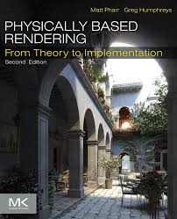
This course should be called 3D rendering
Rendering : creating an image, based on a description of a scene, using algorithms
Description is models, textures, animations, camera settings… and a bunch of other stuff
“graphics programming” would also be a good name for this course

Slide 9
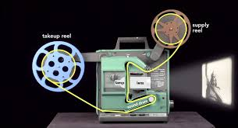
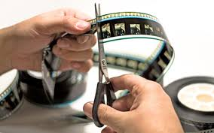
Frame rendering
We want to specifically render moving images
Movies are created by showing a fast sequence of static (not moving) images
The term “film” refers to the very thin material (English: film) where the images were printed on in sequence. A single image is called a frame
These were pulled over a lamp, projecting the image
The amount of different frames we show per second is called frames per second, or fps for short
Editing a movie involved literally cutting and gluing film
“Left on the cutting room floor”: proverb meaning “work or plans not included in a final plan or project”. Was literally true: film left discarded on the floor.

Slide 10

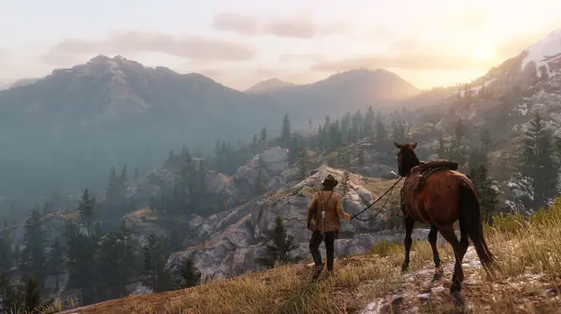
There are two kinds of rendering
Does anyone know the difference between these 2?
Or even where they’re from?

Slide 11
There are two kinds of rendering
Movie
Game

Slide 12
There are two kinds of rendering
Game Do calculations continuously
Why?
Offline rendering Do calculations once

Slide 13
There are two kinds of rendering
(offline) rendering
Happens at the studio once
Long before you view it in the theatre
Realtime rendering
Happen while you play
Why is this needed?

Slide 14
What is the big difference?
How long do we have to render the frame? Assume we’re rendering 60 frames per second (fps)

Slide 15
What is the big difference?
60 frames per second
1 second / 60
16.6 ms per frame

Slide 16
What is the big difference?
How long do we have to render the frame?
Movies display at least 24 fps

Slide 17
Trick question! It doesn’t matter
We only need to render once (no user input)
Anecdotally, about 80-400 hours on a single pc for one frame, but is always rendered on a farm

Slide 18
Offline vs online
We can spend as much time rendering a movie, as we only need to be able to play it back
We can’t do this in games, as the image we render depends on user input (eg moving the camera)
Whiteboard: how much faster do games render?
Why do movies take so long? (Real answer in the aliasing class)
(We’re skipping over some interesting details such as vsync and double buffering)

Slide 19
This course should be called “realtime 3D rendering”
We need to learn how to make 3D images
→ determine the color of every object on the screen
We need to use the graphics card (GPU) to do it fast enough

Slide 20

Course schedule
 | Monday | Thursday
Week 1 | Introduction | C#/Unity
Week 2 | 3D reasoning | 3D reasoning
Week 3 | Basic Pipeline | HLSL
Week 4 | Textures | Normal maps
Week 5 | Camera’s | Light
Week 6 | Advanced pipeline | Advanced pipeline
Week 7 | Materials | Aliasing
Week 8 | Procedural generation | Procedural generation
Week 9 | Project explanation | Project lab
Week 10 | Guest Lecture Project Labs | Guest Lecture Project Labs
Week 11 | Revision | Revision
Highly likely to change ☹

Slide 21
This might not make a lot of sense yet
We’ll do some hands one things with Unity this class and (hopefully) it will start to make more sense
Unfortunately, this will be true of this course as well. Rendering is a lot of simple separate parts, that only make once you can make the connections

Slide 22
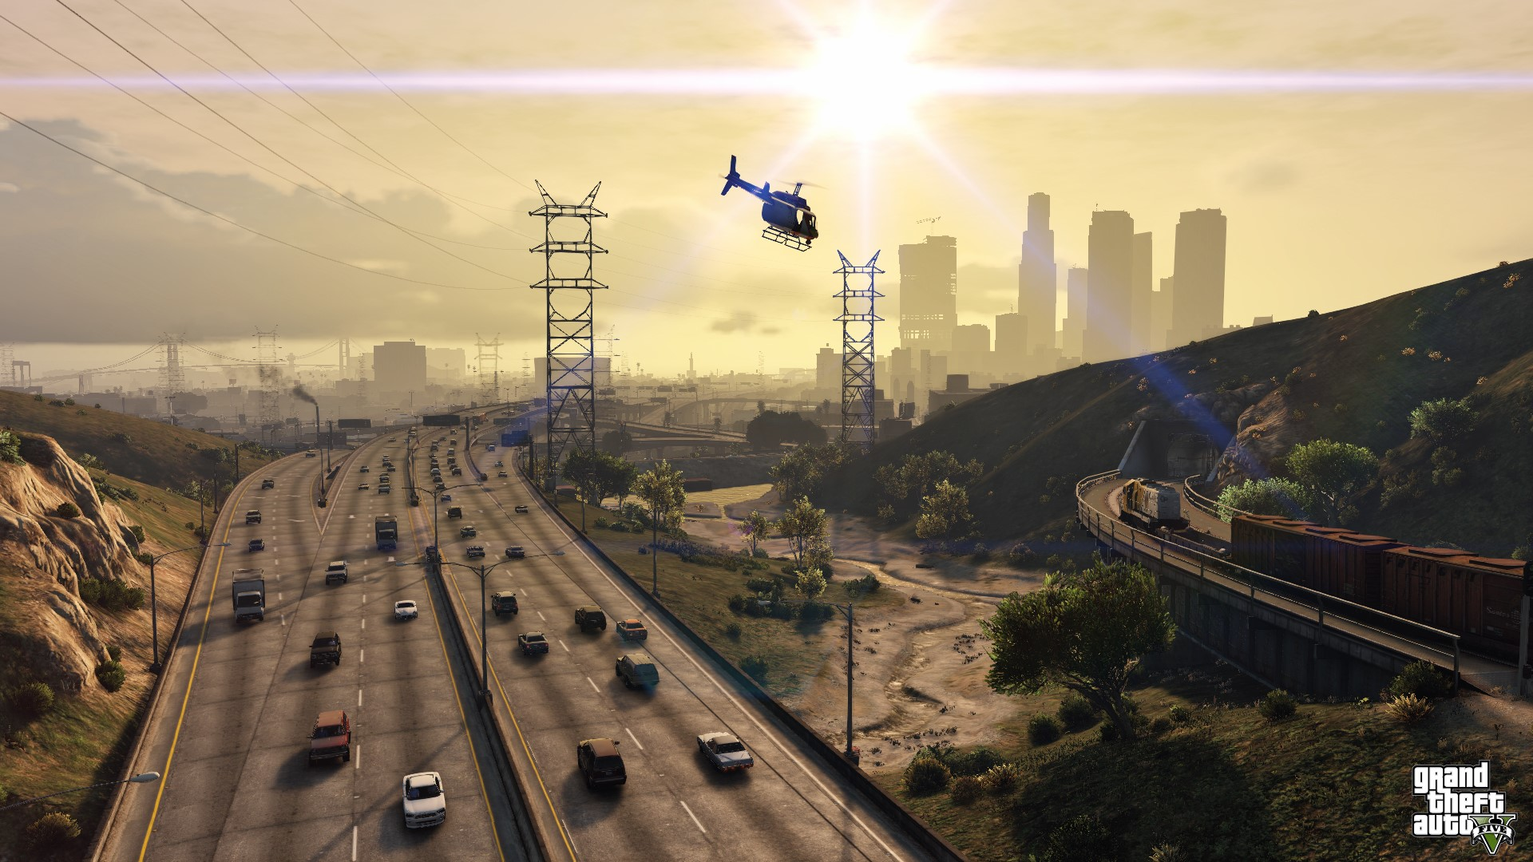
In other words, we want to understand why a pixel has it’s color

Slide 23
What questions do you have?

Slide 24
This class
Contents of this course
→ Evaluation of this course ←
Some bureaucracy
Get our hands dirty with Unity

Slide 25
Evaluation of this course
20 points on project
Labs are parts of the project
Oral exam defending both
Deadlines will be posted this week
Danger : oral exam checks you understand what you did in the exercises and project. It’s a defence, but it’s also an oral exam of the theory as you used it.

Slide 26
Project
Multiple scenes (levels)
Several small ones with a specific task
Create a 3D box in code
Animate 3D water
Shade (give color to) water using a shader (gpu program)
….. And a lot more
One large one, where you put everything together from above, with some extras
Minecraft terrain (boxes in chunks), procedurally generated
Water, also infinite
Portal, with animated center
….. And a lot more

Slide 27
Short evaluation history of this course
First year: 95% pass in June
Second year: 50% pass in June o_O
Second year had better slides, project, ….
Anyone want to guess what happened?

Slide 28
ChatGPT et al
Second year I started asking questions about the code in depth
I consider all your code to be yours, so you need to be able to explain all of it
If your code calls a library method, I want you to know what that method does
Of course you’re allowed to use ChatGPT to do your labs / project
ChatGPT and other LLM’s are not allowed during the exam
Use it to understand, not to generate

Slide 29
The “right” answer
There’s a theoretically correct, professional* way to write rendering code
There’s also the more improvisational, amateurish* way
Compare this to someone who learned how to code at UCLL, vs watching youtube videos at home
I’m very fast at reading your code, and knowing if you (incorrectly) implemented the assignment, or if you generated something with the same requirements, but with a different approach than the course
I’m also very fast and finding your code that implements the theory, and asking about it
* This is totally not a quality judgement btw, in the extended reality course I encourage the improvisational approach. The reasoning is that VR is a messy subject: it’s a lot of UI/UX, psychology, and domain specific requirements/expectations. 3D graphics, however, is more like engineering: it’s mostly known how to do it in the best way

Slide 30
Is that clear? Any concerns?

Slide 31
This class
Contents of this course
Evaluation of this course
→ Some bureaucracy ←
Get our hands dirty with Unity

Slide 32
Questions
Just put up your hand
If it’s not related to lesson, ask at the start of end so other people hear

Slide 33

Contacting me : send me an email!
I usually respond in 2 or 3 working days
If I don’t reply within 4 working days, send me a polite reminder
I might miss you on Toledo or Teams, just send me an email
I never get enough emails from my students
Write me in English or Dutch

Slide 34

Abscences
Class is not mandatory \o/
I strongly recommend you come
This is a hard subject to condense into 2 weeks
Bugs can be hard to track down

Slide 35
This class
Contents of this course
Evaluation of this course
Some bureaucracy
→ Get our hands dirty with Unity ←

Slide 36
First install the following
Unity Hub : https://unity.com/download
Still need to install an engine! Open the hub, install what it suggests

Slide 37
What is Unity?
Unity is a “game engine”
Framework for interactive application (do you know any other than games?)
Provides API for rendering, physics, networking, AI, collision, etc….

Slide 38
Why Unity? Any ideas?

Slide 39
Why Unity?
Most popular game engine on the market
Easier to google problems (or ChatGPT ☹)
C# is a low barrier to entry (Unreal uses C++)
Useful for other courses

Slide 40
Why not Unity? Any ideas?

Slide 41
Why not Unity?
Closed source
Hides what we’re interested in
Has a lot of things we don’t need
Maybe we would like to do things ourself
Uncertain future

Slide 42
What do we need to learn
Unity Editor
C#
HLSL
(Visual Studio (not code))

Slide 43
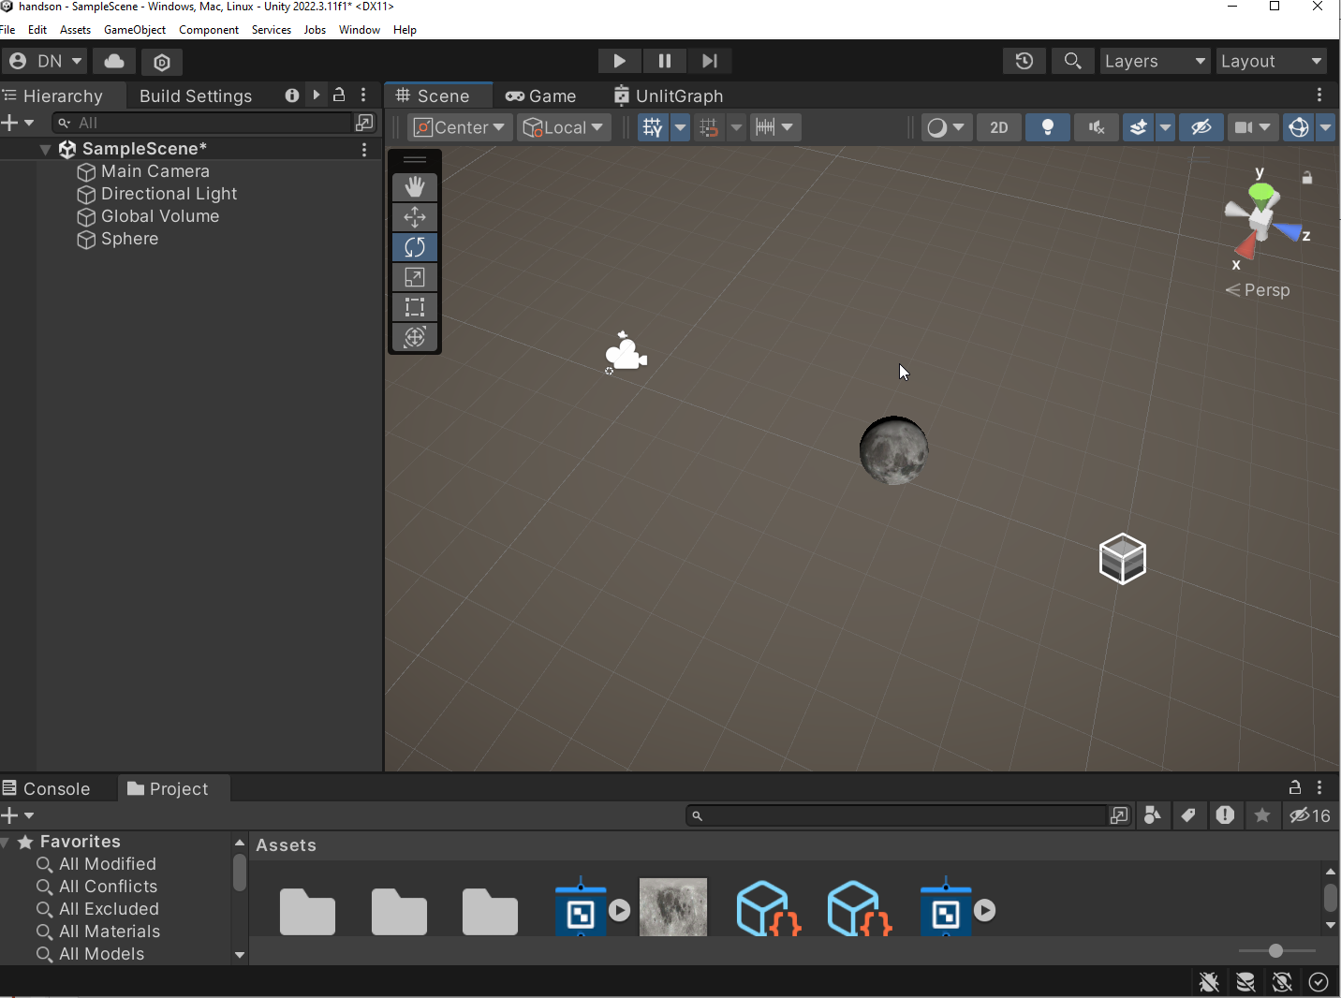
1 Unity Editor
Lot’s of buttons ☹
Artist focused ☹

Slide 44
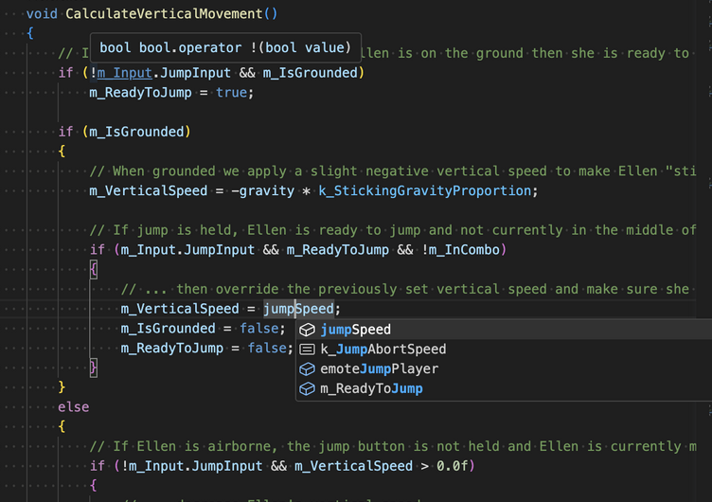
2 C#
Used by Unity for CPU scripting
Very useful language to know
Looks a lot like Java

Slide 45
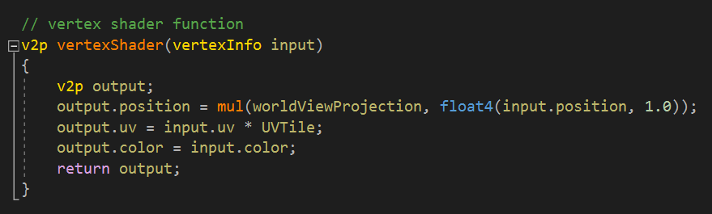
3 HLSL
GPU programming language
No oop ☺
Lots of support for math

Slide 46
The next hour-ish
We’re going to do an experiment
We’re going to implement a “material” (how something looks) in Unity
We want to see if we can render a blue sphere
We’re going to introduce a lot of terms fast
Don’t worry! Will come back in detail in class
This is an exercise to show you (most) of what we’re going to see

Slide 47
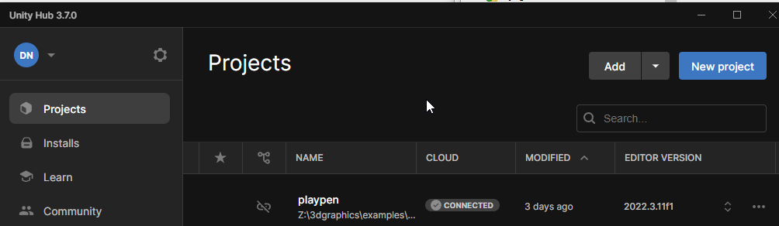
1 : Create a new project

Slide 48
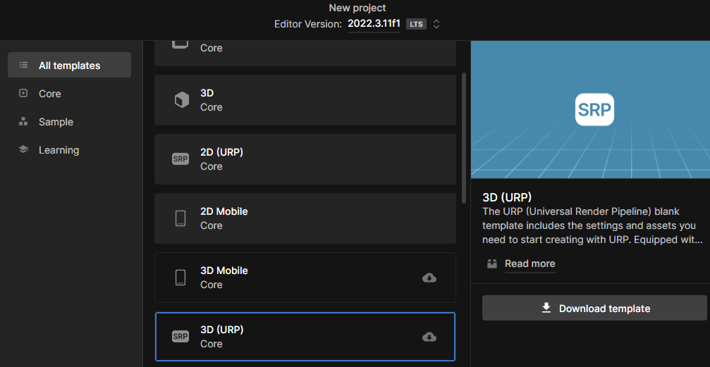
2. Choose 3D (URP), download template

Slide 49
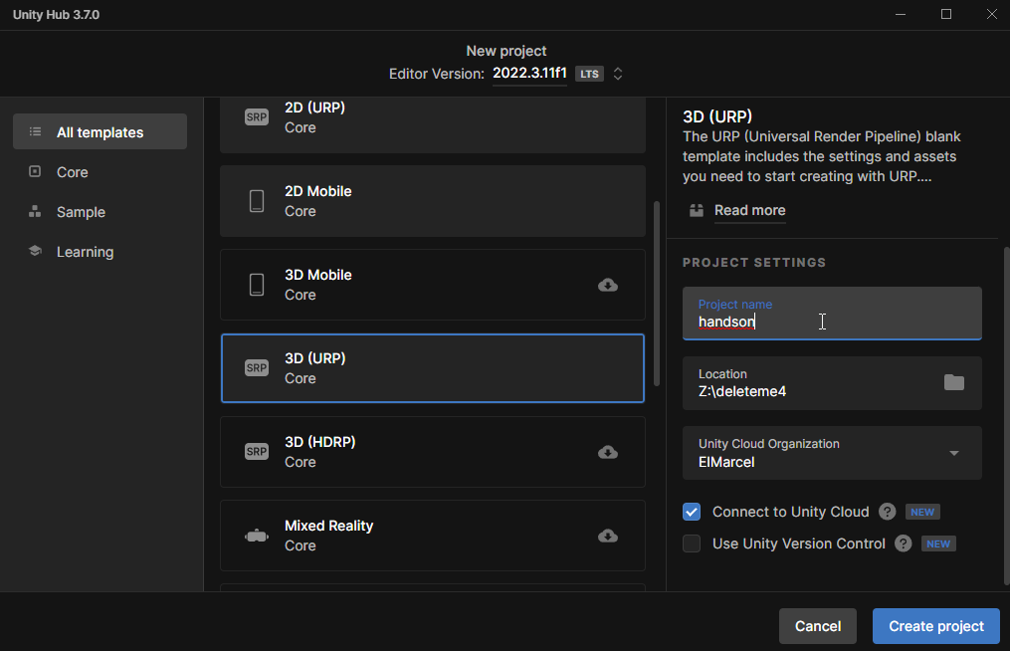
3 Actually create the project
Location doesn’t matter
We won’t use this project after this class
Not a cloud drive (like OneDrive)!

Slide 50
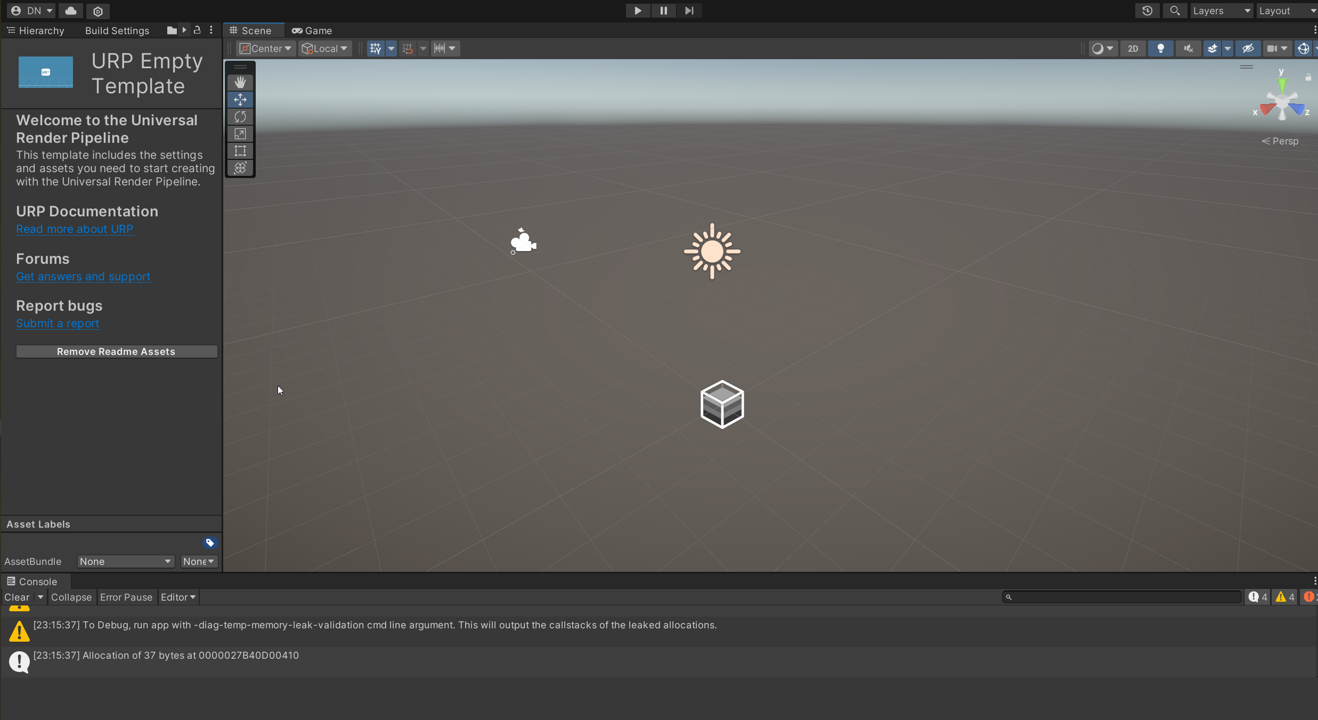
4 Check that you see this, and try to move around
RMB to rotate the camera
MMB to pan the camera
Scrollwheel to zoom

Slide 51
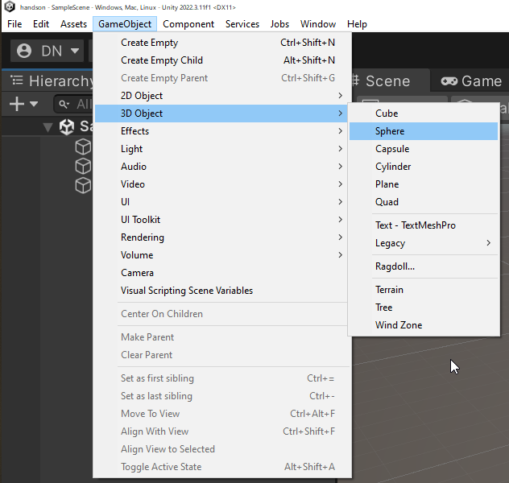
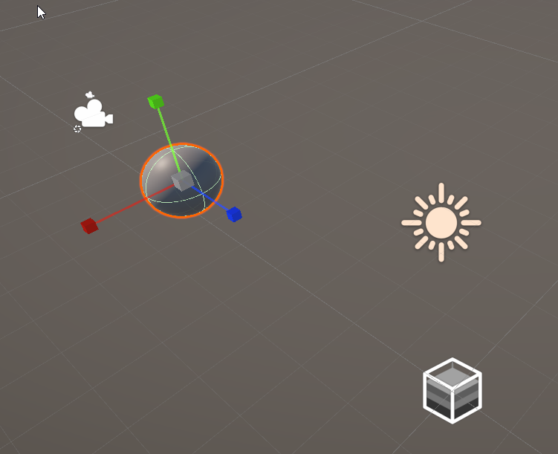
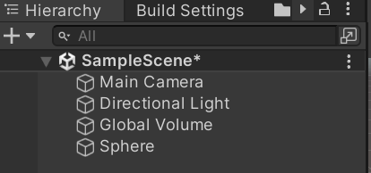
5 Add a sphere to the world

Slide 52
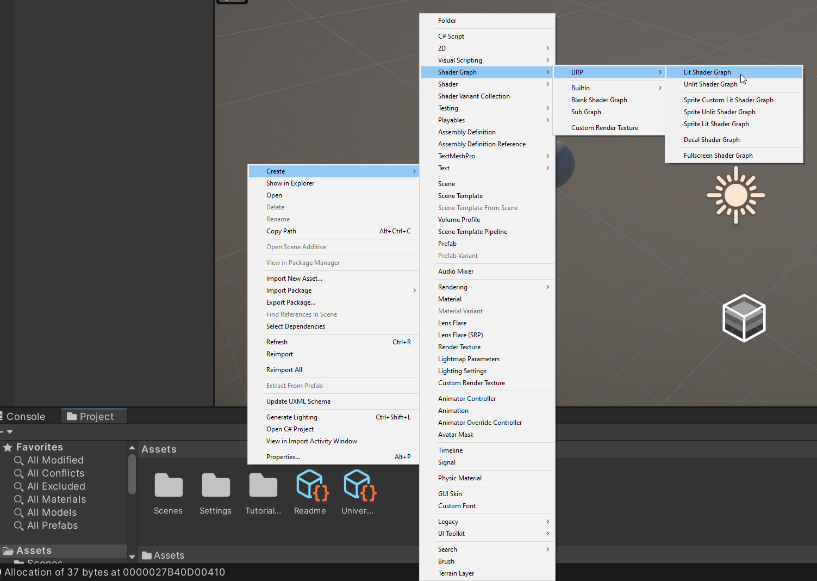
6 Right click in project window, Create->Shader Graph->URP->Lit Shader Graph

Slide 53
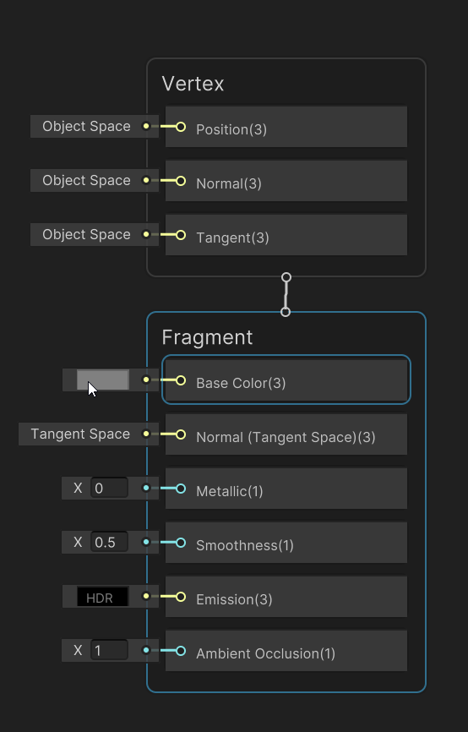
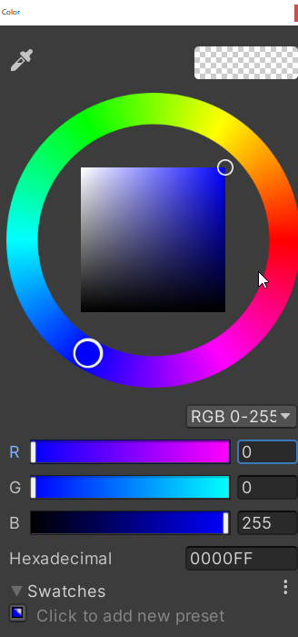
7 Click the box next to “Base Color”, and pick blue

Slide 54
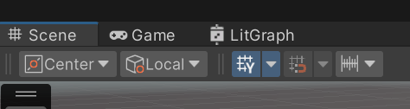
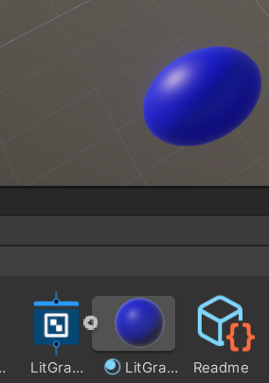

8 Go back to scene view. Click arrow next to graph, and drag that (material) on the scene sphere

Slide 55
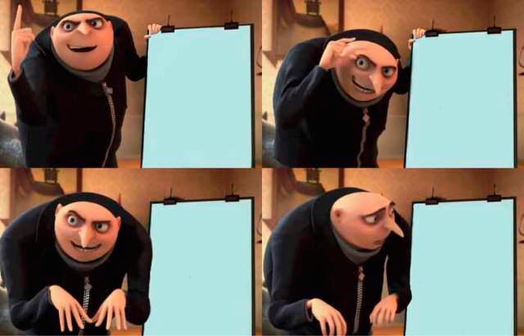

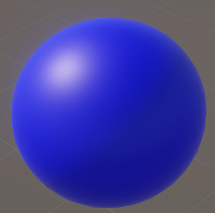
9 Victory?

Slide 56
What is the difference between these two?

Slide 57
This is a sphere that is pure blue

Slide 58
This is a blue sphere, lit by a light

Slide 59
We are going to learn how to make the lit one
By ourself
This is an example of Unity being helpful (we don’t need to know)
But it’s unhelpful (we want to learn how it to do it)

Slide 60
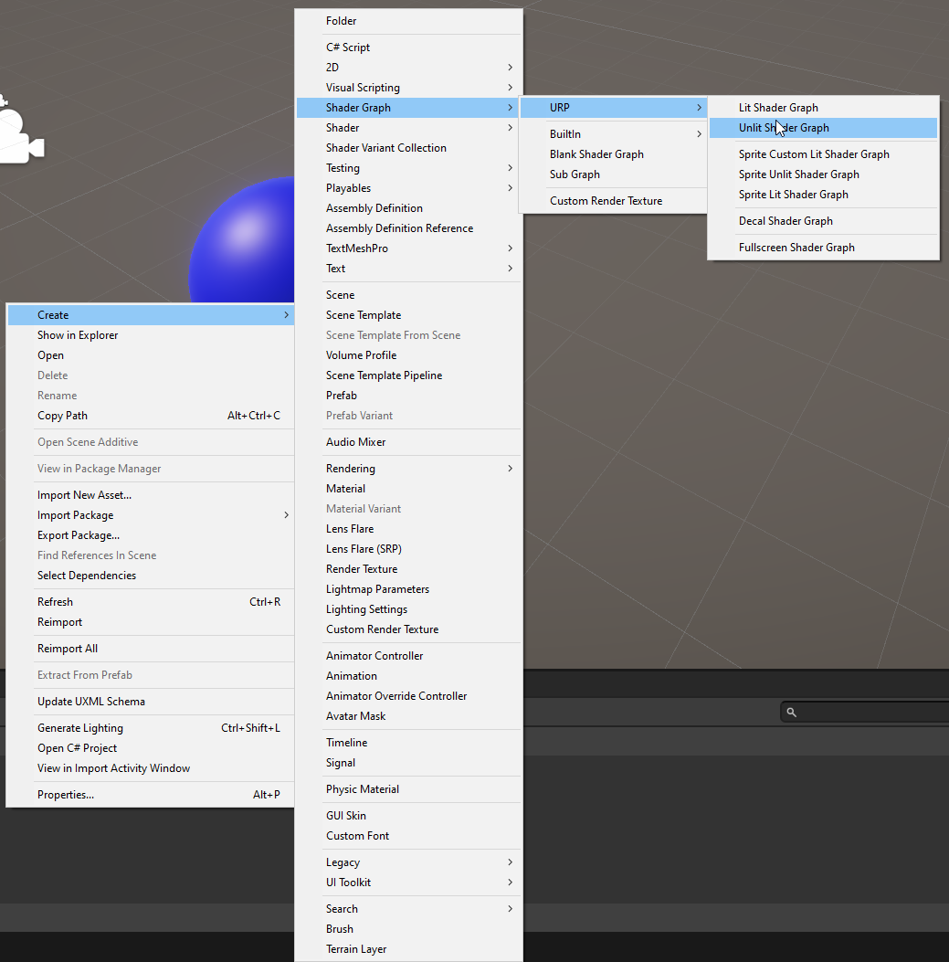
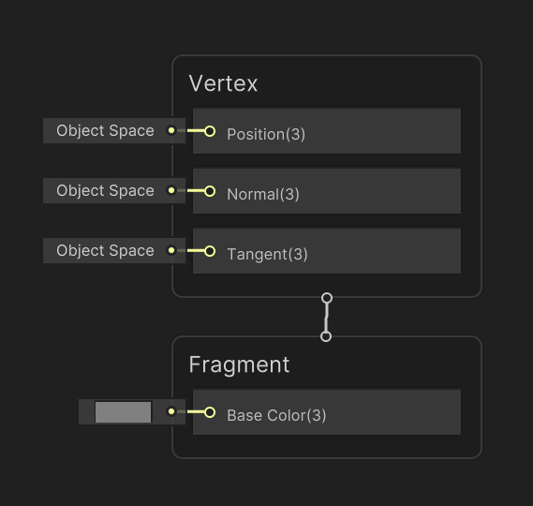
10 Right click in project window, Create->Shader Graph->URP->Unlit Shader Graph

Slide 61
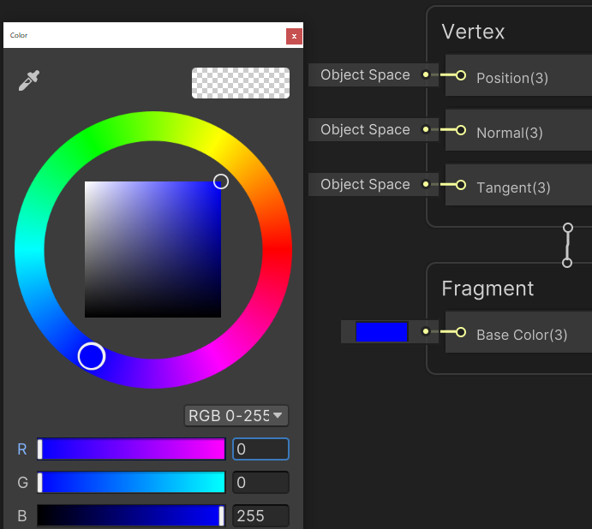
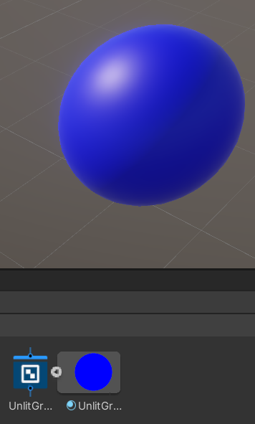
11 Set base color to blue, SAVE, apply the material

Slide 62

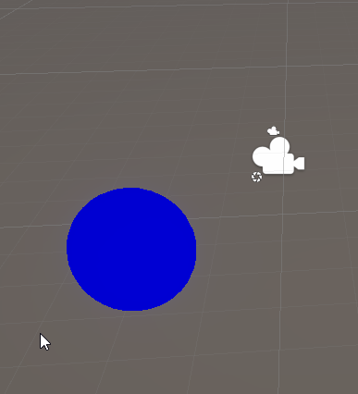
12 Check your results in Scene View

Slide 63
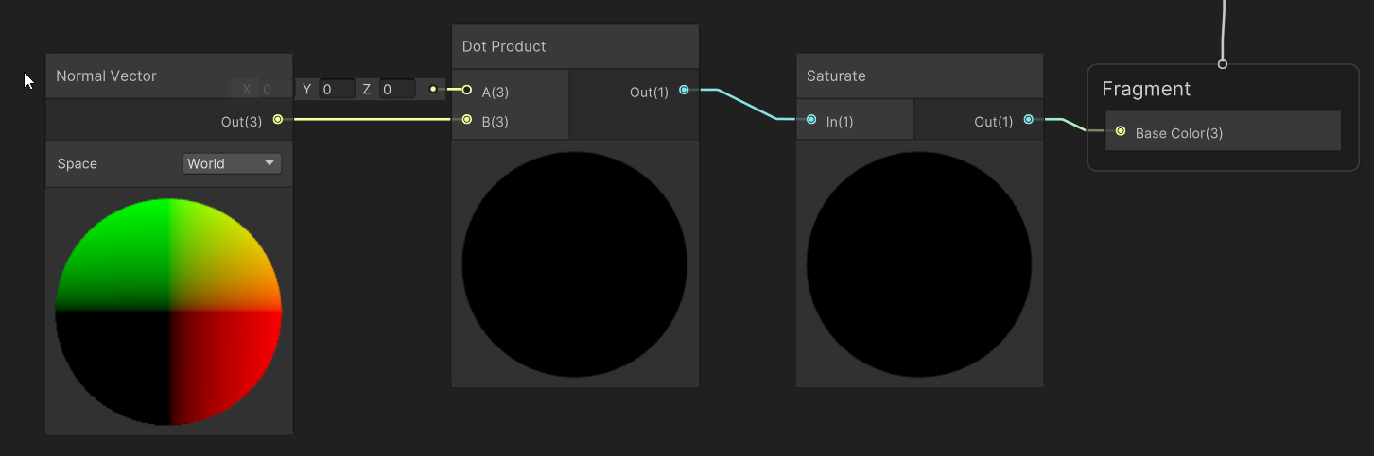
13 Start adding nodes to your graph On graph: right click, create node
Create a Saturate node, connect its output to Base Color’s input
Create a Dot Product node, connect its output to Saturate’s input
Create a Normal Vector node, connect it’s ouptup to Dot Product’s input

Slide 64
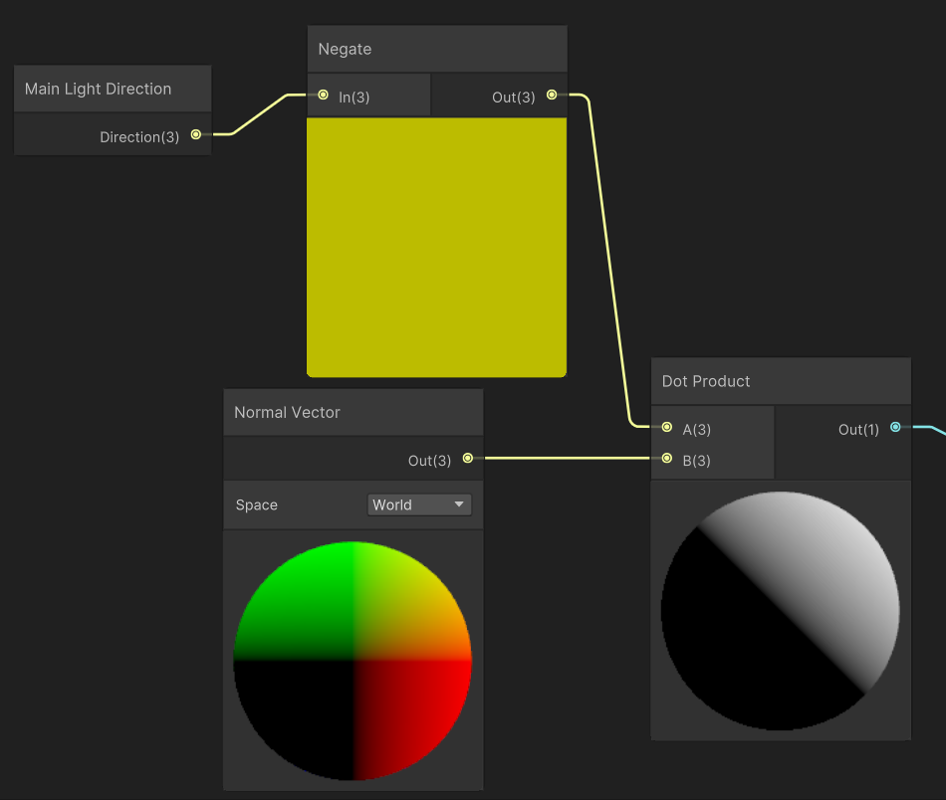
14 Continue adding nodes to your graph
Create a Negate node
Connect it to Dot Product’s free input
Create a Main Light Direction node
Connect it to Negate’s input

Slide 65
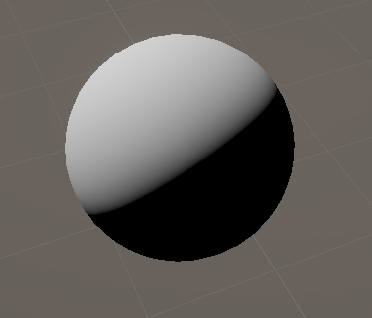
15 Save your graph and check your results

Slide 66
This looks very interesting!
Does this look like something you know?
If you think your answer is ridiculous, it might be correct

Slide 67
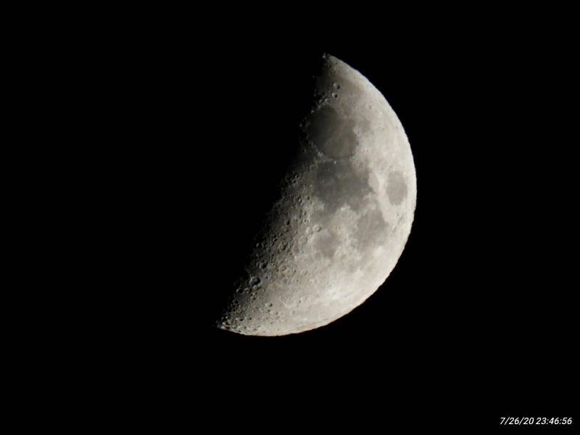
This looks very interesting! (not a joke)

Slide 68
We have just implemented diffuse lighting
Diffuse lighting dominates on rough materials : unglazed pottery, dusty surfaces
It’s color and intensity is independent of the angle you look at it from
You can check by moving your head
Any other examples of diffuse materials?

Slide 69
We used 3 concept to implement it
The normal, N
The light direction, L
The dot product

Slide 70
1 N is the vector perpendicular to the surface
N

Slide 71
1 N is the vector perpendicular to the surface

Slide 72
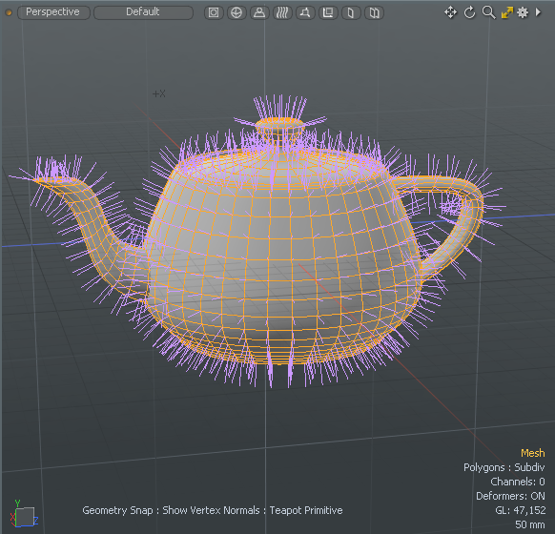
1 N is the vector perpendicular to the surface

Slide 73
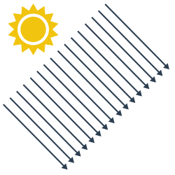
2 The light direction
N

Slide 74

2 The light direction
L
Main Light
Direction
N
N

Slide 75
3 The dot product
Takes two vectors
Outputs how “similar” the vectors are
Goes from -1 to +1
Dot = 1.0
Dot = -1.0
Dot = 0.0
Dot = 0.7

Slide 76
So now we should understand this image
Blue = N
Yellow = L

Slide 77
You see why this course is complex
Many small parts before it comes together
This diffuse implementation is incredibly simple
But now we can build on it
It’s still unclear, because I left quite a lot out

Slide 78
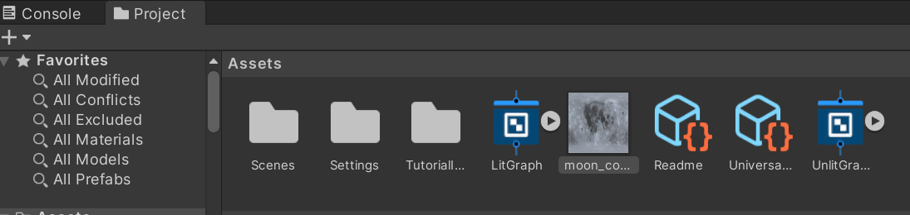
Let’s use a texture for a nicer result
Download textures from Toledo
Drag moon_color.jpg onto your project window

Slide 79
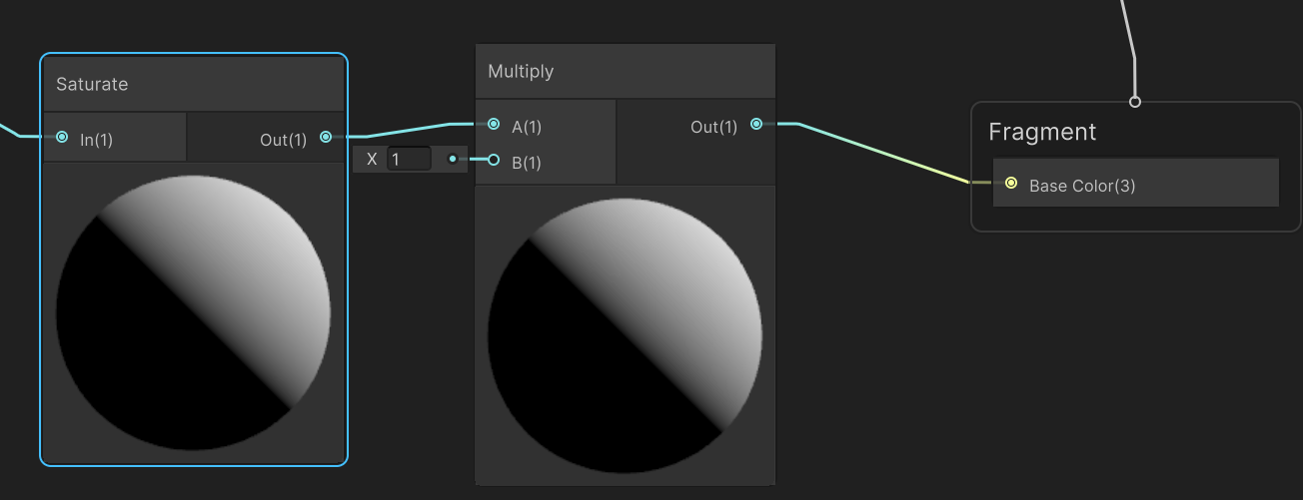
Add a Multiply between Saturate and the output

Slide 80
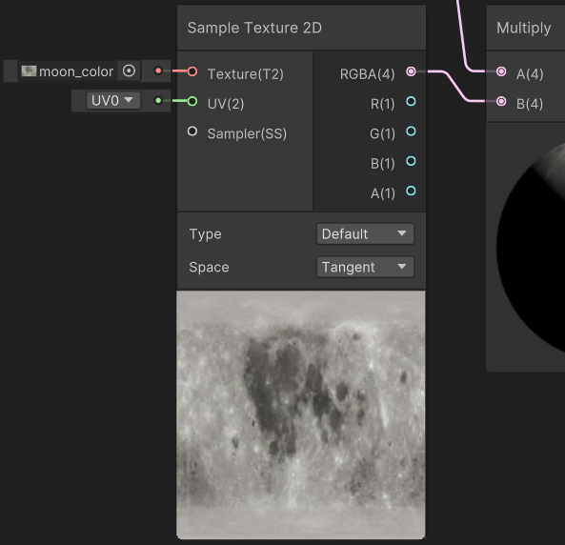
Add a Sample Texture 2D
Connect the output to the free input on Multiply
Set the input texture to our moon_color

Slide 81
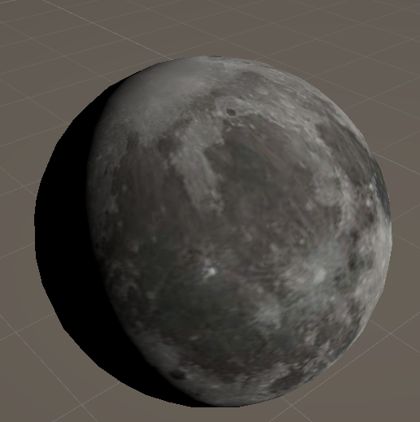
Save and check your results
Does this look good to you?
What is missing?

Slide 82
It looks flat
It looks painted on
Almost like a balloon or marble
This is because we are still lighting it as a sphere
Normal maps can fix this

Slide 83
Quick highlights of the rest of the course
What we just did was already a large part

Slide 84
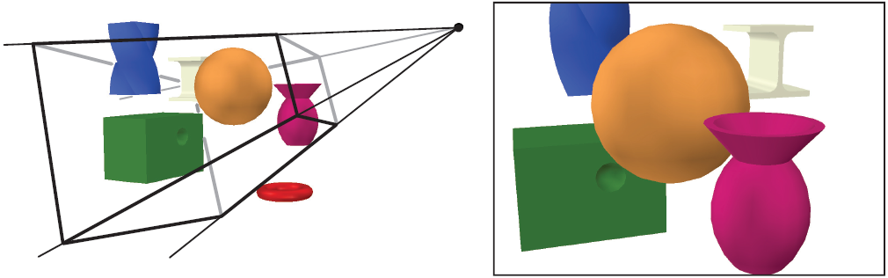
Camera’s

Slide 85
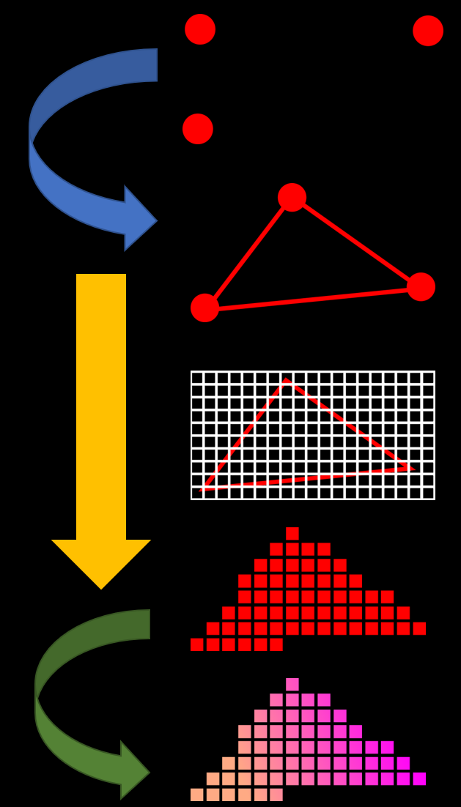
Pipeline

Slide 86
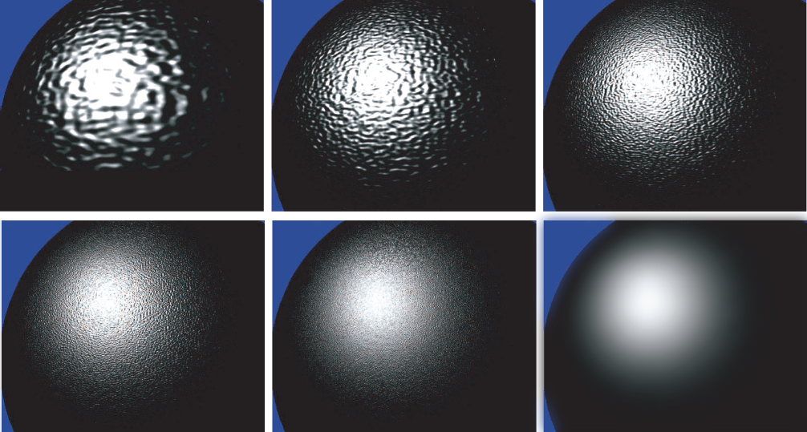
Materials

Slide 87
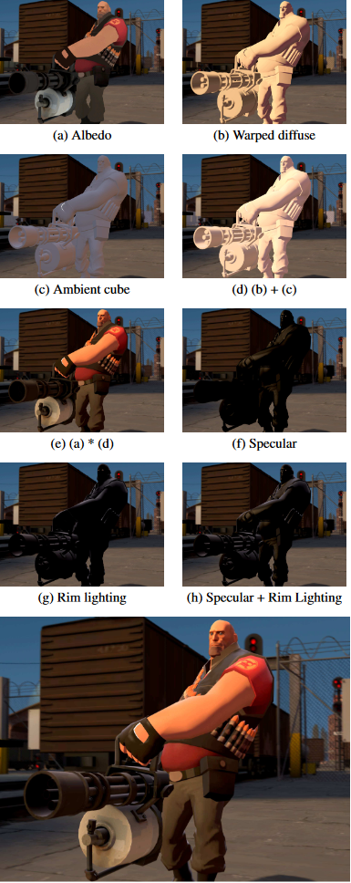
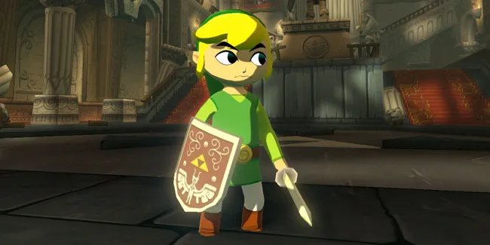
Materials

Slide 88
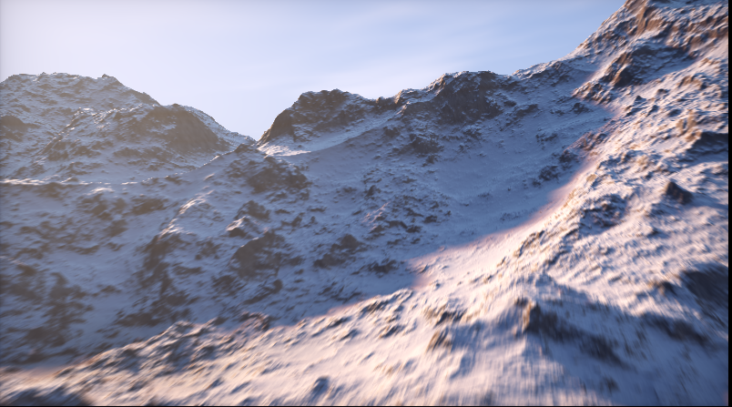
Procedural generation
https://www.shadertoy.com/view/MdX3Rr

Slide 89
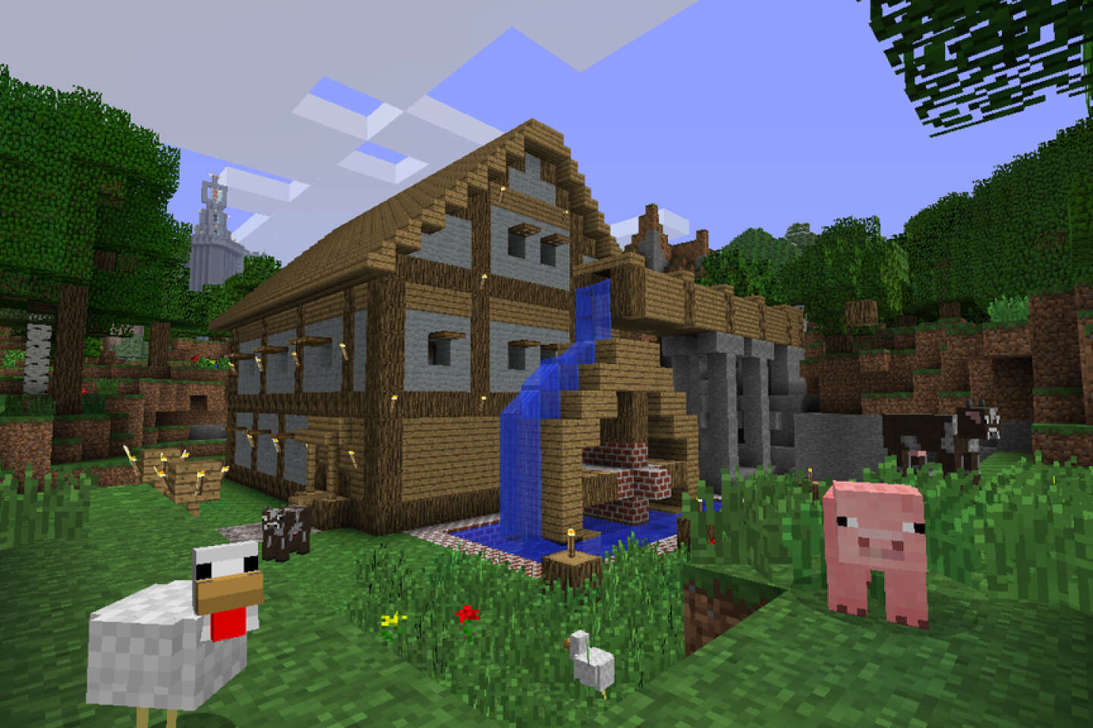
Procedural generation

Slide 90
Aliasing

Slide 91

Hardware

Slide 92
Recap
This course teaches you how 3d rendering works
Specifically, realtime 3d rendering
It’s a lot of simple concepts
These concepts interact, so it can be rough

Slide 93
Thursday
Architecture of Unity
Focus on C#
Focus on Unity types
Some 3D coordinates and manipulation

