Slide 1
Week 2a: 3D reasoning

Slide 2
Last class
3D coordinate system
Points & Vectors
Translate
Rotate
Scale
We’ll go over them again

Slide 3
This class
3D coordinates
3D transforms
Why they are important
Dot & Cross product
Quaternions

Slide 4
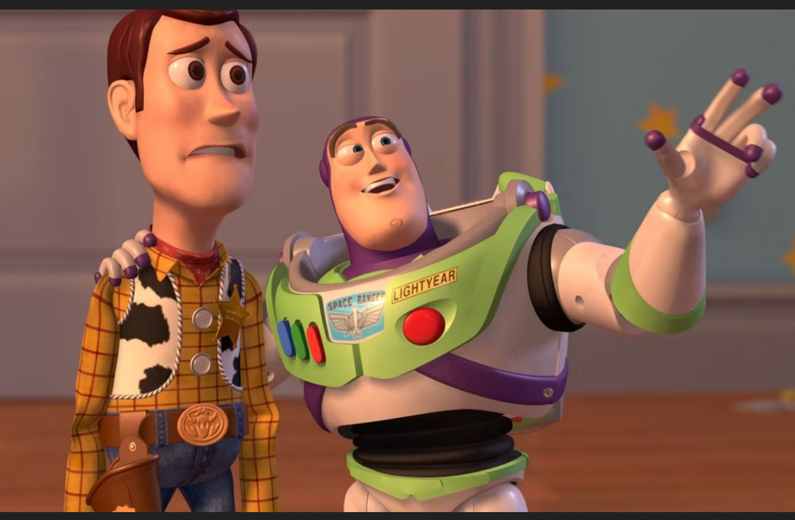
Course schedule
 | Monday | Thursday
Week 1 : 12/02 | Introduction | C#/Unity Lab
Week 2 : 19/02 | 3D reasoning | 3D Lab
Week 3 : 26/02 | Basic Pipeline | Lab
Week 4 : 04/03 | Textures Normal maps | Post processing / lab
Week 5 : 11/03 | Camera’s Light | lab
Week 6 : 18/03 | Advanced pipeline | Advanced pipeline lab
Week 7 : 25/03 | Materials Aliasing | Materials Lab
Week 8 : 15/04 | Procedural generation | Procedural generation lab
Week 9 : 22/04 | Project explanation | Project lab
Week 10 : 29/04 | Guest Lecture Project Labs | Guest Lecture Project Labs
Week 11 : | Revision | Revision
Highly likely to change ☹

Slide 5
This class
→ 3D coordinates ←
3D transforms
Why they are important
Dot & Cross product
Quaternions

Slide 6

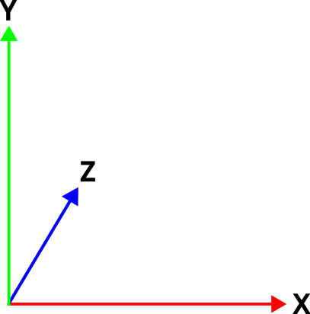
3D coordinate system
Left-handed coordinate system
Y is up

Slide 7
Points
A position in our coordinate system
Represented by a tuple of 3 floats
For example, a point at position (2, 1, 0)
(2, 1, 0)
1
2

Slide 8
Origin
A position in our coordinate system
Position is (0, 0, 0)
Place where all the axis are 0
(0, 0, 0)

Slide 9
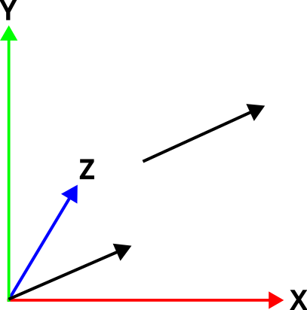
Vector
A Vector is the name for that tuple of floats, eg (2, 1, 0)
It’s not a location
Rather, it’s an offset
The black arrows are the same vector (2, 1, 0)

Slide 10
Unity
// initialize with all components
Vector3 v1 = new Vector3(2, 1, 0);
// shorthand for (0, 0, 0)
Vector3 v2 = Vector3.zero;
// shorthand for (1, 0, 0). All 6 directions exist
Vector3 v3 = Vector3.right;

Slide 11
Questions?

Slide 12
We can do calculations with vectors
I’m going to remove the Z axis for the next couple of slides, for clarity

Slide 13
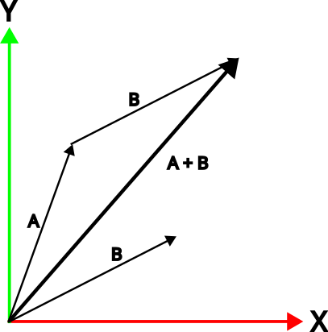
Addition
We can add two vectors together
We add all components separately
This is called “component-wise”
A = (1, 2, 0)
B = (2, 1, 0)
A+B = (3, 3, 0)

Slide 14
Addition
We can add two vectors together
We add all components separately
This is called “component-wise”
A = (1, 2, 0)
B = (2, 1, 0)
A+B = (3, 3, 0)
Vector3 a = new Vector3(1.0f, 2.0f, 0.0f);
Vector3 b = new Vector3(2.0f, 1.0f, 0.0f);
Vector3 c = a + b;

Slide 15
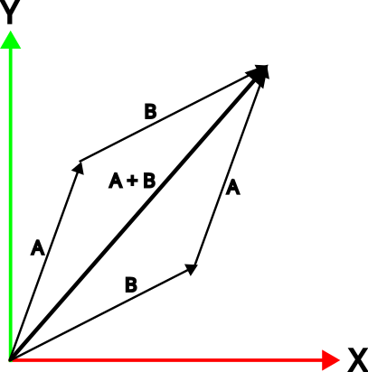
Addition is communicative
Order doesn’t matter
A + B = B + A

Slide 16
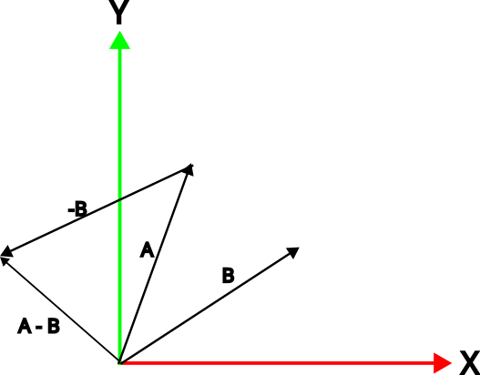
Subtraction
We can subtract one vector from another
We subtract all components separately
Order does matter
A = ( 1, 2, 0)
B = ( 2, 1, 0)
A-B = (-1, 1, 0)

Slide 17
Multiplication / division
We can’t meaningfully multiply/divide 2 vectors
But we can multiply/divide by a single float (“scalar”)
A = (2, 1 , 0)
A*2 = (4, 2 , 0)
A/2 = (1, 0.5, 0)

Slide 18
Multiplication / division changes length
A
A * 2 A / 2

Slide 19
Normalization
Make a vector length one
N and L are examples of normalized vectors. We call these unit vectors. They are always used for directions
X, Y, and Z axis are unit vectors of (1, 0, 0), (0, 1, 0), and (0, 0, 1)

Slide 20
This class
3D coordinates
→ 3D transforms ←
Why they are important
Dot & Cross product
Quaternions

Slide 21
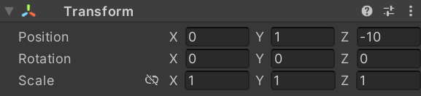
So, why did we learn all of this?
Now we can learn about Unity transforms
Every Unity GameObject has a TransformComponent
It contains:
A position
A rotation
A scale

Slide 22
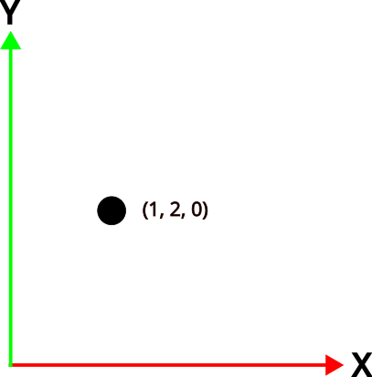
Transform.position
Remember: position is a point in space
is a property on Transform
Has a getter and a setter
We can assign or read position
Transform transform = gameObject.transform;
transform.position = new Vector3(1, 2, 0);

Slide 23
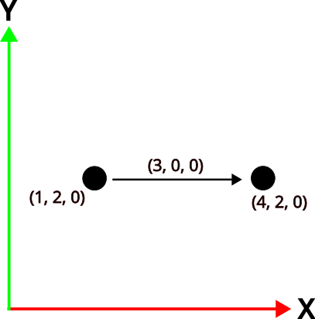
Transform.translate()
Translation is moving an object
Without changing it’s rotation or scale
It’s a relative movement
transform.Translate(new Vector3(3, 0, 0));

Slide 24
Transform.rotation
We will look at them in the Quaternion section

Slide 25
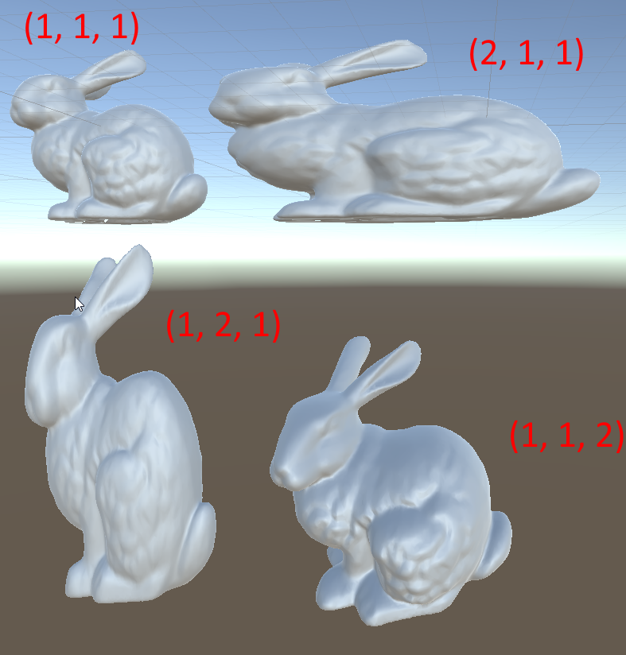
Transform.scale
Stretching coordinates
Among one or multiple axis
Almost always want a “uniform” scale
“uniform scale” = (2, 2, 2)

Slide 26
What are your questions?

Slide 27
Transforms are represented by a Matrix
4x4 grid of floats
Contains a translation, rotation, and scale
Can contain other things (Camera class)

Slide 28
This class
3D coordinates
→ 3D transforms ←
Why they are important
Dot & Cross product
Quaternions

Slide 29
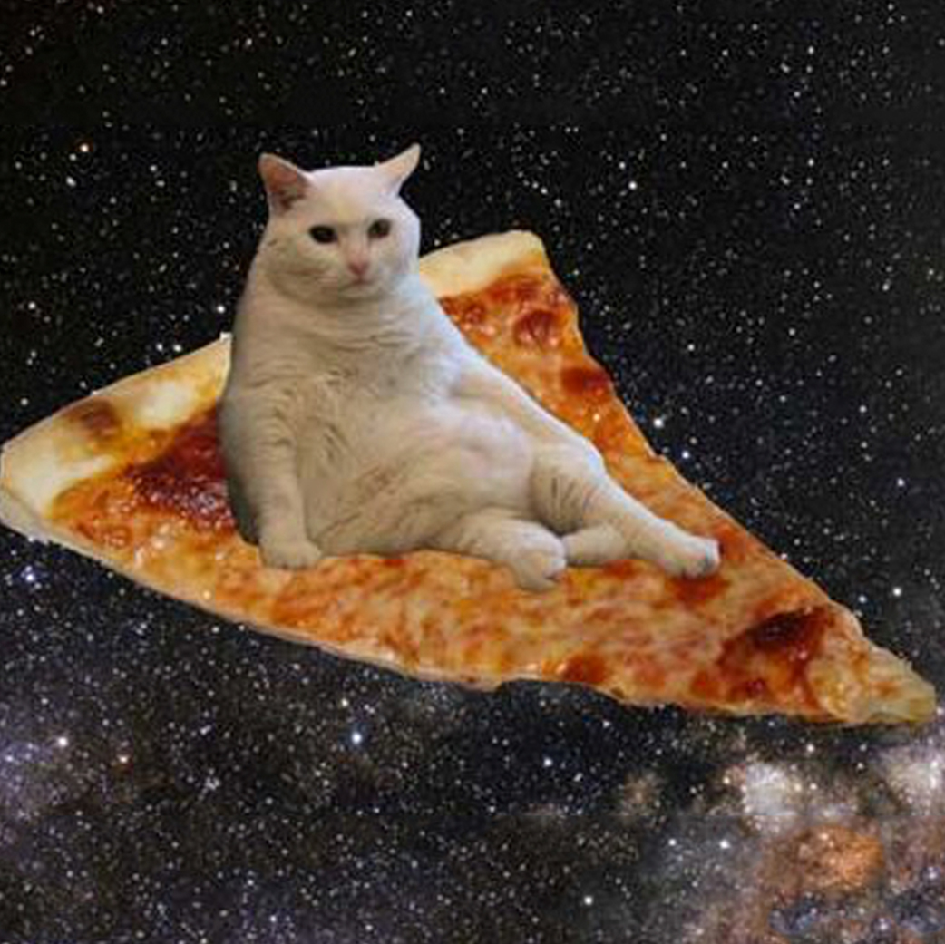
Let’s learn about space(s)

Slide 30
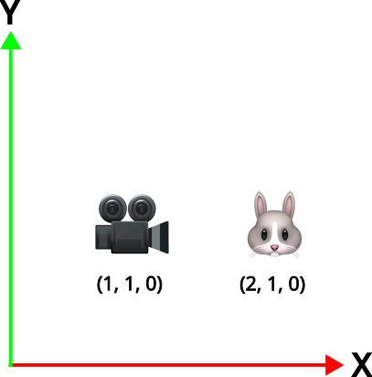
Example

Slide 31
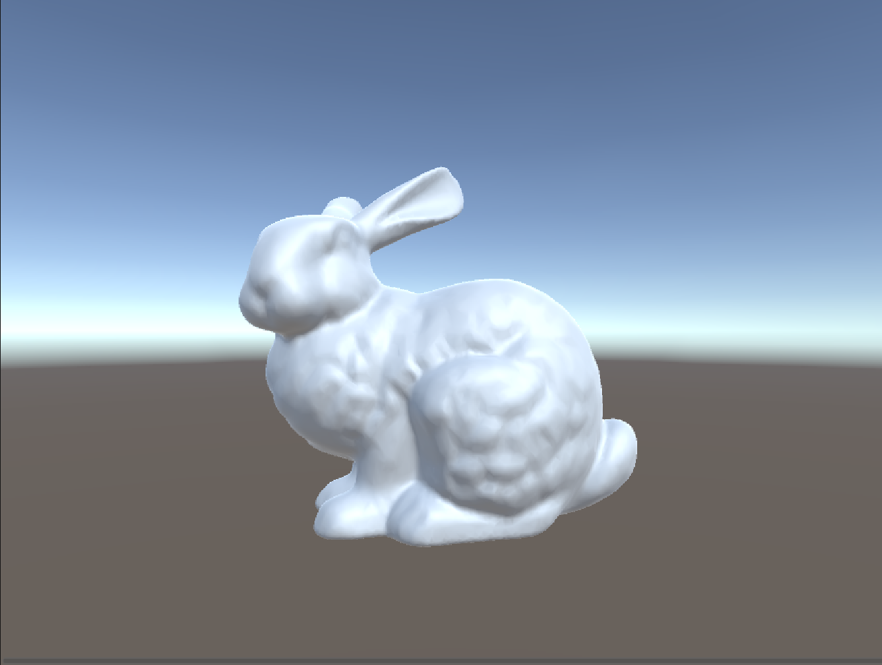
Camera is looking down +X

Slide 32
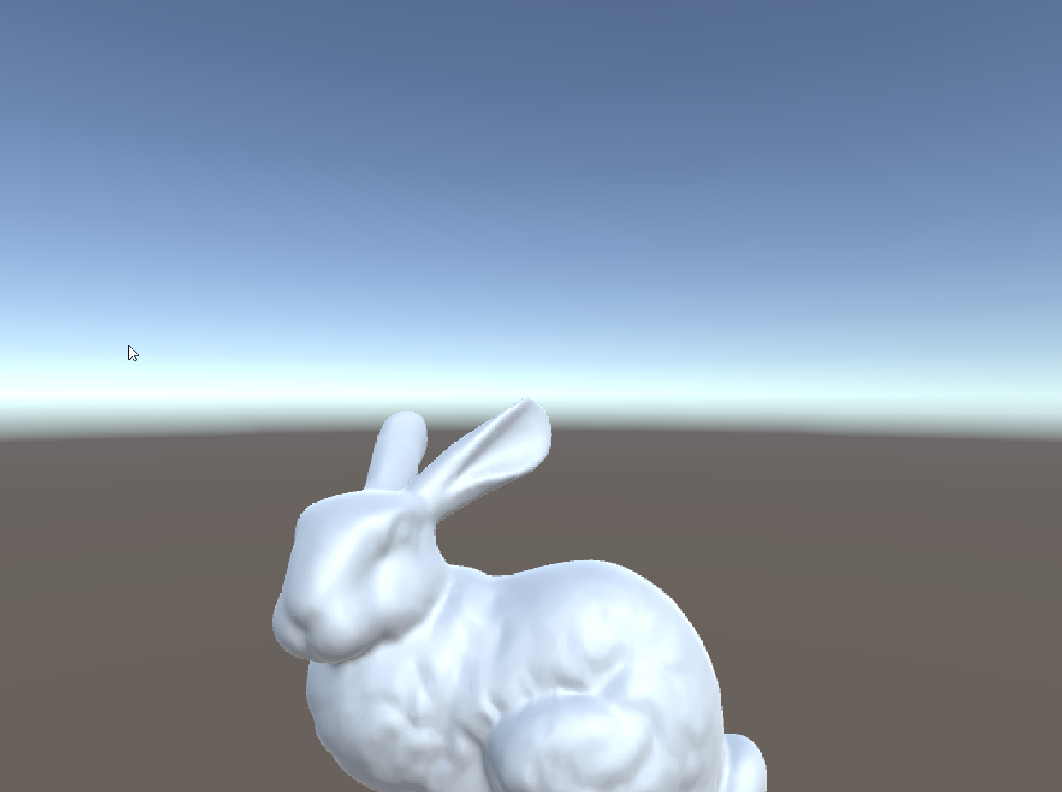
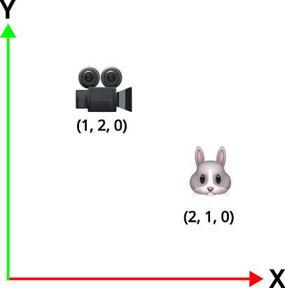
We move the camera up (+Y) by one unit

Slide 33
The bunny moved down
This doesn’t surprise us, but maybe it should!

Slide 34
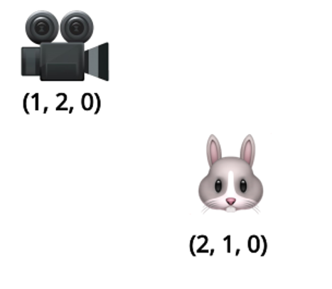
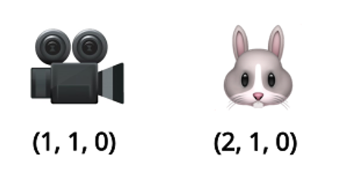
Rendering is done from a camera’s point of view
Moving the camera up is the same as moving the bunny down

Slide 35
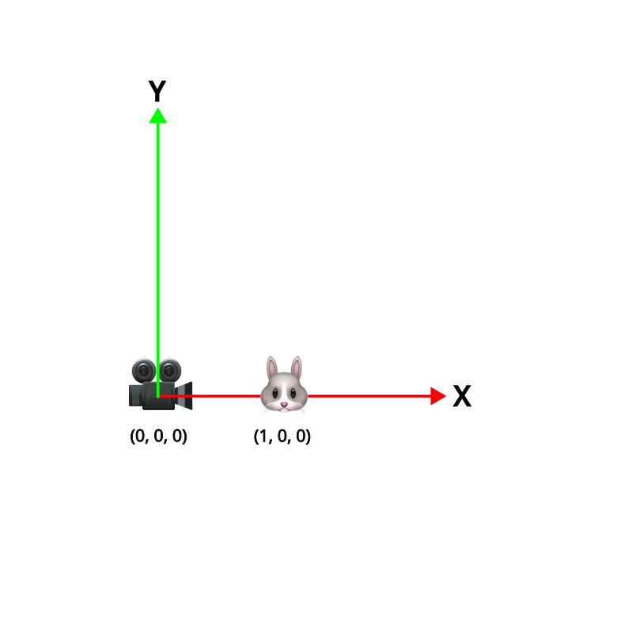
The camera has it’s own coordinate space
Space = frame of reference
We call it view space
When only the camera moves, everything seems to move
It’s because the coordinate system moves

Slide 36
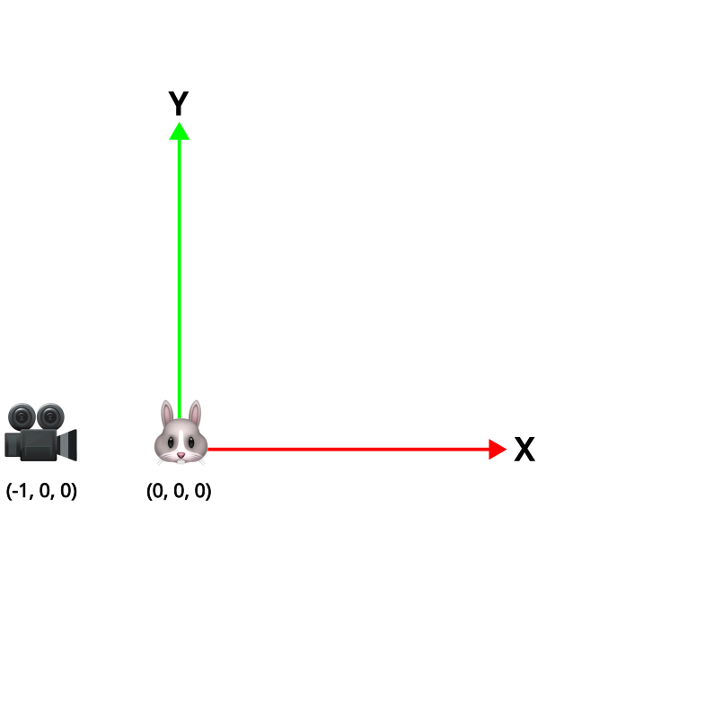
The bunny has it’s own coordinate space
It’s called object or model space
All the triangles are defined in this space
They are static (never change)
We transform them to view space to render

Slide 37
These all exist at the same time
World space
View space
Object space

Slide 38
We can transform point between spaces with transforms
Vector3 position = bunnyGameObject.transform.position; // in WorldSpace
cameraGameObject.transform.InverseTransformPoint(position); // in CameraSpace
position is in WorldSpace
Transform.TransformPoint transforms from LocalSpace to WorldSpace
Transform.InverseTranformPoint transform from WorldSpace to LocalSpace
Every Matrix transforms form one space to another
Inverting the Matrix does it the other way around

Slide 39
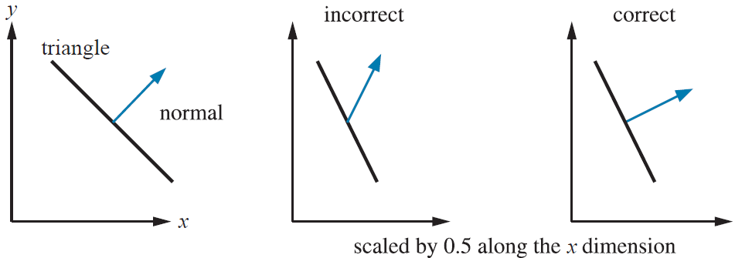
Warning! Use different methods for directions
Direction = N or L
Use TransformDirection
Not TransformPoint, your result will be incorrect

Slide 40
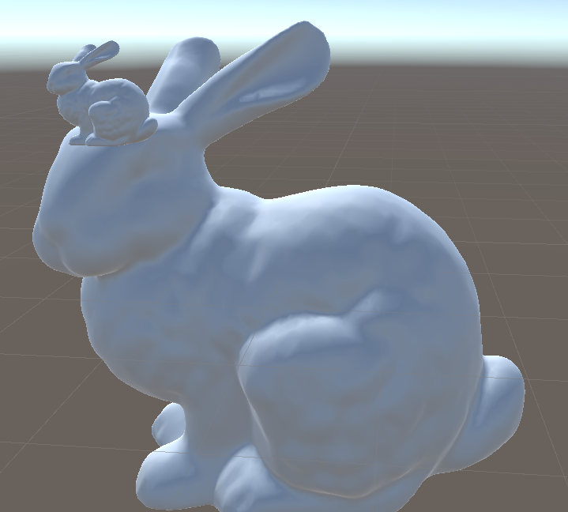
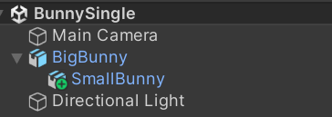
It’s a big hierarchy
SmallBunny’s transform is relative to BigBunny
If I translate BigBunny, SmallBunny follows
It’s transform is in “BigBunny space”
All previous examples had no explicit parents
It had the root as parent
And that is world space
Same here for BigBunny

Slide 41
Cool things we can do
Matrices multiply, and it add’s (concatenate) the transforms
Matrix4x4 worldToView = cameraGameObject.transform.worldToLocalMatrix;
Matrix4x4 bunnyToWorld = bunnyGameObject.transform.localToWorldMatrix;
Matrix4x4 bunnyToView = bunnyToWorld * worldToView; If you name it like this, bugs are very obvious

Slide 42
Does that make sense?

Slide 43
This class
3D coordinates
3D transforms
→ Why they are important ←
Dot & Cross product
Quaternions

Slide 44
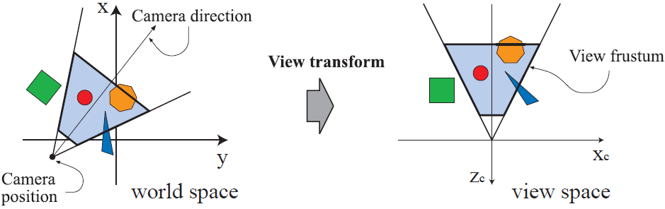
This is how we position object in front of the camera

Slide 45
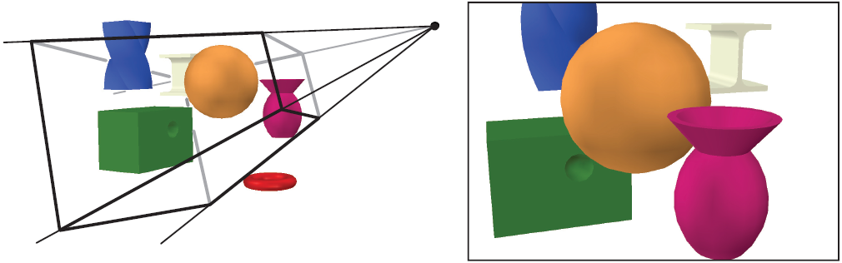
This is how we position object in front of the camera

Slide 46
This is how you fix your camera from Lab 1
Live demo

Slide 47
This class
3D coordinates
3D transforms
Why they are important
→Dot & Cross product ←
Quaternions

Slide 48
Dot product
A
angle
B
Definition 1 : Dot(A,B) = A.length() * B.length() * cos(angle)
Definition 2 : A.x * B.x + A.y * B.y + A.z * B.z
Unit vectors: Dot(A,B) = cos(angle)
Measure of closeness

Slide 49
Unit vectors → just the cosine
Dot = 1.0
Dot = -1.0
Dot = 0.0
Dot = 0.7

Slide 50
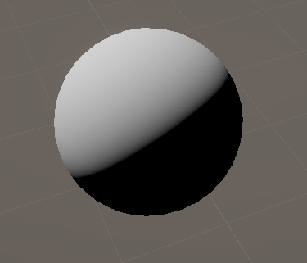
Dot product uses: shading

Slide 51
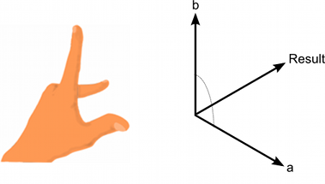
Cross product
Creates a third vector perpendicular to two given vectors
Order matters! AxB = -BxA (result is flipped)
Length depends on angle, length of A and B
Perpendicular A and B, A and B are unit vectors : length 1

Slide 52
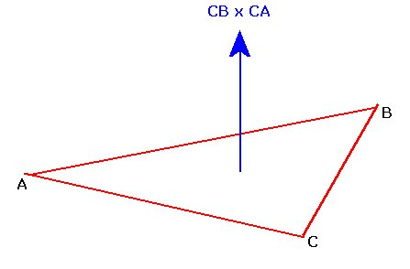
Cross product uses : calculate normal

Slide 53
This class
3D coordinates
3D transforms
Why they are important
Dot & Cross product
→ Quaternions←

Slide 54
Quaternion: better rotations
Used by unity to represent rotations
Based on complex numbers (we treat it as a black box)
Implemented as a Vector 4

Slide 55
Quaternion: advantages
Brings us too far
Feel free to check https://www.youtube.com/watch?v=zjMuIxRvygQ
TLDW Quaternions do not have some problems separate XYZ rotations have

Slide 56
Quaternion : uses
// rotation to bunny
Quaternion rotation = Quaternion.LookRotation(
bunnyGameObject.transform.position - transform.position, Vector3.up);
// rotate around up
Quaternion rotation = Quaternion.AngleAxis(30, Vector3.up);

Slide 57
Recap
Transformations move positions and directions between spaces
Unity transform is relative to the parent
We can use Matrix4x4 to transform between any 2 spaces
A dot product gives us a measure of similarity between 2 vectors
A cross product construct a vector perpendicular to 2 other vectors

Slide 58
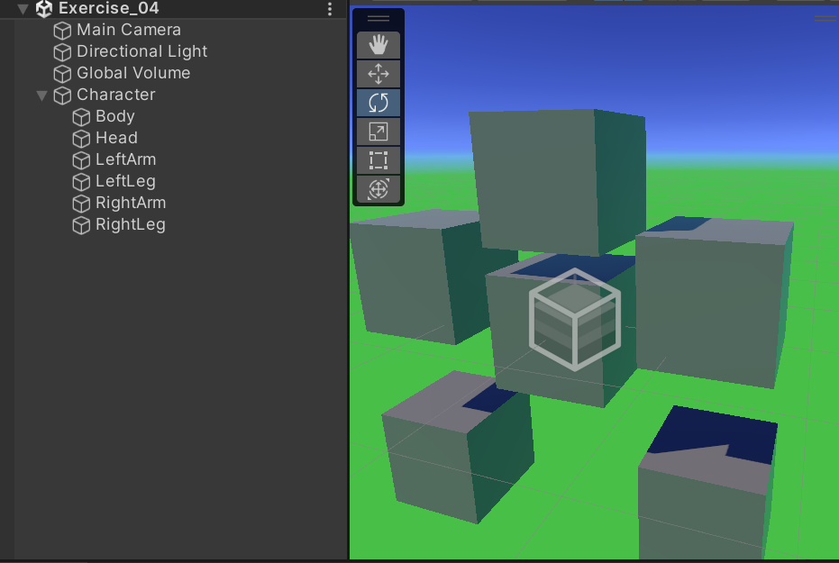
Next lab
We’ll make a character creator
And add some programmer animation

Slide 59
Rest of this class
Lab! Might want to fix your debug camera

