Slide 1
Week 10b: Guest lecture

Slide 2
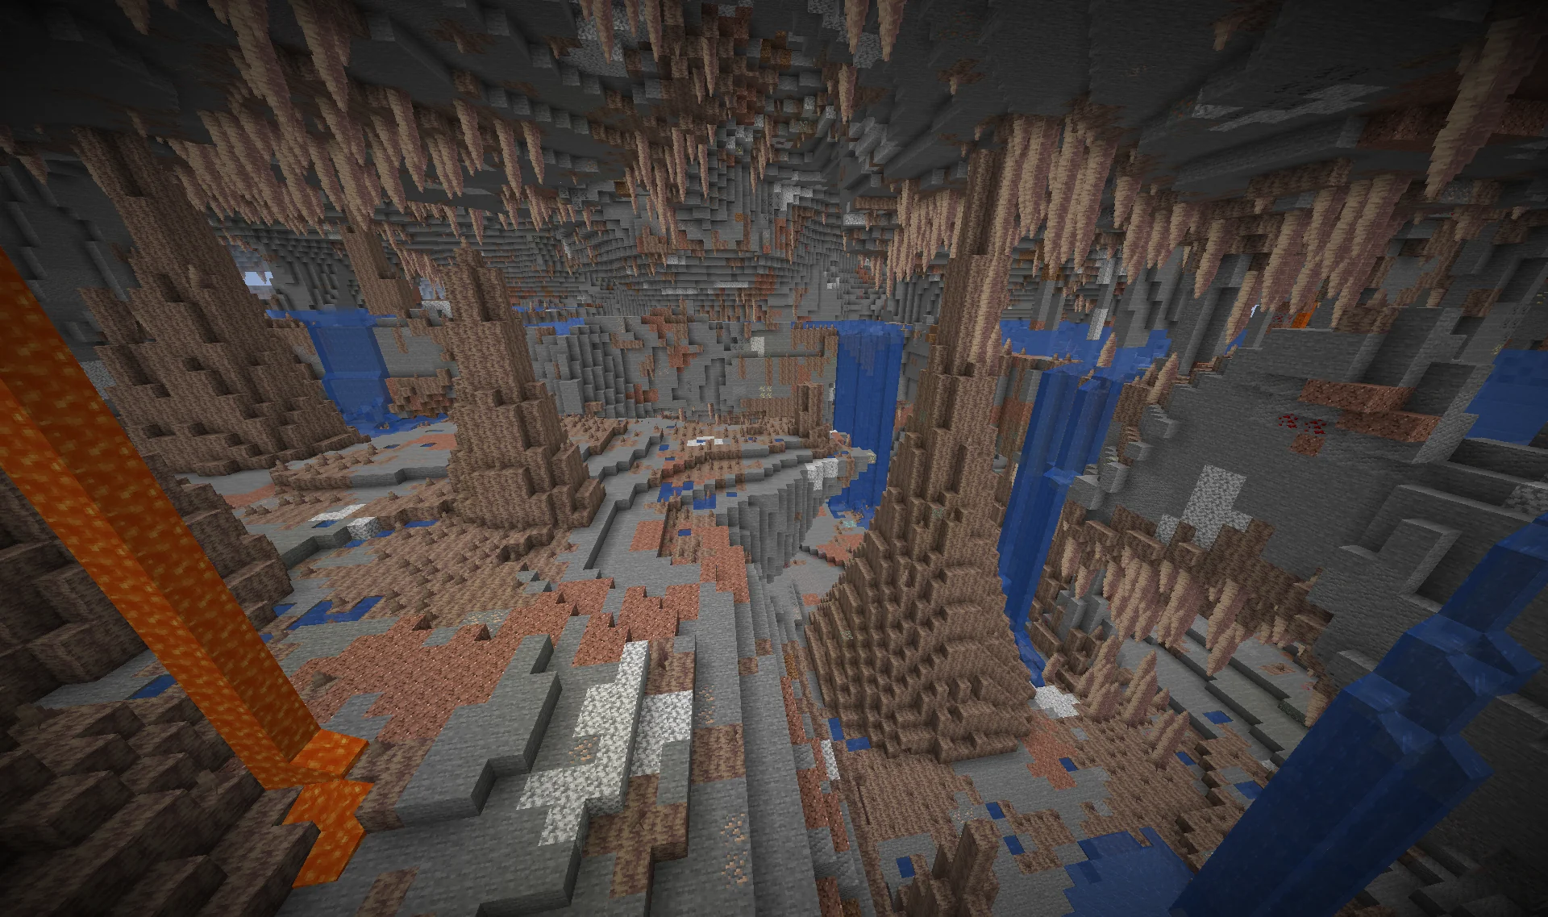
Last class
Overhangs / caves
Pupil lab

Slide 3
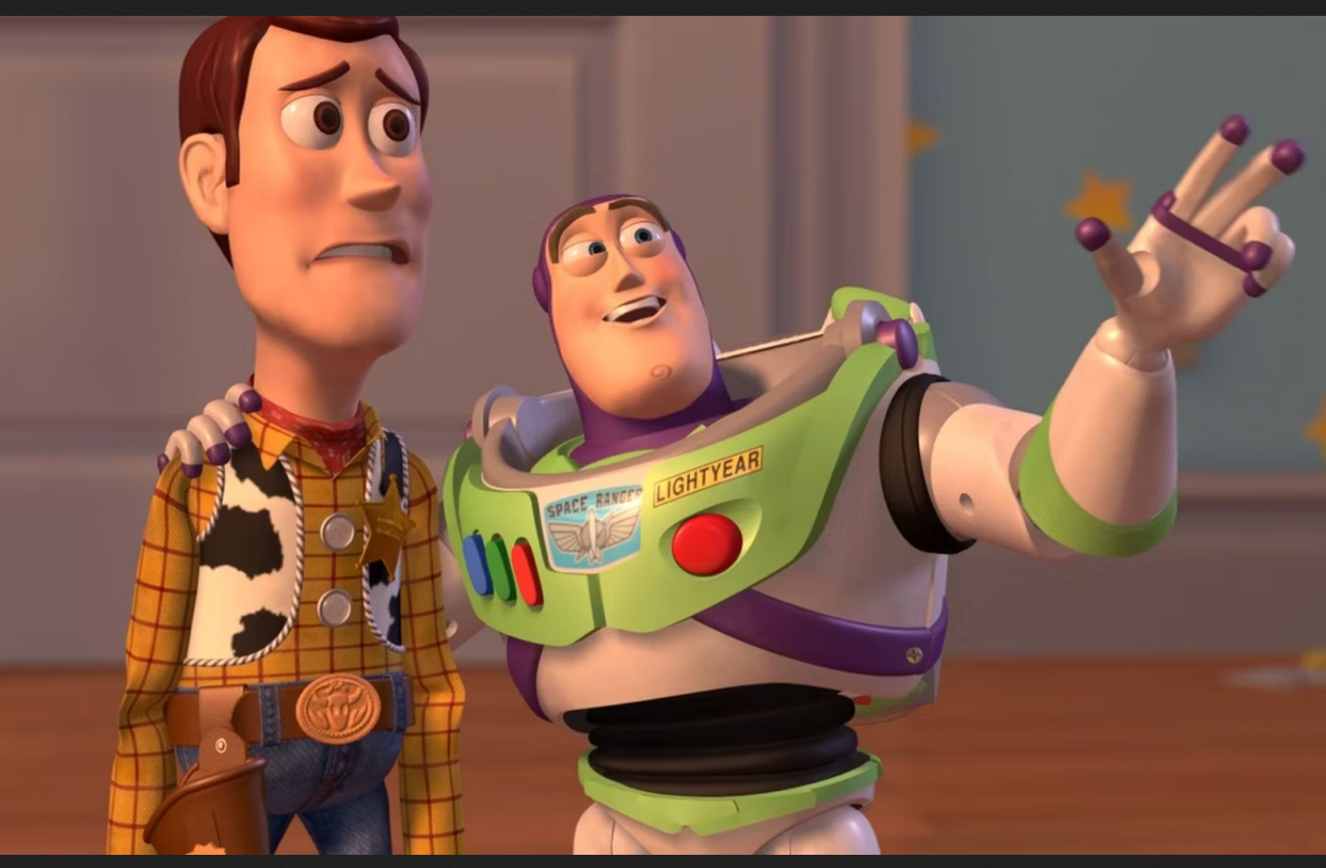
Course schedule
 | Monday | Thursday
Week 1 : 12/02 | Introduction | C#/Unity Lab
Week 2 : 19/02 | 3D reasoning | 3D Lab
Week 3 : 26/02 | Basic Pipeline | Lab
Week 4 : 04/03 | Textures | Normal maps Labs
Week 5 : 11/03 | Post processing | Camera’s Light
Week 6 : 18/03 | Materials | Aliasing Materials Lab
Week 7 : 25/03 | Procedural generation Theory | Procedural generation Practice
Week 8 : 15/04 | Advanced pipeline | Cancelled
Week 9 : 22/04 | Lab 07 explanation | Project explanation
Week 10 : 29/04 | Project explanation 2 | Guest Lecture Project Labs
Week 11 : | Problem solving 101 | Holiday

Slide 4
Bureaucracy
Chunk coord is described as ‘int2’, should be Vector2Int
Will upload updated project description by class Monday (with announcement)
Want to add more explanation (images)

Slide 5
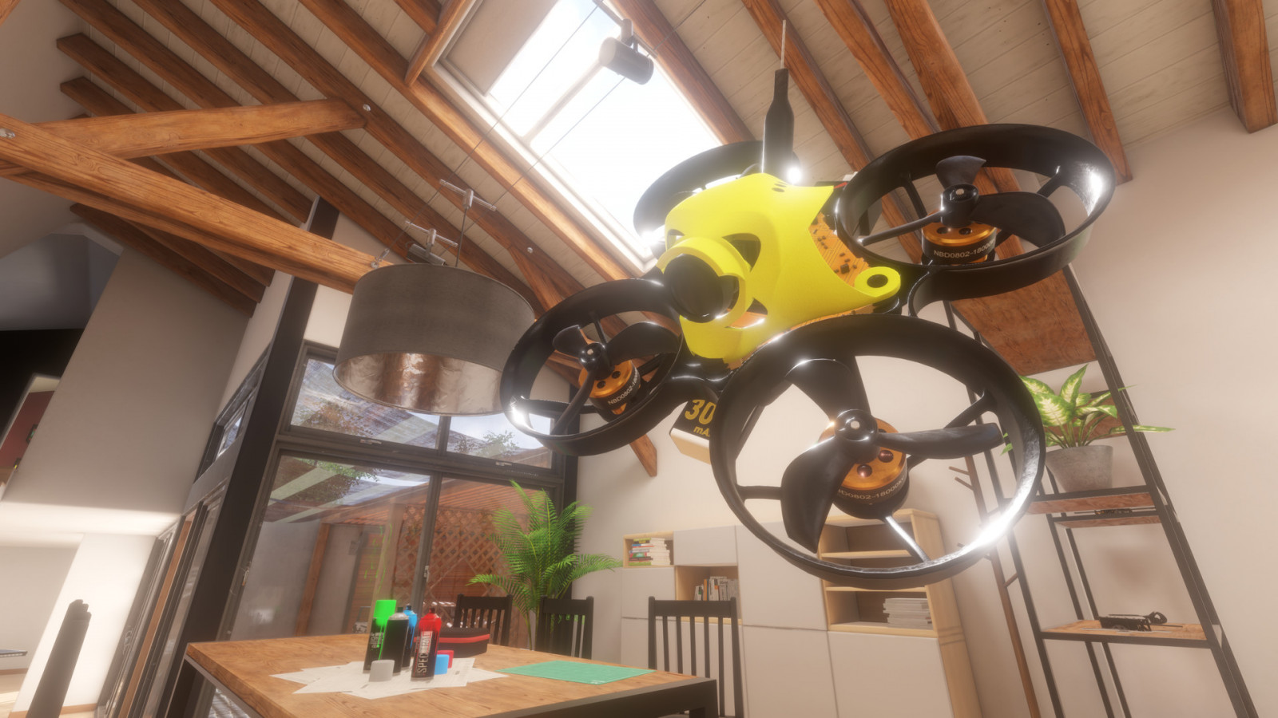
This class

Slide 6
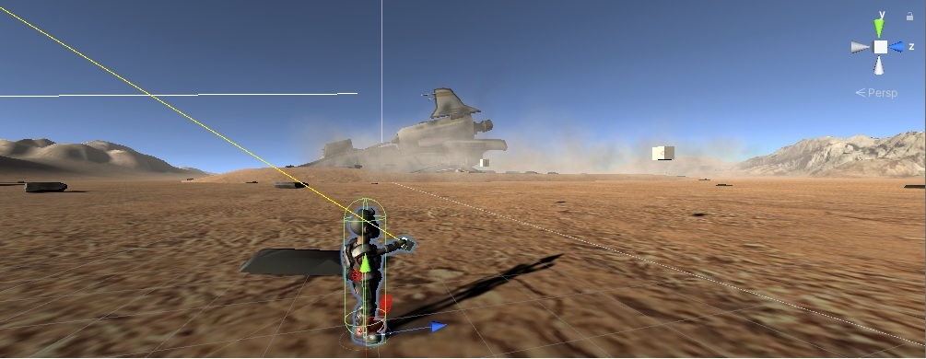
Next class
Unity debug drawing
Defensive coding

