Slide 1
Week 3a: Graphics pipeline

Slide 2
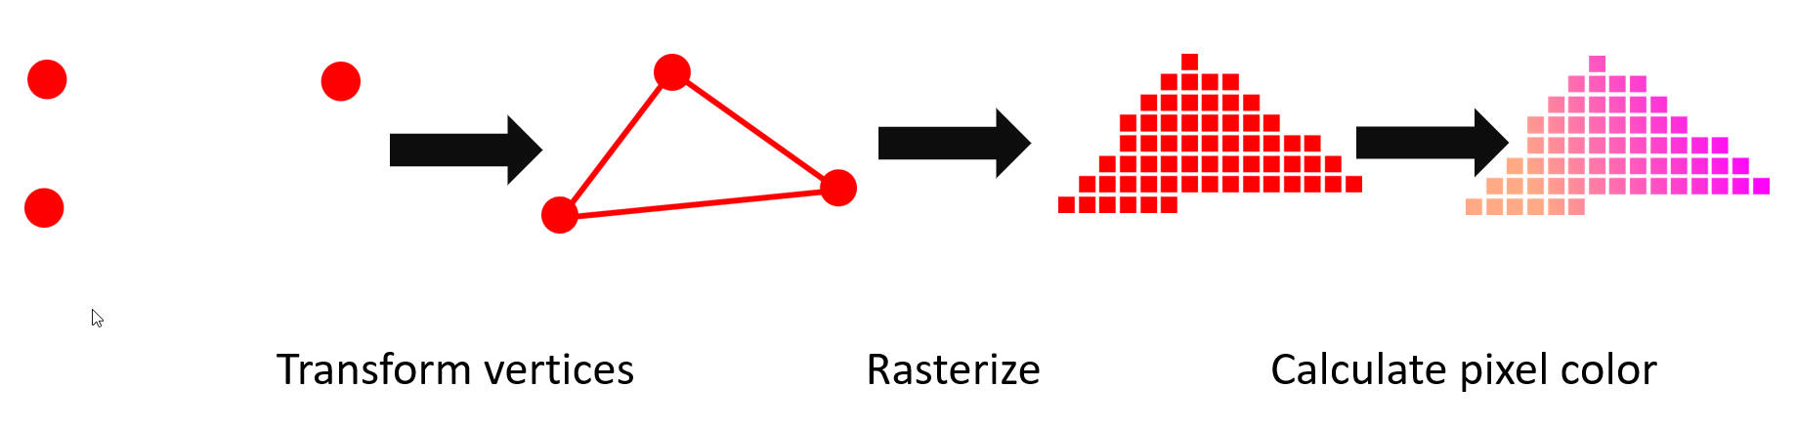
Last class
Raytracing vs Rasterization
GPU internals
Graphic API’s
HLSL (GPU language)
Forward/Deferred rendering

Slide 3

Course schedule
 | Monday | Thursday
Week 1 : 12/02 | Introduction | C#/Unity Lab
Week 2 : 19/02 | 3D reasoning | 3D Lab
Week 3 : 26/02 | Basic Pipeline | Lab
Week 4 : 04/03 | Textures | Normal maps Labs
Week 5 : 11/03 | Post processing | Camera’s Light
Week 6 : 18/03 | Advanced pipeline | Advanced pipeline lab
Week 7 : 25/03 | Materials Aliasing | Materials Lab
Week 8 : 15/04 | Procedural generation | Procedural generation lab
Week 9 : 22/04 | Project explanation | Project lab
Week 10 : 29/04 | Guest Lecture Project Labs | Guest Lecture Project Labs
Week 11 : | Revision | Revision
Highly likely to change ☹

Slide 4
This class
→ Texture basic ←
Texture types
Texture nuances

Slide 5
Textures
Can someone tell me what they are?

Slide 6
Textures
Commonly : “a 2d grid of colors”
3d graphics : “spatially varying information”

Slide 7
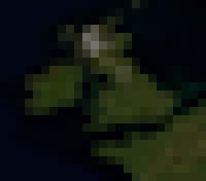
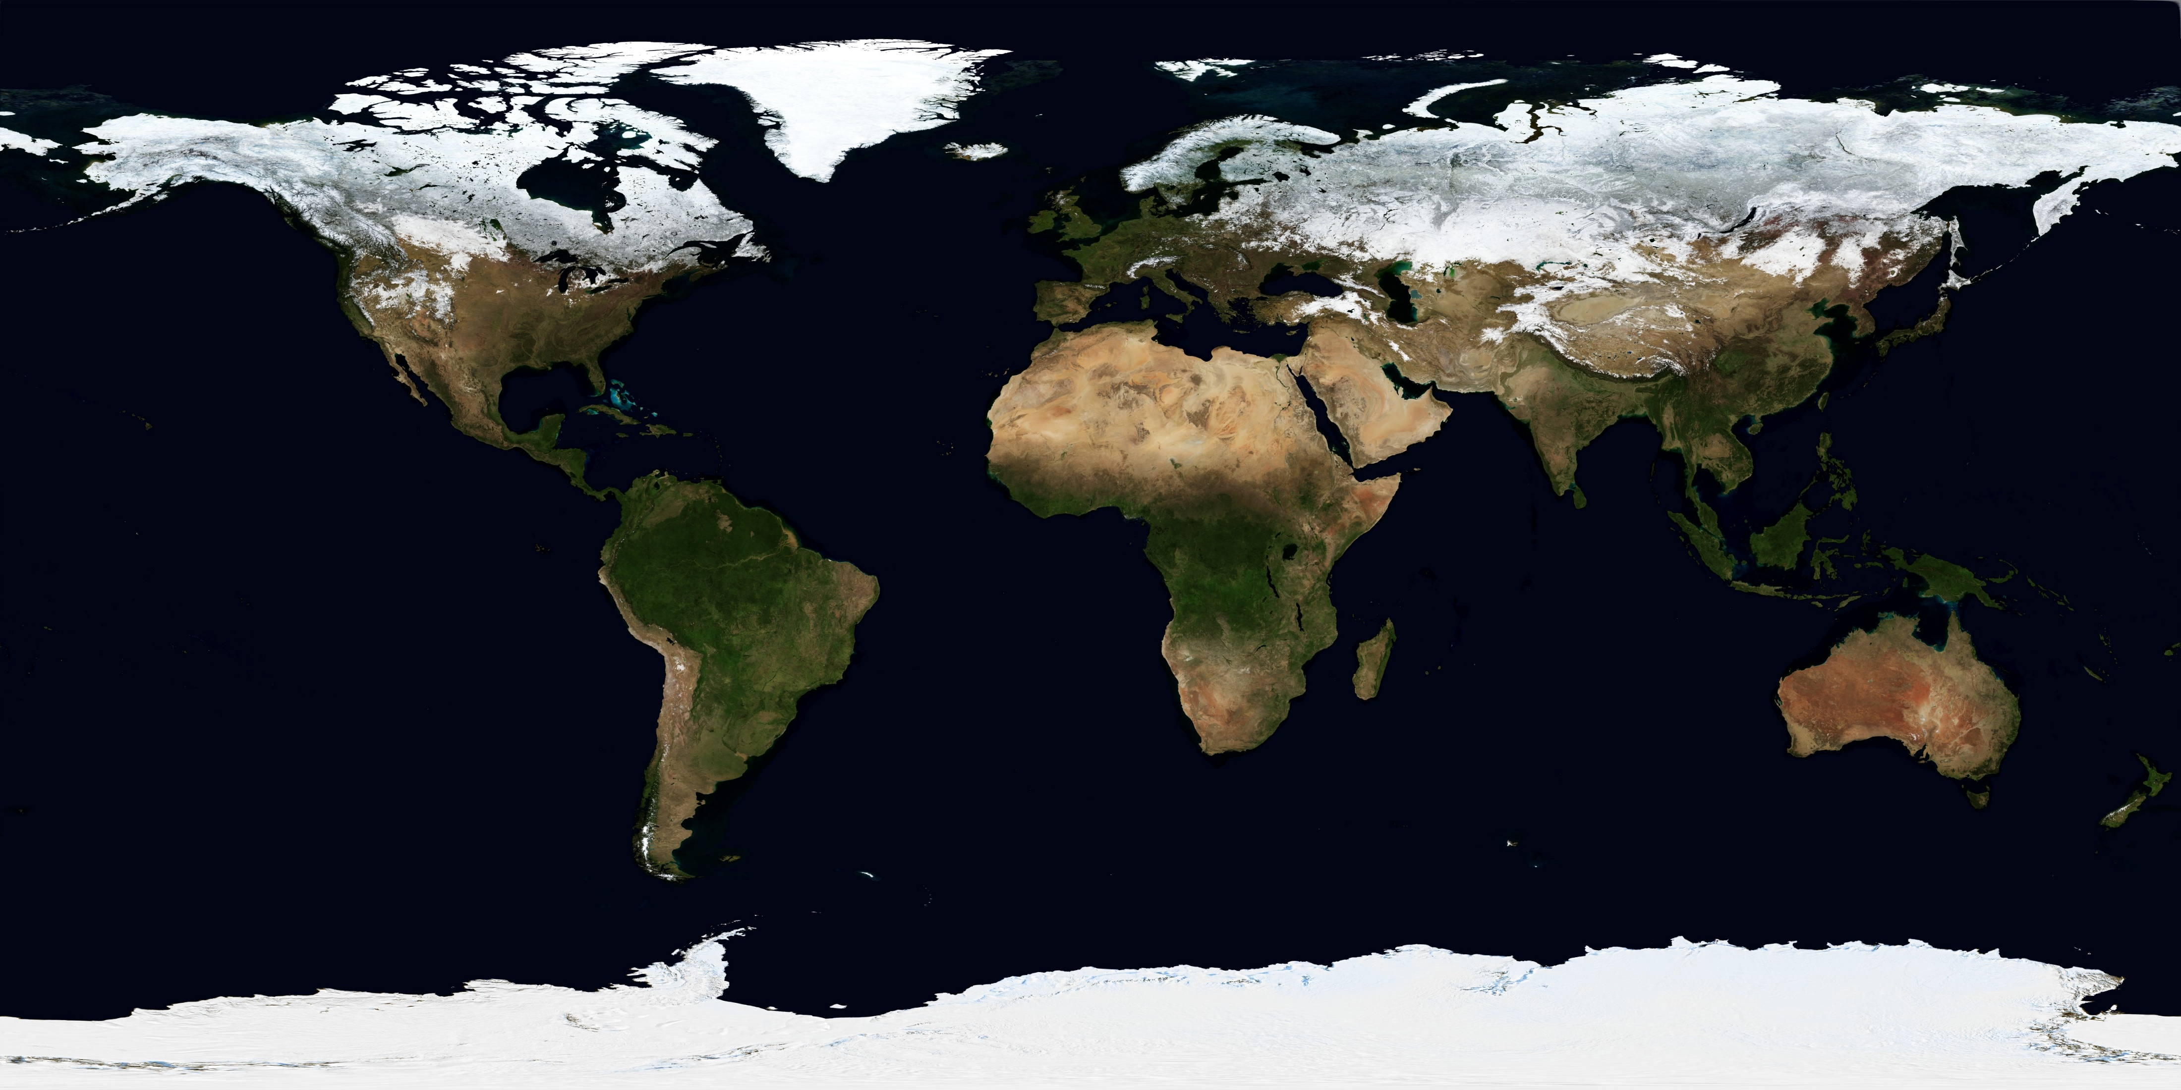
Textures : 2D grid of colors

Slide 8
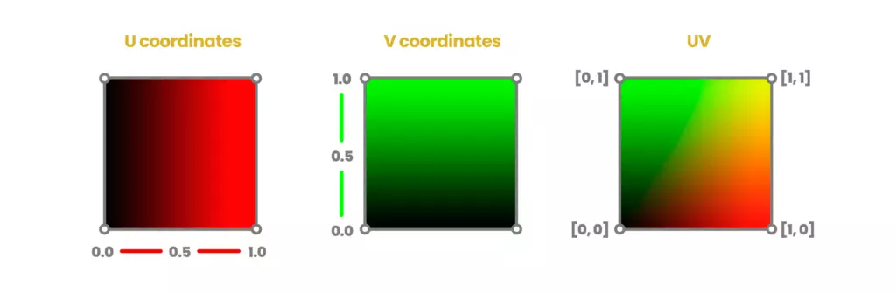
But we’re in 3D. How do we know the coordinates?
We use UV coordinates.
Vector2D, 0.0 -> 1.0 (typically)
They are part of the vertex

Slide 9
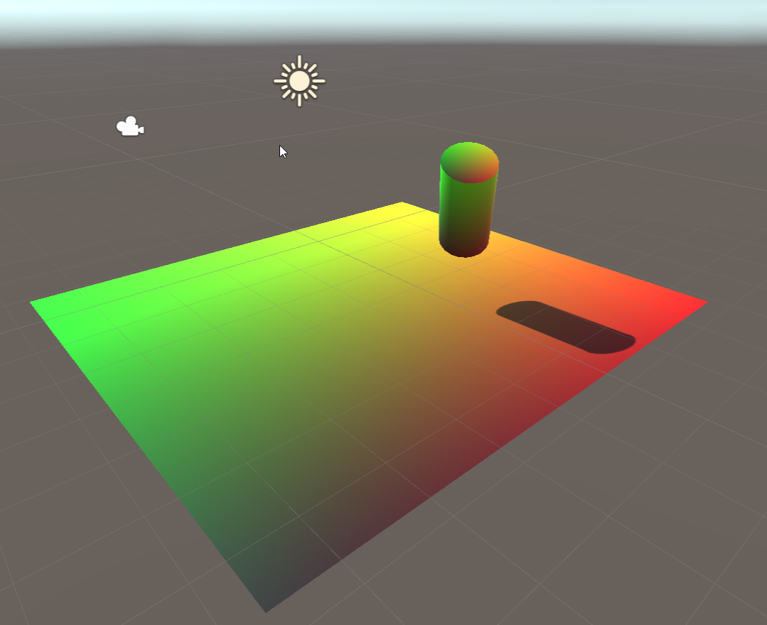
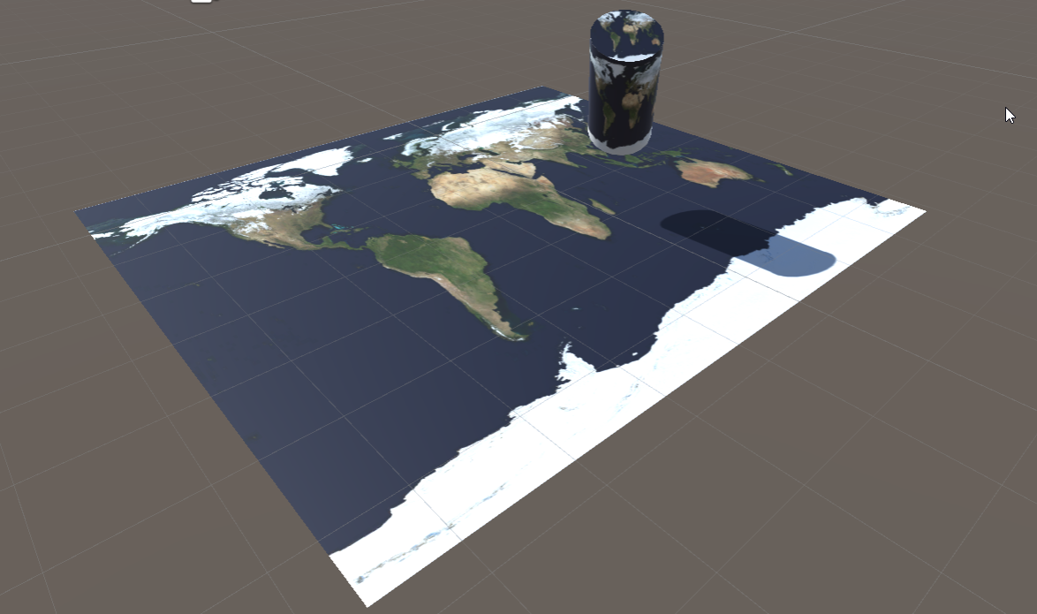
UV: float2 coordinates image: int2 coordinates
float2 uv(0,0) -> image[0,0]
float2 uv(1,1) -> image[width, height]

Slide 10
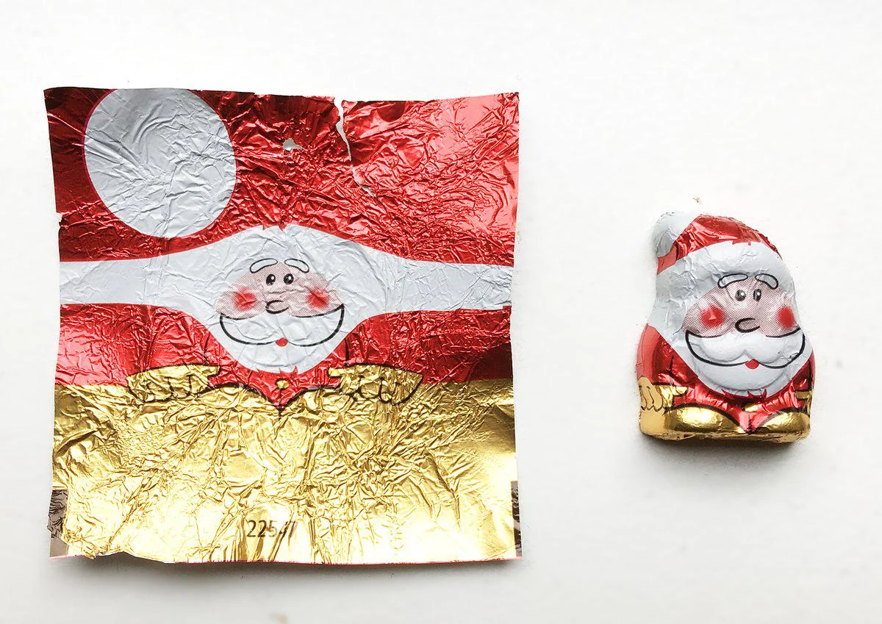

Slide 11
In code
// in Properties
_MainTex ("Albedo (RGB)", 2D) = "white" {}
// in SubShader
sampler2D _MainTex;
struct Input
{
float2 uv_MainTex;
}; // in fragment shader fixed4 color = tex2D (_MainTex, IN.uv_MainTex)

Slide 12
Why not put this information in a vertex?
Good question!
Vertices vary with geometric complexity (ears have more vertices than cheeks)
Vertices have all data
Textures can vary in resolution

Slide 13
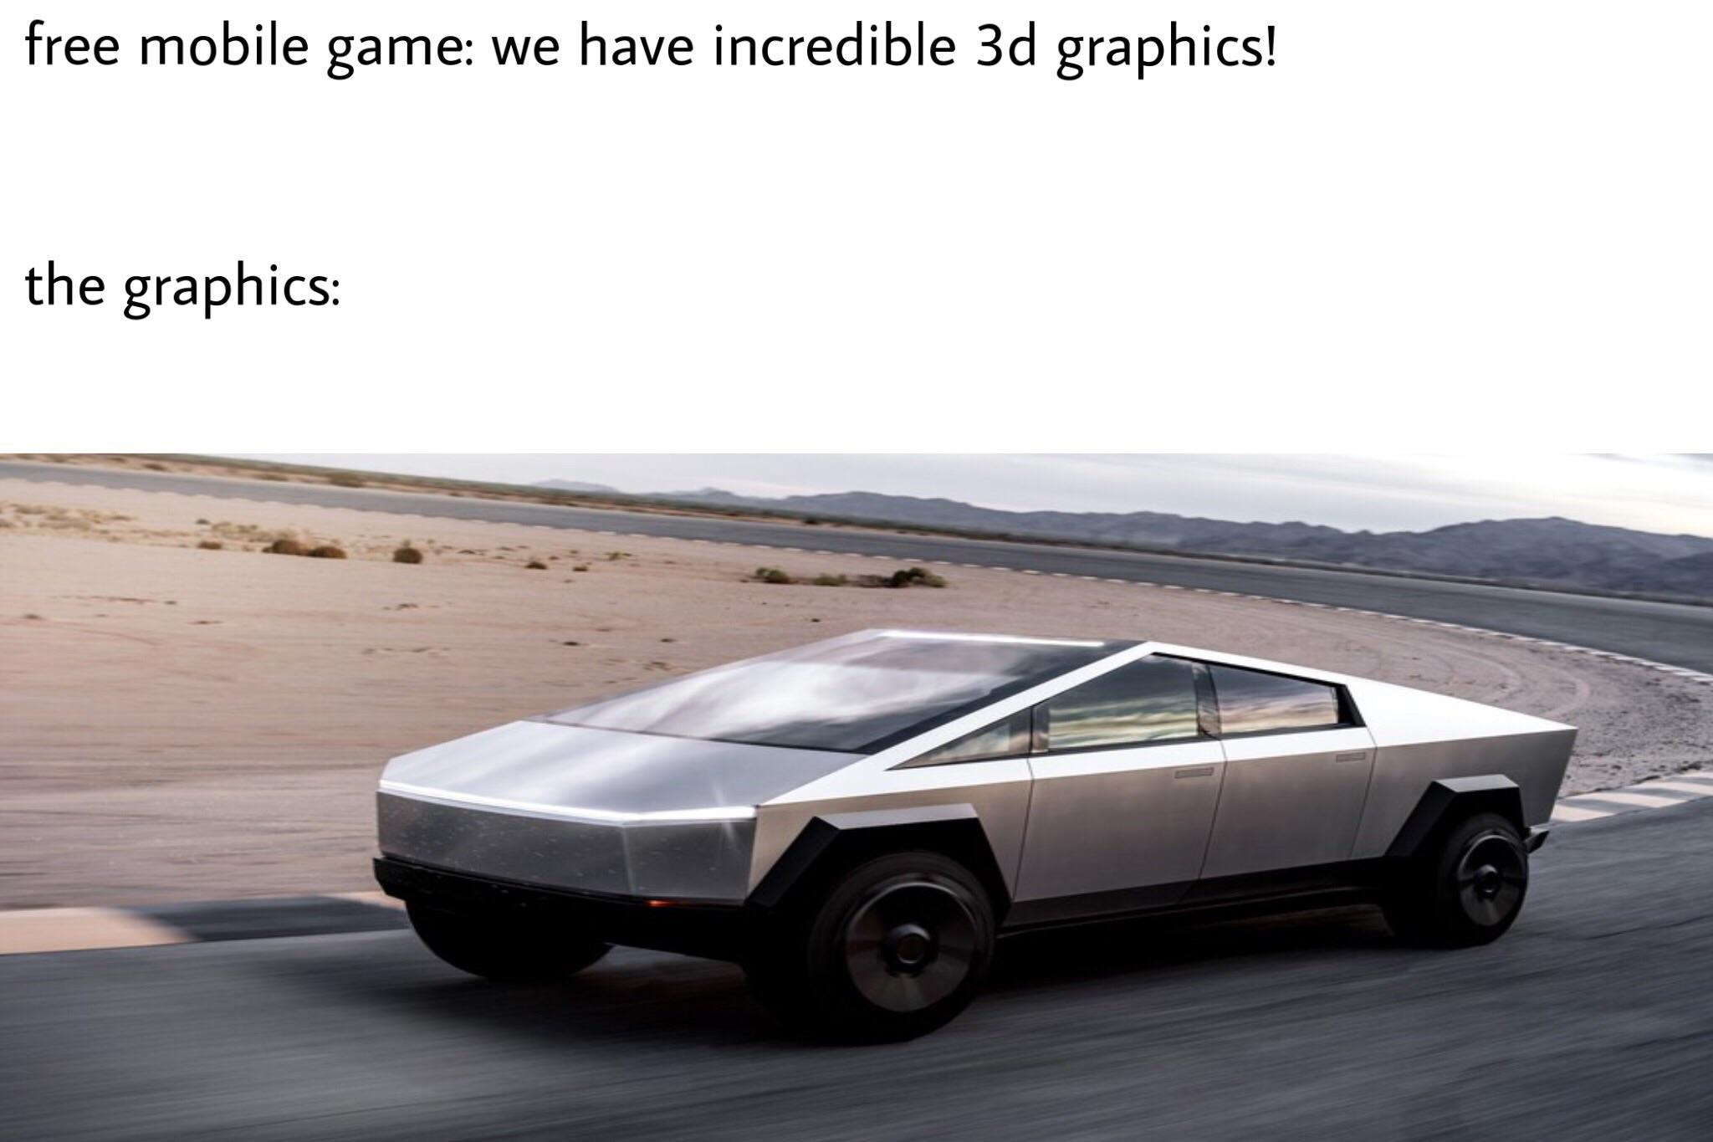
Any questions?

Slide 14
Texture basic
→ Texture types ←
Texture nuances

Slide 15
We just saw Texture2D as an example
Anyone guess what the others types are?

Slide 16

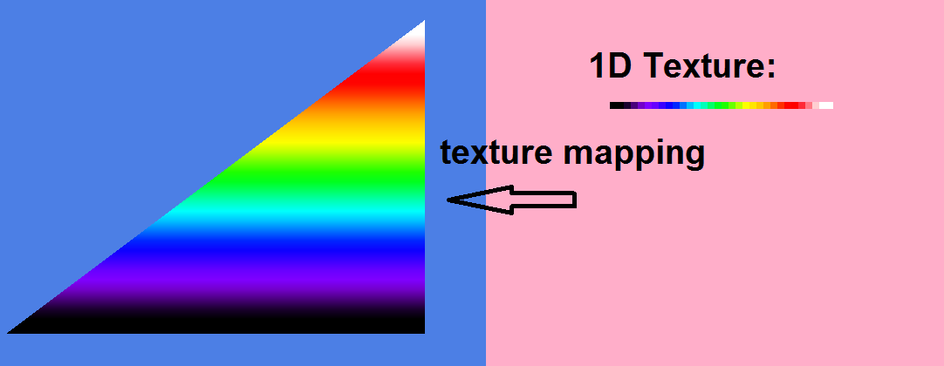
Texture 1D
Used for lookup tables
In practice, 2D textures anyway

Slide 17
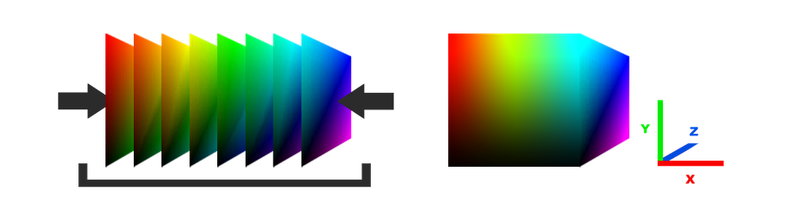
Texture3D
Has width, height, and depth
Need float3 uv’s
Gets large quick
Anyone have an example?

Slide 18
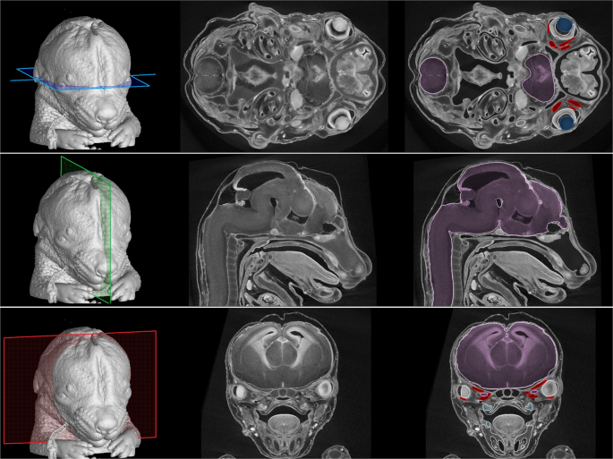

Slide 19
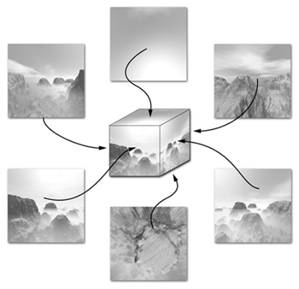
TextureCube
Resembles a six sided die
We index it with a direction
POV: center of the cube
Perfect for a skybox / reflections

Slide 20
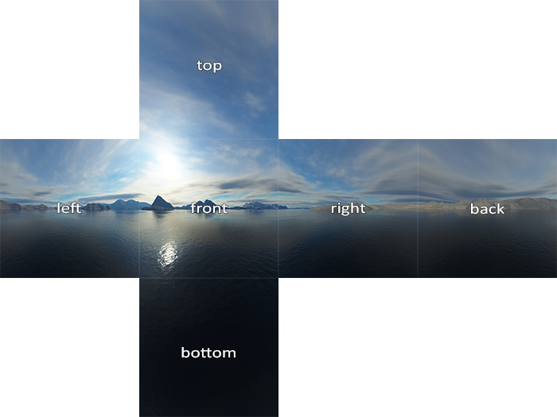

Slide 21
This class
Texture basic
Texture types
→Texture nuance ←
Example : color textures
Example : normal maps

Slide 22
Texture nuances
→ Borders ←
Mipmapping
Sampling

Slide 23
We said UV’s typically go 0.0->1.0
We can configure what happens when access the texture with uv coordinates going outside that range

Slide 24
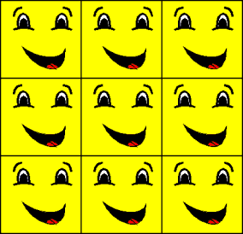
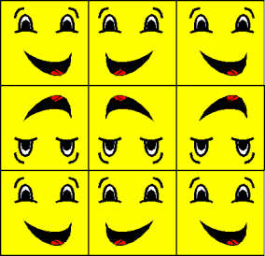
Wrap and mirror
Good for tiling textures
These are often used in terrain

Slide 25
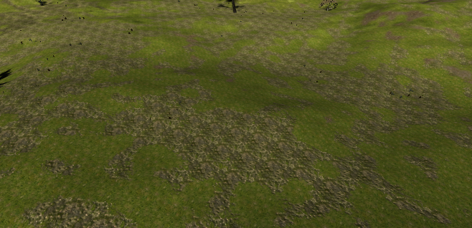

Slide 26
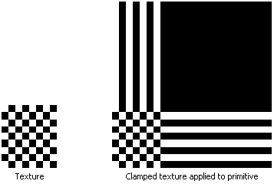
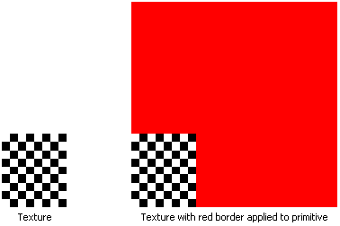
Clamp and border
Clamp is a good default
Border is good for finding bugs

Slide 27
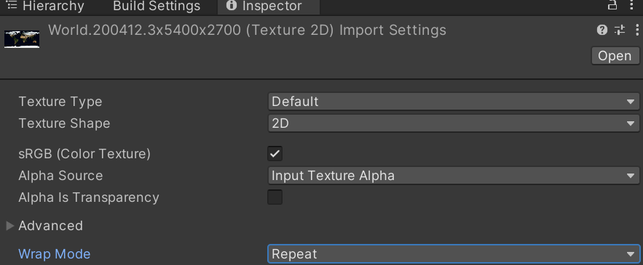
In unity, you can find this on your asset

Slide 28
Is everything clear?

Slide 29
Texture nuances
Borders
→ Mipmapping ←
Sampling

Slide 30
Textures have some problems
For faraway objects, we still need the entire texture in memory
For faraway objects, the full texture is too detailed, and creates aliasing (later class)

Slide 31
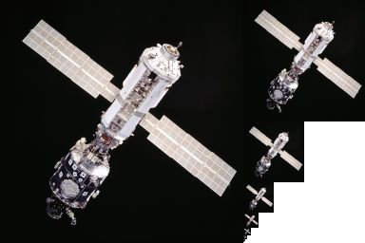
Solution
Create smaller versions iteratively
Often called a “pyramid”
Increases size by 50% (unless special implementation)
Worth it
Also for 1D, cube, and 3D

Slide 32
We don’t use this directly (in this course)
Unity handles a lot under the hood
Very important concept
We’ll see more in the aliasing class

Slide 33
Texture nuances
Borders
Mipmapping
→ Sampling ←

Slide 34

Our uv / texcoords are floats
We can sample a texture with eg (0.0, 0.4)
Imagine we have a 2x2 texture
What should the result be?
(Assume the border mode is set to clamp)

Slide 35
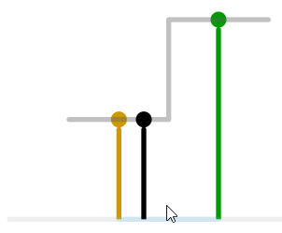
You probably said black
And this is true is some circumstances
Especially since we know it’s a checkerboard
We call this “nearest neighbour” or “point” filtering

Slide 36
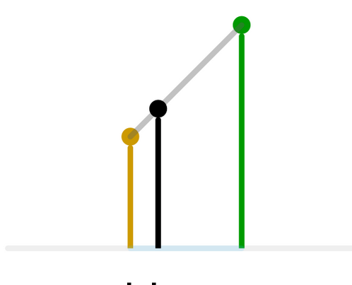
We can also try to make a smoother transition
We calculate the distances between pixels of our “sample”
We interpolate linearly

Slide 37
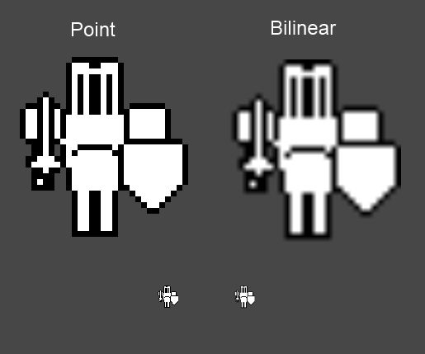
Point is good when you want *exact* pixel values
2D sprites
Fonts

Slide 38
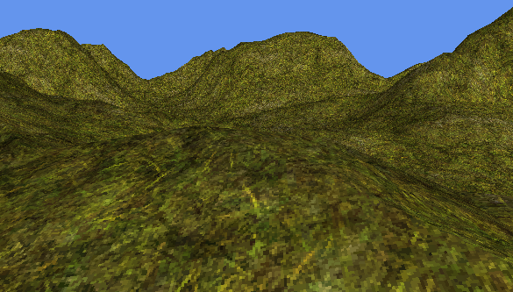
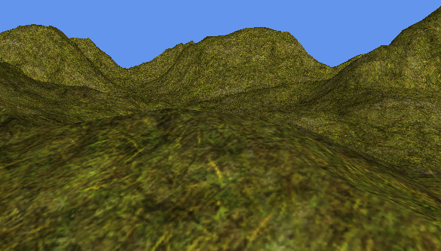
Linear is good in realistic 3D scenes
Less aliasing
Looks higher resolution

Slide 39
BTW, I’m sweeping sampling under the rug
We can see the gray line (and the texture) as a function
Asking a value is called “Sampling”
There’s a ton of theory behind it
In HLSL, we create a Texture (grid of values)
We also create a Sampler (the way in which values are calculated for our uv coordnates

Slide 40
Recap
You usually want linear
In 2D, you usually want point
Point filtering gives your exact pixel values
Linear gives you smoother transition

Slide 41
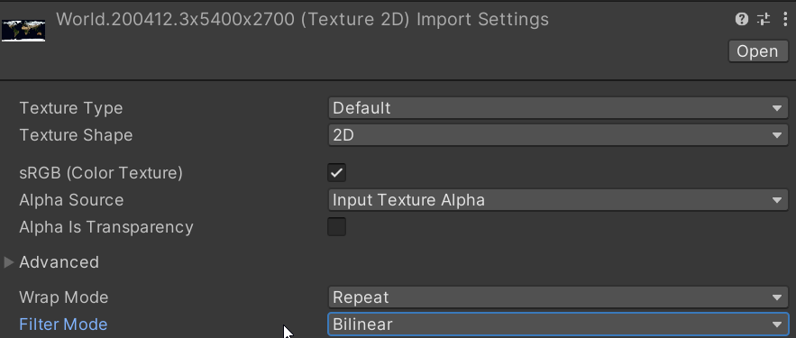
In Unity : Asset -> Filter mode

Slide 42
Recap
Textures are used for spatially varying information
They can be 1,2, and 3d. Or cubes.
They can be used for visible color, or normal, or any other parameter

Slide 43
Next class
Open up the labs ☹
Look at normal maps

