Slide 1
Week 5a: Post Processing

Slide 2
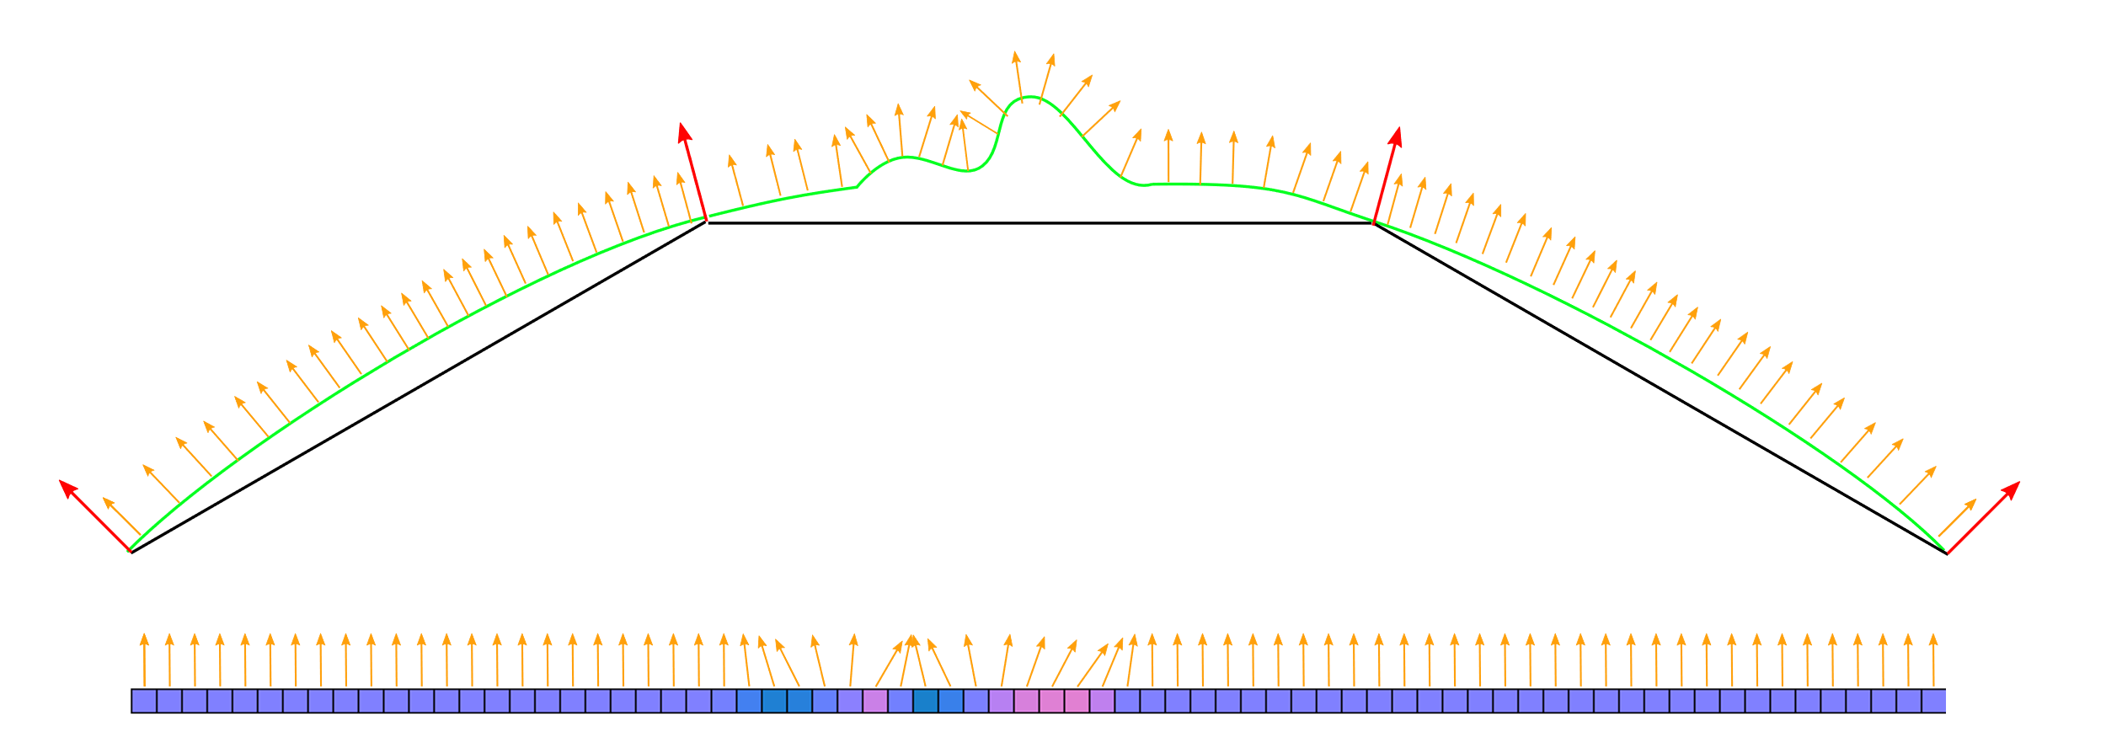
Last class
Normal maps

Slide 3
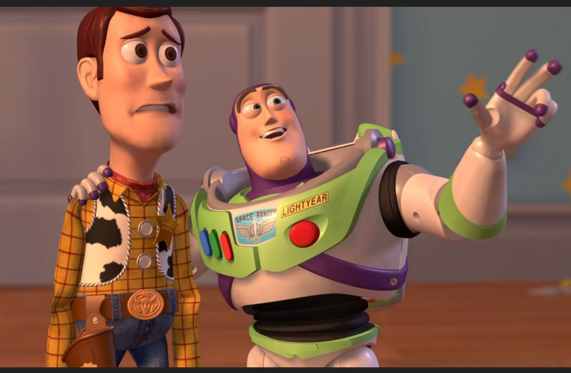
Course schedule
 | Monday | Thursday
Week 1 : 12/02 | Introduction | C#/Unity Lab
Week 2 : 19/02 | 3D reasoning | 3D Lab
Week 3 : 26/02 | Basic Pipeline | Lab
Week 4 : 04/03 | Textures | Normal maps Labs
Week 5 : 11/03 | Post processing | Camera’s Light
Week 6 : 18/03 | Advanced pipeline | Advanced pipeline lab
Week 7 : 25/03 | Materials Aliasing | Materials Lab
Week 8 : 15/04 | Procedural generation | Procedural generation lab
Week 9 : 22/04 | Project explanation | Project lab
Week 10 : 29/04 | Guest Lecture Project Labs | Guest Lecture Project Labs
Week 11 : | Revision | Revision
Highly likely to change ☹

Slide 4
Labs are available on Friday
Sorry about that ☹
Will post them on Friday
How are labs going?

Slide 5
This class
→ Render to texture←
Post processing
Examples of Post processing

Slide 6
Render to Texture
Forgot to mention this last week
Normally, we render objects directly to the screen
But we can also render into a texture: a Render Target
This is called render to texture

Slide 7
This class
Render to texture
→Post processing ←
Examples of Post processing

Slide 8
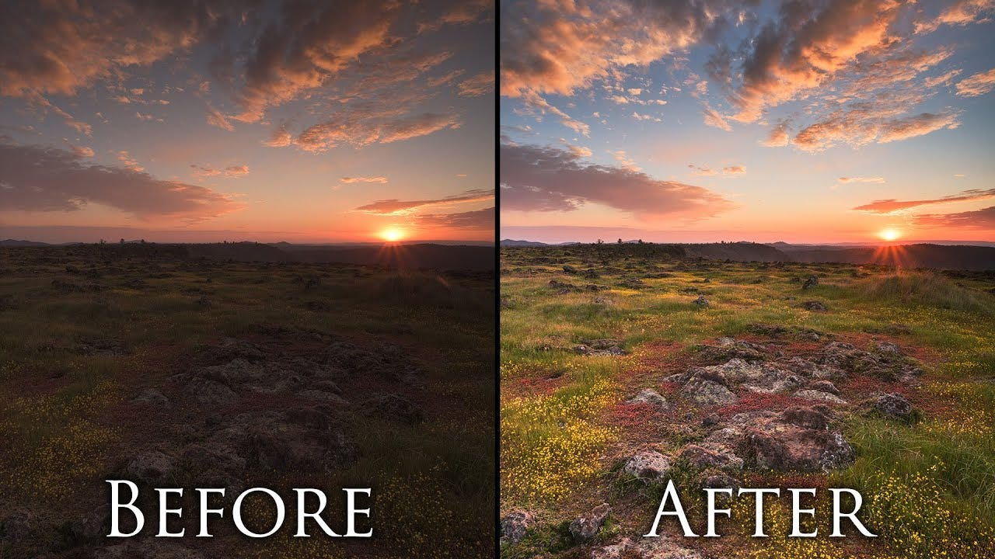
Postprocessing
Take a render of the scene (post)
Process it (many options)
Using a fragment shader (or compute)

Slide 9
This class
Render to texture
Post processing
→ Examples of Post processing ←

Slide 10
Examples of postprocessing
→Grayscale ←
Tonemapping
Bloom
Ambient occlusion

Slide 11
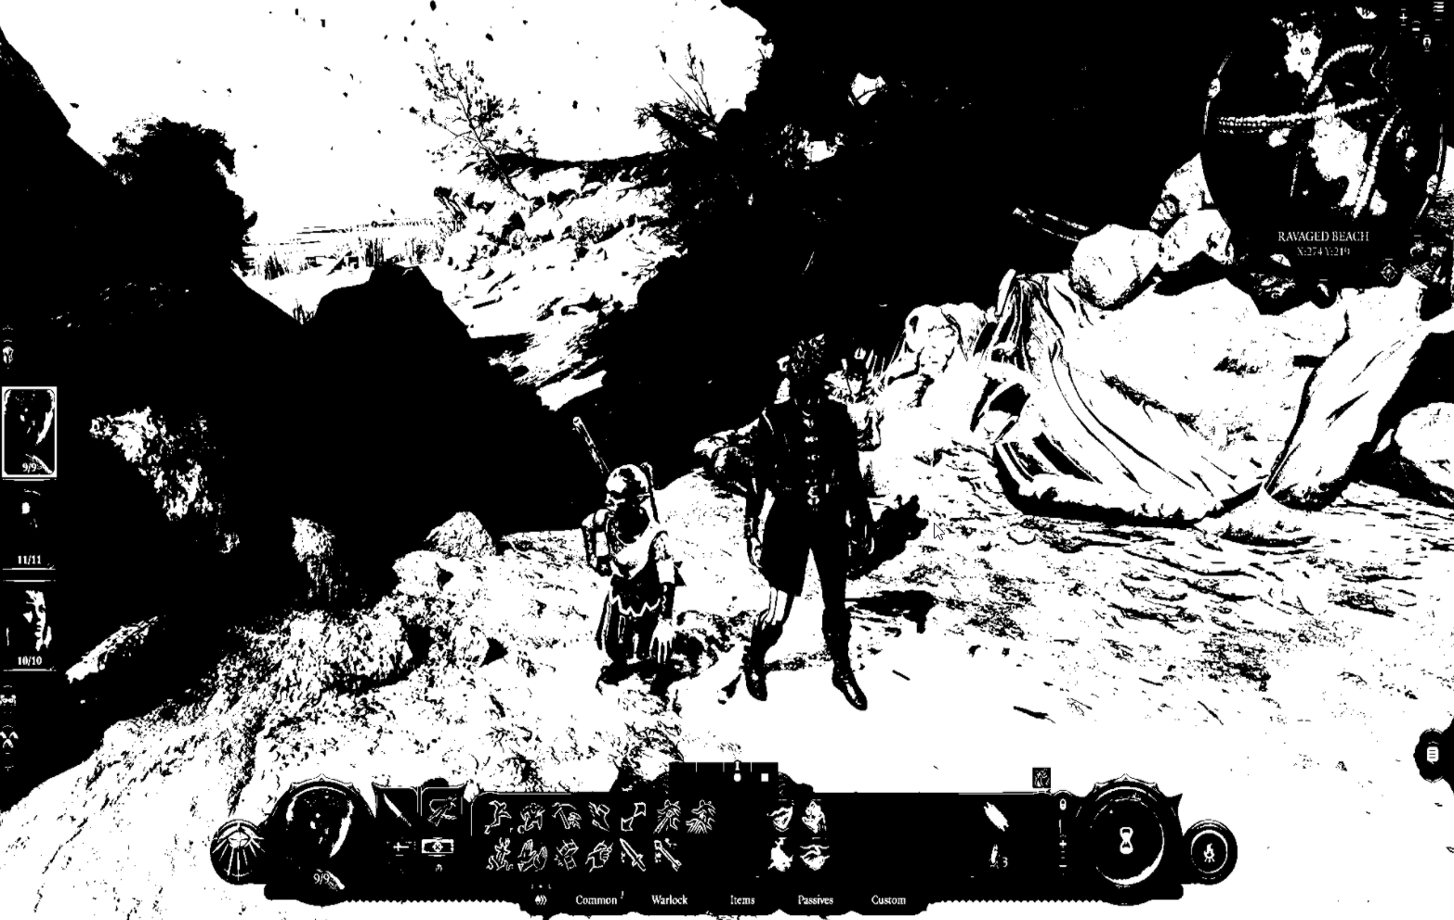
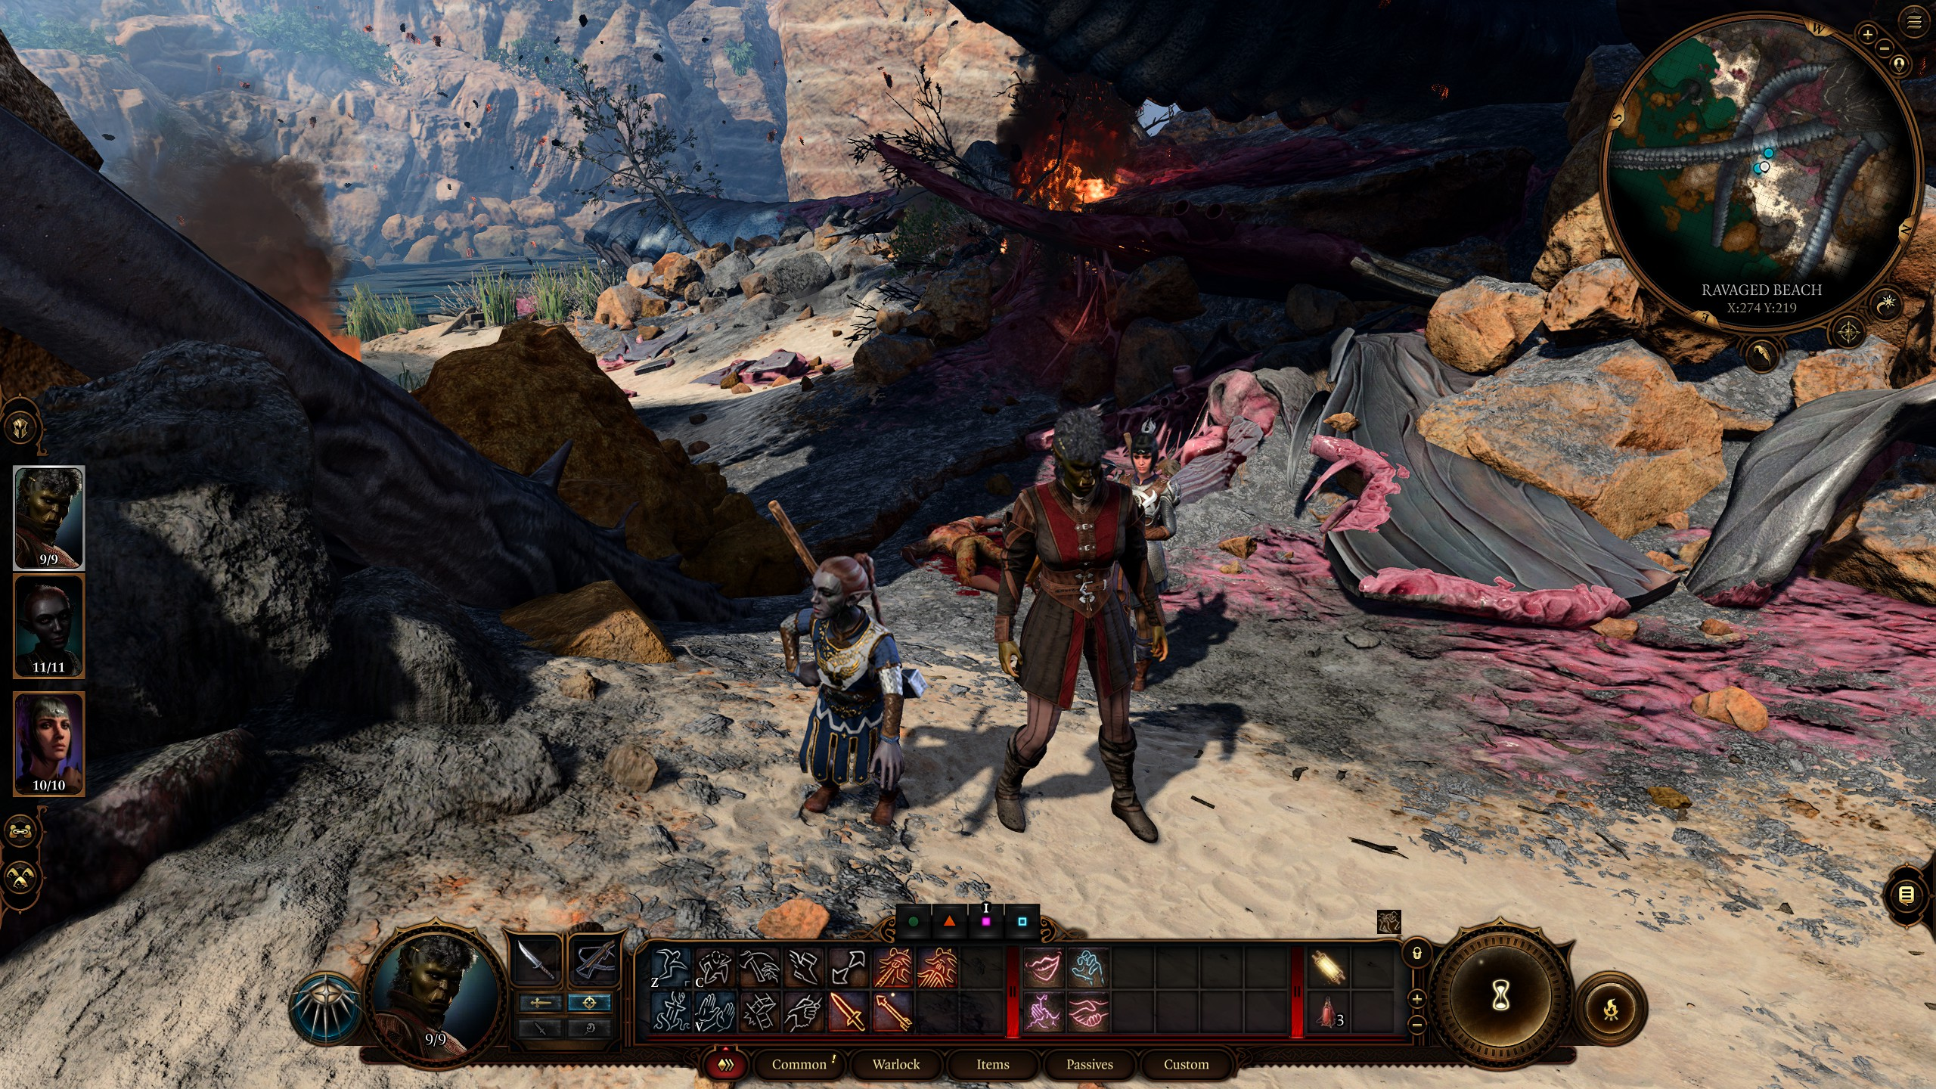
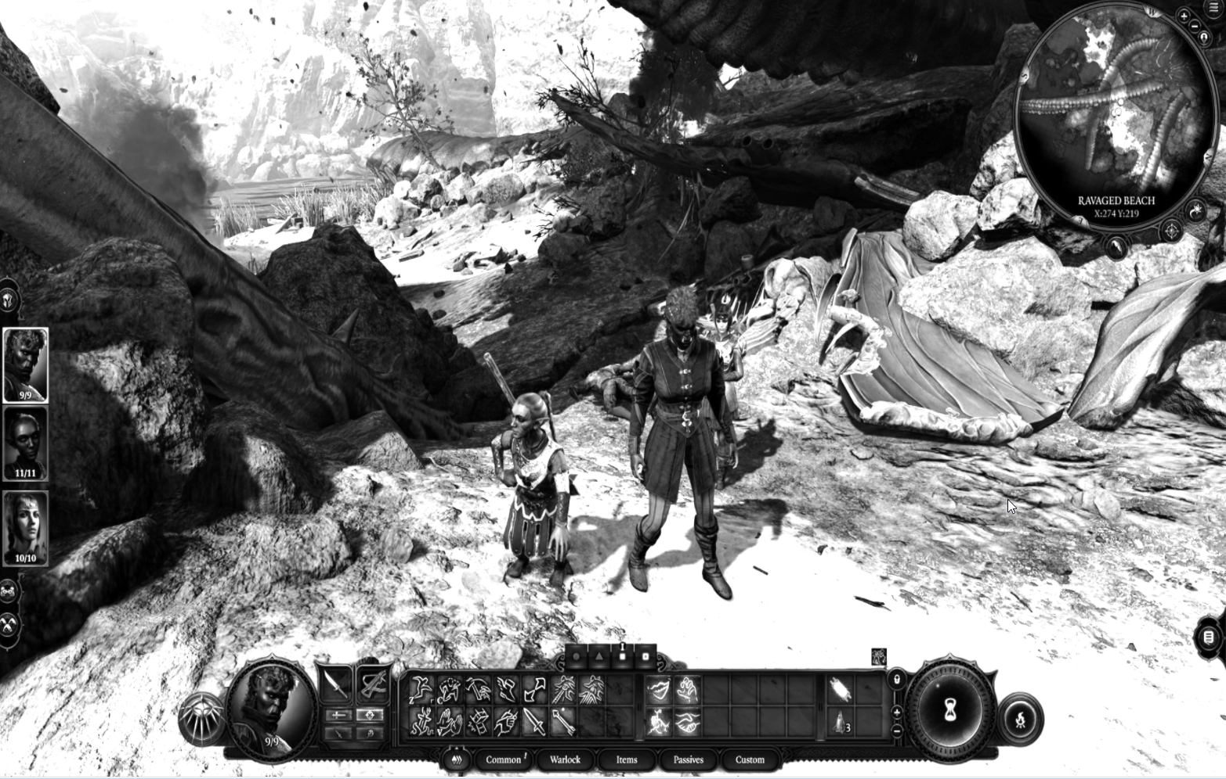
Grayscale
Grayscale == Black and White
More accurate term
How would you do it?

Slide 12
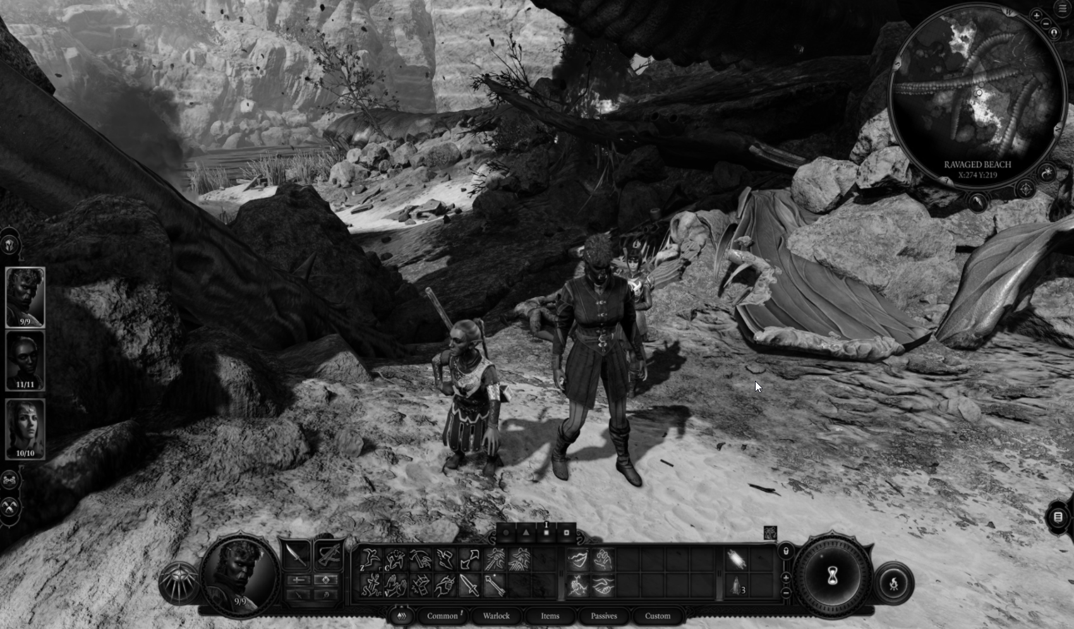
Obvious solution
Average red, green and blue
Greyscale = R*0.333 + G*0.333 + B*0.333

Slide 13
Less obvious
Not every color channel (r, g, b) is created equal
They’re perceptually more or less bright
Perceptually = To our eyeballs (perceived)
Try to sort the next slides in perceived brightness

Slide 17
How would you rank the brightness?

Slide 18
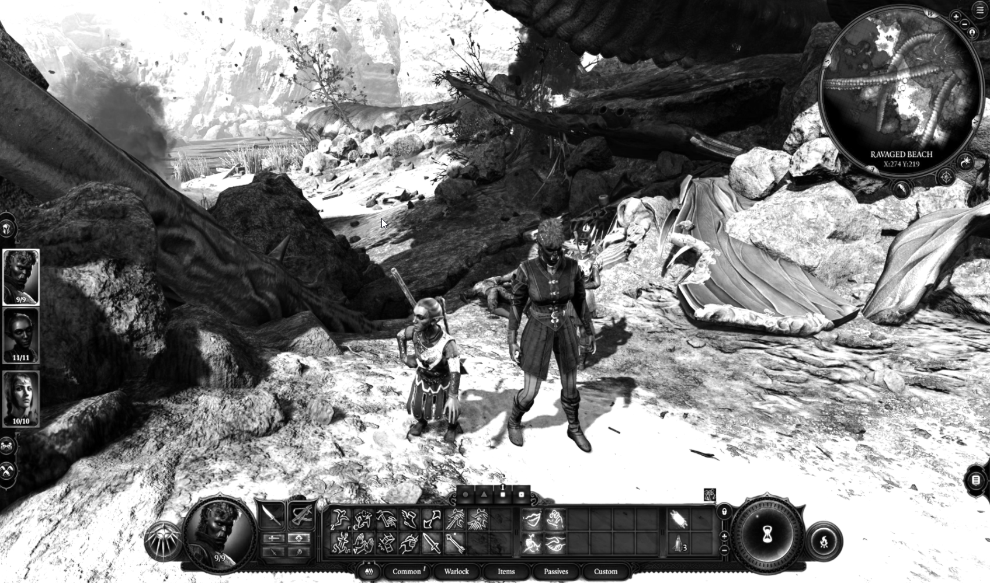
Better feeling solution
Greyscale = R*0.3 + G*0.59 + B*0.11

Slide 19
Recap
Textures are used for spatially varying information
They can be 1,2, and 3d. Or cubes.
They can be used for visible color, or normal, or any other parameter

Slide 20
Side by side

Slide 21
Examples of postprocessing
Grayscale
→Tonemapping ←
Bloom
Ambient occlusion

Slide 22
Tonemapping
Problem: screens / rendertextures expect values 0-255
Scene rendering is unbounded
Example : sunlight = 10000 times brighter than starlight

Slide 23
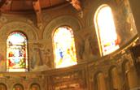
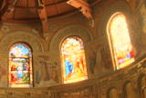
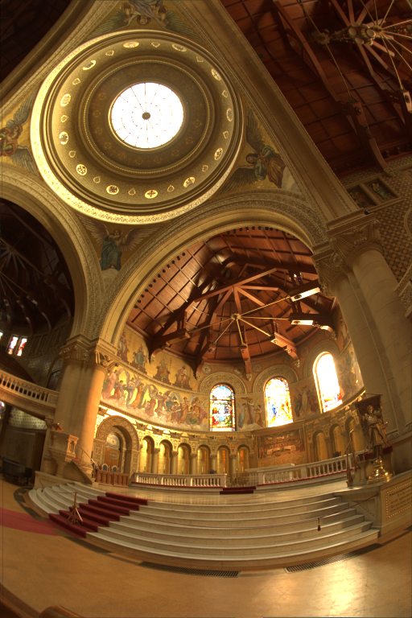
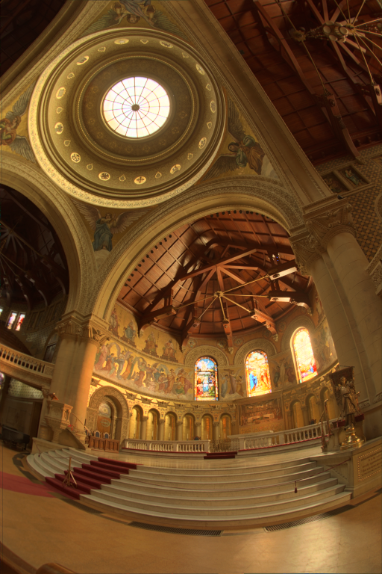
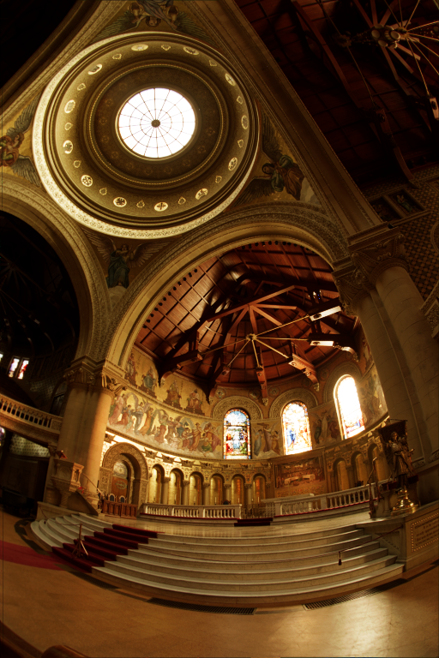
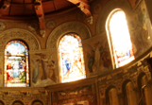
Tonemapping
Store the scene in a HDR texture (float3)
Use a function (curve) to bring this into [0-255] range
Many ways to do this

Slide 24
Can use camera parameters
Such as exposure
We’ll see that on Thursday

Slide 25
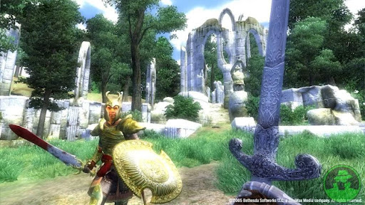
Examples of postprocessing
Grayscale
Tonemapping
→ Bloom ←
Ambient occlusion

Slide 26
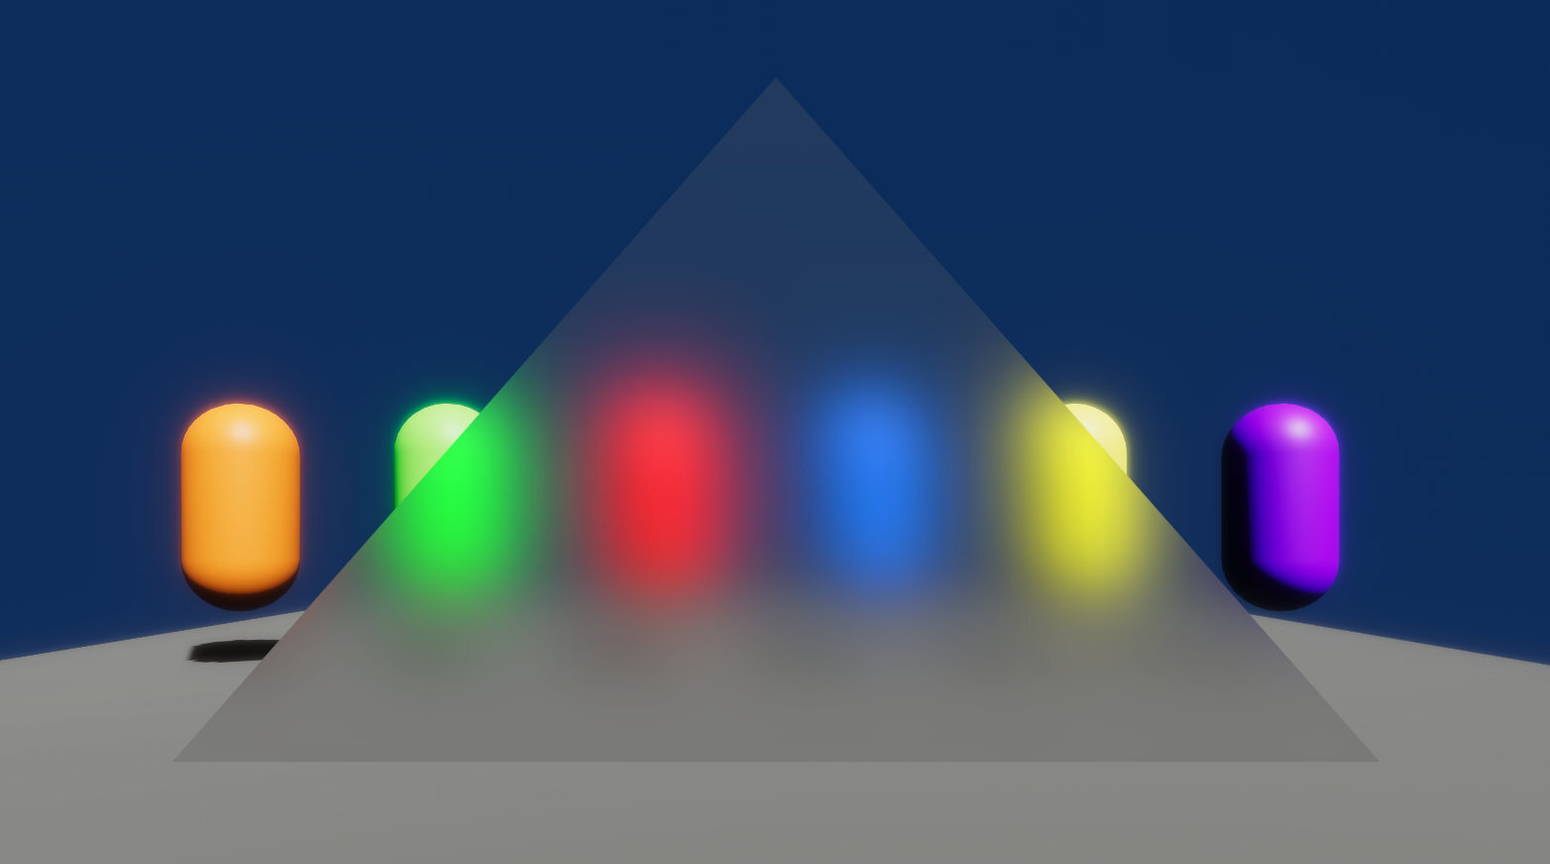
Bloom
Emphasizes bright areas by “bleeding” into neighbouring pixels
We use a blur
Opposite idea: gather pixels around us

Slide 27
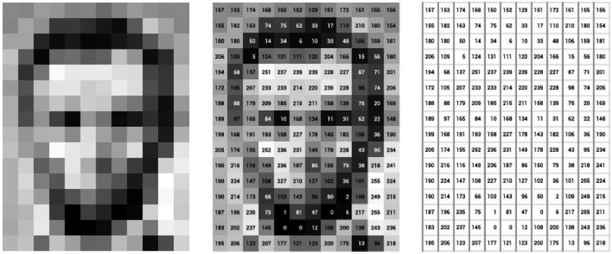
Image as matrix

Slide 28
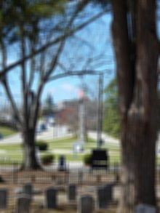
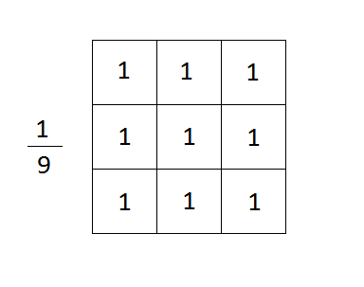
Blur as a matrix
Center pixel is the pixel we’re working on
Number is weight (multiply)
Add them all together
Left term is normalization (so it doesn’t get brighter
The matrix is called a kernel (this is a box blur)

Slide 29
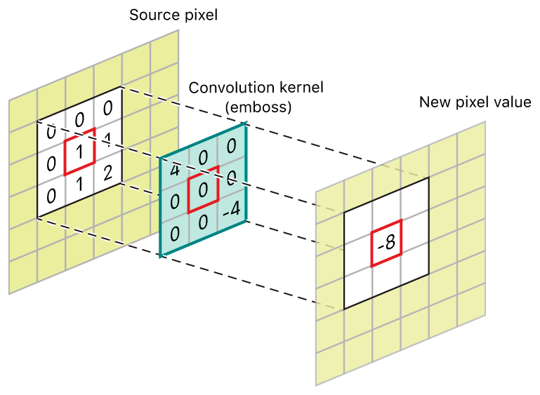
Convolution
Convolution is applying our kernel to the image
For each pixel
Sample the texture for each element in the kernel
Normalize

Slide 30
Box blur in code
fixed4 c = 0;
for (int y = -1; y < 2; ++y)
{
for (int x = -1; x < 2; ++y)
{
float2 uv = IN.uv_MainTex;
uv.x += pixelSize * x;
uv.y += pixelSize * y;
c += tex2D (_MainTex, uv);
}
}
c /= 9;

Slide 31
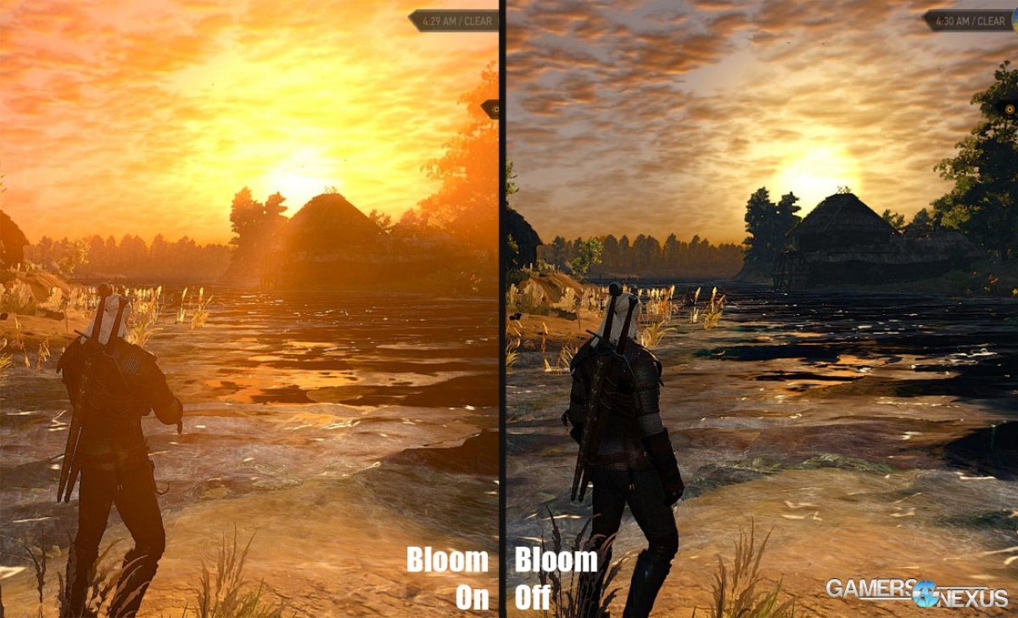
Bloom
Want to blur very bright values
But keep everything else sharp

Slide 32
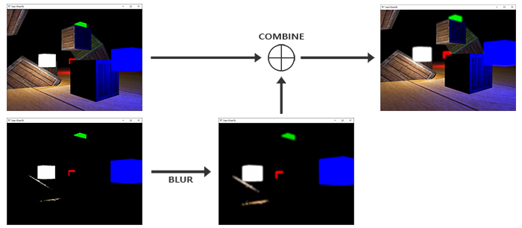
Visually

Slide 33
Fixed
fixed4 c = 0;
int weight = 0;
for (int y = -1; y < 2; ++y)
{
for (int x = -1; x < 2; ++y)
{
float2 uv = IN.uv_MainTex;
uv.x += pixelSize * x;
uv.y += pixelSize * y;
float4 temp = tex2D (_MainTex, uv);
//only blur bright pixels
if (dot(temp.xyz, float3(0.3, 0.59, 0.11) > 10 ||
x == 0 && y == 0)
{
weight += 1;
c += temp;
}
}
}
c /= 9;

Slide 34
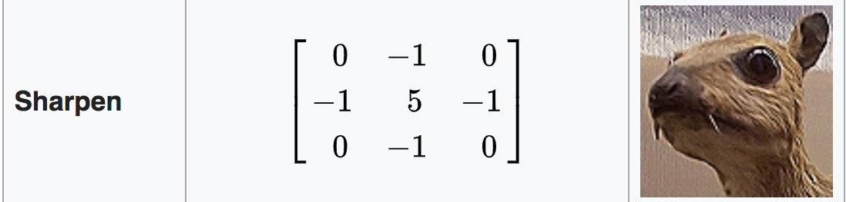
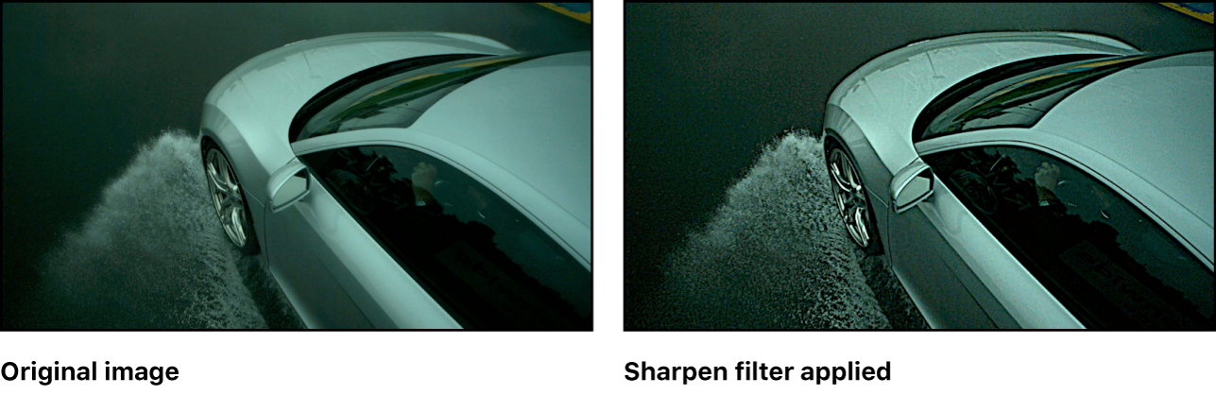
Many effects are achieved by using a kernel

Slide 35
Note that our blur is very basic
Realistically:
Not 3x3
Not the same value everywhere (eg Gaussian)
Tricks to make it fast

Slide 36
Examples of postprocessing
Grayscale
Tonemapping
Bloom
→ Ambient occlusion ←

Slide 37
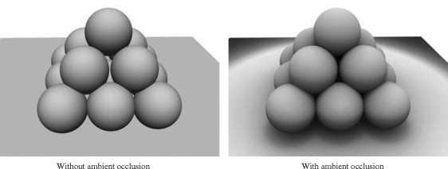
Problem
What problems on the left do you see fixed on the right?

Slide 38
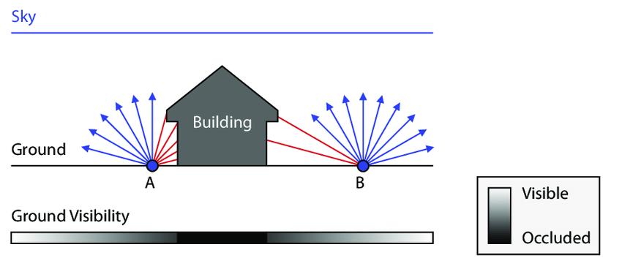
Ambient occlusion simulates how difficult light reaches an are (not shadows)

Slide 39
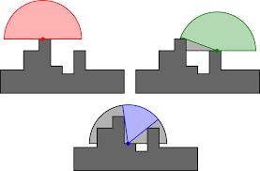
Per pixel operation, uses the depth buffer

Slide 40
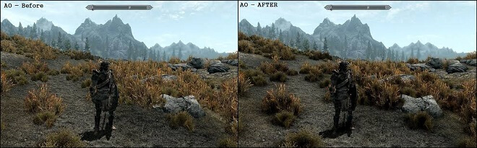
Results

Slide 41
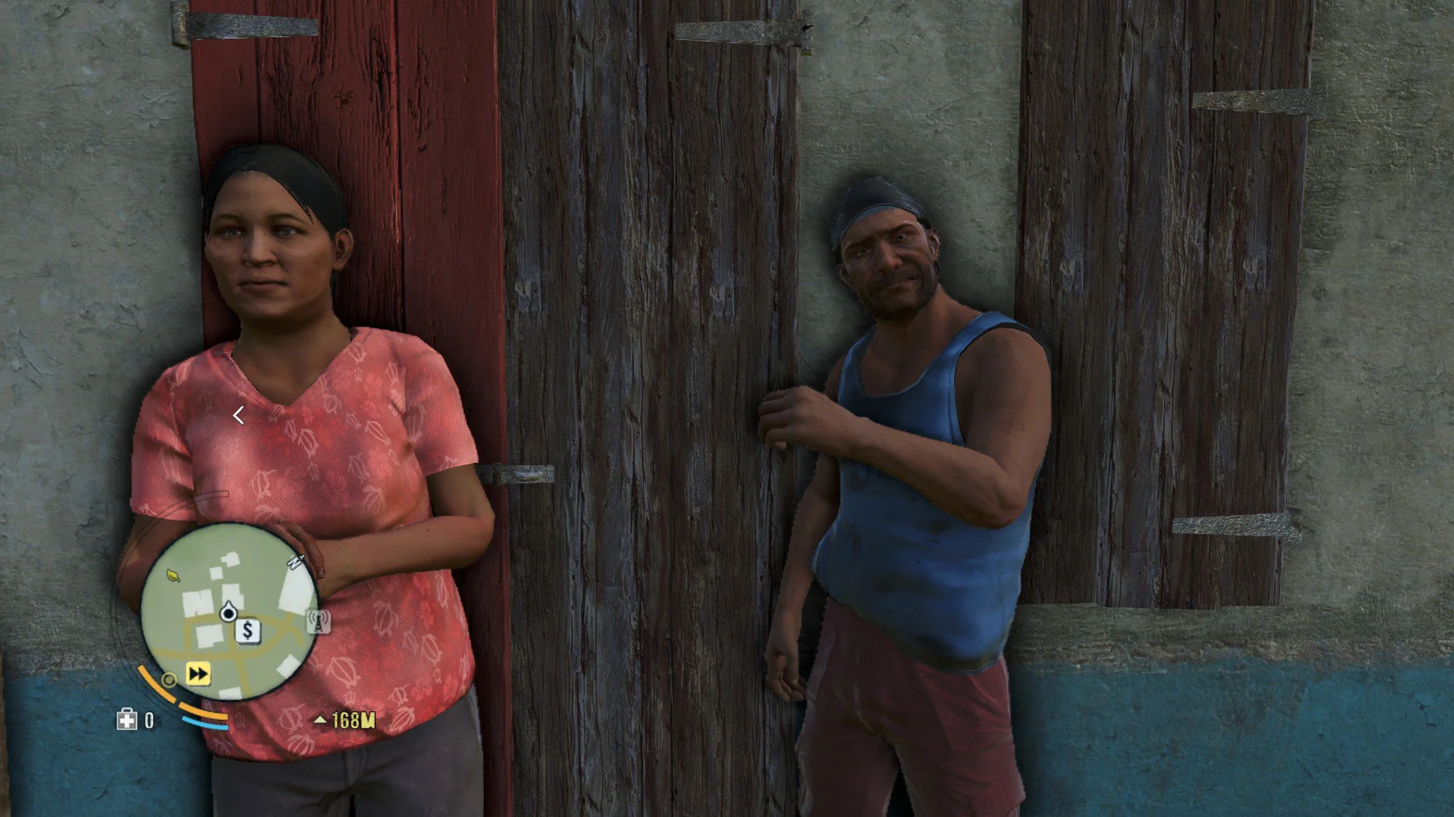
Bad results

Slide 42
Recap
We can render object into a texture
A post-process takes a rendered scene in a texture, and outputs a modified texture
Examples are bloom, ambient occlusion, …..
A kernel is a matrix of weights
Convolution is applying that matrix to an image

Slide 43
Next class
Camera’s
Light
…. and color

