Slide 1
Week 5a: Post Processing

Slide 2
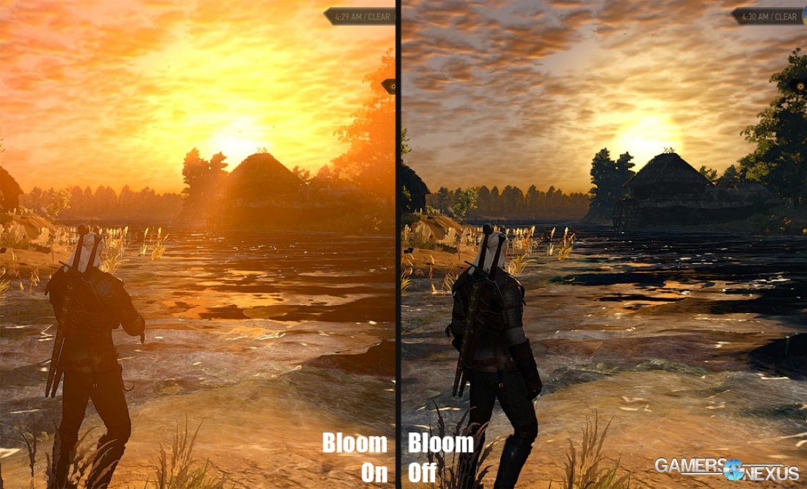
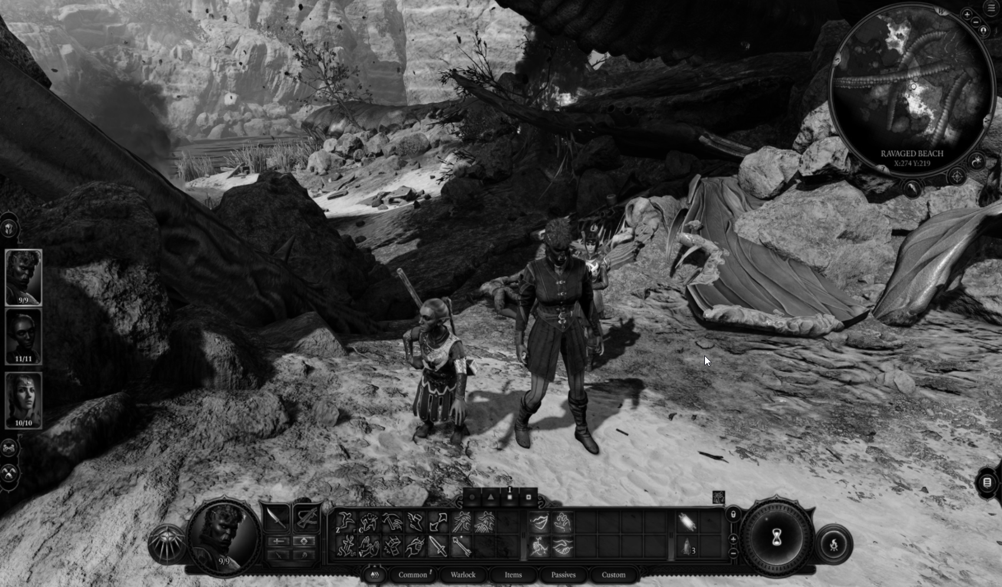
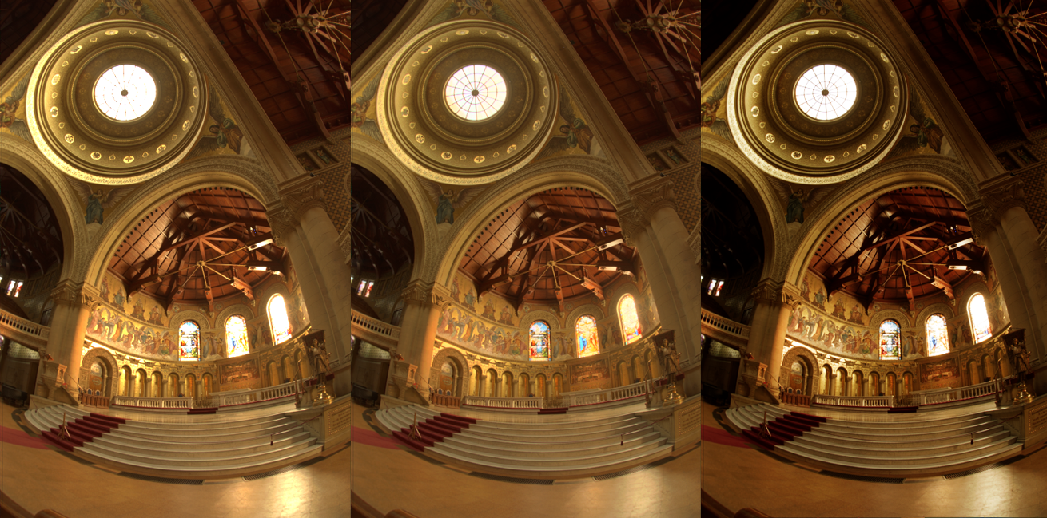
Last class
Postprocessing

Slide 3
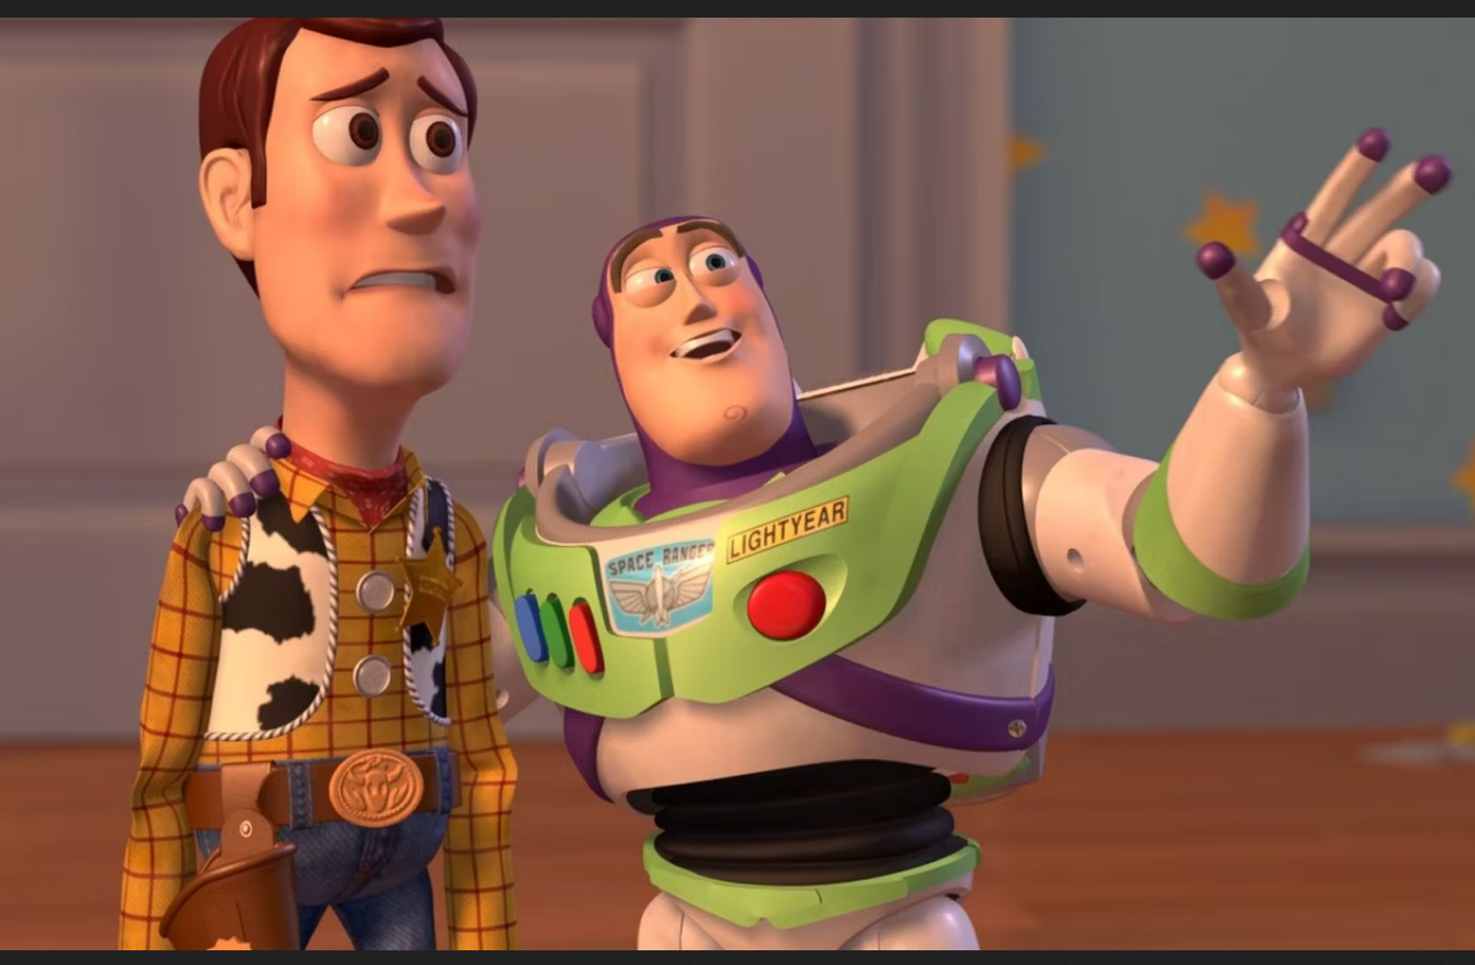
Course schedule
 | Monday | Thursday
Week 1 : 12/02 | Introduction | C#/Unity Lab
Week 2 : 19/02 | 3D reasoning | 3D Lab
Week 3 : 26/02 | Basic Pipeline | Lab
Week 4 : 04/03 | Textures | Normal maps Labs
Week 5 : 11/03 | Post processing | Camera’s Light
Week 6 : 18/03 | Materials Aliasing | Materials Lab
Week 7 : 25/03 | Procedural generation | Procedural generation
Week 8 : 15/04 | Advanced pipeline | Advanced pipeline lab
Week 9 : 22/04 | Project explanation | Project lab
Week 10 : 29/04 | Guest Lecture Project Labs | Guest Lecture Project Labs
Week 11 : | Revision | Revision
Highly likely to change ☹

Slide 4
No labs for this week
Post processing is part of the project
Will look into opening it sooner

Slide 5
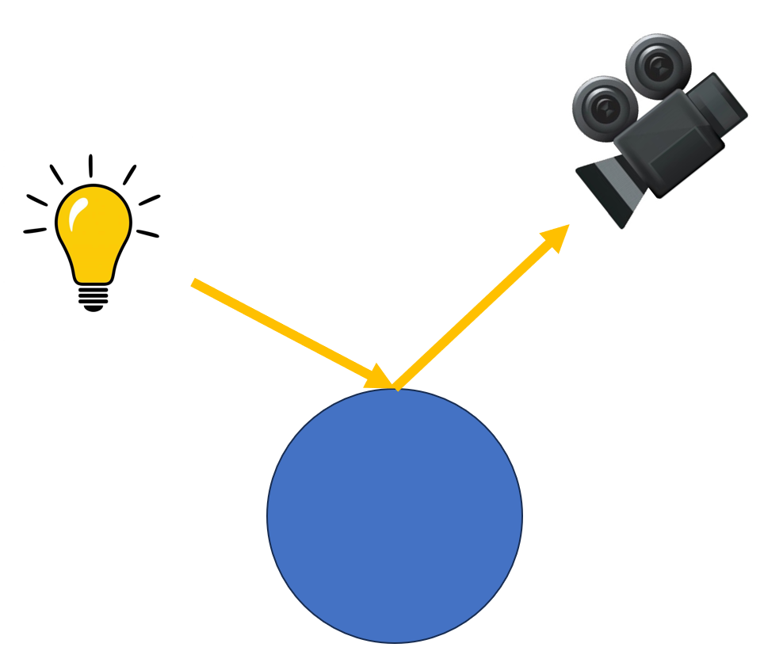
This class
→ Camera’s←
Lights

Slide 6
Camera’s
→Perspective←
Orthographic

Slide 7

Perspective camera
Objects get smaller the further they are (depth cue)
All real cameras are perspective camera’s

Slide 8
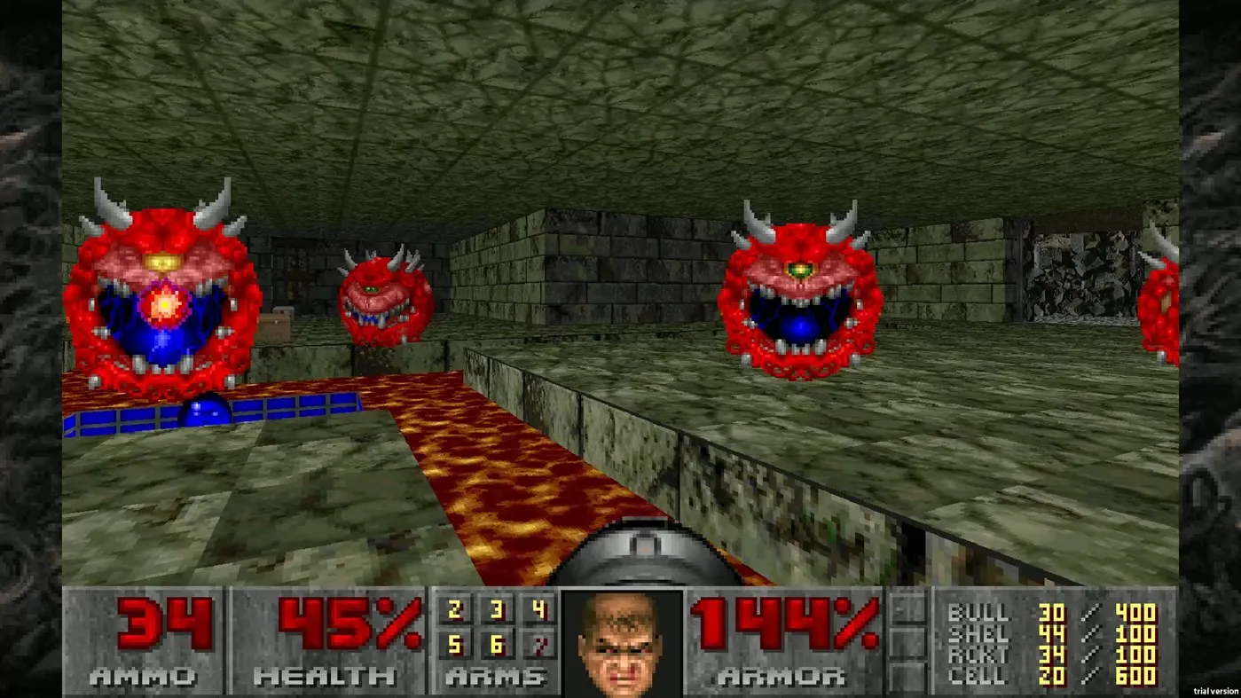

Slide 9
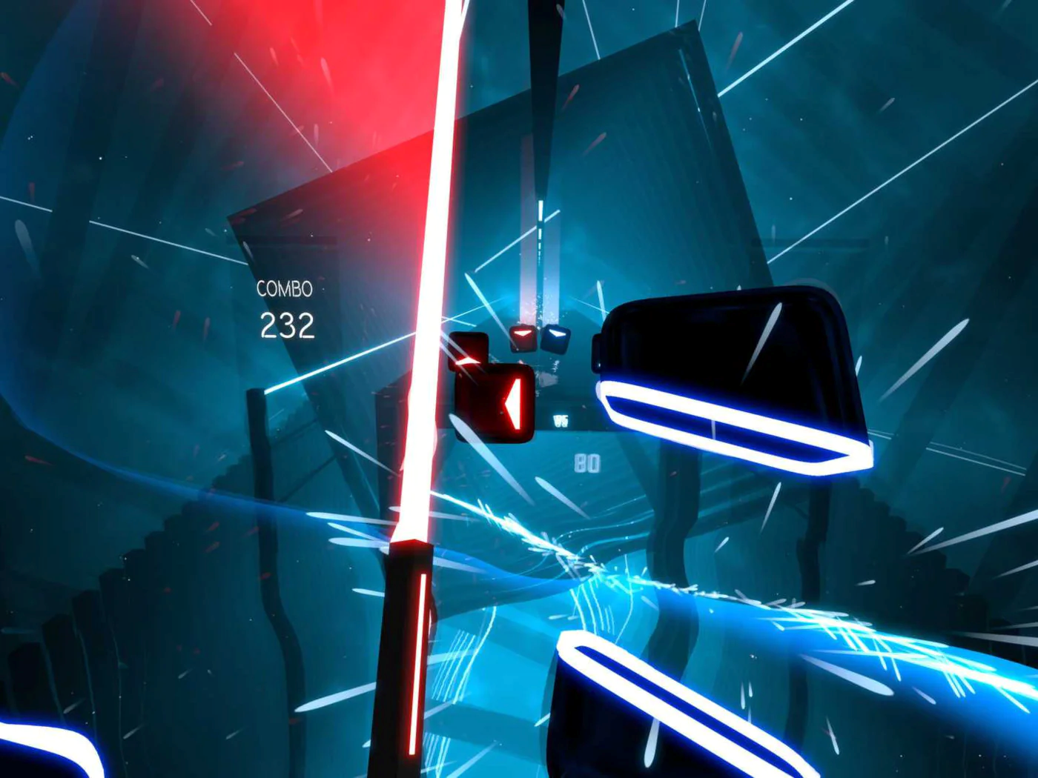

Slide 10
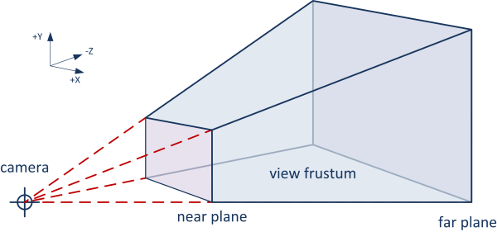
Perspective camera : frustum
The camera has a frustum (capped pyramid)
Anything visible has to be in the frustum

Slide 11
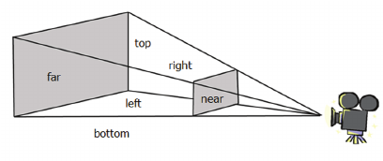
Perspective camera : near / far
The closest cutoff is called the near plane
The furthest cutoff is called the far plane
We need the cutoff due to the depth buffer

Slide 12
Perspective camera : field of view
This might already be familiar to you?

Slide 13
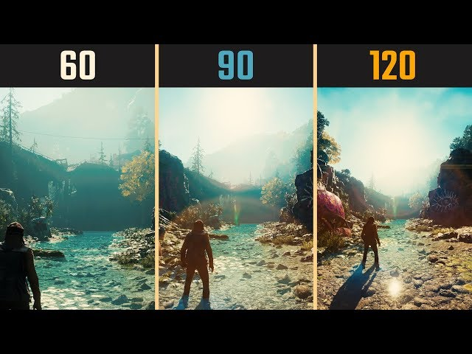
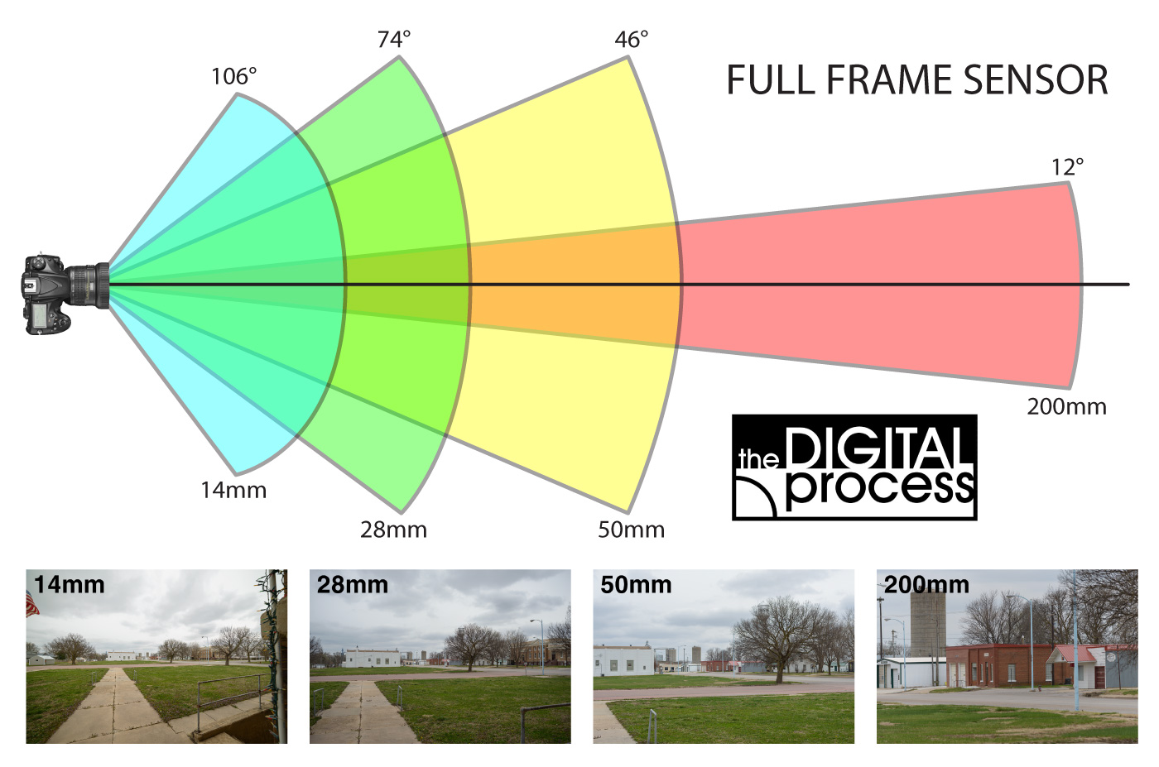
Analogous to different lenses
Larger field of view : smaller objects

Slide 14
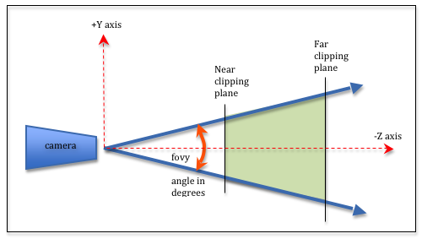
Field of view in frustum

Slide 15
Field of view is determined by aspect ratio
Aspect ratio : resolution.x / resolution.y
Eg 1920 * 1080
Common (nowadays) : 16/9
For FOV, we usually choose the vertical one, eg 90 degrees Multiply by aspect ratio for horizontal one : (16 * 90) / 9 FOV = (160, 90)

Slide 16
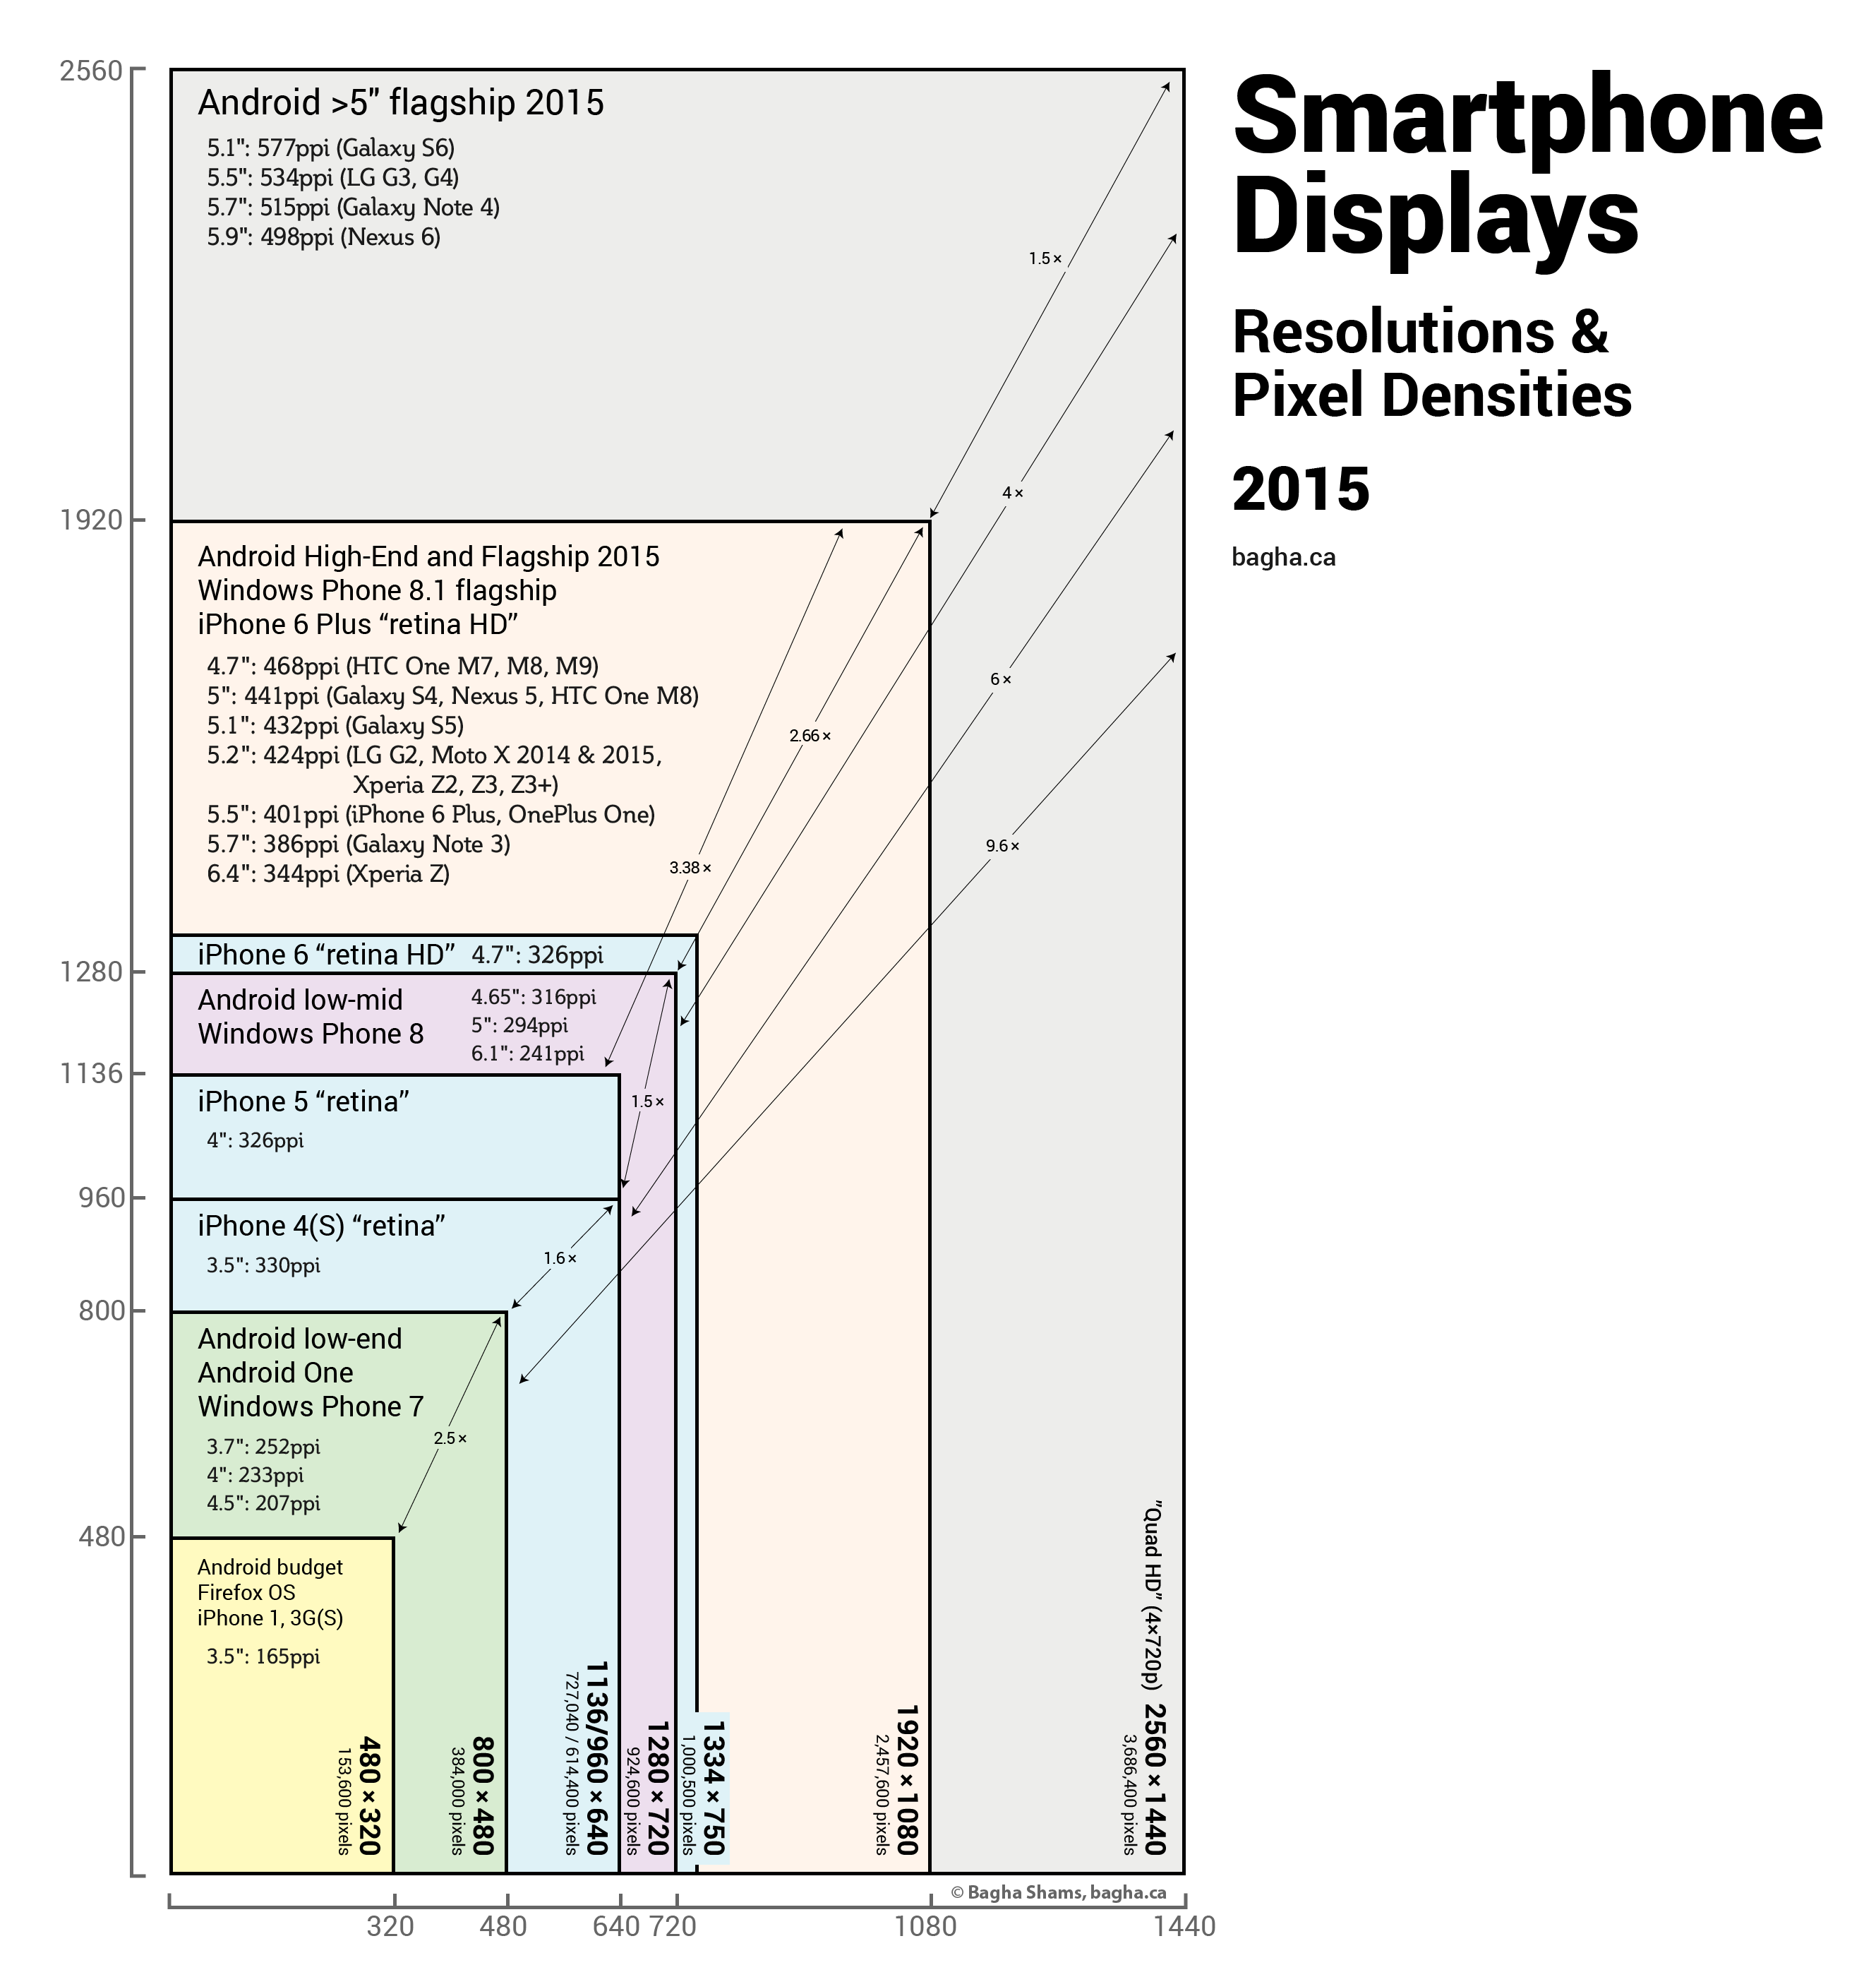
Phones are a nightmare

Slide 17
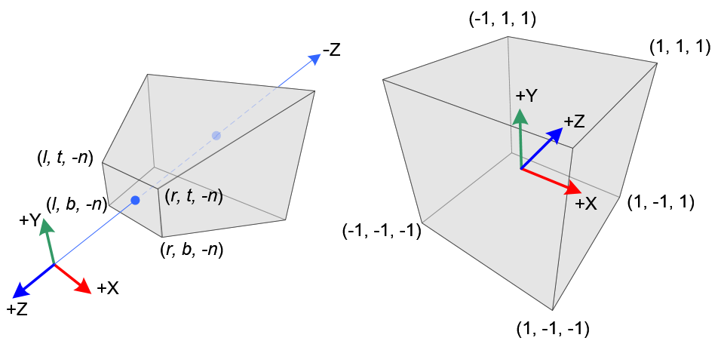
Perspective matrix
Takes care of perspective transform
Comes after the view matrix
Common : MVP (ModelViewProjection)

Slide 18
Questions?

Slide 19
Camera’s
Perspective
→Orthographic←

Slide 20
Orthographic
Objects do not get smaller as they get further
Does anyone know an example?

Slide 21
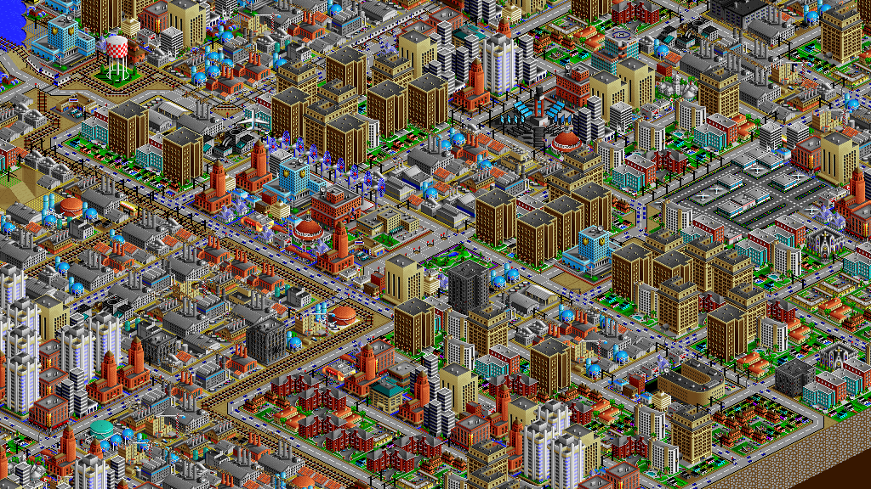

Slide 22
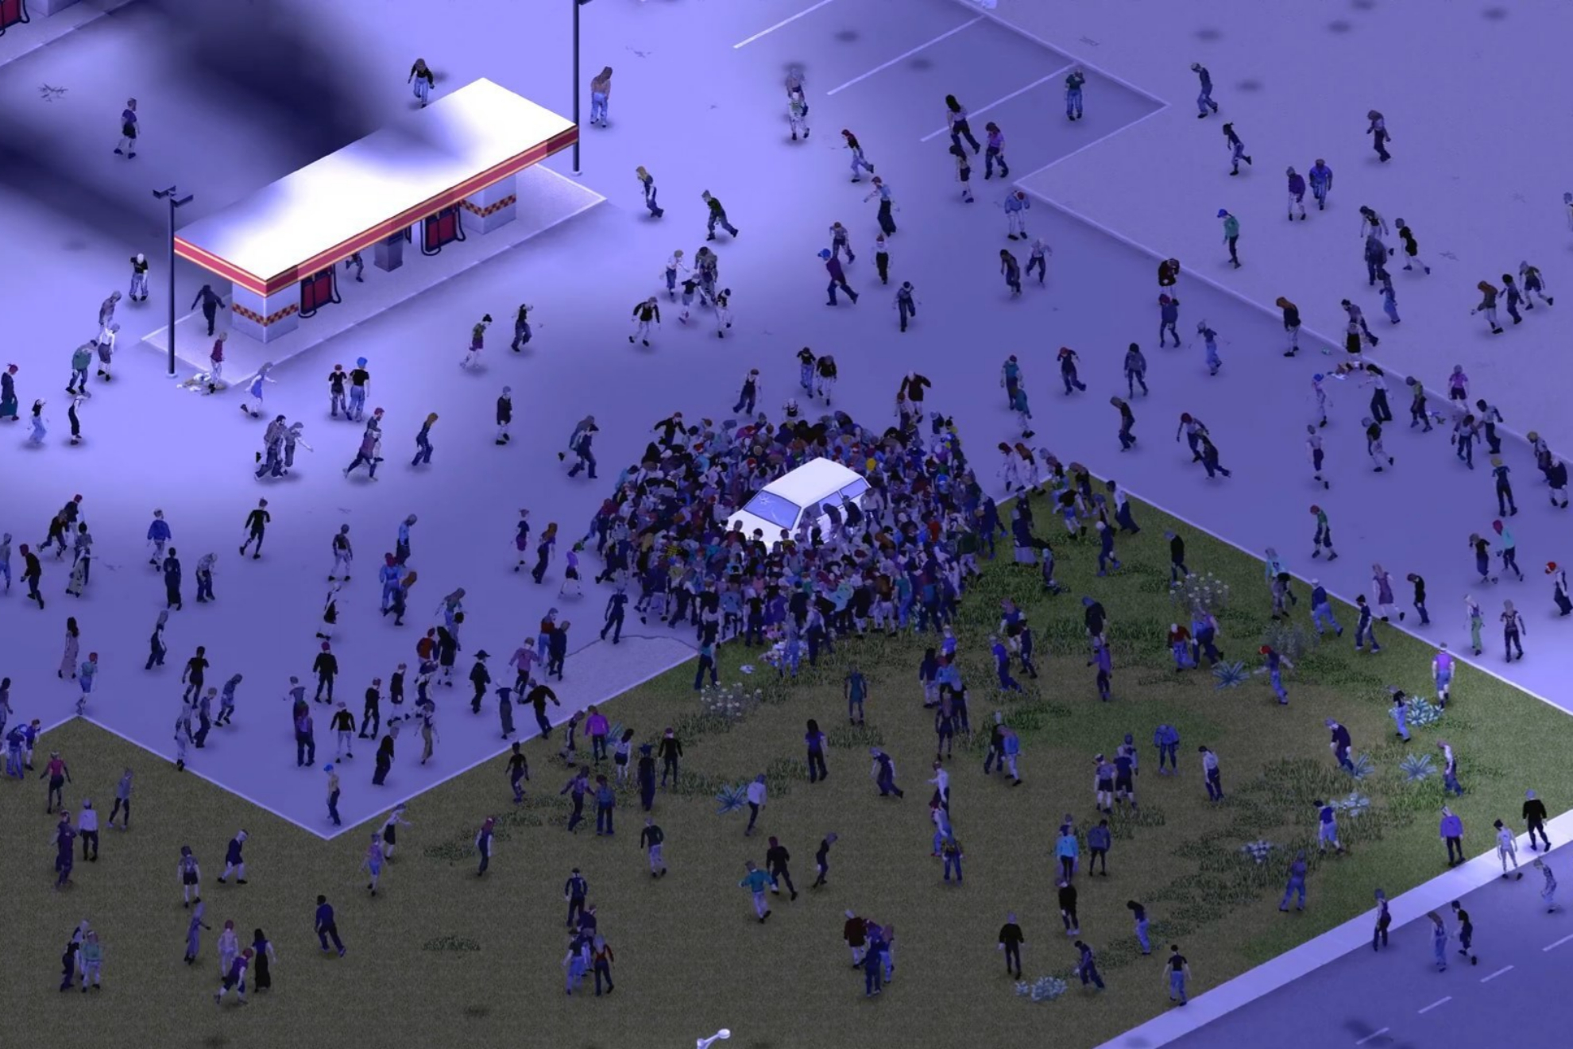

Slide 23
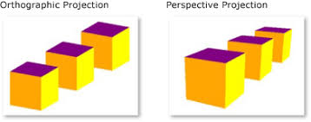
Comparisio n1

Slide 24
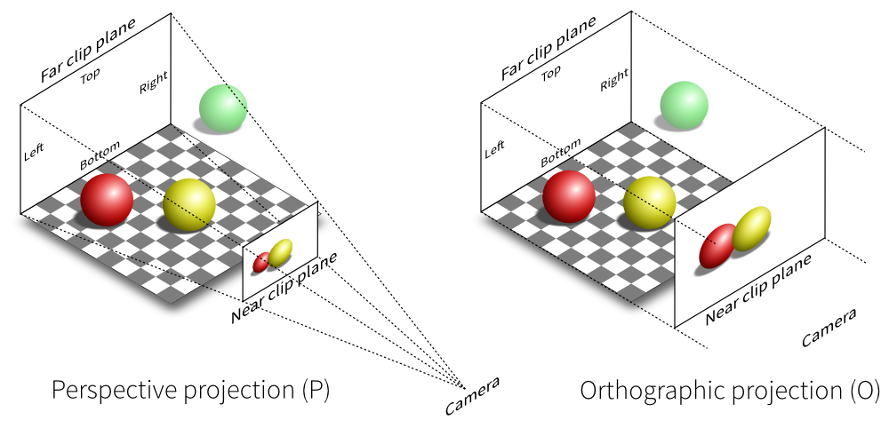
Comparison 2
Very similar to perspective
No fov
Near (and far) have width and hight

Slide 25
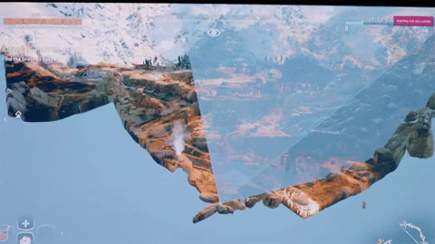
Bonus slide : frustum culling

Slide 26
This class
Camera’s
→ Lights ←

Slide 27
Light is multiplicative and additive
If we make the light twice as strong, the material emits twice as strong
We can treat two lights separately, they don’t influence each other

Slide 28
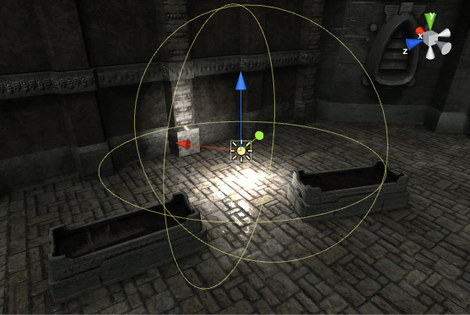
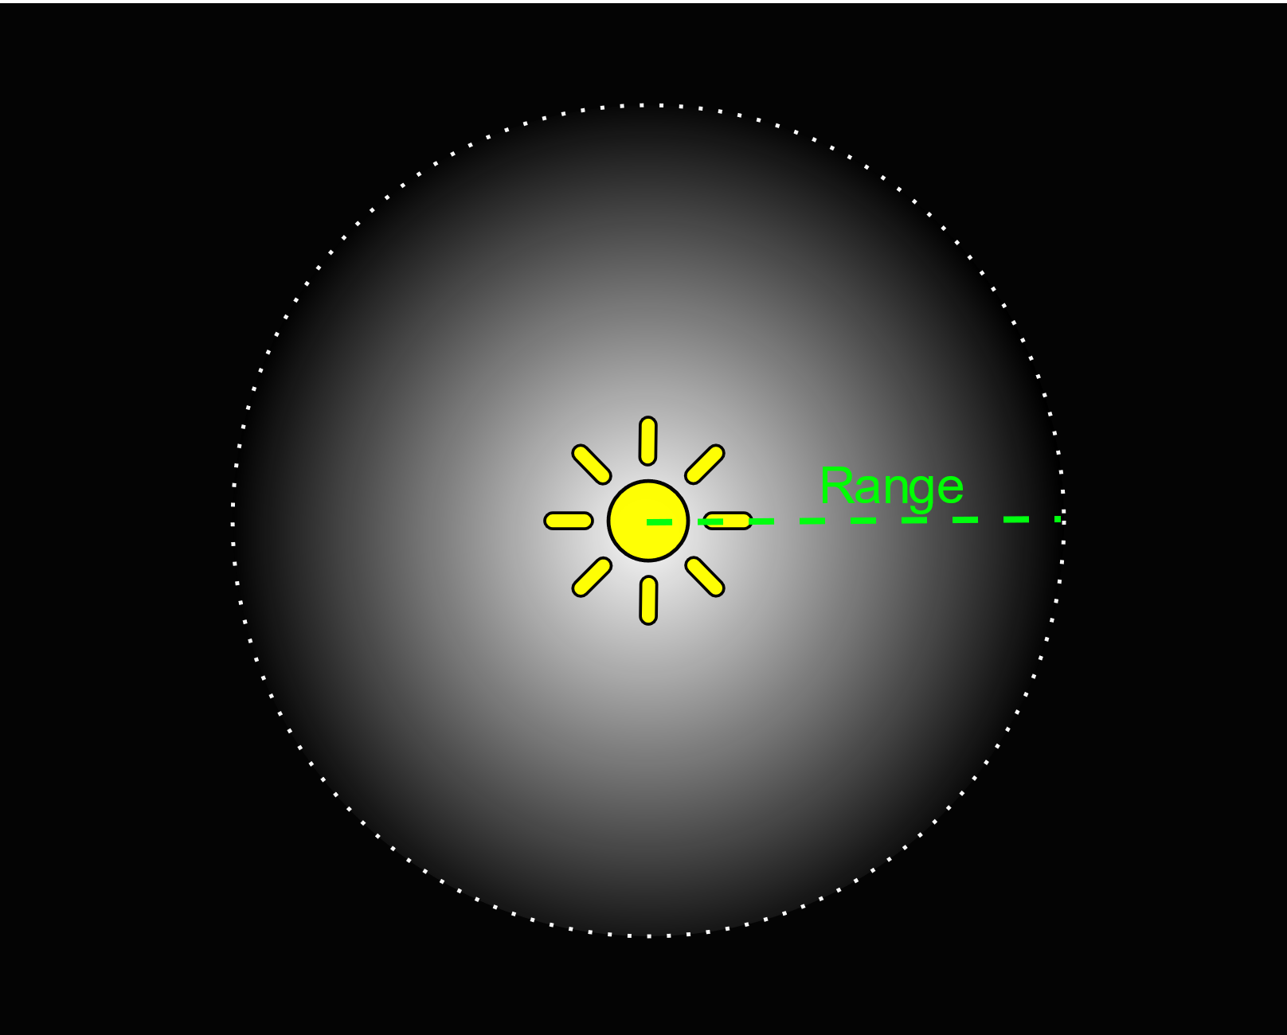
Point lights

Slide 29
Attenuation
Most get less intense with distance

Slide 30
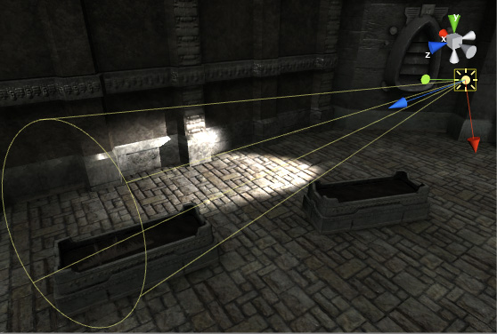
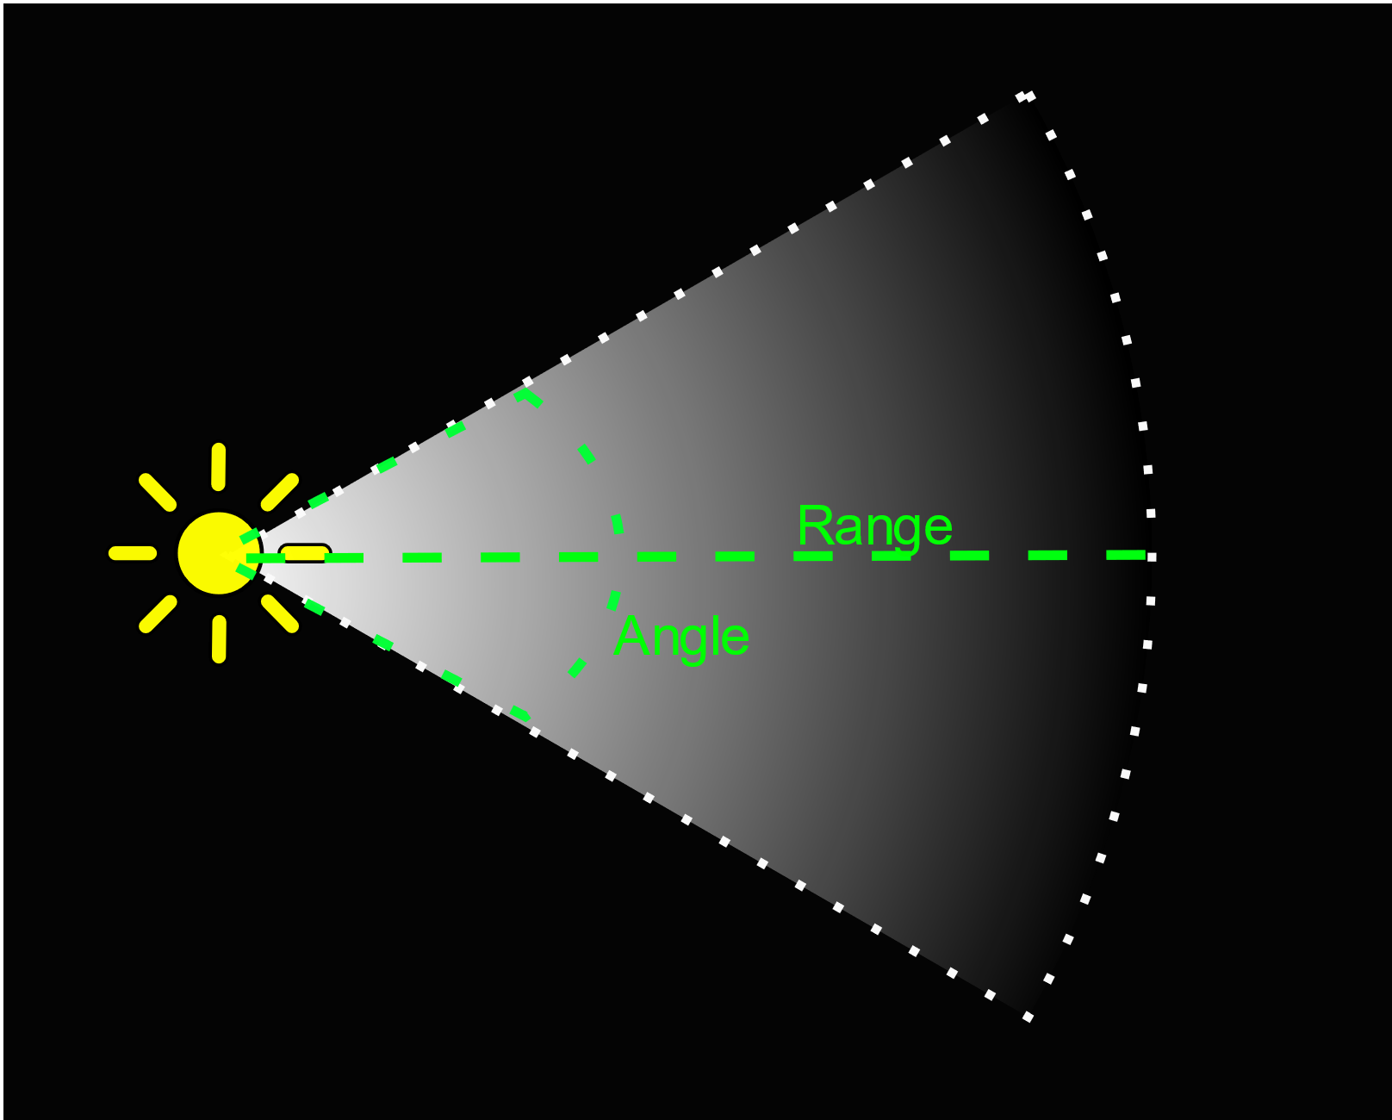
Spot light

Slide 31
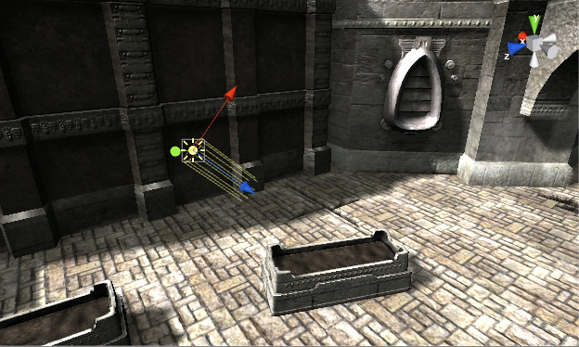
Directional light
Like sunlight
Does not fall off with distance
Why?

Slide 32

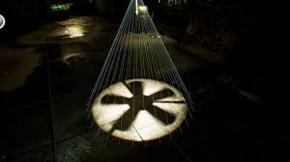
Light cookies
Like a painted plastic film on a light
Cheap way to create detail

Slide 33
Recap
There are perspective and orthographic camera’s
The transformation is called the projective matrix
The full transformation is the MVP (ModelViewProjection)
Lights are additive and multiplicative
There are several kinds of light : Point, Spot, Directional, (Area)

Slide 34
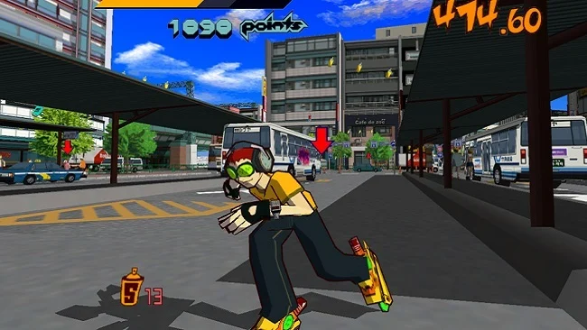
Next class
Materials
Aliasing

