Slide 1
Week 6a: Materials

Slide 2
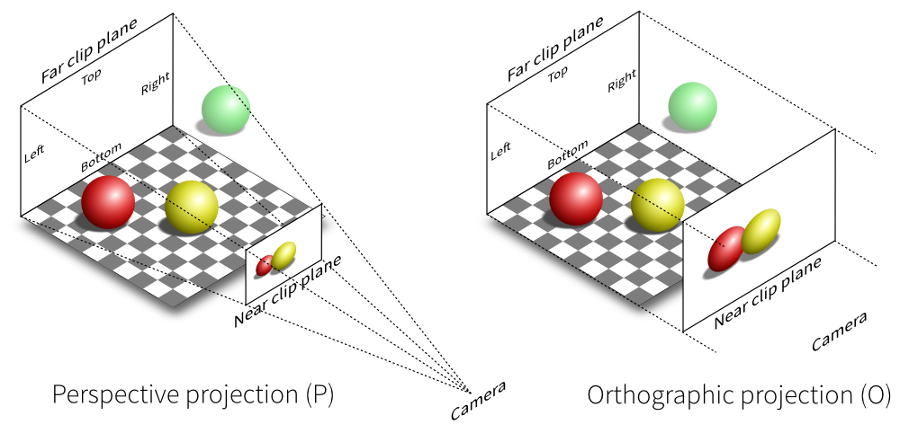
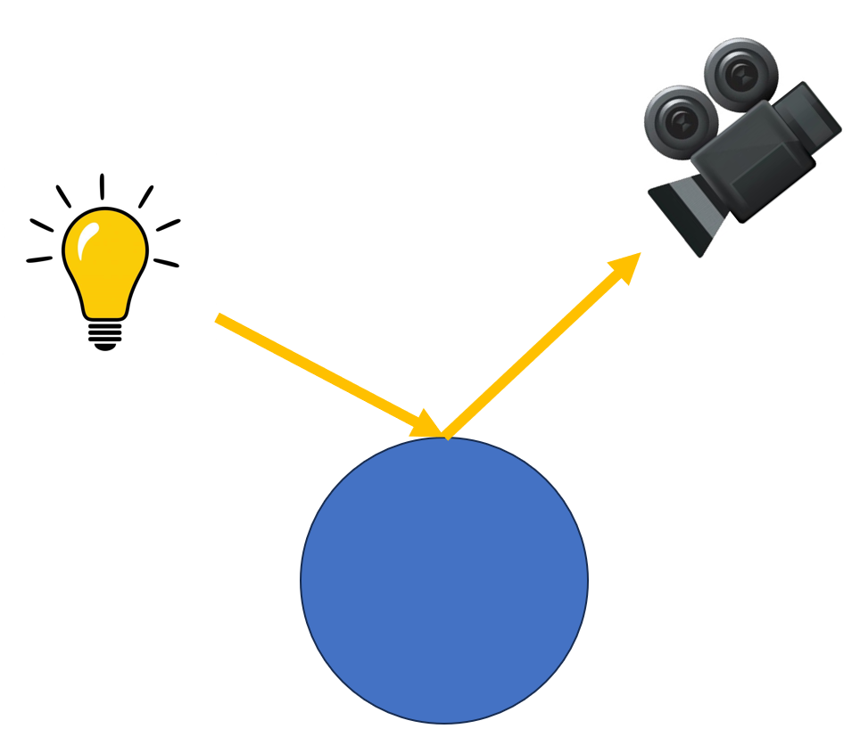
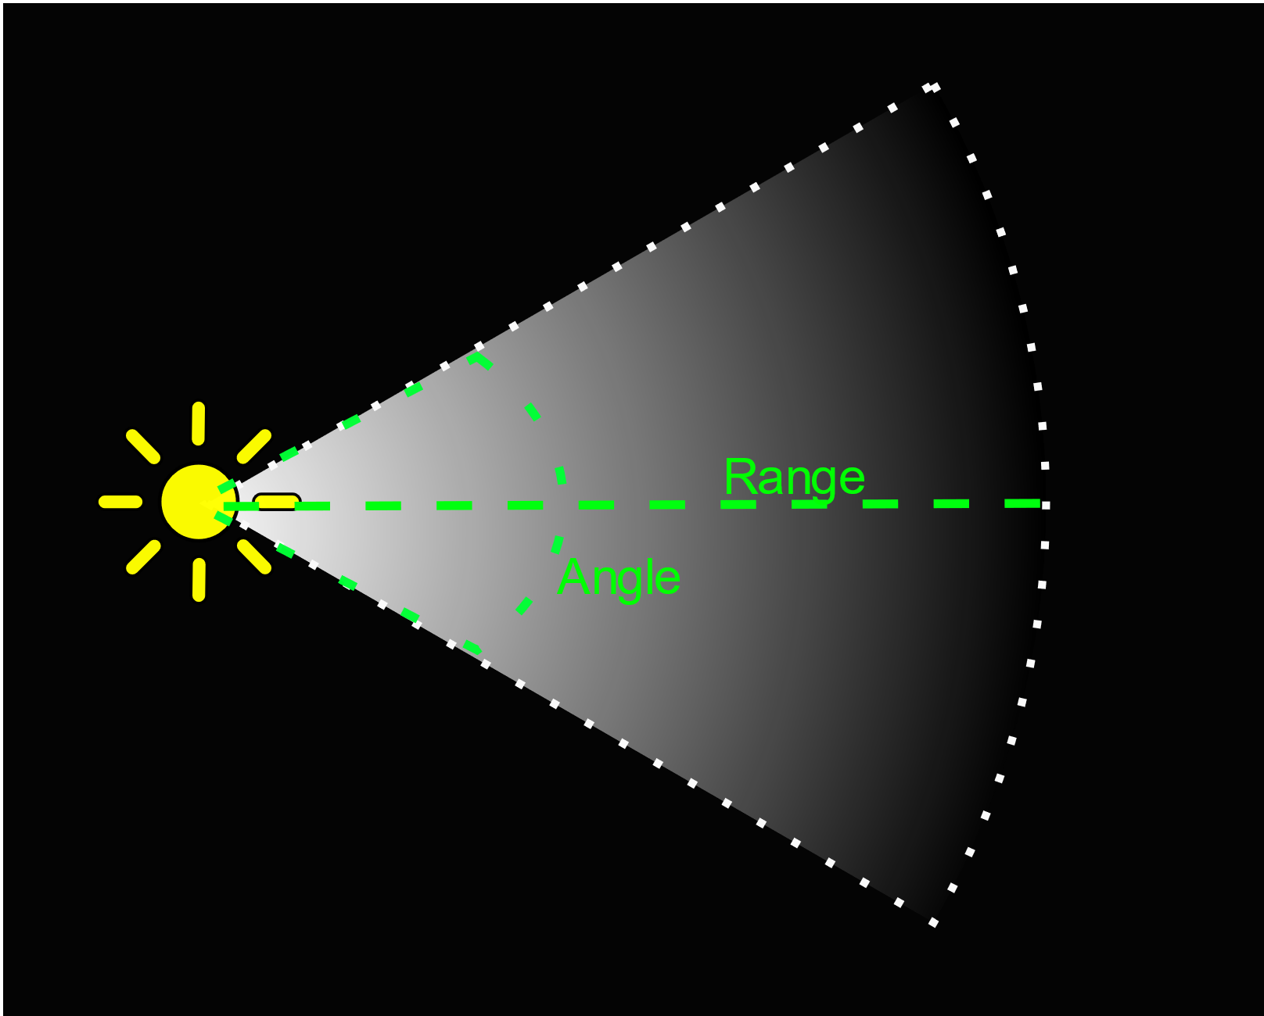
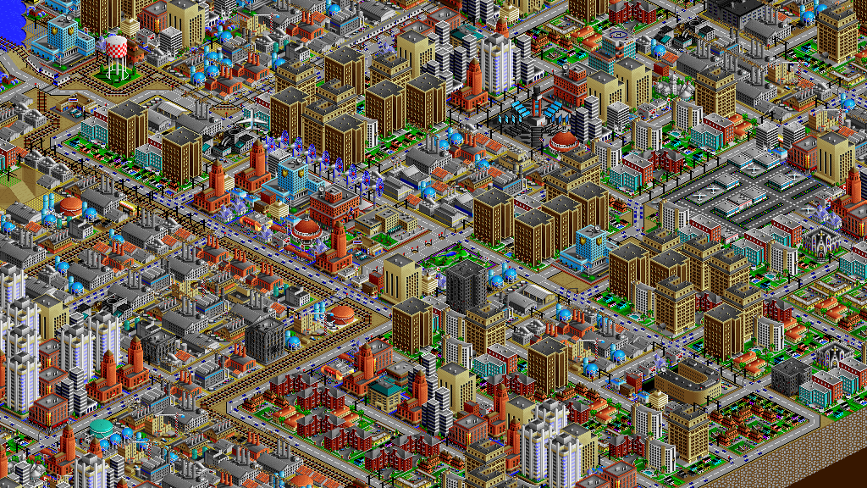
Last class
Camera’s
Light

Slide 3
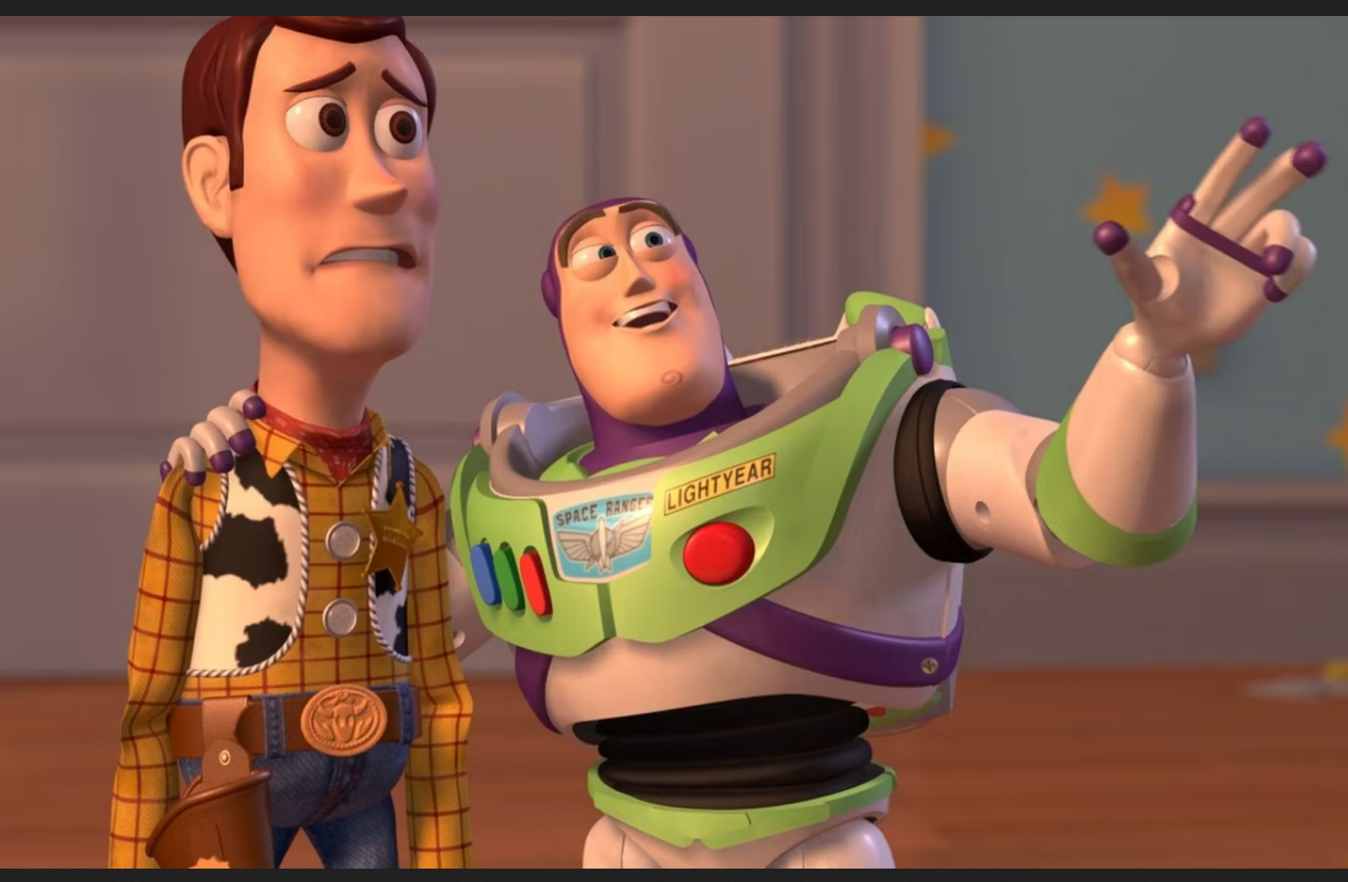
Course schedule
 | Monday | Thursday
Week 1 : 12/02 | Introduction | C#/Unity Lab
Week 2 : 19/02 | 3D reasoning | 3D Lab
Week 3 : 26/02 | Basic Pipeline | Lab
Week 4 : 04/03 | Textures | Normal maps Labs
Week 5 : 11/03 | Post processing | Camera’s Light
Week 6 : 18/03 | Materials | Aliasing Materials Lab
Week 7 : 25/03 | Procedural generation | Procedural generation
Week 8 : 15/04 | Advanced pipeline | Advanced pipeline lab
Week 9 : 22/04 | Project explanation | Project lab
Week 10 : 29/04 | Guest Lecture Project Labs | Guest Lecture Project Labs
Week 11 : | Revision | Revision
Highly likely to change ☹

Slide 4
This class
→ Materials←
Blinn Phong
NPR

Slide 5
Material ~= BRDF
Material in unity : parameters for a shader
Material “in general” : how a surface reacts to light
Precise term : BRDF
Bidirectional Reflectance Distribution Function

Slide 6
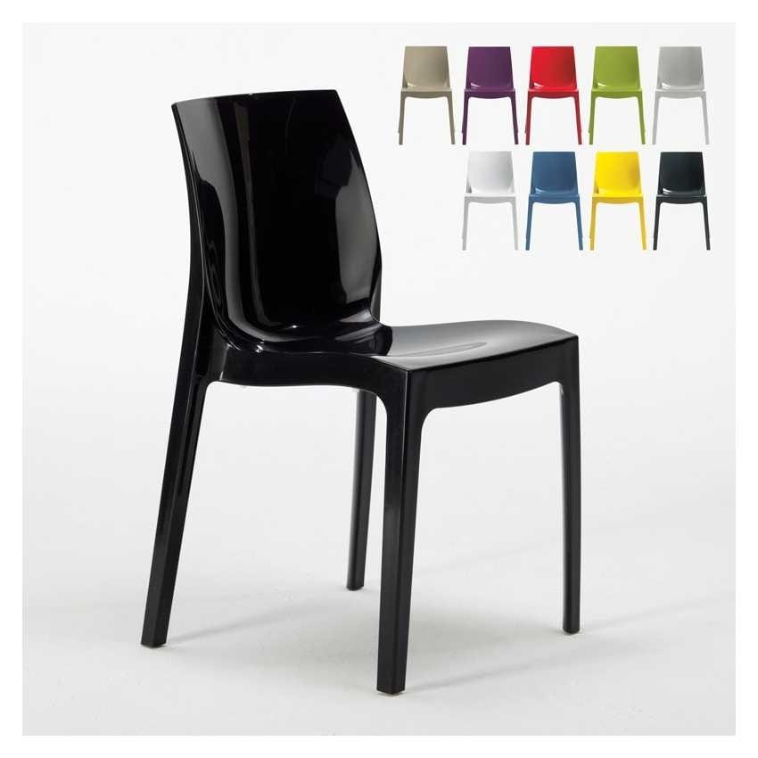
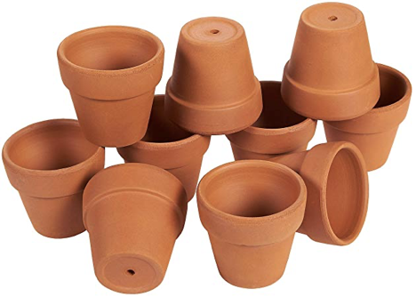
BRDF’s tend to have a diffuse and specular part
Diffuse : independent on view direction (like dirt, unglazed pottery)
Specular : dependent on view direction (like plastic, metal)

Slide 7
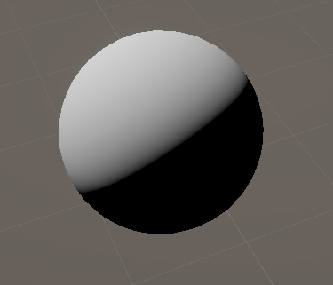
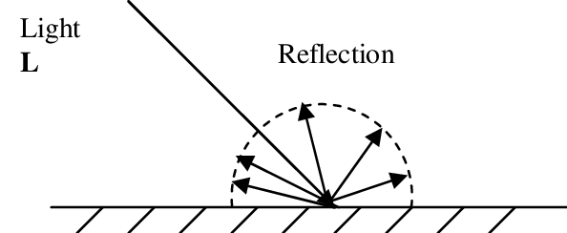
Lambert diffuse
Light enters an object
Scatters / reflects in all directions
dot(N, L)

Slide 8
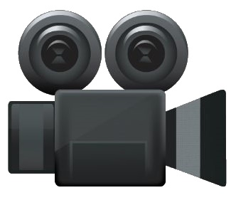
Lambert diffuse
Diffuse is view-independent
Same color / intensity no matter how we look at it

Slide 9
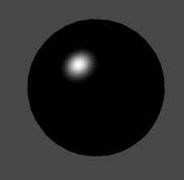
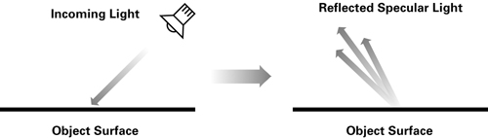
Blinn-Phong specular
“Shininess”
Looks like a highlight
Is view dependent (highlight changes position when you move your head)

Slide 10
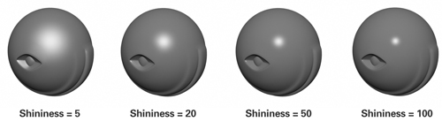
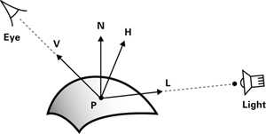
Blinn-Phong specular
specular = K_{s} x lightColor x facing x (max(N · H, 0)) ^{shininess}
More details in lab

Slide 11
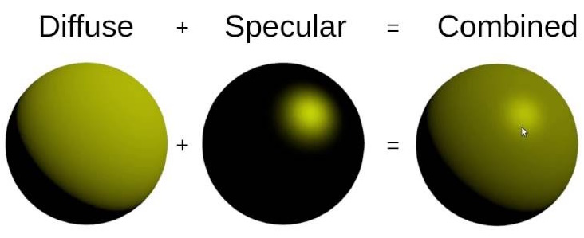
Putting it together
Simply diffuse + specular

Slide 12
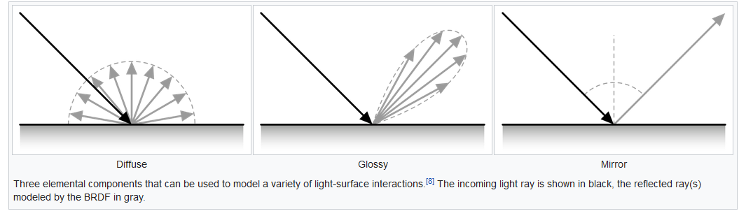
Mirrors are perfectly specular

Slide 13
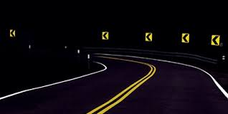
How does this work?

Slide 14
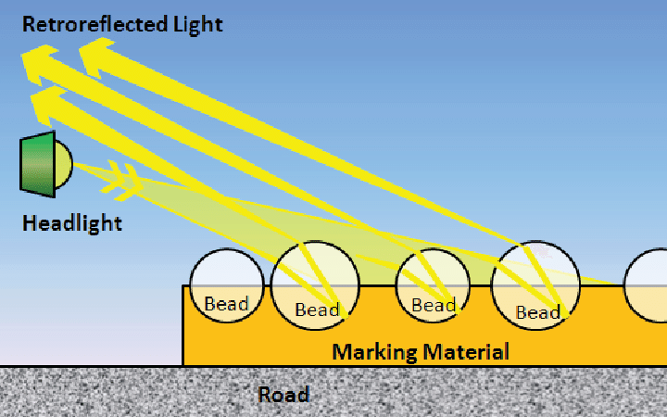
Retroreflectivity

Slide 15
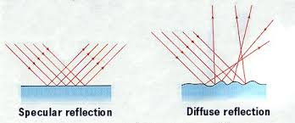
Microfacets
The origin of these models is the microscopic structure of materials
If it’s rough, it tends to be diffuse
If it’s flat, it tends to be specular

Slide 16
Recap
There are perspective and orthographic camera’s
The transformation is called the projective matrix
The full transformation is the MVP (ModelViewProjection)
Lights are additive and multiplicative
There are several kinds of light : Point, Spot, Directional, (Area)

Slide 17
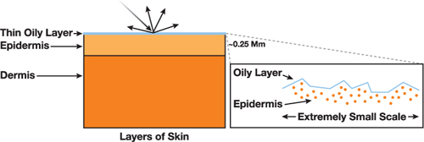
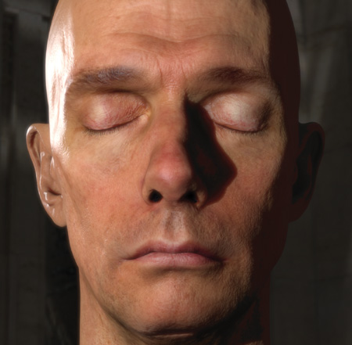
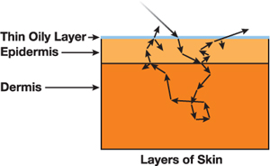
Complicated models : skin
Skin has layers : oil, epidermis, fatty tissues. And light penetrates.

Slide 18
Unity : GGX
Unity uses deferred rendering (more info in advanced pipeline class)
Can only support 1 BRDF
Unity uses GGX

Slide 19
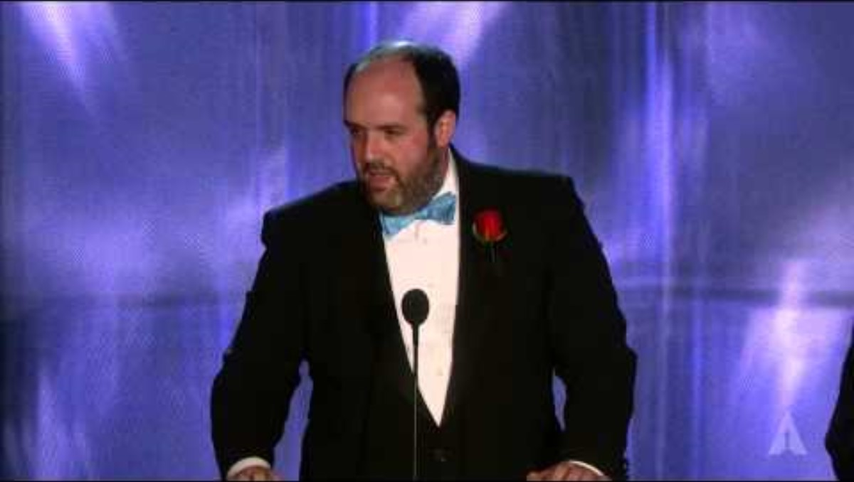
Physically based rendering

Slide 20
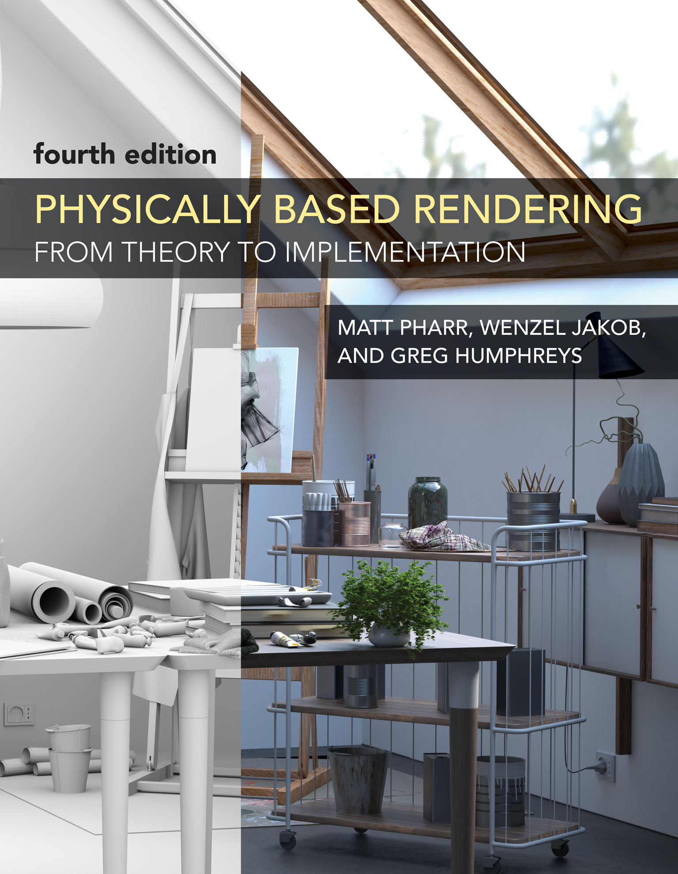
Physically based rendering
So good it won an oscar
Available at https://www.pbrt.org/ for free (not mandatory)
Physically based rendering theory is rendering while respecting physics
Before 2010’s, everything was pretty hacky
When it’s based in physics, everything works predictably
Example: an object should only reflect as much light as entered it
Example: a light shines on all objects (no artist set exceptions)

Slide 21
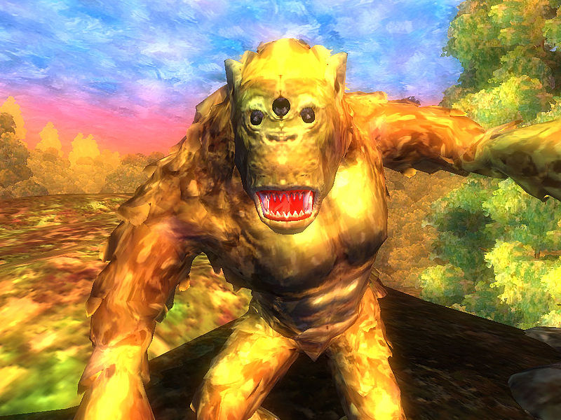
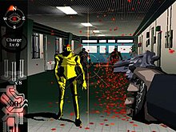
Another idea : Non photorealistic rendering
Because sometimes we don’t want our images to look photorealistic

Slide 22
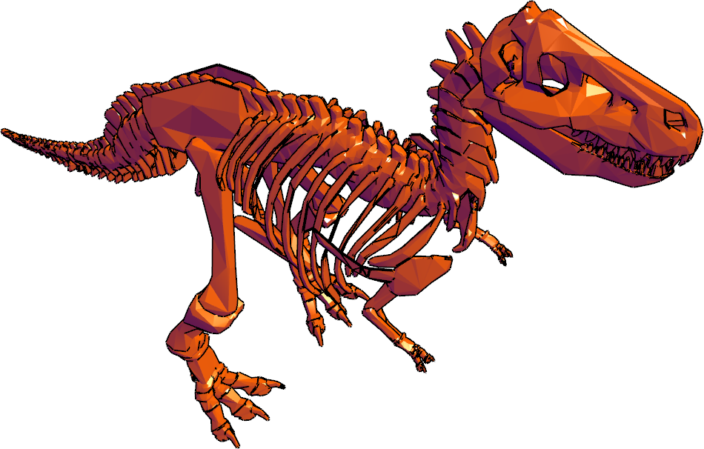
Gooch shading
Used for technical drawing
Want more readability in dark areas

Slide 23
Gooch shading
Normal rendering: dot(N,L) -1 : black 0 : black 1 : color
Gooch rendering
dot(N,L) -1 : purple 1 : color

Slide 24
Recap

Slide 25
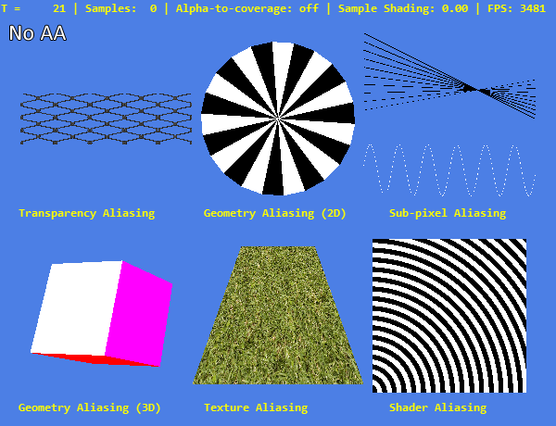
Next class
Aliasing

