Slide 1
Week 7a: Procedural Generation

Slide 2
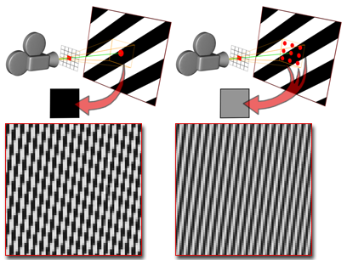
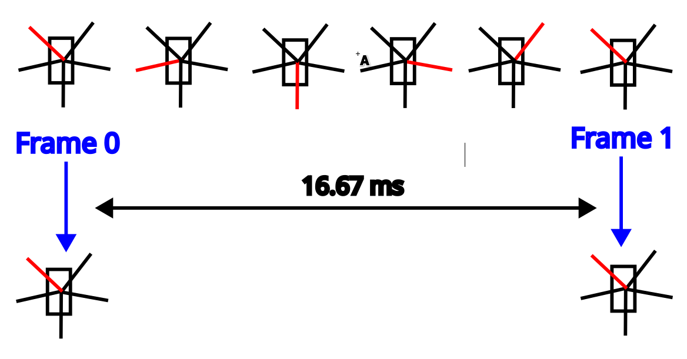
Last class
Aliasing
Anti-Aliasing

Slide 3

Course schedule
 | Monday | Thursday
Week 1 : 12/02 | Introduction | C#/Unity Lab
Week 2 : 19/02 | 3D reasoning | 3D Lab
Week 3 : 26/02 | Basic Pipeline | Lab
Week 4 : 04/03 | Textures | Normal maps Labs
Week 5 : 11/03 | Post processing | Camera’s Light
Week 6 : 18/03 | Materials | Aliasing Materials Lab
Week 7 : 25/03 | Procedural generation Theory | Procedural generation Practice
Week 8 : 15/04 | Advanced pipeline | Advanced pipeline lab
Week 9 : 22/04 | Project explanation | Project lab
Week 10 : 29/04 | Guest Lecture Project Labs | Guest Lecture Project Labs
Week 11 : | Revision | Revision
Highly likely to change ☹
Got a bonus week! Need inspiration

Slide 4
This class
→ Procedural generation←
Noise
Applications of noise
Other primitives

Slide 5
Procedural generation
Making content using code, not data
Using code to make models, textures, etc…

Slide 6
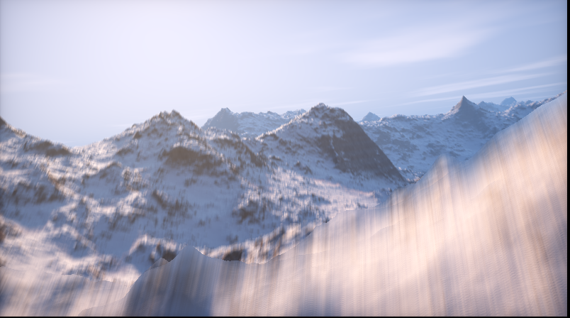
Example : Elevated
Very small (about 4kb)
https://www.shadertoy.com/view/MdX3Rr
Includes renderer!

Slide 7
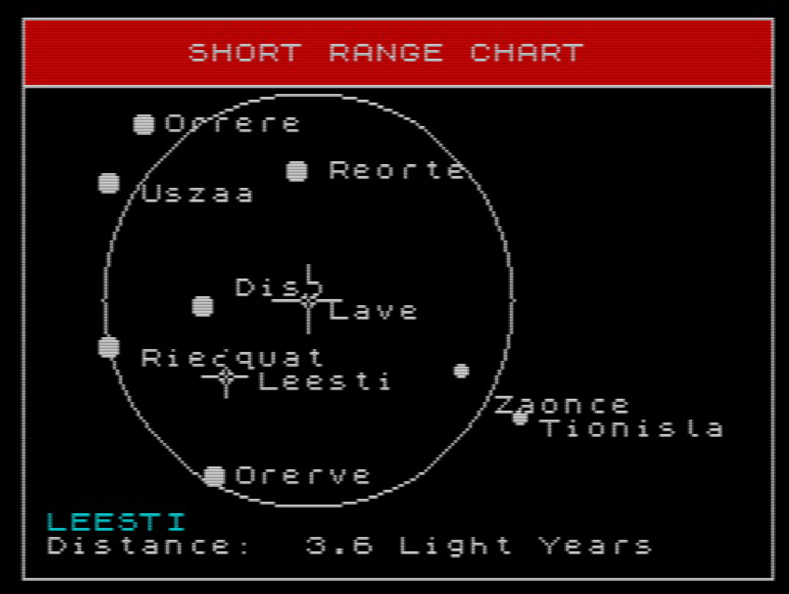
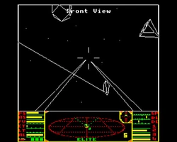
History: Elite 1984
“…star systems were procedurally generated from a fixed seed, which generated the description of the star system, including its economy, government, and population. There were 8 galaxies of stars in the original Elite, each with 256 generated stars.”
“There were originally going to be 282 trillion galaxies in the game, but Acornsoft, the publisher, convinced the developers to trim it down to a manageable eight, each with 256 stars. Running your generator too many times often results in less interesting results.”
“text strings are chosen numerically from a lookup table and assembled to produce unique descriptions, such as a planet with "carnivorous arts graduates"

Slide 8
Why did they use procedural generation?

Slide 9
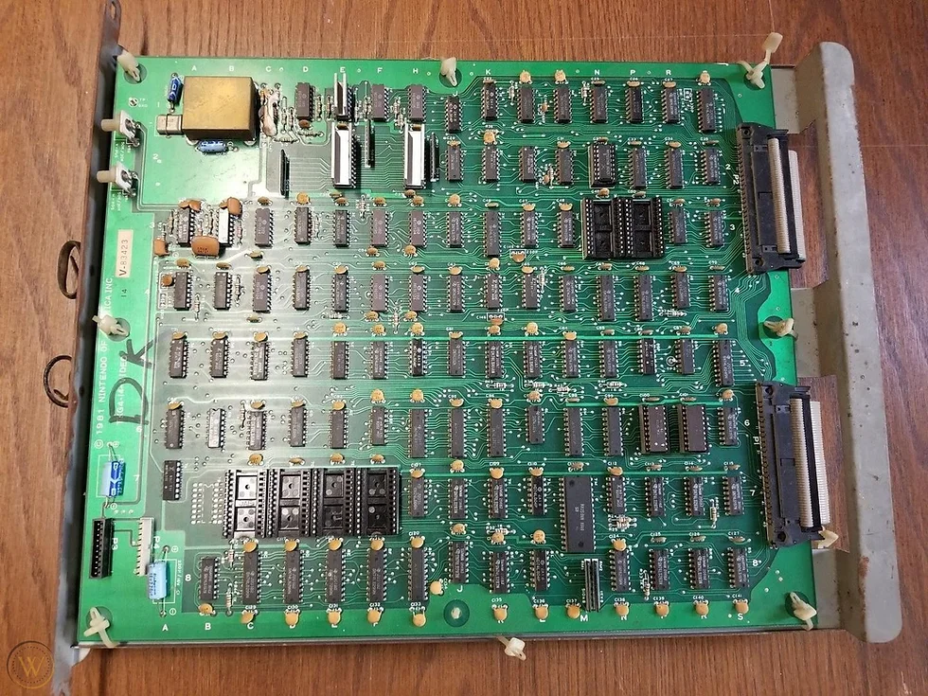
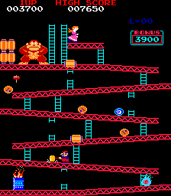
Why did they use procedural generation?
Memory was extremely expensive
Procedural generation allows “on demand” generation

Slide 10
Quick random number recap
Random number sequence: 77, 1, 4, 9, 0, 0, 0, 0, 0, 0, 0, 0, 1, 31, 25
Deterministic from seed! Same seed, same sequence Seed : 15 Rand : 1, 5, 5, 1, 84, 38, 94 Seed : 17 Rand : 208, 198, 150, 28 Seed : 15 Rand : 1, 5, 5, 1, 84, 38, 94
Elite used seed to have the same planets every time (why?)
Pseudorandom, but for us that is fine (not for encryption)

Slide 11
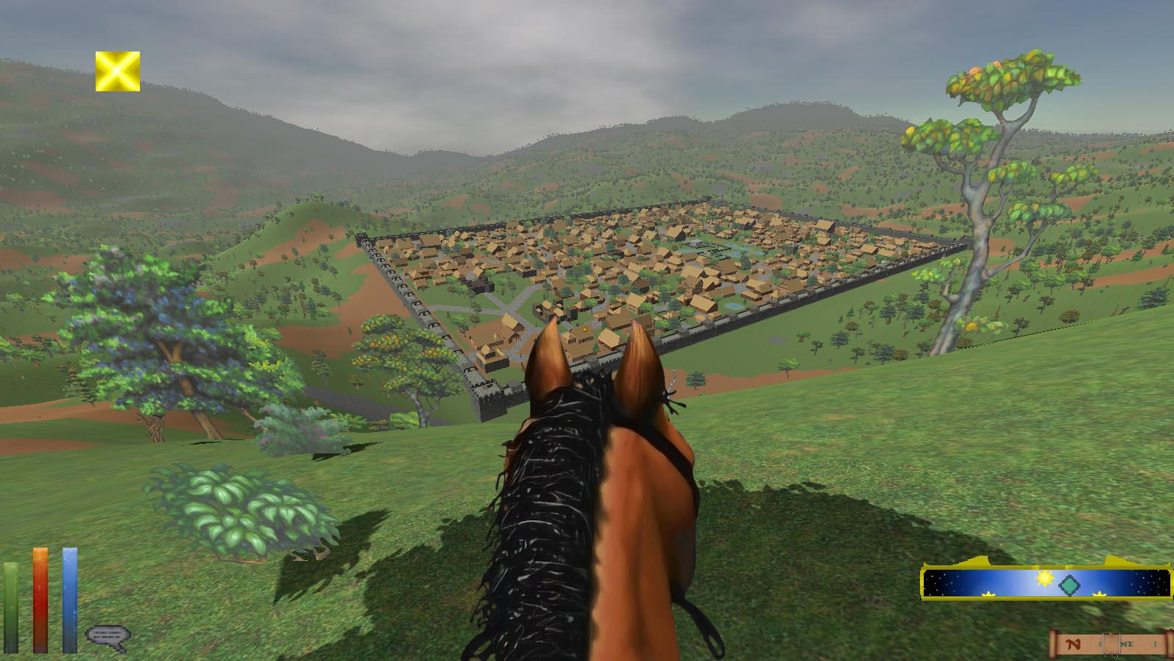
Elder Scrolls : Daggerfall 1997
Procedural generation for terrain, villages, npc’s
229,000 square kilometers
Why would they use procedural generation?

Slide 12
Elder scrolls : reasoning
Space reasons
If we had 1Gb, and 32bit rgb, how big would one color cover?
But also artist time
Any problems with this approach?

Slide 13
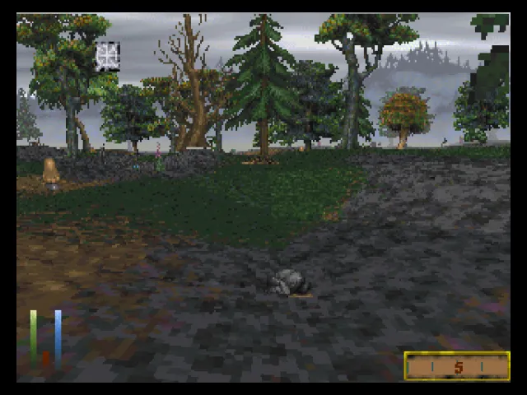
Elder scrolls : “sameyness”
When we use the same algorithm a lot of times, everything still looks similar
(50 shades of gray)
Only very little of the terrain is interesting

Slide 14
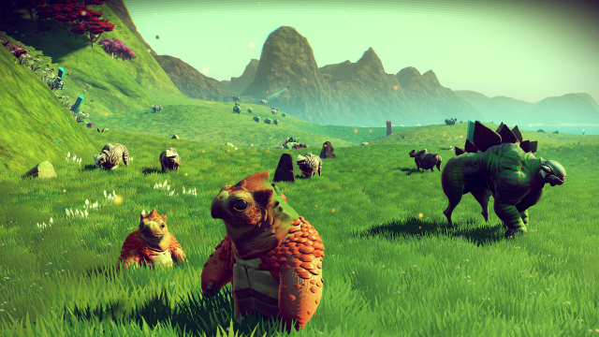
No man sky

Slide 15
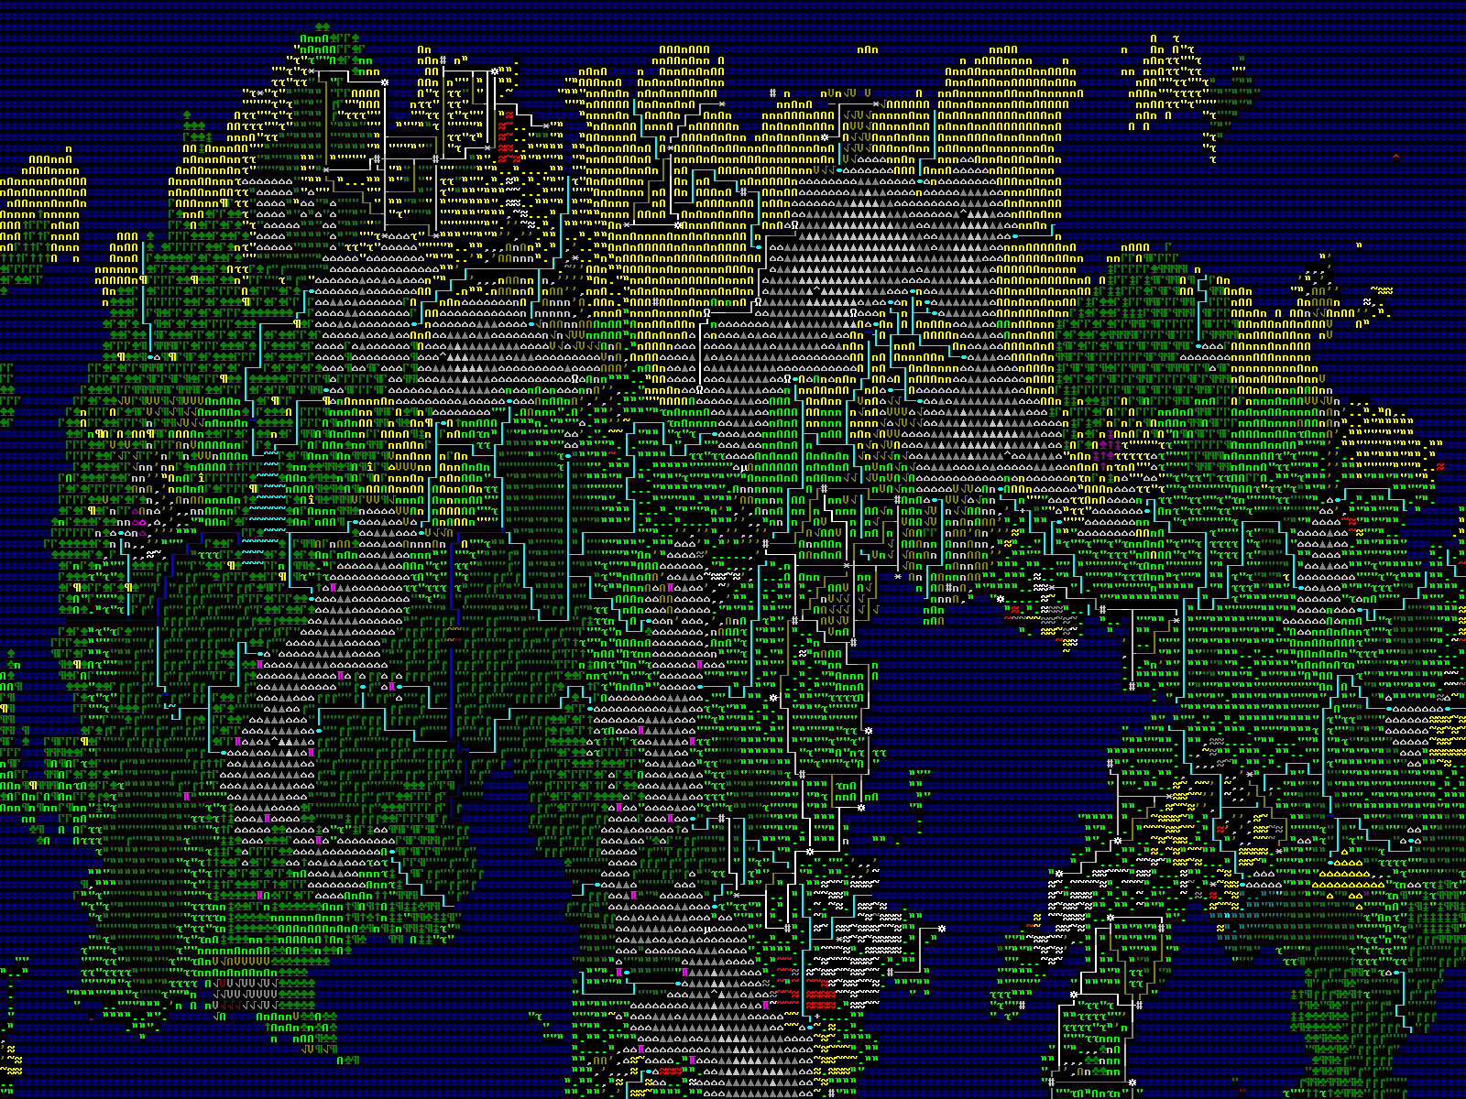
Dwarf fortress
Generates world
And history
And pantheon
And description
“On the wheel of cheese is an image of a wheel
cheese”

Slide 16
This class
Procedural generation
→ Noise ←
Applications of noise
Other primitives

Slide 17
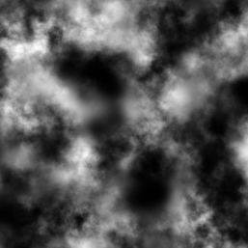
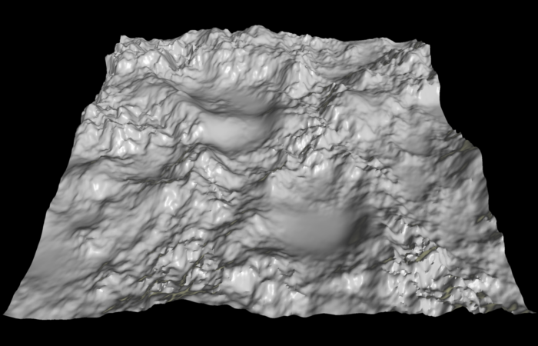
Heightmaps
Use a texture to store height
Use texture on a plane
Offset with texture value
Great for tooling! (photoshop, terragen)
Great for explaining noise

Slide 18
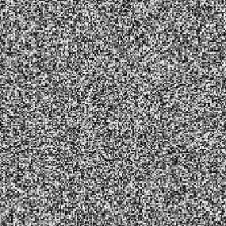
Random numbers
No correlation between numbers (samples)
Any number can come after any number

Slide 19
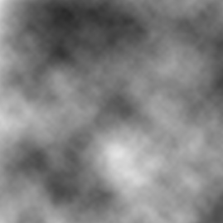
Value noise
Interpolates between random numbers

Slide 20
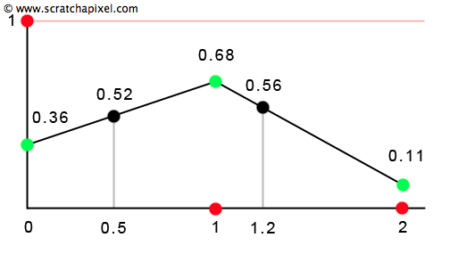
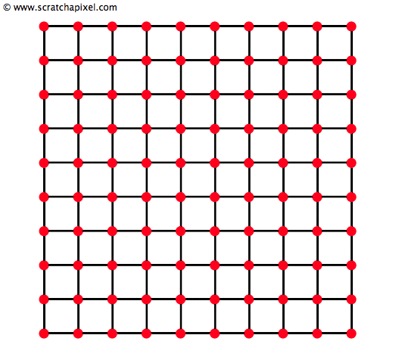
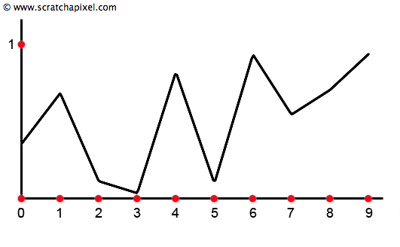
Value Noise

Slide 21
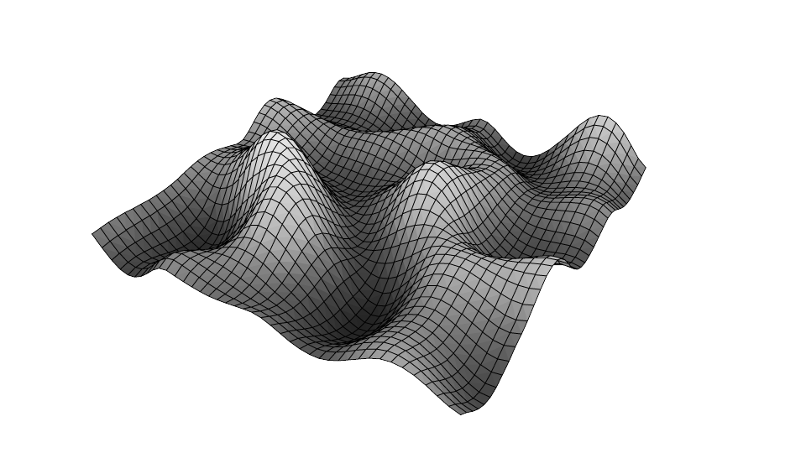
Value Noise
Getting somewhere
Too smooth
Equally chunky everywhere

Slide 22
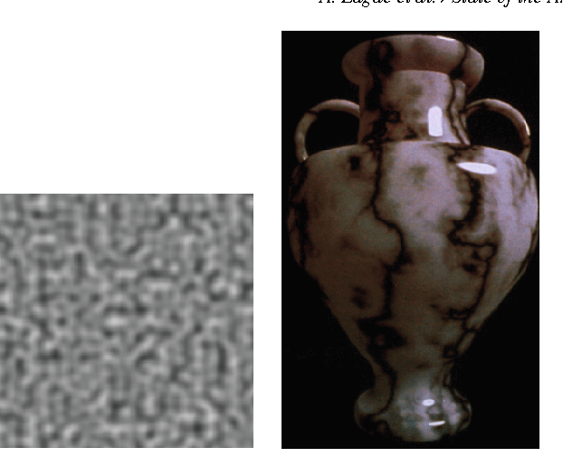
Other noise
Perlin noise : the original one
Often interchangeable
Value noise is usually better, especially on the gpu

Slide 23
This class
Procedural generation
Noise
→ Applications of noise ←
Other primitives

Slide 24

Making it better : fBm

Slide 25
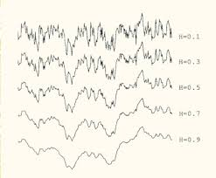
fBm: fractal Brownian Motion
Add several layers value noise
Make each layer smaller, in all dimensions

Slide 26
This class
Procedural generation
Noise
Applications of noise
→ Other primitives ←

Slide 27
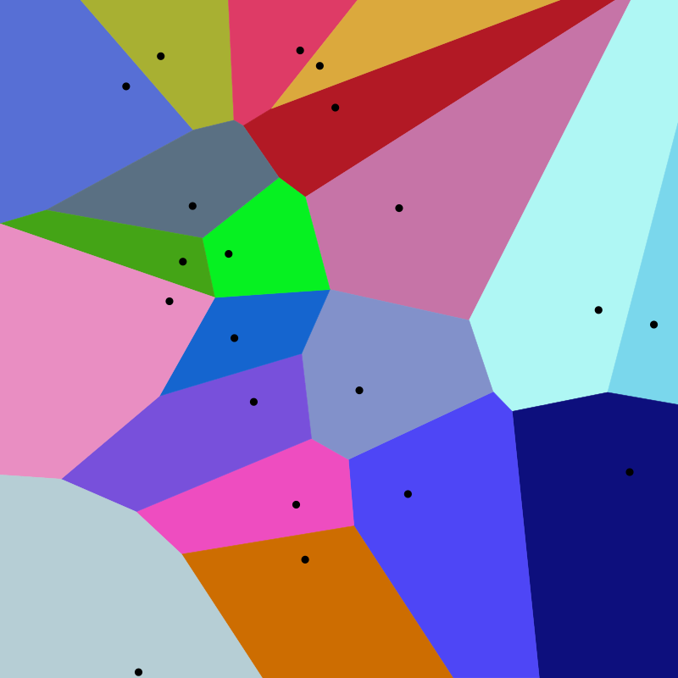
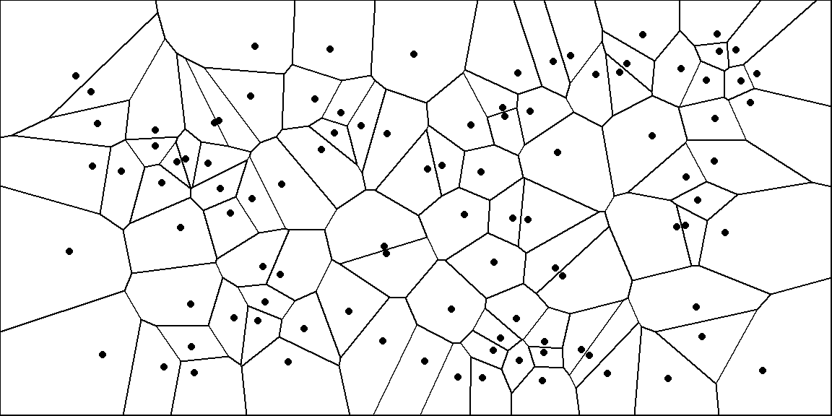
Voronoi
Generate random points
Assign random value to point
Sample: take closest point’s value

Slide 28
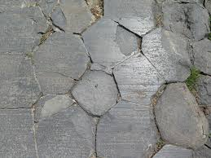
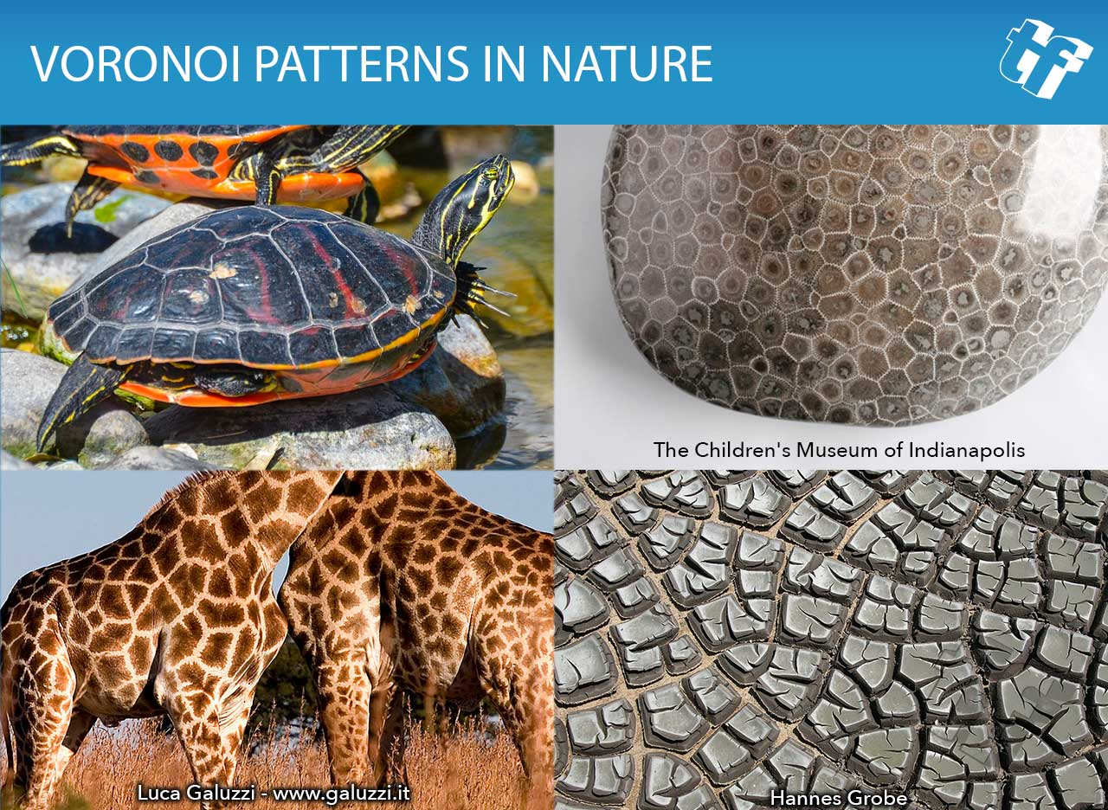
Voronoi applications

Slide 29
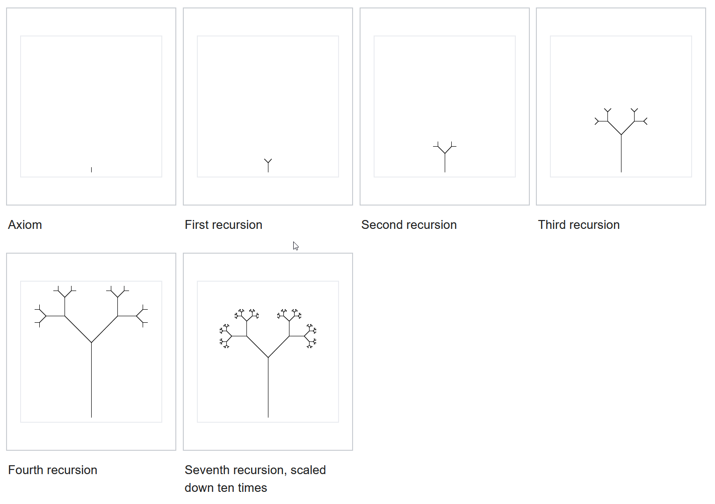
L Systems

Slide 30
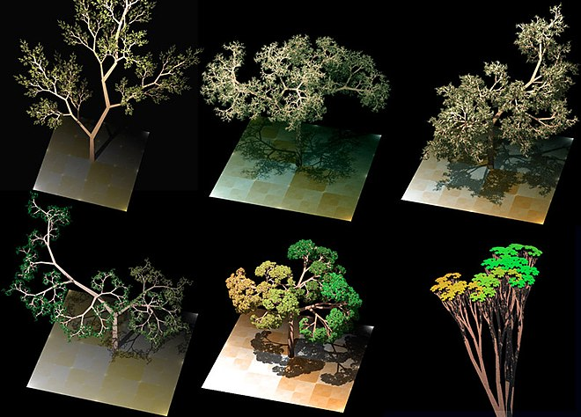
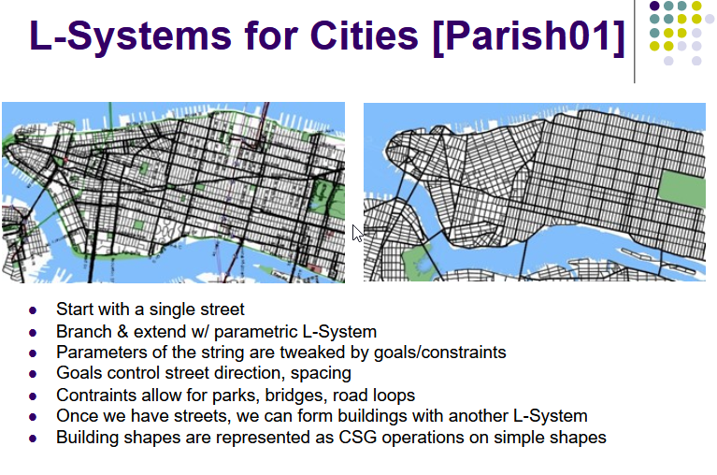
L Systems

Slide 31


Slide 32
Recap
Procedural generation can be used to optimize size, artist time, or enable worlds otherwise impossible
Noise is different than a random value
Noise is an important building block
Other primitives exist, like Voronoi

Slide 33
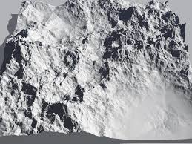
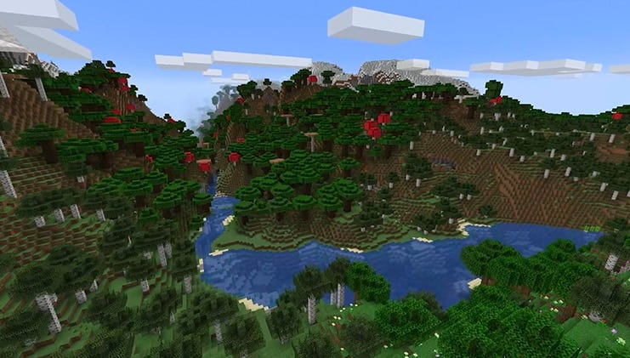
Next class
More pratical procedural generation

