Slide 1
Week 8a: Advanced Pipeline

Slide 2
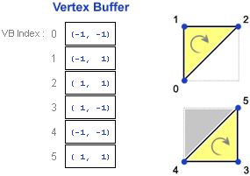
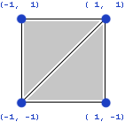
Last class
Creating meshes in code
Creating textures ins code

Slide 3

Course schedule
 | Monday | Thursday
Week 1 : 12/02 | Introduction | C#/Unity Lab
Week 2 : 19/02 | 3D reasoning | 3D Lab
Week 3 : 26/02 | Basic Pipeline | Lab
Week 4 : 04/03 | Textures | Normal maps Labs
Week 5 : 11/03 | Post processing | Camera’s Light
Week 6 : 18/03 | Materials | Aliasing Materials Lab
Week 7 : 25/03 | Procedural generation Theory | Procedural generation Practice
Week 8 : 15/04 | Advanced pipeline | Procedural lab explanation
Week 9 : 22/04 | Project explanation | Project lab
Week 10 : 29/04 | Guest Lecture Project Labs | Guest Lecture Project Labs
Week 11 : | Problem solving 101 | Problem solving 101

Slide 4
I’m still behind on the labs ☹
Will post ASAP and push notify on Toledo
Last lab of this course
Remember : Deadline 28 / 04

Slide 5
This class
→ Quick recap←
Procedural Textures

Slide 6
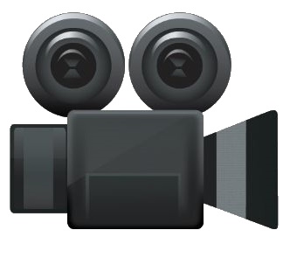

Light transport
Light hits an object
That light bounces
It enters our eye

Slide 7
Light transport
Light hits an object
That light bounces
In many directions
Some materials more than others
Some of it enters our eye

Slide 8
Light transport
Light hits an object
That light bounces
In many directions
Most hit another object (and bounce again)
Some of it enters our eye

Slide 9

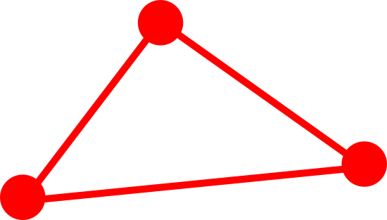


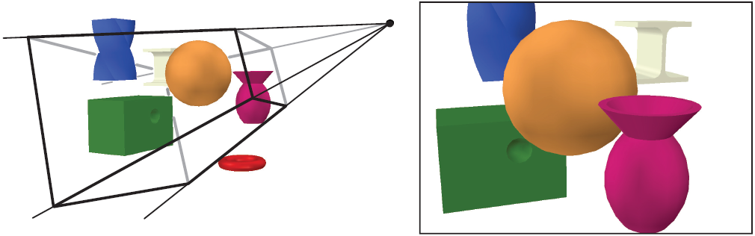
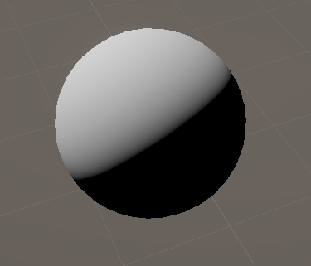
GPU Pipeline
Transform vertices
Rasterize
Calculate pixel color

Slide 10
We need an algorithm to render multiple objects / lights
Raytracing is one way, but it’s inefficient (slow)
Forward rendering
Deferred rendering

Slide 11
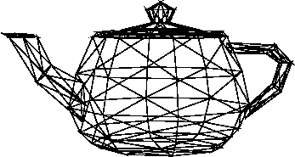
Forward rendering
For each object
Give it all the lights (in fragment shader)
Calculate final pixel color
We’ve been doing this in our unlit shaders
+

Slide 12
Forward rendering : advantages
Complete freedom in choosing your materials (that’s why we used it in labs)
Supports transparency

Slide 13
Forward rendering : disadvantages Permutations
Can write a shader that supports all possible light combinations
Eg Array of spotlights, array of pointlights
Loop through all arrays
But this is slow
Solutions is to create multiple shades
Create a shader for each situation: 1 spot, 2 spot, 1 spot + 1 point
This is known as the permutation problem

Slide 14
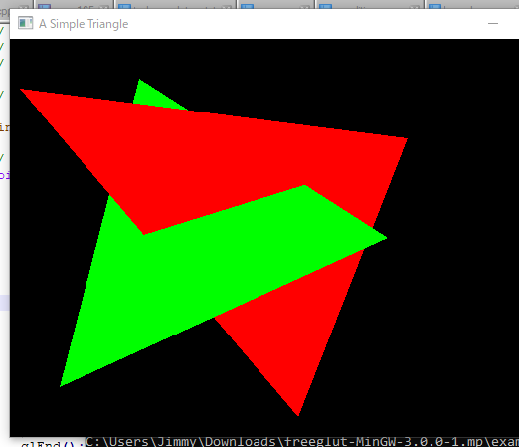
Forward rendering : disadvantages Overdraw
Can shade a pixel that is discarded due to the depth buffer
But we shaded it with an expensive material, multiple lights
Just to throw is away at the last second

Slide 15
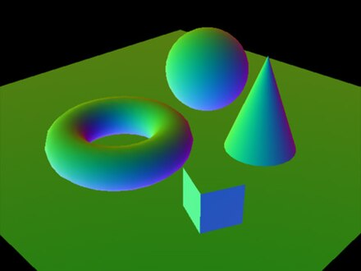
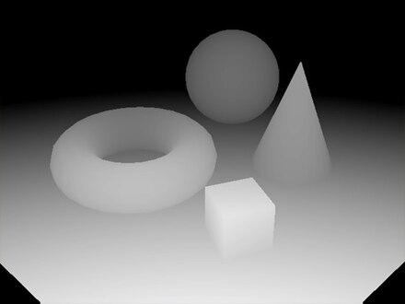
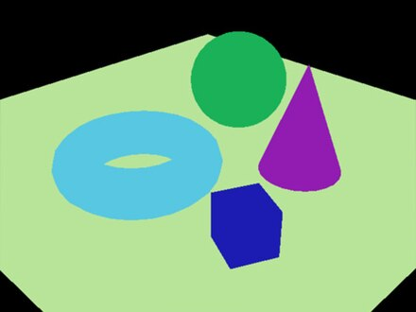
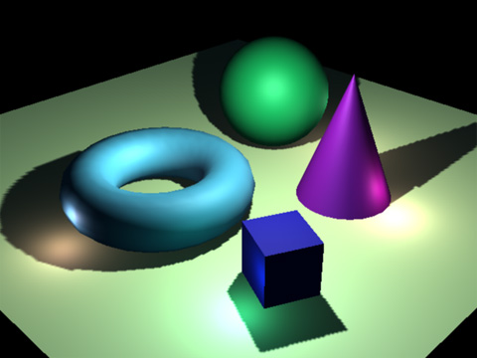
Solution : deferred rendering
Decouple everything
Render objects (normal, position, texture coordinates, material parameters) We render into a Gbuffer, a texture with information needed for the material
Render lights, applying material

Slide 16
Deferred rendering : advantages
No shader permutations
No shading of invisible pixels

Slide 17
Deferred rendering : disadvantages
Much less flexibility for material (eg Unity is always GGX)
No transparency (why?)

Slide 18
What do you think modern games use?

Slide 19
Using both solves a lot of problems
Deferred for most object
Forward for transparent and custom objects
Most disadvantages mitigated
Lot of implementation effort
Btw, how many graphics programmers for a AAA game?

Slide 20
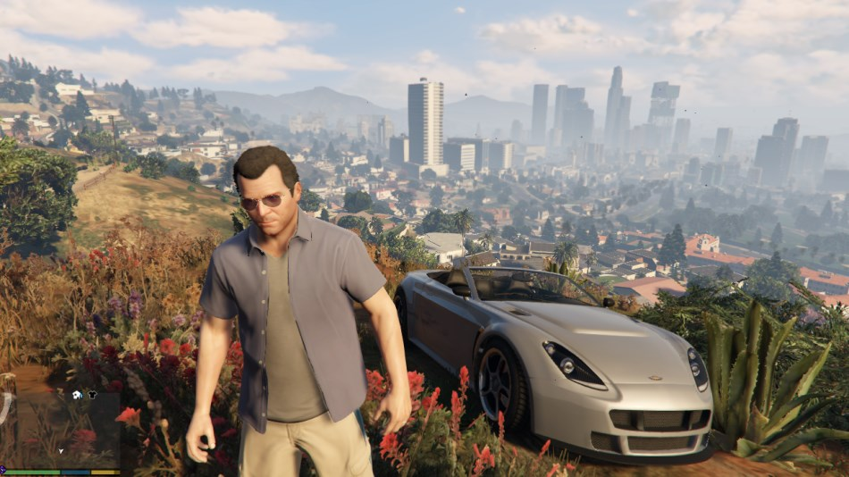

Slide 21
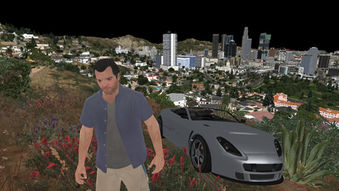
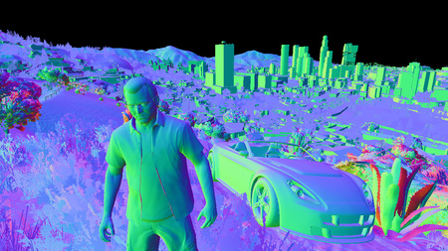
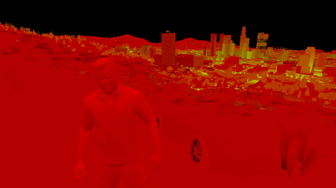
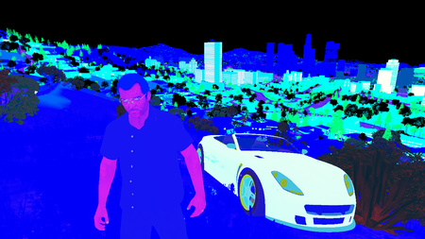

Slide 22
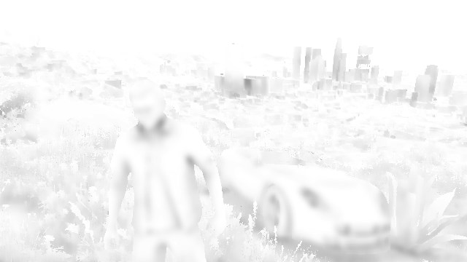

Slide 23
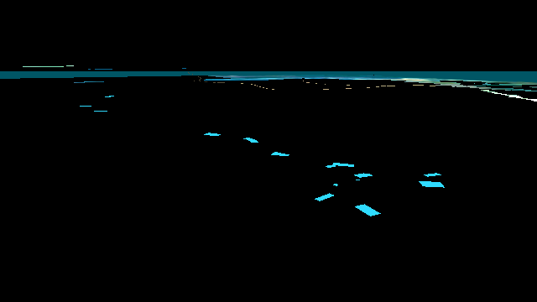
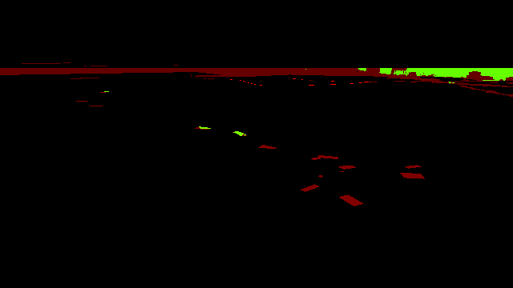

Slide 24
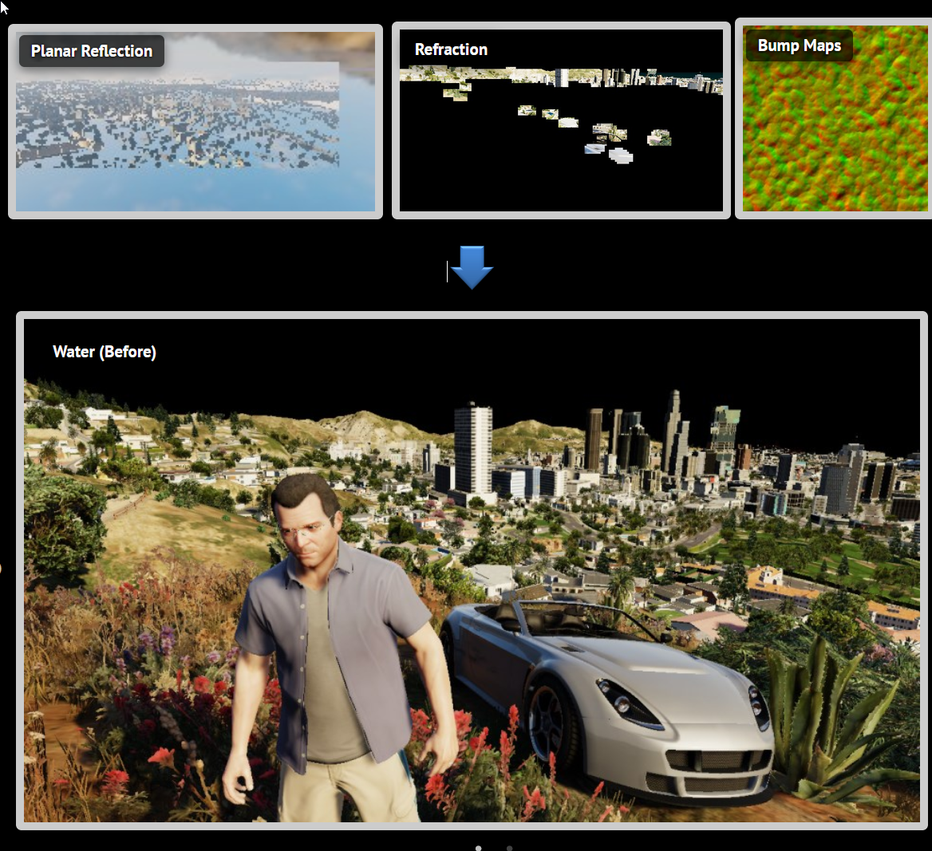

Slide 25
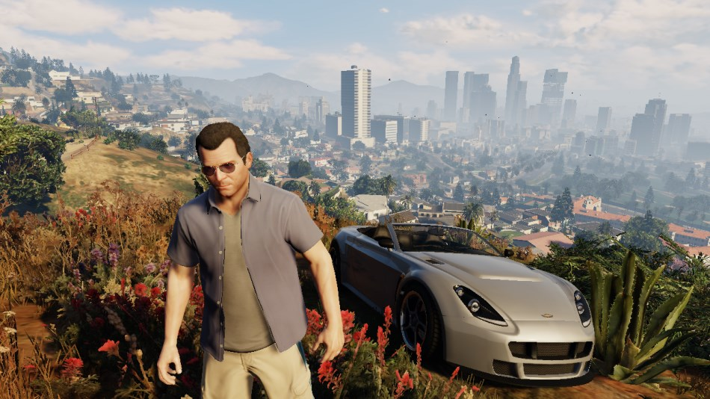

Slide 26
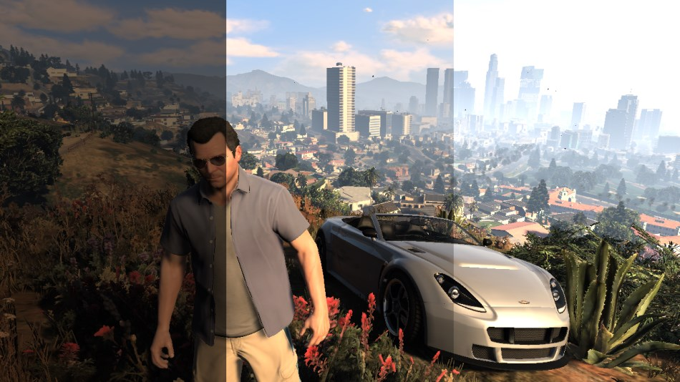

Slide 27
Next class
Procedural lab explanation

