Slide 1
Week 9b: Project

Slide 2
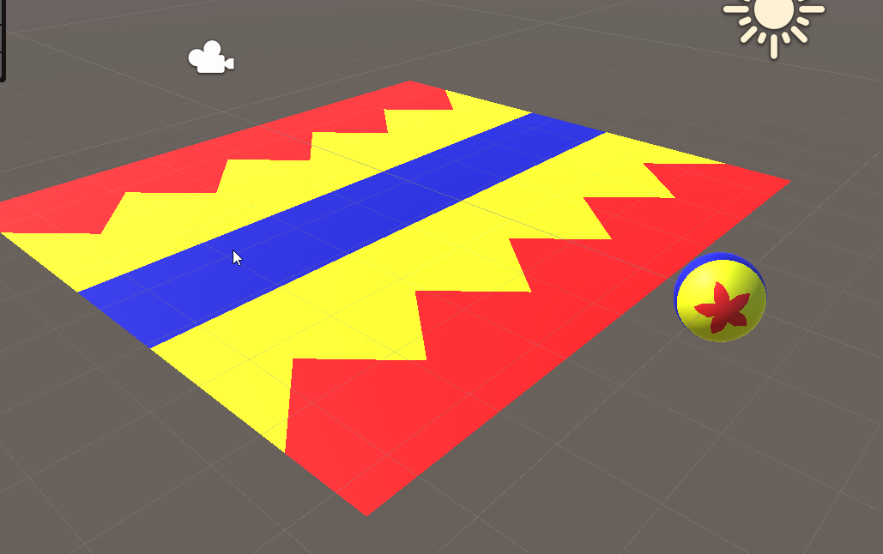
Last class
“Solved” the pixar ball

Slide 3

Course schedule
 | Monday | Thursday
Week 1 : 12/02 | Introduction | C#/Unity Lab
Week 2 : 19/02 | 3D reasoning | 3D Lab
Week 3 : 26/02 | Basic Pipeline | Lab
Week 4 : 04/03 | Textures | Normal maps Labs
Week 5 : 11/03 | Post processing | Camera’s Light
Week 6 : 18/03 | Materials | Aliasing Materials Lab
Week 7 : 25/03 | Procedural generation Theory | Procedural generation Practice
Week 8 : 15/04 | Advanced pipeline | Cancelled
Week 9 : 22/04 | Lab 07 explanation | Project explanation
Week 10 : 29/04 | Project explanation 2 | Guest Lecture Project Labs
Week 11 : | Problem solving 101 | Holiday

Slide 4
This class
→ Project details ←
Blocks
Chunks
Chunk spawning

Slide 5
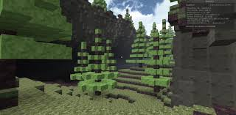
Project details
Toledo assignment and project document on Monday ☹
But you can already start ☺
It’s Minecraft, mostly block rendering / adding / removing
We’re using the 3D (core template for the assignment)

Slide 6
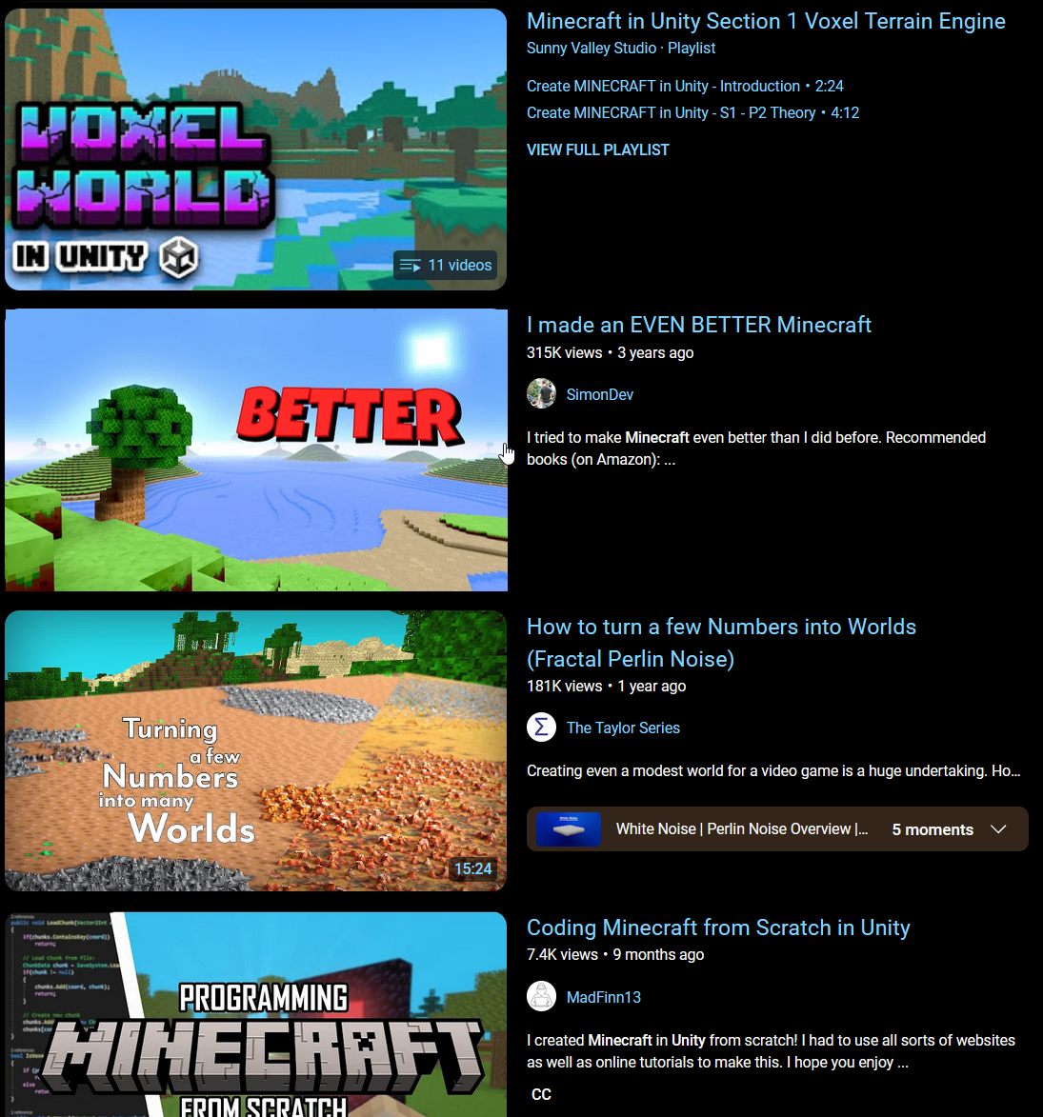
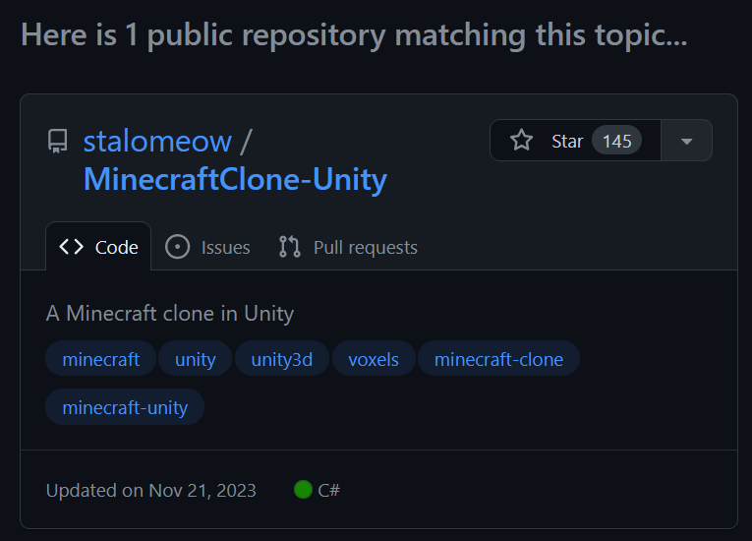
Complications : tons of content already
Bad : want this to be more than following a tutorial
Good : happy that it’s there, want you to use the tutorial

Slide 7
Complications : post processing is tricky
I really want a post processing part
There’s a ton of **** in Unity, Kaspar is pointing me in the right direction

Slide 8
This class
Project details
→ Blocks ←
Chunks
Chunk spawning

Slide 9
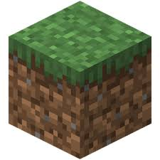
Blocks
Our terrain is made out of blocks
1 unit wide
Axis aligned (no rotation)
Different blocks can have different materials

Slide 10
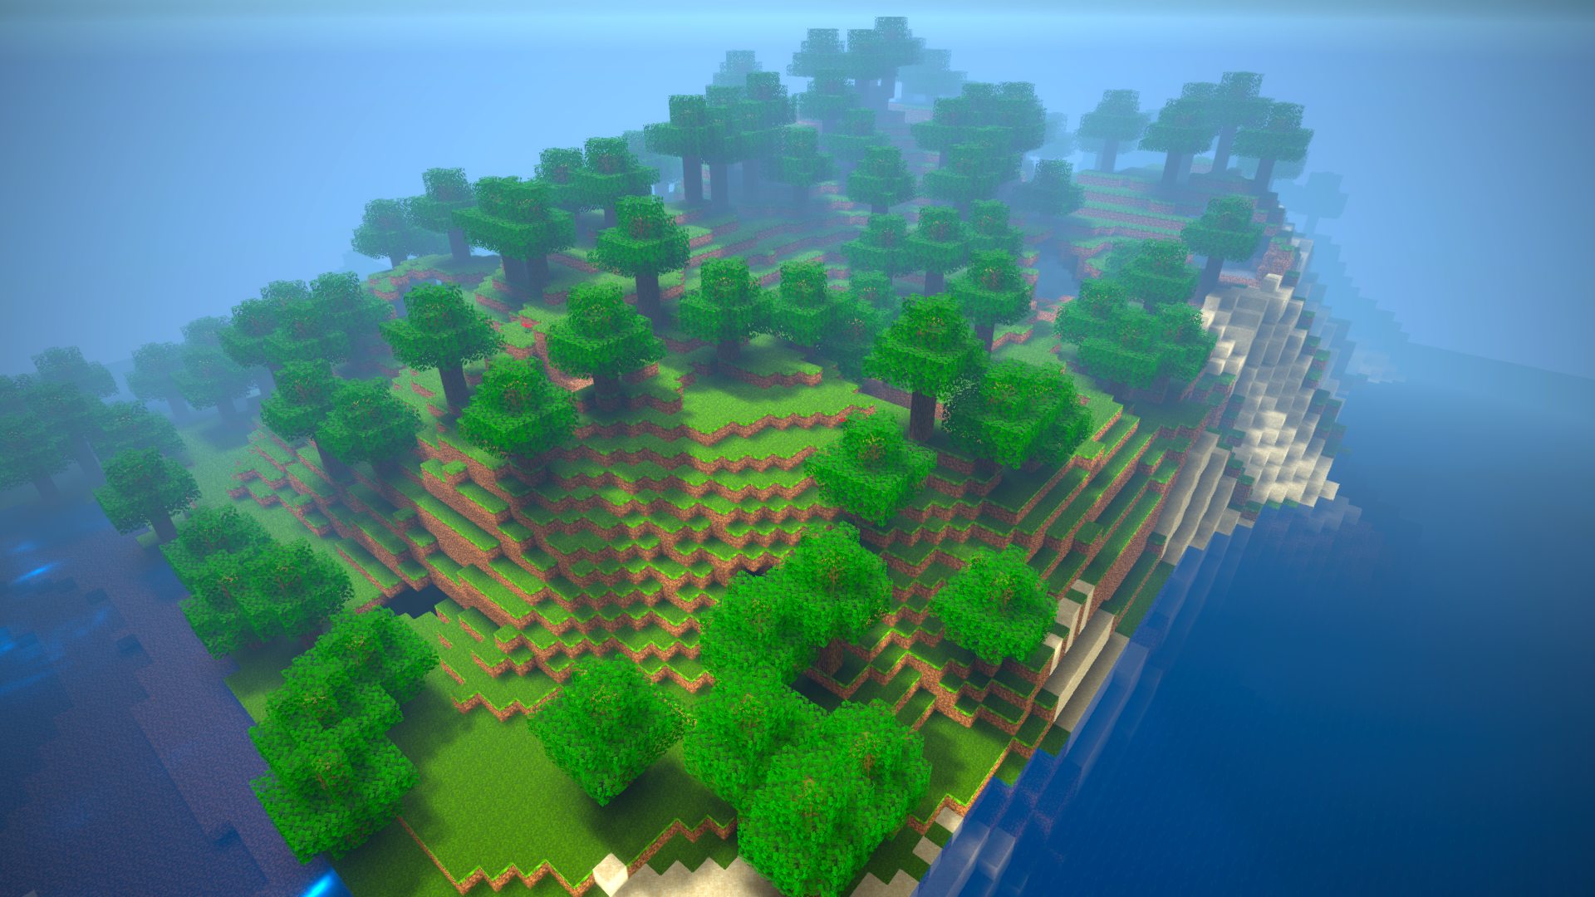
How would you render this?

Slide 11
Not as cubes
We see thousands of cubes
This is possible to render, but we have a hundred thousand cubes in the ground
We need a smarter system

Slide 12
This class
Project details
Blocks
→ Chunks ←
Chunk spawning

Slide 13
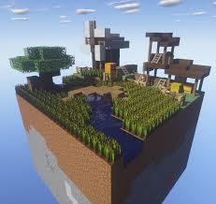
We render chunks
Chunks are a 3d grid of blocks
We can create 1 mesh for the entire chunk
… or 1 mesh per type of block (materials)

Slide 14
Generating this mesh is a fun exercise
For each block type, generate the vertices and indices of the box
Optimize : share the indices
Optimize : remove shared faces (face == square of the box)
Optimize : can we put several block types in the same mesh?

Slide 15
This class
Project details
Blocks
Chunks
→ Chunk spawning ←

Slide 16
When to create a chunk?
Our terrain is infinite
Our memory is not
How do we choose when to create a chunk?

Slide 17
Algorithm
Set a maximum amount of chunks (eg 100)
Every frame, “score” all chunks within a reasonable distance
Check what the 100 chunks with the highest score are
Do you have a chunk loaded < 100 ? Unload
Load highest scoring

Slide 18
Scoring
Distance from camera
Improvement : only in front of the camera
Improvement : only in frustum

Slide 19
Terrain generation
What algorithm should we use?
What space should we use?

Slide 20
Next class
Post processing
If I drop it, something else project related

