Slide 1
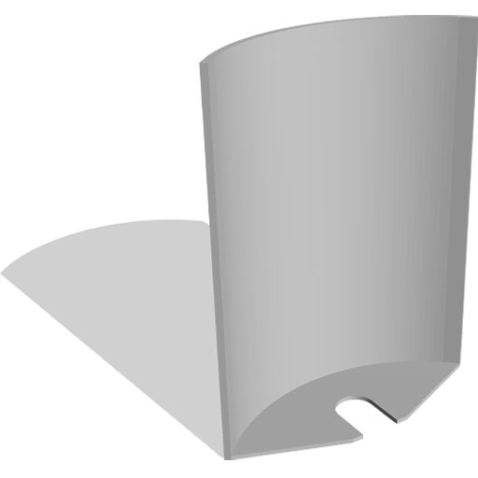
Walter Creations – Business Card Maker
Harvey Walter

Slide 2
Problem Description
There are many creative tools
They are all over the place
They are not well known

Slide 3
Why it Matters
Lack of Accessibility
Wasted Time
Inconsistency

Slide 4
Existing Solutions
- (and their limits)​
Adobe Suite
Canva
Online tools (10015.io, TinyWow, PineTools, etc.)

Slide 5
Realizing the Need
Needing tools & clipart
Discovering & finding quick fixes online
Enjoying convenience

Slide 6
Discovery & Research
Many tools online
Lots of variation
Frustration in utility

Slide 7
Proposed Solution
An online platform for hosting online tools
A library of already existing ones
The ability to make and add more
A unified web-based creative platform

Slide 8
The Foundation
Collection of tools
Shared global js and css
Separate navbar.html
Consistent layout
Day/night mode
Ability to Expand

Slide 9
Core Features
Shared navigation
Reusable UI components
Mobile Responsive

Slide 10
Website Architecture
Separate navbar.html
Rigid File Structure
Separate files for tools
Separate html, js, and css for all tools
Global css and js + night mode

Slide 11
Design Decisions
Button standardization
Typography
Mobile compatibility

Slide 12
Implementation Steps
Initial tools
Navbar.html creation
Day/Night mode
ChatGPT

Slide 13
Risks & Constraints
Time limitation
Solo development
Knowledge limitation
JS
ChatGPT

Slide 14
Evaluating Purpose
Is it intuitive
Is navigation consistent

Slide 15
Evaluating Usability
Informal testing
Accessibility
Mobile responsiveness

Slide 16
Success Criteria
Ease of use
Expandability
Maintainability

Slide 17
Results & Impact
What worked
What surprised me
What does the platform demonstrate

Slide 18
Lessons Learned
Website architecture
Scope management
UX thinking

Slide 19
Future Work & Ambition
More tools
Better searchability
User accounts
Other avenues

Slide 20
Self-Evaluation
Strengths: (initiative, vision)
Weaknesses: (knowledge, time management)
Growth as a developer / designer
What would I do differently

Slide 21

Q&A

