Slide 1




Project Demonstration · Group 11
Basecamp
At a glance
All-in-one
Messages, to-dos, files, calendar and chat in a single project
Managing a Capstone Project with an all-in-one collaboration tool
Built for teams
Invite members, assign work, notify the right people
What is Basecamp?
Basecamp is a web-based project management and team collaboration platform built by 37signals. Instead of spreading work across email threads, chat apps, spreadsheets and shared drives, Basecamp puts everything a project needs in one place: discussions, tasks, files, schedules and status updates. Every project gets its own space where the whole team can see who is doing what, by when, and what has changed.
Transparent
A live activity feed shows every change as it happens
Asynchronous
Automatic check-ins replace routine status meetings
Notes:
Basecamp is a web-based project management and collaboration tool from 37signals. It replaces scattered email, chat, spreadsheets and shared drives with one shared space per project. In our demo we used it to run our capstone project end to end.

Slide 2








The building blocks of a Basecamp project
Message Board
To-dos
Docs & Files
Card Table
Announcements and threaded discussions in one place
Task lists with assignees, due dates and subtasks
Central storage for documents, reports and media
Kanban board to move work from triage to done
Automatic Check-ins
Calendar
Email Forwards
Chat
Recurring questions that collect progress updates
Shared schedule of deadlines and milestones
Forward outside emails straight into the project
Real-time group chat for quick conversations
Notes:
Every Basecamp project is made of these tools. In our demo we used the Message Board, To-dos, Docs & Files, Card Table, Automatic Check-ins and the Calendar.

Slide 3
Our demo: Capstone Project Management System
The scenario
We created a Basecamp project to run a capstone project from start to submission. The work involved:
Collecting datasets from GovInd
Feature engineering and training a model
Building and deploying a frontend dashboard
Submitting code files and the final report
Team members in the project
VS
Vedika Shetty
Created the project, posted the brief, set up to-dos, check-ins and files
J
Jainam
Shared the code on GitHub and set up the Frontend Dashboard card
VP
Vansh P.
Added to the project; receives check-ins and tasks
Notes:
Our demo project was the Capstone Project Management System. We set it up the way a real student team would use it, with three members and real tasks: datasets, model training, a frontend dashboard and the final submission.

Slide 4
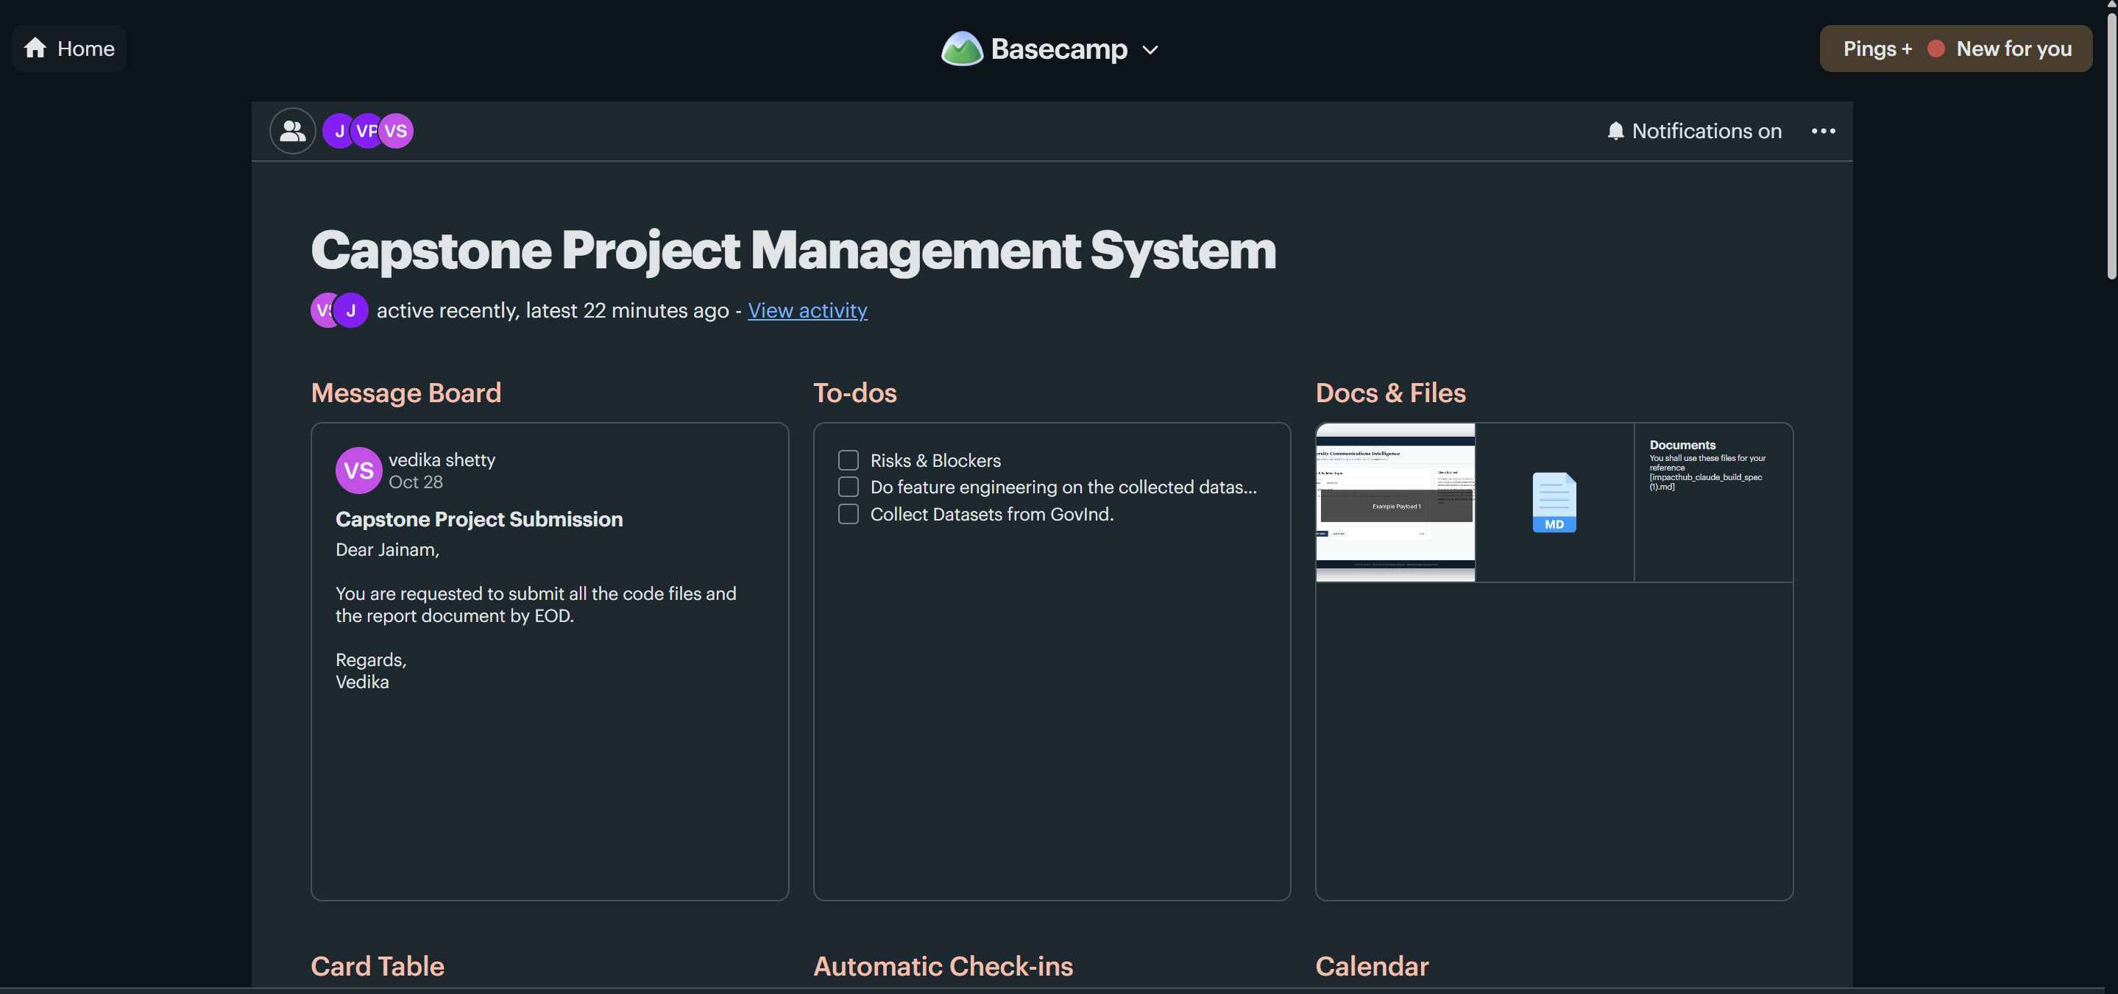
Project home: Message Board, To-dos and Docs & Files
Message Board
A “Capstone Project Submission” post asks the team to submit all code files and the report by EOD.
To-dos
Three task lists: Risks & Blockers, Feature engineering & model training, and Collect Datasets from GovInd.
Docs & Files
The demo video, project proposal and reference documents are stored for the whole team.
Notes:
The project home is the single dashboard for the whole project. Everything the team needs is one click away.

Slide 5
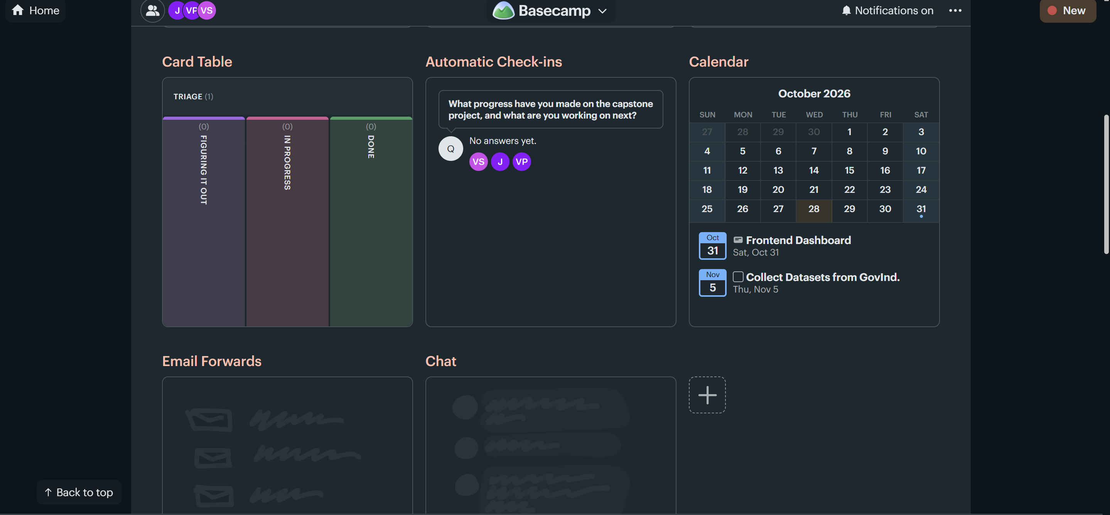
Card Table, Automatic Check-ins and Calendar
Card Table
A Kanban board with Triage → Figuring it out → In progress → Done columns.
Automatic Check-ins
A recurring question asks VS, J and VP what progress they have made and what comes next.
Calendar
Deadlines are visible to all: Frontend Dashboard (Oct 31) and Collect Datasets (Nov 5).
Notes:
These tools cover planning and tracking: the card table visualises workflow stages, check-ins collect updates without meetings, and the calendar shows every deadline.

Slide 6
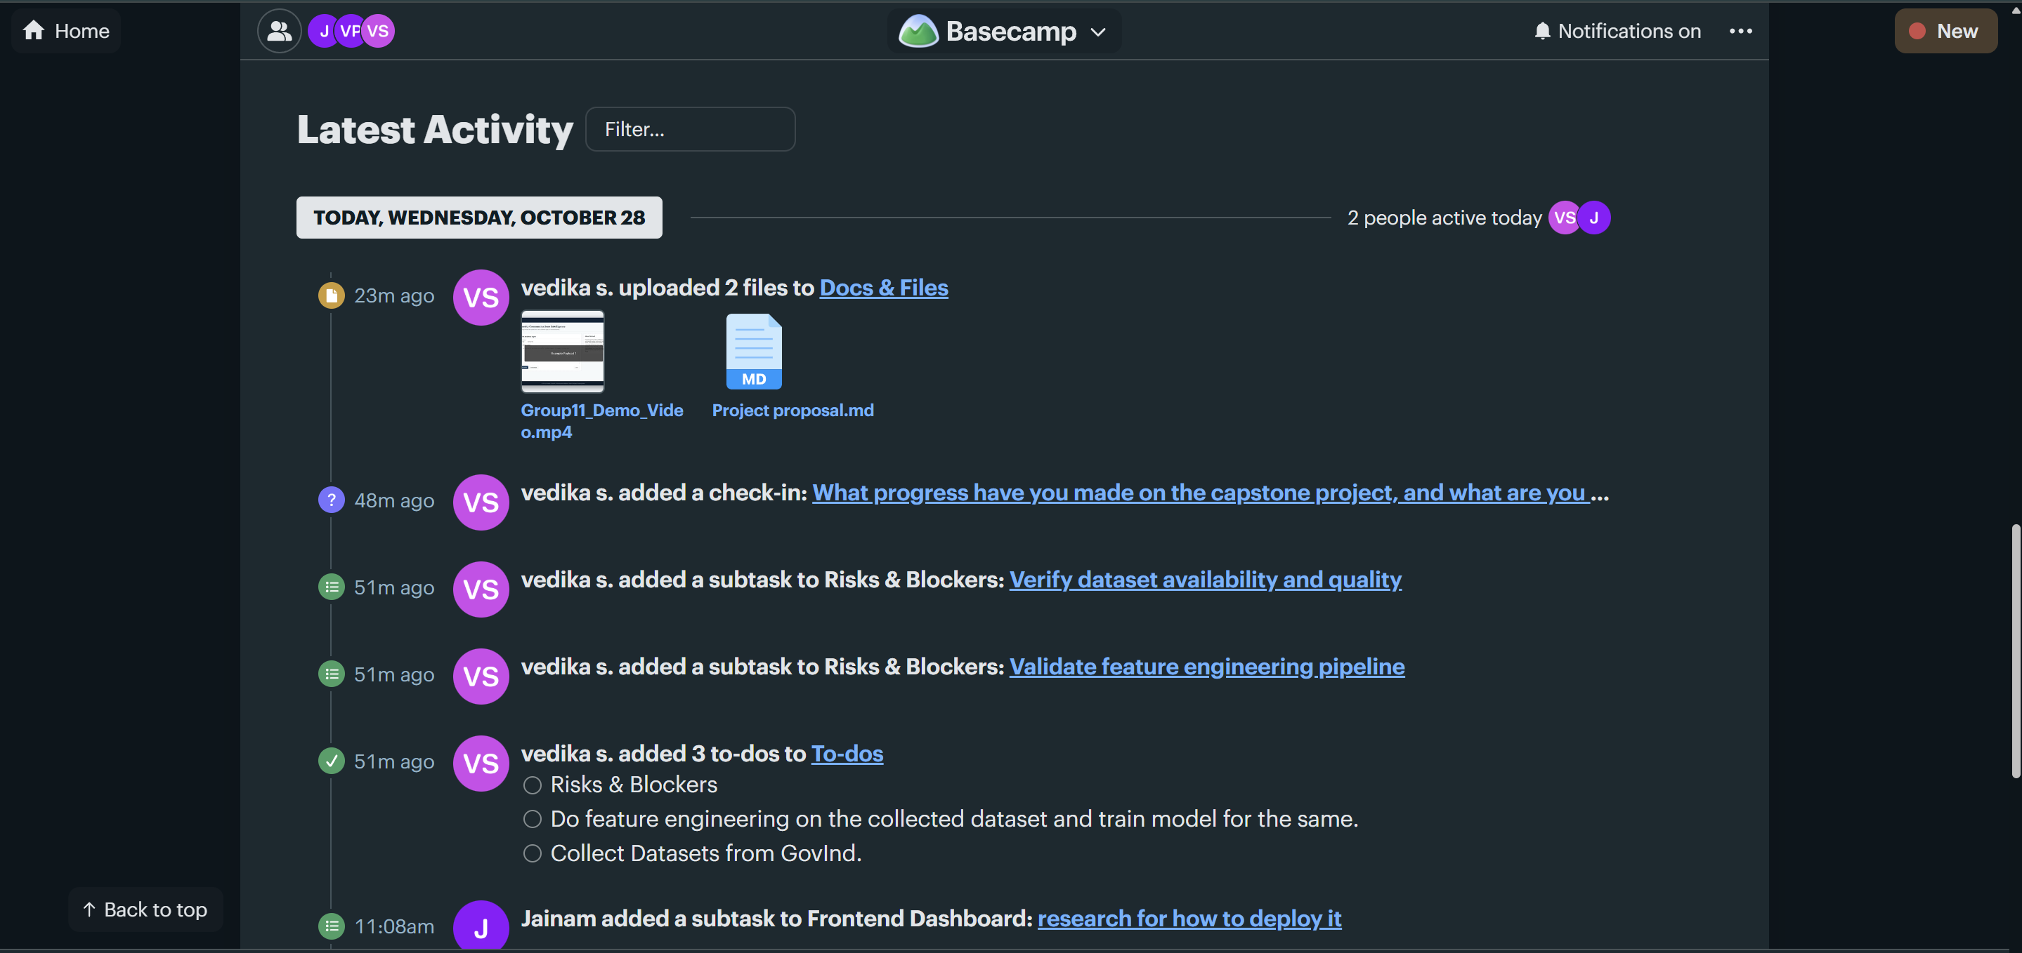
Latest Activity: every update in one feed
Files uploaded
Group11_Demo_Video.mp4 and Project proposal.md added to Docs & Files.
Check-in added
A progress question scheduled for the whole team.
Subtasks & to-dos
“Verify dataset availability and quality” and “Validate feature engineering pipeline” added under Risks & Blockers, plus three new to-dos.
Notes:
The Latest Activity feed is a live log of everything that happens in the project, with who did it and when. Nobody has to ask what changed.

Slide 7
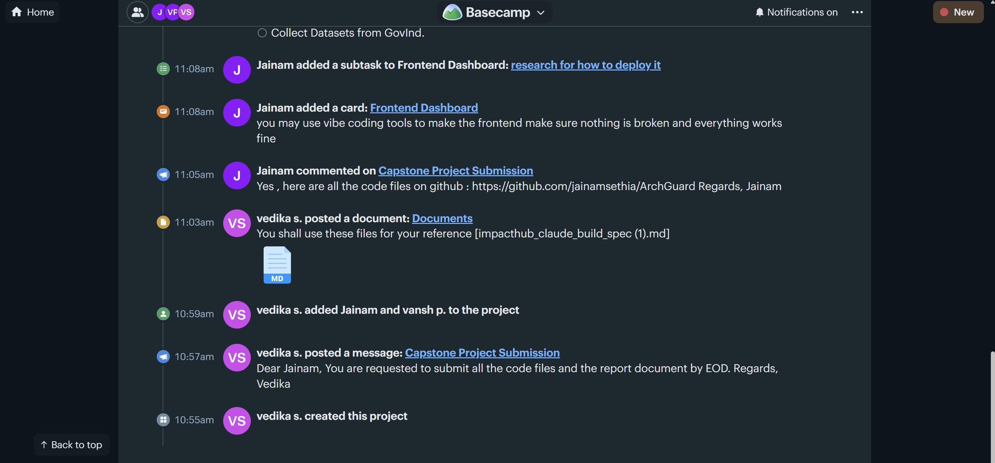
Activity history: how the project was built
10:55 – 10:59
Project created, submission message posted, Jainam and Vansh added to the team.
11:03 – 11:05
Reference document posted; Jainam replied with the code on GitHub (ArchGuard).
11:08
Frontend Dashboard card created with a subtask: research how to deploy it.
Notes:
Scrolling further down the activity feed shows the full history of the demo, from creating the project to assigning the frontend work.

Slide 8



Demo workflow, step by step
01
02
03
04
05
06
Create
Invite
Communicate
Plan
Track
Deliver
Set up the “Capstone Project Management System” project
Add teammates so everyone sees the same project
Post the brief on the Message Board; reply in comments
Break work into to-dos, subtasks and Card Table cards
Set deadlines on the Calendar and schedule check-ins
Share the code link, demo video and proposal in Docs & Files
Notes:
This is the flow we followed in the demo: create the project, invite the team, communicate, plan, track and deliver. Each step uses a different Basecamp tool, but all of them live in the same project.

Slide 9

What we observed from the demo
Single source of truth
Brief, tasks, files, code link and deadlines all sat in one project instead of separate apps.
Clear accountability
Each to-do and card has an owner and a due date, so responsibilities were never in doubt.
Fewer status meetings
Automatic check-ins gathered progress from every member asynchronously.
Full transparency
The activity feed recorded every action with a timestamp, making progress easy to review.
Notes:
The demo showed four clear benefits: one place for everything, clear ownership, fewer meetings thanks to check-ins, and full transparency through the activity feed.

Slide 10
Conclusion
Using Basecamp, our team managed the complete life cycle of the Capstone Project — from creating the project and assigning work to tracking deadlines and submitting deliverables — without switching between tools. Its simple, organised structure made collaboration faster and kept every member informed at every stage.
Thank You
Questions & Discussion
Notes:
To conclude, Basecamp let our team run the full capstone project from one place. Thank you — we are happy to take questions.

