Slide 1
Line Go Up
Harvey Petersen Madeline Gesquiere

Slide 2
Design
Extract data from Twitter API and Yfinance API
Create multiple reports
Output data to a website at the press of a button

Slide 3
Tools
Python
HTML
PHP
CSS
WAMP
JSON

Slide 4
Concepts
Engagement – measure of interaction with Twitter content
Percent Change – change in stock’s price as a percent of its price
Trade volume – the number of stocks bought and sold in a day
Volatility Index – our way of measuring the correlation between these values

Slide 5
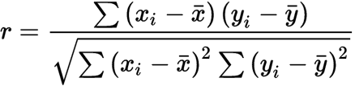
The Math
Twitter engagement:
Like – 1 point
Retweet – 2 points
Quote tweet – 3 points
Comments – 4 points
Correlation Coefficient

Slide 6
Issues
Can only pull data from the last 7 days
Learning curves
Formatting data
Building Database of Sample Data

Slide 7
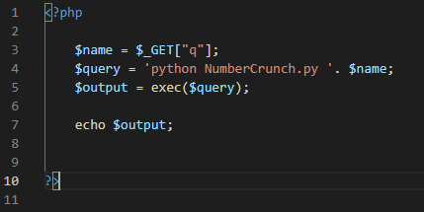
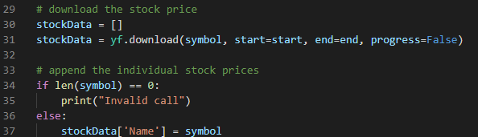
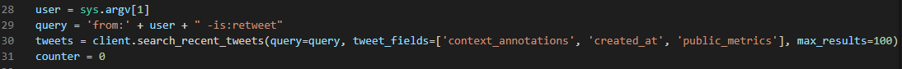
Code Snippets

