Slide 1


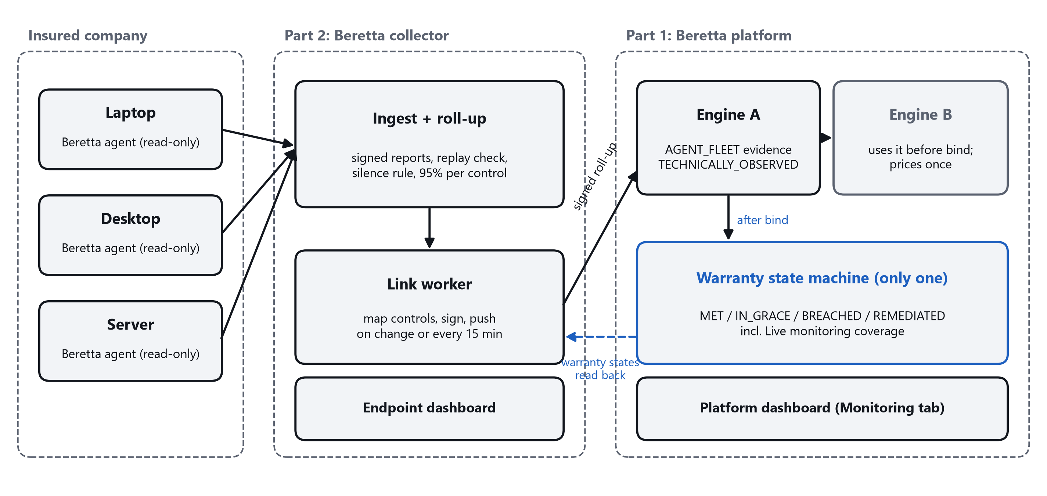
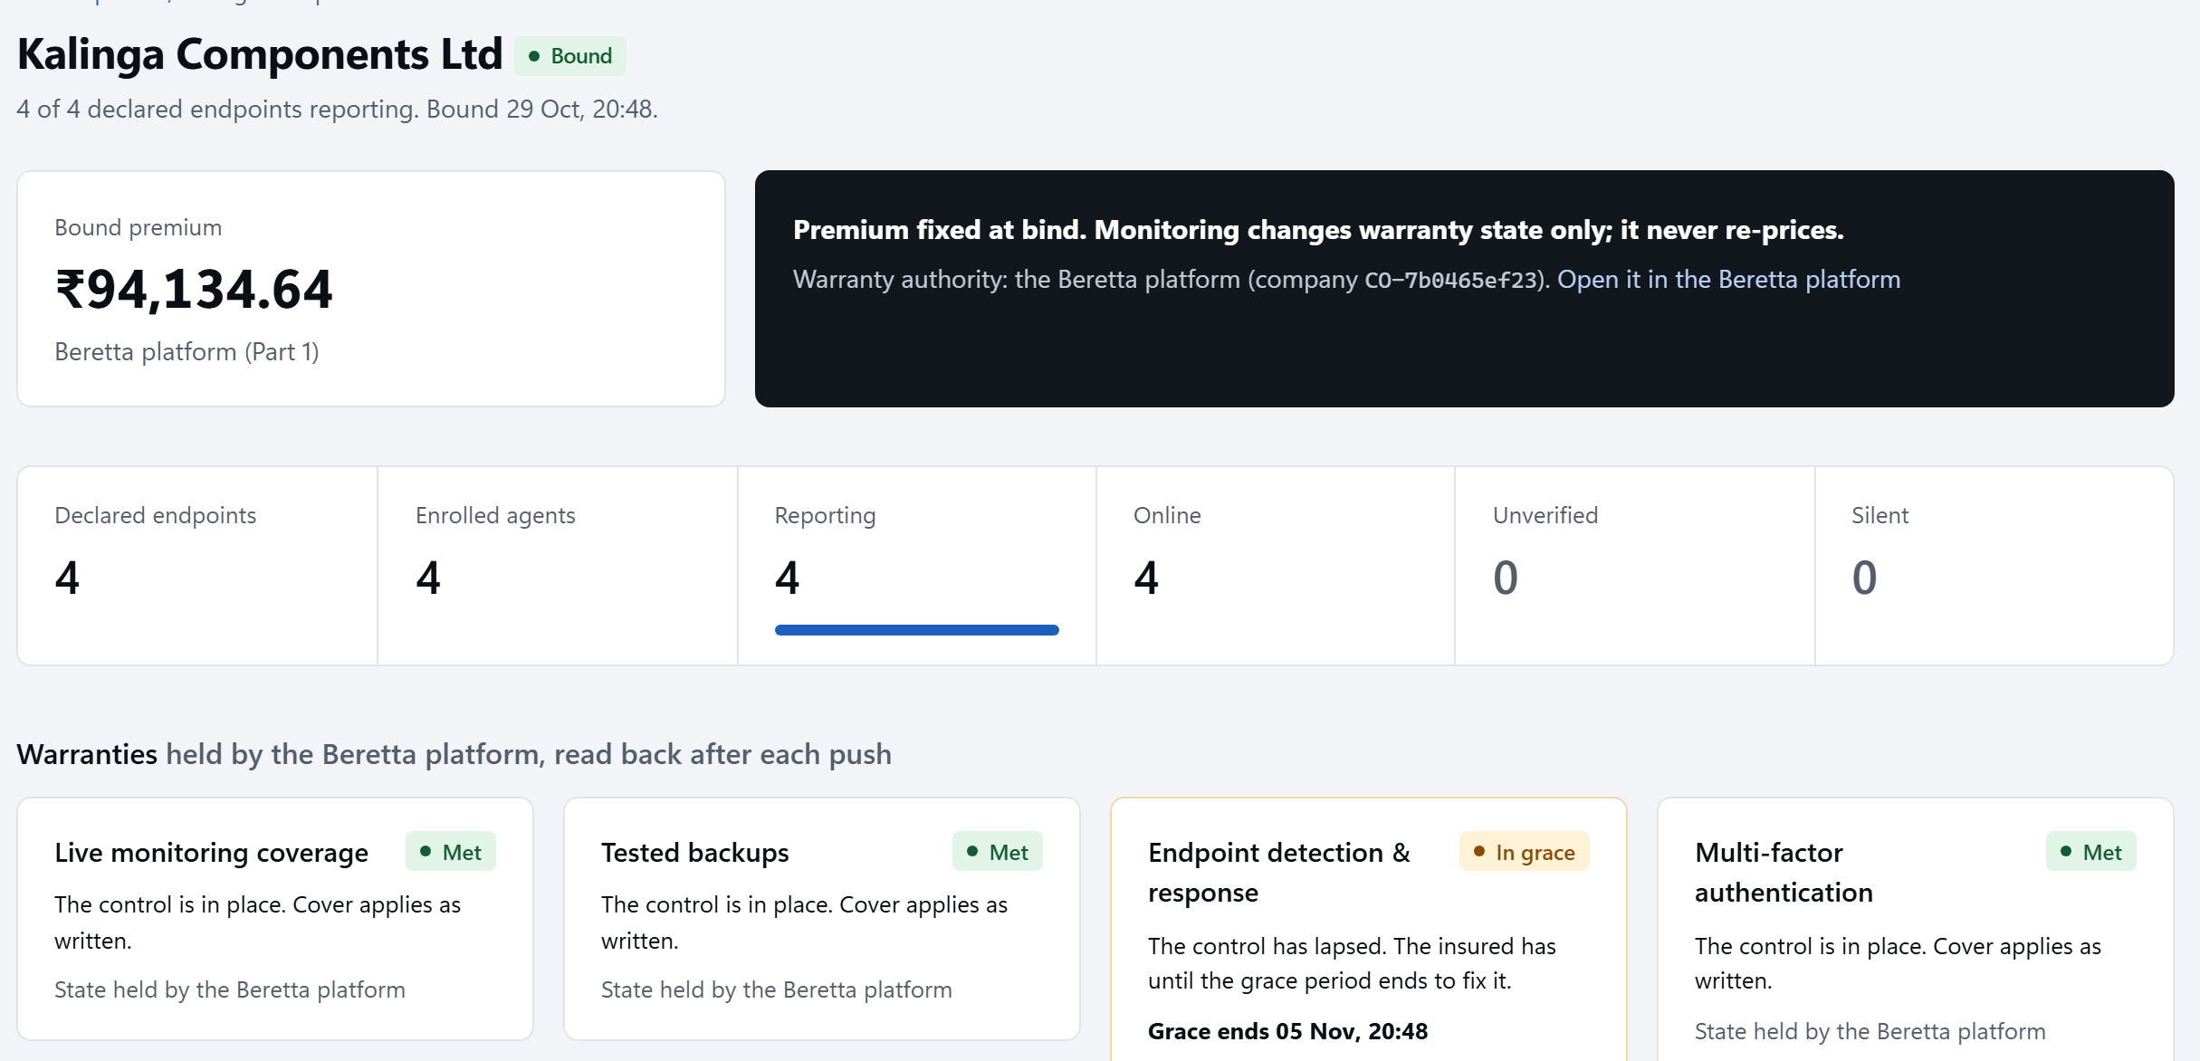
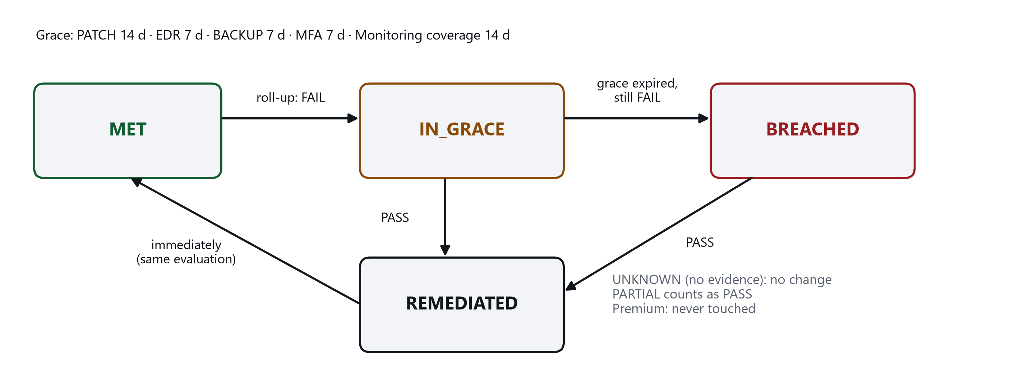
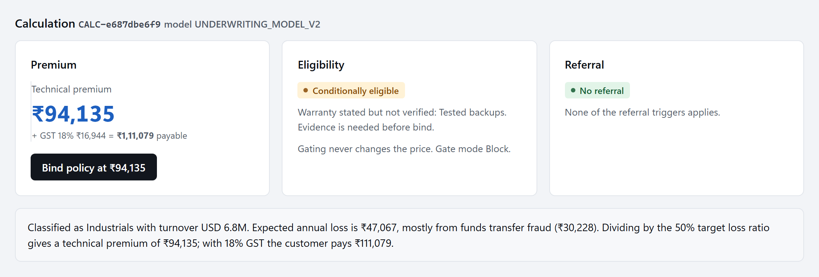
An Explainable Automated Cyber-Insurance Underwriting and Continuous Monitoring Platform
Capstone Project · Group 19 · B.Tech CSE (Cybersecurity) · MPSTME, SVKM’s NMIMS, Mumbai · 2026-27
Krish Mundhra (K041) · Harsh Rathod (K080) · Yugandhara Goud (K023) Faculty Mentor: Prof. Rohit Suryawanshi
Abstract
Methodology
Results
Indian SMEs face the same ransomware, email-compromise and payment-fraud attacks as large firms, yet few carry cyber insurance, and the cover they can buy is priced from a self-completed questionnaire that nobody checks again. Beretta is an open prototype that links evidence, pricing, binding and post-bind monitoring in one inspectable pipeline. Evidence for each control is graded from DECLARED to TECHNICALLY_OBSERVED; a frequency–severity engine prices five perils from published claims data; and after bind a read-only agent sends signed reports that move warranty states but never the premium. Every parameter carries its source, and all 224 automated tests pass.
Two engines share one record of evidence. Signed reports flow from the insured’s machines to the collector, and one signed roll-up per company flows to the platform.
System architecture
Problem Statement
Risk engine: grading evidence by strength
224 / 224
₹32,421
1
Priced with traditional thinking
Short, heavy-tailed loss history; premiums rest on revenue and industry.
stronger evidence → more premium credit
automated tests pass (65 platform, 158 agent and collector, 1 end to end)
saved by verifying privileged access alone (worked example)
2
The premium is a black box
The insured cannot see which answer raised it or what would lower it.
DECLARED
DOCUMENTED
TESTED
TECHNICALLY OBSERVED
1.38% vs 1.48%
Under 16%
questionnaire
policy, SOC 2, ISO 27001
restore test, pen test
agent, fleet, scan
modelled peril frequency vs published (1.47% with other claims)
largest premium change from any one assumption
3
One questionnaire, once a year
A self-completed form fixes the price until renewal.
Pricing engine: five perils, priced once
Live demonstration (SIMULATED endpoints)
4
Controls are never verified
A declared “yes” is priced the same as a test result.
Frequency
λ = λ_global × turnover × sector × controls × claims
Severity
lognormal loss, σ = 2.193 (NetDiligence SME claims)
5
A static view of a dynamic landscape
Nothing is checked after bind; gaps surface only at claim time.
Payout
integrated through the retention and the limit
Premium
expected loss ÷ 0.50 target loss ratio, + 18% GST
Market Context
A stated control earns 60% of a verified control’s credit; claims history uses credibility (α = 4.22). Every number carries its source and a tag.
EDR stopped on 1 of 4 machines: the warranty moved to IN_GRACE within seconds, then BREACHED, then back to MET after the fix. The bound premium stayed at ₹94,135, and a re-price was refused.
8.84 crore
Under 5%
After bind: warranties, never the premium
Future Work
enterprises on India’s Udyam portals (2026)
of Indian companies hold cyber cover (estimates)
18.4% a year
₹25.5 crore
A sturdier, more autonomous agent that tracks current threats such as zero-days, staying read-only
More controls monitored, with identity-provider connectors to verify MFA
Better loss models from data, including Indian claims
Policy conditions and limits on the platform, so coverage and payouts appear on the dashboard
macOS and wider OS support
forecast growth in India, against 14.2% worldwide
average cost of a breach in India (IBM 2026)
The gap: premium is concentrated in large firms, underwriting still rests on a self-completed questionnaire, and we did not find an Indian insurer that includes continuous monitoring in its policy. Sources: Ministry of MSME via KNN India; IJIRL (2025); MarketsandMarkets; IBM Cost of a Data Breach 2026.
Every quote explains itself
References
Objectives
[1] Coalition, 2025 Cyber Claims Report, 2025.
[2] NetDiligence, Cyber Claims Study 2025, 2025.
[3] Marsh McLennan, Using Data to Prioritize Cybersecurity Investments, 2023.
[4] H. Bühlmann, Experience rating and credibility, ASTIN Bulletin, 1967.
[5] S. Romanosky et al., Content analysis of cyber insurance policies, J. Cybersecurity, 2019.
[6] D. Woods et al., Mapping the coverage of security controls in proposal forms, JISA, 2017.
Verify declared controls with a read-only agent
Grade evidence by strength
Develop a pricing mechanism from industry data
Make premiums transparent and explainable
Monitor warranties continuously after bind
Give every user an interactive dashboard
The quote shows the premium, what is needed before cover, and how the figure was reached.
Built with
Python standard library
HTML, CSS, JavaScript
SQLite
HMAC-SHA256
TLS
Source code: github.com/harxhhr/beretta-cyber-insurance · Mukesh Patel School of Technology Management & Engineering, SVKM’s NMIMS, Mumbai

