Slide 1

An Explainable Automated Cyber-Insurance
Underwriting and Continuous Monitoring Platform
Krish Mundhra (K041) | Harsh Rathod (K080) | Yugandhara Goud (K023)
Faculty Mentor : Prof. Rohit Suryawanshi

Slide 2
Table Of Content
Project Title
Introduction
Literature Survey
Problem Statement
Project Objectives and Scope
Tools and Technologies used
Market Research
Design Document (external pdf)
Implementation (live)
Future Extensions
References
2

Slide 3
Introduction
The world is going digital, and so are the criminals. Today cybersecurity isn’t just a concept – it isn’t just a feel-good addition, it is a defining factor in an organization’s very existence. With the unprecedented pace at which technology is being developed and adopted, we stand at a pivot where security for and from digital systems decides who survives. Cybersecurity is the final frontier.
Alongside security, a new field is burgeoning – ‘Cyber Insurance’.
Cyber insurance has become a core topic in boardrooms and regulatory frameworks alike, emerging as a key strategy for the mitigation and transfer of cyber risk. However, the new industry has massive gaps, as currently most policies are offered by traditional insurance players. Cyber insurance poses a much more complex and dynamic problem than traditional insurance, and hence there is a requirement for new ideas, technologies and mechanisms to accurately and transparently price cyber risk. For Indian SMEs the need is sharper: the CERT-In Directions require incidents to be reported within six hours, and the DPDP Act allows penalties of up to ₹250 crore.
3

Slide 4
Introduction
“You are either breached and you know it, or you are breached and you don’t know it.”
Everyone is exposed now
Not only banks and IT firms. Any organisation that holds customer information carries the risk.
Breaches are a matter of when
The question has moved from whether an attack happens to how quickly it is noticed and contained.
So a new market appears
Cyber insurance: paying a premium so the loss from an incident does not fall entirely on the company.
Cyber insurance is the natural next step — but only if the price reflects how secure a company actually is.
4

Slide 5
Literature Survey
Research papers behind the pricing model
Paper | Key finding | Where it is used in Beretta
Bühlmann (1967), Experience rating and credibility | A firm’s own claims should be weighted against the collective rate. | Pricing engine claims multiplier: M = (α + N) / (α + λT), in pricing_v2.py.
Maillart and Sornette (2010), Heavy-tailed distribution of cyber-risks | Breach sizes are heavy-tailed, so rare events dominate the average. | expected_payout() in the pricing engine integrates the whole loss distribution through the retention and limit.
Edwards et al. (2016), Hype and heavy tails | Breach sizes fit a lognormal, and breach counts a negative binomial. | Lognormal severity for all five perils; the negative binomial fit behind α = 4.22.
Romanosky et al. (2019), Content analysis of cyber insurance policies | Carriers price mainly on revenue and industry, with little technical detail. | Reason the pricing engine prices security control by control, not through a few broad modifiers.
Pal et al. (2014), Will cyber-insurance improve network security? | Insurance improves security only if contracts discriminate by security level. | Control multipliers: firms with the same sector and turnover pay differently if their evidenced controls differ.
Doshi-Velez and Kim (2017), Interpretable machine learning | Decisions that must be justified need to be interpretable. | A product of named factors, each shown in the stored quote breakdown.
5

Slide 6
Literature Survey
Research papers behind evidence and monitoring
Paper | Key finding | Where it is used in Beretta
Woods et al. (2017), Mapping the coverage of security controls in proposal forms | 24 proposal forms ask whether a control exists, not how it is verified. | Risk engine evidence ladder: a questionnaire answer is the weakest grade (Declared), and the form asks about existence, currency and testing.
Shetty et al. (2010), Competitive cyber-insurance and Internet security | If insurers cannot observe security, insurance can reduce security effort. | Technically Observed evidence from the agent before bind, and warranty monitoring after it.
Woods and Simpson (2017), Policy measures and cyber insurance | Insurers can act at application, at premium and conditions, and after bind. | The overall pipeline: evidence intake, a priced quote with warranties, then post-bind monitoring.
Dambra et al. (2020), SoK: Cyber insurance | System-security research should supply the measurements insurers lack. | Live monitoring: the read-only agent with 12 checks, signed reports and the collector roll-up.
6

Slide 7
Literature Survey
Industry data behind the numbers (all in pricing_v2_params.json)
Source | What it provides | Where it is used in Beretta
Coalition (2025), Cyber Claims Report | Claim frequency and average loss by peril, sector and turnover. | Base frequency and severity for the five perils; sector and turnover relativities; control bounds of 0.27 and 3.0.
NetDiligence (2025), Cyber Claims Study | SME claim costs, including the mean and the tail. | Lognormal shape σ = 2.193; sector severity for sectors Coalition does not report.
Cyentia IRIS (2022, 2025) | Incident probability by firm size and sector. | Credibility parameter α = 4.22 (2022); the turnover band under $10M and three sector relativities (2025).
Marsh McLennan (2023) | How much more often firms without a control have a claim. | Frequency multipliers for the controls.
Sophos (2024); IBM (2023) | Cost of compromised backups; savings from incident-response plans and training. | Severity multipliers for tested backups, incident-response plans and awareness training.
Fitch (2024); NAIC (2026); IRDAI (2023) | Cyber loss ratios; the Indian expense cap. | Loadings: target loss ratio of 0.50 and expense ratio of 30%.
7

Slide 8
Problem Statement
1
Priced with traditional thinking
2
The premium is a black box
Traditional insurers price a risk unlike any they know. Loss history is short and heavy-tailed, and premiums rest mainly on revenue and industry (Romanosky et al., 2019).
The insured gets one number. It cannot see which answers raised the premium, or what it could do to lower it.
3
One questionnaire, once a year
4
Controls are never verified
The policy rests on a form the company fills in itself, answered once and not revisited until renewal.
A “yes” is priced the same as a test result. Forms ask whether a control exists, not how it was verified (Woods et al., 2017).
5
A static view of a dynamic landscape
Questionnaire: the only check
Risk moves, the assessment does not. Cyber risk changes week to week, but nothing is checked after the policy is bound. A gap surfaces only at claim time, when a false answer can void the cover.
Claim: gap found
Bind
Actual security (illustrative)
Month 12
The result: a premium built on unverified answers, which nobody can explain or keep current.
8

Slide 9
Project Objectives and Scope
Evidence
Pricing
Monitoring
Verifying controls
A read-only agent validates declared controls on the company’s own machines, turning self-reported claims into observed fact.
Development of pricing solution
A premium mechanism built on published industry claims data, so each price reflects a company’s own controls, size and sector.
Continuous monitoring and determination of risk
Endpoints are watched across the policy year, with every warranty control tracked.
Grading evidence by strength
Every input is classed as Declared, Documented, Tested or Technically Observed, so stronger proof earns greater premium credit.
Transparent and explainable premiums
Every factor behind the premium is laid bare, so a company sees exactly why it pays what it pays.
Making the agent trustworthy
Read-only on Windows, with signed reports that cannot be forged or replayed.
Interactive user dashboards
Dedicated views for the underwriter, administrator and insured, with a live view of the entire fleet.
9

Slide 10
Project Scope
Risk engine
Pricing engine
How secure is the company, in fact?
What should that risk cost?
15
12
5
100%
Graded
evidence
Security controls
Agent checks
Perils priced
Parameters traceable
Evidence from questionnaires, documents, scans and the agent
Read-only agent on Windows
Collector sending signed, per-company results
Warranty tracking that never re-prices a bound policy
Frequency and severity built on published claims data
Lognormal losses passed through retention and limit
Control credit that rises with the strength of evidence
Every factor explained, with the saving per control
Built for Indian SMEs, and delivered as a working prototype with a live demonstration.
10

Slide 11
Tools and Technologies
Frontend
HTML
CSS
Vanilla JavaScript
Hash-based routing
Backend
Python 3.9+
http.server
SQLite
JSON APIs
Endpoint agent
Python
PowerShell
System commands
Windows
Testing and demo
Oracle VirtualBox
Windows 11 VM
Simulated endpoints
Built on the Python standard library and plain web technologies, with no frameworks.
11

Slide 12
Market Research
The threat: how often incidents happen, and what they cost
22,052
$20.9 billion
$4.99 million
₹25.5 crore
confirmed breaches analysed by Verizon (DBIR 2026)
US reported cybercrime loss in 2025, all victims (FBI IC3)
global average cost of a breach (IBM 2026)
India average cost of a breach, a record (IBM 2026)
Ransomware appeared in 48% of confirmed breaches. Claim data from Coalition (2026); email compromise share derived as 58% less 27%. Breach counts are what DBIR analysed, not a world total. IC3 counts reports from people and companies in the US only.
12

Slide 13
Market Research
Adoption and premiums: the market is growing, but many firms remain uninsured
SMEs lag behind larger firms
Swiss Re puts take-up at 10–20% for SMEs and 5–10% for micro-SMEs in North America and Europe. UK take-up rose from 43% to 45% to 47% over the last three survey years.
Premium sources: Insuramore (2021, 2022, direct premiums); Munich Re (2024, 2025, 2030), so definitions differ, and 2023 is left out because estimates conflict. Adoption: Insurance Bureau of Canada, Nationwide, UK government survey 2025/26.
13

Slide 14
Market Research
India: a large base of firms with very little cover
8.84 crore
Under 5%
52–68%
29.44 lakh
enterprises on the Udyam portals, June 2026
of Indian companies hold cover (estimates)
of premium comes from large firms (estimates)
cyber incidents handled by CERT-In in 2025
Adoption and SMEs
Cover is concentrated: large firms pay most of the premium, and about 70% of demand comes from financial and technology companies.
MSMEs have the widest gap, with the most firms and limited cover.
The DPDP Act and CERT-In rules raise the cost of an incident, which gives them a reason to buy.
Top players in India
ICICI Lombard
HDFC ERGO
Bajaj
Tata AIG
SBI General
No insurer-level market shares are published, so these are not ranked.
Sources: Lok Sabha statement via KNN India (Udyam); IJIRL (2025) and industry estimates (penetration); IMARC and ReportCubes (large-enterprise share); ReportCubes (players, demand); CERT-In figure via Morung Express. Some estimates put penetration under 1%. These figures are secondary estimates, not regulator data.
14

Slide 15
Market Research
Market size, growth and the gap Beretta targets
Market | 2025 | 2030 | Multiple
India | $255 million | $594 million | 2.3x
World | $16.3 billion | $32.4 billion | 2.0x
SMEs are under-served
Premium is concentrated in large firms, while MSMEs form the widest uninsured base.
Evidence stays unverified
Underwriting still rests on a cyber questionnaire the company completes itself.
Monitoring is hard to find
We did not find an Indian insurer that includes continuous monitoring in its policy.
Sources: MarketsandMarkets (India size, both growth rates); Munich Re (world size). India 2025 estimates range from $115 million (Ken Research) to $753 million (IMARC), because the studies define the market differently. Questionnaire point from Dealplexus (2026). Monitoring gap is from our own search, not a published finding.
15

Slide 16
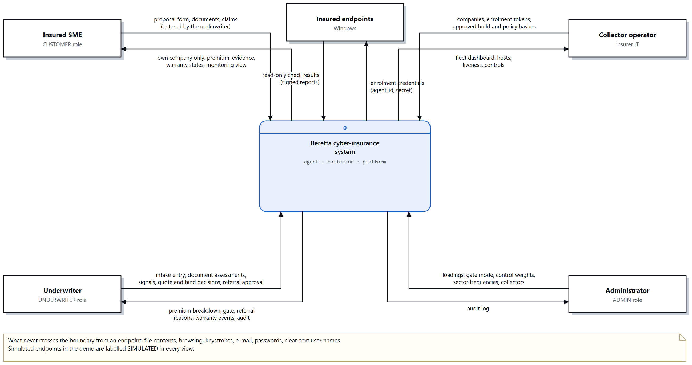
Design Document
Context diagram: Beretta and the people and machines around it
16

Slide 17
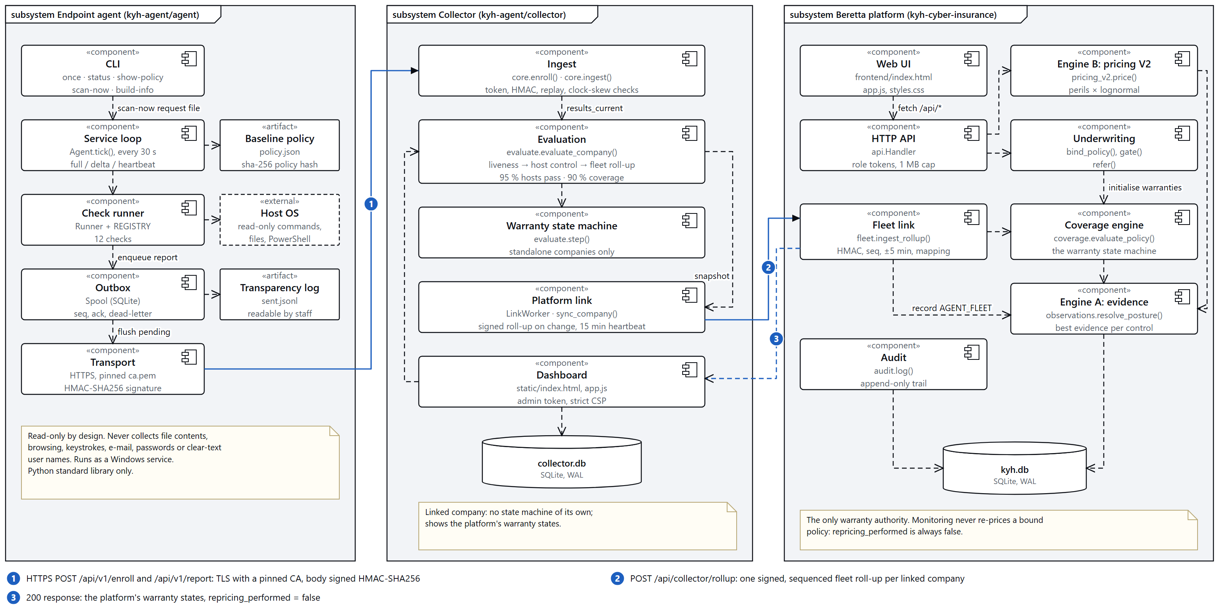
Design Document
Component diagram: the three subsystems and how they connect
17

Slide 18
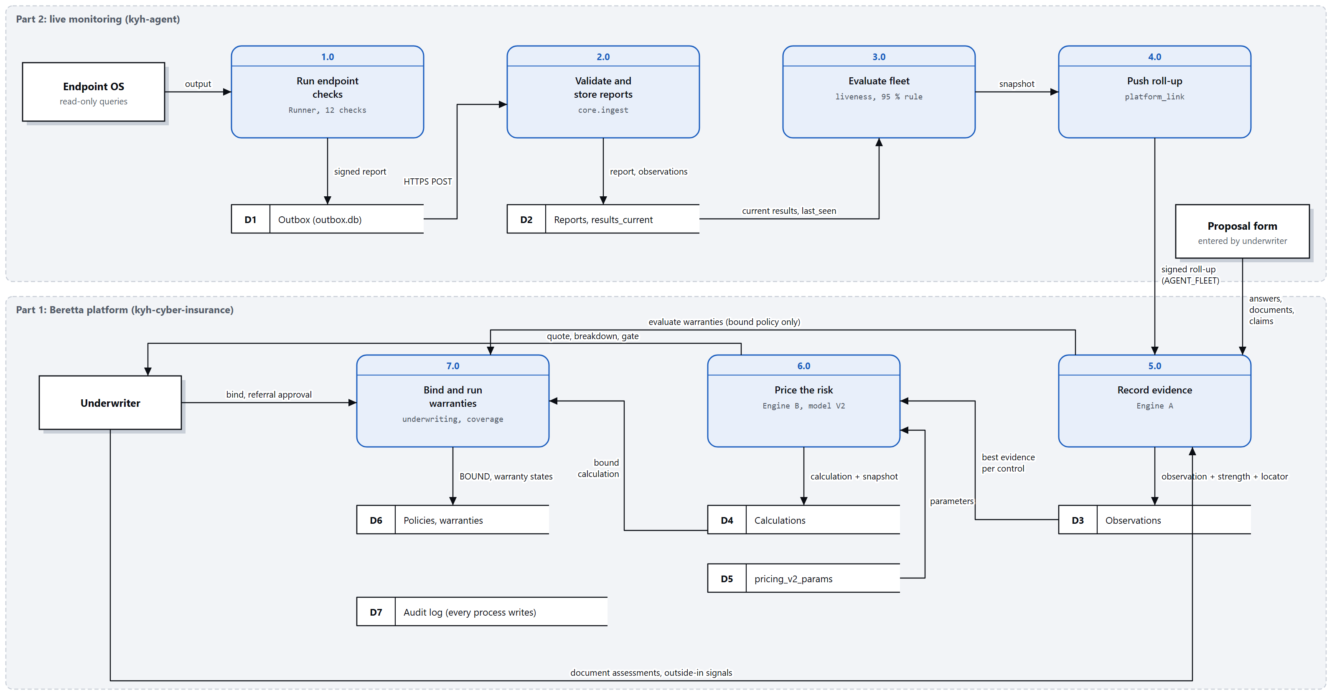
Design Document
Data flow diagram: how evidence travels from an endpoint to a warranty state
18

Slide 19
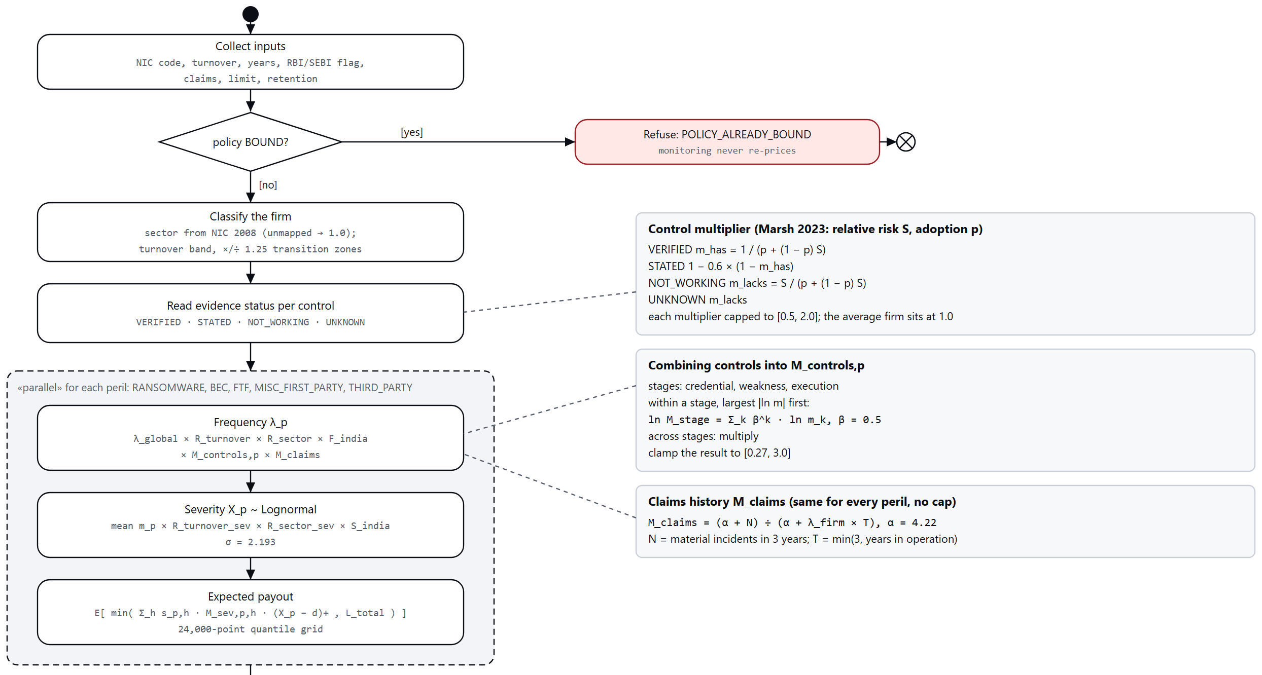
Design Document
Algorithm: how the pricing engine calculates a premium (1 of 2)
19

Slide 20
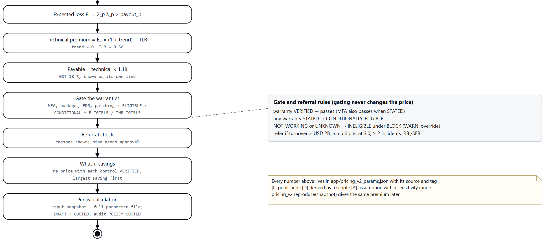
Design Document
Algorithm: how the pricing engine calculates a premium (2 of 2)
20

Slide 21
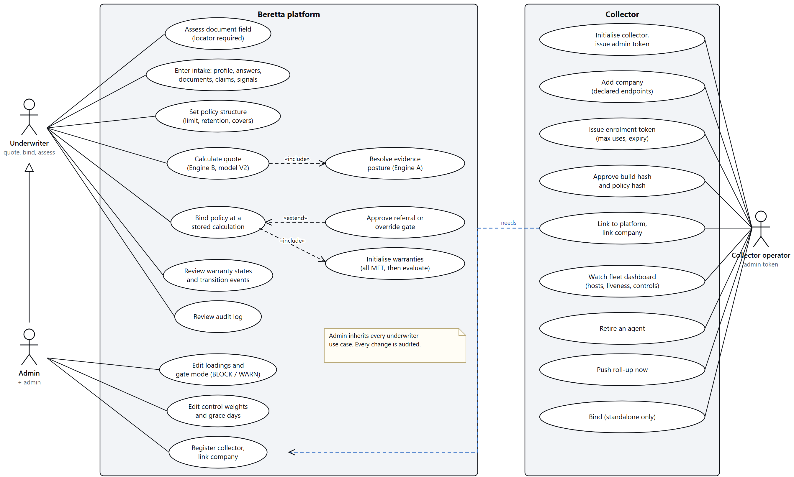
Design Document
Use cases: underwriter, administrator and collector operator
21

Slide 22
Future Extensions
Making the agent more sturdy and reliable
Stronger tamper resistance, signed updates and a lower load on the machines it runs on.
Making the agent more autonomous
Letting it research current trends such as zero-days and take them into account in its checks, while staying read-only.
Increasing the number of controls monitored and their accuracy
More checks and fewer false results, with identity-provider connectors so that MFA can be verified.
Fine-tuning the pricing mechanism
Creating better loss models from data, including Indian claims as they become available.
Integrating policy conditions and limits into the platform
So that coverage and payouts can be shown on the dashboard.
Wider OS compatibility
Bringing the agent to macOS and beyond, tested on real hardware.
22

Slide 23
References
Research papers
[1] H. Bühlmann, “Experience rating and credibility,” ASTIN Bulletin, vol. 4, no. 3, pp. 199–207, 1967.
[2] T. Maillart and D. Sornette, “Heavy-tailed distribution of cyber-risks,” The European Physical Journal B, vol. 75, no. 3, pp. 357–364, 2010.
[3] B. Edwards, S. Hofmeyr, and S. Forrest, “Hype and heavy tails: A closer look at data breaches,” Journal of Cybersecurity, vol. 2, no. 1, pp. 3–14, 2016.
[4] S. Romanosky, L. Ablon, A. Kuehn, and T. Jones, “Content analysis of cyber insurance policies: How do carriers price cyber risk?” Journal of Cybersecurity, vol. 5, no. 1, art. tyz002, 2019.
[5] R. Pal, L. Golubchik, K. Psounis, and P. Hui, “Will cyber-insurance improve network security? A market analysis,” in Proc. IEEE INFOCOM, Toronto, ON, Canada, 2014, pp. 235–243.
[6] F. Doshi-Velez and B. Kim, “Towards a rigorous science of interpretable machine learning,” arXiv:1702.08608, 2017.
[7] D. Woods, I. Agrafiotis, J. R. C. Nurse, and S. Creese, “Mapping the coverage of security controls in cyber insurance proposal forms,” Journal of Internet Services and Applications, vol. 8, no. 1, art. 8, 2017.
[8] N. Shetty, G. Schwartz, M. Felegyhazi, and J. Walrand, “Competitive cyber-insurance and Internet security,” in Economics of Information Security and Privacy. Boston, MA, USA: Springer, 2010, pp. 229–247.
[9] D. Woods and A. Simpson, “Policy measures and cyber insurance: A framework,” Journal of Cyber Policy, vol. 2, no. 2, pp. 209–226, 2017.
[10] S. Dambra, L. Bilge, and D. Balzarotti, “SoK: Cyber insurance – technical challenges and a system security roadmap,” in Proc. IEEE Symposium on Security and Privacy (SP), 2020, pp. 1367–1383.
23

Slide 24
References
Industry data and regulation
[11] Coalition, Inc., 2025 Cyber Claims Report. San Francisco, CA, USA: Coalition, 2025.
[12] NetDiligence, Cyber Claims Study 2025. Gladwyne, PA, USA: NetDiligence, 2025.
[13] Cyentia Institute, Information Risk Insights Study (IRIS) 2022. Cyentia Institute, 2022.
[14] Cyentia Institute, Information Risk Insights Study (IRIS) 2025. Cyentia Institute, 2025.
[15] Marsh McLennan, Using Data to Prioritize Cybersecurity Investments. New York, NY, USA: Marsh McLennan, 2023.
[16] Sophos, The Impact of Compromised Backups on Ransomware Outcomes. Abingdon, U.K.: Sophos, 2024.
[17] IBM Security and Ponemon Institute, Cost of a Data Breach Report 2023. Armonk, NY, USA: IBM, 2023.
[18] Fitch Ratings, US standalone cyber insurance loss ratios, as reported in Insurance Journal, May 2024.
[19] National Association of Insurance Commissioners, Report on the Cybersecurity Insurance Market. Kansas City, MO, USA: NAIC, 2026.
[20] Insurance Regulatory and Development Authority of India, IRDAI (Expenses of Management of Insurers transacting General or Health Insurance Business) Regulations, 2023, Hyderabad, India, 2023.
[21] Indian Computer Emergency Response Team (CERT-In), Directions under sub-section (6) of section 70B of the Information Technology Act, 2000, No. 20(3)/2022-CERT-In, New Delhi, India, Apr. 28, 2022.
[22] Government of India, The Digital Personal Data Protection Act, 2023 (No. 22 of 2023), The Gazette of India, Aug. 11, 2023.
24

Slide 25
References
Market research sources
[23] Verizon, 2026 Data Breach Investigations Report, 2026.
[24] Federal Bureau of Investigation, Internet Crime Report 2025, as reported by SecurityWeek.
[25] IBM, Cost of a Data Breach Report 2026; India figures via Deccan Herald and IANS, Aug. 2026.
[26] Coalition, 2026 Cyber Claims Report, 2026.
[27] Munich Re, global cyber premium estimates, as reported by Business Insurance and Reinsurance News.
[28] Insuramore, global cyber insurer rankings, as reported by Insurance Business and Insurance-Canada.
[29] Swiss Re, Shifting cyber insurance growth into the next gear.
[30] Nationwide, business owner survey, as reported by Risk & Insurance.
[31] UK government cyber security breaches survey 2025/26; Insurance Bureau of Canada survey, Aug. 2025; both via secondary coverage.
[32] MarketsandMarkets, India Cybersecurity Insurance Market, to 2030.
[33] IMARC Group, India Cyber Insurance Market, to 2034.
[34] ReportCubes, India Cyber Insurance Market; Ken Research, India Cyber Insurance Market.
[35] KNN India, Over 8.84 crore MSMEs registered on Udyam platforms, 2026.
[36] Morung Express, CERT-In handled over 29.44 lakh cyber incidents in 2025, 2026.
[37] IJIRL, Cyber-insurance and liability distribution in India, 2025; Dealplexus, Cyber insurance for Indian SMEs, 2026.
25

