Slide 1
DEVELOPED BY TEAM CYPHORA
DeleGate
Intent-Aware Authorization & Runtime Enforcement Layer for Multi-Agent AI
“Delegating a task does not mean delegating unlimited authority.”

Slide 2
The delegation blind spot in multi-agent workflows
User
Agent A
Agent B
Tool C
Poisoned by untrusted text
Unauthorized execution
Uncontrolled multi-hop handoffs
Indirect prompt injection
The enterprise blind spot
OWASP LLM01. Untrusted tickets, pull requests and web scrapes hijack reasoning into unauthorized commands.
EDRs and firewalls watch binaries and sockets. Tool calls under valid credentials look like normal developer activity.
Production tools via MCP, LangGraph, CrewAI, AutoGen.
Orchestrator → Researcher → Tool
Production database wipes · IP exfiltration · Cascading business-interruption losses

Slide 3
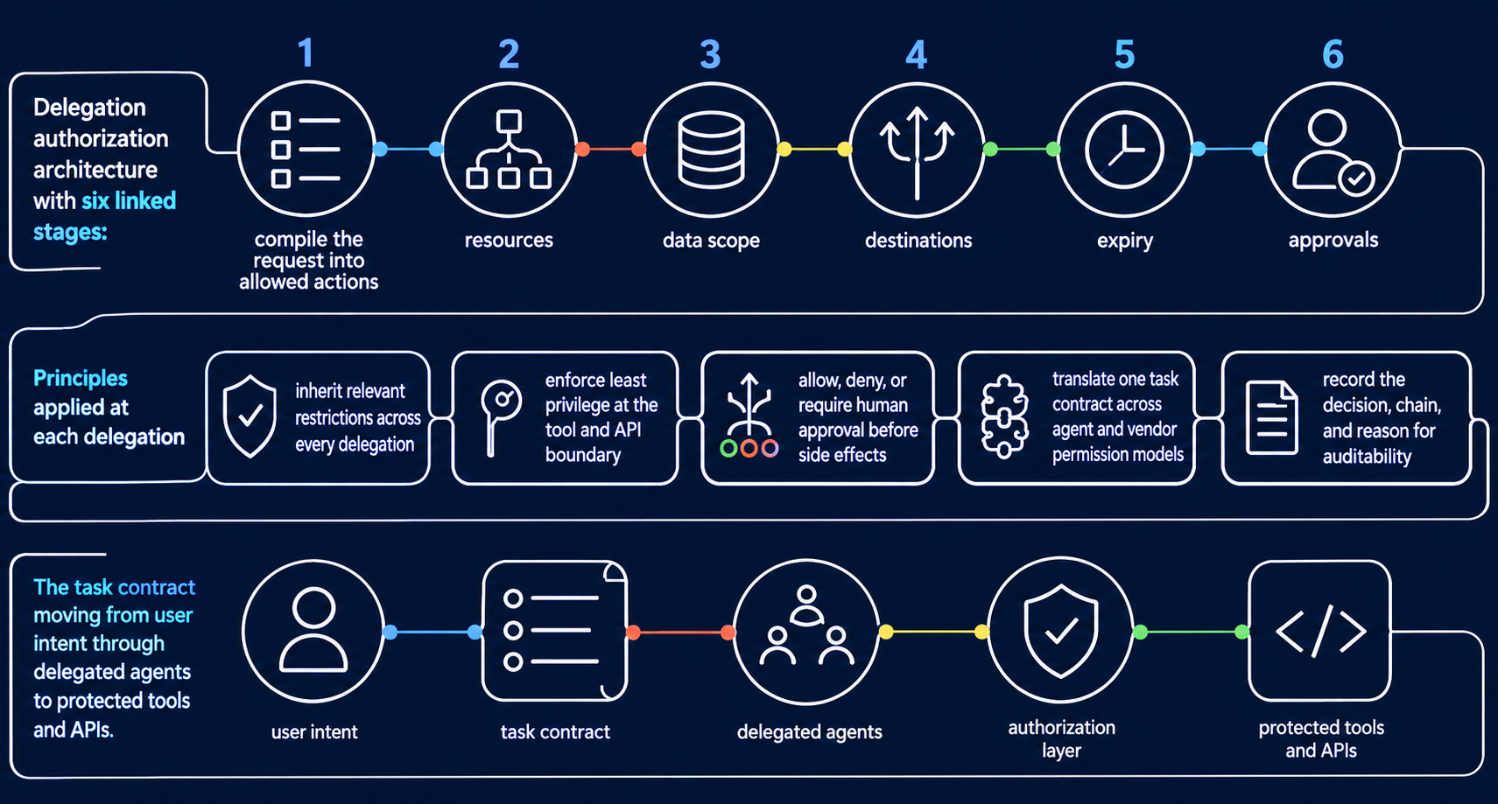
Intent becomes a machine-enforceable contract

Slide 4





Deterministic control at every delegation hop
Inherit restrictions
Least privilege
Tri-state decisions
Cross-vendor translation
Full auditability
Authority never expands beyond the root contract.
Tool and API boundary. Under 10ms. No LLM re-prompting.
Allow, Deny, or Require human approval.
One contract across heterogeneous agents and API permission models.
Cryptographic log of the delegation chain, decisions and reasons.

Slide 5
Legacy defenses miss agent-to-agent handoffs
EDR | AI guardrails | Static API gateways | DeleGate
CrowdStrike SentinelOne | NeMo Guardrails Llama Guard | Kong Apigee | Team Cyphora
✓ OS binaries and kernel calls | ✓ Prompt tokens at ingress and egress | ✓ Long-lived OAuth scopes | ✓ Dynamic, prompt-scoped, multi-hop contracts
× Blind to LLM context and handoff drift | × Misses multi-hop tool execution | × Cannot issue ephemeral, prompt-scoped parameters | ✓ Deterministic microsecond enforcement at runtime tool boundaries

Slide 6



Runtime enforcement of DPDP 2023 and OWASP
Purpose limitation
Sovereign data protection
OWASP LLM Top 10
DPDP ACT 2023 · SECTION 6
Stops agents exfiltrating Indian citizen PII to third-party LLM APIs.
LLM06 Excessive Agency
LLM01 Indirect Prompt Injection
LLM02 Sensitive Information Disclosure
Personal data is processed only for the consented purpose. DeleGate blocks downstream agents from repurposing it.
Aadhaar · PAN · Phone numbers

Slide 7



High-margin ARR and lower insured risk for Mitigata
Proprietary SaaS
Loss ratio optimization
Gordon AI platform enrichment
80%+
De-risks Mitigata's IRDAI-regulated cyber insurance portfolio by preventing autonomous-agent business-interruption claims.
Adds “Privilege Drift” and “Autonomous Lateral Movement” threat telemetry to Mitigata's AI SOC.
Gross margin
Enterprise AI Governance & MCP Security module. ₹1,500 per developer seat per month.
Net-new recurring ARR, not OEM reselling.
“DeleGate: Keeping Autonomous AI Fleets Strictly Within Their Human Mandate.”

