Slide 1
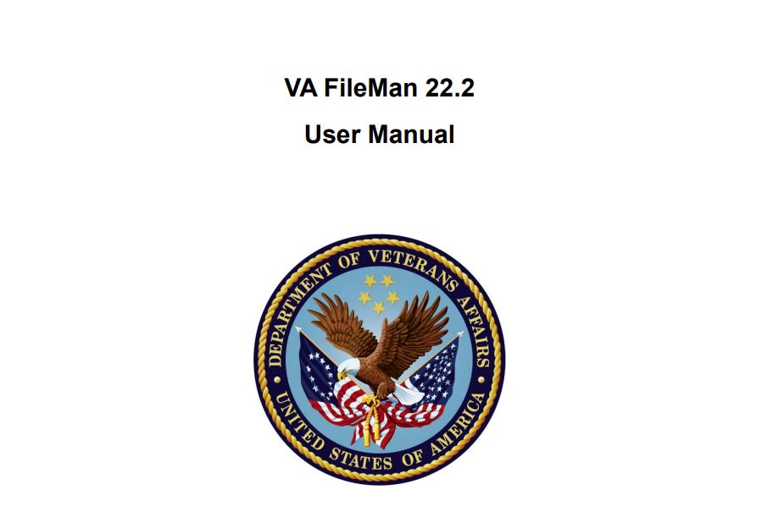
Notes:
NOTE:
To change the image on this slide, select the picture and delete it. Then click the Pictures icon in the placeholder to insert your own image.

Slide 2
wait
access
Python

Slide 3
What is VA FileMan?
VA FileMan is the database management system for the Veterans Health Information Systems and Technology Architecture user (VistA) environment. VA FileMan creates and maintains a database management system

Slide 4
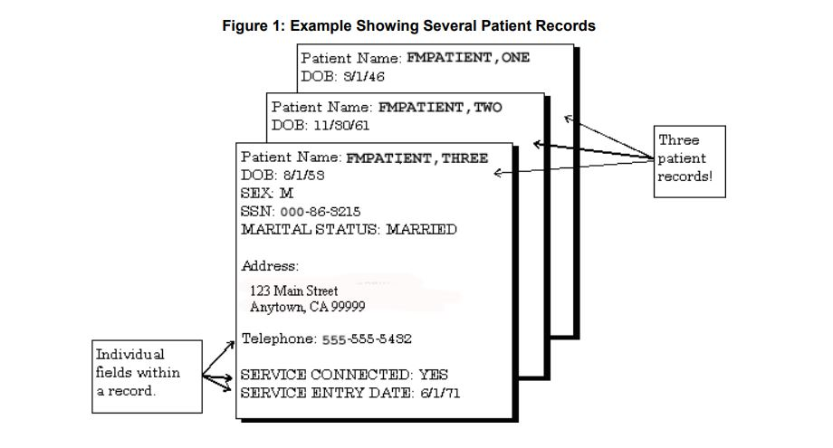
Fields, Records, and Files
A computer database, such as VA FileMan, organizes your data, storing it in fields, records, and files, much as you might arrange and preserve information on paper. A record is a group of fields of data. Each record has a name (e.g., a patient name for a patient record). You can use the record name to recall the record for editing or for printing out. Records are also known as file entries

Slide 5
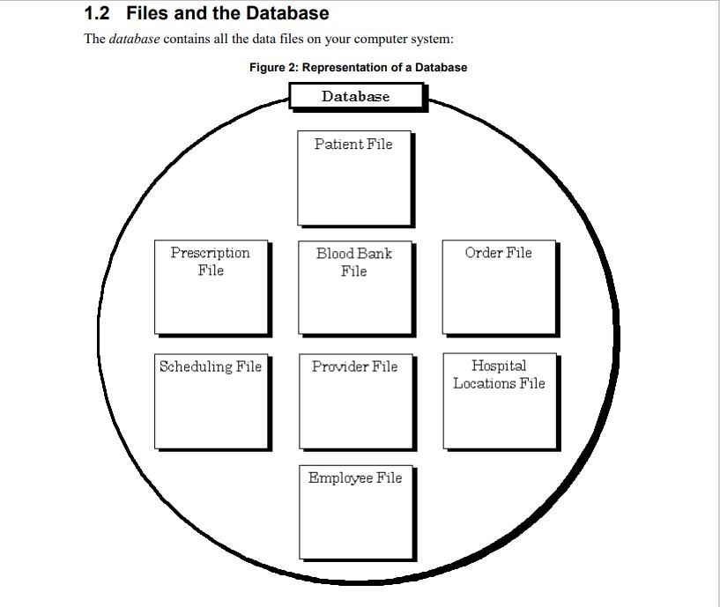
Files and the Database
The database contains all the data files on your computer system:

Slide 6
print records from the database
• Inquire to File Entries
• Print File Entries
• Search File Entries
• Browser

Slide 7
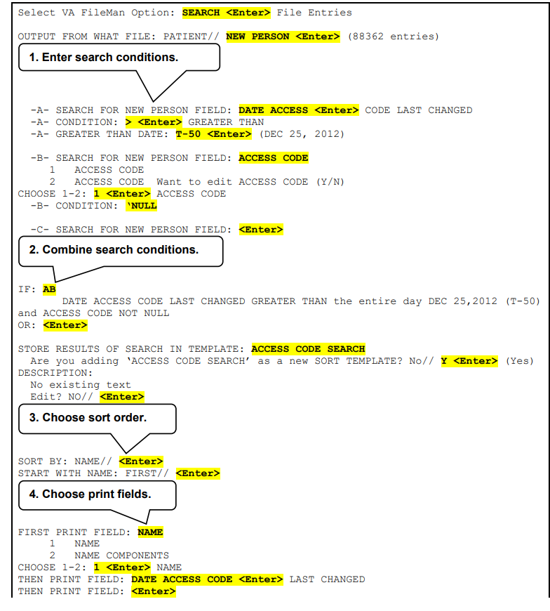
Search
SELECT column1, column2, ...
FROM table_name
WHERE condition1 AND condition2
ORDER BY column1, column2, ... ASC|DESC;

Slide 8
DATA TYPE field values
• DATE/TIME
• NUMERIC
• FREE TEXT
• WORD-PROCESSING
• COMPUTED
• POINTERS

Slide 9
Acceptable Formats for Entering Dates
The following are acceptable formats for entering dates:
• JULY 20, 1999 or July 20, 1999
• 7/20/99
• 20 JUL 99
• 10jul99
• 10 jul 99
• 072099
To simplify entering dates, you can use shortcuts such as:
• T for today
• T-1 for yesterday
• T+1 for tomorrow
• D for day. For example, T-2D means two days ago. • W for week. For example, T+1W means today plus one week. • M for month. For example, T+4M means four months from today

Slide 10
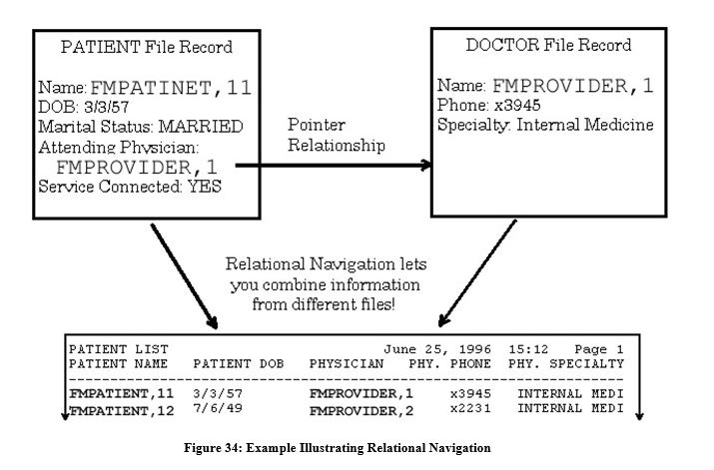
Relational Navigation
Relational navigation gives you a way to reach beyond the current file to reference fields within other files.

Slide 11
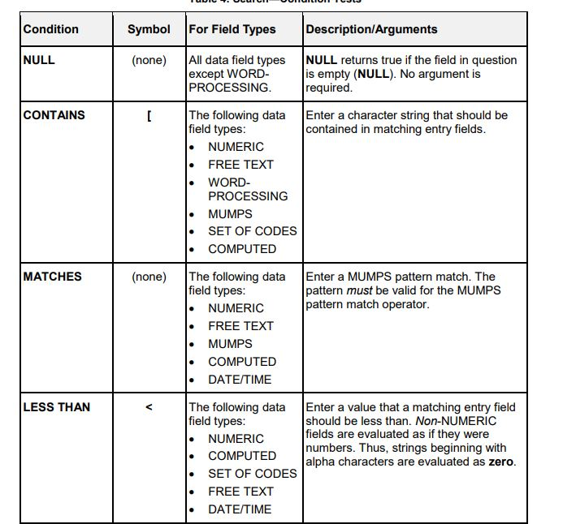
Search
Search Condition Tests

Slide 12
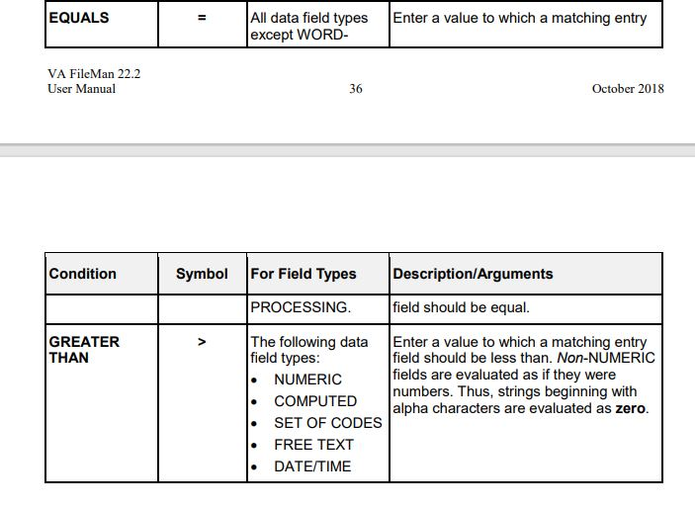
Search
Search Condition Tests

Slide 13
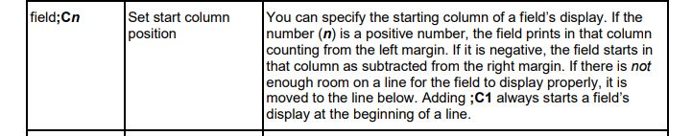
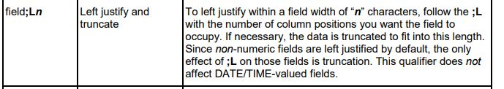
Print Qualifiers to use at “PRINT FIELD:” Prompts

Slide 14
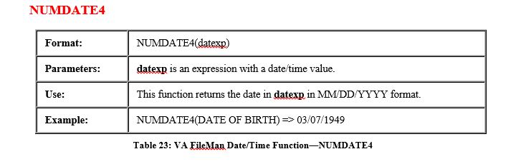
VA FileMan Functions
Date/Time Functions

Slide 15
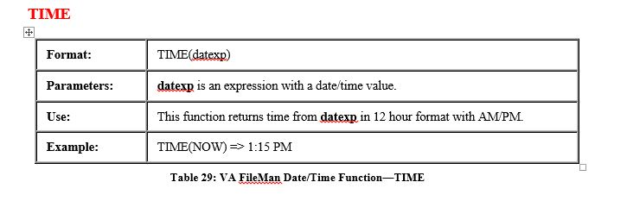
VA FileMan Functions
Date/Time Functions

Slide 16
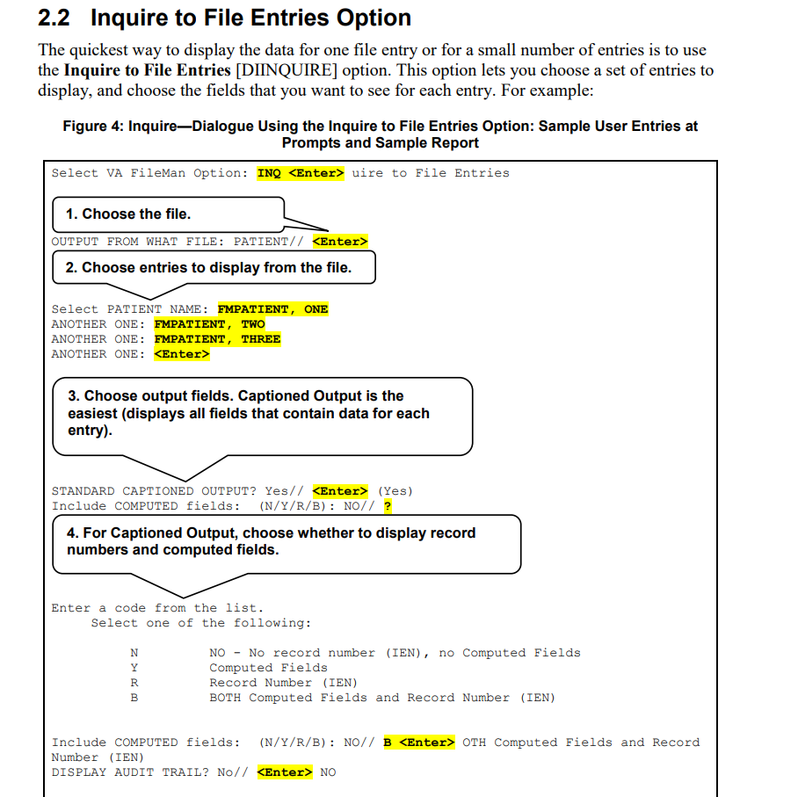
Inquire to File Entries Option

Slide 17
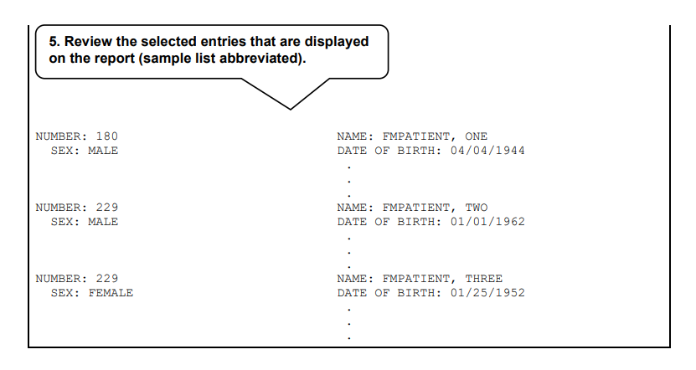
Inquire to File Entries Option

Slide 18
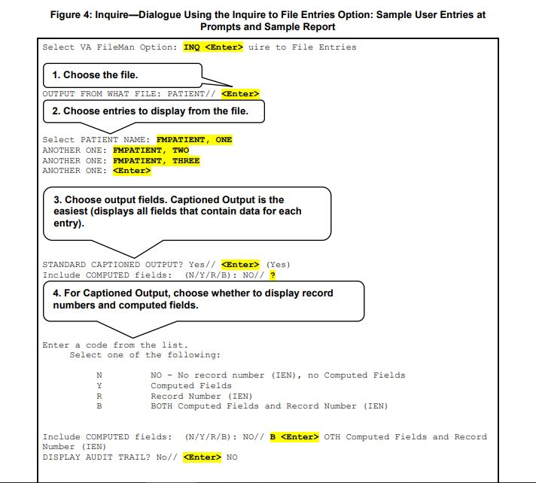
Inquire to File Entries Option
One way of getting at the information stored in a database is to generate reports that print out selected records. You do not have to print every field in a record; you can just choose a subset of fields to print out

Slide 19
FILES
2 | PATIENT | NAME, DATE OF BIRTH and NID
9000001 | IHS | MRN
8925 | TIU DOCUMENT | Progress Notes, Consult Reports, and Discharge Summaries
63 | LAB DATA | CHEM,MICRO
100 | ORDER | orders/requisitions made
 | BSDX APPOINTMENT | appointment definitions
120.5 | VITALS | GMRV VITAL MEASUREMENT
405 | PATIENT MOVEMENT | admissions, transfers, discharges, treating specialty changes, and lodger movements
74 | RAD/NUC MED REPORTS | reports for registered exams
55 | PHARMACY PATIENT | UNIT DOSE,IV
9000010 | VISIT | clinic visits

