Slide 1
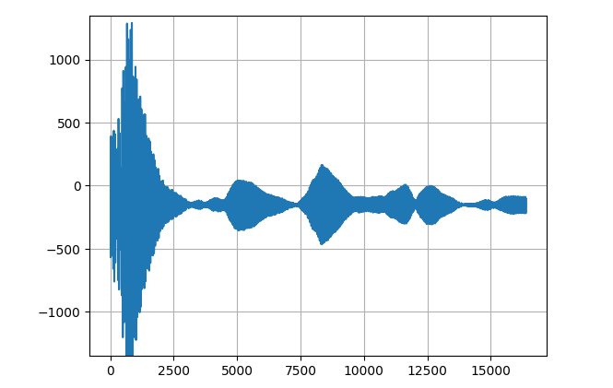
ADC Direct from Sensor

Slide 2
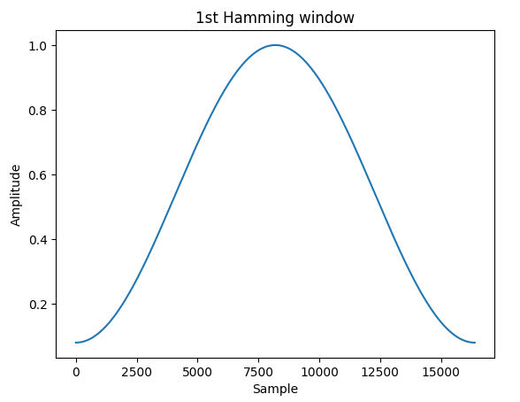
Notes:
Hamming Window

Slide 3
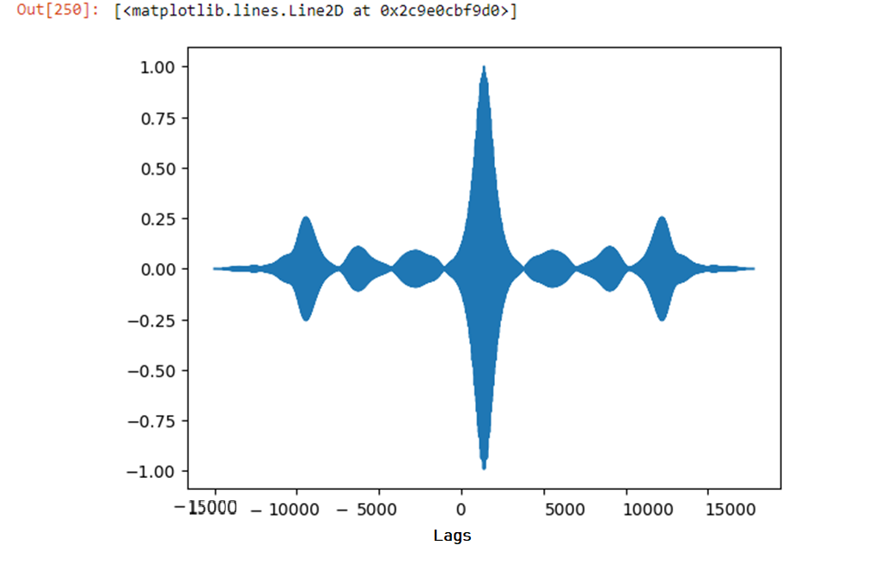
ACF
Notes:
ACF

Slide 4
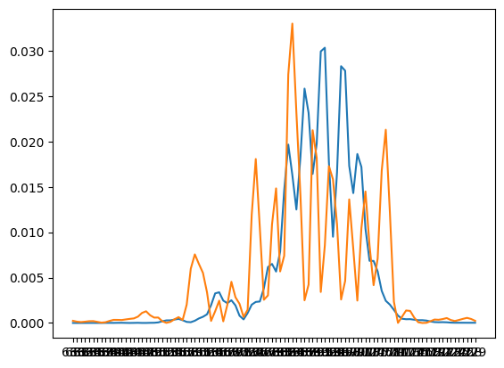
PSD
Notes:
Blue – empty, orange - baby

Slide 5
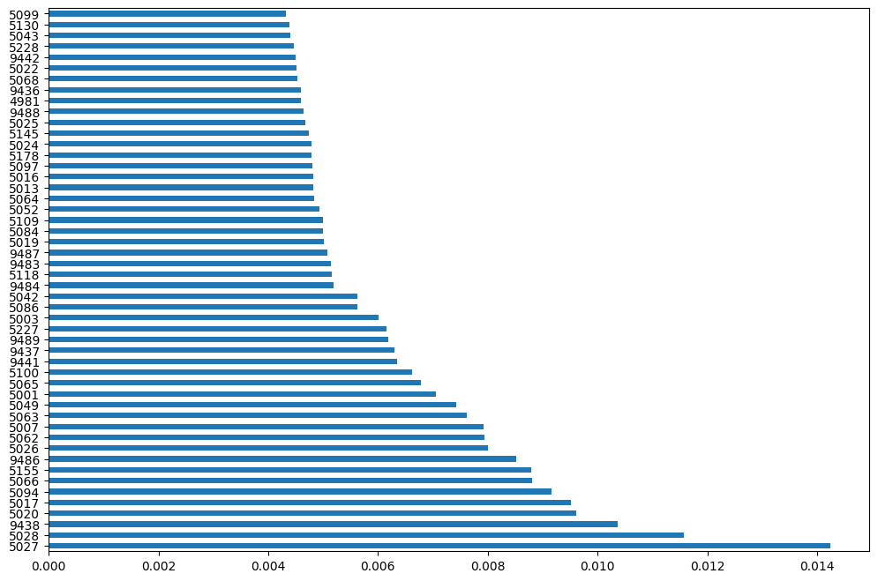
Feature Importance - ADC

Slide 6
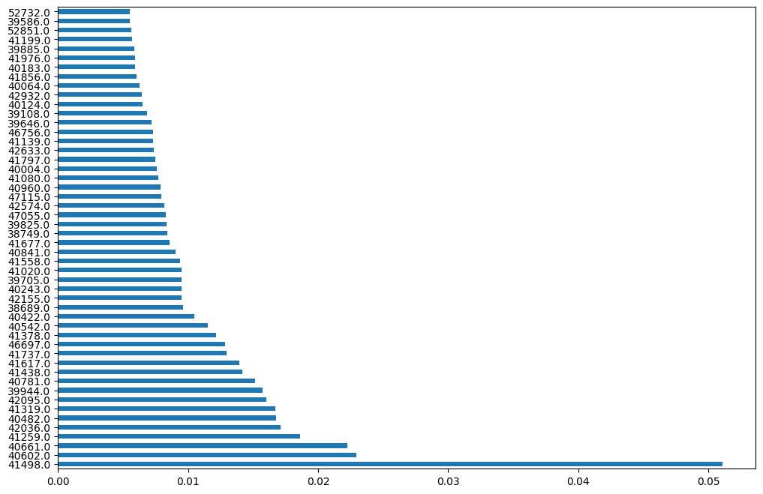
Feature Importance - PSD

Slide 7
How to submit data and code ? Git Repo or pendrive or how ?
Does Neural network have to be deep with more than 2 layers? Or just one hidden layer is enough? I have also tried with 1d conv cnn, but could not select the layers and optimize it well. So shall I just focus on MLP?
I have done a portion of work regarding training with adc data as well, shall I put it in the documentation ? Any special focus ?
All submission only soft copy right?

