Slide 1
Progressive Sports Performance Through Big Data
Hannu Rytkönen - Suunto
29.10.2016

Slide 2
Hannu Rytkönen
Lead developer, Suunto
Specialized in data visualization and UI
Hobbies: triathlon, skateboarding, dancing

Slide 3
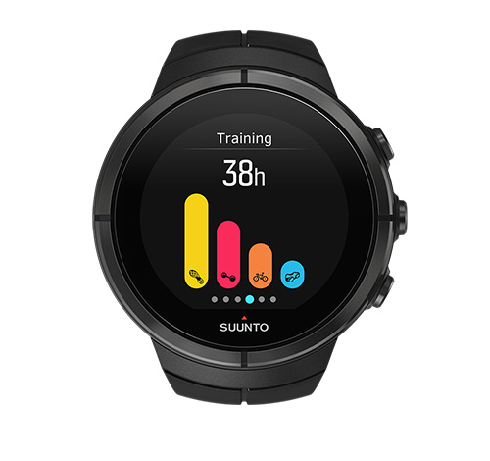

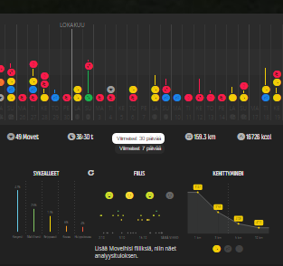
Suunto
Founded in 1936
Products
Sport watches
Dive computers
Movescount.com
Compasses
Subsidiary of Amer Sports
Employees 300 - 400
Located in Vantaa, Finland

Slide 4
Movescount.com - an online training community
First version published in 2010
Platform for managing moves recorded by Suunto watches
Over 1.5 million registered users
Over 125 million moves
About 70 000 - 150 000 new moves per day

Slide 5
Metrics & Records
Part of the Suunto Next Generation feature set

Slide 6
Analysed sports
Running
Trail running
Cycling
Mountain biking
Open water swimming
Pool swimming
Triathlon
Totally over billion metrics

Slide 7
Looking for answers to the following questions
Am I progressing?
How good I am?
How to train?

Slide 8
Am I progressing?

Slide 9
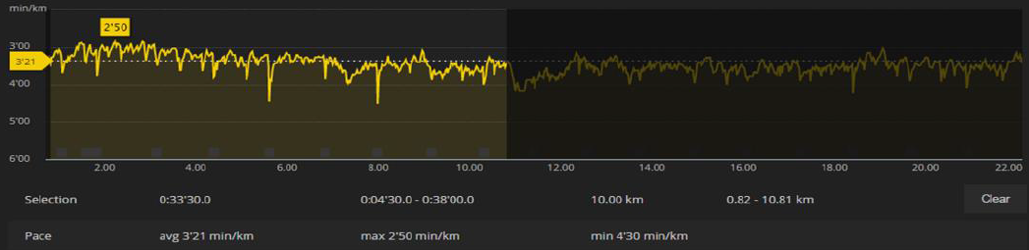
How is this done?
All individual moves are analysed and key metrics gathered
Example move: Running 22.5 km
Fastest 1km, 1mile, 2km, 3km, 2miles, 5km, 10km, 15km and 21km searched
10km

Slide 10
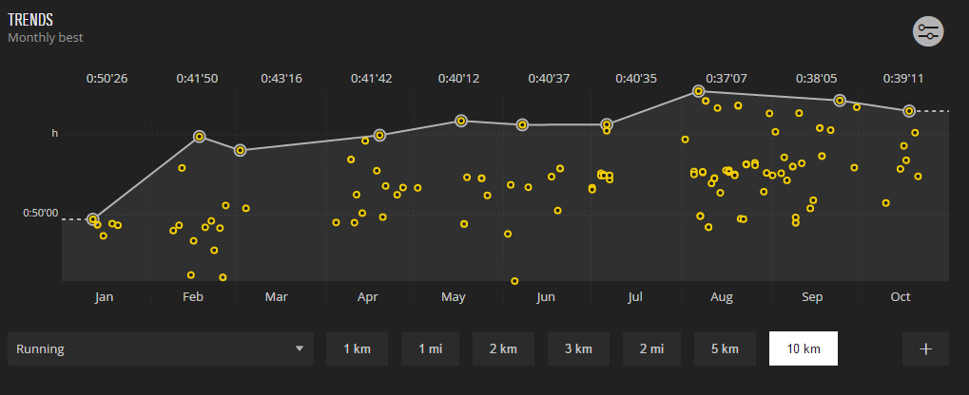
Result (1/2)
Fastest 10km from every running move from January to October

Slide 11
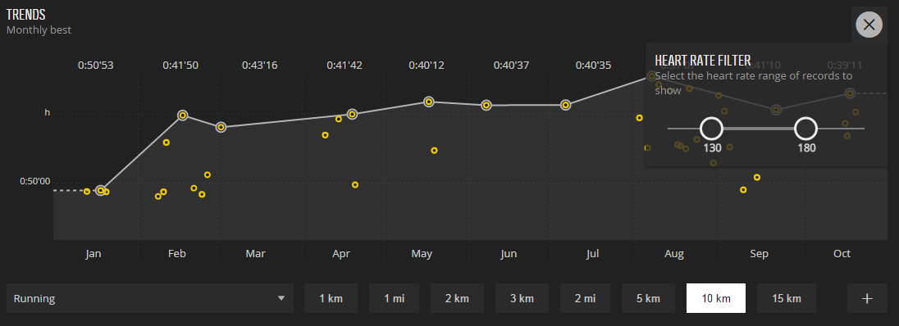
Result (2/2)
Fastest 10km from every running move from January to October, which are run between the heart rate of 130 - 180 bpm.

Slide 12
How good I am?

Slide 13
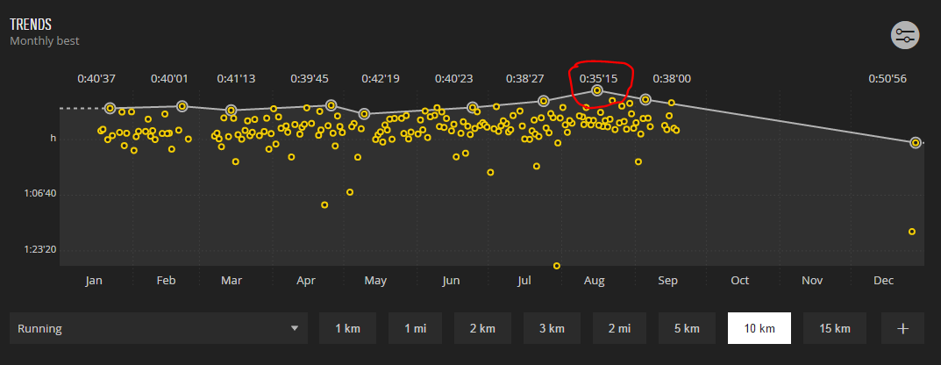
How is this done?
Users’ personal bests are identified from each metric. Fastest 10km run, highest power for 1h in cycling, the fastest 1500m swim, etc.

Slide 14
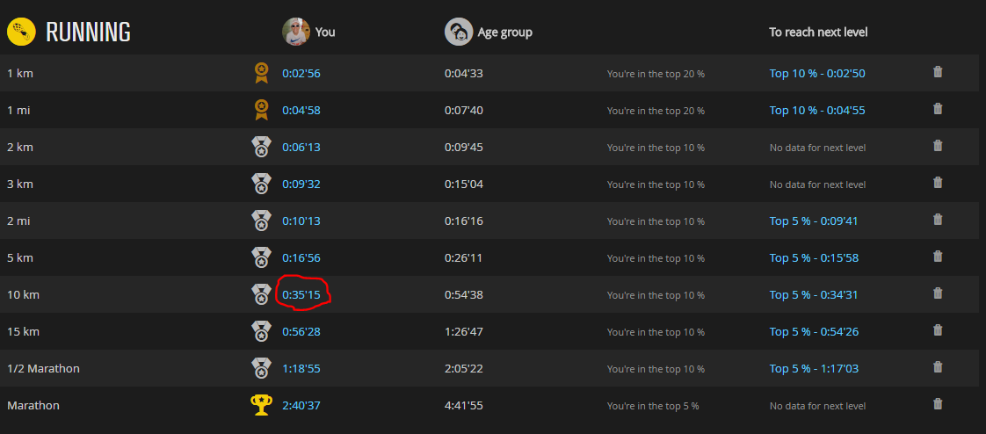
Result

Slide 15
How to train?

Slide 16
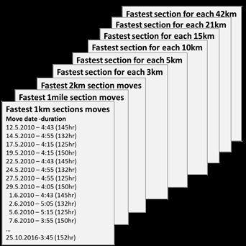
How is this done?
over 1.5 million members
over 125 million moves
over 1 billion metrics

Slide 17
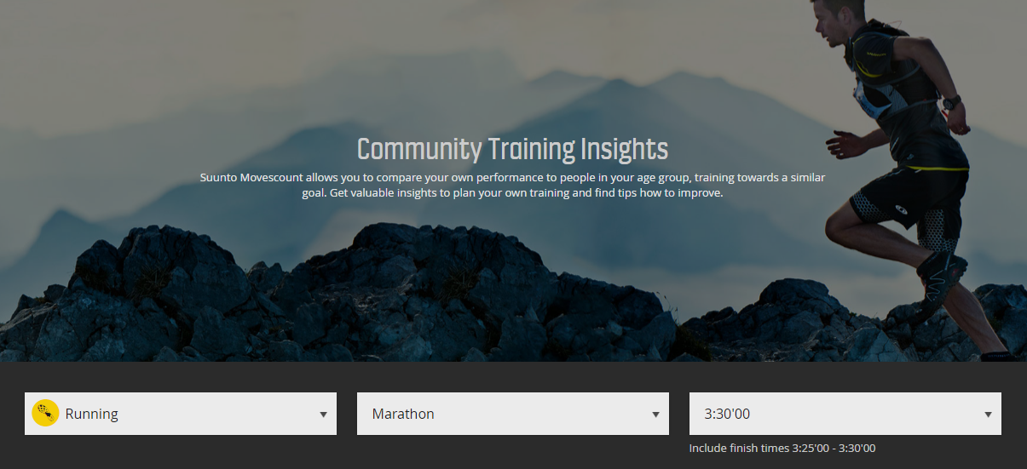
Search for results

Slide 18
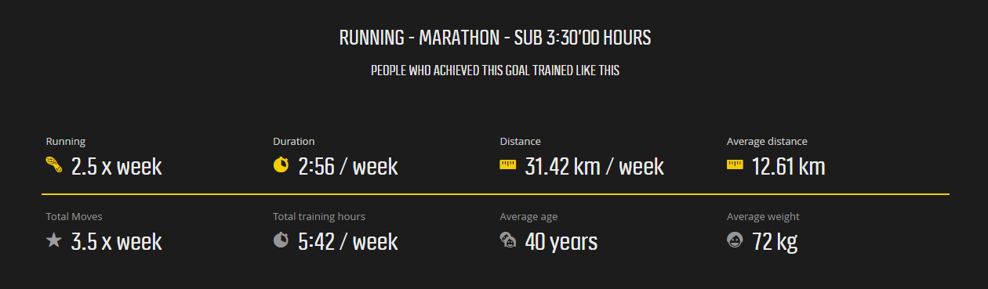
Results (1/4)

Slide 19
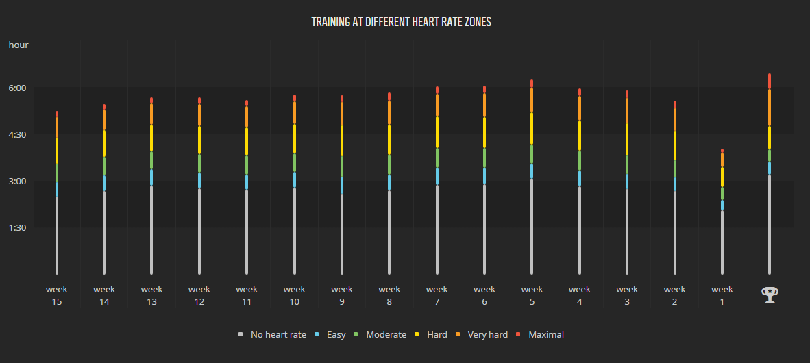
Results (2/4)

Slide 20
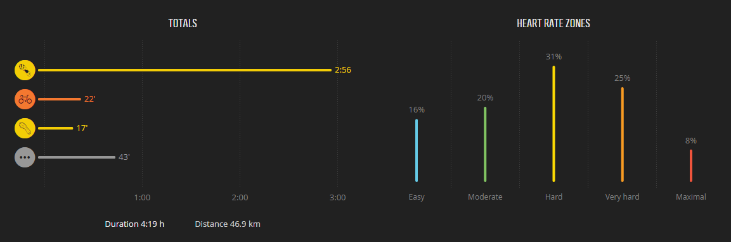
Results (3/4)

Slide 21
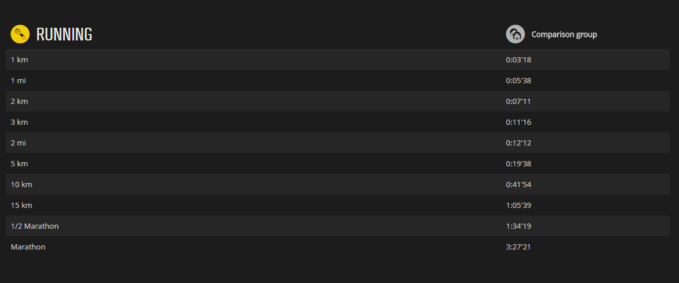
Results (4/4)

Slide 22
Some technical facts
Data visualization library: D3.js
Database: HP Vertica
Infrastructure: Amazon Web Services

Slide 23
Questions?

Slide 24

Thank you.
@HannuRytkonen

