Slide 1

Global AI Bootcamp
Melbourne, Australia
http://azureaibootcamp.me
#GlobalAIBootcamp

Slide 2




Financial Predictions with Azure Machine Learning
Stefano Tempesta
@stefanotempesta
/in/stefanotempesta

Slide 3

AGENDA
Online Payment Fraud Detection
Credit Risk Prediction
DISCLAIMER
This is neither a solicitation for investment nor a financial advice.

Slide 4
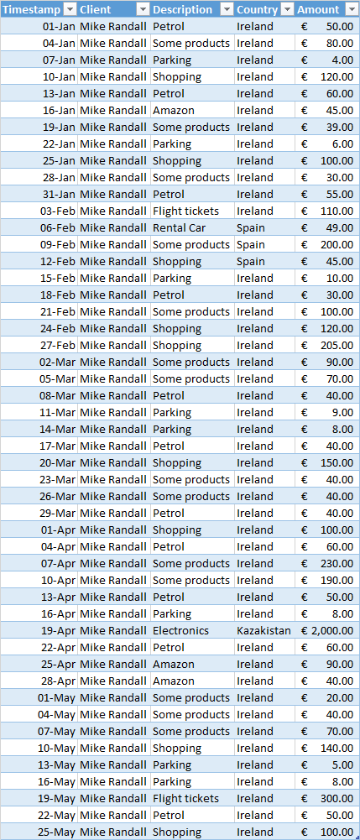
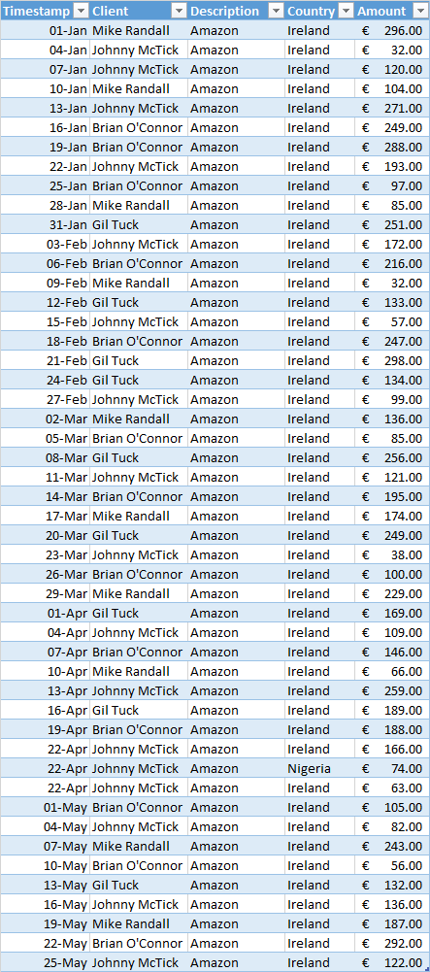
VISA handles
2000 transactions / sec
>170M tpd
In 2017, financial fraud totaled a cost of
USD 1.1B

Slide 5
Traditional Payment Fraud Detection
Analyze transactions and human-review suspicious ones
Use a combination of data, horizon-scanning and “gut-feel”
Every attempted purchase that raises an alert is either declined or reviewed
False positive
Fail to predict unaware threats
Need to update risk score regularly
Notes:
The traditional approach to tackling this problem is to use rules or logic statements to query transactions and to direct suspicious transactions through to human review. While there is some variation, it is notable that over 90 percent of online fraud detection platforms still use this method, including platforms used by banks and payment gateways. While this is effective to some degree, in cases where there is a sufficient gap between an order being received and goods being shipped, it is also incredibly costly and far slower than alternatives.
The “rules” in these platform use a combination of data, horizon-scanning and gut-feel. The system is backed with manual reviews to confirm experts’ decisions. If we take the recent reports of an abundance of Turkish credit cards available on the darknet due to the publicized data breach in Turkey: businesses recognize the increased risk of Turkish cards as fraudulent and can simply add a rule to review any transactions from Turkish credit cards
Following this, every attempted purchase made by such a card raises an alert and is declined or reviewed. However, this raises two significant issues. The first is that such a generalized rule may turn away millions of legitimate customers, ultimately losing the business money and jeopardizing customer relations. Secondly, while this can deter future threats after such fraud has been found, it fails to identify or predict potential threats that businesses are not aware of.
These rules tend to produce binary results, deeming transactions as either good or bad and failing to consider anything in between. And until the rules are manually reviewed, the system will continue to prevent such transactions as those from Turkish credit cards, even if the risk or threat is no longer prominent.

Slide 6
ML Payment Fraud Detection
Large, historical datasets across many clients and industries
Benefit also small companies
Non-binary → Optimize recall and precision
Self-learning models not determined by a fraud analyst
Feature contribution is driven by the training set
Risk score is updated quickly
Notes:
Machine learning works on the basis of large, historical datasets that have been created using a collection of data across many clients and industries. Even companies that only process a relatively small number of transactions are able to take full advantage of the data sets for their vertical, allowing them to get accurate decisions on each transaction. This aggregation of data provides a highly accurate set of training data, and the access to this information allows businesses to choose the right model to optimize the levels of recall and precision that they provide: out of all the transactions the model predicts to be fraudulent (recall), what proportion of these actually are (precision)?
Within the datasets, features are constructed. These are data points such as the age and value of the customer account, as well as the origin of the credit card. There can be hundreds of features and each contributes, to varying extents, towards the fraud probability. Note, the degree in which each feature contributes to the fraud score is not determined by a fraud analyst, but is generated by the artificial intelligence of the machine which is driven by the training set. So, in regards to the Turkish card fraud, if the use of Turkish cards to commit fraud is proven to be high, the fraud weighting of a transaction that uses a Turkish credit card will be equally so. However, if this were to diminish, the contribution level would parallel. Simply put, these models self-learn without explicit programming such as with manual review.

Slide 7
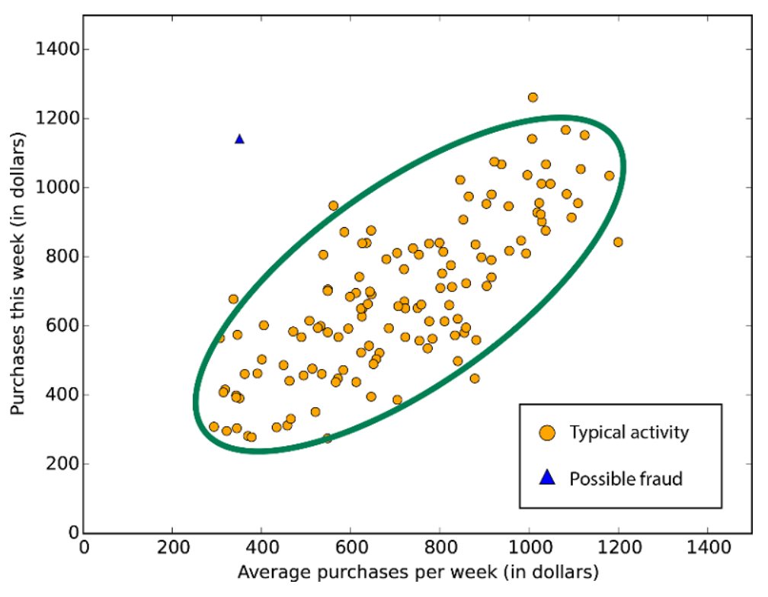

Slide 8
Anomaly Detection
Anomaly Detection encompasses many important tasks in Machine Learning:
Identifying transactions that are potentially fraudulent
Learning patterns that indicate an intrusion has occurred
Finding abnormal clusters of patients
Checking values input to a system
Azure Machine Learning supports:
PCA-Based Anomaly Detection → Unsupervised Learning
One-Class Support Vector Machine → Supervised Learning
Notes:
This module is designed for use in scenarios where it is easy to obtain training data from one class, such as valid transactions, but difficult to obtain sufficient samples of the targeted anomalies. For example, if you need to detect fraudulent transaction, you might not have enough examples of fraud to train the mode, but have many examples of good transactions. However, if you use the PCA-Based Anomaly Detection module, you can train the model using the available features to determine what constitutes a "normal" class, and then use distance metrics to identify cases that represent anomalies.
Principal Component Analysis, which is frequently abbreviated to PCA, is an established technique in machine learning that can be applied to feature selection and classification. PCA is frequently used in exploratory data analysis because it reveals the inner structure of the data and explains the variance in the data.
PCA works by analyzing data that contains multiple variables, all possibly correlated, and determining some combination of values that best captures the differences in outcomes. It then outputs the combination of values into a new set of values called principal components. In the case of anomaly detection, for each new input, the anomaly detector first computes its projection on the eigenvectors, and then computes the normalized reconstruction error. This normalized error is the anomaly score. The higher the error, the more anomalous the instance is.
You can use the One-Class Support Vector Model module to create an anomaly detection model.
This module is particularly useful in scenarios where you have a lot of "normal" data and not many cases of the anomalies you are trying to detect. For example, if you need to detect fraudulent transactions, you might not have many examples of fraud that you could use to train a typically classification model, but you might have many examples of good transactions.

Slide 9
Feature Engineering
Aggregated variables: aggregated transaction amount per account, aggregated transaction count per account in last 24 hours and last 30 days.
Mismatch values: mismatch between shipping Country and billing Country.
Risk tables: fraud risks are calculated using historical probability grouped by country, IP address, etc.
Notes:
To enhance the predictive power of the ML algorithms, an important step is feature engineering, where additional features are created from raw data based on domain knowledge.
For example, if an account has not made a big purchase in the last month, then a thousand-dollar transaction all of a sudden could be suspicious. The new features generated in this scenario include:
Aggregated variables, such as aggregated transaction amount per account, aggregated transaction count per account in last 24 hours and last 30 days;
Mismatch variables: such as mismatch between shippingCountry and billingCountry, which potentially indicates abnormal behavior.
Risk tables: fraud risks are calculated using historical probability grouped by country, state, IPAddress, etc

Slide 10
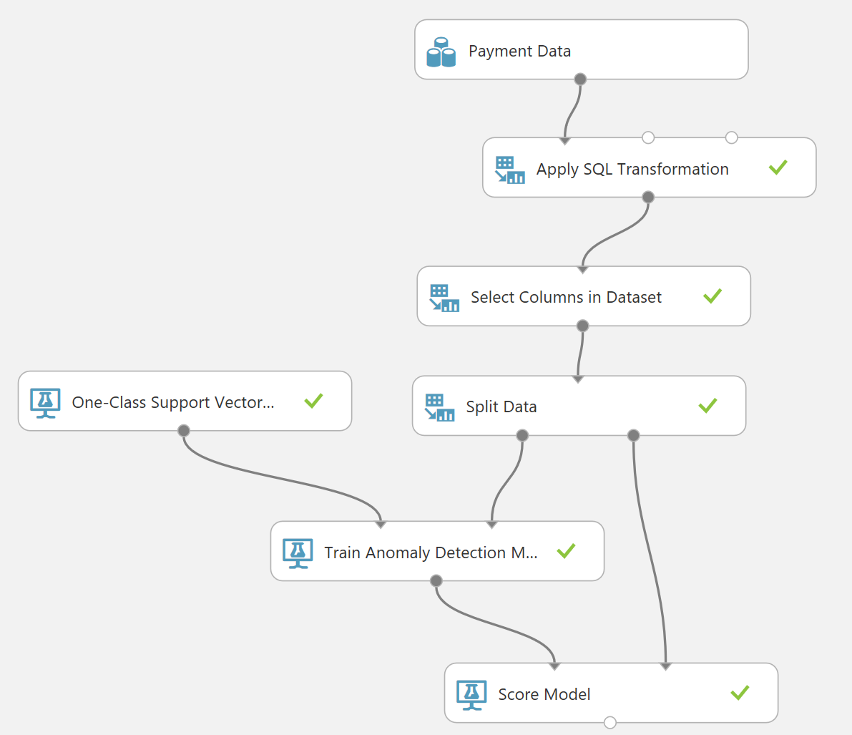
Anomaly Detection in Azure ML Studio

Slide 11
Credit Risk
The problem
Predict an individual’s credit risk based on the information they gave on a credit application.
The solution
A predictive binary classification model based on publicly available credit risk data.
UCI Statlog (German Credit Data) Data Set
from the UC Irvine Machine Learning repository
http://archive.ics.uci.edu/ml/datasets/Statlog+(German+Credit+Data)

Slide 12
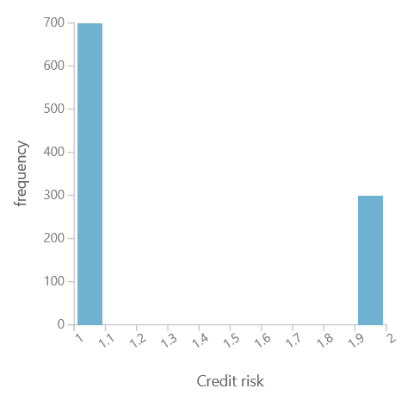
Dataset
20 variables for 1000 past applicants for credit → features
Financial information, credit history, employment status and personal information
Applicant's calculated credit risk
700 applicants identified as a low credit risk
300 applicants identified as a high credit risk
Notes:
Column names
Status of checking account, Duration in months, Credit history, Purpose, Credit amount, Savings account/bond, Present employment since, Installment rate in percentage of disposable income, Personal status and sex, Other debtors, Present residence since, Property, Age in years, Other installment plans, Housing, Number of existing credits, Job, Number of people providing maintenance for, Telephone, Foreign worker, Credit risk

Slide 13
Model Training
Two-Class Boosted Decision Tree
Supervised learning method → Classification model
The second tree corrects for the errors of the first tree, the third tree corrects for the errors of the first and second trees, and so forth…
Predictions are based on the entire ensemble of trees together that makes the prediction
Produce better results when features are somewhat related
Memory-intensive → holds everything in memory
Notes:
This article describes how to use the Two-Class Boosted Decision Tree module in Azure Machine Learning Studio, to create a machine learning model that is based on the boosted decision trees algorithm.
A boosted decision tree is an ensemble learning method in which the second tree corrects for the errors of the first tree, the third tree corrects for the errors of the first and second trees, and so forth. Predictions are based on the entire ensemble of trees together that makes the prediction. For further technical details, see the Research section of this article.
Generally, when properly configured, boosted decision trees are the easiest methods with which to get top performance on a wide variety of machine learning tasks. However, they are also one of the more memory-intensive learners, and the current implementation holds everything in memory. Therefore, a boosted decision tree model might not be able to process the very large datasets that some linear learners can handle.
Usage tips
To train a boosted decision tree model, you must provide multiple data instances. An error is generated during the training process if the dataset contains too few rows.
If your data has missing values, you must add indicators for the features.
In general, boosted decision trees yield better results when features are somewhat related. If features have a large degree of entropy (that is, they are not related), they share little or no mutual information, and ordering them in a tree does not yield a lot of predictive significance. If this is not the case, you might try a random forests model.
Boosting also works well when you have many more examples than features because the model is prone to overfitting.
Do not normalize the dataset. Because the treatment of features is a simple, non-parametric, less-than or greater-than comparison, normalization or any form of non-monotonic transformation function might have little effect.
Features are discretized and binned prior to training, so only a relatively small set of threshold candidates are considered, even for continuous features.
https://docs.microsoft.com/en-us/azure/machine-learning/studio-module-reference/two-class-boosted-decision-tree

Slide 14
Model Training
Two-Class Support Vector Machine (SVM)
Supervised learning method → Classification or regression model
Recognizes patterns in a multi-dimensional feature space called hyperplane
Predictions of two possible outcomes, based on either continuous or categorical variables
Produce better results when the dataset is normalized and your goal is speed over accuracy
Notes:
Module overview
This article describes how to use the Two-Class Support Vector Machine module in Azure Machine Learning Studio, to create a model that is based on the support vector machine algorithm.
Support vector machines (SVMs) are a well-researched class of supervised learning methods. This particular implementation is suited to prediction of two possible outcomes, based on either continuous or categorical variables.
After defining the model parameters, train the model by using one of the training modules, and providing a tagged dataset that includes a label or outcome column.
More about support vector machines
Support vector machines are among the earliest of machine learning algorithms, and SVM models have been used in many applications, from information retrieval to text and image classification. SVMs can be used for both classification and regression tasks.
This SVM model is a supervised learning model that requires labeled data. In the training process, the algorithm analyzes input data and recognizes patterns in a multi-dimensional feature space called the hyperplane. All input examples are represented as points in this space, and are mapped to output categories in such a way that categories are divided by as wide and clear a gap as possible.
For prediction, the SVM algorithm assigns new examples into one category or the other, mapping them into that same space.
https://docs.microsoft.com/en-us/azure/machine-learning/studio-module-reference/two-class-support-vector-machine

Slide 15
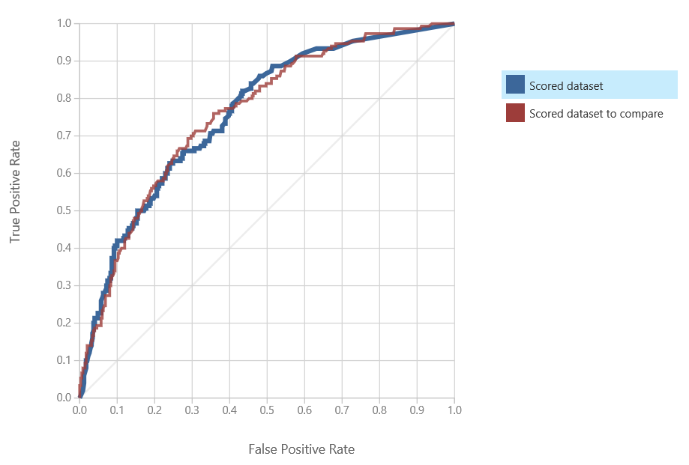
Model Evaluation

Slide 16
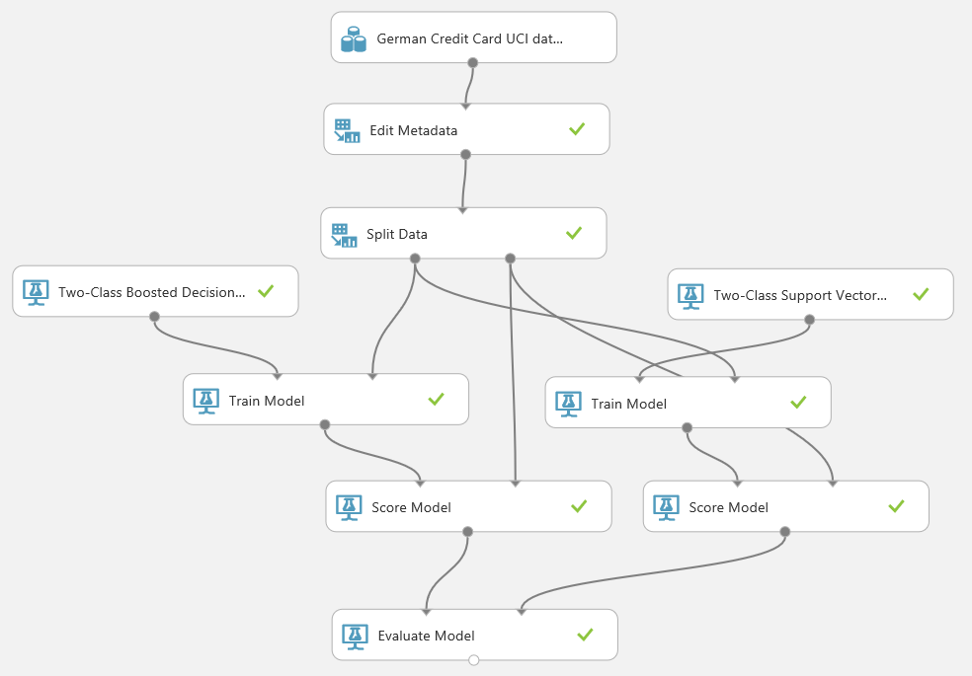
Credit Risk Prediction in Azure ML Studio

Slide 17

https://aischool.microsoft.com

Slide 18
Global AI Bootcamp
Melbourne, Australia
@stefanotempesta
/in/stefanotempesta
http://azureaibootcamp.me
#GlobalAIBootcamp

