Slide 1
Inheritance
Objectives - when we have completed this set of notes, you should be familiar with:
  deriving new classes from existing classes
  the protected modifier
  creating class hierarchies
  abstract classes
  indirect visibility of inherited members
  designing for inheritance

Slide 2
Inheritance
Suppose that you are creating a program to keep track of products in a store’s inventory
You need to represent the following:
  General products -> price, name
    Clothing products -> price, name, size
    Food products -> price, name, isRefrigerated
Each of the above classes needs variables for price and name, but the clothing products and food products classes have additional characteristics

Slide 3
Inheritance
Possible solutions:
  Write classes Product, FoodProduct, ClothingProduct and include price and name (and methods) in each
  Use inheritance so that you only have to write common code once [We’ll use this approach!]
The existing class (Product.java) is the parent class, superclass, or base class
Each derived class (e.g., FoodProduct, ClothingProduct) is the child class or subclass
A child classes inherits the variables and methods defined by the parent class

Slide 4
Deriving Subclasses
In Java, we use the reserved word extends to establish an inheritance relationship
We say ClothingProduct is derived from Product; or ClothingProduct is subclass of Product
Two children of the same parent are called siblings
  ClothingProduct and FoodProduct are siblings
public class ClothingProduct extends Product {
}

Slide 5
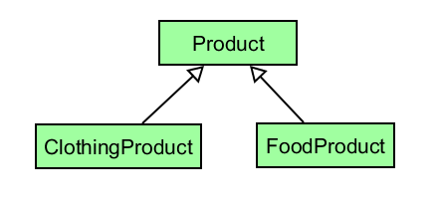
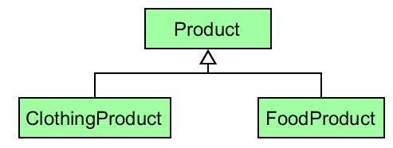

Inheritance
UML Class Diagram* shows inheritance:
or
is-a relationship: the child is a
more specific version of the
parent
Vehicle
*Open the StoreInventory.gpj project file
to generate the UML Class Diagram
Car

Slide 6
The protected Modifier
Variables / methods / constants declared as private cannot be referenced in a child class
  This is fine unless the child class needs to reference a specific variable or method
Variables / methods / constants declared with public access can be referenced in a child class
  But declaring variables as public violates encapsulation!
Solution: the protected access modifier
  Only allows subclasses (child classes) and classes in the same package to access the variable or method

Slide 7
The protected Modifier
If instance variables for price and name need to be accessed directly in subclasses of Product, we can use the protected modifier:
public class Product {
protected String name;
protected double price;
}
Variables name and price can now be accessed by FoodProduct and ClothingProduct:
public class ClothingProduct extends Product
public class FoodProduct extends Product

Slide 8
The super Reference
Constructors are not inherited
However, you can avoid repeating all of the code in the parent’s constructor using the reserved word super
The first line of a child’s constructor can use the super reference to call the parent’s constructor (See ClothingProduct constructor)
The super reference can also be used to reference variables and methods defined in the parent class (See toString in FoodProduct)

Slide 9
Parameterless Constructors
Recall that Java provides a parameterless constructor for your class if you do not provide a constructor.
If a constructor in a subclass does not call the super constructor directly, the parameterless constructor of the superclass is automatically called - - - all the way up the hierarchy.
  If there is no parameterless constructor in the superclass (parent), then you must call the super constructor in the child class; otherwise a compile-time error will occur. Modify ClothingProduct so that the super constructor is not called to see this error.
InheritanceExample.java
(Open project file to generate UML Class Diagram)

Slide 10
Overriding Methods
A child class can override the definition of an inherited method
The new method must have the same signature as the parent's method, but can have a different body
  Most classes override the toString method
  Recall, food items do not include tax in their total price so the totalPrice method is redefined in FoodProduct
  In the InheritanceExample, the compute() defined in class A is then overridden in classes B and C

Slide 11
Overriding fields
The concept of overriding can be applied to fields and is called shadowing or hiding
  For example, ClothingProduct could also have a variable called name; you would have to use super.name to access the name variable in the parent class
  Shadowing variables should be avoided because it tends to cause unnecessarily confusing code
  (InheritanceExample – field x in classes A and B)
  The exception would be for class constants since they can be qualified with the class name

Slide 12
Overloading vs. Overriding
Recall that overloading deals with multiple methods with the same name but with different signatures in the same class
  Defines a method of the same name as an existing method but with different parameters
Overriding deals with two methods, one inherited from a parent or other ancestor class and one in a child class, that have the same signature
  Redefines a inherited method (same name and matching parameters)

Slide 13
The Object Class
A class called Object is defined in the java.lang package of the Java standard class library
All classes are derived from the Object class
If a class is not explicitly defined to be the child of an existing class, it is assumed to be the child of the Object class
Therefore, the Object class is the ultimate root of all class hierarchies

Slide 14
The Object Class
The Object class contains a few useful methods, which are inherited by all classes
For example, the toString method is defined in the Object class
Every time we define the toString method, we are actually overriding an inherited definition
The toString method in the Object class is defined to return a string that contains the name of the object’s class along with the hash code for the object

Slide 15
The Object Class
The equals method of the Object class returns true if two references are aliases
We can override equals in any class to define equality in some more appropriate way
The String class has overridden the equals method inherited from Object in favor of a more useful version returns true if two String objects contain the same characters
Note: If you override the equals method, our Checkstyle rules require that the hashCode method from Object be overridden as well)

Slide 16
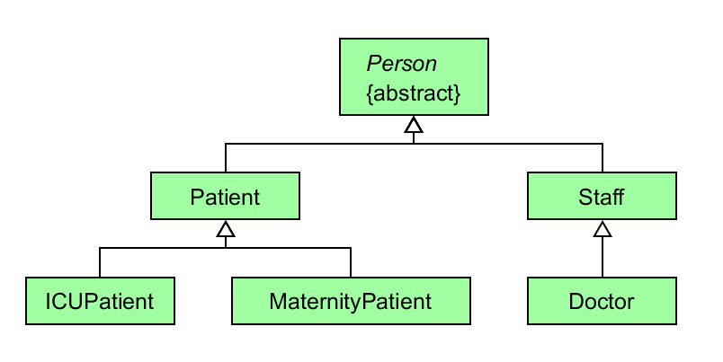
Class Hierarchies
A child class of one parent can be the parent of another child, forming a class hierarchy
(Open the Hospital.gpj project file to generate UML Class Diagram)

Slide 17
Class Hierarchies
Common features should be put as high in the hierarchy as is reasonable (see Person)
A child class inherits from all its ancestor classes
  Doctor inherits all protected and public fields and methods from Staff and Person
  See the toString method in Doctor.java. It accesses firstName and lastName from Person.java as well as phone in Staff.java
(Open Hospital project file to generate UML Class Diagram)

Slide 18
Abstract Classes
An abstract class is a placeholder in a class hierarchy that defines certain variables and behavior
An abstract class cannot be instantiated
We use the modifier abstract on the class header to declare a class as abstract:
  Example: We would never really need a “Person” object, but it can define fields and methods common to Patients and Staff
public abstract class Person

Slide 19
Abstract Classes
An abstract class can contain abstract methods with no definitions (similar to an interface)
  The abstract modifier must be applied to each abstract method
The child of an abstract class must override the abstract methods of the parent or it must be declared to be abstract as well
  getId from Person is defined in Patient, Staff, and Doctor
  getId is not defined in ICUPatient and MaternityPatient so these classes use the getId inherited from Patient

Slide 20
Abstract Classes
Why define abstract methods?
  The hospital is never going to instantiate a Person object, but methods like getName are self-explanatory and will be the same for all child classes.
  The generation of an id is necessary for all child classes, but it’s going to be different for patients, staff, and doctors; making getId abstract forces the immediate subclasses to override it with a non-abstract or “concrete” method
An abstract method cannot be defined as final or static

Slide 21
Benefits of Inheritance
What are the benefits of inheriting methods and variables from an existing class?
  Avoiding redundancy
  Code reuse
  Testing
  Maintainability

Slide 22
Multiple Inheritance
Java supports single inheritance, meaning that a derived class can have only one parent class
Multiple inheritance allows a class to be derived from two or more classes, inheriting the members of all parents
Collisions, such as the same variable name in two parents, have to be resolved
Java does not support multiple inheritance
In most cases, the use of interfaces provides aspects of multiple inheritance without the overhead

Slide 23
Interface Hierarchies
Inheritance can be applied to interfaces as well as classes
That is, one interface can be derived from another interface
The child interface inherits all abstract methods of the parent
A class implementing the child interface must define all methods from both the ancestor and child interfaces

Slide 24
Inheritance Design Issues
Allow each class to manage its own data; use the super reference to invoke the parent's constructor to set up its data
Override the toString and equals methods from the Object class with appropriate definitions as needed
Use abstract classes to represent general concepts that lower classes have in common
Use access modifiers carefully to provide needed access without violating encapsulation

Slide 25
Accessibility Revisited
Variables and methods of a parent class are inherited by its children
Private variables and methods in the parent cannot be referenced directly by a subclass
However, the subclass can reference private variables declared in the parent indirectly using the parent's public methods (e.g., getters, setters)
The super reference can be used to refer to the parent class, even if no object of the parent exists (e.g., the super constructor)

Slide 26
Restricting Inheritance
The final modifier can be used to restrict inheritance
If the final modifier is applied to a class, then that class cannot be used to derive subclasses (e.g., if class A is final then class B cannot extend A)
  Thus, an abstract class cannot be declared as final
If the final modifier is applied to a method, then that method cannot be overridden in any descendent classes
These are key design decisions, establishing that a method or class should be used as is

