Slide 1
👋
#thirtynine

Slide 2
How might we improve the lives of gig workers so that they are financially healthy and more resilient to financial shocks?
Bill & Melinda Gates Foundation

Slide 3
A gig is a single project or task for which a worker is hired, often through a digital marketplace, to work on demand.
US Bureau of Labor Statistics, 2016

Slide 4
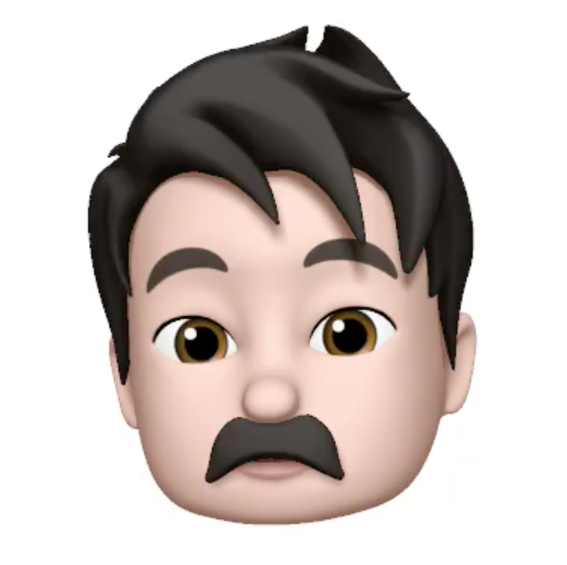

Pain Points
...
Long hours and significant amount of downtime
Low and Volatile Revenue
...
...

Slide 5
User driven Dashboard App for Gig Workers
We are providing a dynamic and transparent mobile platform that enables gig workers to monitor their markets, make smarter decisions and work more efficiently.

Slide 6
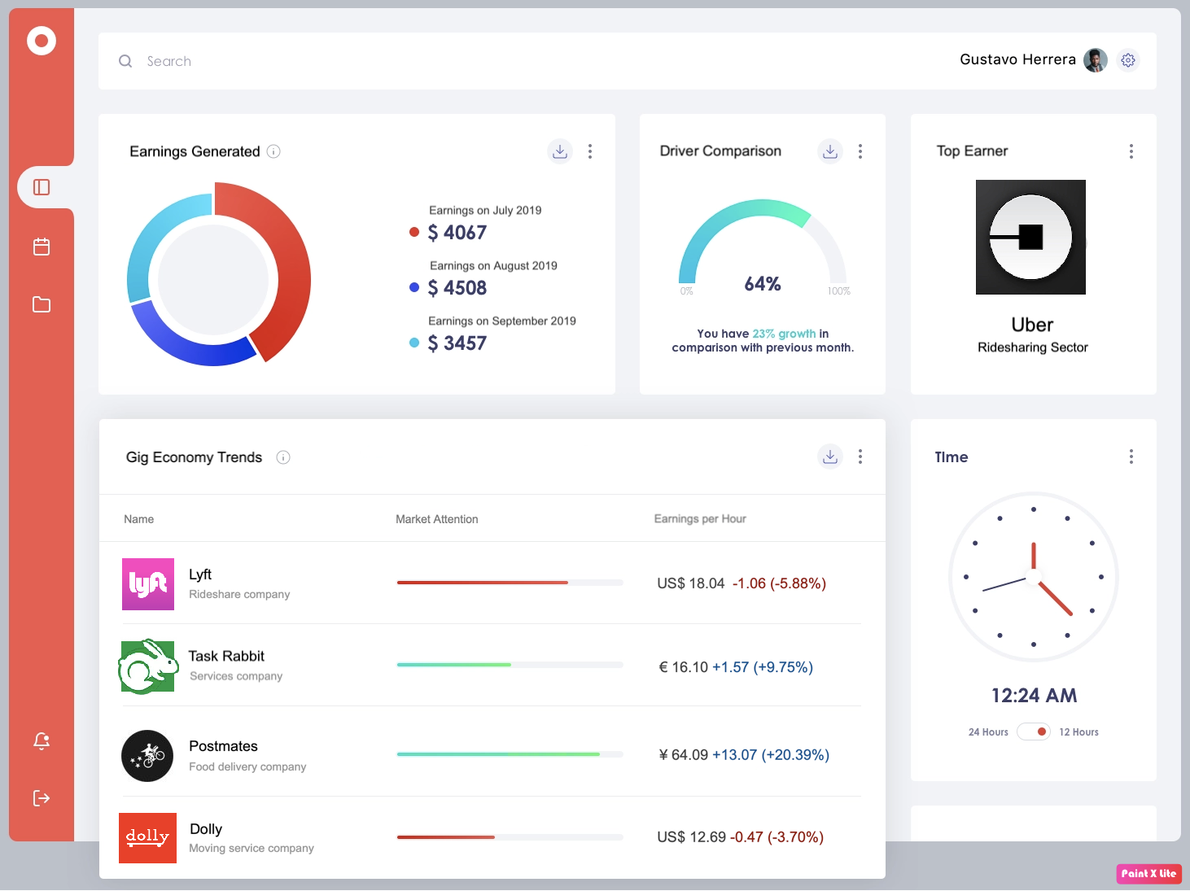
Solution

Slide 7
Demand Side
Supply Side
Workers can manually scan their markets by using the collective knowledge of their personal environments and peer-workers.
Workers could use platforms like Glassdoor or Linkedin to monitor their markets.
Workers can join mobile messaging groups on Whatsapp or Telegram or join market-specific online forums on platforms like reddit
Recruiting sites like Glassdoor
Job sites like Indeed
Stock Market Apps like Robin Hood
Workforce management platforms like GigWalk

Slide 8
Crowd sourced data: Mediums like Glassdoor, Indeed, Craigslist and Taskrabbit are relatively well established to find gig work. There are smaller players like Behance, Fiverr, Freelancer and Toptal which serve high end gig jobs and players like Guru, LocalSolo and Upwork which serve medium to lower wage gigs (major competitors)
Real time tracking: GigWalk is a major player which lets users connect to gig workers in realtime who are in vicinity. This is different from Taskrabbit because this is an aggregator.
Info sharing b/w users: For now, there is no single app in the market which can let gig workers compare prices simultaneously and they have to open multiple apps simultaneously to get this visibility. Eg: Transportation (Uber, Lyft, Juno)
Now
// Crowd sourced data
// Real time tracking
// Info sharing b/w users
New aspects - There are no existing competitors providing below features yet
Aggregated platform to view current price trends of all available gig job opportunities (this can be sorted by vicinity, time, pay range, gig job sector etc.)
Real-time price updates - this will be crowdsourced to maintain the sanctity of prices (think of Google Maps - multiple points of crowd sourced validation)
The app will also provide other utilities by suggesting services like insurance cover as ads. This will generate revenue for the business.
This app will be free to use for gig workers
Soon
// Integrated solution tailored
to the needs of Gig Workers

Slide 9
Will People Use it?
PROS
CONS
- Free and higher value
- Access to information:
+ Lower per-mile costs
+ More productivity
+ Smart decisions
- Easier to use and to share.
- They’ve already used it: WhatsApp and forums.
- Driver empowerment.
- Promote competition between platforms.
- Create online community:
o + Network
o + Reduce risk and downtime
o + Benefits and promotions
- Reveals valuable information
- They already have access to some information
- Increase competition between drivers

Slide 10
Will People Use it [Summary] ?
Landscape:
Very tech savvy community
Most gig workers already manage their work through mobile and web platforms
Our solution offers free and easy access to market specific information
Workers can gain crucial competitive advantages through automated information analysis
Conclusion:
If we are able to implement features that are incorporated into existing work flows and enable gig workers to more effectively scan their markets and help them to make smarter decision based on the newly gained information, adoption is most-likely to succeed!

Slide 11
Configuration Most Likely to Succeed
// Dense urban area with many gig workers that are unhappy
with either the time commitment or the financial gain or both
New York City
San Francisco
// Workforce eager to communicate and make more money
Comfortable with app permissions
Comfortable with passive/active information sharing
Open to switching across gig economy platforms
// Access to digital devices and internet

Slide 12
Can we make it?
\\ Tools for creating minimum product:
Figma / Sketch - mockup of working prototype and UI design
Can be used for a quick pilot to gauge customer interest and intractability
Bubble.io - no code option for fast prototyping and GUI based design process
Similarly can be used to create a prototype with compressed timeframe; can be rolled into version one of final product
\\ Tools for creating final product:
Software development for iOS and Android
UI/UX Design
Database management for aggregated financial data
Data collection method for gathering data
All feasible at Cornell Tech!
\\ Timeframe:
Post-Product Studio:
4-6 months to create a working app with dummy data. Gathering user data will be pain point

Slide 13
Hell Yeah! 💪

Slide 14
Thank You

