Slide 1
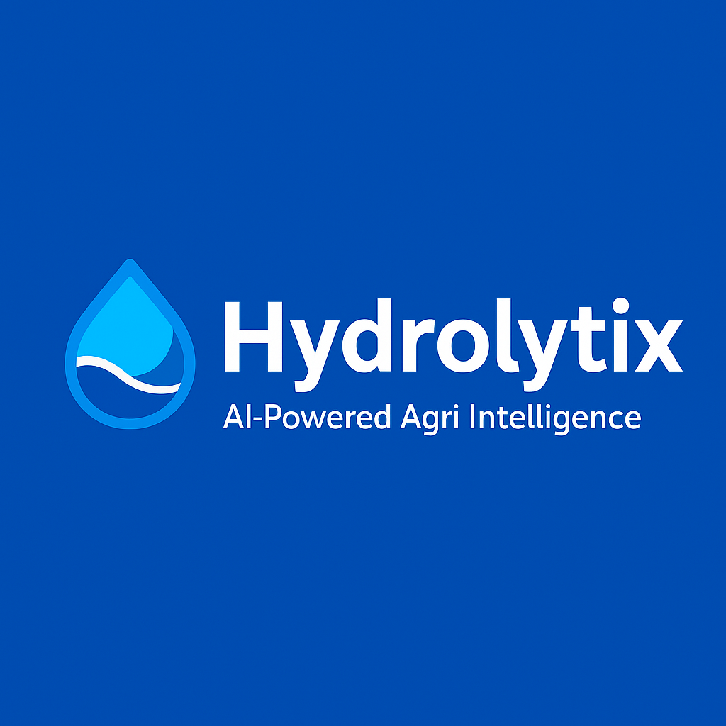
Hydrolytix: AI-Powered Agri Intelligence
Team Members
Muhammad Hasaan Riffaqat Hussain
September 2025

Slide 2
Introduction
Hydrolytix is an AI-powered agricultural intelligence dashboard.
It transforms raw crop data into actionable insights for policymakers,
farmers, and researchers.

Slide 3
Problem Statement
Agricultural datasets are often underutilized due to complexity.
Decision-makers lack interactive tools for analysis, forecasting, and reporting.

Slide 4
Solution Overview
Hydrolytix provides:
Interactive dashboards
Data preprocessing pipeline
Forecasting models
Exportable reports (CSV/PDF)

Slide 5
Objectives
Deliver real-time agricultural insights
Simplify data-driven decision making
Provide forecasting for future crop trends
Support sustainable farming practices

Slide 6
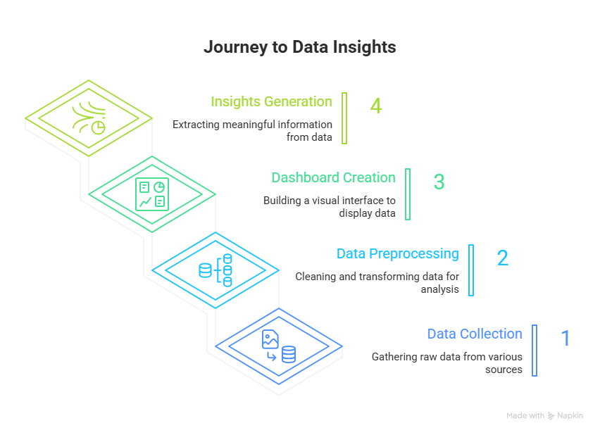
System Architecture

Slide 7
Technology Stack
Python
Dash (Flask-based)
Pandas
Plotly
ReportLab (PDF reports)

Slide 8
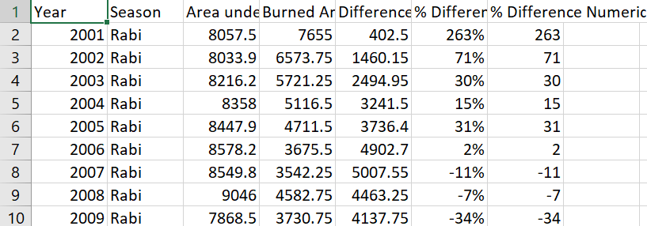
Dataset Overview
Source: Punjab Agricultural Data (CSV)
Fields: Year, Season, Area under Production, Burned Area, Difference, % Difference

Slide 9
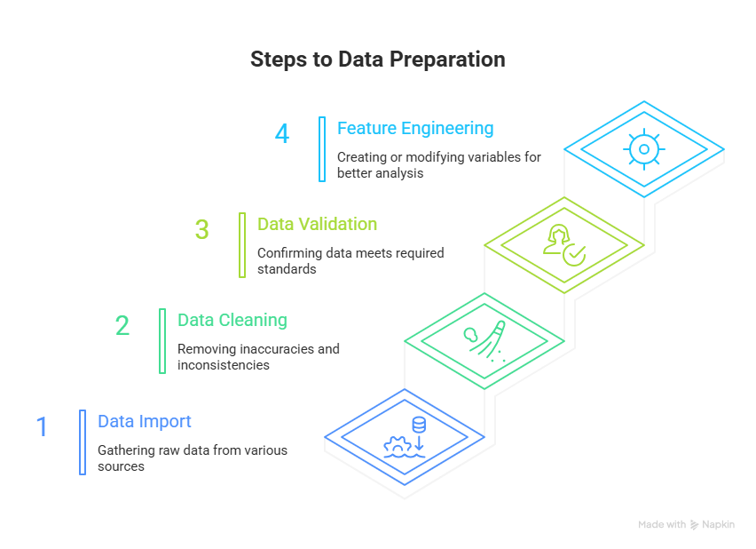
Preprocessing Workflow

Slide 10
Dashboard Features
Overview (KPIs, donut chart, trends)
Year Comparison
Forecasting
Trend Analysis
Export & Reports

Slide 11
Navigation and Layout
Navigation Tabs: Located at the top of the interface for switching between modules.
Filter Panel: Dropdowns for Year and Season.
Dynamic Content Area: Charts, KPIs, and reports update in real-time based on filter selections

Slide 12
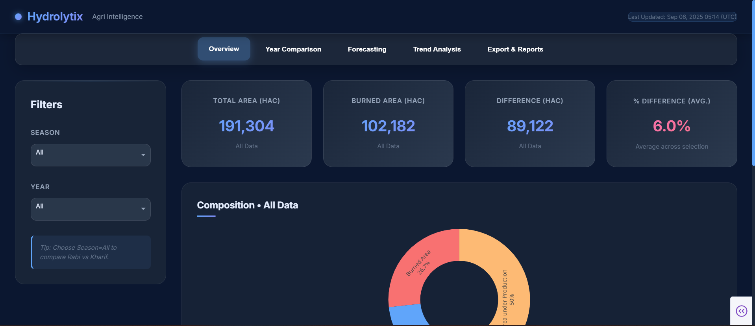
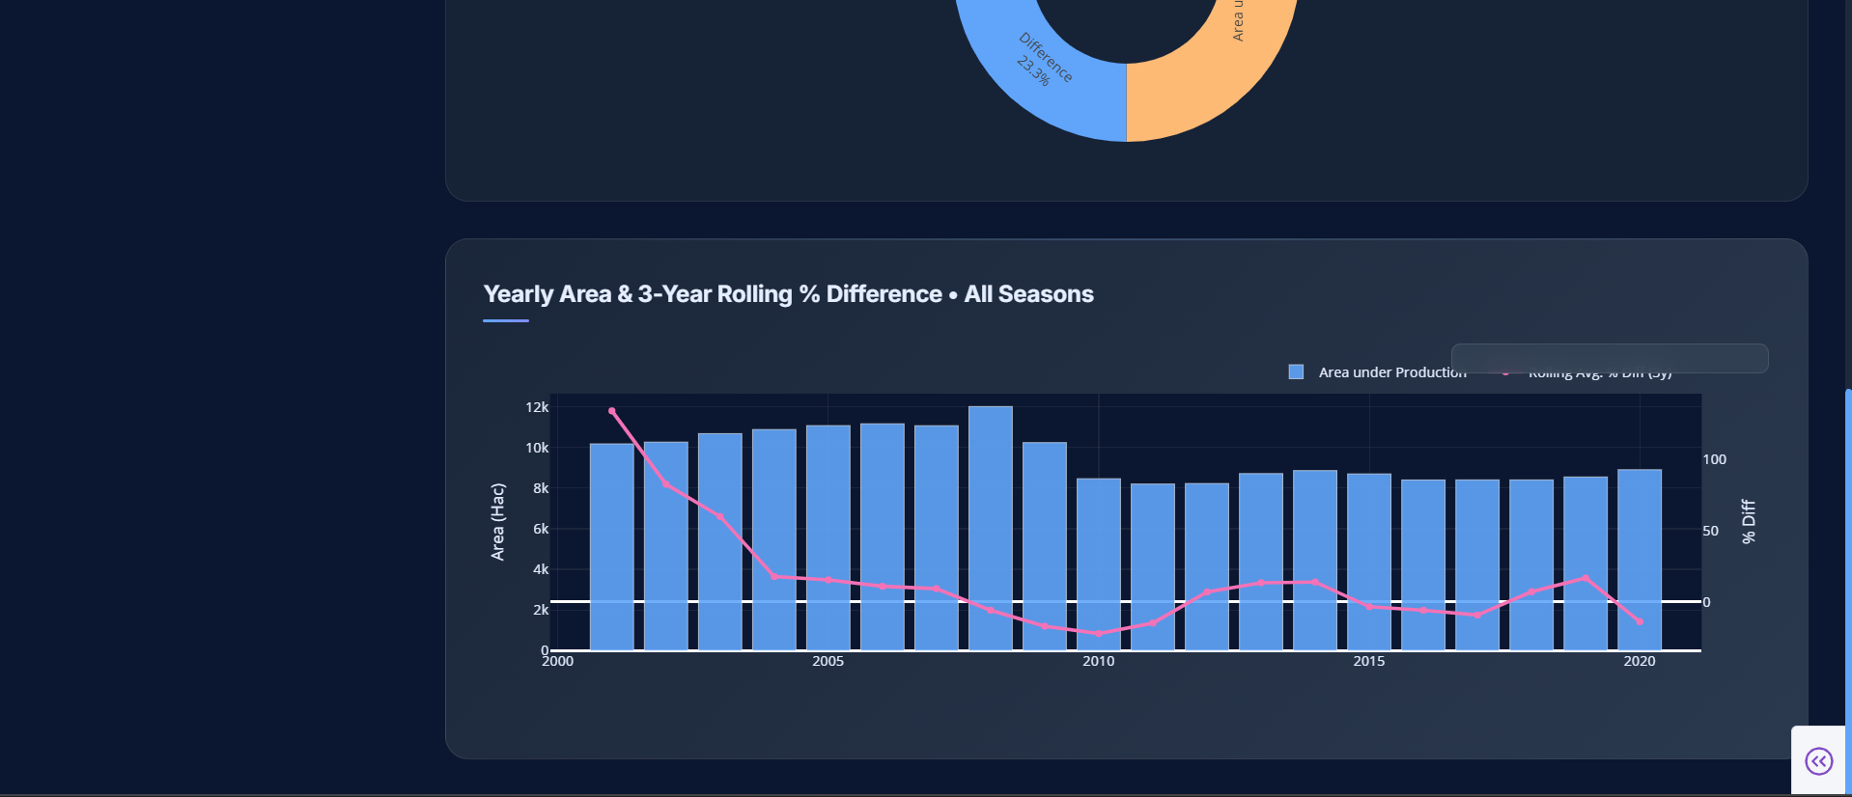

Slide 13
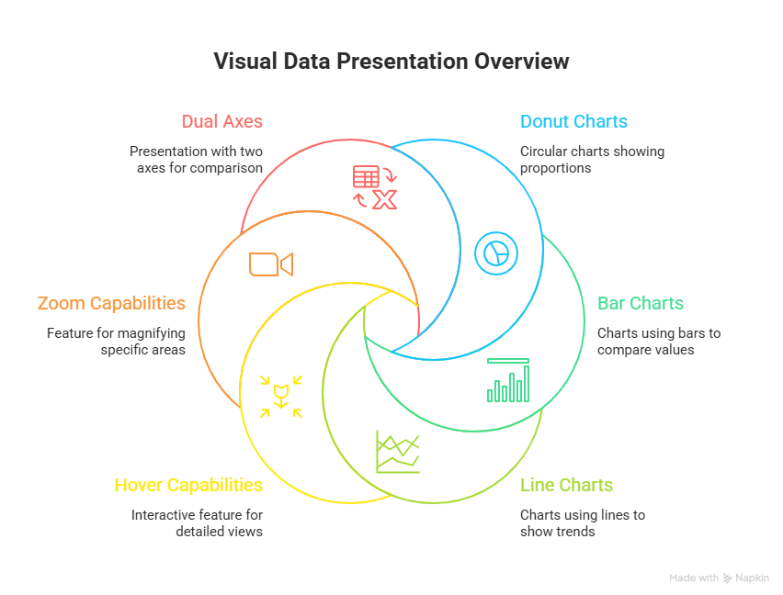
Interactive Visualizations

Slide 14
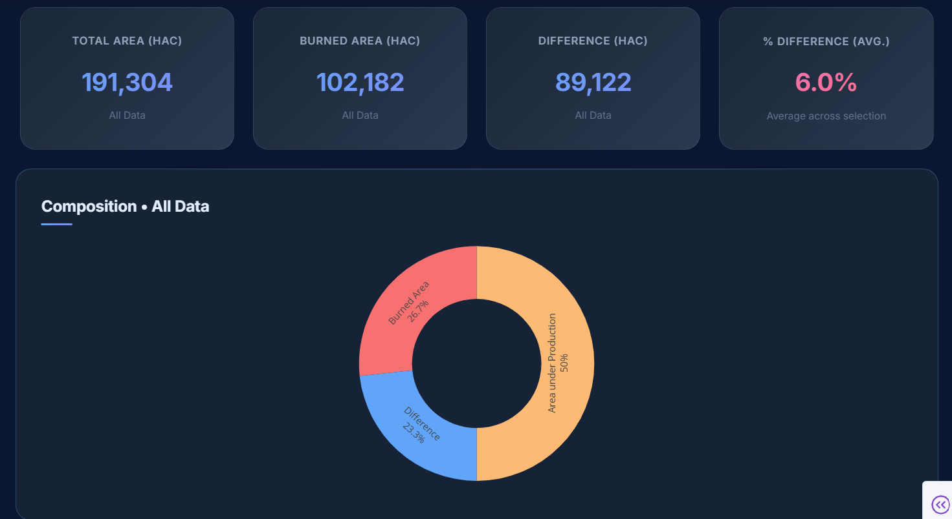
Key Performance Indicators (KPIs)

Slide 15
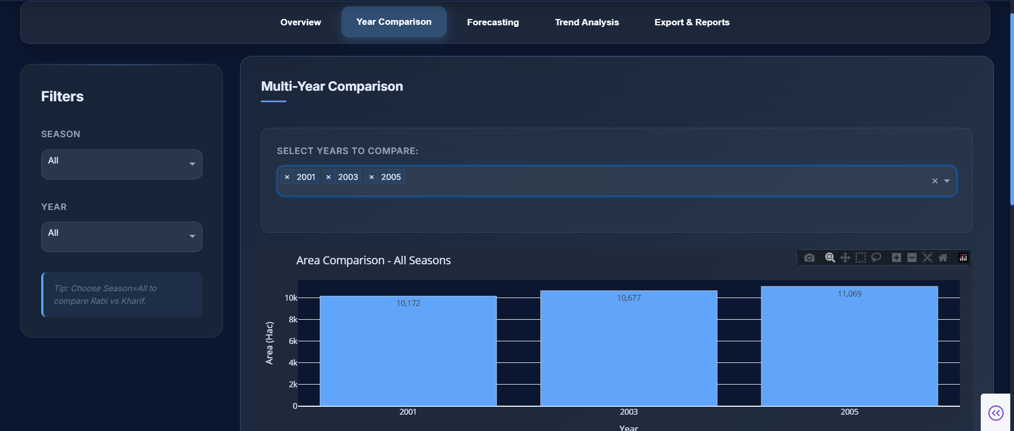
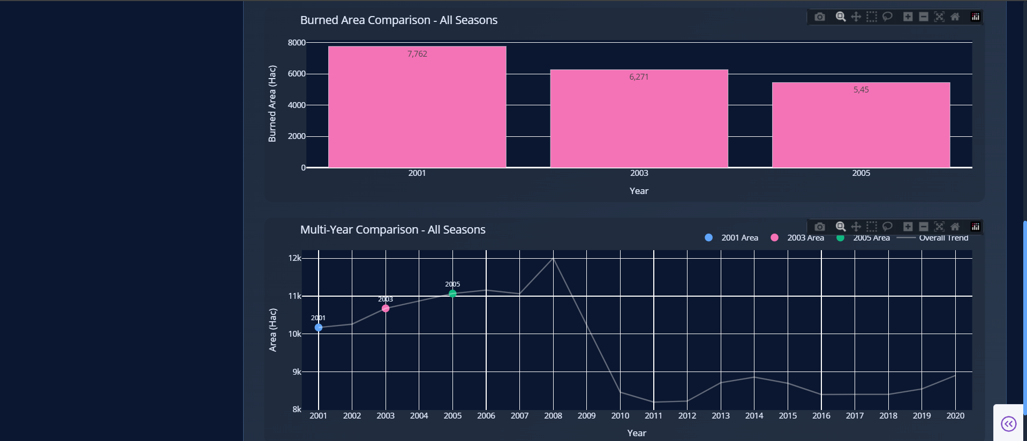
Year Comparison Tab

Slide 16
Forecasting Models
ARIMA
Exponential Smoothing
Use Cases:
- Predict future production trends
- Identify seasonal impacts

Slide 17
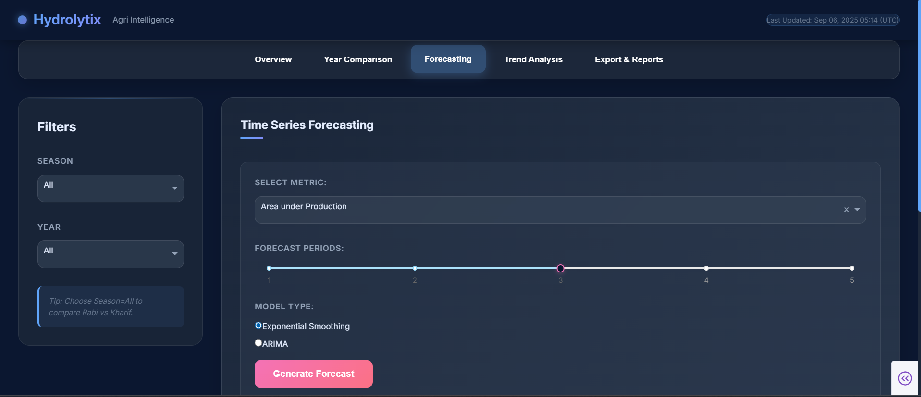
Forecasting Tab

Slide 18
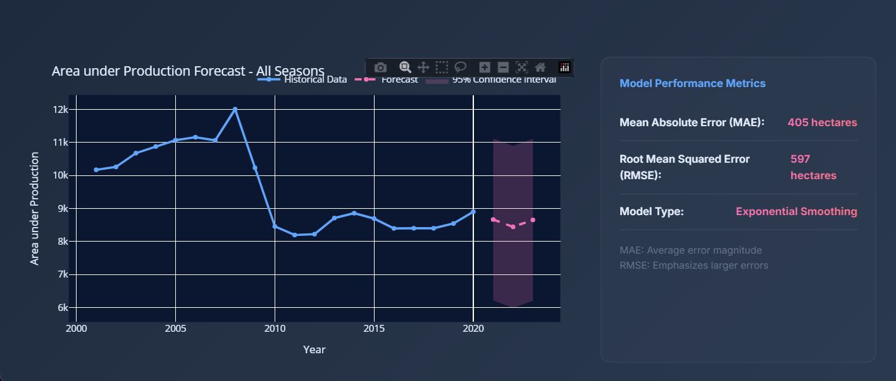
Forecasting Tab

Slide 19
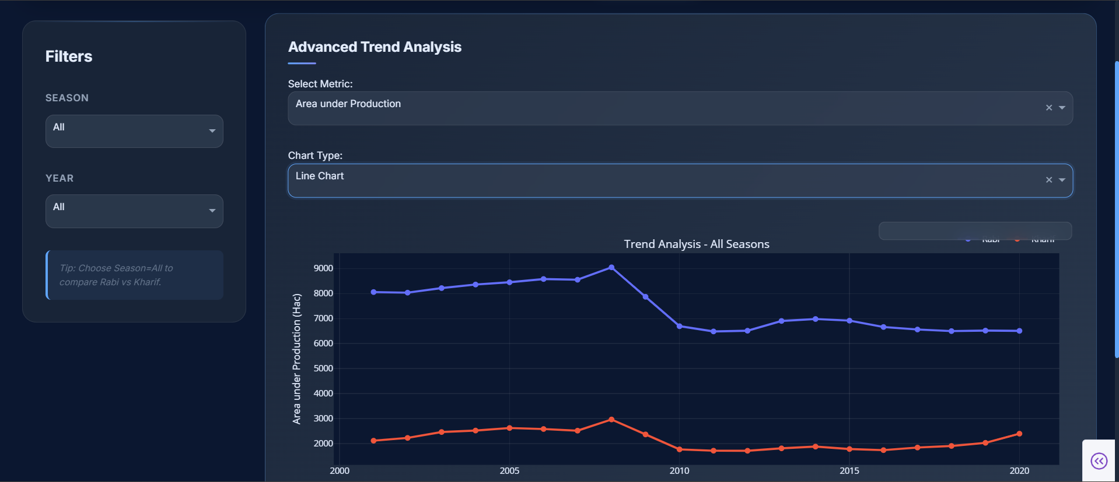
Trend Analysis Tab

Slide 20
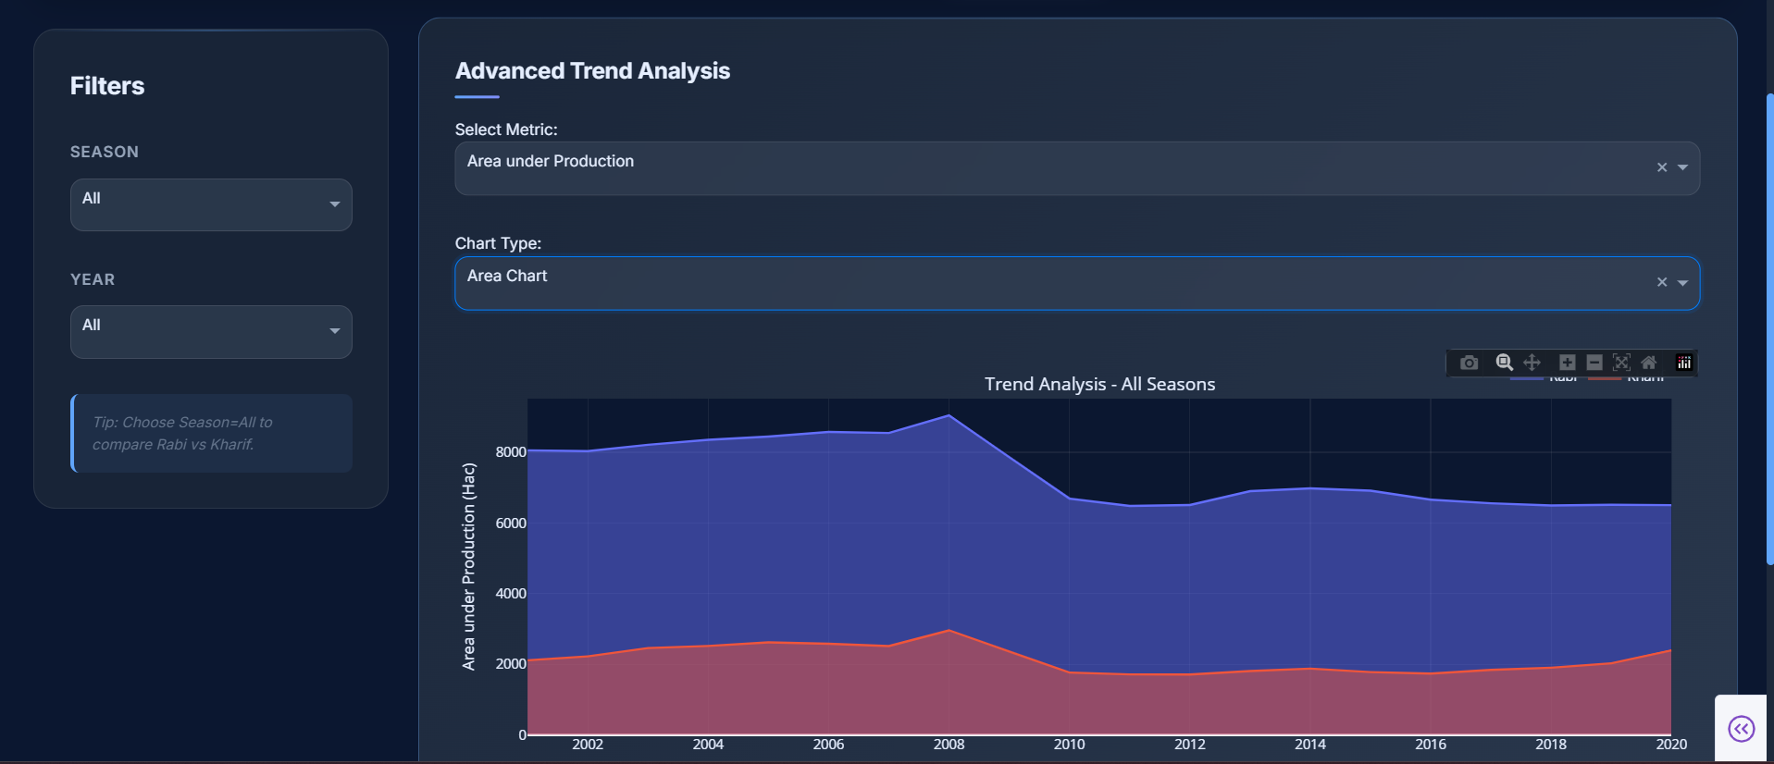
Trend Analysis Tab

Slide 21
Export & Reporting
Export filtered data to CSV
Generate professional PDF reports
Customizable metrics included

Slide 22
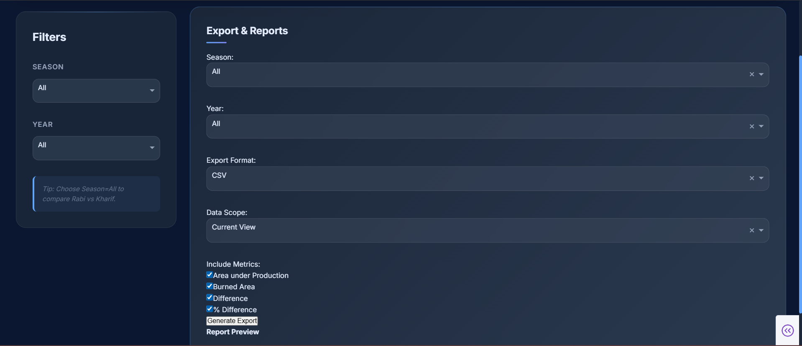
Export & Reports Tab

Slide 23
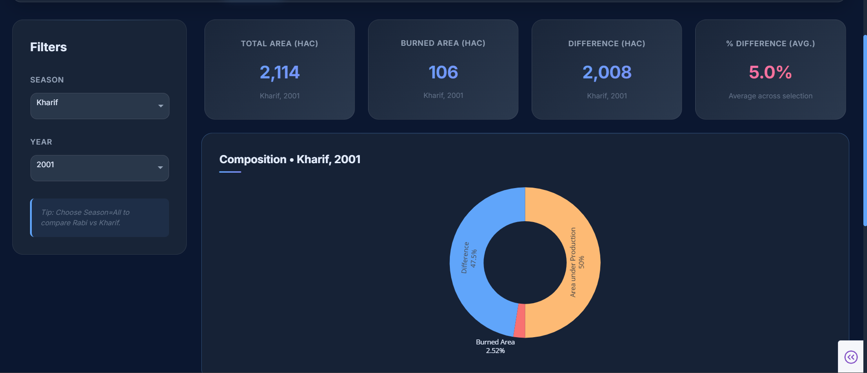
Filters and Interactivity

Slide 24
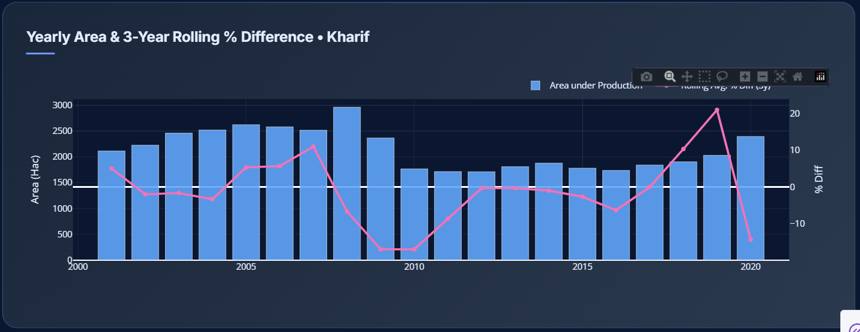
Filters and Interactivity

Slide 25
Customization & Extensibility
Modular design for adding features
Custom theming via CSS
Easy integration with external APIs & tools

Slide 26
Challenges Faced
Ensuring dataset quality
Handling large-scale data
Deployment scalability
Designing user-friendly dashboards

Slide 27
Future Scope
Integration with IoT & real-time sensors
Advanced ML prediction models
Mobile app support
Expansion to other regions

Slide 28
Conclusion
Hydrolytix bridges the gap between raw agricultural data
and meaningful insights, supporting informed decisions
for sustainable agriculture.

Slide 29
Thank You
Hydrolytix: AI-Powered Agri Intelligence
Q&A

