Slide 1
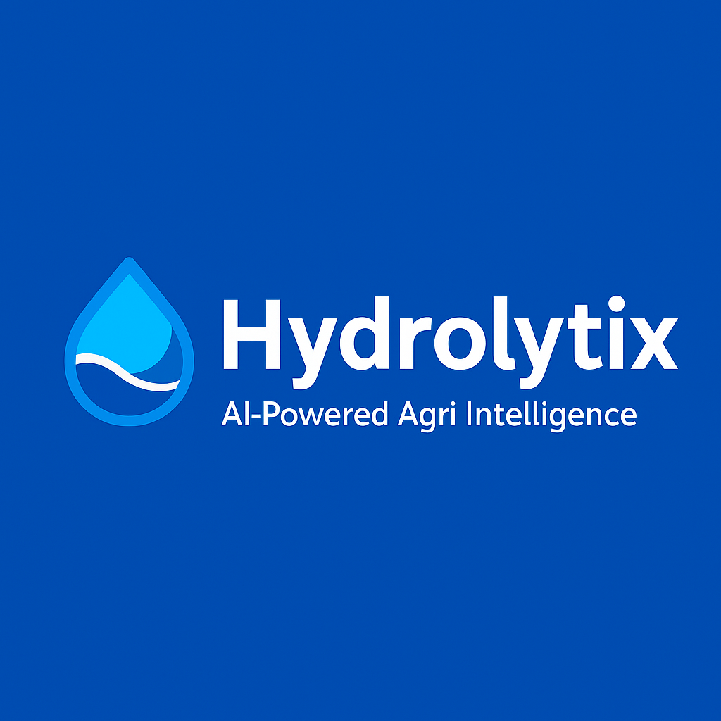
Hydrolytix: AI-Powered Agri Intelligence
Muhammad Hasaan
Pakistan

Slide 2
Introduction
Hydrolytix is an AI-powered agricultural intelligence dashboard.
It transforms raw crop data into actionable insights for policymakers, farmers, and researchers.

Slide 3
Problem Statement
Agricultural datasets are often underutilized due to complexity.
Decision-makers lack interactive tools for analysis, forecasting, and reporting.

Slide 4
Solution Overview
Hydrolytix provides:
Interactive dashboards
Data preprocessing pipeline
Forecasting models
Exportable reports (CSV/PDF)

Slide 5
Objectives of the Project
Deliver real-time agricultural insights
Simplify data-driven decision making
Provide forecasting for future crop trends
Support sustainable farming practices

Slide 6
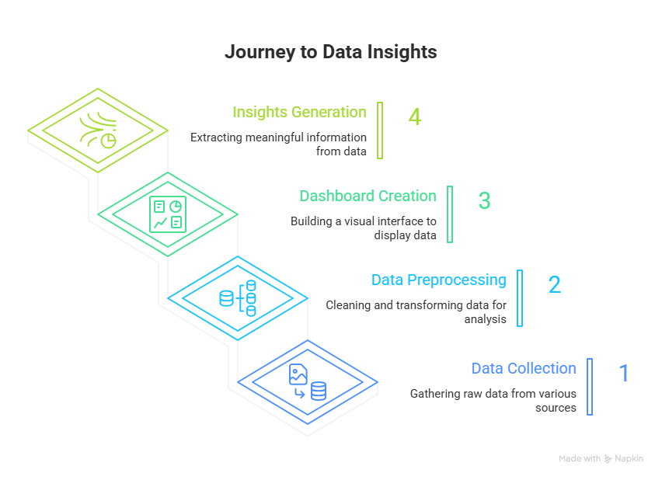
System Architecture

Slide 7
Technology Stack
Python
Dash (Flask-based)
Pandas
Plotly
ReportLab (PDF reports)

Slide 8
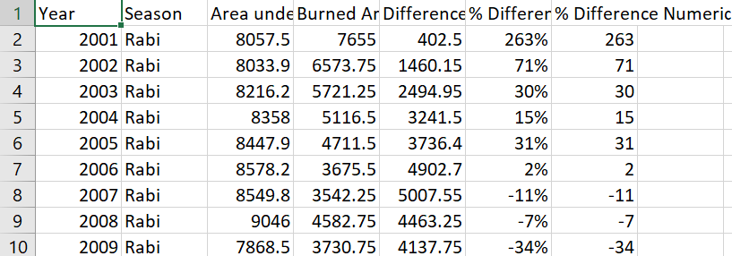
Dataset Overview
Source: Punjab Agricultural Data (CSV)
Fields: Year, Season, Area under Production, Burned Area, Difference, % Difference

Slide 9
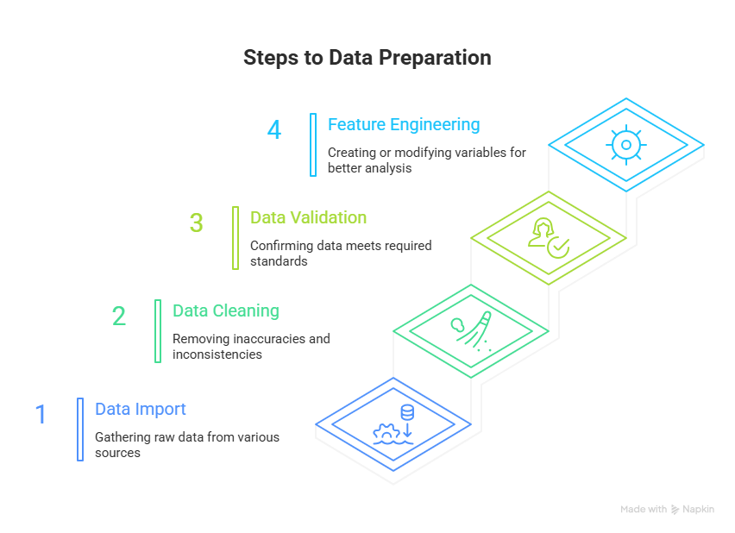
Preprocessing Workflow

Slide 10
Dashboard Features
Overview (KPIs, donut chart, trends)
Year Comparison
Forecasting
Trend Analysis
Export & Reports

Slide 11
Navigation and Layout
Navigation Tabs: Located at the top of the interface for switching between modules.
Filter Panel: Dropdowns for Year and Season.
Dynamic Content Area: Charts, KPIs, and reports update in real-time based on filter selections

Slide 12
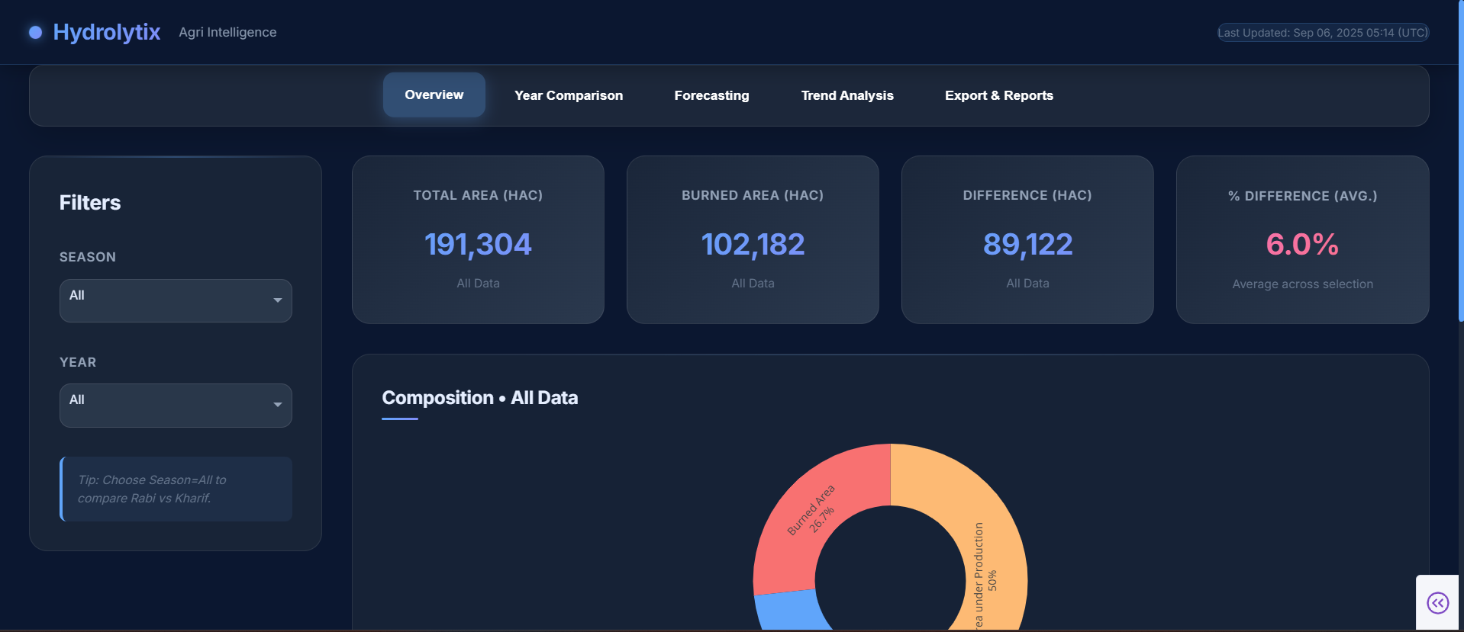
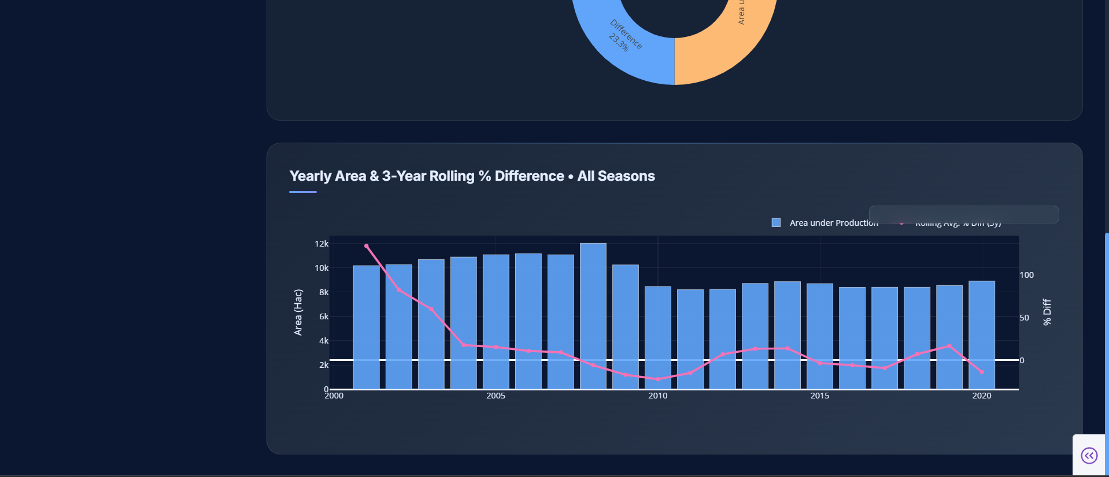

Slide 13
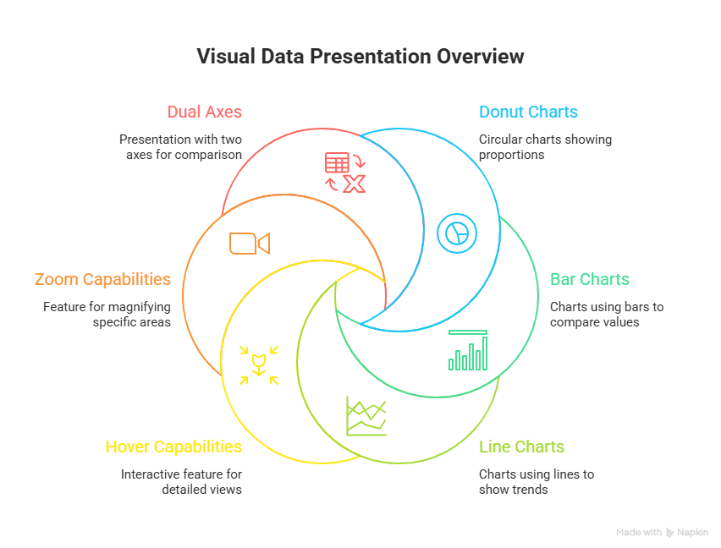
Interactive Visualizations

Slide 14
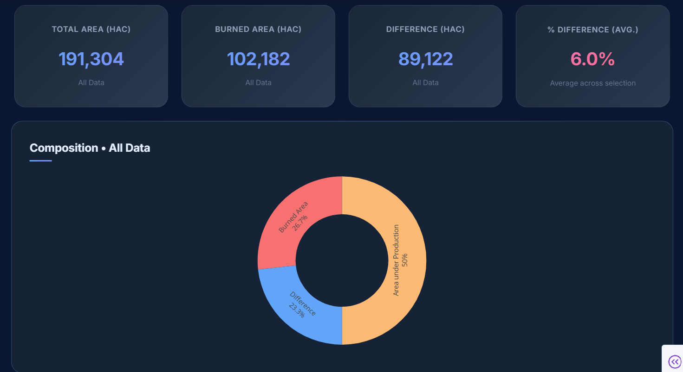
Key Performance Indicators (KPIs)

Slide 15
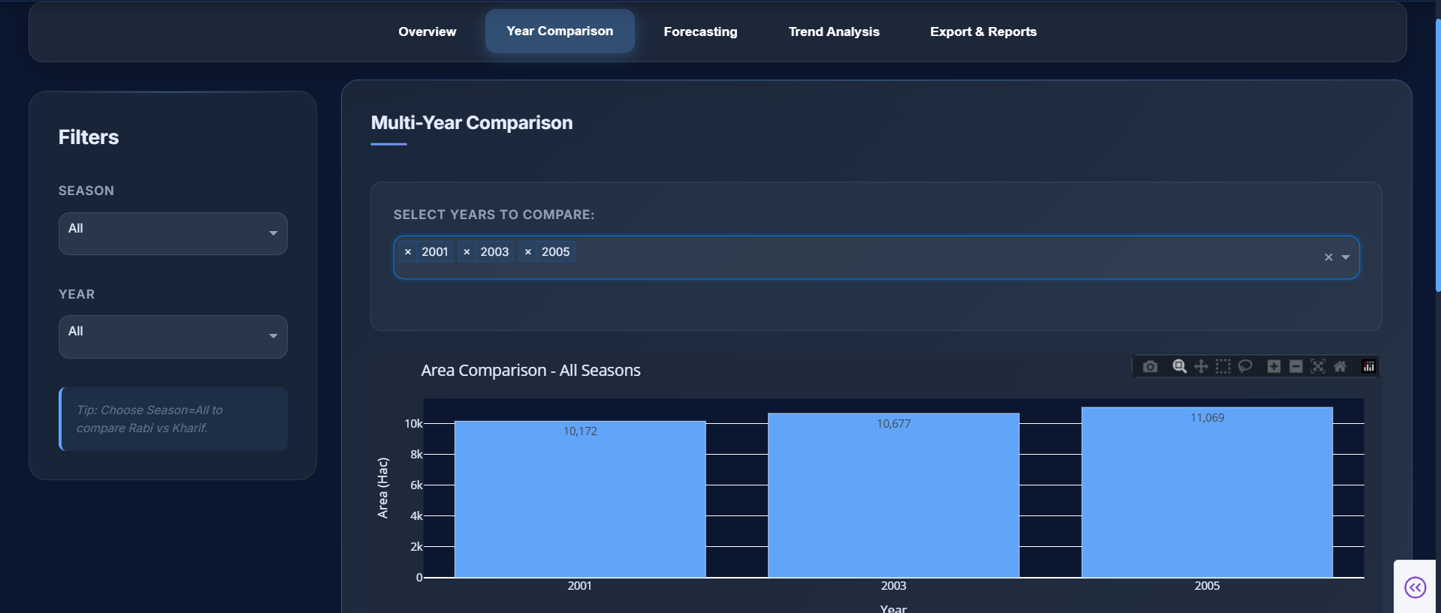
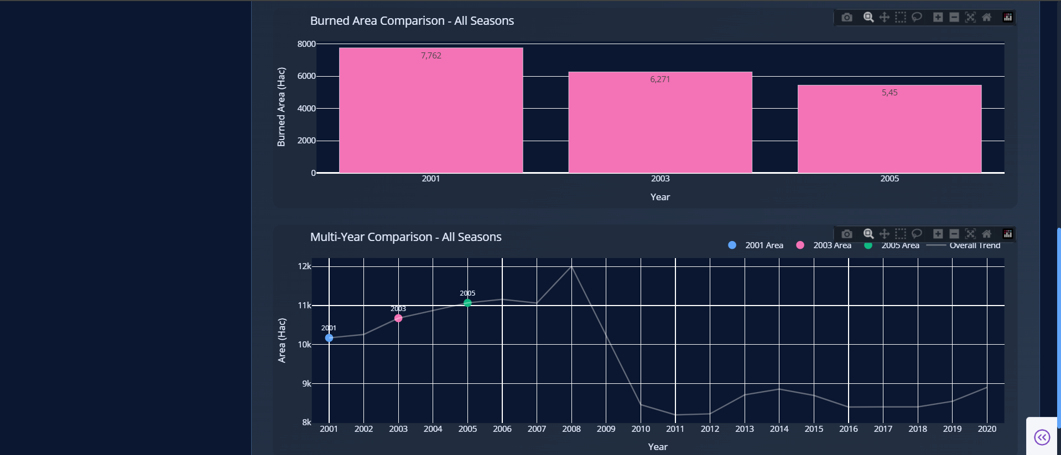
Year Comparison Tab

Slide 16
Forecasting Models
ARIMA
Exponential Smoothing
Use Cases:
- Predict future production trends
- Identify seasonal impacts

Slide 17
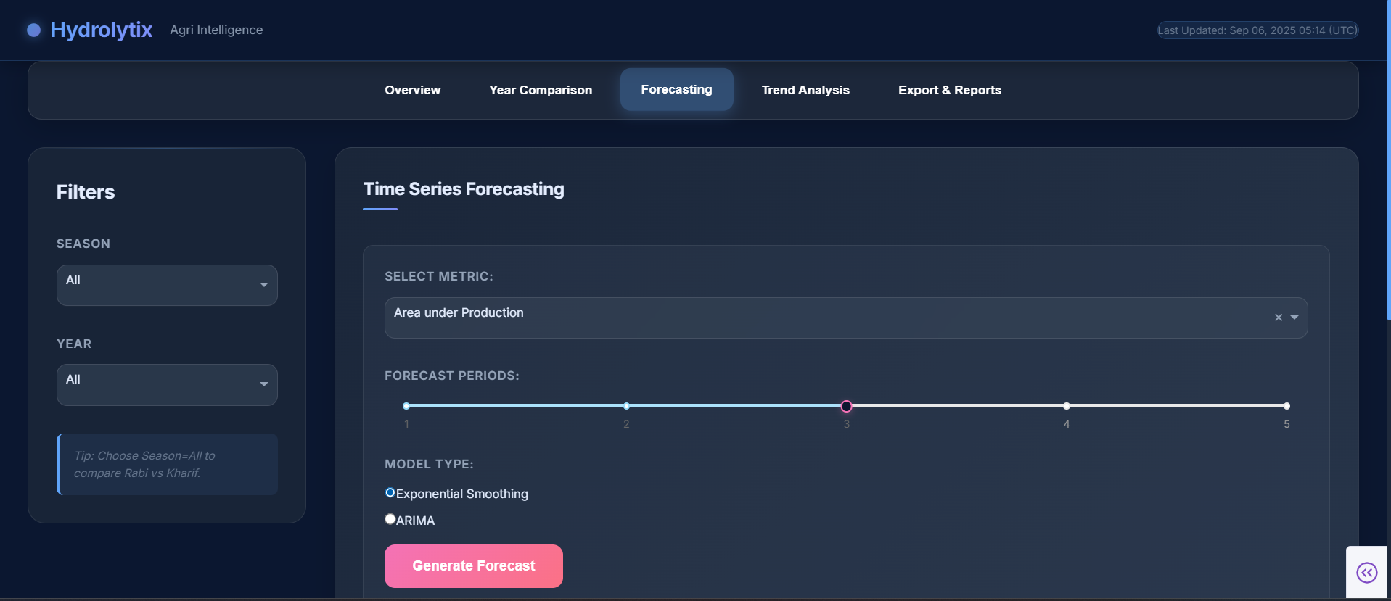
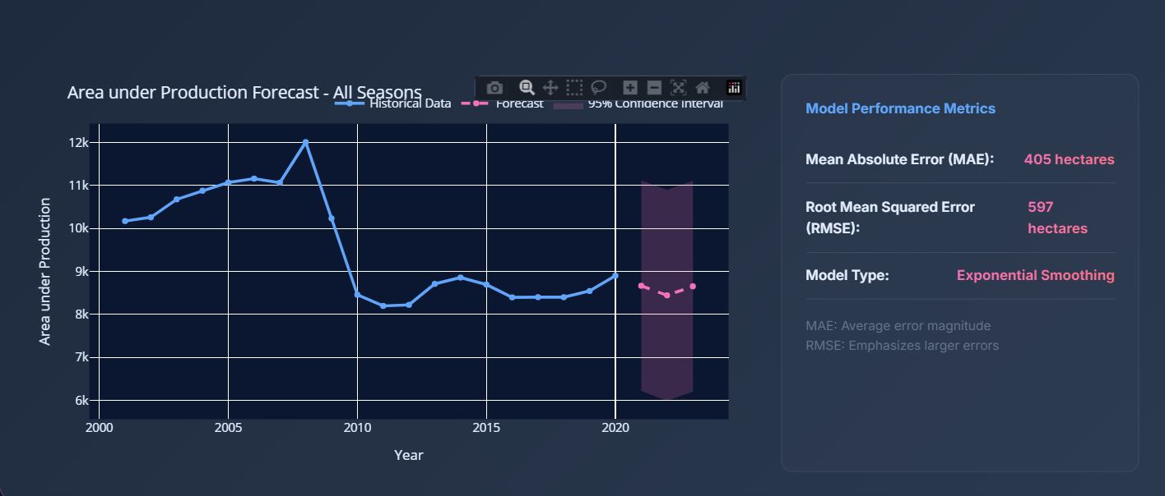
Forecasting Tab

Slide 18
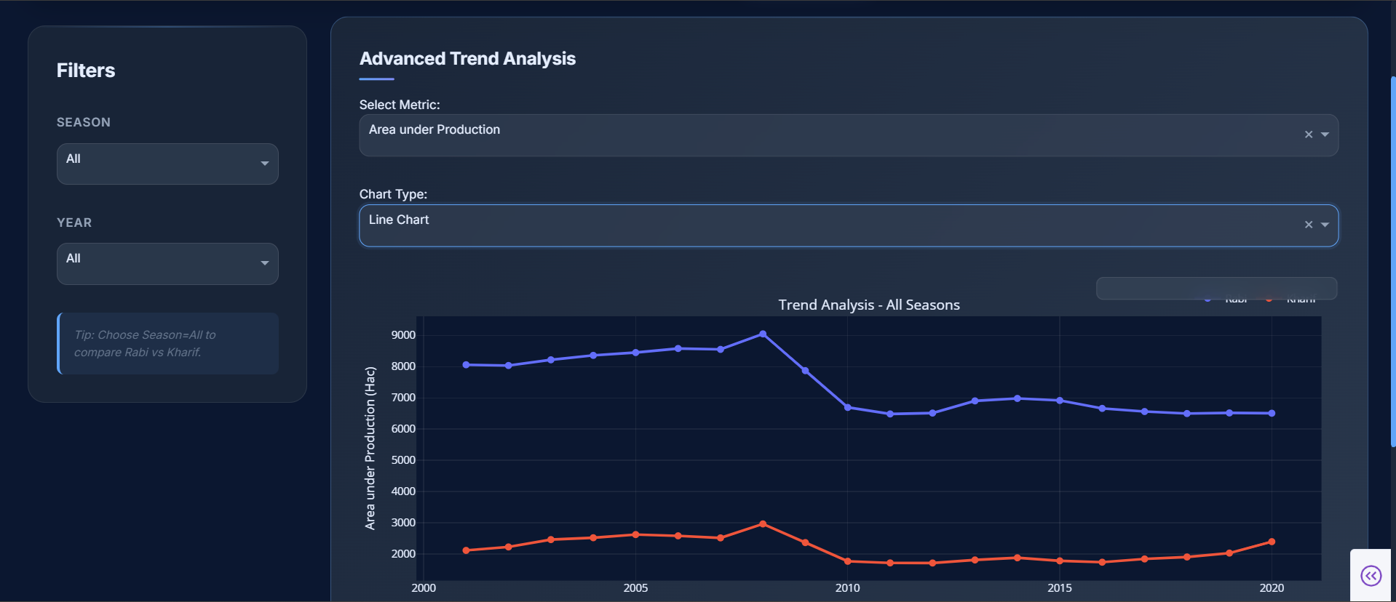
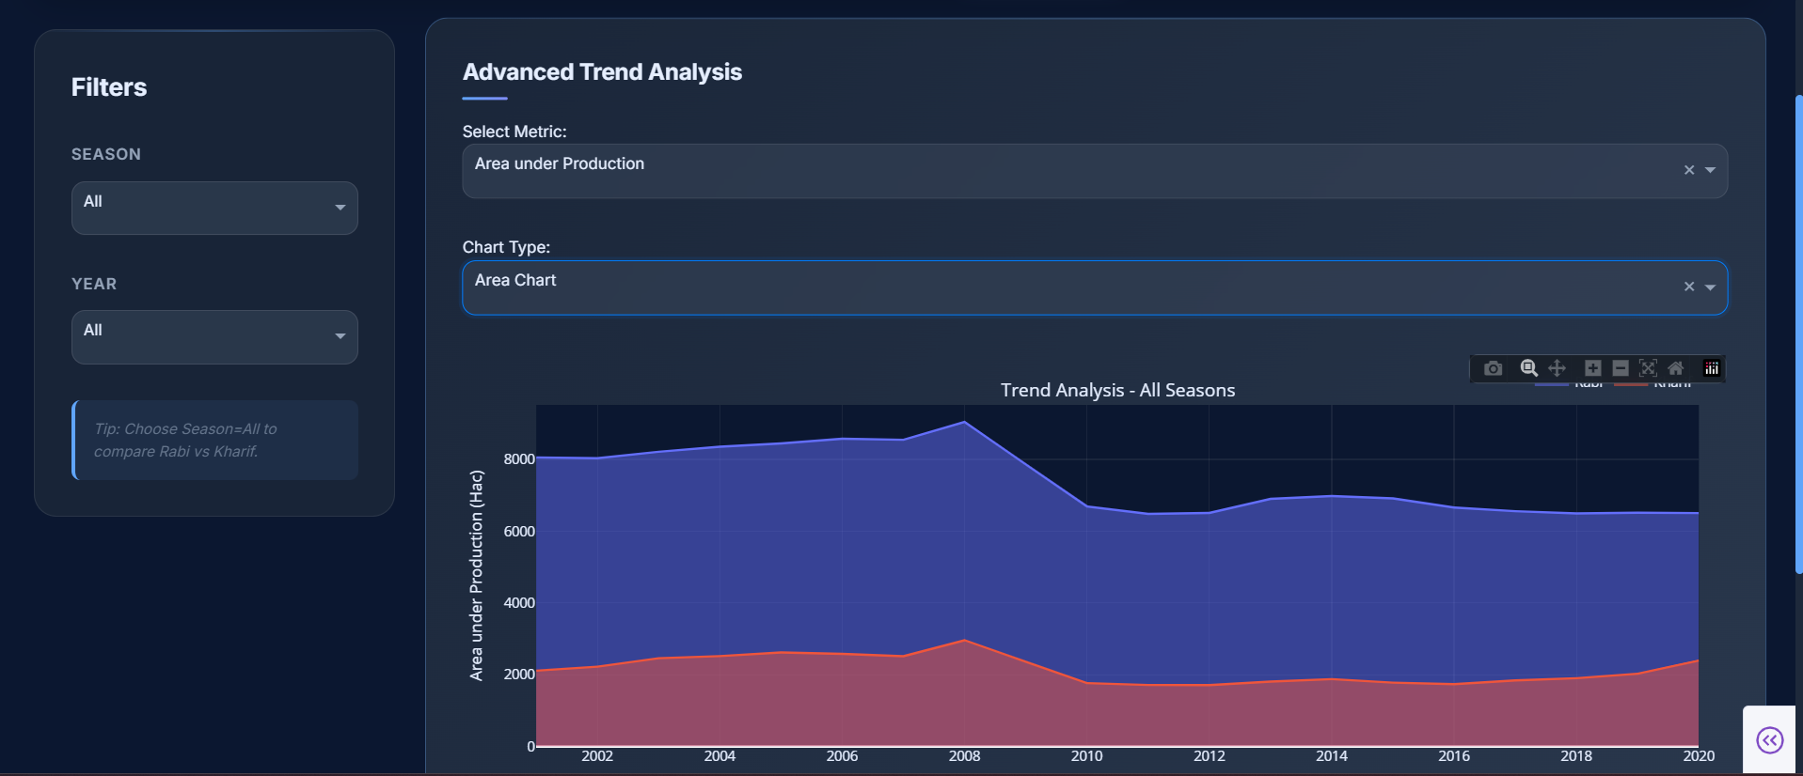
Trend Analysis Tab

Slide 19
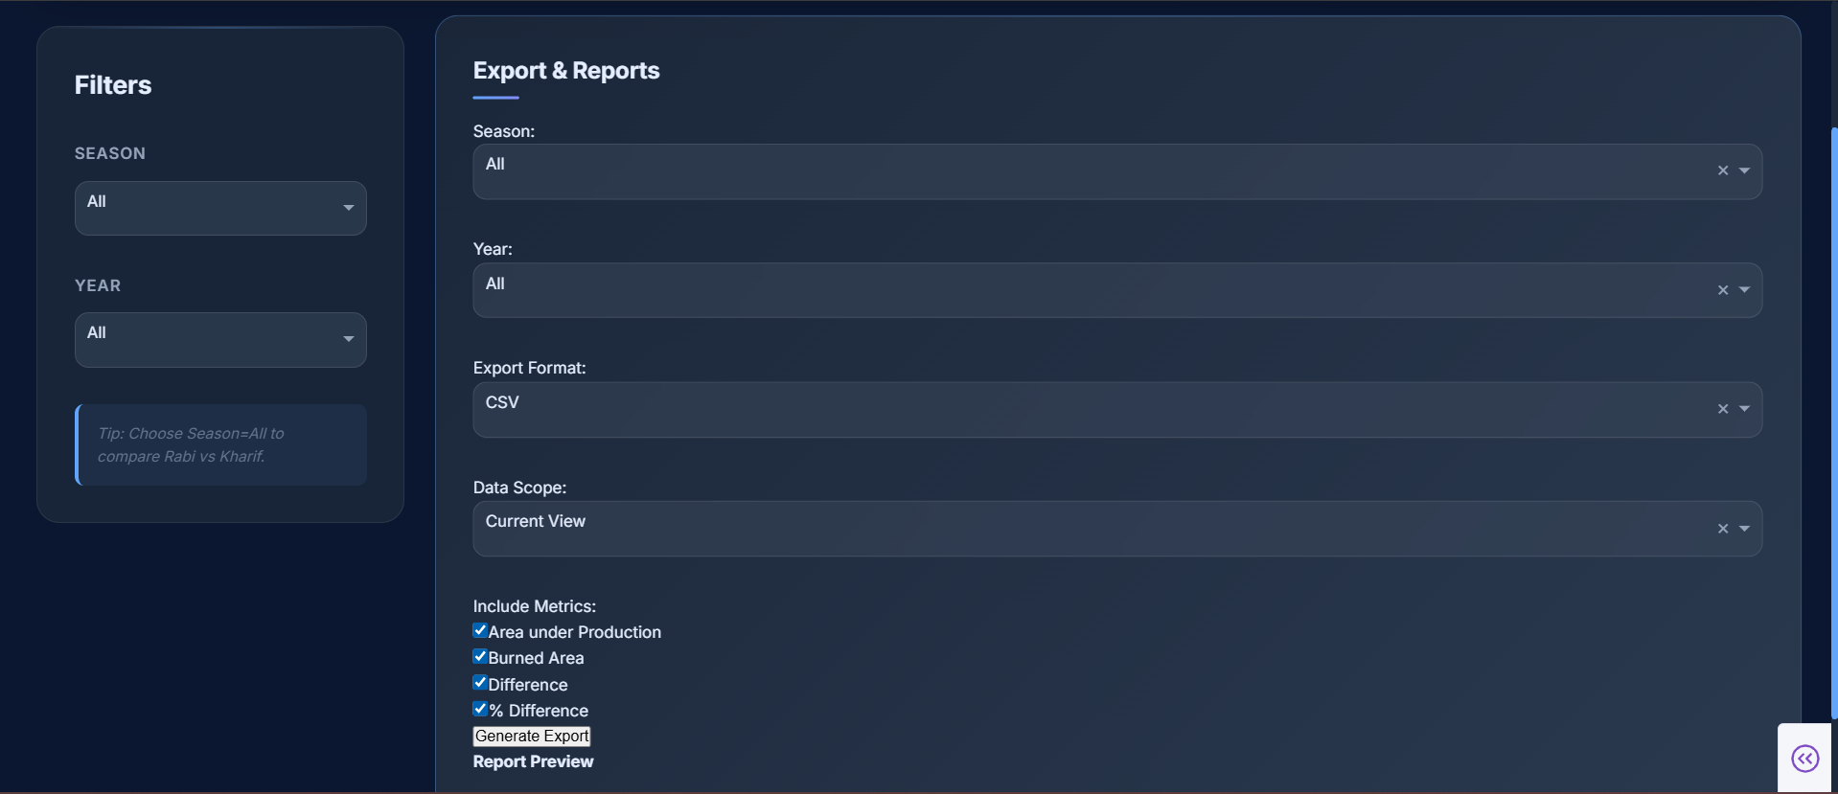
Export & Reporting
Export filtered data to CSV
Generate professional PDF reports
Customizable metrics included

Slide 20
Future Scope
Integration with IoT & real-time sensors
Advanced ML prediction models
Mobile app support
Expansion to other regions

Slide 21
Conclusion
Hydrolytix bridges the gap between raw agricultural data and meaningful insights, supporting informed decisions for sustainable agriculture.

Slide 22
Thank You
Hydrolytix: AI-Powered Agri Intelligence
Q&A
Hydrolytix: AI-Powered Agri Intelligence
Q&A

